Slide 1
Infrastructure FOR OPEN RESEARCH
Laure Haak
Executive Director
l.haak@orcid.org
https://orcid.org/0000-0001-5109-3700
Eric Olson
Membership Specialist, North America
e.olson@orcid.org
https://0000-0002-5989-8244
SSURF Annual Meeting, College Park, MD| 26 june 2018

Slide 2
WHAT IS THE PROBLEM?
Government-funded laboratories award researchers use of facilities and equipment based on a competitive proposal process
Government agencies support collections of samples used by researchers
Making accurate assessment of the scientific impact of these public investments difficult, if not impossible

Slide 3
Initial ACTIONS
Oak Ridge National Laboratory’s (ORNL) neutron sources began collecting researchers’ ORCiD in early 2016 to:
Calculate the return on investment for outreach activities
Acknowledge award of user facility resource and facility service
Connect user facility to researcher’s publication through ORCiD

Slide 4
Background
User Facilities and Publications WG: Findings and Opportunities
Authors: Laurel L Haak, Erin Arndt, Benjamin Brown, Mark D. Doyle, Mariam Elsayed, Patricia Garvey, Terry Law, Kathleen Nasta, Robert Peters, Howard Ratner, Crystal Schrof, Steven Watson, Susan White-DePace
Date of Publication: 21 November 2017
Google Doc Link: https://docs.google.com/document/d/1tHloldKv3E1NsMXSoS7tDLv9-jBP6Y0aGP6ZnXkoAw8/edit#
Abstract: User facilities are specialized government-sponsored research infrastructure available for external use to advance scientific or technical knowledge. Researchers compete for access to these facilities and specialized equipment, but do not consistently acknowledge the contributions made by facilities when they publish the results of their work. Collection of these research outputs is necessary to enable an accurate assessment of the scientific impact of these public investments. Recently several user facilities have begun to explore innovative approaches to these challenges, including adoption of ORCID.
The SSURF 2016 Annual Meeting focused on PIDs and data sharing in and recommends a pilot training reciprocity program using ORCiDs
In January 2017, DOE Office of Science, OSTI, and national laboratories; SSURF; CHORUS; publishers; and ORCiD established a working group to define terms, user stories, and information flows that leverage open identifier infrastructure
The WG published a Report in November 2017 outlining findings and recommendations
Implementation projects launched 2018
Notes:
The group had three objectives: to bring together publishers and facilities to better understand research, publication, and reporting workflows; to define terms to enable conversation; and to identify opportunities for working together to streamline and, where possible, automate impact reporting.

Slide 5
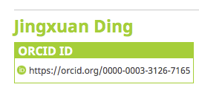
CONNECTED RESOURCES
https://orcid.org/0000-0003-3126-7165

Slide 6
ORCID at EMSL

Slide 7
What is orcid?
ORCID provides researchers with a unique identifier - an ORCID iD - that they can use to reliably and clearly connect with their research contributions and affiliations
ORCID is an open, not-for-profit organization that serves the research community by collaborating and innovating with organizations like yours
Hundreds of systems have integrated ORCID iDs: grant application and reporting, facilities requests, manuscript submission, human resources, research information management systems, thesis completion, and more!
Notes:
Notes for presenter:
From the start ORCID was established to be non-profit, non-proprietary and community-driven. Our core principles establish that we be open to all who want to use a common person identifier for research activities and outcomes - regardless of country, discipline, or industry
ORCID is independently governed by a Board of Directors – representatives from member organizations (majority not-for-profit) plus a researcher representative
ORCID is supported by membership dues from our 500 or so (as of May 2016) member organizations. ORCID iDs are and always will be free for researchers
Our members are integrating ORCID into their systems (around 250 so far). Non-member organizations can also build ORCID iDs into their systems using our public API, but with more limited functionality

Slide 8
ORCID’s vision is a world where
all who participate in research, scholarship, and innovation are uniquely identified
and connected to their contributions and affiliations across time, disciplines, and borders.

Slide 9
These connections matter because research progress, programs, and careers and based on the communication of ideas.
The connections are made possible by a network of partners working together with the purpose of improving how we share research information.

Slide 10
ORCID facts and figures
~5m registrants
~880 organizational members
78% research institutions
50% Europe, 27% US/Canada
17 national consortia
43 countries
Over 560 live integrations
https://orcid.org/statistics
Notes:
Whether for researchers or admin, they will probably want facts and figures
Can get updated stats on our webpage https://orcid.org/statistics
Can get integration info from the website https://orcid.org/members or ask us directly

Slide 11
ORCID Connections
~ 2m iDs with external identifiers
Person, organization, funding, works, peer review
2.5m+ education affiliations
31m+ works
12m+ unique DOIs
~1m works added via auto-update
~0.5m funding activities
~0.25m peer review activities
https://orcid.org/statistics
Notes:
Whether for researchers or admin, they will probably want facts and figures
Can get updated stats on our webpage https://orcid.org/statistics
Can get integration info from the website https://orcid.org/members or ask us directly

Slide 12
MAKING the CONNECTIONS
Researchers are part of the process.
Connections can be made using a electronic “handshake” with researchers as they interact with research systems.
API: Application programming interface. Think of it as a translator service that allows databases to exchange information

Slide 13
integration benefits
A robust ORCID integration brings many advantages:
More transparency and easier sharing
Researchers spend less time spent inputting information
Administrators spend less time verifying and checking information
Improved information quality and reliability

Slide 14
RESEARCHER control and the ORCID record
The ORCID record lists information that the researcher has chosen to connect to their iD. The researcher owns the record, and decides how (or if) it is shared.
Researchers add their iD using an electronic “handshake”, as they interact with research systems, for example during manuscript submission or grant application.
The iD is embedded in the researcher’s contribution by the publisher or funder system, creating a provenanced connection between the contribution and the researcher.
Notes:
Credit card analogy.

Slide 15
CROSS-SECTOR PARTNER NETWORK
PUBLISHER
&
REPOSITORY
Assert authorship & data contributions
EMPLOYER
Assert faculty or staff affiliation
CONNECT
COLLECT
COLLECT
CONNECT
COLLECT
CONNECT
FUNDER & RESOURCE
Assert grant, facilities, and equipment access

Slide 16
Orcid and publishers
THE ASK: Collect iDs and assert authorship into ORCID records
81 publisher and association members and over 9,000 journals collecting iDs
51 signatories to publishers open letter
Community working groups
Journal display guidelines
ORCID in book workflows
Publications and user facilities
https://orcid.org/organizations/publishers

Slide 17
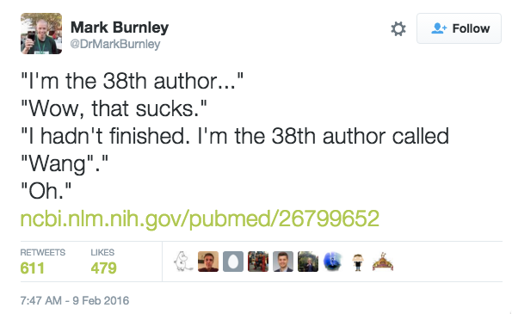
Notes:
Example 1 (slide 1) of why ORCID is needed

Slide 18
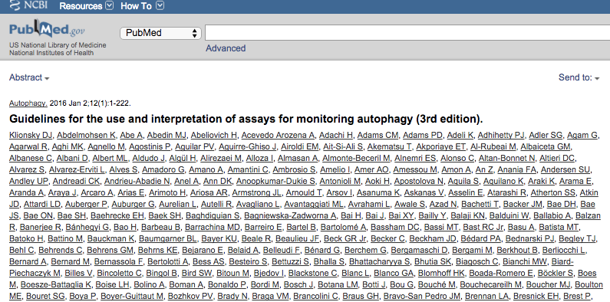

Slide 19
PUBLISHERS
PUBLISHER
&
REPOSITORY
Assert authorship & data contributions
ORG ID
EMPLOYER
Assert faculty or staff affiliation
CONNECT
COLLECT
COLLECT
CONNECT
COLLECT
CONNECT
FUNDER & RESOURCE
Assert grant, facilities, and equipment access

Slide 20
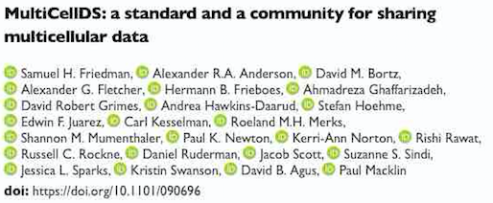
EXAMPLE CONNECTION: People and Paper
ORCID iDs for people: researchers, contributors, innovators, administrators, program staff
DOI for a paper or dataset or grant….

Slide 21
CROSS-SECTOR PARTNER NETWORK
PUBLISHER
&
REPOSITORY
Assert authorship & data contributions
EMPLOYER
Assert faculty or staff affiliation
CONNECT
COLLECT
COLLECT
CONNECT
COLLECT
CONNECT
FUNDER & RESOURCE
Assert grant, facilities, and equipment access

Slide 22
Orcid and research institutions
THE ASK: Collect iDs and assert affiliations
75% of ORCID membership
Institutional Connect being implemented by 150+ members
Community working groups:
Publications and user facilities
Trust working group
https://orcid.org/organizations/research-orgs

Slide 23
RESEARCH INSTITUTIONS
ORG ID
ORG ID
PUBLISHER
&
REPOSITORY
Assert authorship & data contributions
EMPLOYER
Assert faculty or staff affiliation
CONNECT
COLLECT
COLLECT
CONNECT
Assertion requires an affiliation ID or a start date
COLLECT
CONNECT
FUNDER & RESOURCE
Assert grant, facilities, and equipment access

Slide 24
RESEARCHER IDENTITIES & ACTIVITIES
Institutions can collect researcher activities along with the iDs.
Activities can even be tracked in real time.
We are talking to the OneID team about including ORCID iDs in the metadata pulled in from throughout the DoE labs and elements

Slide 25
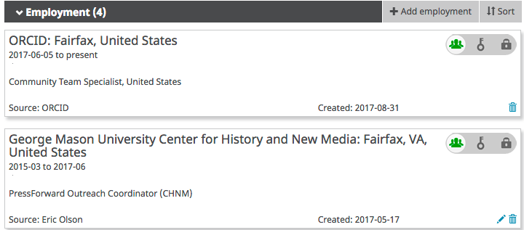
Asserting affiliations
https://members.orcid.org/api/tutorial/update-orcid-records

Slide 26
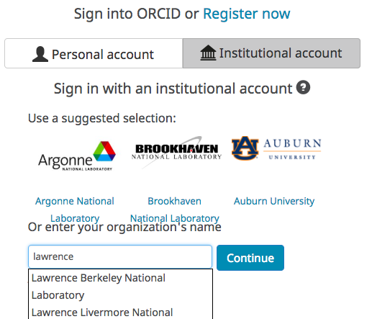
InstitutionAL Sign in
ORCID record holders can couple their ORCID log in with their institutional credentials.
CONFIGURE YOUR SYSTEM!
This functionality is available to all institutions participating in eduGAIN federated identity management network.
https://members.orcid.org/api/integrate/institution-sign-in
Notes:
You can sign in with your existing institution credentials. This works for over 5000 institutions globally with no extra work from them. If it doesn’t work for your institution, contact us and we will work out why, and try to resolve it.

Slide 27
CROSS-SECTOR PARTNER NETWORK
PUBLISHER
&
REPOSITORY
Assert authorship & data contributions
EMPLOYER
Assert faculty or staff affiliation
CONNECT
COLLECT
COLLECT
CONNECT
COLLECT
CONNECT
FUNDER & RESOURCE
Assert grant, facilities, and equipment access

Slide 28
Orcid and FUNDERS and RESOURCES
THE ASK: Collect iDs and assert grants and resource awards
46 members: 25 funders and 21 government agencies
Xx funders integrating ORCID into grants systems, growing number of facilities integrating into proposal process
Community working groups
ORBIT (ORCID Reducing Burden & Improving Transparency)
Publications and user facilities

Slide 29
ORBIT Project GOALS
Improve funding application and reporting processes by
streamlining data entry and sharing funded grant information by
using identifiers in workflows to connect authors, funding, facilities, and publication information
https://orcid.org/organizations/funders/orbit

Slide 30
the ORBIT WORKING GROUP
Australian Research Council
Canadian Inst. Health Research
CAPES (Brazil)
CNPq (Brazil)
CONCYTEC (Peru)
FCT (Portugal)
Howard Hughes Medical Inst. (USA)
Japan Science & Technology Agency
Ministry of Business, Innovation and Employment (New Zealand)
Natl Humanities Alliance (USA)
National Research Foundation (South Africa)
Natural Sciences and Engineering Research Council (Canada)
NIH (USA)
Science and Technology Development Fund (Egypt)
Social Sciences and Humanities Research Council (Canada)
Swiss National Science Fund
UK Research and Innovation
Wellcome Trust (UK)

Slide 31
ORBIT PROJECT COMPONENTS
Analyse information models with Working Group of funding organizations
Engage existing information systems in pathfinder projects to reduce technical barriers for digital transformation
Develop end-to-end workflows for sharing of grant information, from application to publication to reporting.

Slide 32
Connected FUNDING
When funders push successful grant awards to the ORCID registry, it is available for easier funding acknowledgements.

Slide 33
RESEARCH RESOURCES: First Steps
Document workflows and integrate identifiers into user facility registration and proposal processes
Collect ORCiDs
Make the award citable
Facilitate information sharing
Reduce reporting burden
https://orcid.org/content/user-facilities-and-publications-working-group

Slide 34
CONNECTED RESOURCES
https://orcid.org/0000-0003-3126-7165

Slide 35
FUNDERS AND RESOURCES
PUBLISHER
&
REPOSITORY
Assert authorship & data contributions
EMPLOYER
Assert faculty or staff affiliation
CONNECT
COLLECT
COLLECT
CONNECT
COLLECT
CONNECT
ORG ID
FUNDER & RESOURCE
Assert grant, facilities, and equipment access

Slide 36
What’s next?
Couple collection of ORCiDs with other data from the author’s ORCiD record
Collect ORCiDs during manuscript submission or acceptance
Develop user workflow and amend JATS standard to enable collection of additional information from ORCID
Integrate affiliations, funding, and resources into the manuscript publication process

Slide 37
What does THIS Mean?
Researchers can easily share their affiliations, contributions, and resources used
Transparent assertions are created in a robust machine and human readable manner and with researcher permission
Assertions underpin an open graph of connections between people, places, and things, enabling tracking and reporting through article and/or ORCID record metadata

Slide 38
ACTIONS FOR FACILITIES
Join the User Facilities Working group (read report here)
Join ORCID
Integrate ORCID into your proposal workflows
Streamline your reporting processes!
https://orcid.org/organizations/research-orgs/resources

Slide 39
Spend more time making contributions and less time managing them
orcid.org/register

