Slide 1
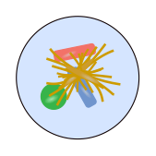
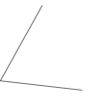
The Trichodesmium consortium
Recovering genomes from metagenomes
Going beyond a marker gene
Conserved heterotrophic co-occurrence
Community composition
“Shotgun”
metagenomic
sequencing
“Reads”
Extract
DNA
5
2
Trichodesmium enrichment culture
“Coverage”
“Contigs”
Assembly
Generate info
about contigs
c1
c2
…
12
6
7
8
…
AAAA
AAAT
AAAC
AAAG
…
5
0
14
3
…
…
…
…
…
…
Sequence
characteristics
2
“Binning”
contigs
5
5
5
2
5
2
2
2
2

