Slide 1
MODELLING SPATIAL INTERACTIONS
AMONG FISH COMMUNITIES, FISHERS
AND OTHER MARINES ACTIVITIES
François Bastardie, Rufener MC, Nielsen JR, Maina I, Kavadas S, Vassilopoulou C, Alexandrov LM, Niculescu D, Spinu A, Nicolaev A, Rosca M, Höffle H, Farnsworth KD, Pedreschi D, Reid D, Bolognini L, Martinelli M, Grati F, Fuga F
Funding by the EU FP7 ERA-net COFASP ECOAST Project under Grant Agreement No. 321553.
IIFET 2018, Seattle, US,
Session on Marine Spatial Planning and Multiple Use Management
Notes:
Key points:
The Title: My talk today is on modelling the spatial interactions among fish communities, fihers and accounting for other marine activities. This work is the result of cooperation with a range of colleagues across European countries and is funded by European grants.
Sophisticated computer simulations can support effective science-based evaluations to facilitate better governance of the marine space. We developed a range of spatial fisheries models, integrating biological with fisher decision-making dynamics and management for assessing management of multiple activities. We present the outcomes of case-specific evaluations with different ecological and socio-economic characteristics i.e. Adriatic, Ionian, Black, Baltic and Celtic Seas, and priorities like fisheries, aquaculture, offshore wind energy or conservation areas. For each case we applied the DISPLACE agent-based modelling platform for simulating bioeconomic dynamics and clarifying options for sustainable and viable fisheries in presence of other marine sectors. The approach is specifically suited for evaluating whether the benefits of spatial plans compensate for the additional economic and ecological costs of displacing fishing to the surroundings including vulnerable habitats or unfished areas. The models generate a comparative overview of short to medium-term impacts of changing spatial footprints both on the fisheries economics and on the underlying ecosystem components by aggregating the individual fishing operations, at the same time detailing the spatiotemporal dimensions for particular fishing activities, harbor communities or national fleets. We discuss some lessons learnt when developing operational modelling frameworks that incorporate stakeholder responses to spatial management options. Results show that the models enable comprehensive evaluation of spatial management strategies, taking account of underlying biological dynamics, interactions among fisheries and other marine activities. Comparison of case studies reveals how spatial management can mitigate conflicts and impacts on ecosystems at spatial and temporal scales relevant to fisheries interests and policy makers.

Slide 2
Why the time and space dimensions are so important?
We gather data & tools
for capturing
the interlinked dynamics,
the joint production and
the technical interactions
between activities
=> the DISPLACE platform
anticipate unintended consequences
Fishermen locate in space, have some cost to reach the grounds and operate the fishing, choose species among the available and depending on market demand, policies, environmental influences etc.
Fish do not evenly distribute, move along the growth, responding to change in envt conditions (food, predators, mates, etc.)
Notes:
What did we do:
We gathered data & tools for capturing the interlinked dynamics between activities, the joint production and the technical interactions among them….And we do it accounting for the time and space dimensions….
And why should we care? (The who, what, where and when…)
Well…it is because the Where and When are often crucial questions because fish do not evenly distribute and most of them move along their growth. Responding to a great variability in environmental conditions (food, predators, mates, etc.)
On the other side, location of people looking for fish is also crucial: how do they harvest fish stocks? what is the amount available? what would be the cost from where they live? where it is worth fishing? for which species? given the economic market demand etc.
Need for tools capturing these dynamics, that would also anticipate unintended consequences on others

Slide 3
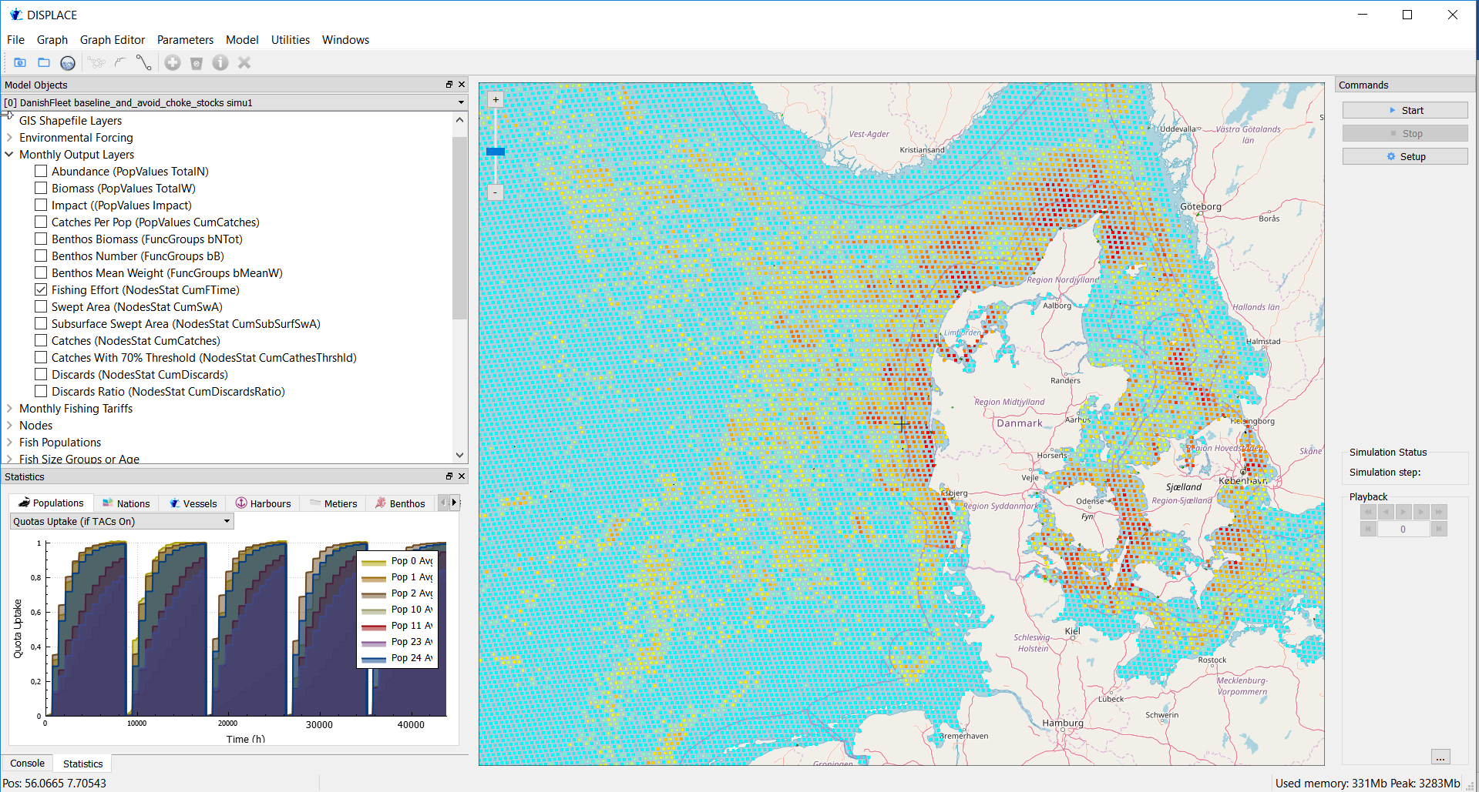
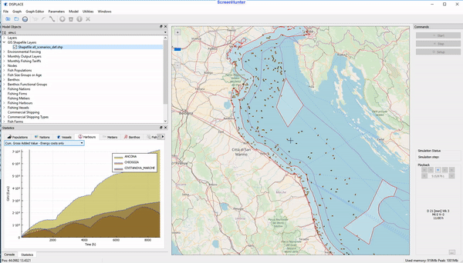
Individual vessel-based bioeconomic model combined to spatial population dynamics and other activities
The agent-based
DISPLACE
platform
Notes:
…so we developed the DISPLACE platform which is an indivdual vessel-based bioeconomic model that combine to spatial fish population dynamics and to other activities at sea. Here you can see a snapshoot of the Graphical Use Interface we developed, showing you the movement of individual vessels, together with some tracking of some indicators aggregating the indicators across the individual vessels, the fishing harbour communities, the type of activity, and finally at the nation scale. You can track the time series or the equivalent data on maps….

Slide 4
MANAGEMENT
FISHING
RESOURCE
Notes:
I should mention that DISPLACE in a support for Management Strategies Evaluation, that create mathematical models of the fisheries system, and making possible a full feedback loop between the fish population models, the fishing, and the management options. Then the whole idea is to make each of our computer worlds slightly different to represent our uncertainty about the real system.

Slide 5
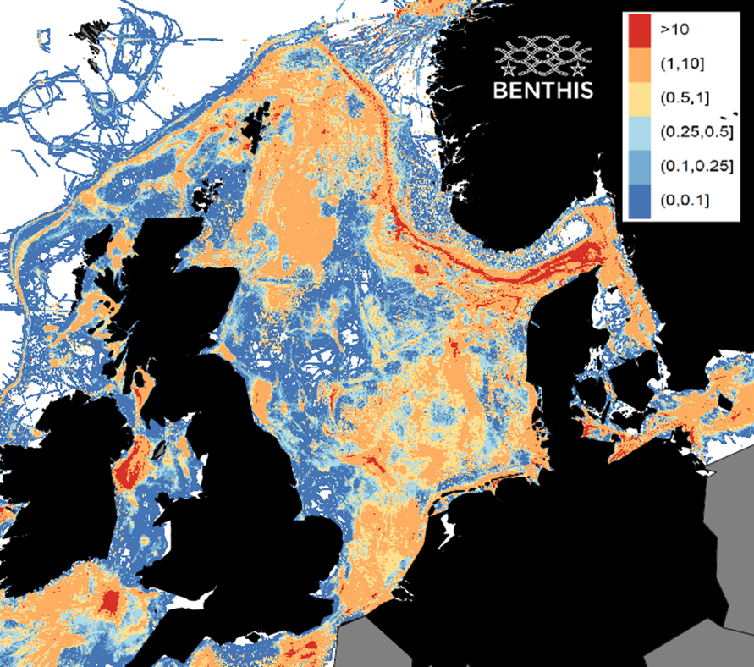
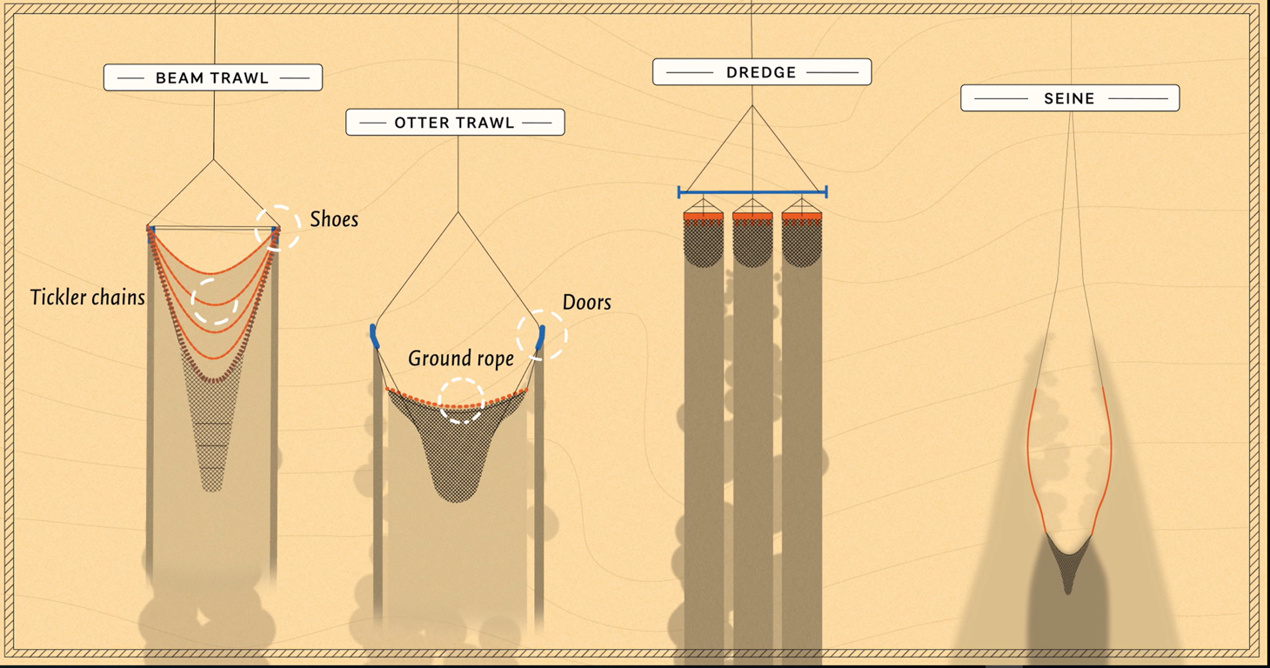
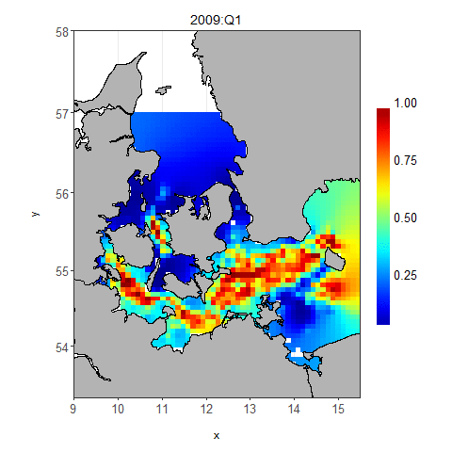
Using & generating
fishing intensity, spatial footprint &
Population fields
Rufener et al. In prep
Notes:
So to do this we use newest available data admitting that fishing is a heterogeneous practice….
For example, we now got a brand-new picture of where the fishing is ongoing, and at which intensity.
We also analyse by looking at the subcomponents of the fishing gears in use what will be the spatial footprints of these different activities
And finally we make use of brand new dynamics and statistical modelling of how the fish populations distribute in space and time.
what will be the future opportunities will depend on the opportunities within this different practices. We want to evaluate what is the effect of varying decision making facing different ecological-economic paths in the future…….and possibility for mitigating/displacing the pressure

Slide 6
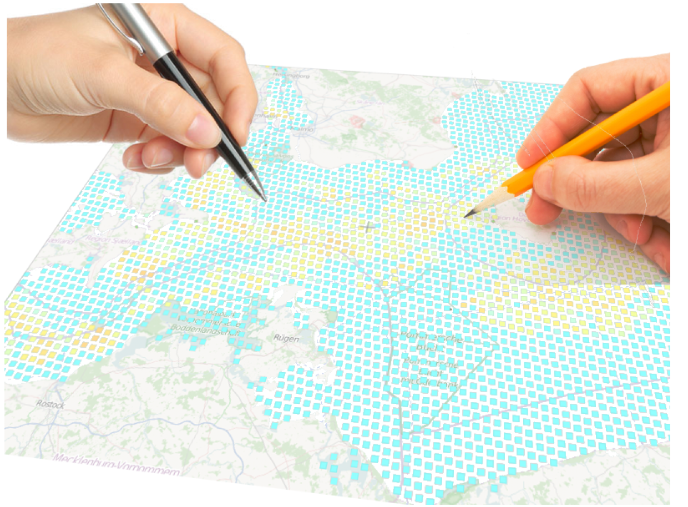
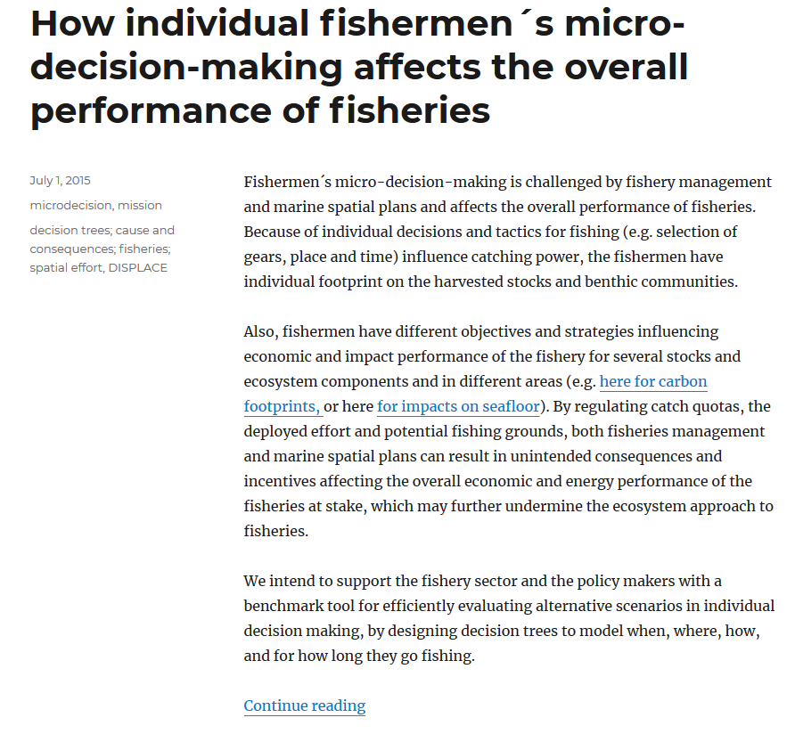
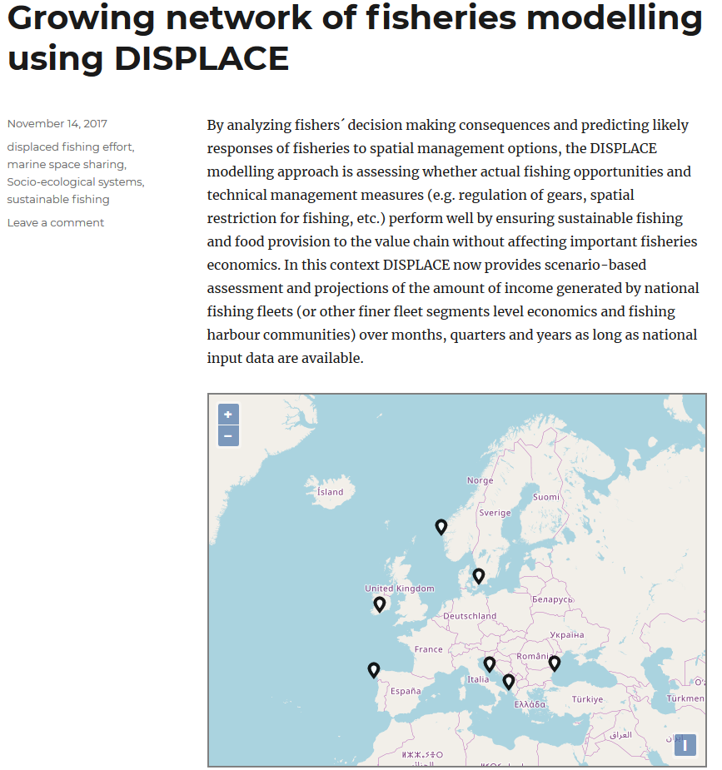
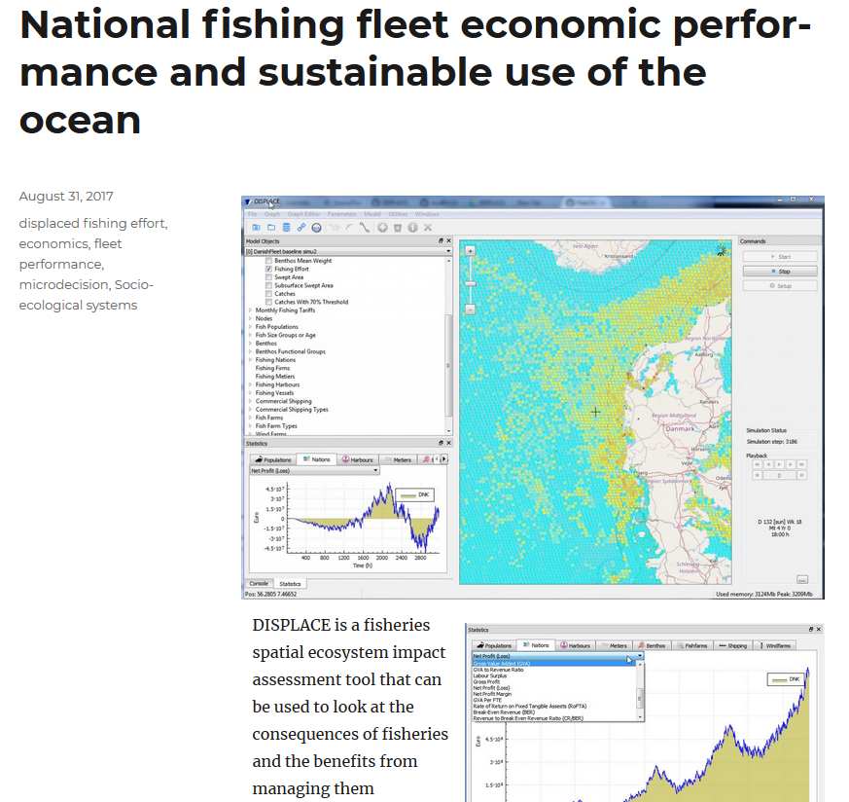
The Helicopter View on
Five European Case Studies
Notes:
Now just take an helicopter view on Five European Case studies. Those cases are also decribed somehow on the DISPLACE website where you can also download the software….
Example of Use – one step further – The dynamic approach – put everything in a common platform and model forward to test alternative scenarios suggested by the practitioners

Slide 7
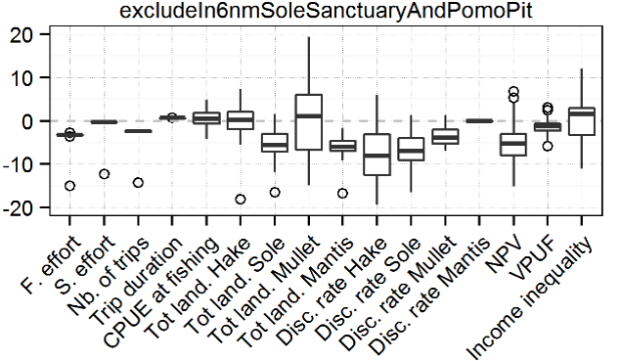
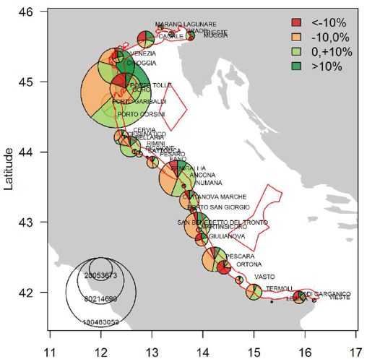
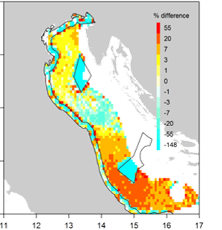
Demersal fisheries in the Adriatic Sea
Spatial conflicts between mutually exclusive gears and conservation areas, and trade-off analysis
Notes:
We had different issues for these different case studies. For the Adriatic Sea case we were tasked to evaluate and then try to mitagate the spatial conflicts that is ongoing between mutually exclusive activities, testing conservation areas, and looking at what are the trade-offs between them.
So we checked a range of indicators regarding the fishing trip patterns, the change in landings and discards per species, and the profitability, the energy use and the income inequality if any. This includes different options for restricting the fishing in space and time (for example practitioner were willing to implement a 6nm buffer area from the coastline, or closing some sensitive areas etc.)
We then got a picture of different stress levels on the revenues from the fishing and look at some vessels that gain from the play, and some others that will be under stress….and this for different fishing harbours communities as this picture shows

Slide 8
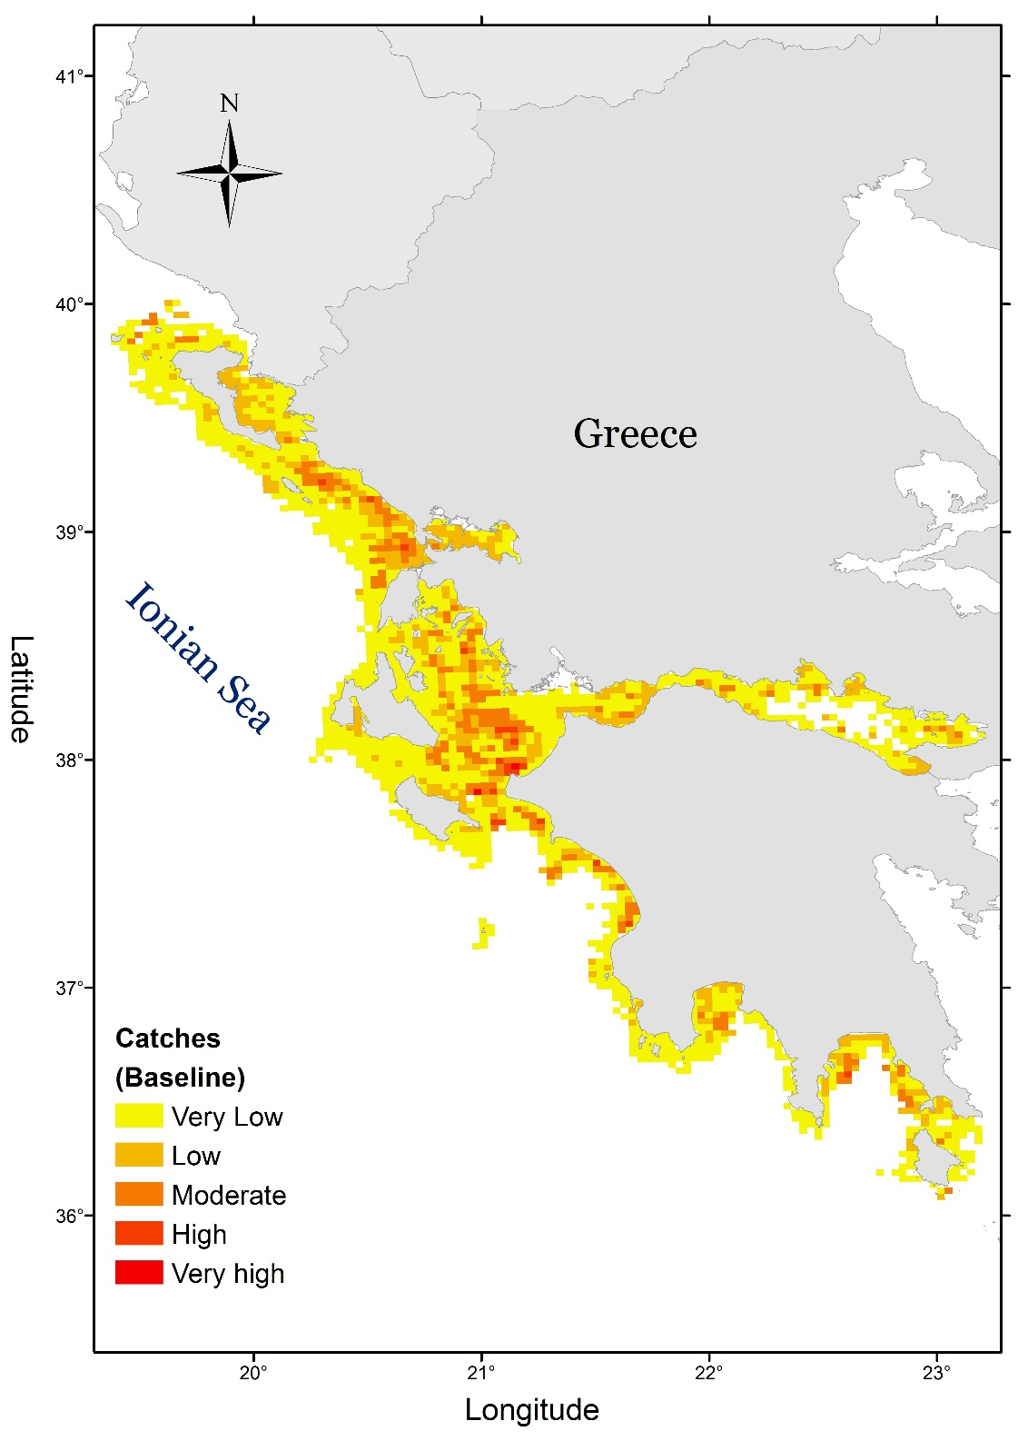
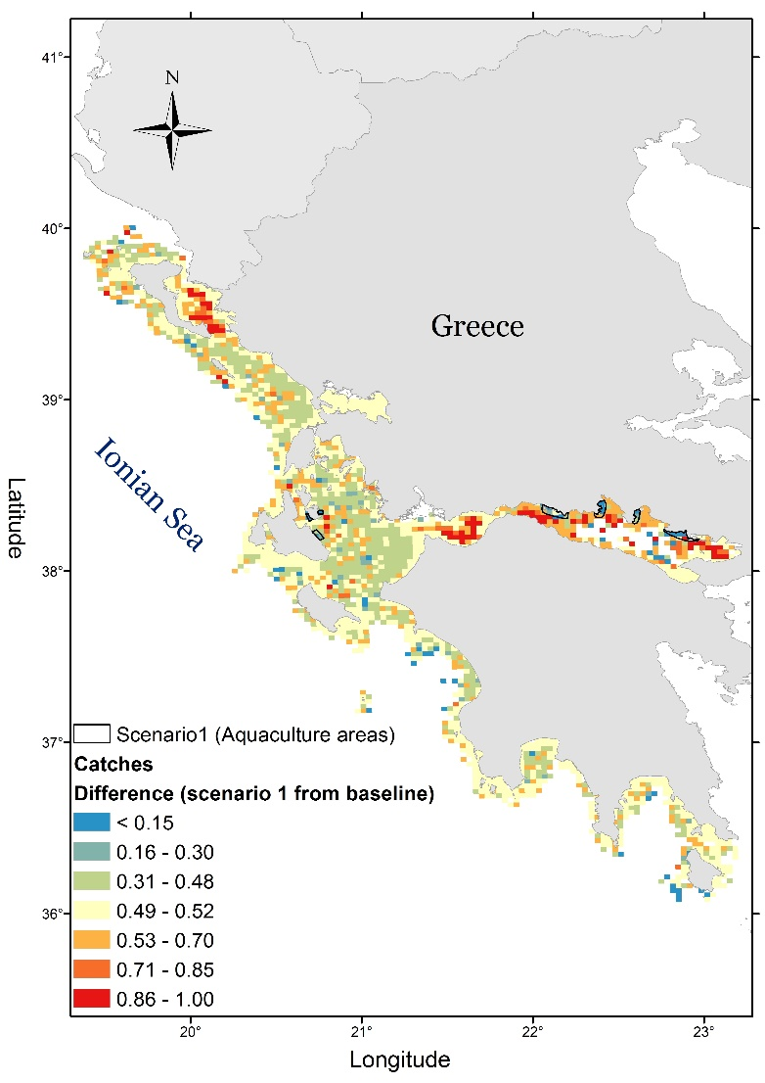
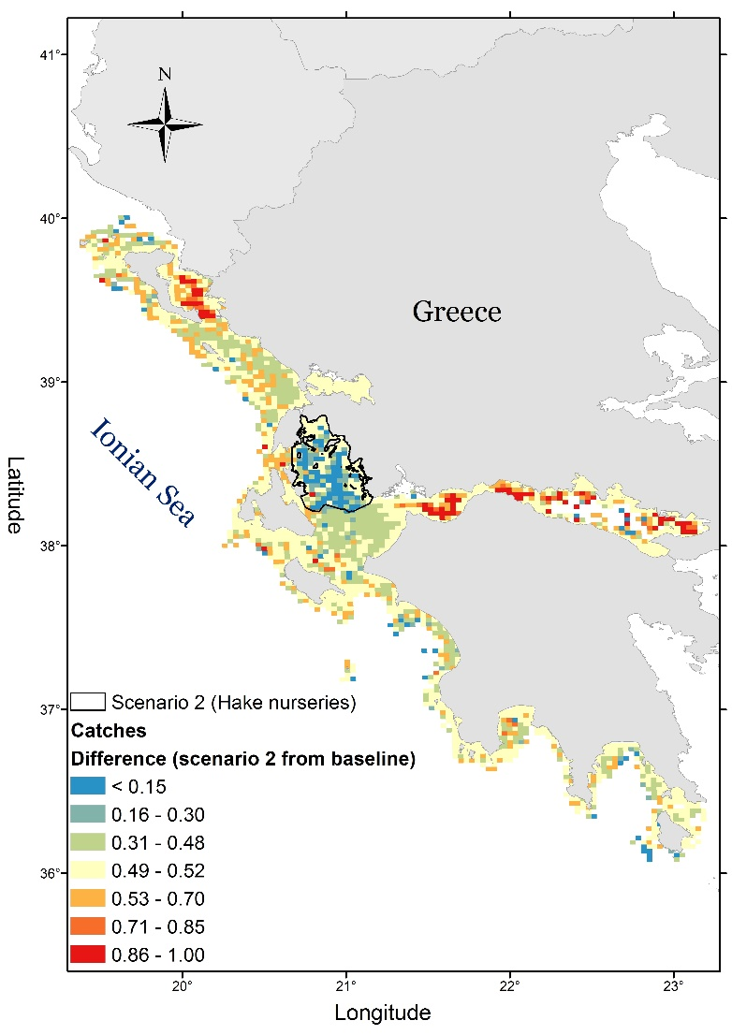
Demersal Greek fisheries in Ionian Sea
Spatial conflicts between mutually exclusive use and trade-off analysis / define priority sites also ensuring the sustainable use of the seas
Catches
Aquaculture placement
Nurseries protection
Notes:
Another case we investigated was the Greek demersal fisheries in the Ionian Sea. Here the issue is to suggest management that would mitigate the conflicts between aquaculture sites and potential sites, and also trying to design protection areas for valuable nurseries here. Here you ve got a picture of where the fishing is ongoing, and here a picture a relative change of scenarios outcomes compared to the baseline situation.

Slide 9
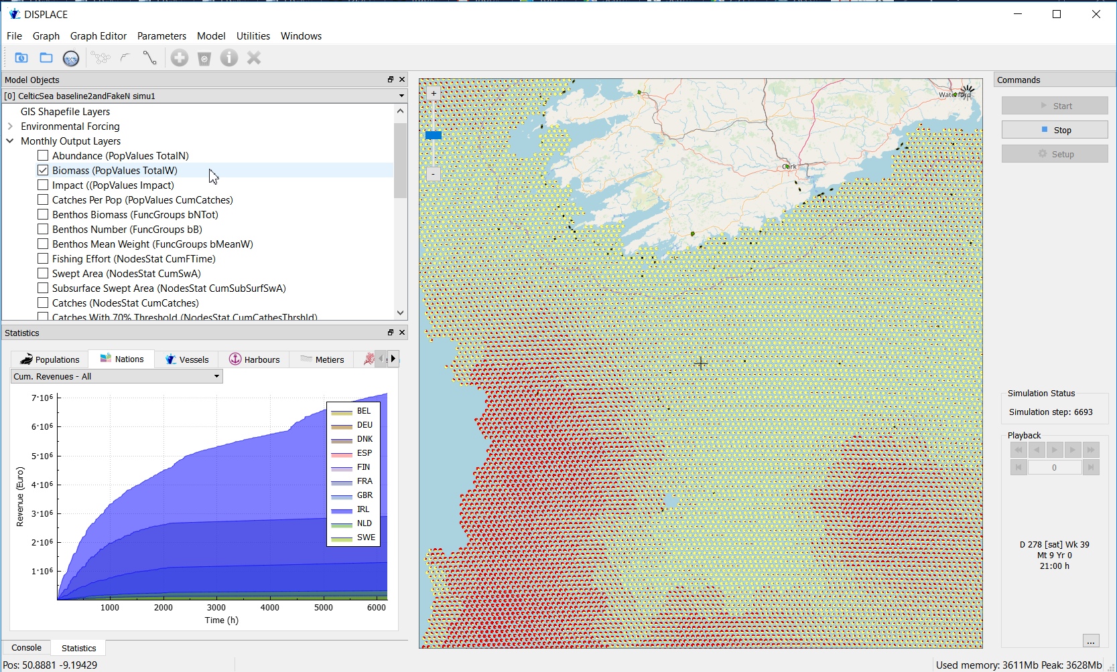
Demersal Irish Fisheries in the Celtic Sea
Annual decisions on TACs and problems of quota underutilization from choked species.
Benefits for fishing from displacement effects and associated ecosystem and fisheries impacts (habitat credit system)
=> Sizespectra modelling & trophic cascading
Notes:
The third case we implemented (still ongoing work) is to look at the problem of choked species and quota underultisation that can occur in this case, espacially focusing on the Demersal mixed fisheries in the Celtic Sea. Here we look at the benefits that could occur from displacing the fisheries on surrounding areas, also looking at potential side effect through trophic cascading, etc.

Slide 10
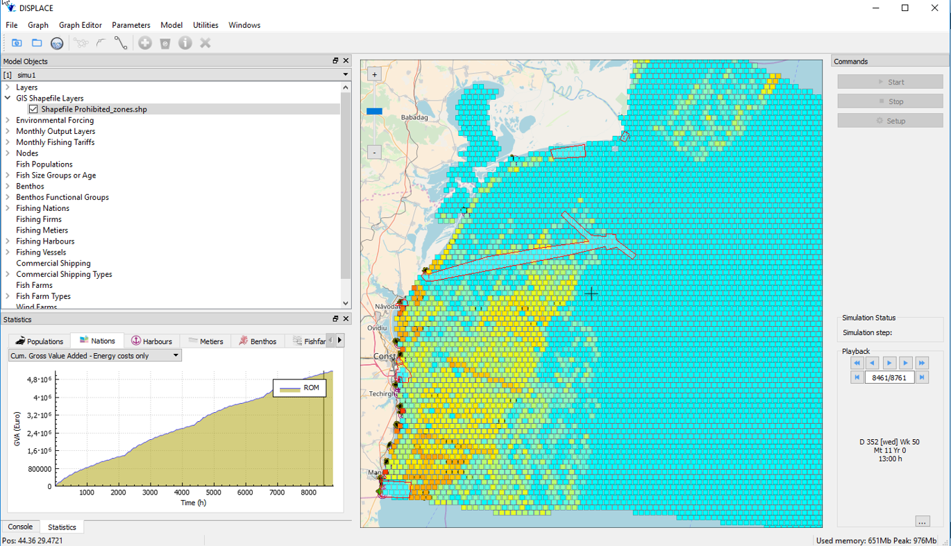
Romanian fisheries in the EEZ
Ensure viable fishing within ongoing Marine Spatial Planning / impact assessement of top down decisions for spatial reservation
Notes:
The fourth case is in the Romanian Exclusive Zone. Here the goal is to ensure a viable fishing in the context of maritime spatial planiing and conducting impact assessment of potential top dowm decision that would decide reserving some space for other activites than fishing.

Slide 11
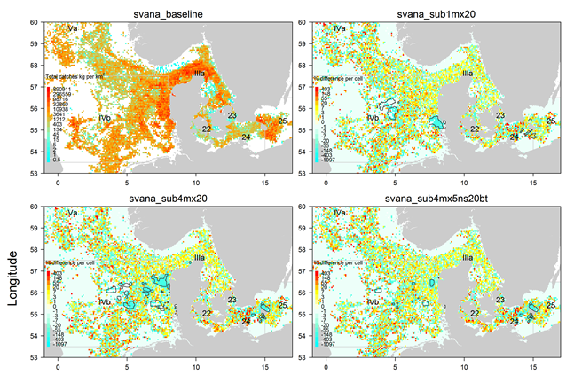
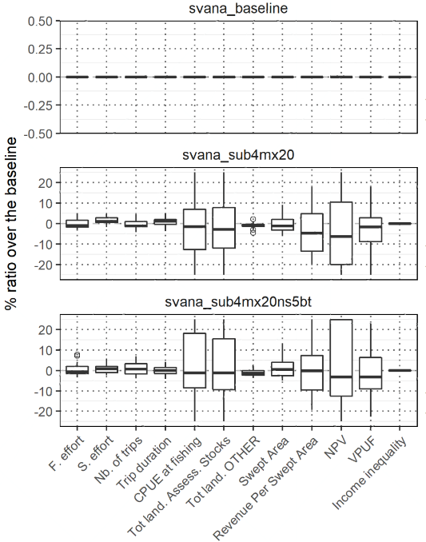
Danish Mixed Fisheries in the North Sea & Baltic Sea
Displacement effects for fishing and associated ecosystem and fisheries impacts
Notes:
The final case we present here is the complex Danish Mixed Fisheries that occurs in-between two large management areas that are the North Sea and the Baltic Sea. Here we looked at what would be the effect of displacing the fishing from some conservation areas (for example design from MARXAN) on the sustainaibility of the harvesting, and also quantifying the potential side effects on other components of the ecosystems.

Slide 12
Overarching goals: Consider the exploitation of marine fishery resources with regards to all maritime activities
Maintaining the accessibility of fishing grounds still reachable at the reasonable cost
Ensuring stable yields
Ensuring a high quality of food production from the landing of the more valuable fish
Maintaining sustainable long-term biomass levels
Avoiding unintended consequences on other components of the marine ecosystem including the social fabrics
Notes:
A slide to summarize the overarching goals of what we are doing:
In this maritime Spatial Planning Context from the perspective of the fisheries we want to:
1) Maintaining…
2)Ensuring…
….

Slide 13
Stakeholders´views (some of)
“Shared stocks” issue: Most of the catches of the Romanian targeted stocks are done outside the EEZ. Effort of mitigation done within the EEZ will have small impact only. Need for cross border concertation!!!
Help for fixing possible lack of coordination in implementation of policy, e.g. in designating areas to protect might lead to inconsistent network of areas when several EEZs that biology connect
Doubts on the robustness of some of the input data used. However the platform is precisely useful here for getting uncertainties around estimates!
A useful platform to integrate and discuss several data layers from different participating countries, for co-creation & social acceptance
Notes:
This is in line with the views from stakeholders and here we listed just 4 of them:
For the Romanian case stakeholder have an issue with the shared stock situations. Then they stress on developing corss border concertation to make the management relevant and efficient when the stocks are shared!!!
should recognize the needs for consulting other stakeholders than the ones from the fishing sectors given that we all know there are diverse activities underway in our seas and there are also multiple regulatory and agency activities. As one say, bringing this complexity together to support an EBM process requires overcoming geographic boundaries, political boundaries, and administrative boundaries.
Among other things you had in mind, it may also be a good idea to push forward the ECOAST DISPLACE Italian/Greek applications in this context when one important aspect of blue growth and Integrated Maritime Policy is to avoid duplication and consequently re-use as far as possible some existing tools that have proven to be useful in other areas. Hence the idea is to tailor or downscale our current applications to a particular case study area via the close consultation of local stakeholders that would promote the co-creation the solutions and ensure the social acceptance of some of the spatial plans or management options...

Slide 14
Stakeholders´views (some of)
“Shared stocks” issue: Most of the catches of the Romanian targeted stocks are done outside the EEZ. Effort of mitigation done within the EEZ will have small impact only. Need for cross border concertation!!!
Help for fixing possible lack of coordination in implementation of policy, e.g. in designating areas to protect might lead to inconsistent network of areas when several EEZs that biology connect
Doubts on the robustness of some of the input data used. However the platform is precisely useful here for getting uncertainties around estimates!
A useful platform to integrate and discuss several data layers from different participating countries, for co-creation & social acceptance
Notes:
In the Danish case, this is kind of similar problem. In a lot of contiguous exclusive zone in the European waters some mangement appear disconnected and sometime contradictory while it is obvoius we should take care of how the biology connects in space and time…….

Slide 15
Stakeholders´views (some of)
“Shared stocks” issue: Most of the catches of the Romanian targeted stocks are done outside the EEZ. Effort of mitigation done within the EEZ will have small impact only. Need for cross border concertation!!!
Help for fixing possible lack of coordination in implementation of policy, e.g. in designating areas to protect might lead to inconsistent network of areas when several EEZs that biology connect
Doubts on the robustness of some of the input data used. However the platform is precisely useful here for getting uncertainties around estimates!
A useful platform to integrate and discuss several data layers from different participating countries, for co-creation & social acceptance
Notes:
In the Italian case, there were some doubts expressed regarding the quality of the input data. Some stakeholders does not beleive in some estimates used as input….but the platform is precisely useful for that case…..

Slide 16
Stakeholders´views (some of)
“Shared stocks” issue: Most of the catches of the Romanian targeted stocks are done outside the EEZ. Effort of mitigation done within the EEZ will have small impact only. Need for cross border concertation!!!
Help for fixing possible lack of coordination in implementation of policy, e.g. in designating areas to protect might lead to inconsistent network of areas when several EEZs that biology connect
Doubts on the robustness of some of the input data used. However the platform is precisely useful here for getting uncertainties around estimates!
A useful platform to integrate and discuss several data layers (and animate them) from different participating countries, for co-creation & social acceptance
Notes:
All in all, many stakeholders expressed the feeling that the platform is useful to integrate several data layers and make them dynamics to understand potential future paths in time….this is especially important to ensure the co-creation of the management and facilitate the social acceptance of the proposed solutions…..

Slide 17
MODELLING SPATIAL INTERACTIONS
AMONG FISH COMMUNITIES, FISHERS
AND OTHER MARINES ACTIVITIES
François Bastardie, Rufener MC, Nielsen JR, Maina I, Kavadas S, Vassilopoulou C, Alexandrov LM, Niculescu D, Spinu A, Nicolaev A, Rosca M, Höffle H, Farnsworth KD, Pedreschi D, Reid D, Bolognini L, Martinelli M, Grati F, Fuga F
Funding by the EU FP7 ERA-net COFASP ECOAST Project under Grant Agreement No. 321553.
IIFET 2018, Seattle, US,
Session on Marine Spatial Planning and Multiple Use Management
Find out more on www.displace-project.org or @navigate4sea
Notes:
DTU-Aqua will be capable of providing support to the science, especially stock assessment issues, management targets and limits evaluation, and spatial population surveying and modelling, in line with the ICES work and EU Research Projects, and furthermore offering a tool that integrate both the CFP and the MSFD (and potentially the MSPD) i.e. the added value of the DISPLACE platform that would strengthen the ecosystem management of fisheries, evaluating the socioeconomic impacts and the performance of alternative HCRs and multiannual plans in a MSE framework etc. We believe that DISPLACE is almost ready for this to answer special requests on demand and in short notice both for the North Sea and the Baltic Sea.

