Slide 1
A Cloud-based Science Gateway for the Geoscience Community
Mohan Ramamurthy
20 July 2018
2018 ESIP Federation Summer Meeting
Tucson, AZ

Slide 2
Unidata
A cyberinfrastructure facility for the atmospheric and related sciences.
We are funded by the U. S. National Science Foundation.
Acquire and provide meteorological data to the community;
Develop and provide software for accessing, managing, analyzing, visualizing geoscience data (e.g., NetCDF, THREDDS Data Server, LDM, IDV,…)
Provide support and training on our software and data systems.

Slide 3
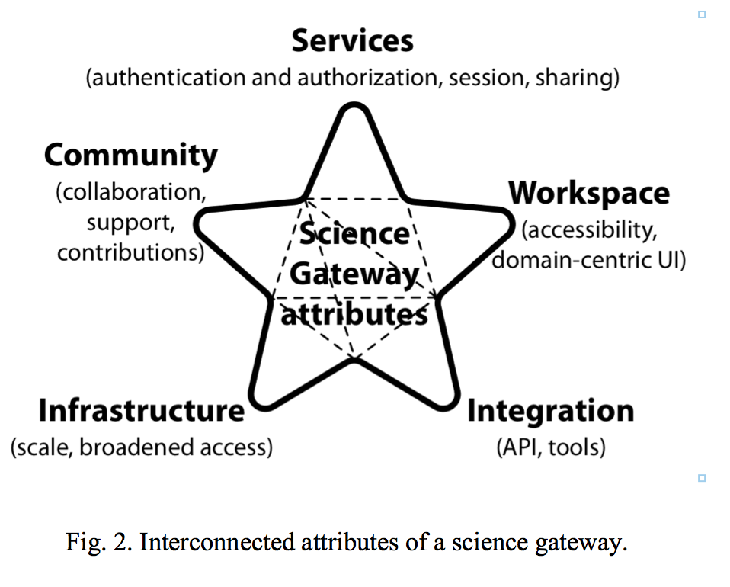
Science Gateway Attributes
Data, Tools, Services, API
Pierce et al., 2018

Slide 4
Motivation
Data volumes are getting to be too large to bring all of the data to your local environment.
Need to keep data close to the point of dissemination and provide the requisite tools and services to create a workspace in the cloud.
We need to move from “bringing the data to the scientist” to “bringing the science to the data”.
We would like to exploit the on-demand resource provision, elasticity, and virtualization aspects of the "cloud."
Goal: Shrink Time to Science by Decreasing Data Friction
Goal: Shrink Time to Science by Decreasing Data Friction

Slide 5
Approach
The cloud-enabled deployment of Infrastructure as a Service, Data as a Service, and Software as a Service is key to the delivery of Science as a Service.
Transform “client-side” analysis and visualization tools to become “server-side” tools that reside close to the location of data. (Similar to Office 365 and Adobe Photoshop)
Connect those server-side tools and data via a workbench to provide an ecosystem of tools and resources for scientists.
Goal: To shrink “time to science”
Goal: Shrink Time to Science by Decreasing Data Friction
Goal: Shrink Time to Science by Decreasing Data Friction

Slide 6
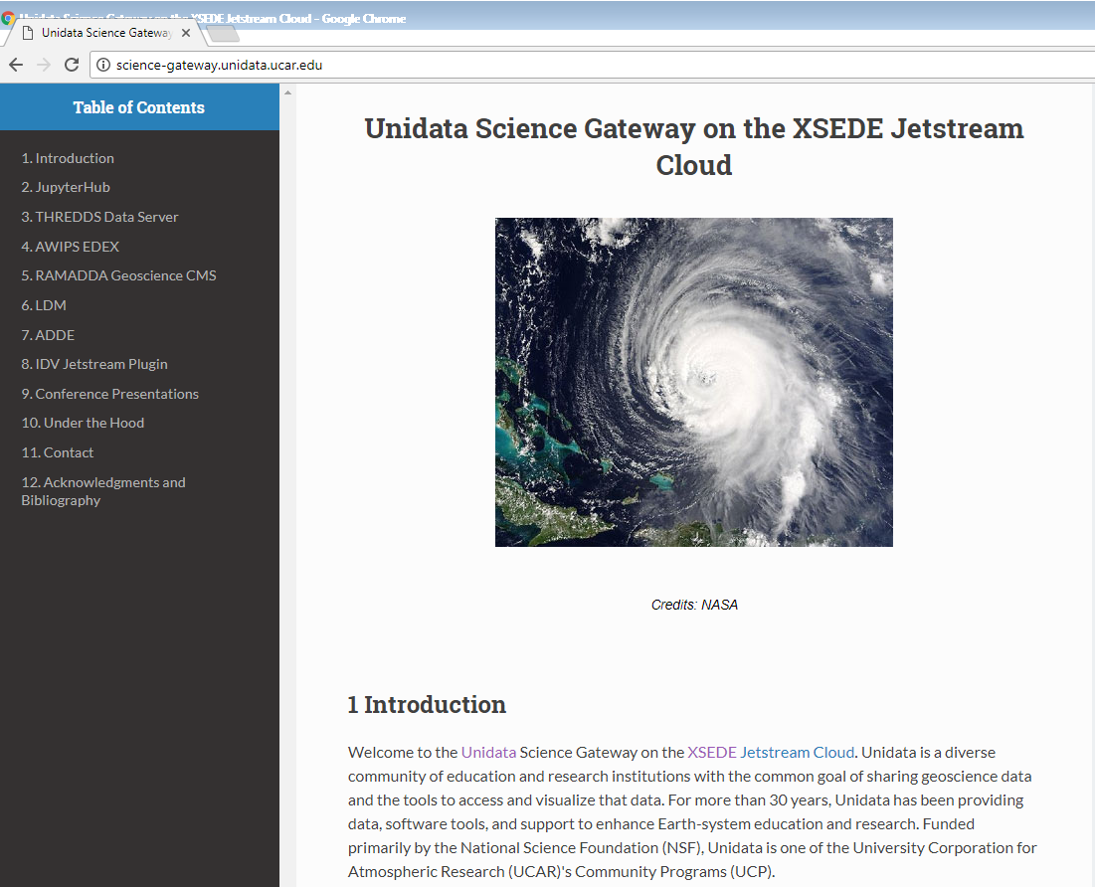
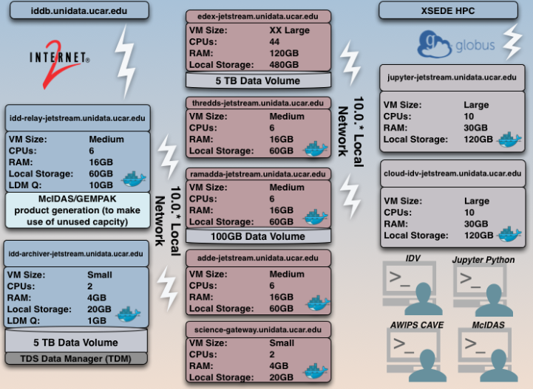
Unidata Science Gateway
http://science-gateway.unidata.ucar.edu/

Slide 7
Gateway Services
Access to large volumes of meteorological data, via OPeNDAP, ADDE, WCS, WMS, netCDF APIs and protocols, including access to subsets of data
Data transformation and format conversion
Extensive data analysis capabilities
Visualization of data provided by the gateway
Access to a collection of Jupyter Notebooks for data analysis
Access to Advanced Weather Information Processing System EDEX data server from CAVE client application
Goal: Shrink Time to Science by Decreasing Data Friction
Goal: Shrink Time to Science by Decreasing Data Friction

Slide 8
Real-time Data Hosting
Model
Satellite
Radar
About a terabyte of data from 30 different streams of real-time weather data from diverse sources are moved each day and hosted on the Unidata Science Gateway.
Satellite
Radar
Lightning
Surface, upper-air observations
Operational Weather Model output, …
…

Slide 9
AWIPS Data Servers in the Cloud
AWIPS is the system for processing, integrating, and displaying all types of meteorological and hydrological data in National Weather Service offices.
Unidata distributes a version of AWIPS to the university community.
AWIPS has a data-server component called EDEX and a client side application, CAVE.
Unidata is running AWIPS-EDEX data server in the cloud.
Notes:
Unidata AWIPS (formerly AWIPS II) is a meteorological display and analysis package originally developed by the National Weather Service and Raytheon, repackaged by Unidata to support non-operational use in research and education by UCAR member institutions.

Slide 10
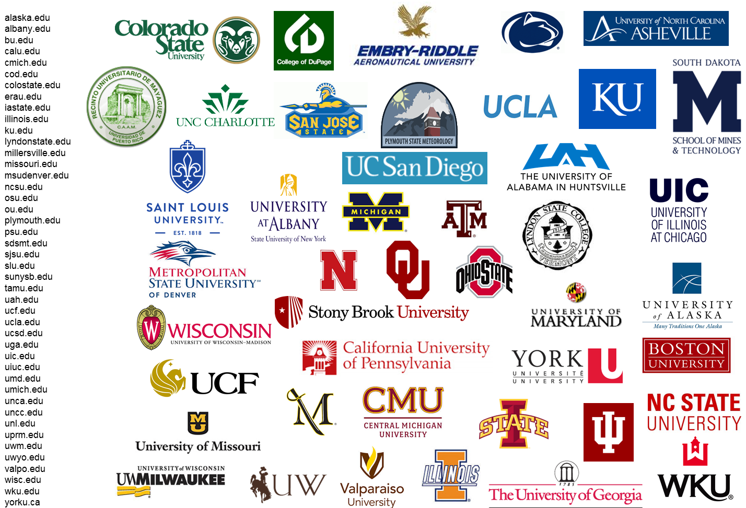
Use of AWIPS Data Server in the Cloud
Over 40 universities are using Unidata’s cloud-hosted EDEX.
Notes:
Unidata AWIPS (formerly AWIPS II) is a meteorological display and analysis package originally developed by the National Weather Service and Raytheon, repackaged by Unidata to support non-operational use in research and education by UCAR member institutions.

Slide 11
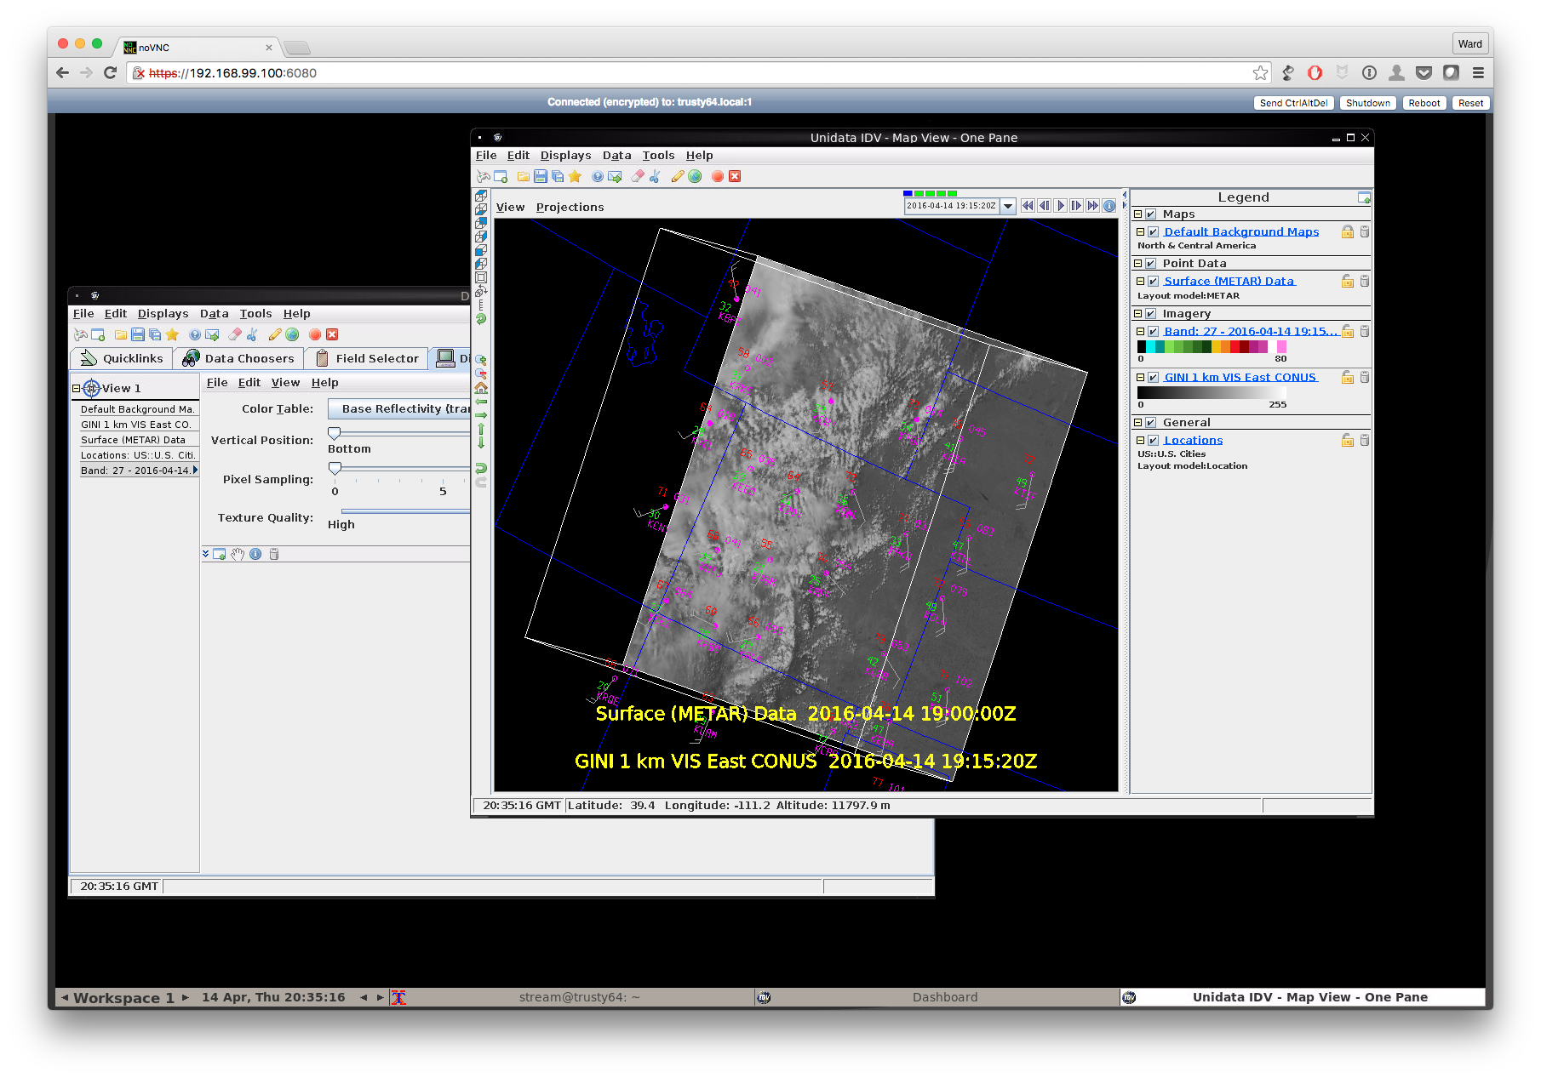
CloudIDV
Benefits
No need to download, install, and keep updating software
IDV can be co-located with data, reducing data movement.
No longer limited by desktop/laptop memory and network bandwidth.
Unidata is currently working with a small group of early adopters to work out the details.

Slide 12
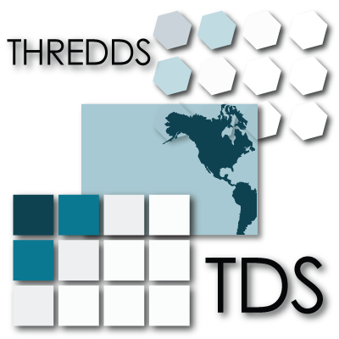
Remote Data Analysis & Visualization
Unidata is also leveraging other cloud technologies to enable data proximate analysis and visualization capabilities.
Specifically, Unidata is integrating the capabilities of THREDDS Data Server, Jupyter Notebook platform, Siphon Python data access tool, and MetPy/CartoPy/Matplotlib/xarray and GEMPAK analysis and visualization applications.

Slide 13
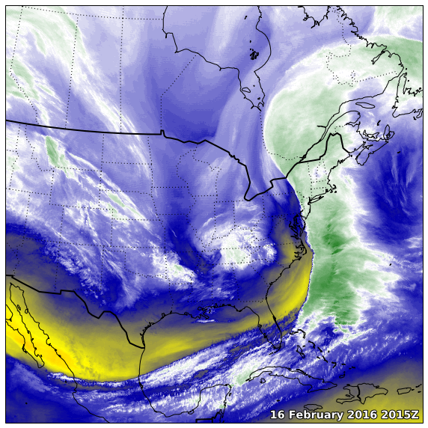
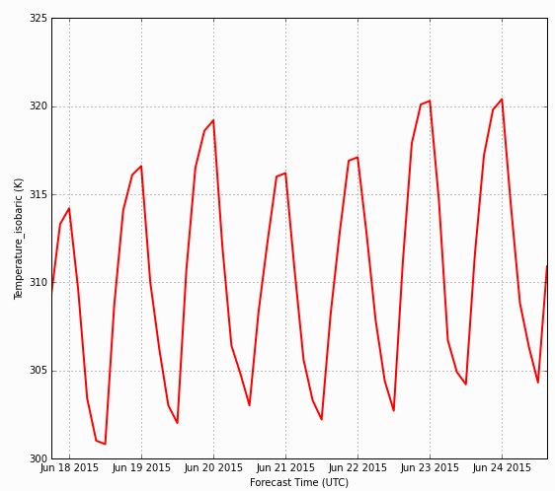
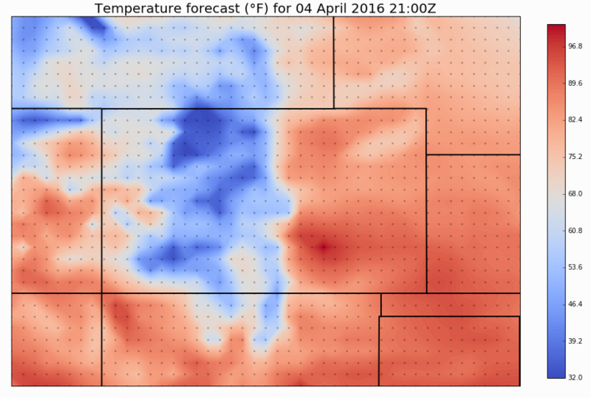
Geospatial Analysis& Visualization Jupyter Notebooks:TDS+Siphon+MetPy
Using Siphon to query the NetCDF Subset Service and plotting it to a map

Slide 14
Containerizing Applications
We have created Docker container images for several Unidata applications, including the Integrated Data Viewer (IDV), THREDDS Data Server, Local Data Manager (LDM), and many Python tools.
We have been deploying these applications in our own cloud instances and also making them available on GitHub as downloadable software to our users.
The use of Container Applications and Jupyter Notebooks is practical way to advance Reproducibility in Science

Slide 15
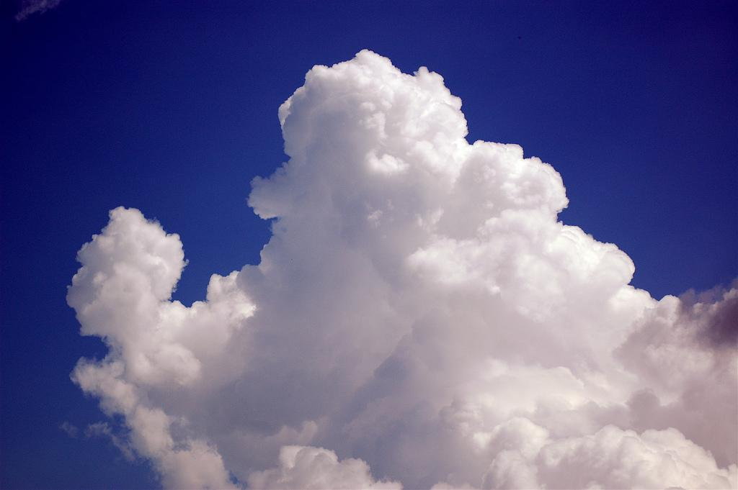
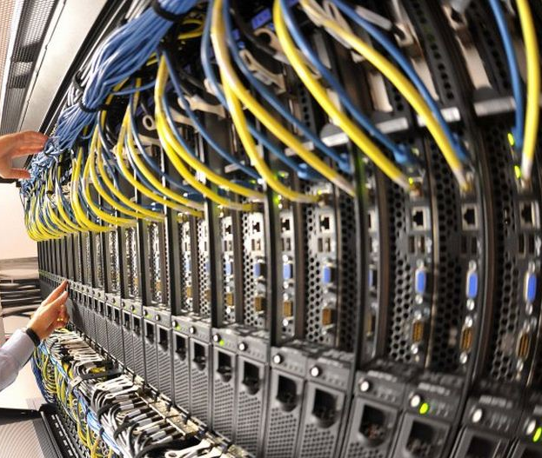
Framework of the Future: HPC+scalable, data-proximate computing in the Cloud
* LDM, TDS, ADDE * Globus * JupyterHub * Kubernetes
* Dask
* Xarray
Zarr, HSDS,
Cloud IDV, AWIPS
Cloud
HPC
* InfiniBand * Globus
CPUs
WRF
Modeler
Scientist, Student, ...
* Browser
* Browser
Signell, 2017

Slide 16
Acknowledgement
Unidata is one of the University Corporation for Atmospheric Research (UCAR)'s Community Programs (UCP), and is funded primarily by the National Science Foundation (Grant NSF-1344155).

