Slide 1
SEADTrain Analysis with Azure: Publishing environmental sensor data by PID’ifying the Research Object
Presenters: Yu Luo & Kunalan Ratharanjan
Data To Insight Center
Indiana University Bloomington
ESIP Summer 2018, Bloomington, IN

Slide 2
Publish daily data down to per device/per day granule

Slide 3
Device & Sensor
Sensor: one of the measurement units on the sensor (temperature, air pressure, humidity)
Device: the chassis that holds sensors

Slide 4
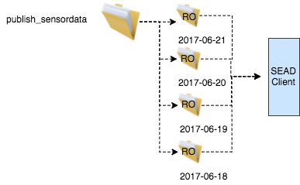
Step 1: group data arriving by MQTT into per day RO
A SEAD client checks a directory regularly for new files.
Packages all devices’ sensor data for each day as Research Object (RO)
RO: one day of measurement data for all devices that happen to be publishing on the one MQTT channel that we are reading from.
Creates ORE for RO
Submit for publishing

Slide 5
Step 2: RO Validation
SEAD’s Curbee is a lightweight publishing workflow.
Validates RO; RO is in JSON format, including metadata information about RO.
Persists information about ROs published by SEAD
Identifier, Creation date, Publication date
Title, Label, Creator, Abstract
Size
File type
Notes:
What exactly does Persist refer to?

Slide 6
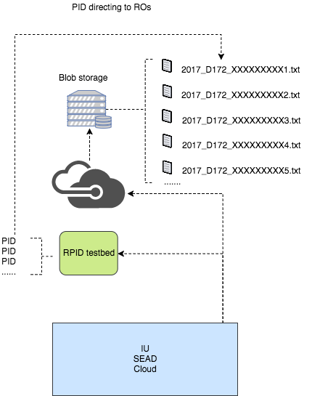
Step 3: Publish to Azure
Publishing is in two steps:
Execute SEAD strategy for assignment of PIDs within the RO
Utilize RPID Testbed to obtain handles
Deposit raw data into Azure Blob
Stable and long-term repository for storing data.

Slide 7
SEAD strategy for assigning PIDs to an RO**
First the RO is assign a PID that we call the Root PID
Admin information from Handle.Net shows kernel information for the top level RO PID
The URL link in Root PID is referencing to the JSON metadata of root PID

Slide 8
SEAD strategy for assigning PIDs within an RO
The internal files are assigned Child PIDs.
The URL link in Child PID is referencing to the raw data file of one device
Child PIDs are stored to a single ORE map file that is associated with the parent (RO)
The parent maintains rich metadata about the RO; the children have only PID Kernel Information about them

Slide 9
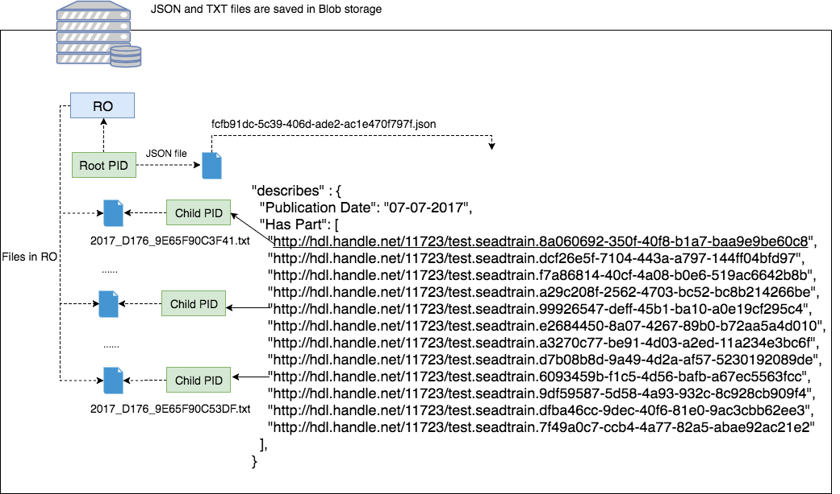
PIDs Relationship
Notes:
needs simplification.

Slide 10
AirBox Ingest Demo
Publishing through SEAD is an automatic process
For demo purposes, we show how each step works by stepping manually through the process
Notes:
From here, we start the demo.

Slide 11
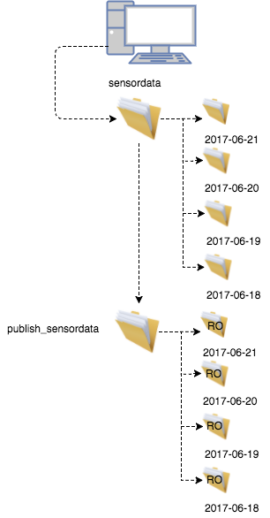
Create ORE & Submit Publication Request
Validate RO Metadata
Update & Persist ORE
Persist RO
Mint PIDs
Publish RO
Copy the data folder for one day into publish_sensordata folder

Slide 12
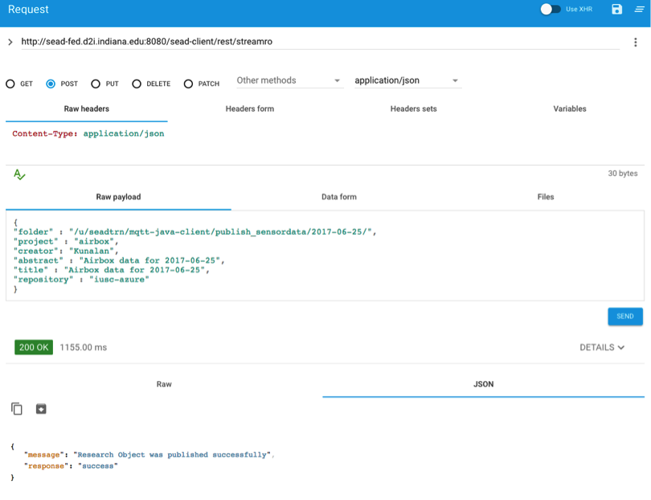
Create ORE & Submit Publication Request
Validate RO Metadata
Update & Persist ORE
Persist RO
Mint PIDs
Publish RO
Publishing: Start
SEAD Client
SEAD Curbee
IU SEAD Cloud
Completed
Manually send a request with the given JSON input to URL for triggering SEAD Client to recognize the new incoming data: http://d2i-dev.d2i.indiana.edu:8080/sead-client/rest/streamro.
Later SEAD creates a RO request for daily sensor data, and pass it to SEAD Curbee.
SEAD packages raw data files into digital RO.

Slide 13
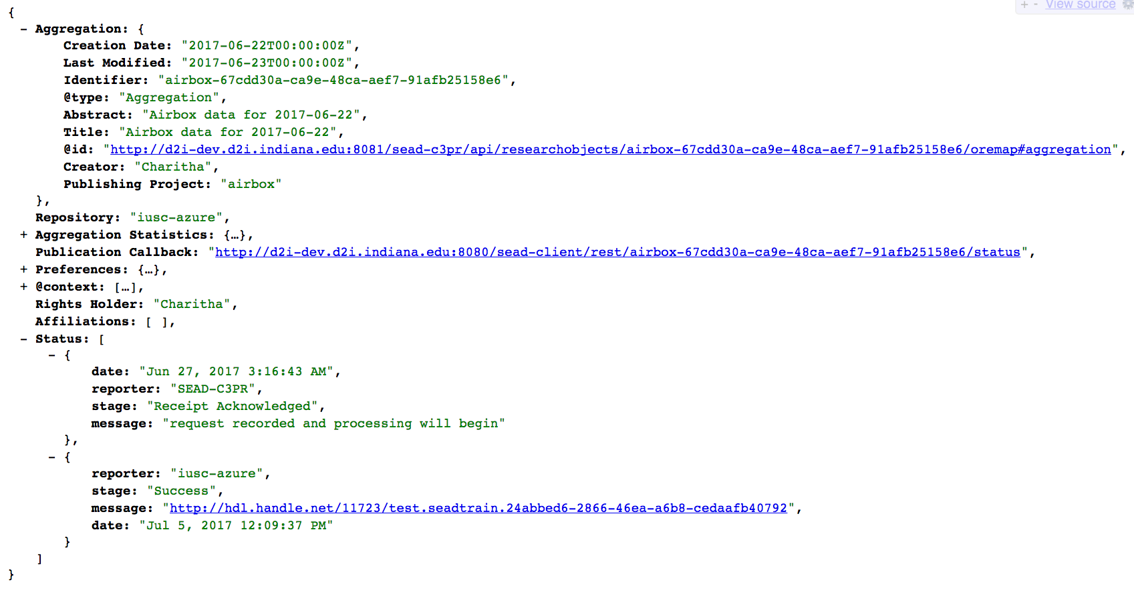
RO ORE map
Create ORE & Submit Publication Request
Validate RO Metadata
Update & Persist ORE
Persist RO
Mint PIDs
Publish RO
Publishing: Start
SEAD Client
SEAD Curbee
IU SEAD Cloud
Completed

Slide 14
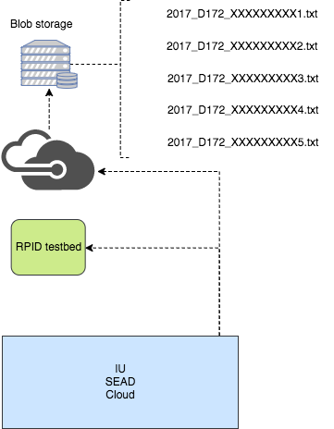
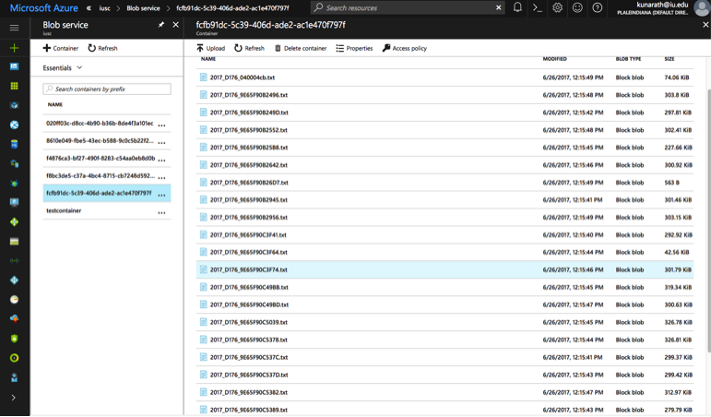
Create ORE & Submit Publication Request
Validate RO Metadata
Update & Persist ORE
Persist RO
Mint PIDs
Publish RO
Publishing: Start
SEAD Client
SEAD Curbee
IU SEAD Cloud
Completed
Assign PIDs according to SEAD PID assignment strategy
PIDs minted by handle service of RPID Testbed
Deposit files as BLOBs into Azure repository
After IU SEAD Cloud completes, raw data files are deposited into Azure blob storage

Slide 15
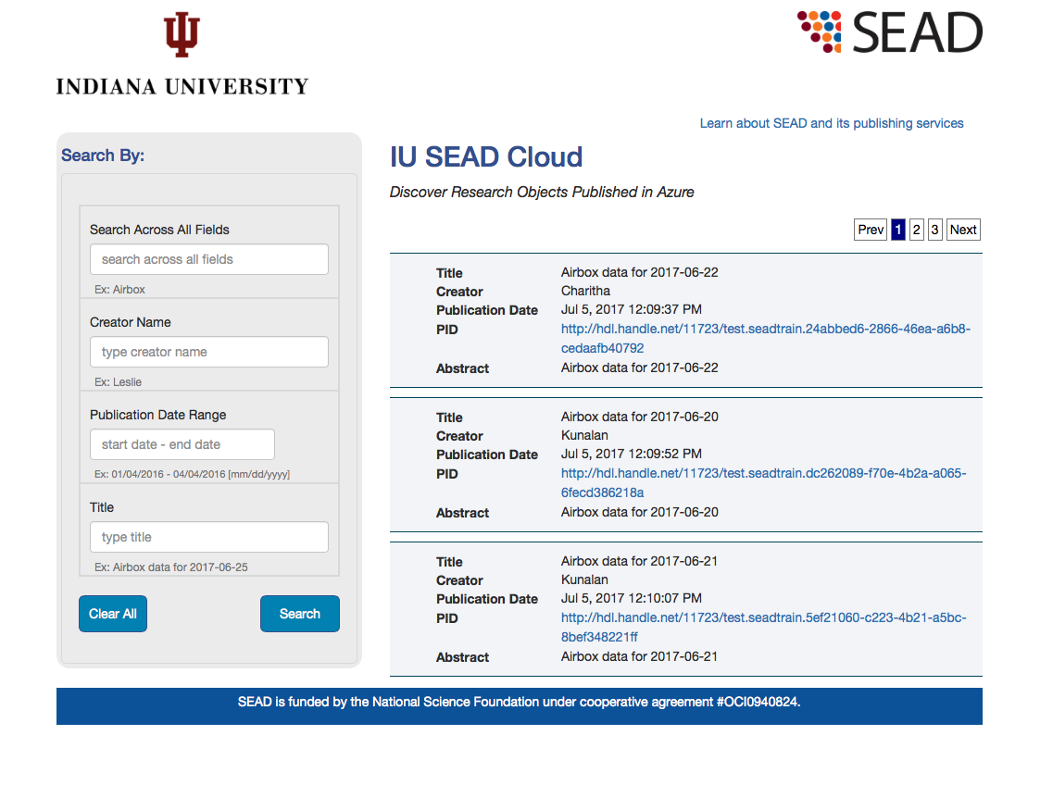
Create ORE & Submit Publication Request
Validate RO Metadata
Update & Persist ORE
Persist RO
Mint PIDs
Publish RO
Publishing: Start
SEAD Client
SEAD Curbee
IU SEAD Cloud
Completed
Discovery User Interface for finding published root PID.
http://d2i-dev.d2i.indiana.edu:8081/iusc-azure-search/search.html

Slide 16
Next up: Hands-on Setup
Help Section
Hands on participation setup.
VMs available on Azure for user to do analysis on raw Airbox sensor data.
In folder on VM, there’s a folder called “ESIP” that has some scripts in it.
Follow the instructions and have fun using Power BI

