Slide 2
Rapid Seismic Domain Transfer:
Seismic Velocity Inversion and Modeling Using Deep Generative Neural Networks
Lukas Mosser, Wouter Kimman, Jesper Dramsch*, Steve Purves, Alfredo De la Fuente, Graham Ganssle

Slide 3
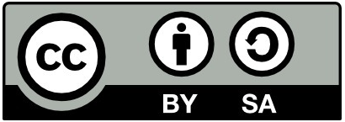
Rapid Seismic Domain Transfer: Seismic Velocity Inversion and Modeling Using Deep Generative Neural Networks
Lukas Mosser, Wouter Kimman, Jesper Dramsch*, Steve Purves, Alfredo De la Fuente, Graham Ganssle

Slide 4
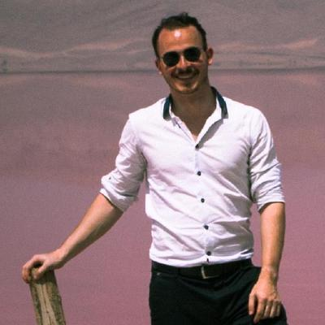
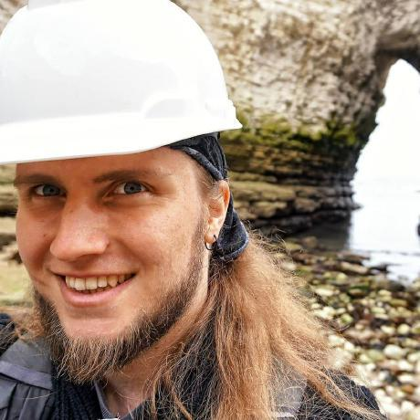
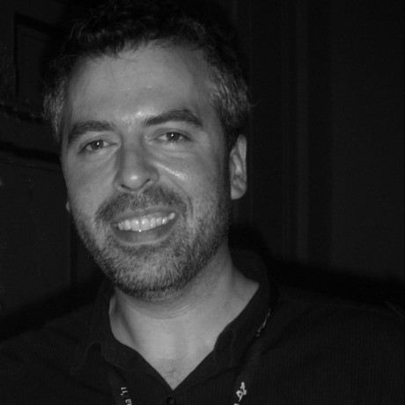
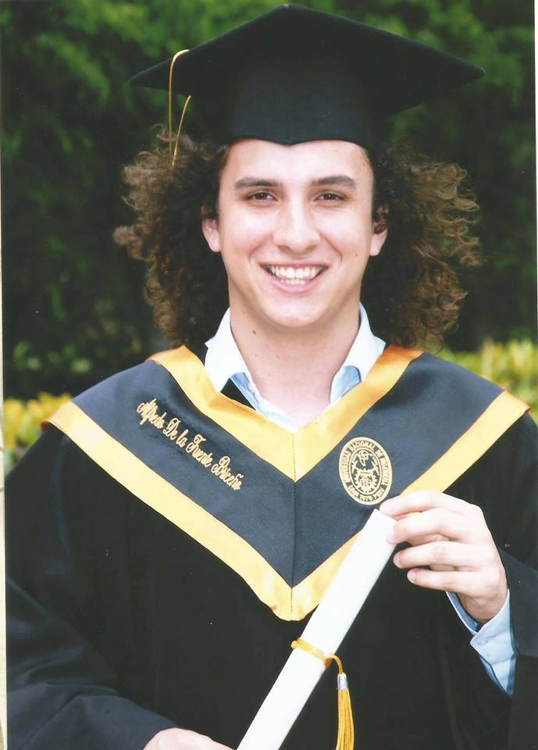
Team Introduction
Lukas Mosser Imperial College London
Jesper Dramsch Technical University of Denmark
Wouter Kimman Open Energi
Graham Gannsle Expero Inc.
Steve Purves Software & Algorithm Development
Alfredo de la Fuente Skoltech

Slide 5
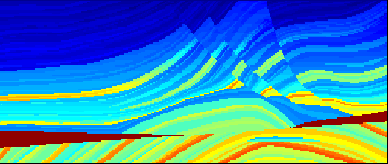
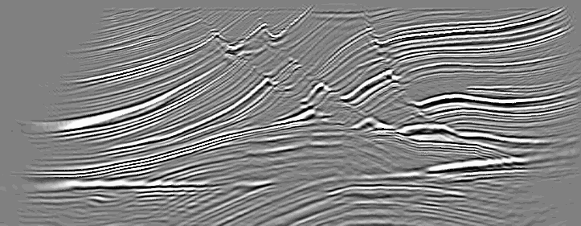
Motivation
Extracting rock properties/geo-models from seismic data
Time and Labour Consuming
Computational Expensive
Similar process applied to different datasets
Leverage modern deep learning and combine with seismic understanding.
Forward Operator
Inverse Operator
Velocity Model X
Observed Seismic Y

Slide 6
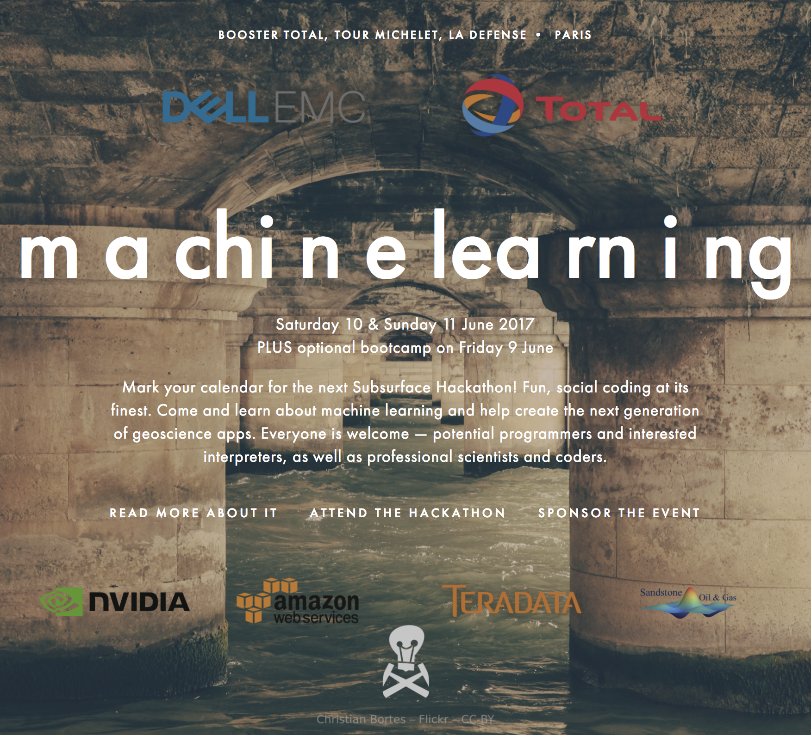
Project Inception
context: Agile Scientific SubSurface Hackathon. Paris, 2017 theme: Machine Learning :> 13 Teams :> 2 days + 1 week virtual brainstorm :> geoscience applications: - Well Log Interpretation - Document Parsing - Thin Section Mineral Classification - First break detection - more...

Slide 7
Outline
Motivation and Project Context
Generative Adversarial Networks
Model2Seismic
Technical Inspiration
Textural and Domain Transfer Methods
Training Data
Results
Challenges and Future Work

Slide 8
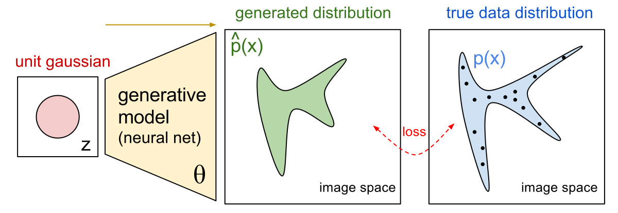
Generative Methods
Generative Model (Courtesy OpenAI)

Slide 9
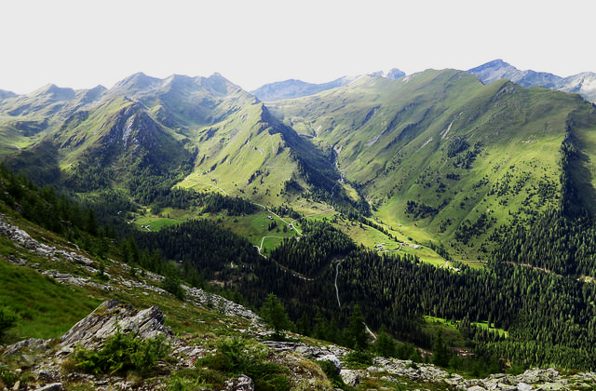
How do we generate data like this with a GAN?
Real Data (CC-BY A. Çuğun)

Slide 10
Generative Adversarial Networks
Legend
Network
Data
Real Data (CC-BY A. Çuğun)

Slide 11
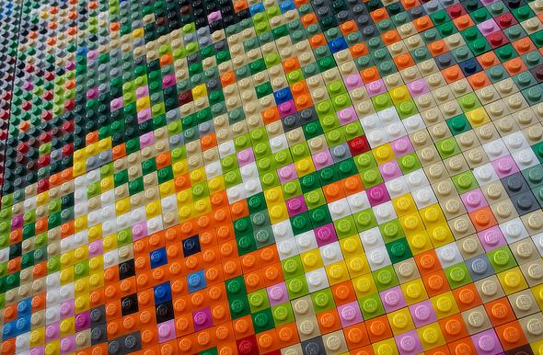
Start from latent space
Legend
Network
Data
Latent Space (CC-BY Hudson)
Real Data (CC-BY A. Çuğun)

Slide 12
Feed it to a Generator
Legend
Network
Data
Latent Space (CC-BY Hudson)
Real Data (CC-BY A. Çuğun)
Generator (CC-BY-SA T. Vaughn)

Slide 13
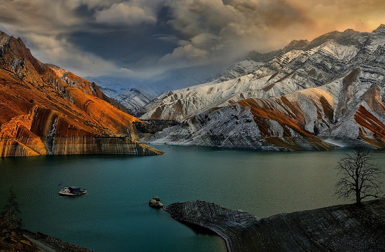
That generates some Fake Data
Legend
Network
Data
Latent Space (CC-BY Hudson)
Real Data (CC-BY A. Çuğun)
Fake Data (CC-BY Tony A.)
Generator (CC-BY-SA T. Vaughn)

Slide 14
Discriminator judges if sample is real
Legend
Network
Data
Latent Space (CC-BY Hudson)
Real Data (CC-BY A. Çuğun)
Discriminator(CC-BY Brickset)
Fake Data (CC-BY Tony A.)
Generator (CC-BY-SA T. Vaughn)

Slide 15
Both networks learn regardless if D is correct
Legend (CC-BY Dramsch)
Network
Data
Latent Space (CC-BY Hudson)
Real Data (CC-BY A. Çuğun)
Discriminator(CC-BY Brickset)
Fake Data (CC-BY Tony A.)
Generator (CC-BY-SA T. Vaughn)
Loss (CC-BY S. MacEntee)

Slide 16
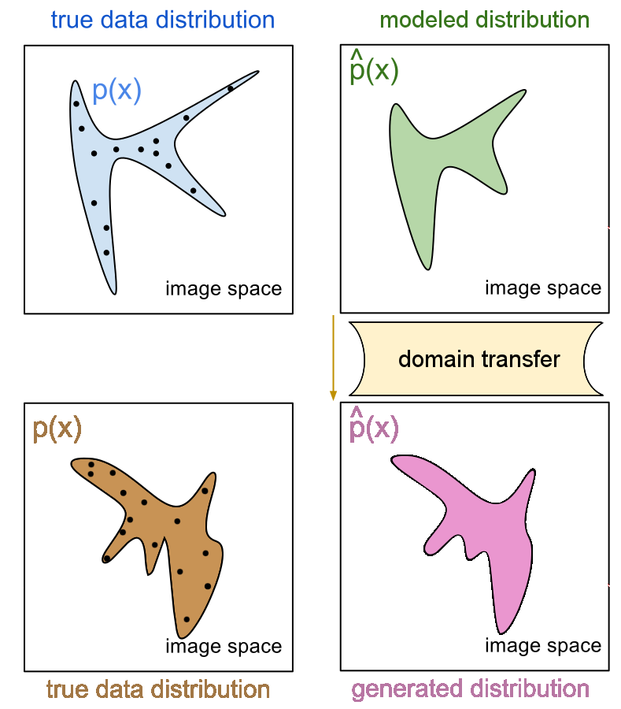
Domain Transfer
True data distributions needs model
Domain transfer is a transformation
Ideal operator to map data points to other data domain
Trivial example (in seismic)
Fourier Transform
Non-Trivial
Radon Transform
Seismic Migration
Domain Transfer (Modified from OpenAI)

Slide 17
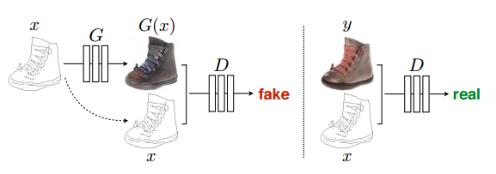
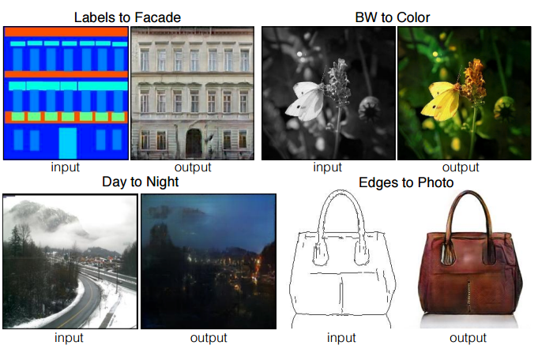
Inspiration: Paired Domain Transfer
Isola et al. 2016: Replace pre-trained perceptual networks (VGG) with generator-discriminator (GAN) pairing for perceptual loss.
Image-to-Image Translation with Conditional Adversarial Networks

Slide 18
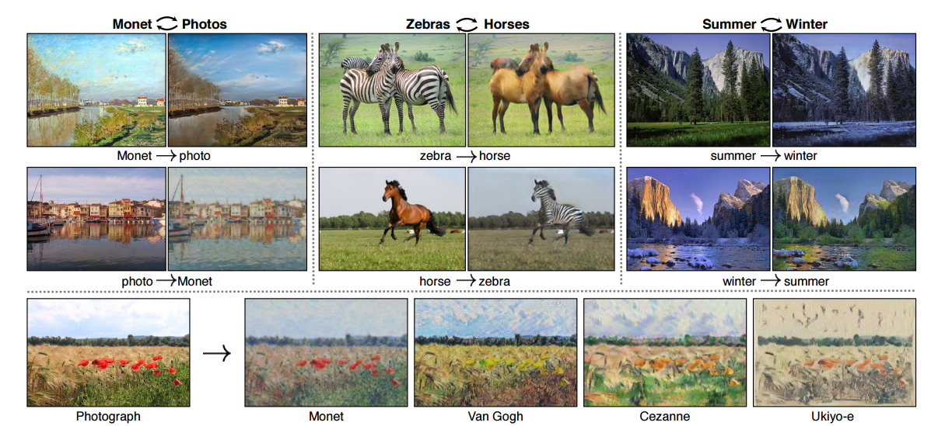
Inspiration: Unpaired Domain transfer
Find functions G(X) and F(Y) to map between two unpaired domains
Unpaired Image-to-Image Translation using Cycle-Consistent Adversarial etworks
Zhu et al. 2017:

Slide 19
Inspiration: Unpaired Domain transfer

Slide 20
Inspiration: Unpaired Domain transfer

Slide 21
Inspiration: Unpaired Domain transfer

Slide 22
Inspiration: Unpaired Domain transfer

Slide 23
Inversion as a domain transfer problem
Velocity Model
Observed Seismic
Uses unpaired velocity models and seismic observations
Does not require solution of non-linear optimization problem
Training computationally expensive, forward pass cheap
G(X) and F(Y) encode geologically realistic parameterizations/priors
Logical extension to third-dimension

Slide 24
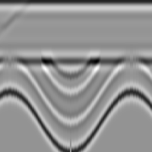
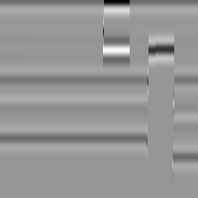
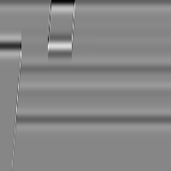
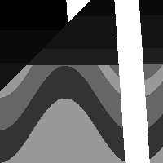
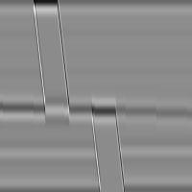
Training Data
Synthetic velocity models Synthetic Shot Gathers

Slide 25
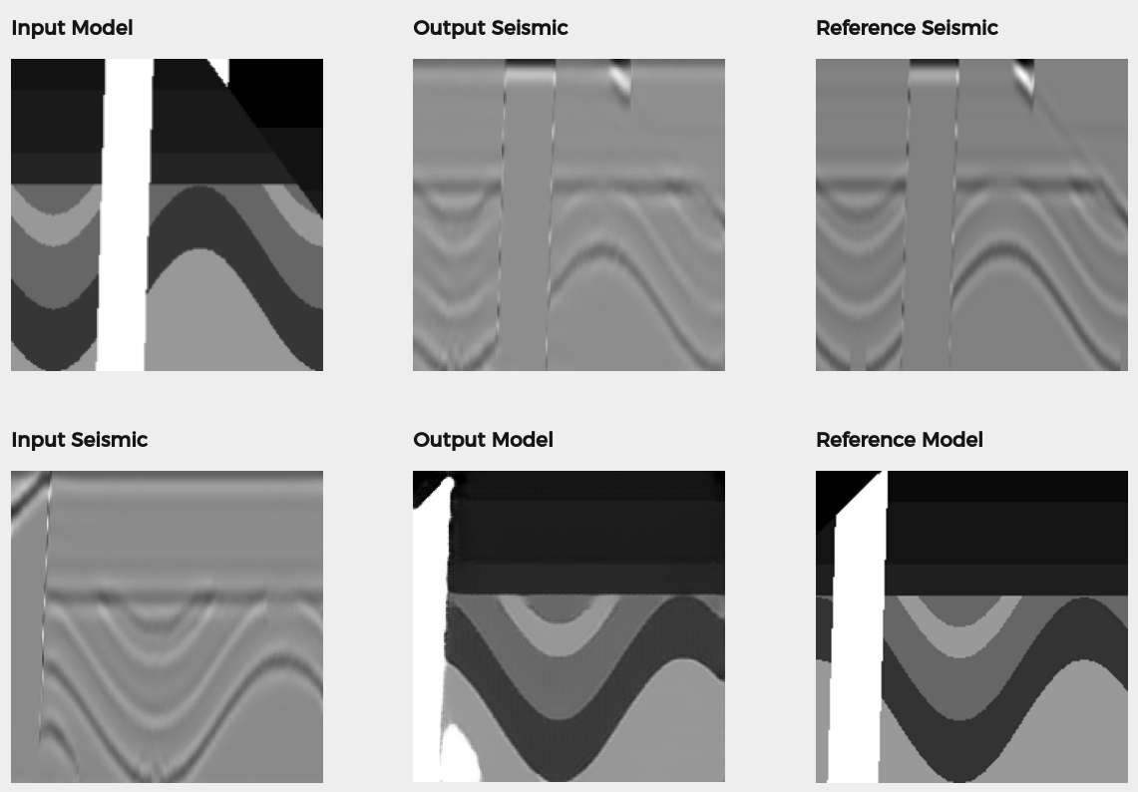
Results
Training time ~ 12 hours on single GPU, Forward pass < 1s
Forward Model
Velocity ⟶ Seismic
Inversion
Seismic ⟶ Velocity
Excellent agreement with reference solution on unseen (similar) data

Slide 26
Results
Marmousi 2D, Forward Model < 1 min on single GPU
Input Velocity Model
Forward Model
Velocity ⟶ Seismic
Realistic seismic response, high amplitude near high contrast interfaces

Slide 27
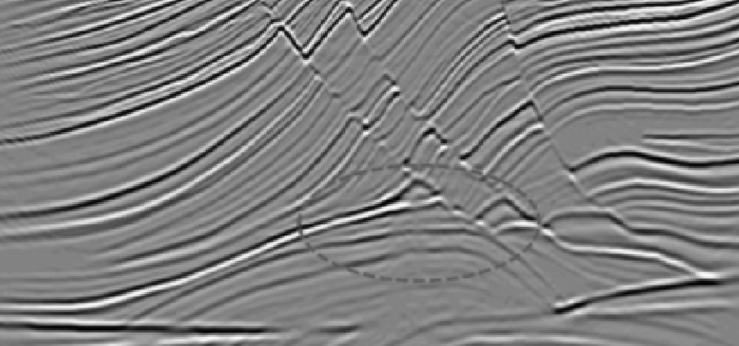
Results
Marmousi 2D Inverse < 1 min on single GPU
Qualitative good results
High vs low contrast interfaces
Limitations of geological prior
More diversity in synthetic models required to produce high quality
Possible use as FWI initialisation

Slide 28
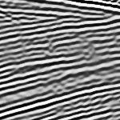
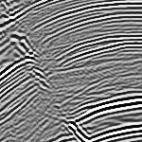
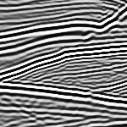
Recent Advances
Better Training Data -> Better Models

Slide 29
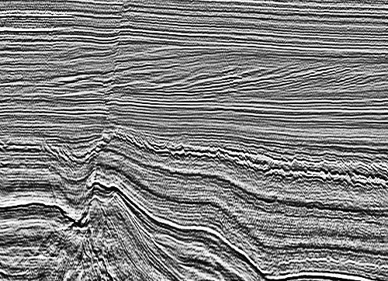
Dutch F3 Dataset
Input Seismic Output Velocity Model

Slide 30
Dutch F3 Dataset
Input Seismic Output
Notes:
This is a video

Slide 31
Opportunity
Tighten the loop on expensive workflows by applying transfer learning using appropriately trained models.
Imaging
updated velocity models from processed seismic
manually updated velocity model and translate it to seismic prior to imagining
Reservoir Characterization
Invert seismic to an impedance or rock property model
Instantly forward model seismic from an inversion product

Slide 32
Conclusion
Physics-free but assumption-free inversion scheme
Quick turn-around after initial training
Inversion as domain transfer
Strong seismic generative model

Slide 33
Thank you!
Questions?
www.model2seismic.com
lukas.mosser@gmail.com, jesper@dramsch.net, wouter.kimman@gmail.com, steve@euclidity.com, gr@m-gan.sl, alfredo.delafuente.b@gmail.com

