Slide 1
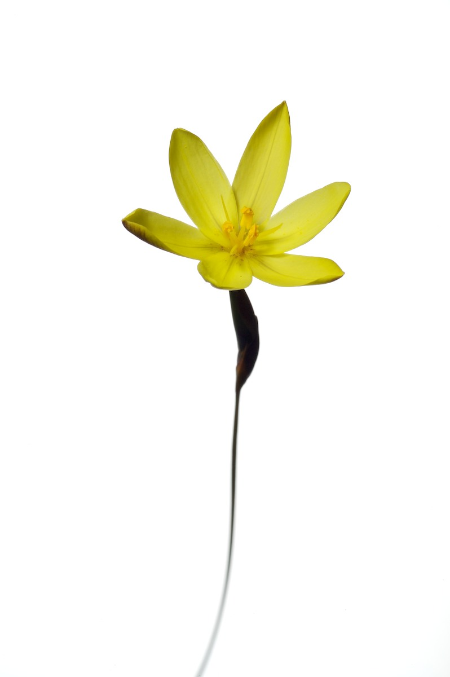

Bulk water augmentation in the Western Cape
Evidence-based or irresponsible?
Jasper Slingsby
Zandvlei Trust AGM
Royal Yacht Club, Lakeside
15 August 2018

Slide 2

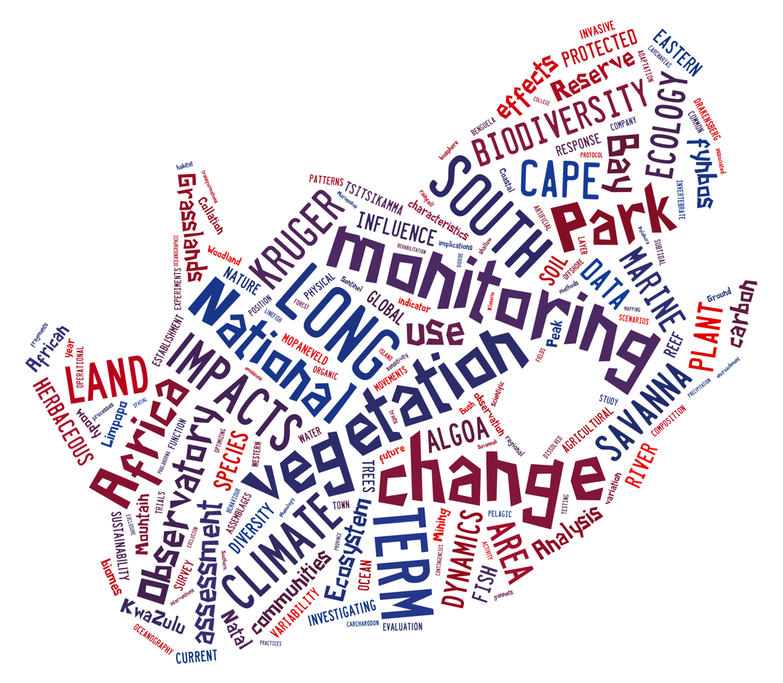
South African agency performing long-term (social-)ecological research (LTER & LTSER) and maintaining environmental research infrastructures
www.saeon.ac.za

Slide 3
1) Observation science and research infrastructure
Perform long-term studies at scales that are relevant to policy and management. Establish, operate and maintain highly-instrumented LTER research infrastructures.
2) Information Management and Decision Support
Collect, store and share long-term data. Develop and maintain online decision support systems.
3) Science Engagement and Human Capacity Development
Support secondary, tertiary and public science engagement

Slide 4
Seven Nodes
Arid Lands
Kimberly
Egagasini (Offshore-marine)
Cape Town
Elwandle (Coastal & Estuarine)
Port Elizabeth
Ndlovu (Savanna)
Phalaborwa
Fynbos
Cape Town
Grassland, Forest & Wetlands
Pietermaritzburg
uLwazi (Data)
Cape Town
www.saeon.ac.za
Notes:
SA MAP Showing Nodes in corner?

Slide 5
Bulk water augmentation in the Western Cape
Evidence-based or irresponsible?
Jasper Slingsby
Zandvlei Trust AGM
Royal Yacht Club, Lakeside
15 August 2018

Slide 6
Is this guy an expert?
No! (at least not on everything I’ll be presenting)
A biologist by training – with focus on Fynbos ecosystems and global change ecology
  But this talk will include:
    Hydrology, geohydrology, economics, politics, population demography, etc etc…
“Well informed” about water issues rather than an expert per se
As a proponent of open data, open science and transparency, I’ll cite all my sources and make this talk publicly available - so you can check my facts
I value feedback, disagreement and discussion – the basis of co-learning. No one knows everything, and I’m learning too!!!
www.ecologi.st
For more on my research and interests

Slide 7
Overview
The situation we find ourselves in
What options are being explored?
What are the pros and cons of these options?
What options aren’t being explored and why?

Slide 8
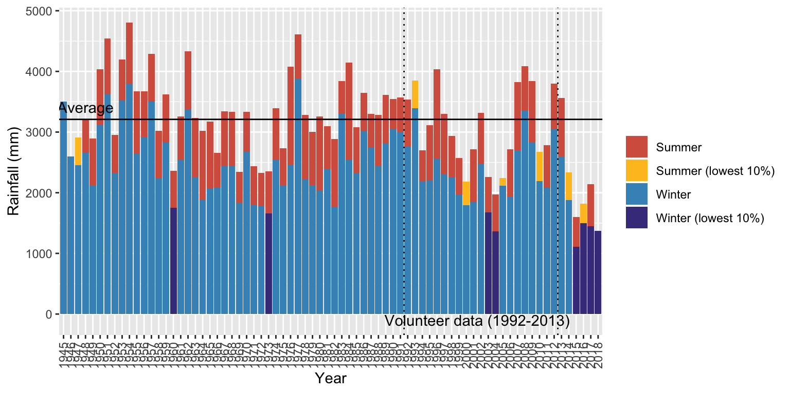
The situation we find ourselves in
Rainfall
http://www.ecologi.st/post/2017-04-01-Langrivier/

Slide 9
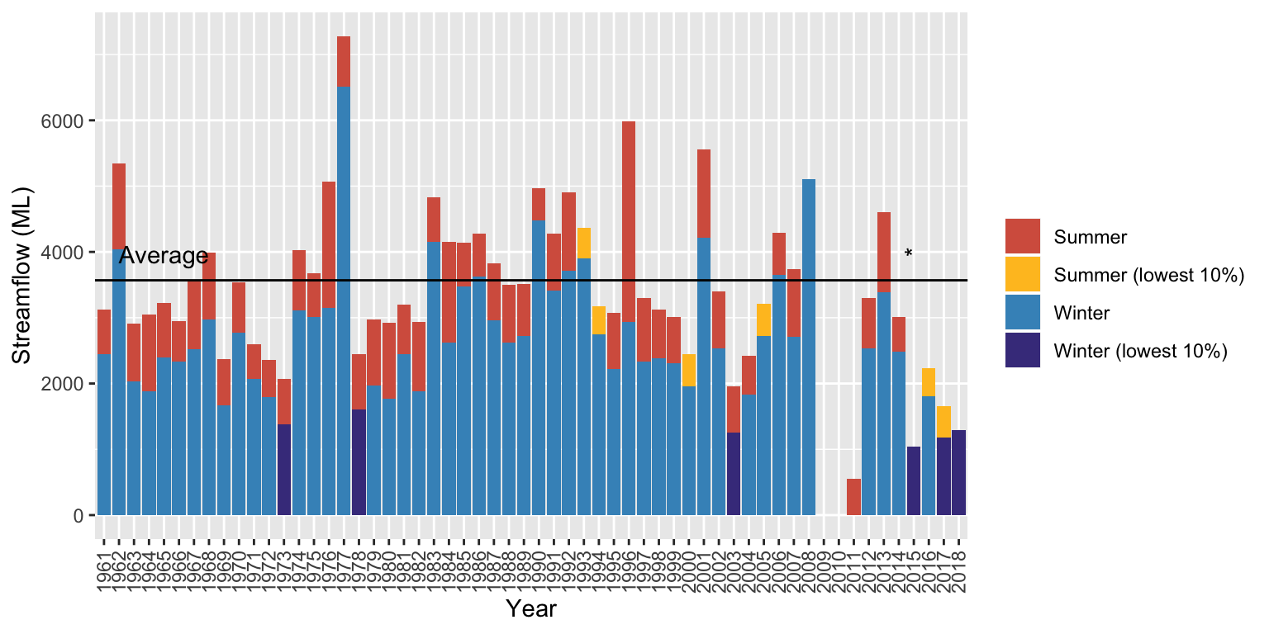
The situation we find ourselves in
Streamflow
http://www.ecologi.st/post/2017-04-01-Langrivier/

Slide 10
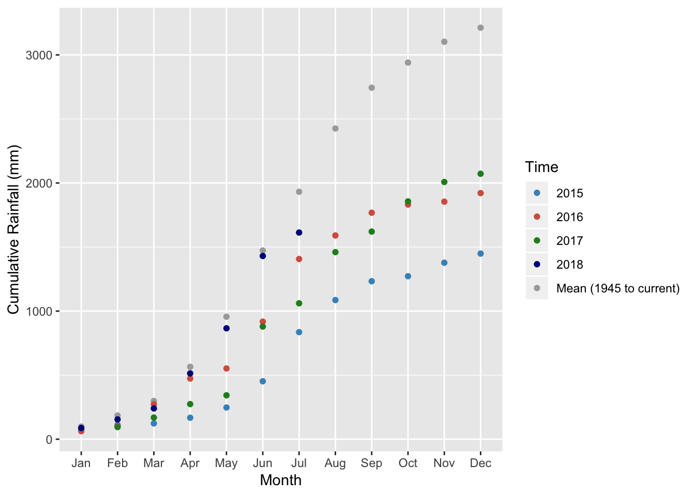
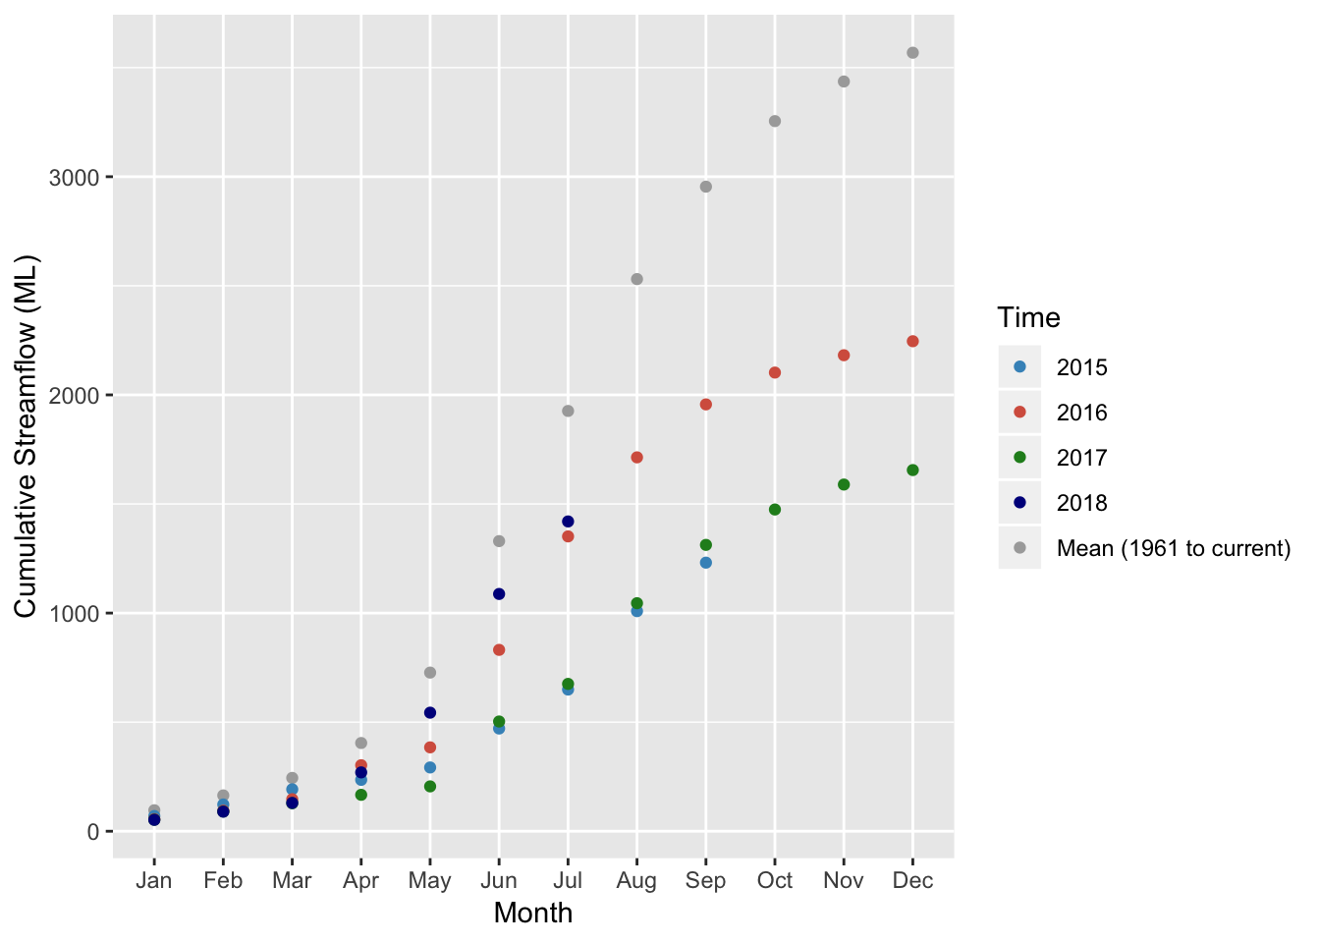
The situation we find ourselves in
Streamflow lower despite higher rainfall… (2017 and 2018)
Cumulative rainfall and streamflow
http://www.ecologi.st/post/2017-04-01-Langrivier/

Slide 11
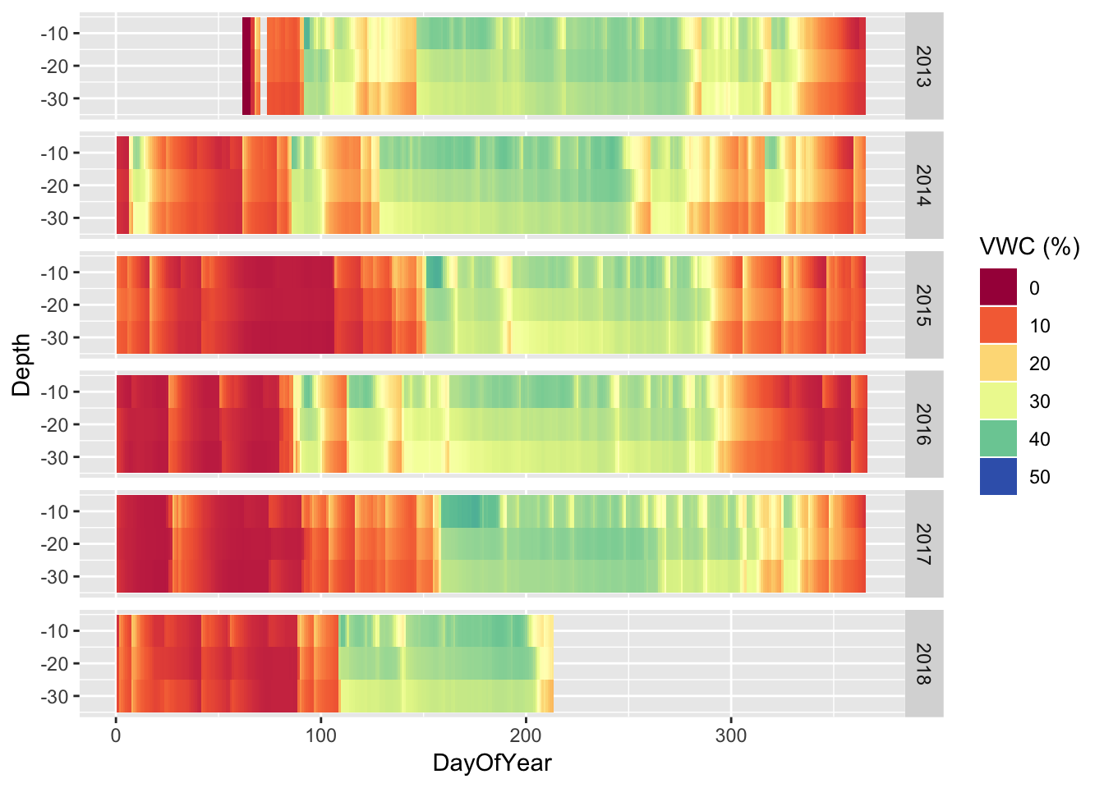
The situation we find ourselves in
Surface soil moisture
http://www.ecologi.st/post/2017-04-01-Langrivier/

Slide 12
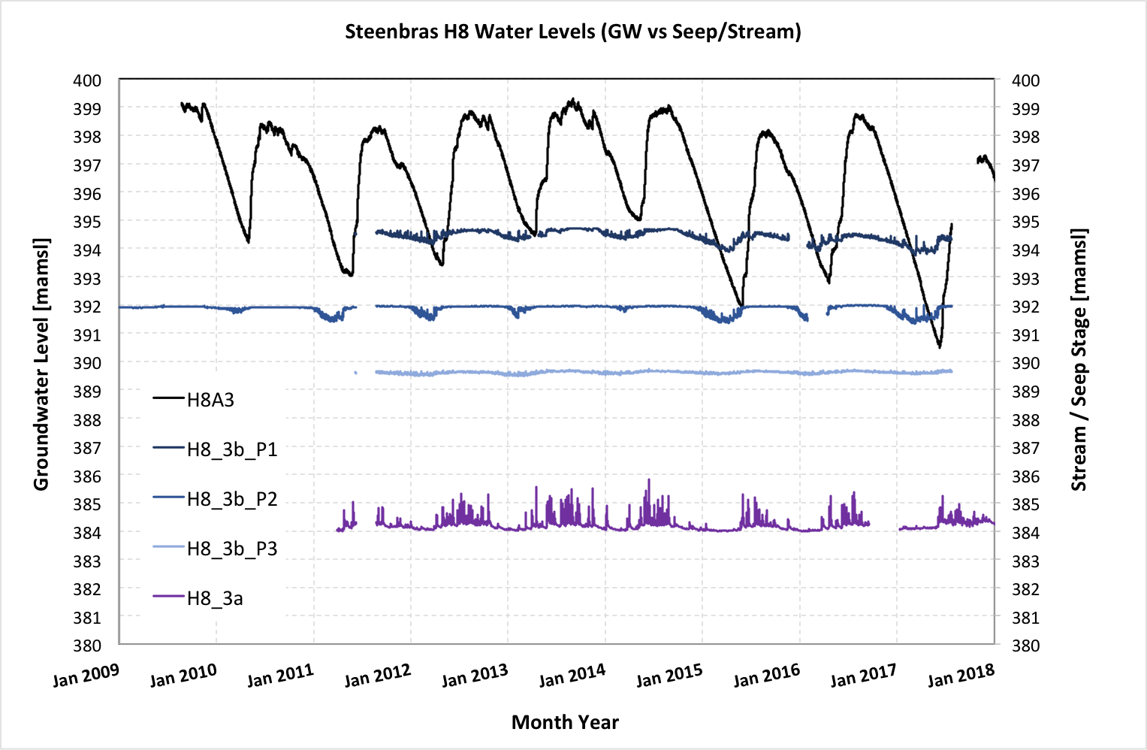
The situation we find ourselves in
Groundwater?
(CoCT TMGA monitoring - Chris Hartnady, Umvoto)

Slide 13
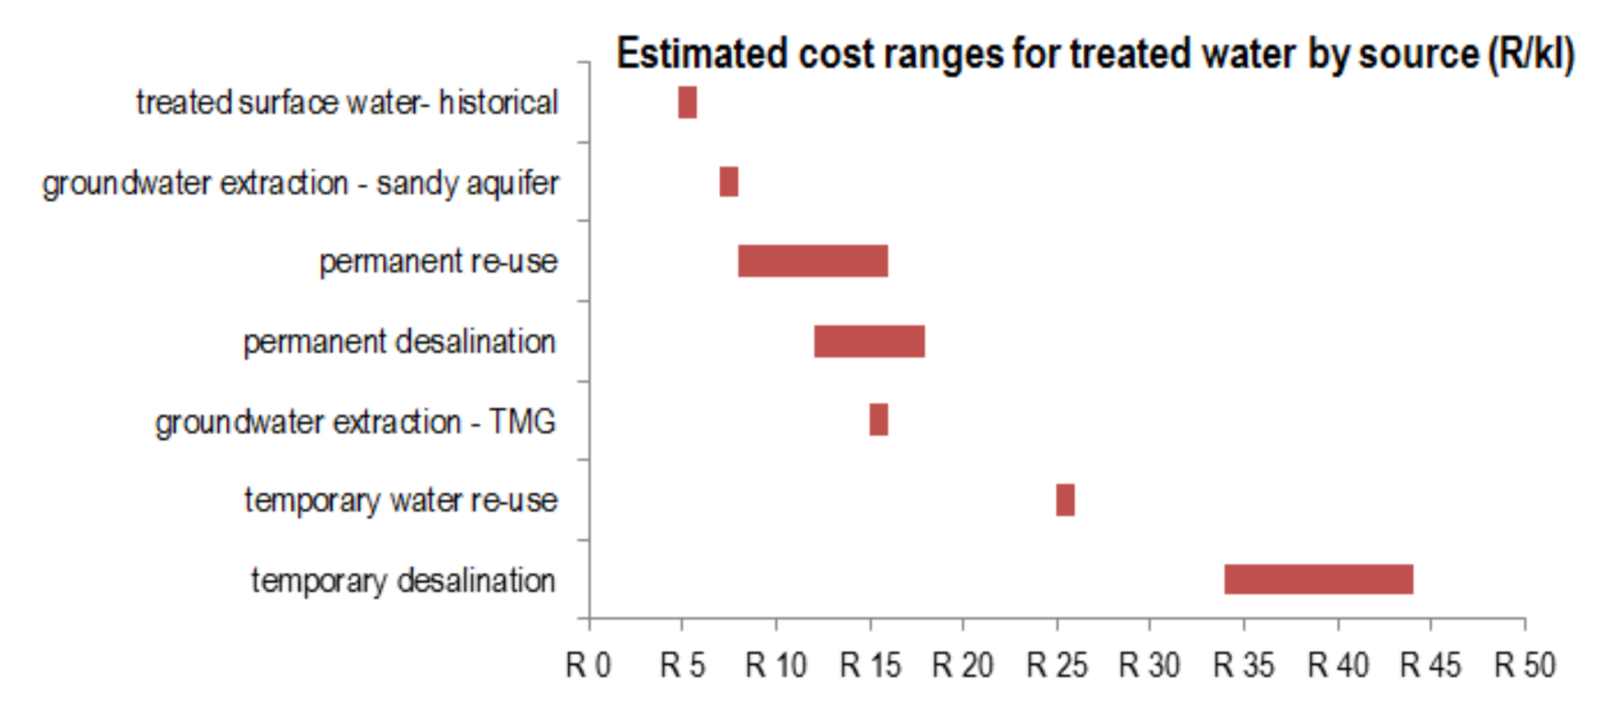
What augmentation options are being explored?
https://www.groundup.org.za/article/what-future-cape-towns-water-supply/
From City of Cape Town New Water Programme Plan

Slide 14
What augmentation options are being explored?
- Existing dams, etc
- Atlantis dunes, Cape Flats
- Fractured rock aquifer (~mountains)
https://www.groundup.org.za/article/what-future-cape-towns-water-supply/
From City of Cape Town New Water Programme Plan

Slide 15
What augmentation options are being explored?
~R820M
~R892M*
>R1000M ea in 2019/20/21
~R1000M in 2020/21
~R720M
*???
~R11M
Figures estimated from SDBIP
http://resource.capetown.gov.za/documentcentre/Documents/City%20strategies,%20plans%20and%20frameworks/Corporate%20SDBIP%20Book%202018-2019.pdf
https://www.groundup.org.za/article/what-future-cape-towns-water-supply/
From City of Cape Town New Water Programme Plan
Notes:
Add amount invested and ML expected
Duplicate and add cost estimate for managing invasives

Slide 16
What augmentation options are being explored?
~R820M
~R892M*
>R1000M ea in 2019/20/21
~R1000M in 2020/21
~R720M
*???
~R11M
Figures estimated from SDBIP
http://resource.capetown.gov.za/documentcentre/Documents/City%20strategies,%20plans%20and%20frameworks/Corporate%20SDBIP%20Book%202018-2019.pdf
https://www.groundup.org.za/article/what-future-cape-towns-water-supply/
From City of Cape Town New Water Programme Plan
Notes:
Add amount invested and ML expected
Duplicate and add cost estimate for managing invasives

Slide 17
A quick aside on units
1m³ = 1000L = 1ML (megalitre)
1Mm³ = 1000m³
1Mm³/year = 2.74 MLD (megalitre/day)
[because you multiply by 1000/365]

Slide 18
Wastewater re-use/reclamation
The City could re-use ~340 MLD in an average year (888 MLD*) - i.e.~40% of used
  204 MLD potable
  178 MLD non-potable
    *City’s current Level 6B restriction is 450 MLD
Cheapest option (after sand aquifers?)
Commonly done throughout the world!
Western Cape Reconcilliation Strategy
http://www.dwa.gov.za/Projects/RS_WC_WSS/Docs/Overview-Water%20Re-use%20Potential.pdf

Slide 19
Ground water
“Ground water is faster to implement, compared to permanent desalination (at scale) and is also much cheaper. Ground water has a lower environment impact compared to the alternatives. Importantly, groundwater can be managed as a form of water storage through recharge and without evaporation losses.”
- Water Outlook 2018 Report, City of CT
http://resource.capetown.gov.za/documentcentre/Documents/City%20research%20reports%20and%20review/Water%20Outlook%202018%20-%20Summary.pdf

Slide 20
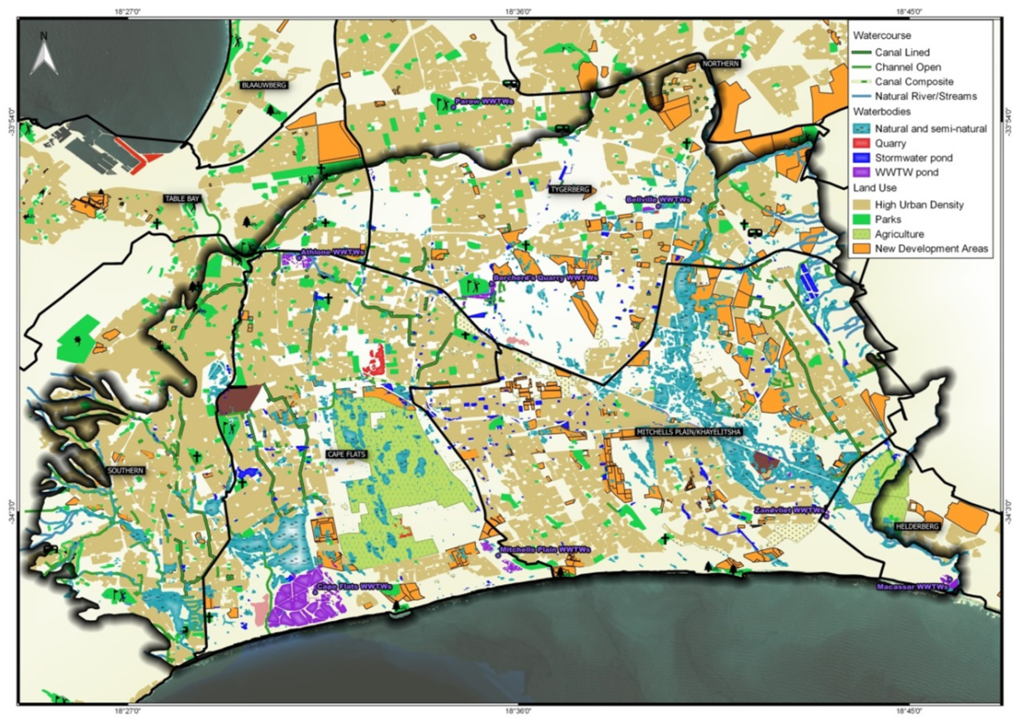
Cape Flats Sand Aquifer
Hay et al 2015
https://www.imesa.org.za/wp-content/uploads/2015/11/Paper-16-Cape-flats-aquifer-and-false-bay-Opportunities-to-change-Rowena-Hay.pdf

Slide 21
1880-1900
Hay et al 2015
https://www.imesa.org.za/wp-content/uploads/2015/11/Paper-16-Cape-flats-aquifer-and-false-bay-Opportunities-to-change-Rowena-Hay.pdf

Slide 22
2015
Hay et al 2015
https://www.imesa.org.za/wp-content/uploads/2015/11/Paper-16-Cape-flats-aquifer-and-false-bay-Opportunities-to-change-Rowena-Hay.pdf

Slide 23
Hay et al 2015
https://www.imesa.org.za/wp-content/uploads/2015/11/Paper-16-Cape-flats-aquifer-and-false-bay-Opportunities-to-change-Rowena-Hay.pdf

Slide 24
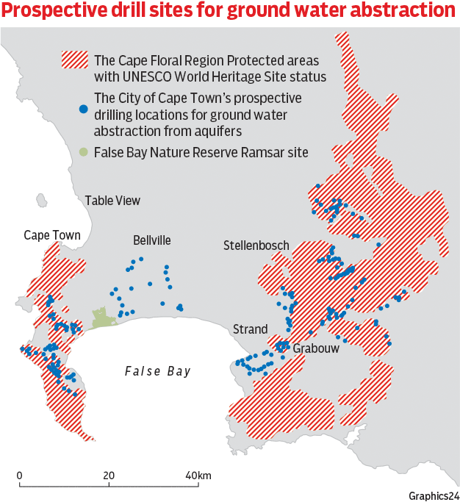
https://www.news24.com/Video/SouthAfrica/News/tmg-aquifer-drilling-too-risky-ecologists-warn-20180220
Notes:
Video of city expansion since 1940

Slide 25
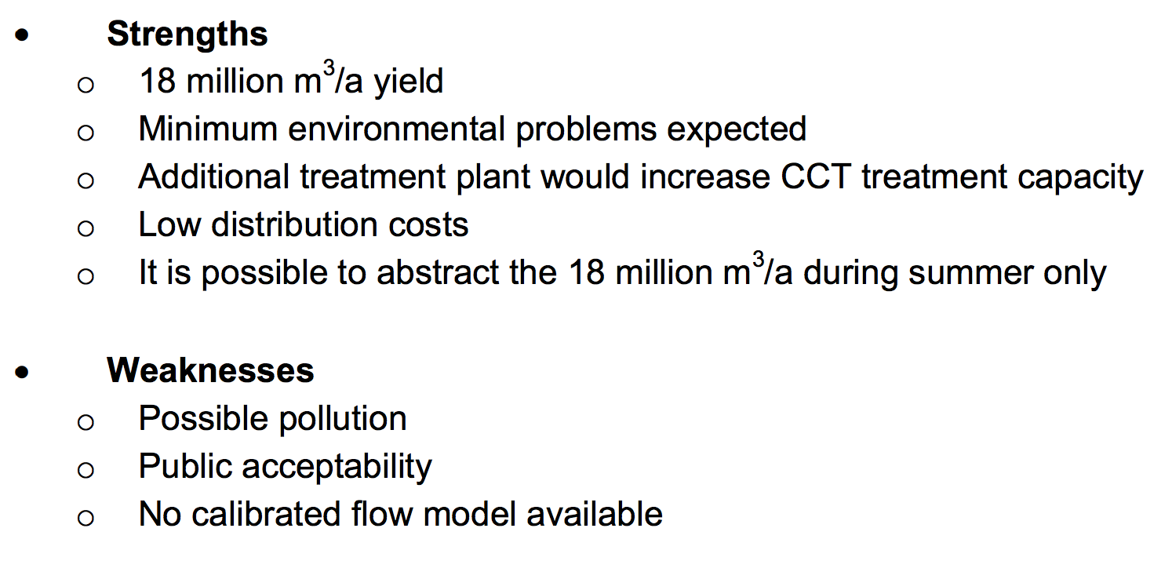
Cape Flats Sand aquifer
Western Cape Reconcilliation Strategy
http://www.dwaf.gov.za/documents/other/wma/19/wcwssscenariojun07anbsecf.pdf

Slide 26
Cape Flats Sand aquifer
Other strengths
  Potential to reduce “unnatural flooding” of settlements and ecosystems because of importing and redirection of water
  Potential to see improved water quality management and “ecological infrastructure” (wetlands and rivers)
  Potential for managed aquifer recharge (MAR)
Other risks/weaknesses
  Potential for saline intrusion (hence MAR required)
  Requires water treatment (for use and/or MAR) which could dramatically increase costs
  “Competition” with re-use?
Western Cape Reconcilliation Strategy
http://www.dwaf.gov.za/documents/other/wma/19/wcwssscenariojun07anbsecf.pdf

Slide 27
Cape Flats Sand aquifer
Status?
~ 40 boreholes
  Most in transformed areas (i.e. not natural ecosystems)
Most sites either have enough water or good enough water quality, but not both…
Risk that natural areas become target…
Risk that recharge water not treated to suitable standard (i.e. why pump good water into dirty water)
  But recharging with “dirty” water is bad news in the long term
Western Cape Reconcilliation Strategy
http://www.dwaf.gov.za/documents/other/wma/19/wcwssscenariojun07anbsecf.pdf

Slide 28
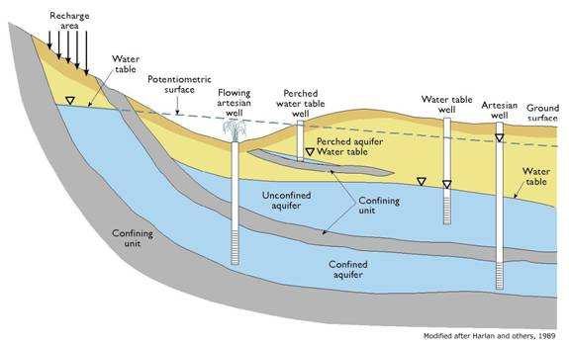
TMG (fractured rock) aquifers
Confined vs Unconfined

Slide 29
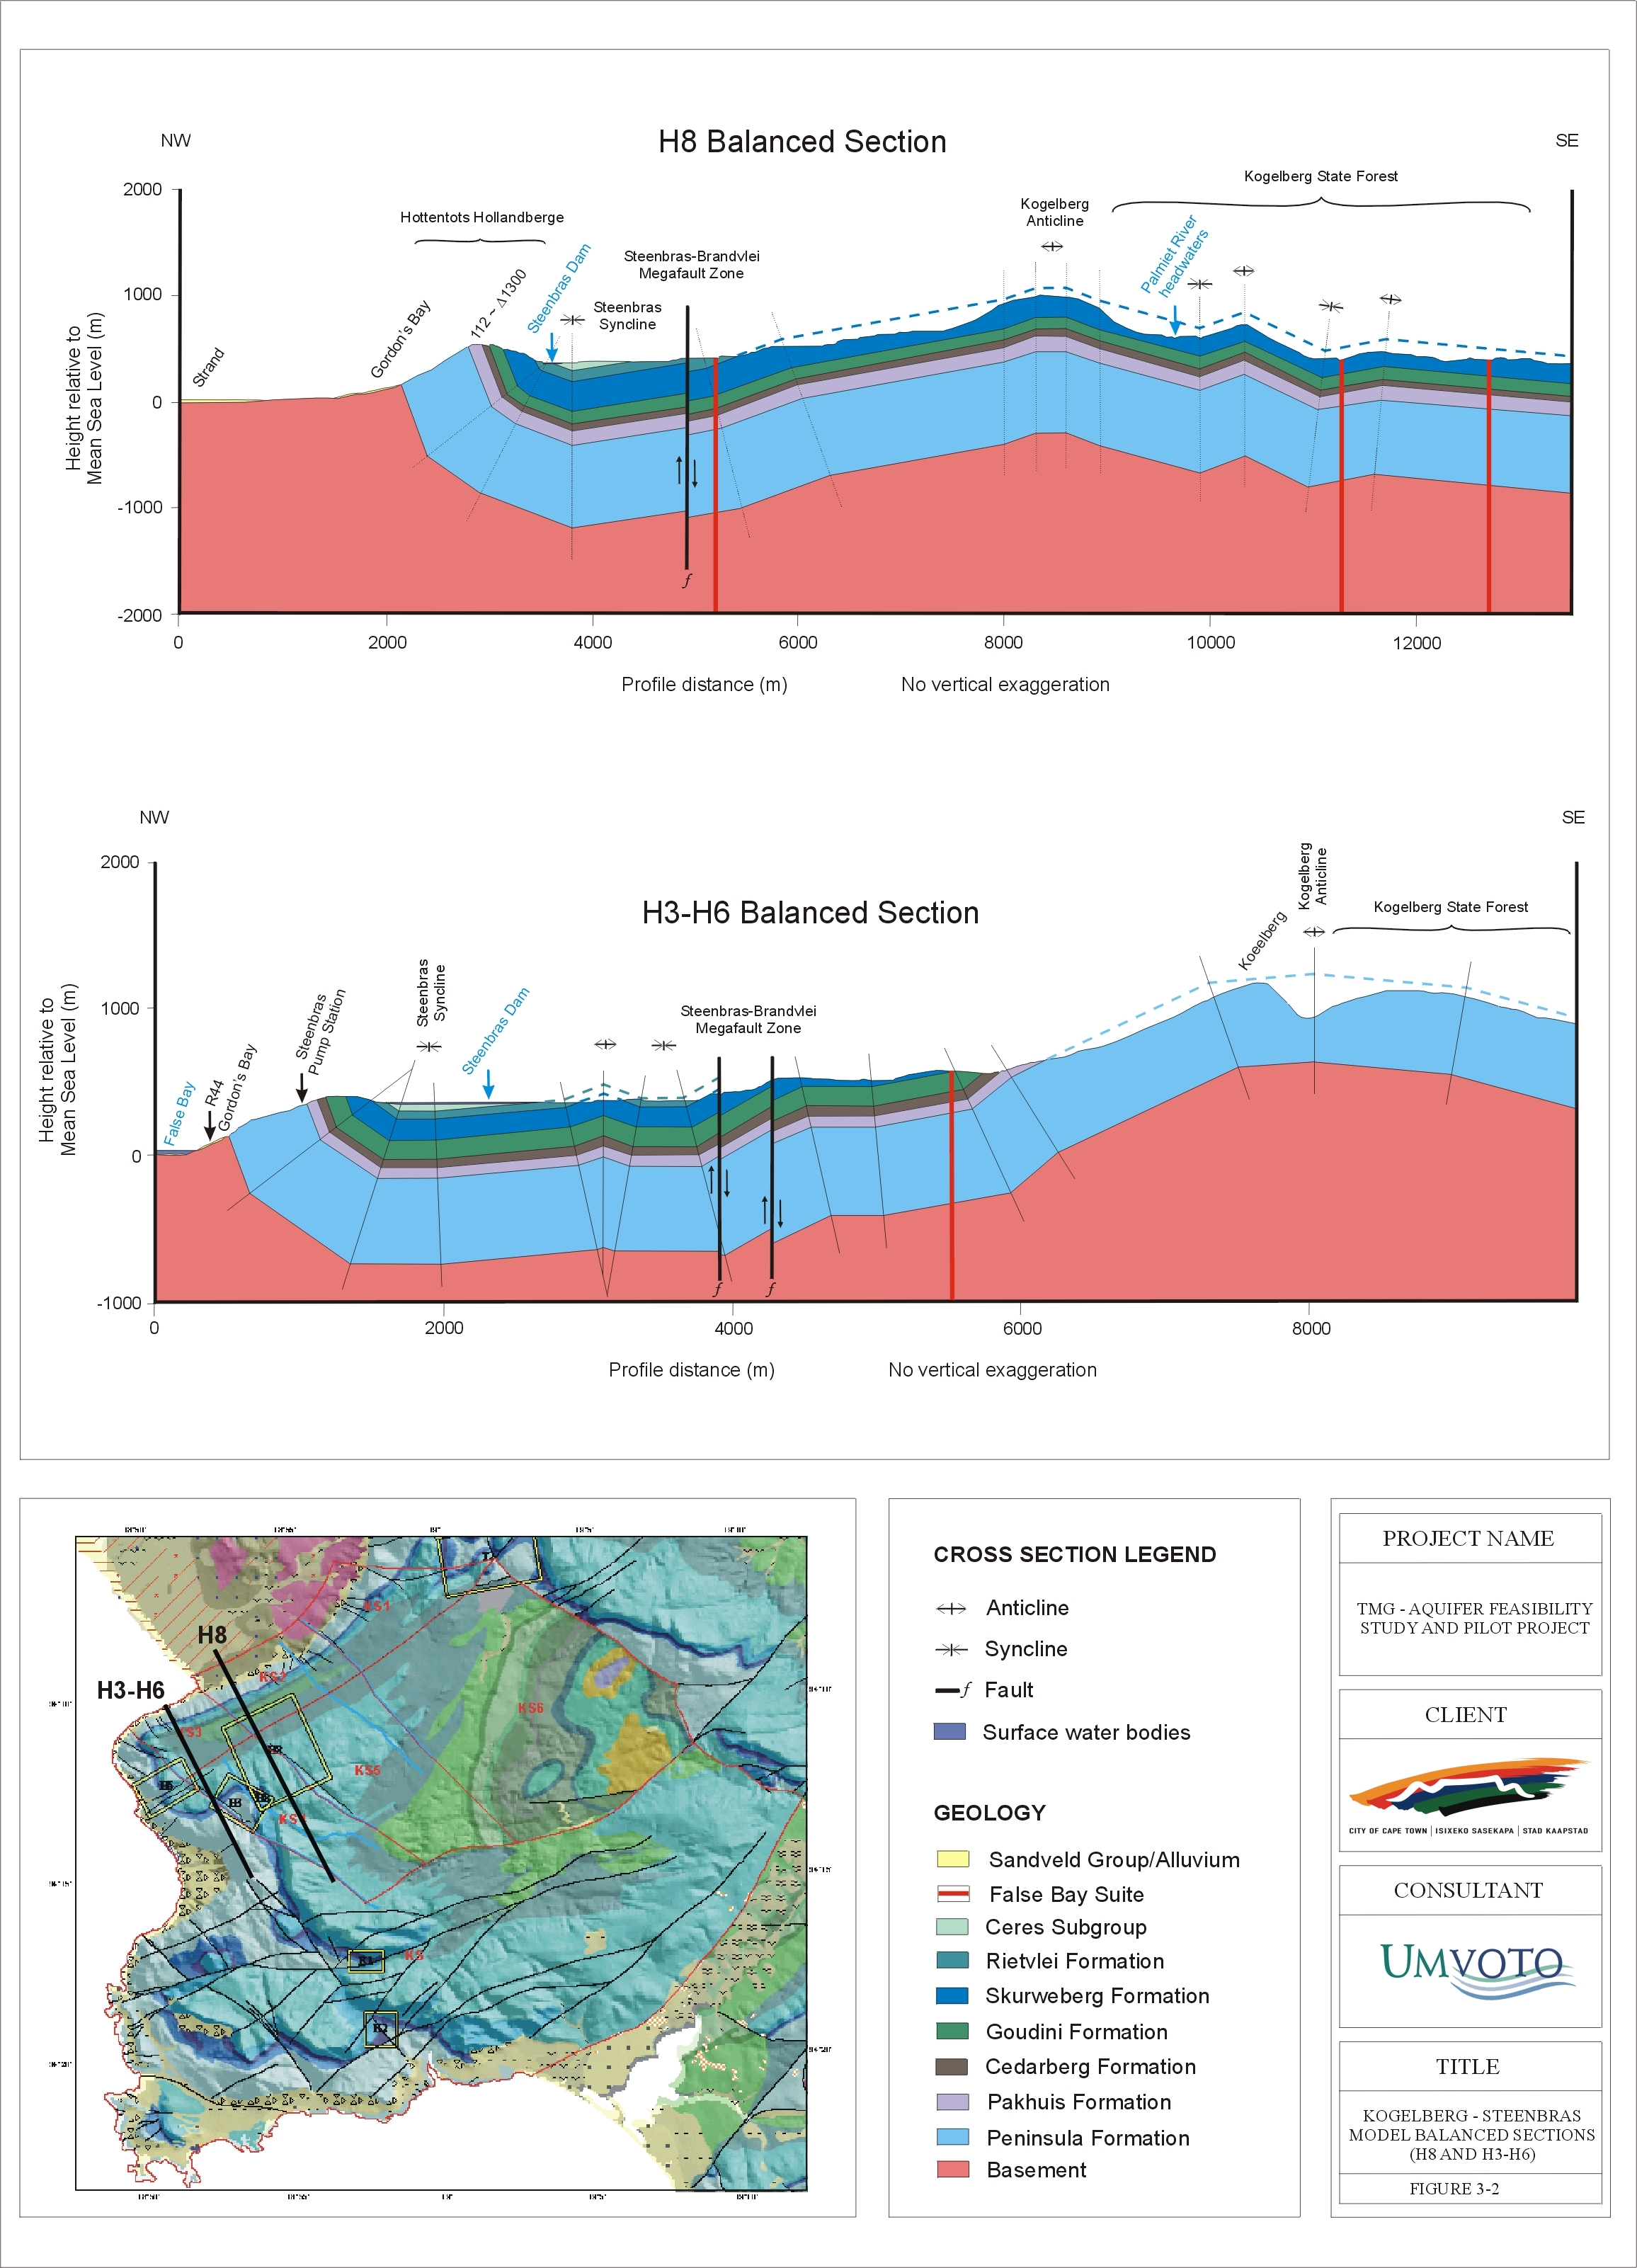
TMG (fractured rock) aquifers

Slide 30
TMG (fractured rock) aquifers

Slide 31
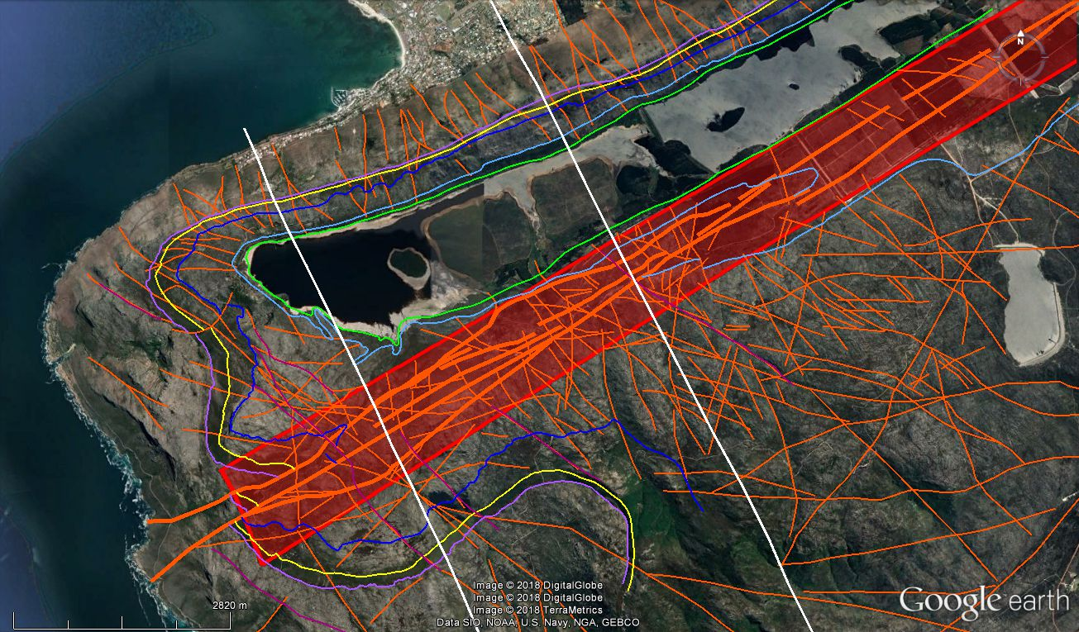
TMG (fractured rock) aquifers
Water predominantly moves along fault lines

Slide 32
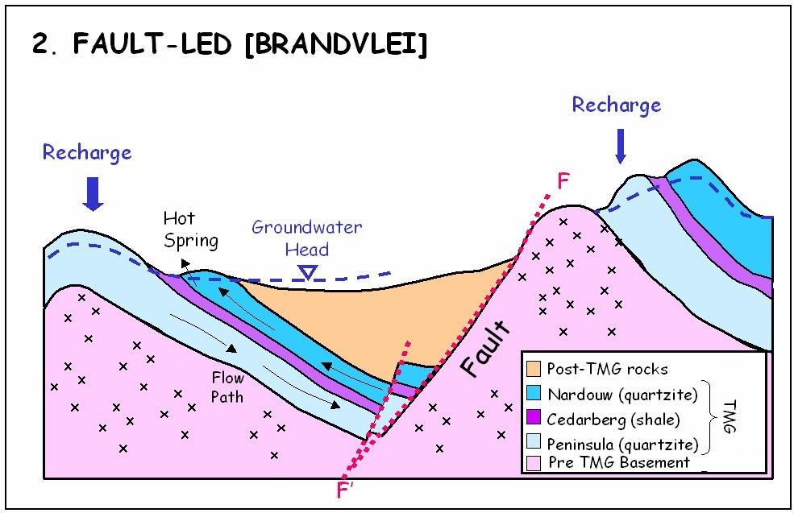
Hot springs?

Slide 33
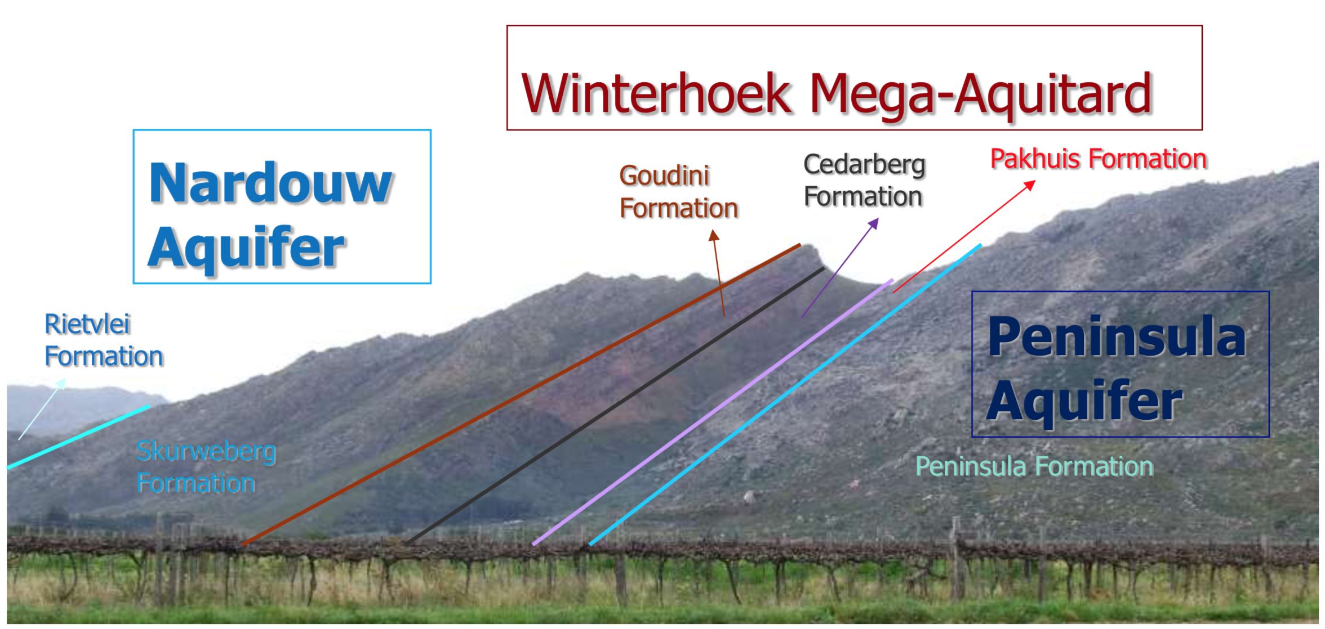
Hot springs?

Slide 34
TMG (fractured rock) aquifers
Formations are confined in some areas
and unconfined in others

Slide 35
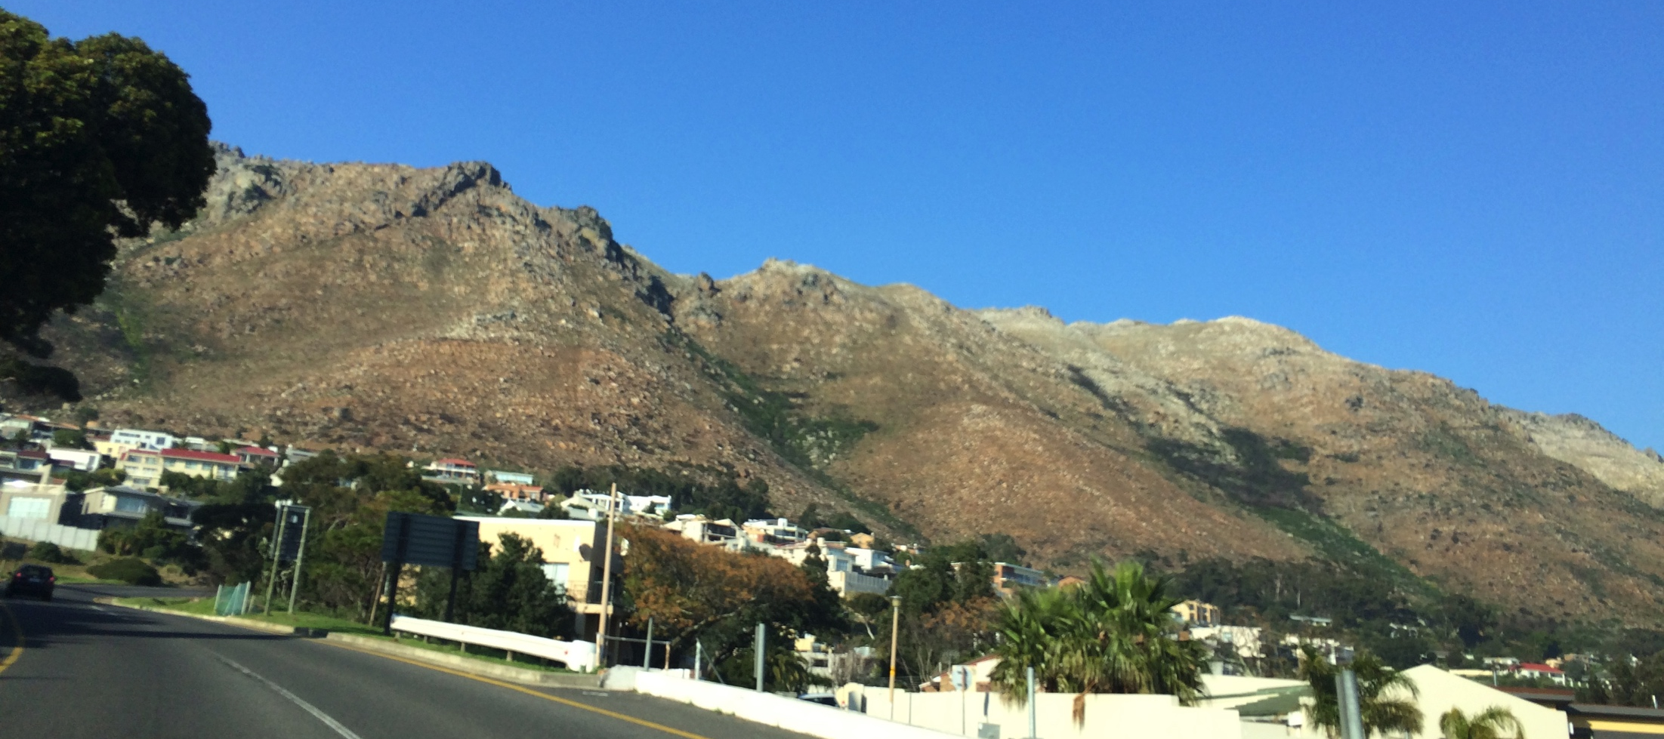
TMG (fractured rock) aquifers
Exposed Peninsula formation above Gordon’s Bay

Slide 36
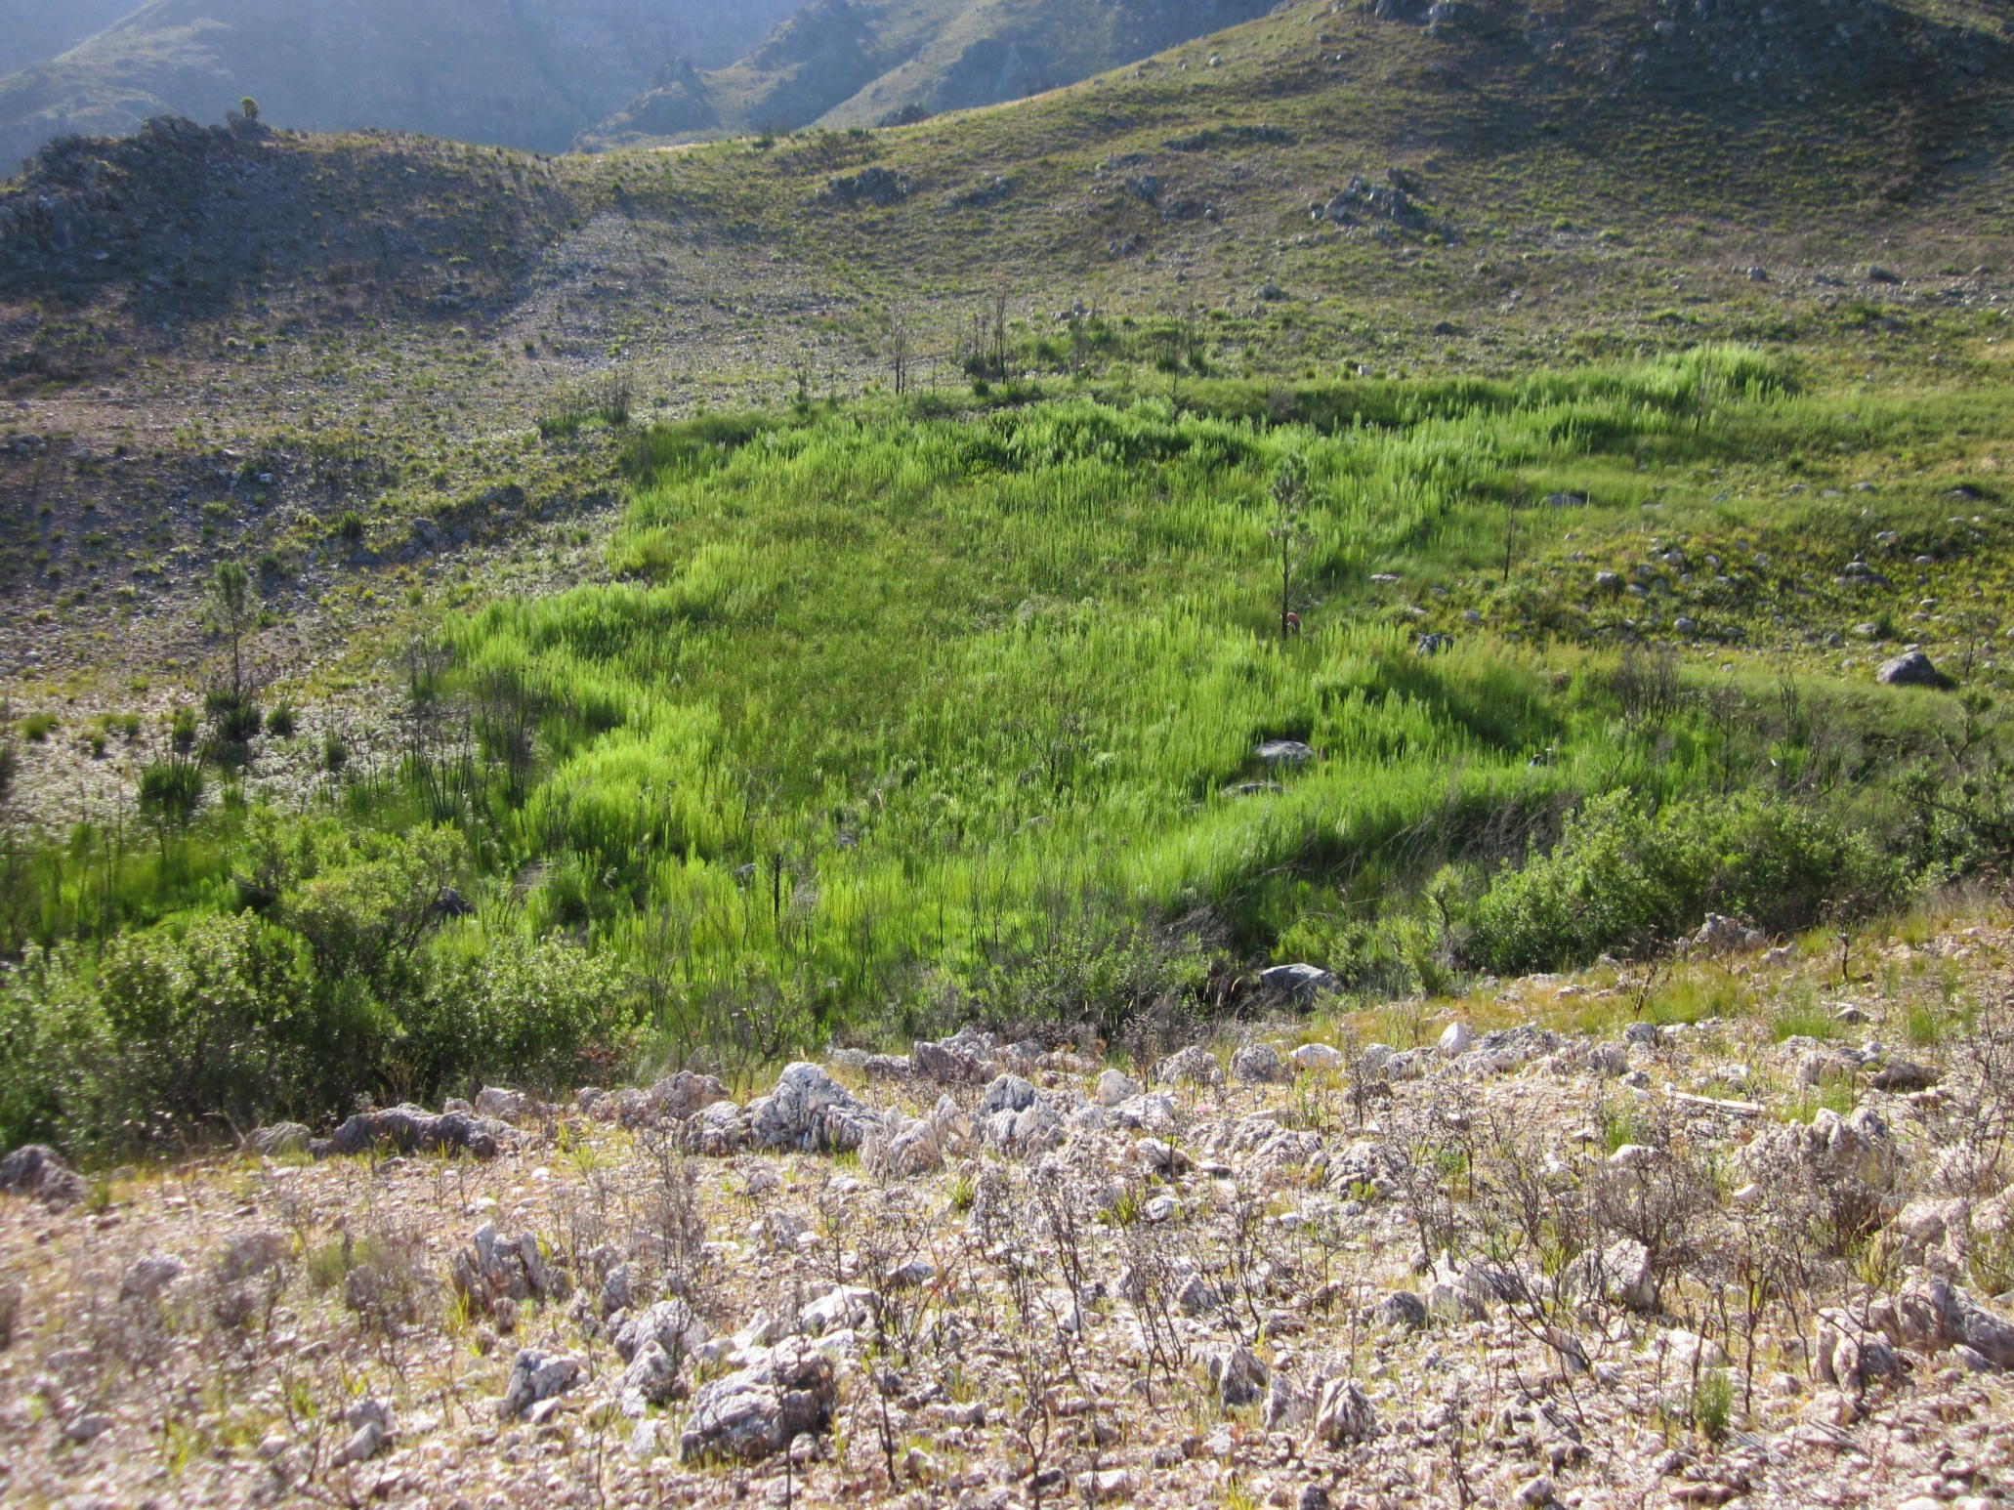
TMG (fractured rock) aquifers
Boesmanskloof seep, Franschoek Mountains
above Theewaterskloof

Slide 37
Hydraulic refugia!
McLaughlin et al. 2017 Global Change Biology

Slide 38
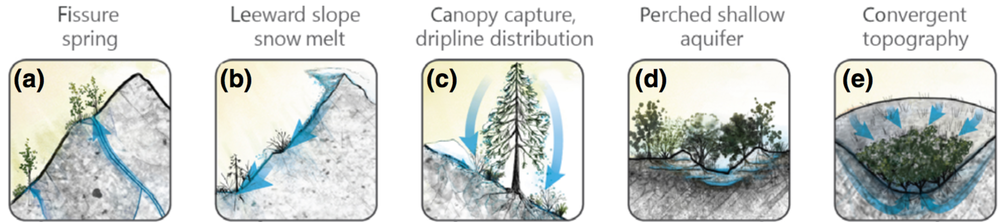
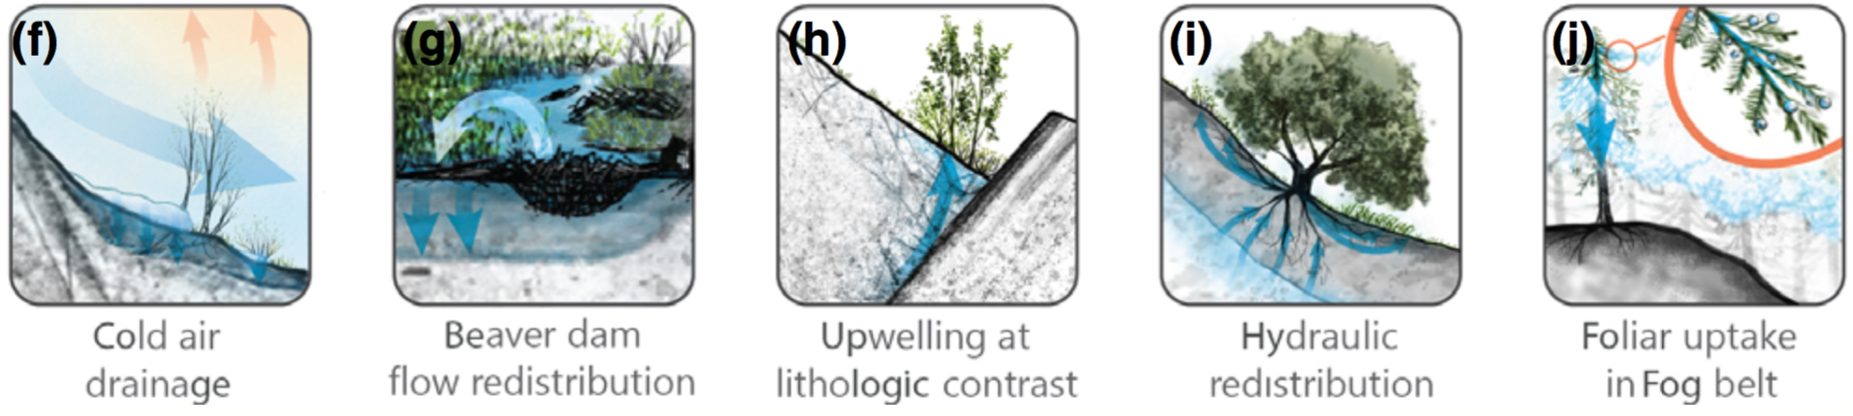
McLaughlin et al. 2017 Global Change Biology

Slide 39
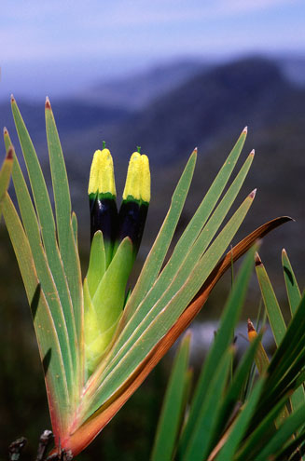
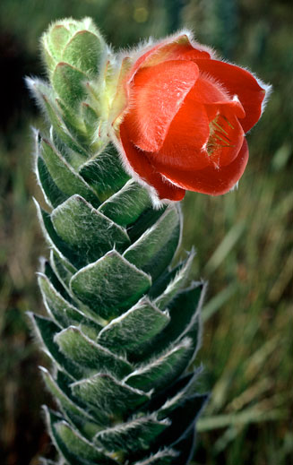
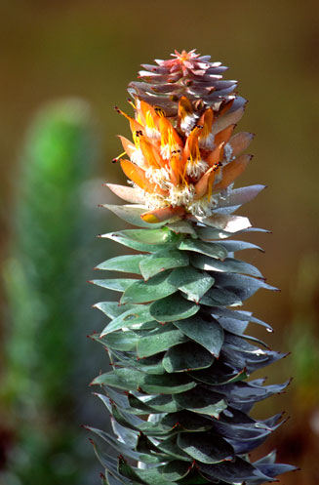
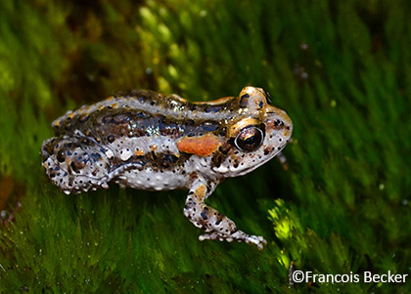
It seems to be very important in the Cape!!!
Notes:
Fog/cloud
Figure on the frequency of terms like “cloud”, “fog”, etc from distribution records?
Hydraulic refugia in general
“seepage”, suurvlakte, impeded drainage, etc

Slide 40
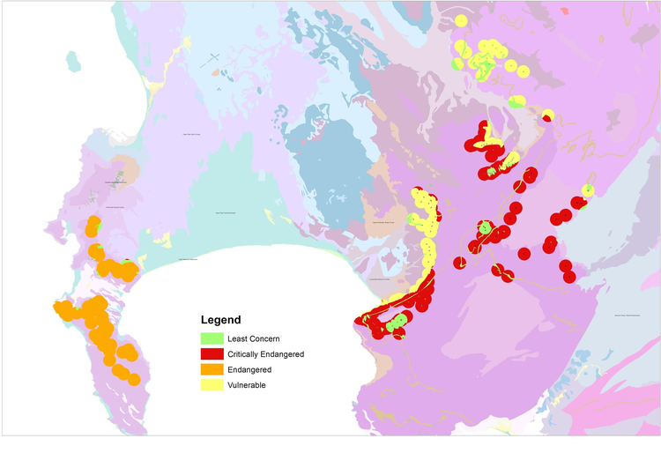
TMG (fractured rock) aquifers
The City of Cape Town’s proposed sites are extensive

Slide 41
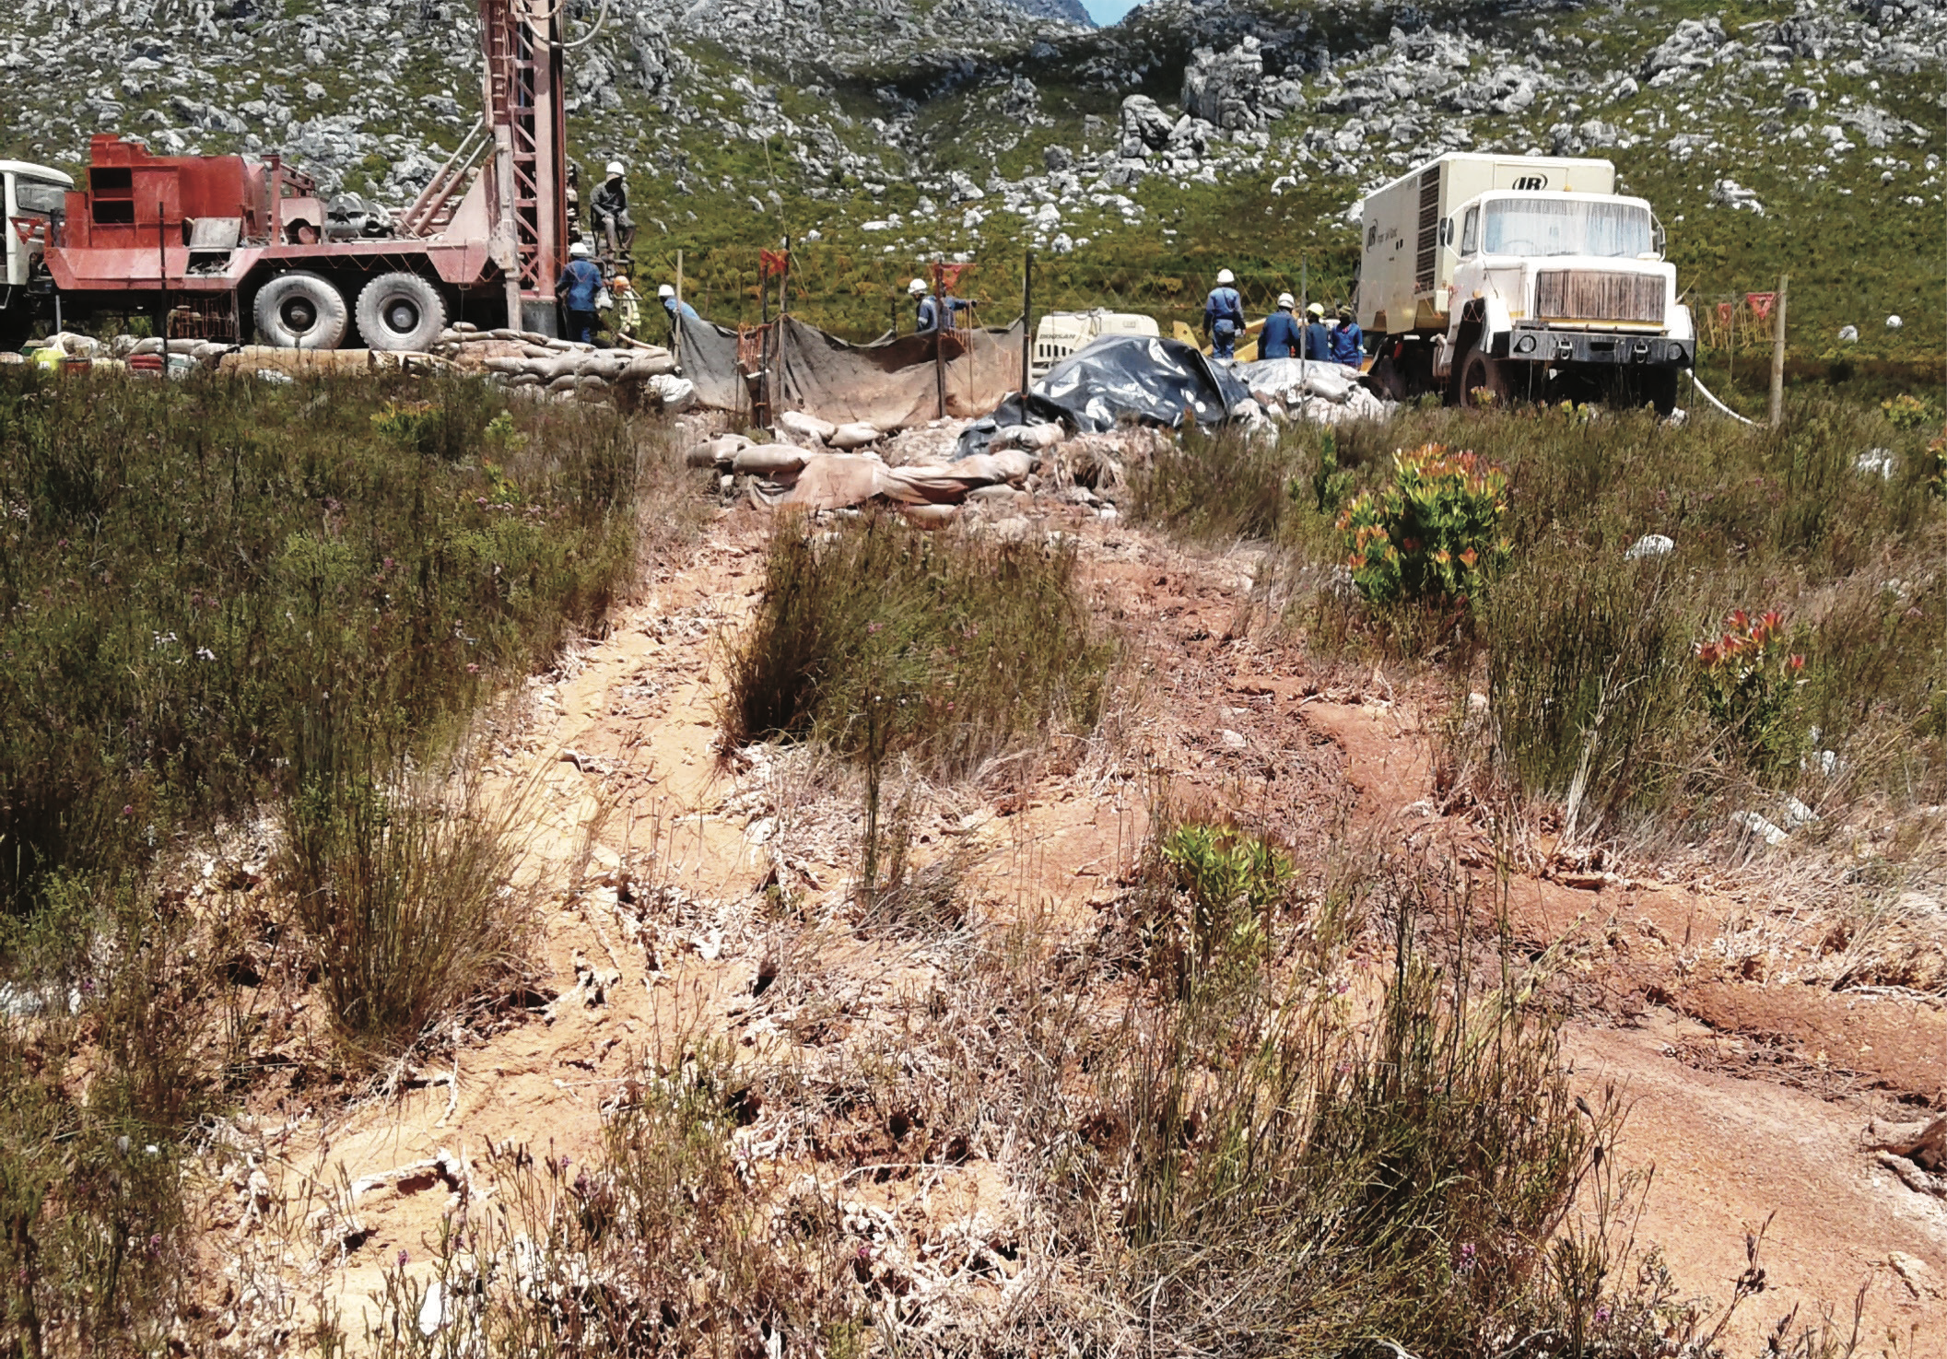
TMG (fractured rock) aquifers
The tip of the iceberg…

Slide 42
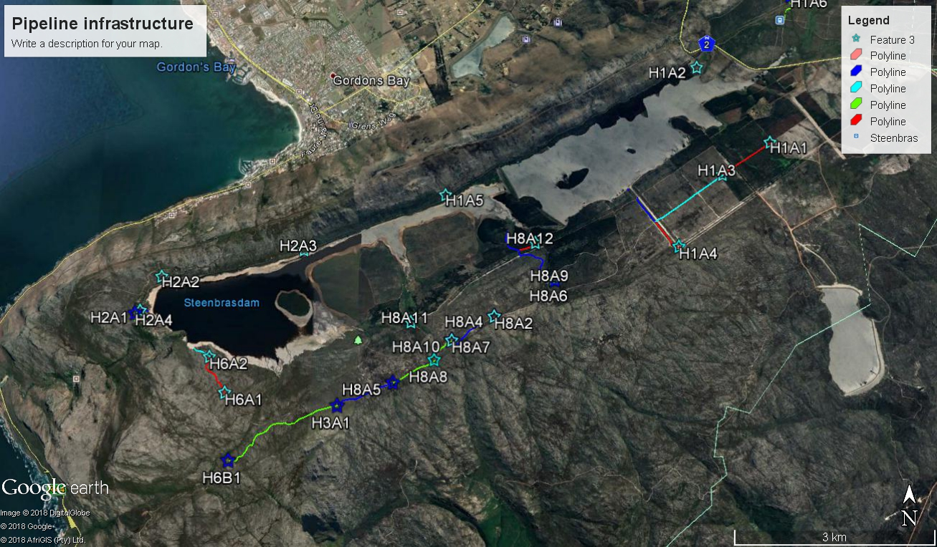
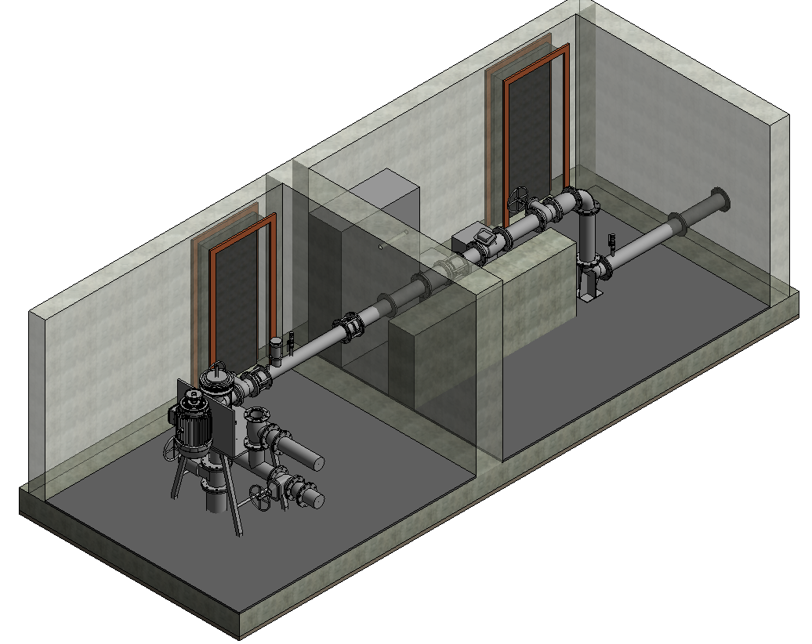
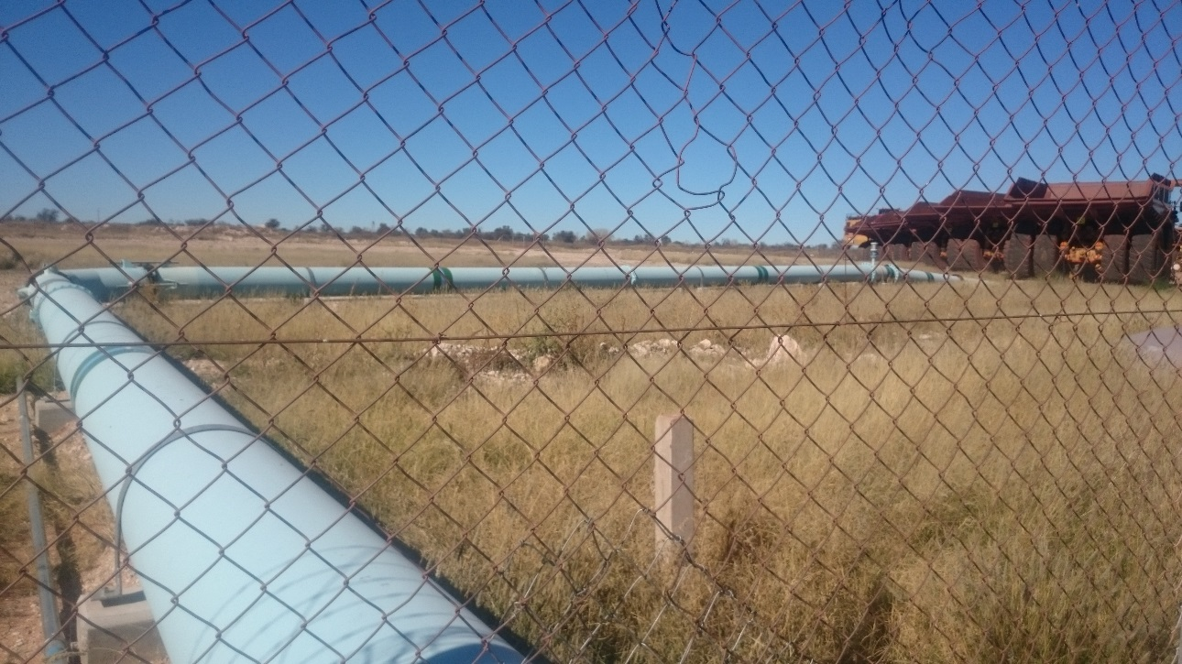
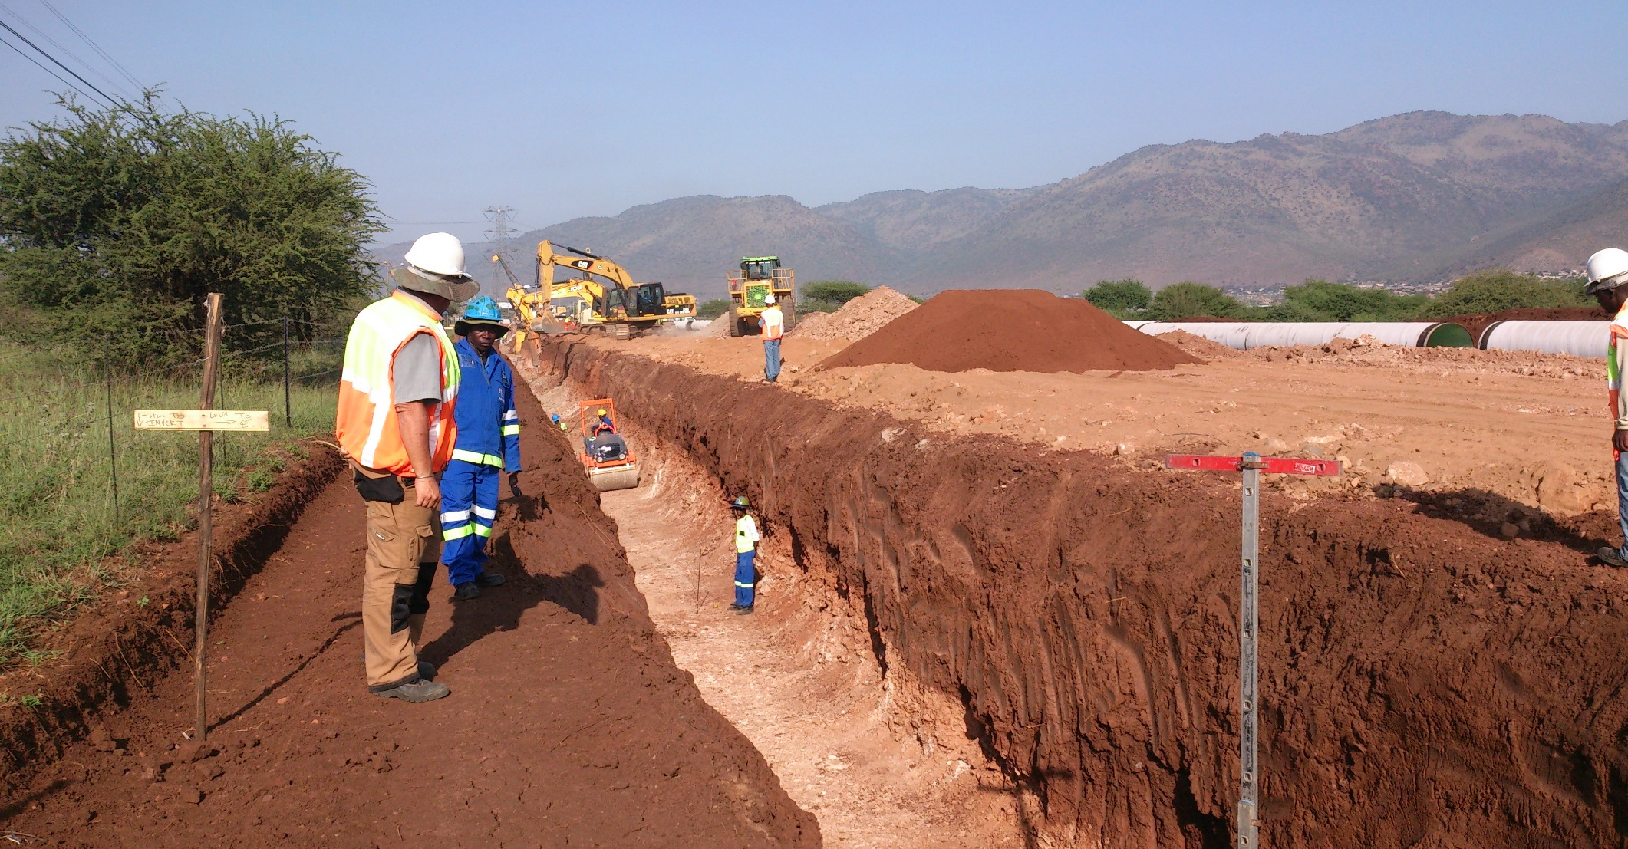
Surface impacts?

Slide 43
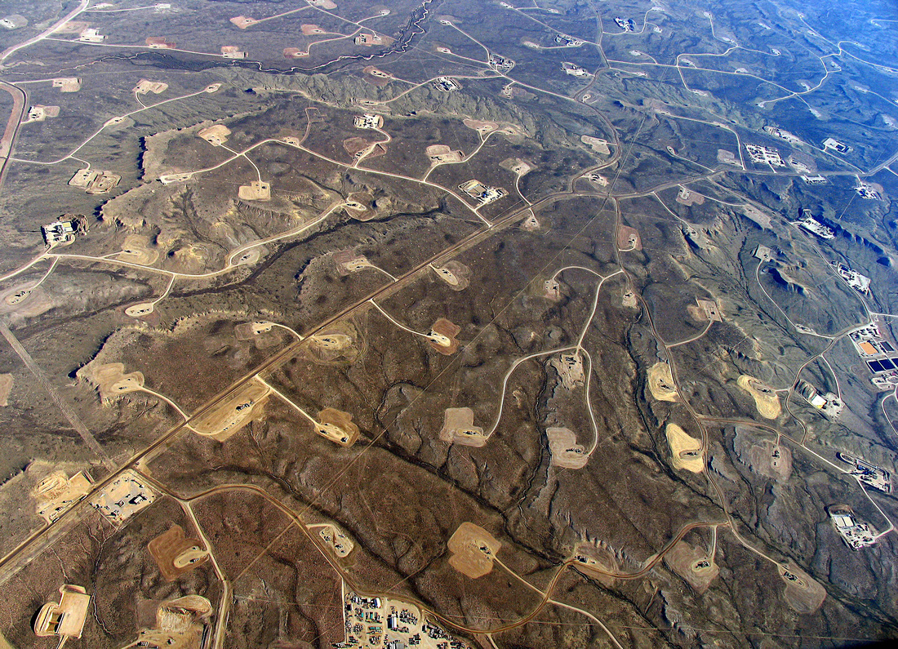
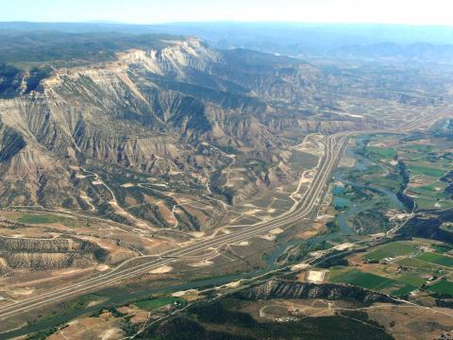
Fracking landscapes?

Slide 44
Draw down impacts?
Drying of seeps and rivers (and loss of species dependent on them)
  Already happening at Kammannasie/Dysselsdorp
Reduced (summer) base-flow in rivers (and supply to other ecosystems and dams)
A dependent and more vulnerable human population next time there’s a major drought…
Recharge is already threatened by invasive species and climate change

Slide 45
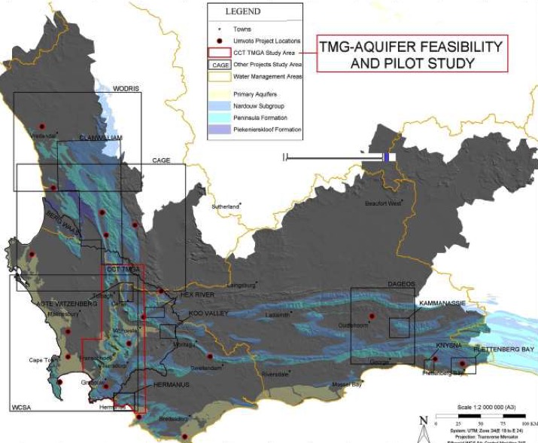
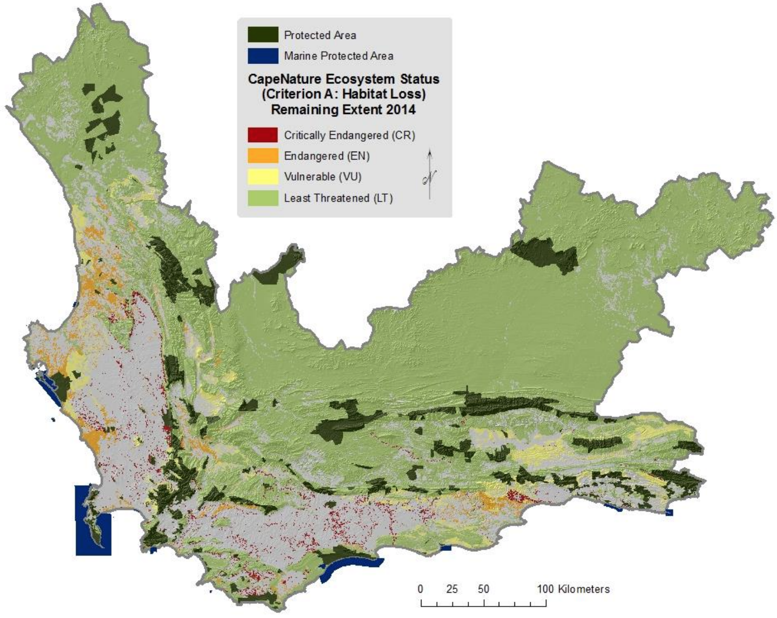
TMG (fractured rock) aquifers
Almost all of the Cape Fold Mountains have
potential for groundwater development…

Slide 46
TMG (fractured rock) aquifers?
“Ground water is faster to implement, compared to permanent desalination (at scale) and is also much cheaper. Ground water has a lower environment impact compared to the alternatives. Importantly, groundwater can be managed as a form of water storage through recharge and without evaporation losses.”
- Water Outlook 2018 Report, City of CT
http://resource.capetown.gov.za/documentcentre/Documents/City%20research%20reports%20and%20review/Water%20Outlook%202018%20-%20Summary.pdf

Slide 47
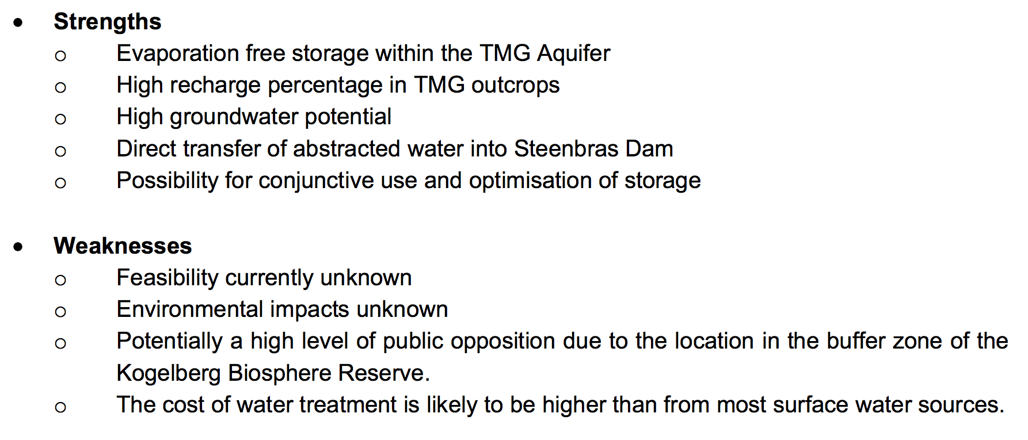
TMG (fractured rock) aquifers
More expensive
More damaging
More uncertain
No managed recharge
???????!!!!!!!!!
Western Cape Reconcilliation Strategy
http://www.dwaf.gov.za/documents/other/wma/19/wcwssscenariojun07anbsecf.pdf

Slide 48
A better alternative?

Slide 49
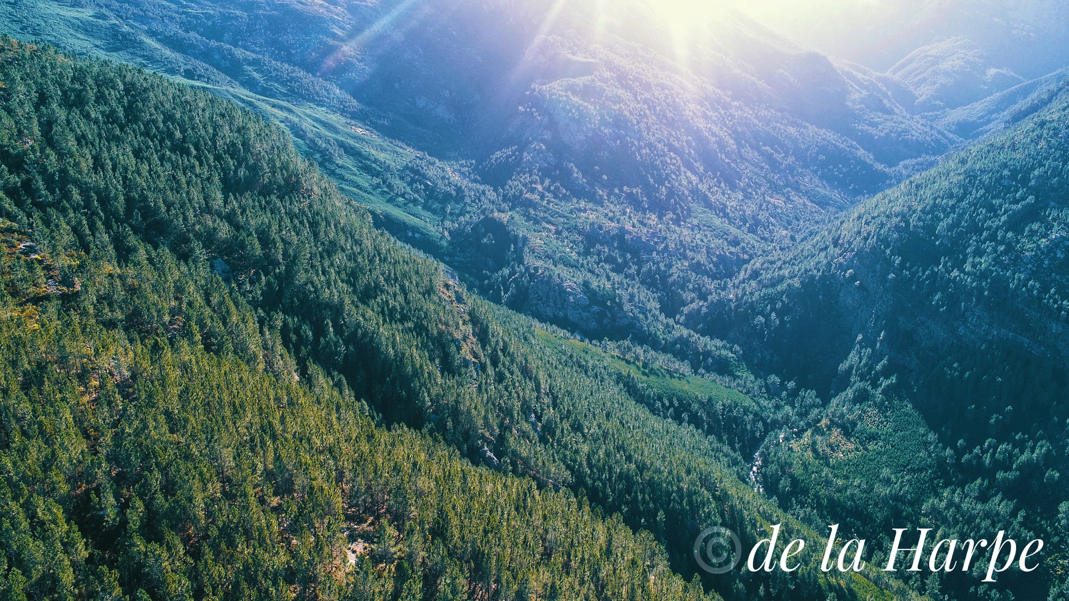
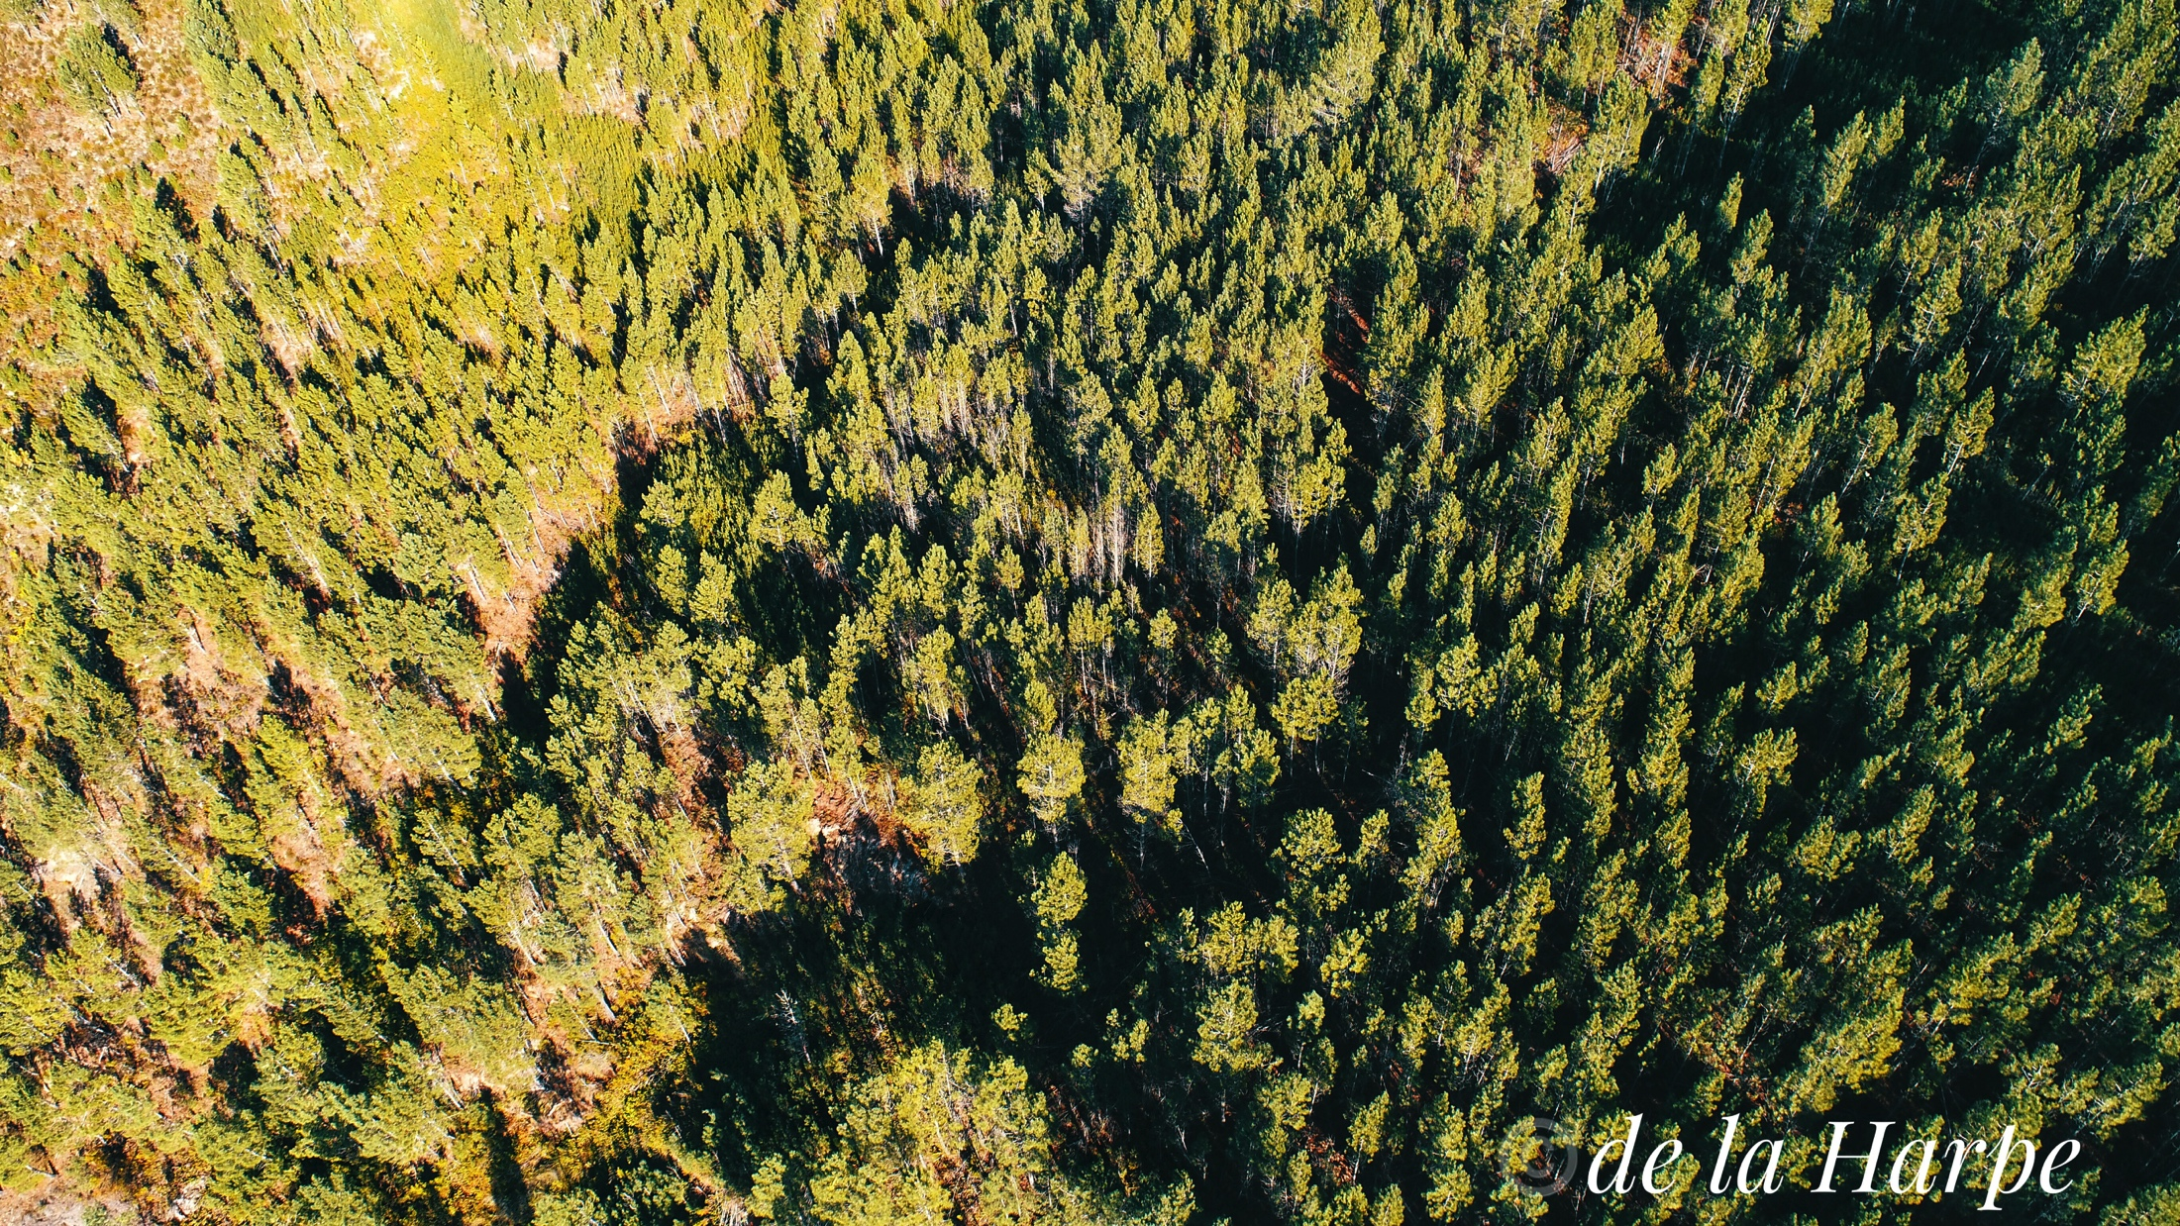
A better alternative?

Slide 50
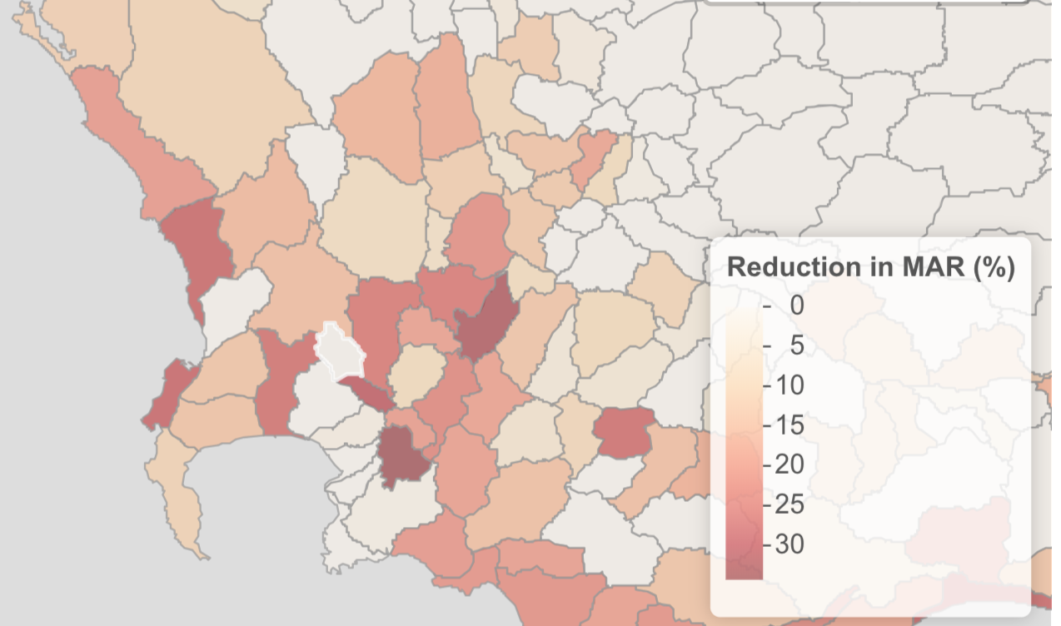
A better alternative?
In 2008 ~10% of runoff from the catchments supplying the dams in the WCWSS was lost to invasive alien plants ~105 MLD
www.ecologi.st/post/aliens/

Slide 51
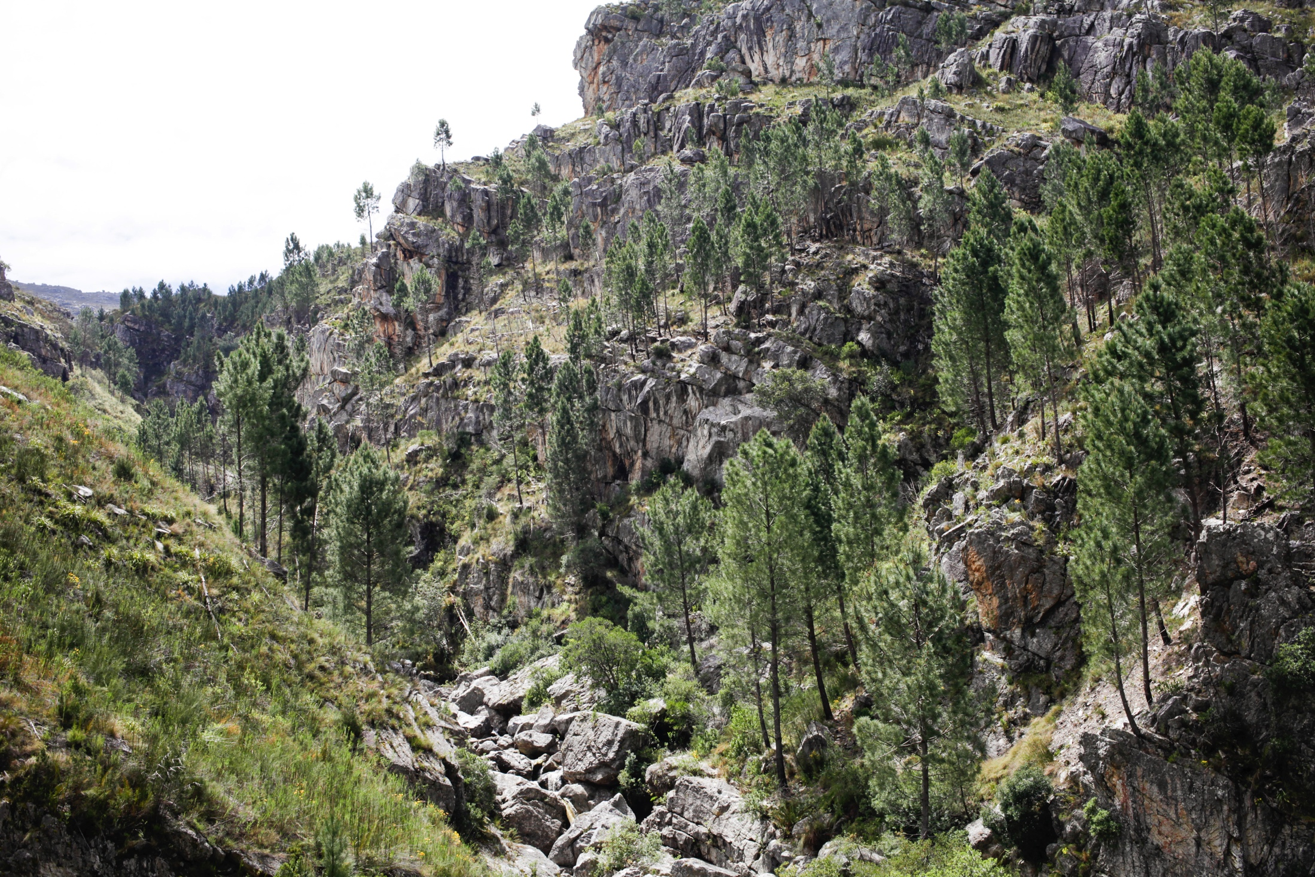
A better alternative?
By 2045, without adequate we will likely be losing 356MLD – the equivalent of a Berg River dam (139Mm3) every year.

Slide 52
Context?
2018?
2045
2008
http://resource.capetown.gov.za/documentcentre/Documents/City%20research%20reports%20and%20review/Water%20Outlook%202018%20-%20Summary.pdf
Notes:
Add current and projected losses to invasive plants…

Slide 53
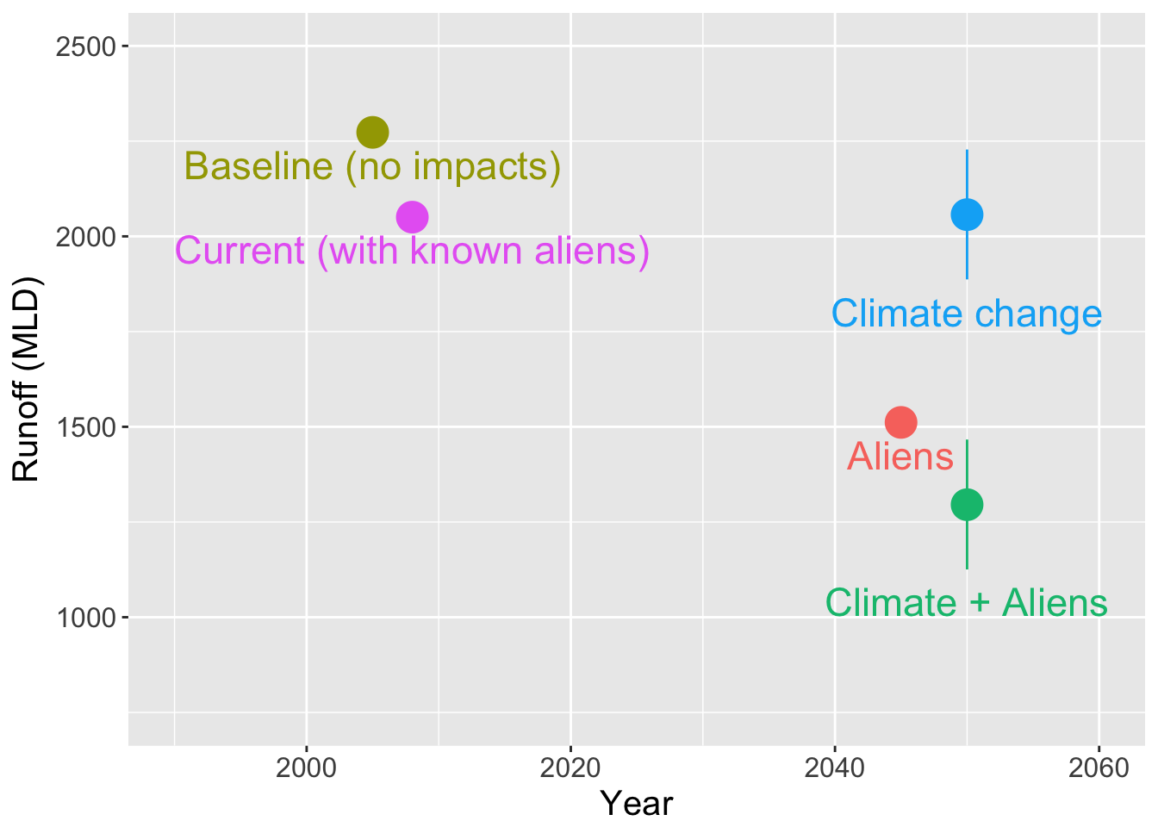
Worse than climate change?
www.ecologi.st/post/alienvspredator/
Notes:
Add current and projected losses to invasive plants…

Slide 54
A better alternative?
Clearing costs?
R650 Million over 30 years
  (starting with R120M for first 2)
https://www.dailymaverick.co.za/article/2018-07-02-clearing-thirsty-alien-trees-will-yield-water-returns-for-cape-town/

Slide 55
My conclusion
(please decide for yourself)
There’s clearly enough budget to clear aliens from our catchments
Restoring our catchments provides water at a lower cost than any of the augmentation schemes and has a multitude of associated benefits
If we do not clear aliens from our catchments they will continue to reduce our the recharge of groundwater and our dams
Developing dependence on groundwater without first addressing the greatest threat to the resource is lighting the fuse on a time bomb
If the city insists on groundwater exploration it should proceed slowly, cautiously and with a concerted research effort to ensure sustainability of both the resource and the environment

Slide 56
Have your say!!!
Most experts in this field are consultants or work for municipality/province/state
They either have a conflict of interest, or they’re muzzled by their institution
We need well-informed citizens/civil society to lead the charge

Slide 57
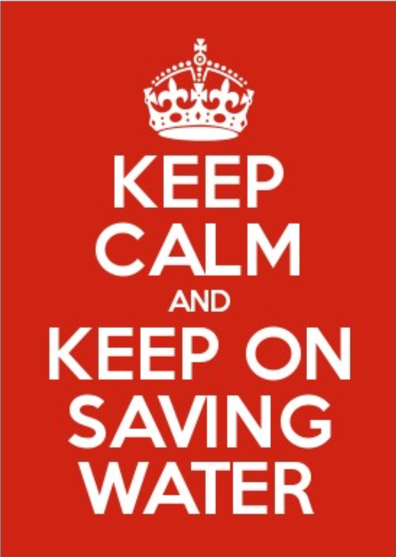
Thank you!

