Slide 1
The future of coupled modeling at NWS
Dr. Ir. Hendrik L. Tolman
Senior Advisor for Advanced Modeling System
Office of Science and Technology Integration
National Weather Service / NOAA
Hendrik.Tolman@NOAA.gov

Slide 2
Overview
Planning at NWS
Coupled ensemble modeling
NOAA Unified Modeling Committee whitepaper
A Strategic Vision for NOAA’s Physical Environmental Modeling Enterprise
2017-2018 Roadmap for the 2017-2018 Roadmap for the Production Suite at NCEP
Strategic Implementation Plan
NOAA – NCAR Memorandum of Understanding (MoA)
Coupled modeling
The present and past
The approach
The progress

Slide 3
Planning Overview

Slide 4
A Hierarchy of Plans
A broad “strategy document” from the NOAA Unified Modeling Committee (UMC; under the auspices of the NOAA Research Council); spans the entirety of the NOAA modeling enterprise, inclusive of bio-geo-chemical, social and physical.
The NWS and OAR are developing a Strategic Vision Document looking out 10 years and bridging US Physical Environmental Modeling Enterprise with the higher level NOAA UMC effort.
Also emanating from an NWS-OAR partnership, is a Roadmap document that lays out how we can move the NCEP Production Suite towards the vision described in the Vision Document.
At a practical level, the Strategic Implementation Plan (SIP), describes NOAA’s concrete steps over the next 3 years to build the Next Generation Global Prediction System based on the Unified Forecast System, beginning with numerical weather prediction across scales and in partnership with with the community (all stakeholders).
1. UMC
Unified Modeling Committee: High-level NOAA Unified Modeling Overview
2. Vision
A Strategic Vision for the US National Physical Environmental Modeling Enterprise
Horizon: 5-10 Years
3. Roadmap
Horizon: 5-10 Years
4. SIP
Strategic Implementation Plan
Scope: NCEP Production Suite (Unified Forecast System)
Horizon: 0-3 Years
Scope: NCEP Production Suite (Unified Forecast System)
Roadmap for the Production Suite at NCEP
Scope: US Environmental Modeling Enterprise (Federal focus, integrated with Academia)
Horizon: 5-10 Years
Scope: NOAA

Slide 5
Unified Modeling Committee
NOAA-wide, long term
Under NOAA Research Council
Policy rather than requirements
* ftp://ftp.library.noaa.gov/noaa_documents.lib/NOAA_UMTF/UMTF_overview_2017.pdf

Slide 6
Strategic Vision
Physical modeling at NOAA, 5-10 year vision
AA level approval
Effort pre-dates UMC
Finalized, awaiting signatures

Slide 7
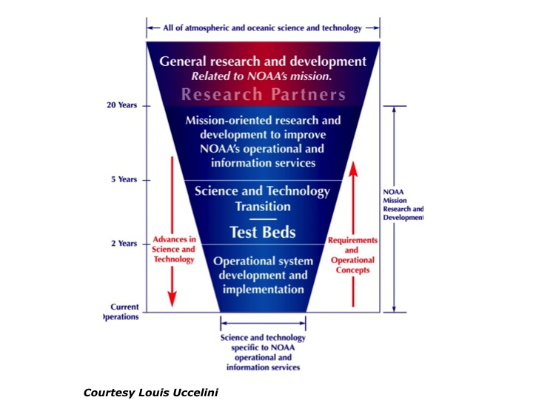
Strategic Vision: Key Elements
Focus on products supporting mission requirements
Unified modeling and data assimilation
Coupled, ensemble based, reforecast and reanalysis
Including pre- and postprocessing, calibration, verification validation
Focus on community modeling
Operations and research
Evidence-driven decisions
Same standards for all who contribute
Transparent and robust governance
Service requirements
Technical requirements / solutions
Prioritization
See SIP for community governance
Strategic Vision Fig. 1

Slide 8
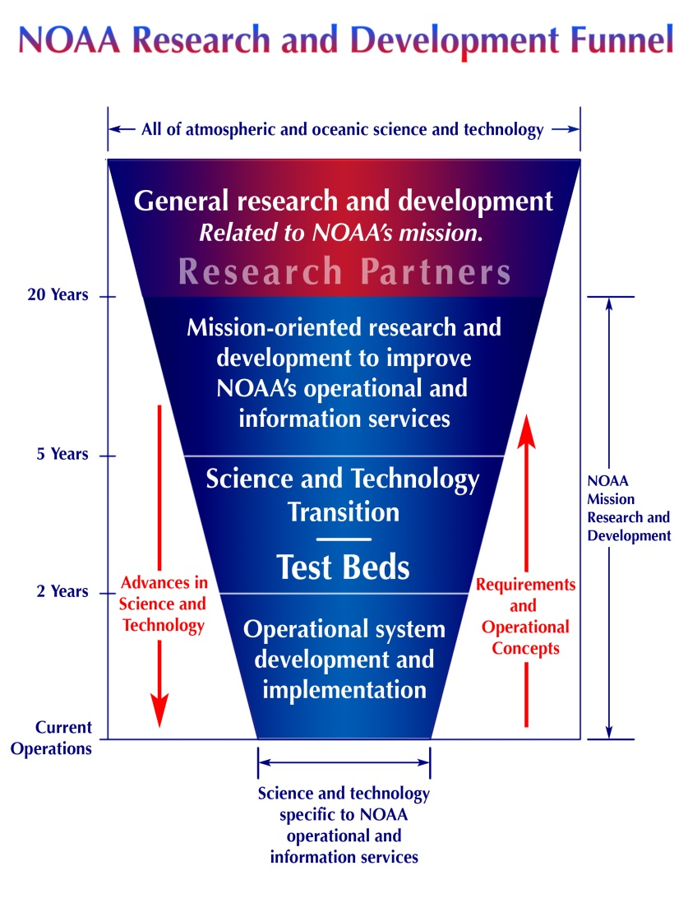
Deconstructing the funnel
Past
Future
“external” community
Community Software
- Updates
Implementable
Research
operations

Slide 9
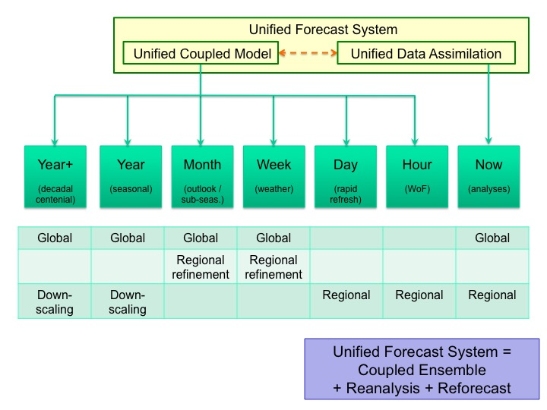
Strategic Vision: Temporal Domains
Strategic Vision Fig. 2

Slide 10
Roadmap
Production Suite, 5-10 years
AA level approval
Effort pre-dates UMC
Finalized, awaiting signatures

Slide 11
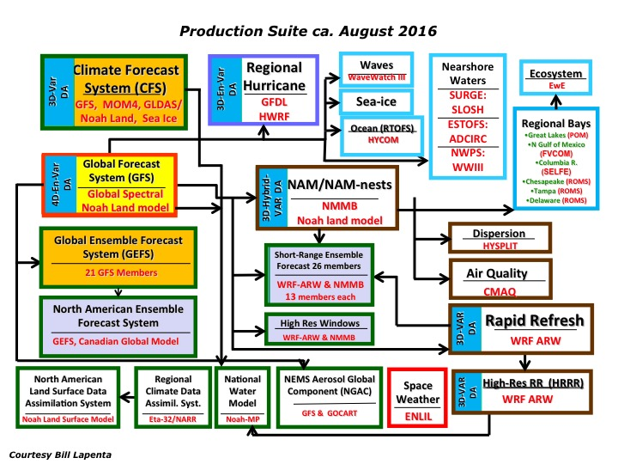
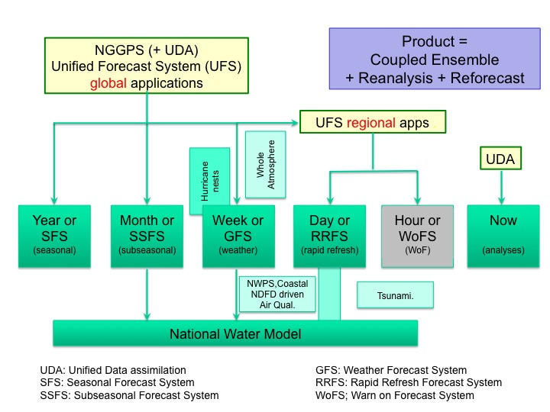
Roadmap: Big Picture
Moving from atmosphere focus to holistic environmental approach
Roadmap Fig. 1
… we will move to a product based system that covers all present elements of the productions suite in a more systematic and efficient way
Starting from the quilt of models and products created by the implementing solutions rather than addressing requirements ….
Roadmap Fig. 2

Slide 12
Roadmap: 5 year “end state”
Focus on transition to Unified System
Roadmap Table 2
SFS= Seasonal Forecast System
SSFS= Sub-Seasonal (Outlook) Forecast System
GFS= Global Forecast System
RRFS= Rapid Refresh Forecast System
WoFS = “Warn on Forecast” System
Changing use of WCOSS
Needing ~ 37 PFlop machine
Resolutions for atmosphere, other component models may have different resolutions

Slide 13
Roadmap: 10 year “best system”
Focus on becoming best in the world
Roadmap Table 4
S3SFS= (Sub-) Seasonal Forecast System
GFS= Global Forecast System
RRFS= Rapid Refresh Forecast System
WoFS = “Warn on Forecast” System
SFS / SSFS use single model
Needing ~ 730 PFlop machine
Resolutions for atmosphere, other component models may have different resolutions

Slide 14
Strategic Implementation Plan
SIP, execution at NCEP 1-3 year
Execution level approval / planning
Annual upgrade through SIP working groups
https://www.weather.gov/sti/stimodeling_nggps_implementation

Slide 15
NGGPS Goals and Objectives¹
Next Generation Global Prediction System
Design/Develop/Implement NGGPS global atmospheric prediction model
Non-hydrostatic scalable dynamics
Improve data assimilation and physics
Position NWS for next generation high performance computing
Engage community in model/components development
Reduce implementation time
Increase effectiveness of product distribution
Post-processing, assessments, and display
World’s Best Global Forecast Guidance
¹From NWS Budget Initiative proposal to OMB
Notes:
Develop and implement NGGPS by 2019. This will extend useful forecast skill to 30 days, and utilize new high performance computing capabilities. This is not just an NWS effort, it is a community effort with participation of NOAA and other federal laboratories and universities.

Slide 16
SIP for Unified Forecast System
Common Goal: Single integrated plan that coordinates activities of
NOAA + external partners in common goal of building a national
unified modeling system across temporal and spatial scales
NGGPS: foundation to build upon
Activities include R&D, testing/eval, V&V, R2O, shared infrastructure, etc.
Approach for SIP development:
Began with existing core R&D partners to organize in functional area Working Groups (WGs) responsible for drafting respective functional SIP components
End product (in final coordination) will be SIP version 1.0, a 3-year plan (FY 2018-2020)
FY18 and following : SIP to be rolling 3-year plan to be updated annually

Slide 17
SIP Working Groups
Governance
Decision making, roles/responsibilities, advisory boards, org. alignment, etc.
Communications and Outreach
Common messaging strategy
Convective Allowing Models (CAMs)
Intermediate steps to CAM ensembles, Warn on Forecast; test/eval w/community
System Architecture
NEMS evolution; community approach
Infrastructure
Standards/doc; CM; code repository; etc.
Role of testbeds; regression testing; etc.
Verification & Validation (V&V)
V&V of ops forecasts vs. R&D testing/eval
Unified/standard tools and data formats
Dynamics and Nesting
FV3 transition on global wx/S2S/climate
Nests for hurricanes (moving?)
Model Physics
Common Comm. Physics Pkg (CCPP); stochastic, scale-aware physics
Data Assimilation
NOAA, NASA integ. w/FV3; coupled DA
Joint Effort for DA Integration (JEDI)
Ensembles
Strategy across scales; model uncertainty
Post-Processing
Comm. PP infrastructure; std formats/tools
Component Model groups
Marine models + NOS coastal/bay models
Aerosols and Atmospheric Composition
Land Sfc Models (LSMs) + hydrology (OWP)
Unified Forecast System (UFS) Steering Committee
New WG or addition (wrt NGGPS)
Augmentation of existing NGGPS group

Slide 18
NOAA – NCAR MoA
NCAR - NWS – OAR

Slide 19
NCAR – NOAA MoA
Letter of Intent for collaboration between NCAR, NWS and OAR signed July 28, 2017
“to develop a Memorandum of Agreement (MOA) that will describe how both organizations will work collaboratively toward the design and construction of a community unified modeling infrastructure. “
Identified benefits include
Synergies
Common repositories
Access to NOAA operational models
Team for writing MoA formed in November 2017
Full MoA text agreed upon by all three organization
Now in NOAA final legal review

Slide 20
The Present and Past

Slide 21
present
Coupled systems
Climate Forecast System (CFS v2)
HYCOM – CICE coupling
Hurricane models (GFDL, HWRF)
GFS/GDAS
NCODA 3D-VAR initialization fields (from NAVO)
Climate Forecast System
GDAS
GSI
6hr
Atmospheric Model
GFS (2007)
T382 64 levels
T,S,U,V
24hr
HYCOM
LANL CICE
LDAS
Land Model
Ice Mdl SIS
6hr
Ice Ext
Ice concentration, Ice drift, Ice temp, shortwave heat flux through Ice
Ocean Model
MOMv4
fully global
1/2ºx1/2º (1/4º in tropics)
40 levels
6hr
GODAS
3DVAR
Outputs:
T, S, U, V, SSH, Ice Drift,
Ice Thickness,
Ice Concentration
Ocean- Sea Ice fields exchanged via ESMF
http://cfs.ncep.noaa.gov/cfsr

Slide 22
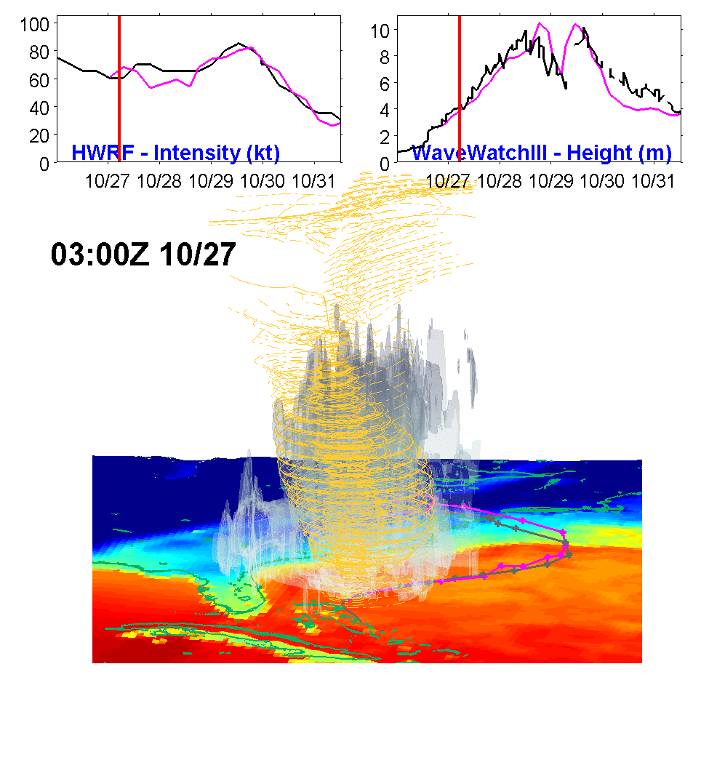
Operational HWRF
High-Resolution (2km) near the storm
Advanced hurricane physics
Coupled to ocean model
1-way coupled to wave model (July 11, 2018)
Custom coupler, 3-way coupling is being tested.
Black: Observed
Pink: HWRF Model
Three telescopic domains: 18km: 80x80º; 6km ~12x12º 2km inner-most nest 7x7º
Accurate intensity and structure forecasts from HWRF → Better wave and storm surge forecasts for landfalling storms

Slide 23
The Approach

Slide 24
Basic approach : coupling
This is not just a science problem
Requirements for additional, traditionally downstream products
‘”One-way” model coupling versus downstream model:
Increases forcing resolution of downstream models while reducing I/O needed to force models
Creates a better integrated test environment for holistic evaluation of model upgrades
Less implementations
Creates environment for investigating benefits of two-way coupling. Enables two-way coupling if science proves benefit
Negative aspects of coupling:
More complex implementations
Less flexibility to tailor product.
Produce “too much”

Slide 25
Basic approach : coupling
Many potentially coupled model components already have products in the production suite :
Where no products exists, science suggests benefit of coupling
For the hourly forecast range, all still TBD
DA is also moving (internationally) to coupling
Space weather making its way into operations
Ecosystems (marine) being considered (not in table)
Subsystem | Year | Month | Week | Day | Hour
Land / hydro | Y | Y | Y | S | ?
Ocean / coast | Y | Y | Y | S/R | ?
Ice | Y | Y | S | ? | ?
Waves | S | Y | Y | Y | ?
Aerosols | S | S | Y | Y | ?
Space weather | ? | ? | Y | ? | ?
Y: present product
S: science benefit
R: unmet requirement
?: TBD

Slide 26
Basic approach : coupling “now”
 | Influencing
 | Atmos. | Land / hydro | Ocean / coast | ice | waves | Aerosols | Space W.
Atmos. |  | yes | yes | yes | yes | yes | yes
Land/hydro | yes |  | inflow | yes | inundation
Ocean/coast | yes | inundation |  | yes | WCI | climate
Ice | yes |  | yes |  | yes
Waves | fluxes |  | WCI | yes
Aerosols | climate |  |  |  |  |  | yes
Space W. | yes |  |  |  |  | yes
Green boxes: light: tradition 1-wy downstream coupling
dark: two-way coupling in selected operations.
Grey boxes: fixed data, not dynamic coupling
Black text: presently in place.
Red text: science has shown impact

Slide 27
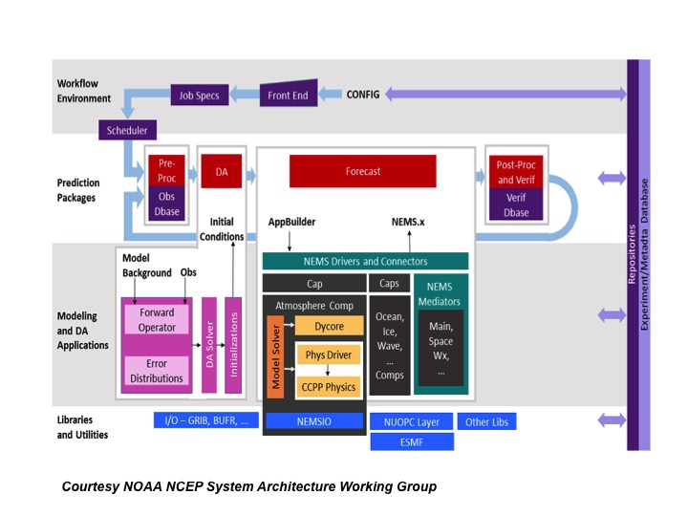
Roadmap: Architecture
ESMF: “Language”
NUOPC: “Dictionary”
NEMS: “Book”
ESMF/NUOPC/NEMS architecture enables unified coupled modeling and DA
Consistent with broader NOAA (UMC) and US vision (National ESPC)
FV3, CCPP, CICE, MOM6 (HYCOM), WW3, GOCART, WRF-Hydro, JEDI, …...
Roadmap Fig. 3

Slide 28
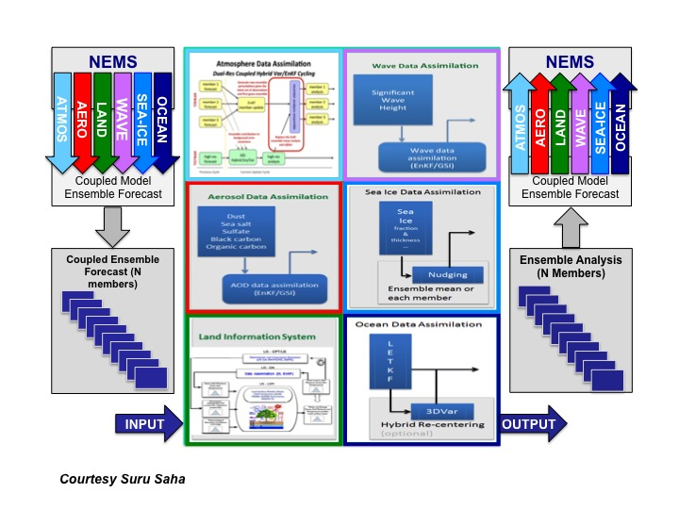
Roadmap: Fully Coupled
Moving to coupled Data Assimilation
Range of work going from weakly to strongly coupled Data Assimiliation
Commitment to go there, not mature enough for hard commitment
Joint Effort of DA Integration (JEDI)
Roadmap Fig. 4

Slide 29
The Progress

Slide 30
Team Efforts (I): Ice, Ocean, DA
The CICE consortium
Started in October 2016
Moving toward community modeling framework
Icepack release this week!
Ocean modeling with ALE models
MOM6 can be seen as a first attempt to merge existing models
NOAA / NWS moving to MOM6 to merge MOM4 and HYCOM applications
Can we go to a single community framework (ESPC discussions)?
Moving toward coupled Data Assimilation
JCSDA Joint Effort for Data Assimilation Integration (JEDI), modular framework to streamline DA
Agile code development techniques
Marine-JEDI investments at NOAA

Slide 31
Team Efforts (II) : Total Water
Total coastal water prediction is identifeid as a major gap in our capabilities.
Remember Harvey ….
Five themes in NOAA with own programs and authorizations,
Building first NOAA plan for total coastal water prediction.
Requirements, solutions, prioritization.

Slide 32
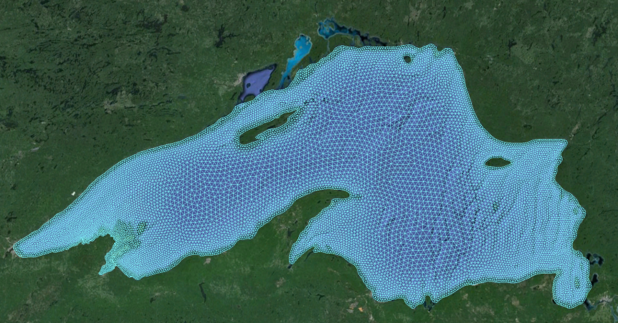
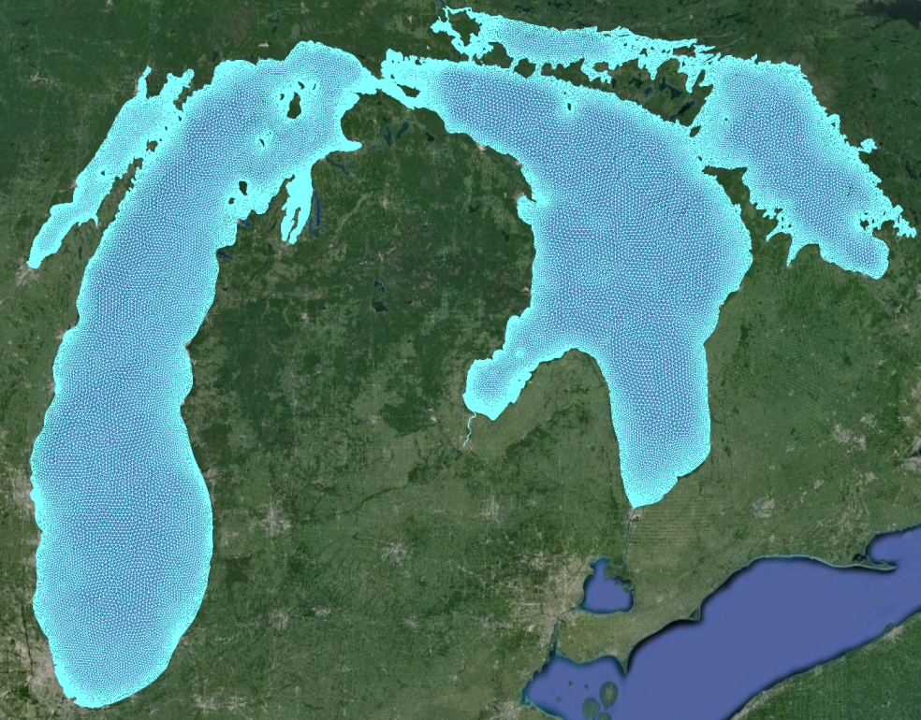
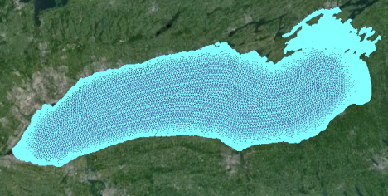
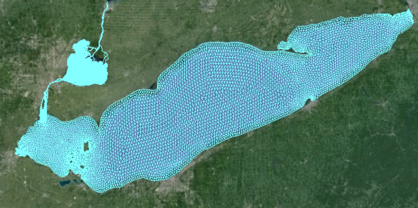
Great Lakes Modeling (I)
LSOFS
2020
Partnership with NOS, OAR and NWS
Higher spatial resolution models (FVCOM) with extended forecast horizon
Enable other types of forecasts:
HAB forecasting (FY17)
Ice forecasting (FY20)
Wave coupling (ongoing)
LMHOFS
2019
LOOFS
2021
HECOFS
2022
LEOFS
2016

Slide 33
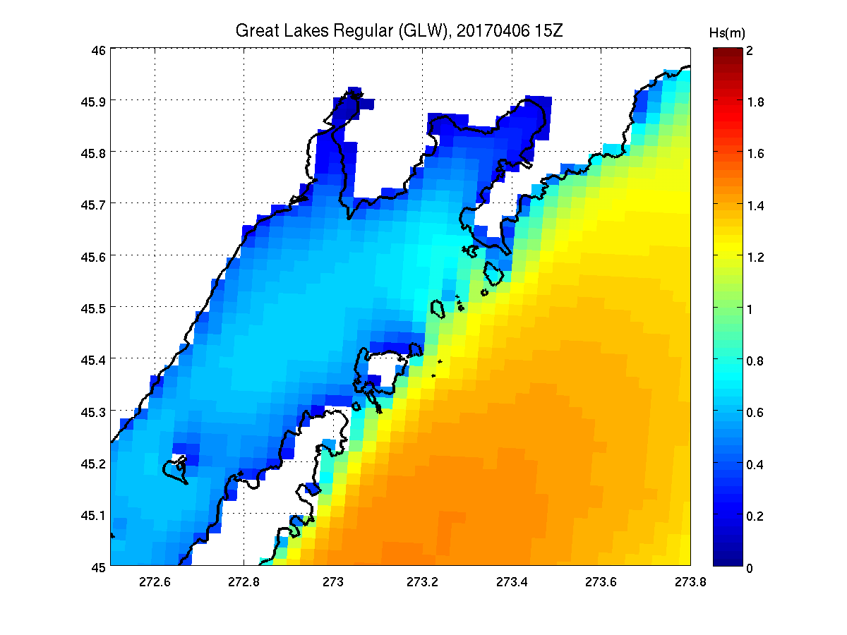
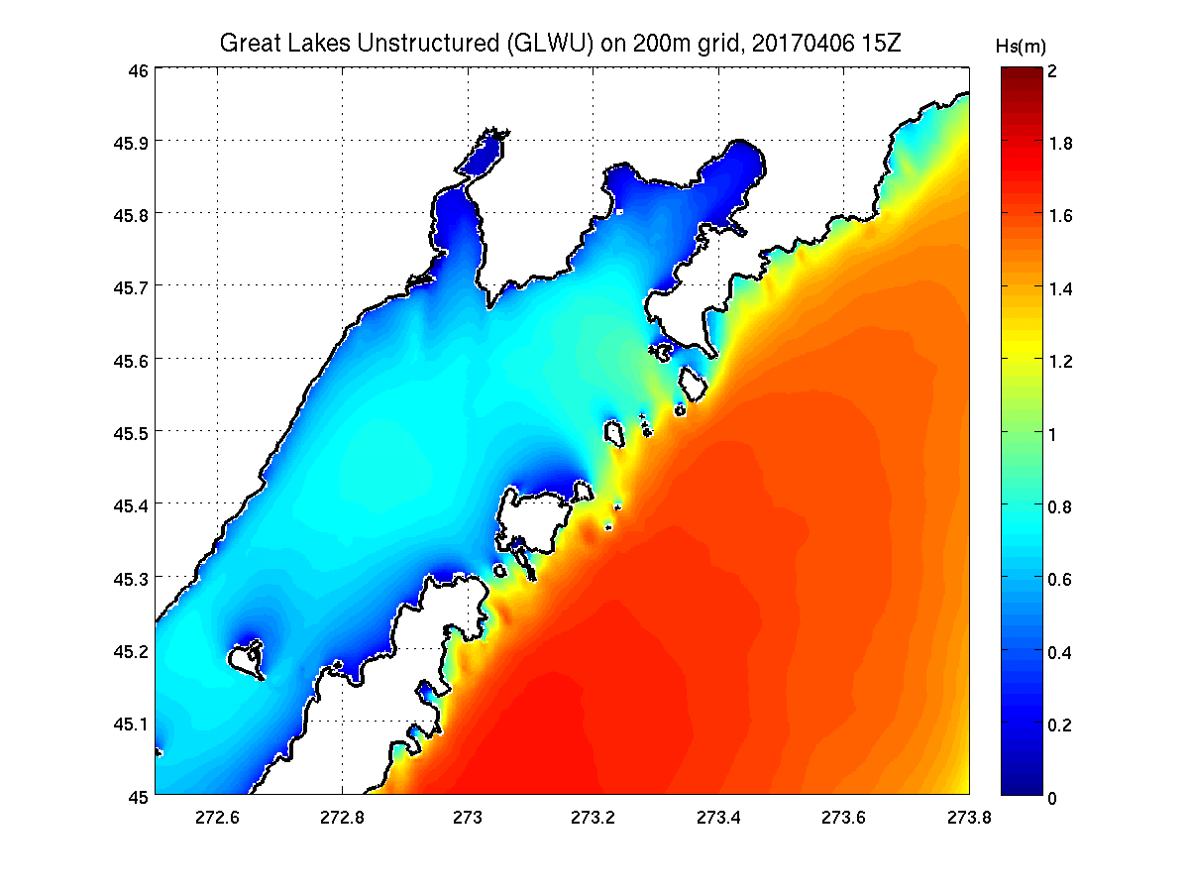
Great Lakes Modeling (II)
Unstructured grid Wave model in ops.
Waves in ops., hourly update
Couple to ice and circulation
Couple to RRFS
2017
Incr.
2022 +

Slide 34
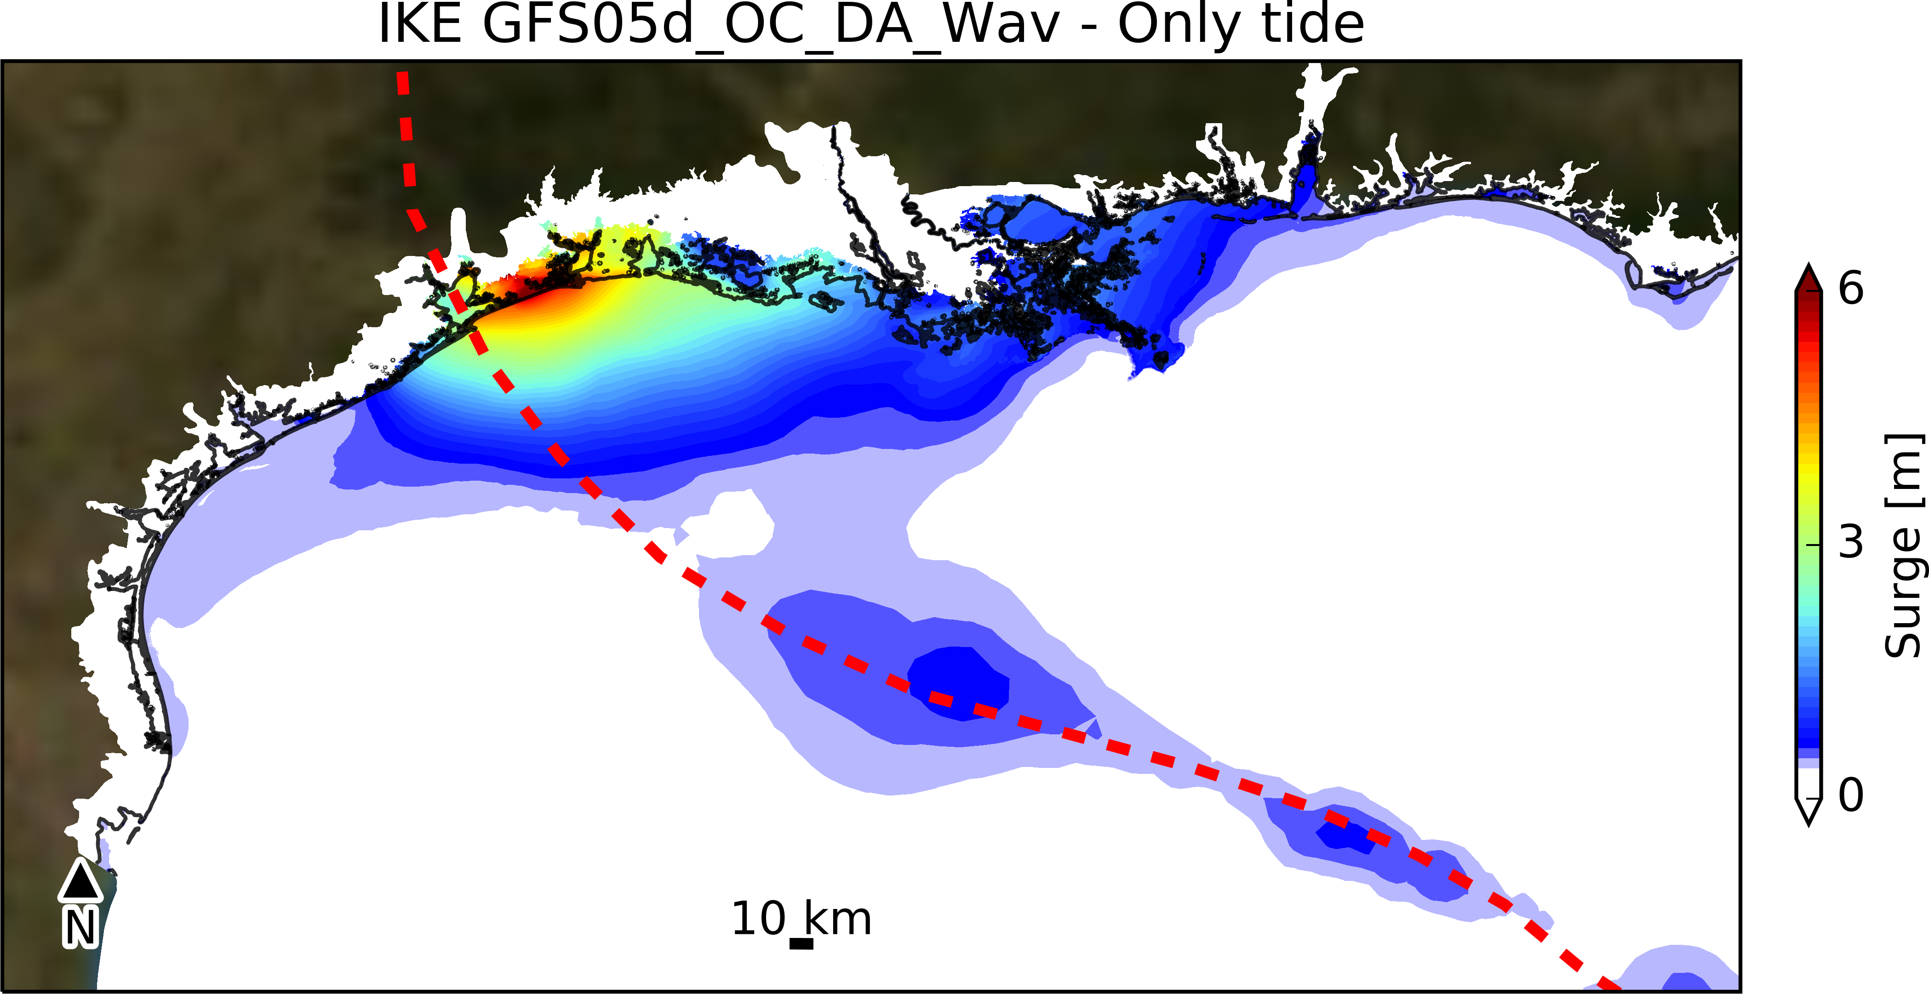
COASTAL Act
WAVEWATCH III – Adcirc coupling
Preliminary findings
Wind
Surge
Wave
Height
Max surge
Credit: S. Moghimi, A. Abdolali and Z. Ma

Slide 35
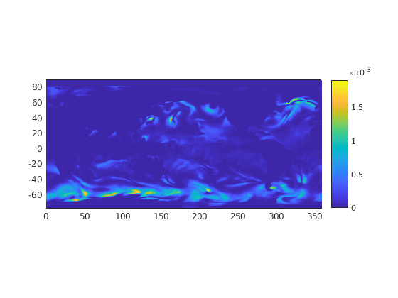
Atm. – wave coupling
NEMS Driver
z0 surface roughness
FV3
WW3
10m wind (u,v)
Will be used in next implementations to move global wave model and global wave ensembles into GFS and GEFS (at least 1-way coupling).
10 m wind speed [m/s]
z0 roughness length
Change in wind speed
(1-way minus 2-way) [m/s]
Courtesy Jessica Meixner

Slide 36
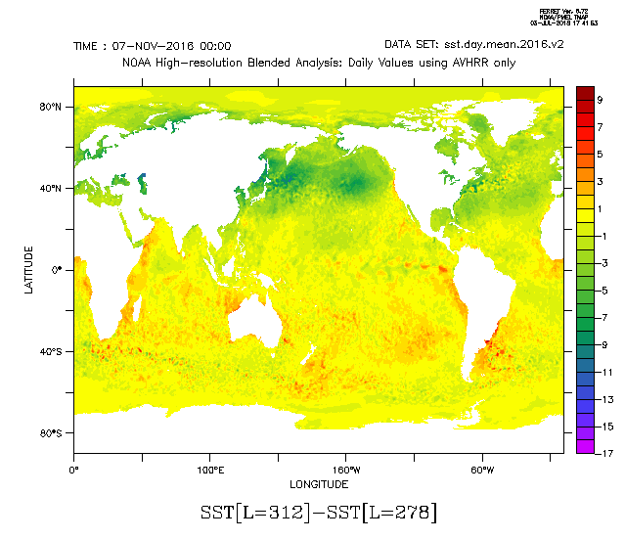
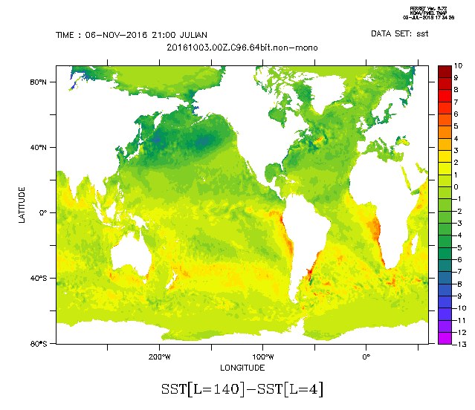
Atm. – ocean – ice coupling
Air-sea fluxes are computed in FV3
Regridding from FV3 to MOM6 is done in coupler
SST from MOM6 is used in FV3
Sea ice fields are received by FV3, but are not used in FV3 yet
Changes in SST after 35 days
Courtesy Bin Li

Slide 37
Thank You !

