Slide 1
New solutions for old problems
Alessandro Pontillo
PhD Student
Dynamic, Simulation and Control Group

Slide 2
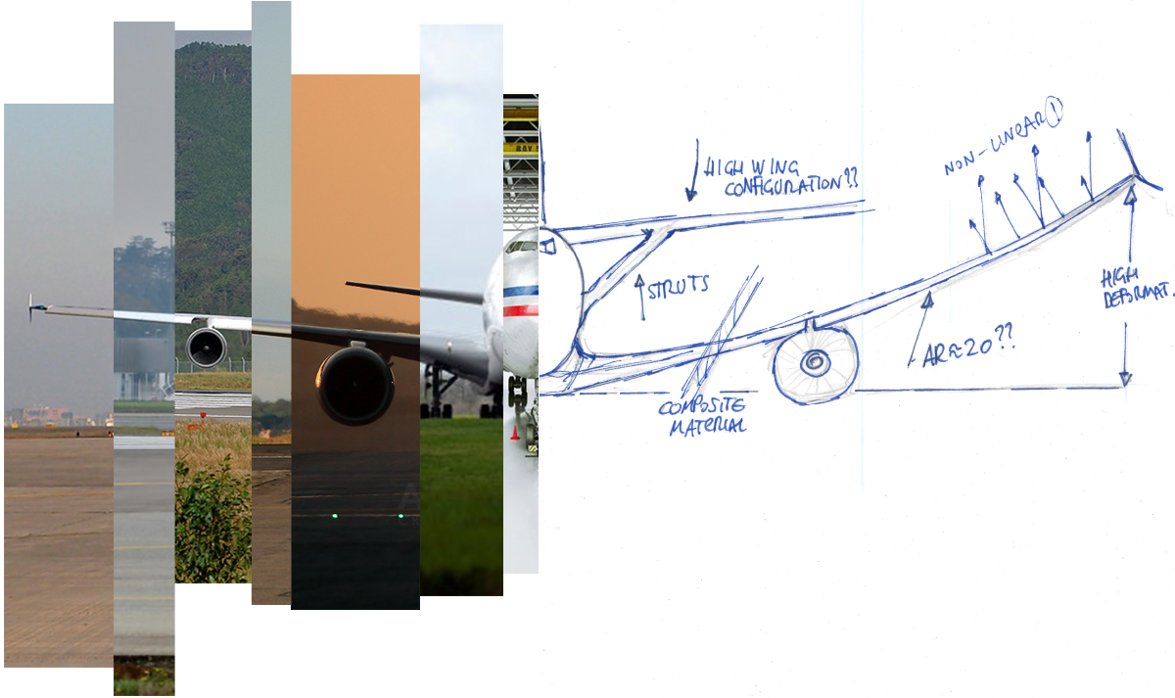
Efficiency
Aerodynamics
Structures
THIS AREA OF YOUR SLIDE WILL BE COVERED BY A TIMER
Aeroelasticity

