Slide 1
A practicioner’s view of deep learning in geophysical imaging
Jesper Soeren Dramsch

Slide 2
Outline
What is Deep Learning anyways?
The building Blocks
How do people apply it?
The Architectures
How did I apply it in the seismic domain?
The Models
How do we progress to physics?
The Hard Part

Slide 3
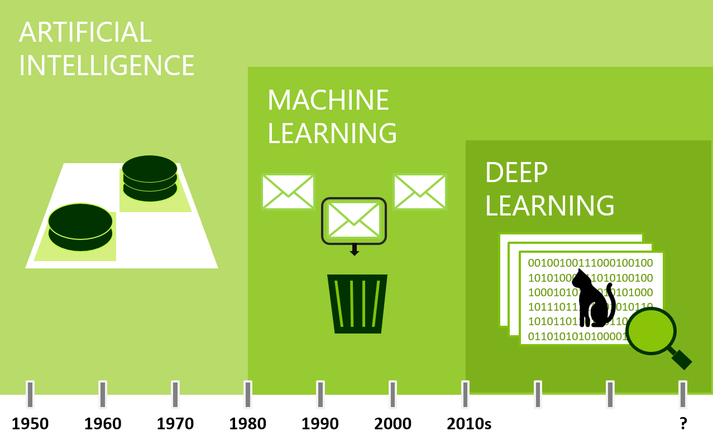
What is Deep Learning?

Slide 4
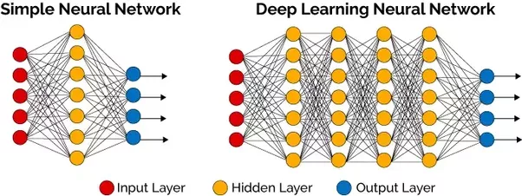
”Deep” Neural Networks

Slide 5
Visual Units

Slide 6
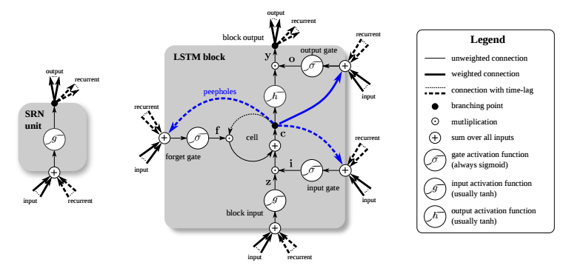
Context Aware Units
/ Recurrent Neural Network
Old
State
Current
State
Recurrent
Neuron
Data
Desired Output
Notes:
https://link.springer.com/chapter/10.1007/978-3-319-70096-0_21

Slide 7
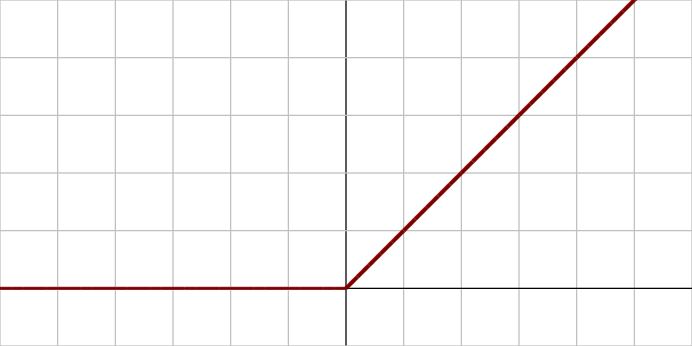
Capturing Non-Linearities
Activation
Data
Non-linear Map

Slide 8
Building Blocks in Deep Neural Networks
Visual Layers
1D / 2D / 3D convolutions
Resampling
Context-Aware Layers
Long-Short Term Memory
other recurrent units
Non-liner Activations
Regularizations
Dense Layers for Classification

Slide 9
Typical Architectures
(For our purposes)

Slide 10
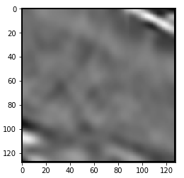
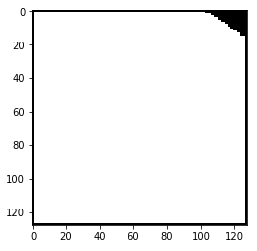
Unet – Automatic Interpretation

Slide 11
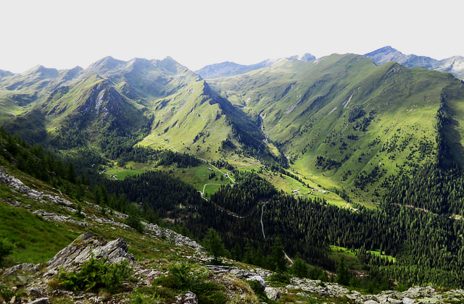
Generative Adversarial Networks
Legend
Network
Data
Real Data (CC-BY A. Çuğun)

Slide 12
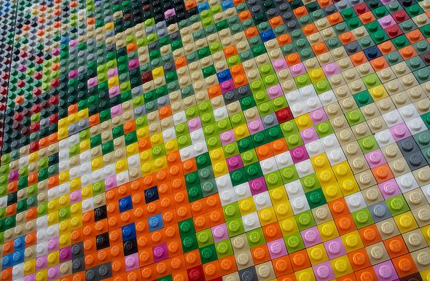
Start from latent space
Legend
Network
Data
Latent Space (CC-BY Hudson)
Real Data (CC-BY A. Çuğun)

Slide 13
Feed it to a Generator
Legend
Network
Data
Latent Space (CC-BY Hudson)
Real Data (CC-BY A. Çuğun)
Generator (CC-BY-SA T. Vaughn)

Slide 14
That generates some Fake Data
Legend
Network
Data
Latent Space (CC-BY Hudson)
Real Data (CC-BY A. Çuğun)
Fake Data (CC-BY Tony A.)
Generator (CC-BY-SA T. Vaughn)

Slide 15
Discriminator judges if sample is real
Legend
Network
Data
Latent Space (CC-BY Hudson)
Real Data (CC-BY A. Çuğun)
Discriminator(CC-BY Brickset)
Fake Data (CC-BY Tony A.)
Generator (CC-BY-SA T. Vaughn)

Slide 16
Both networks learn regardless if D is correct
Legend (CC-BY Dramsch)
Network
Data
Latent Space (CC-BY Hudson)
Real Data (CC-BY A. Çuğun)
Discriminator(CC-BY Brickset)
Fake Data (CC-BY Tony A.)
Generator (CC-BY-SA T. Vaughn)
Loss (CC-BY S. MacEntee)

Slide 17
Geophysical Imaging Examples
From Seismic to Velocity

Slide 18
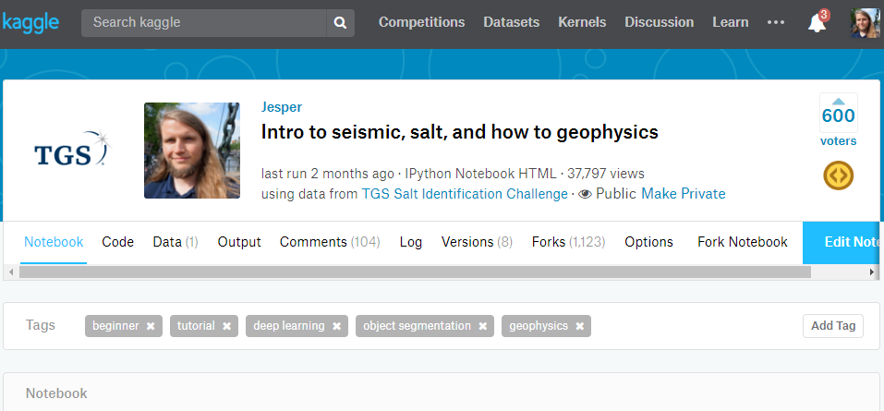
Kaggle Salt intepretation
No nice pictures due to confidentiality

Slide 19
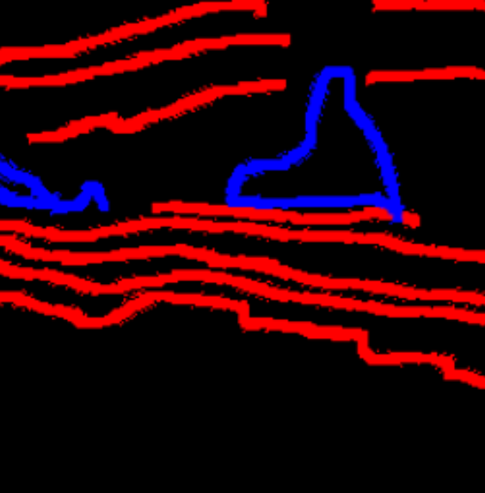
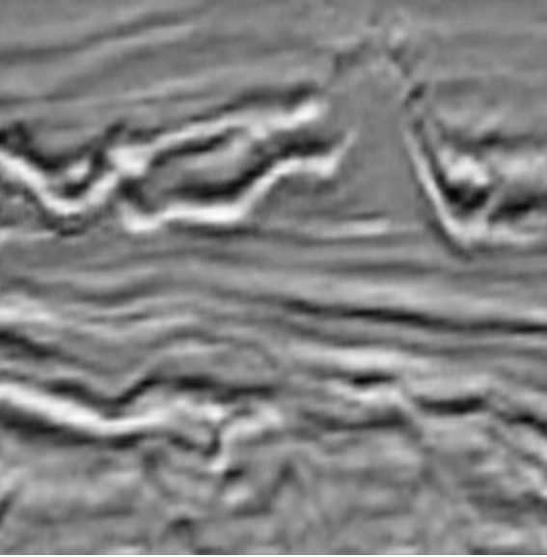
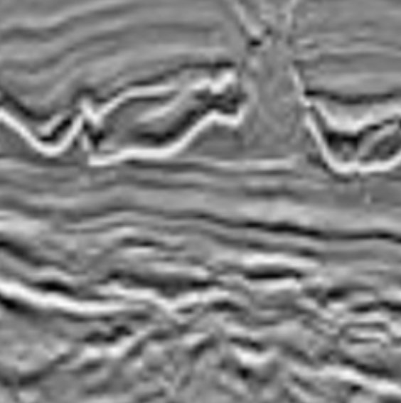
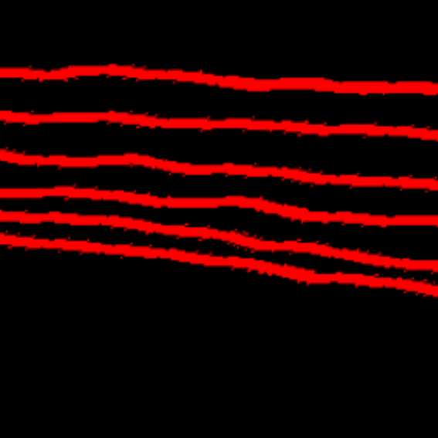
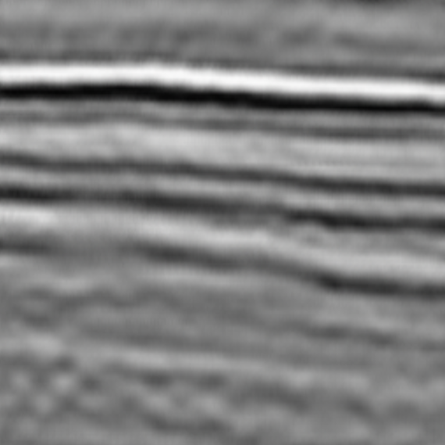
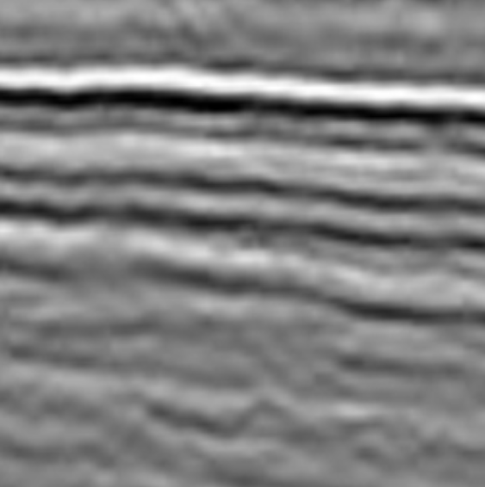
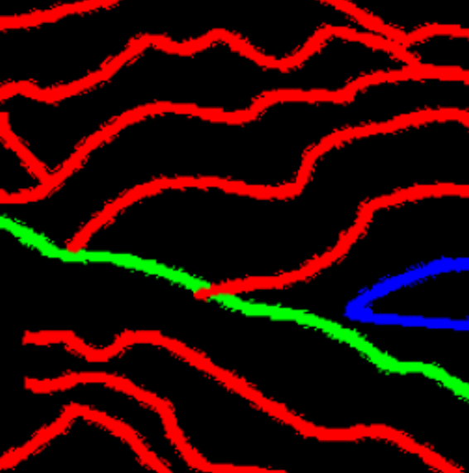
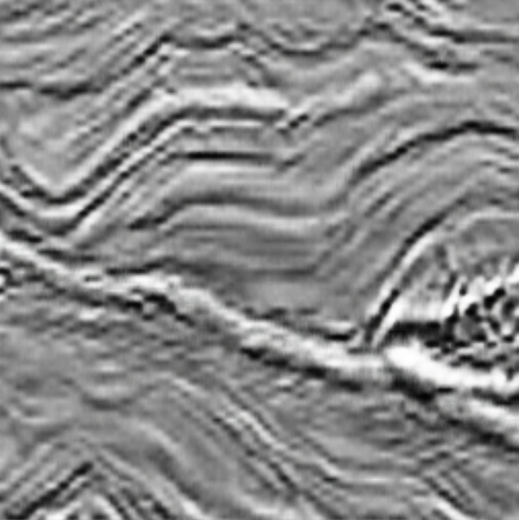
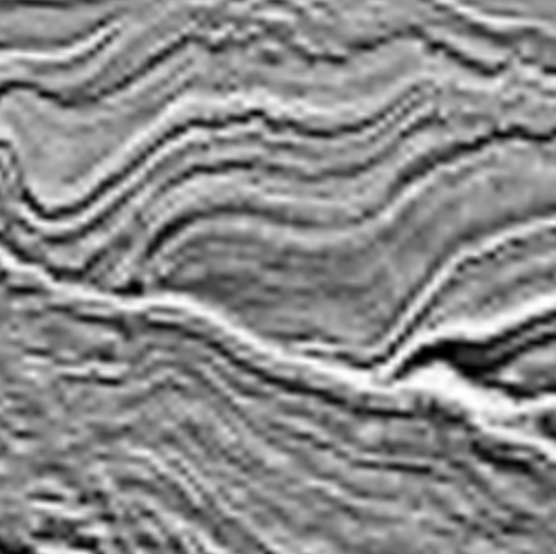
Force Machine Learning Hackathon
Fake
Real
amplt.de/quickseis

Slide 20
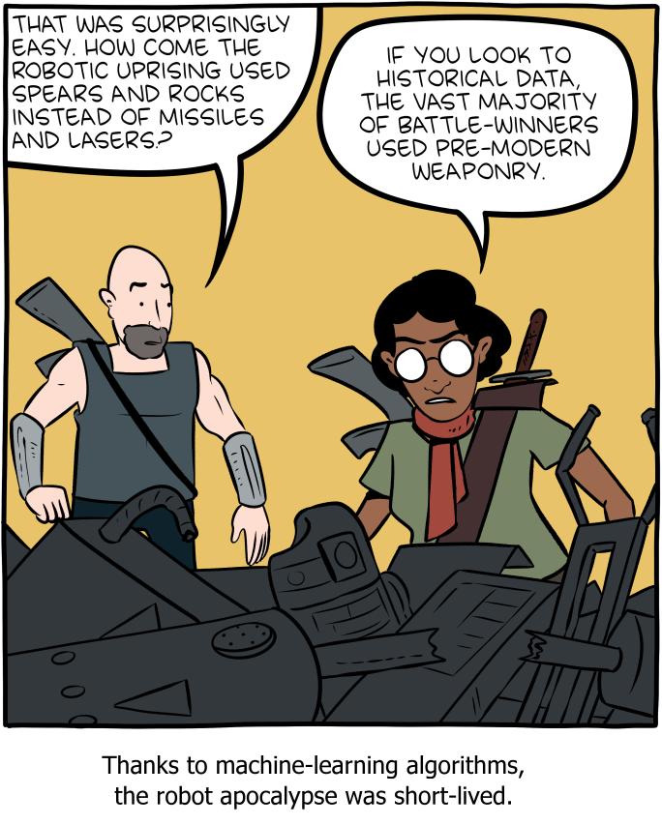
Do
We
Want
To
Learn
Human
Interpretations?

Slide 21
Can we learn physics?
Rhethoric Question. Sorry.

Slide 22
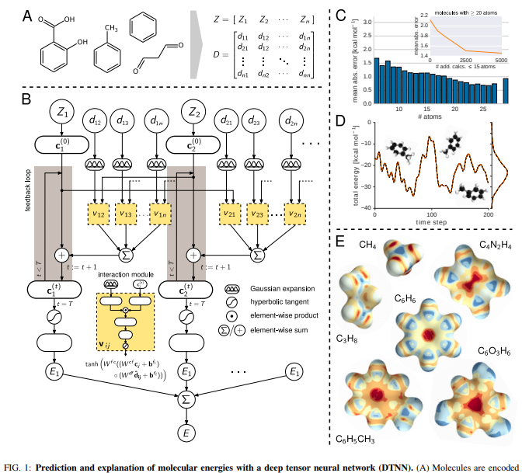
MoleculeNet – Physical Chemistry
Predicts molecular energies
Better than conventional approaches
Below one kalorie error

Slide 23
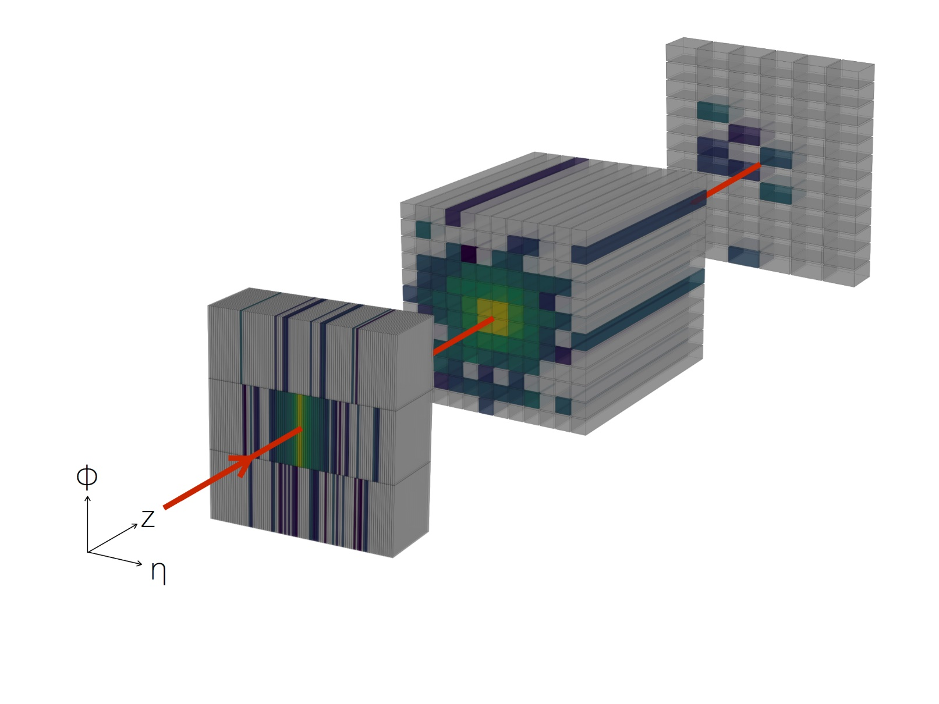
CaloGAN – Particle Physics (CERN)
Simulates Particle Showers
Speed Up of 10^5 on GPU
10^2 to 10^3 on CPU

Slide 24
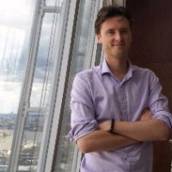
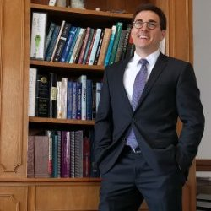
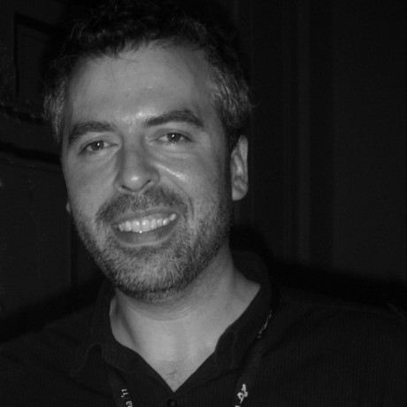
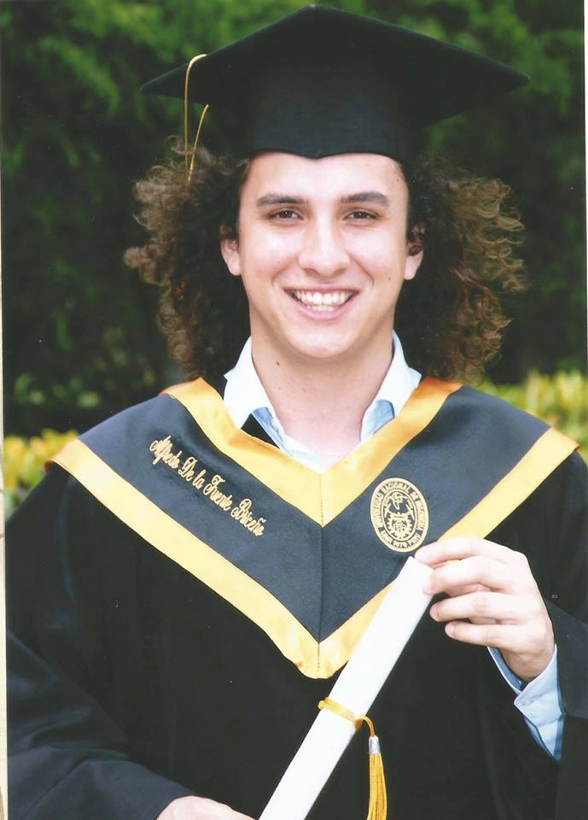
Stratigraphic Inversion
Input Seismic Output Velocity Model
24
Notes:
This is a video

Slide 25
Imaging is going Monte Carlo
Least Squares Migration
Full Waveform Inversion
Why not leverage (deep) statistics?
Implicit model space
Statistical distribution updates robust(er) to noise
Adjoint for gradient descent

Slide 26
Thank you!
Let’s discuss!

Slide 27
On the shoulders of giants
Thanks to
Colin Macbeth, Anders Nymark Christensen, Mikael Luethje
Lukas Mosser, Matt Hall, Steven Purves, Wouter Kimman
DTU and HWU
Dgb for Dutch F3 Data
Google for Tensorflow
Numfocus and Python foundation

