Slide 1
Sizing up the samurai wasp for BMSB control
Tom Saunders
Greg Holwell
Gonzalo Avila
Oregon Department of Agriculture

Slide 2
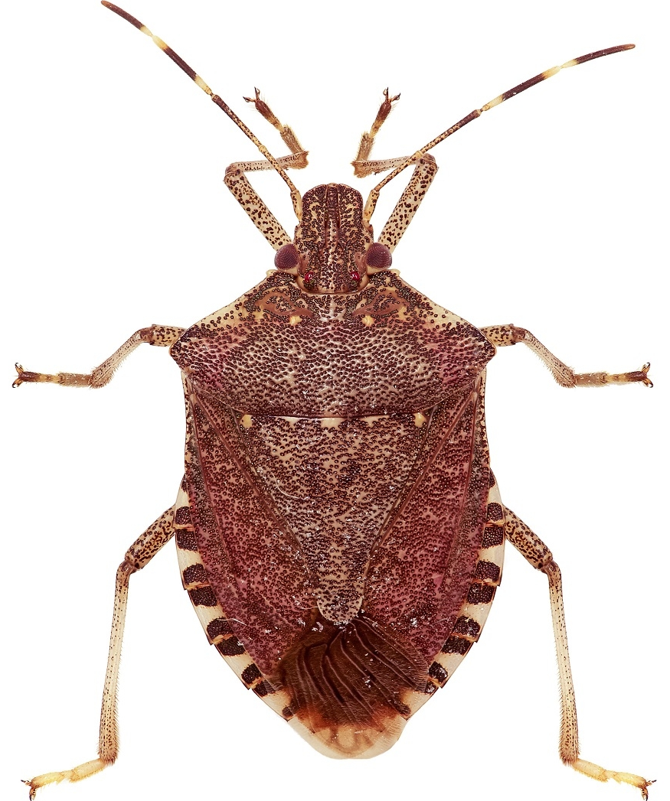
BMSB
Halyomorpha halys Stål, 1855
Native to East Asia
170+ host plants
Aggregations cause a nuisance
Taints wine if crushed
US, EU, Canada, Chile
Hard to kill with pesticides
Classical biocontrol?
Image courtesy Kiwifruit vine Health

Slide 3
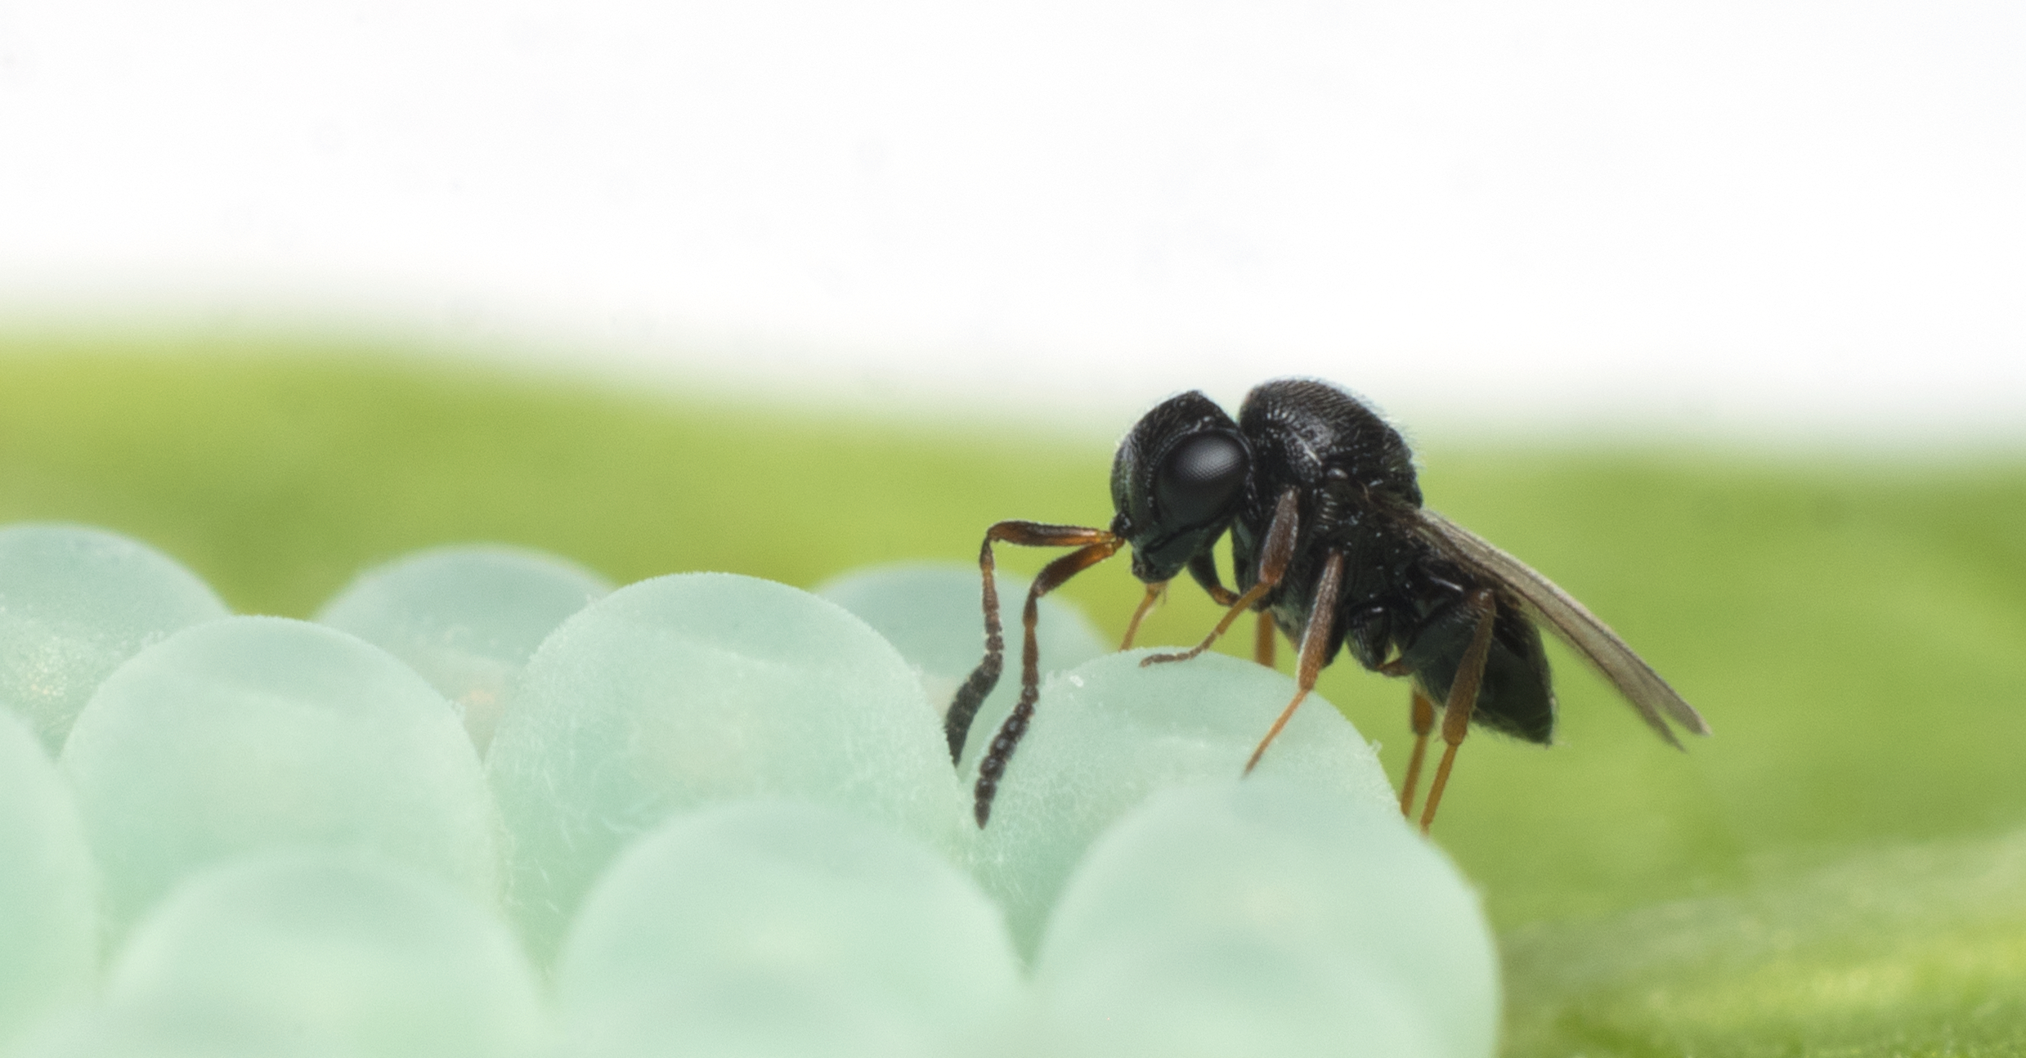
Samurai wasp
Trissolcus japonicus (Ashmead, 1904)
Attacks 2 families of shield bugs (only 1 in NZ)
50-80% parasitism against BMSB in native range
Female-biased sex ratio, short generation times
Found in US (2014), now in 11 states
Oregon Department of Agriculture
Notes:
Attacks only the Pentatomidae and Scutellaridae
The most effective other parasitoids achieve around 12% parasitism rates in the native range
Has been under consideration in the US since 2007
Risk assessment – lead in to NZ fauna
Important to mention that Tjap arrived 'naturally' in the US in 2014 and has been reported already in 11 states (VA, WV, MD, D.C., DE, PA, NJ, NY, OH, OR & WA). All the states mentioned are now requesting approval for release T. japonicus – approval has been granted in Oregon already (Kim Hoelmer, pers. comm.)

Slide 4
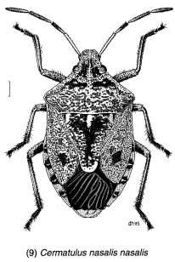
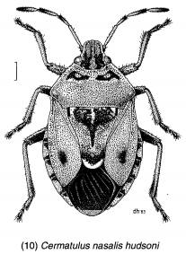
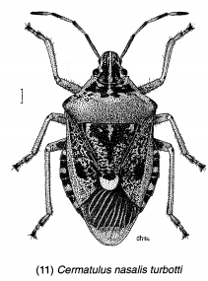
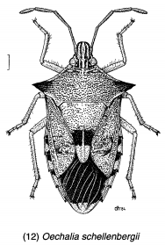
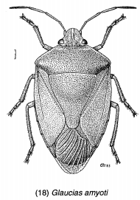
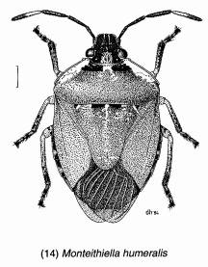
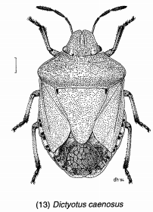
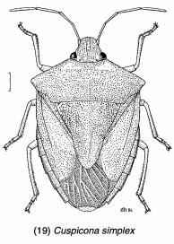
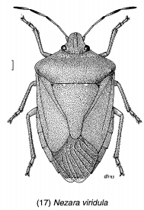
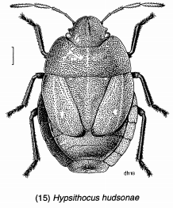
NZ Stinkbugs
Images by Des Helmore © Landcare Research (CC-BY 4.0)
Notes:
So we have predatory stink bugs, which are the 3 subspecies of cermatulus nasalis plus oechalia schellebergi. They feed mainly on the larvae of lepidoptera.
The rest are plant feeders. So we have Glucias, montiethiella, and dictoyotus caenosus, which are found in NZ and Australia, and some other countries in the pacific.
Then we have the cosmopolitan pest species, cuspicona simplex and nezara viridula.
And finally, hypsithocus hudsonae, an endemic alpine shield bug which we were lucky to find in central otago last December.

Slide 5
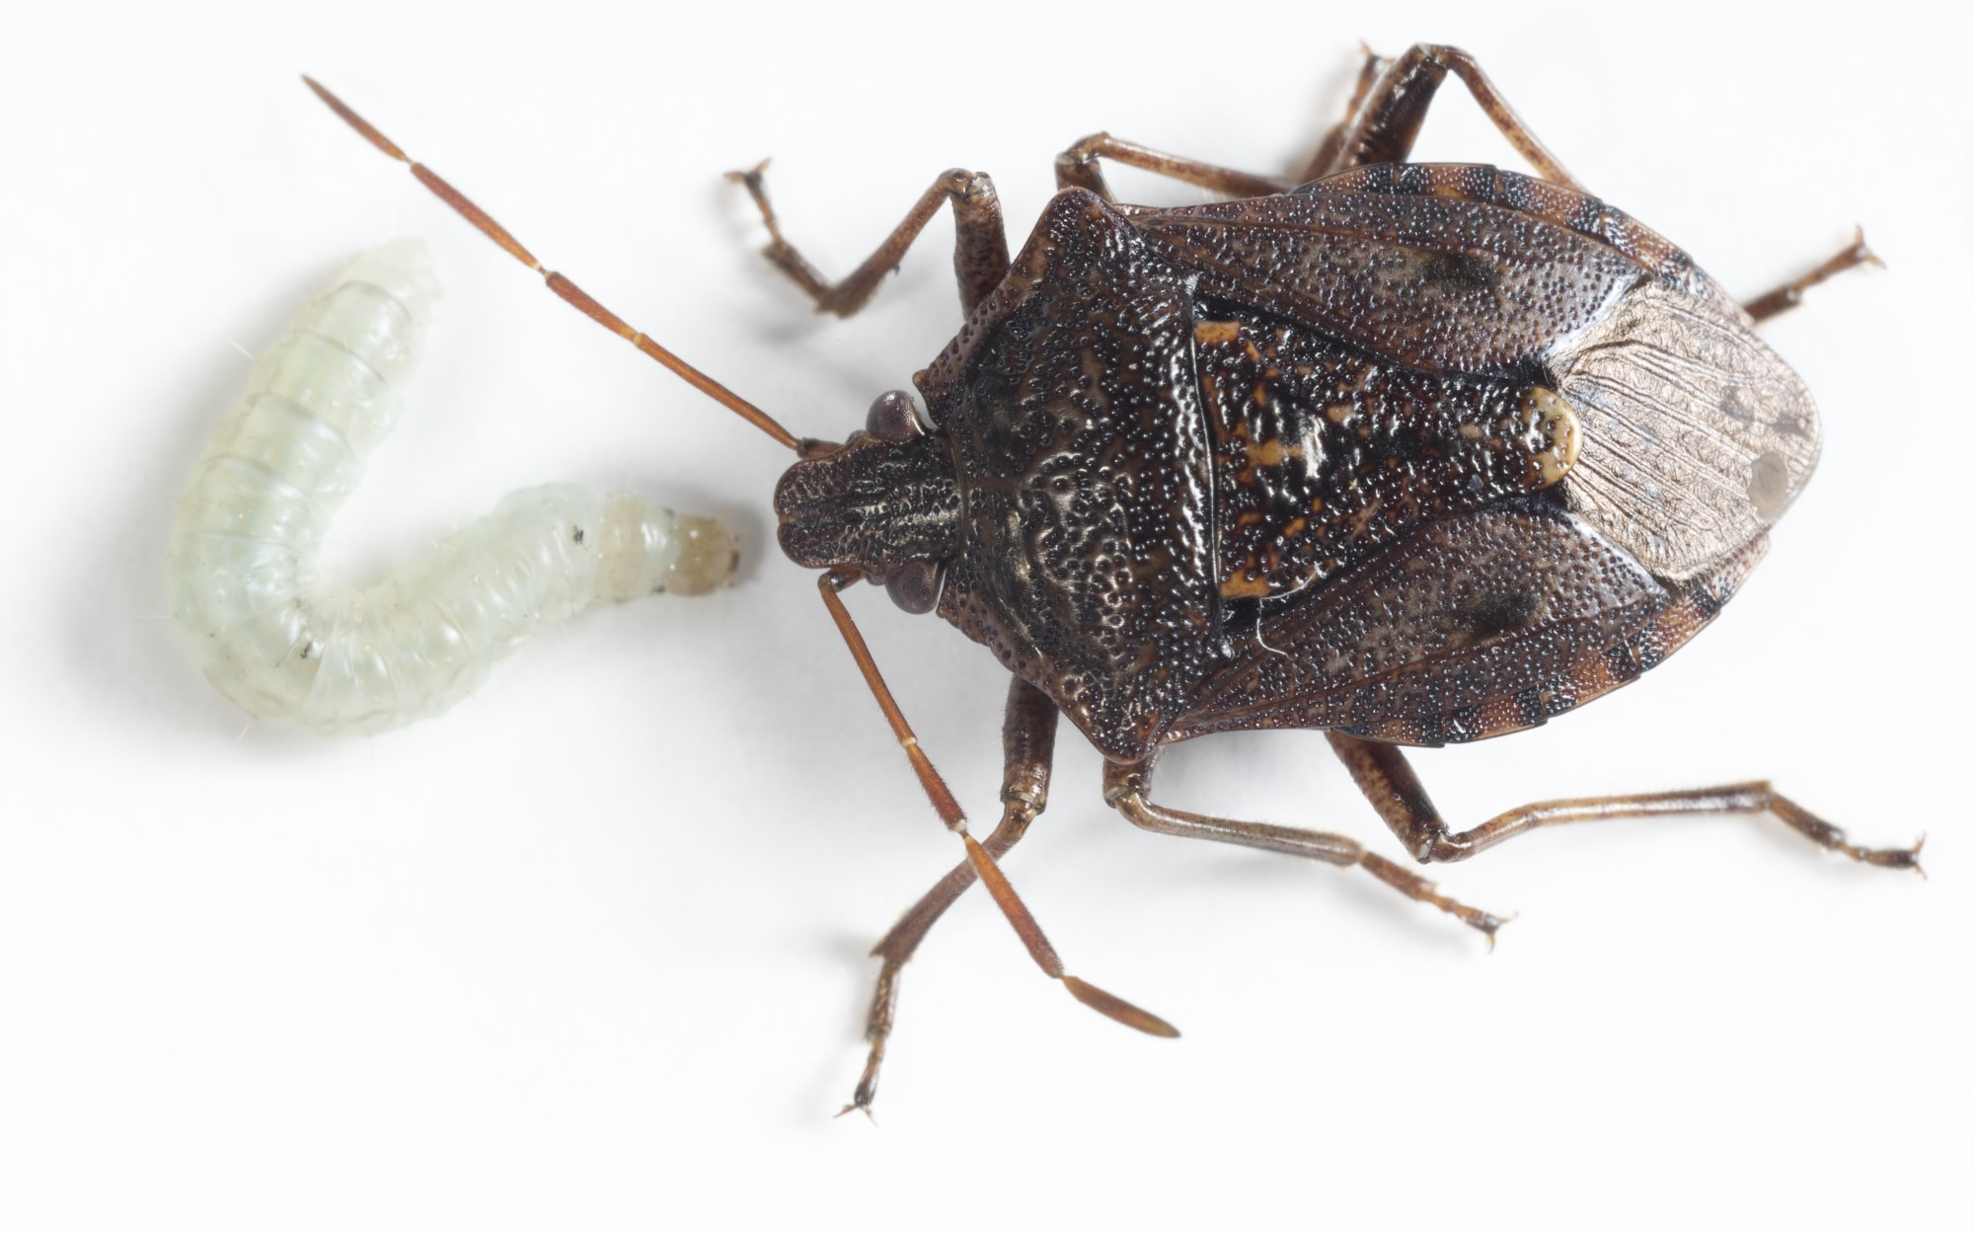
Aims
Will T. japonicus attack non-target stink bugs?
No-choice oviposition test
Y-tube olfactometer choice tests
Electrophysiology tests
Sentinel egg experiment
Rearing on NT hosts
Cermatulus nasalis nasalis
Image © Plant & Food Research
Notes:
The main aim is to understand the risk of non-target impacts on nz Pentatomidae as a result of releasing the samurai wasp against bmsb. Traditionally we would be focusing on the physiological host range, which is the group of species which are attacked by the biocontrol agent, and capable of supporting successful reproduction.
But the aim of my project is to go beyond that by looking at the ecological host range of the wasp, by which I mean the smaller group of species which are actually attacked under more natural field conditions. The ecological host range is smaller than the physiological host range, because under field conditions, a parasitoid will be exposed to a multitude of sensory cues which act like a filter to narrow down the species to a preferred set.
If you have a better understanding of the ecological host range then you have a far more accurate risk assessment of the biocontrol agent, which can help to reduce risky introductions or support less risky introductions.

Slide 6
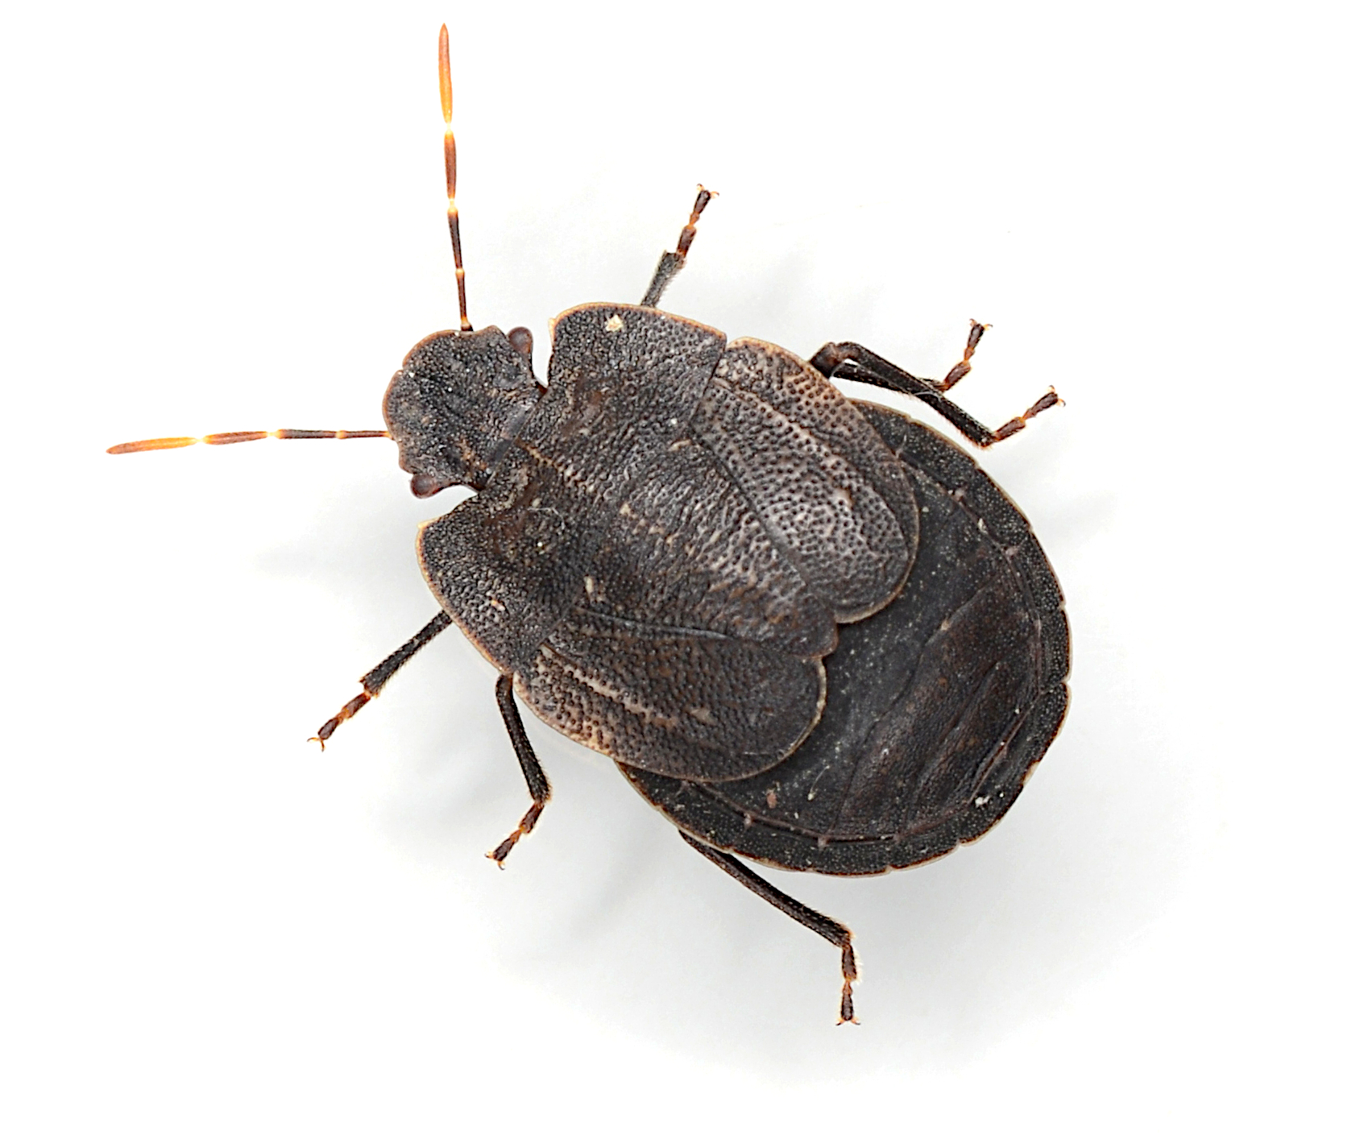
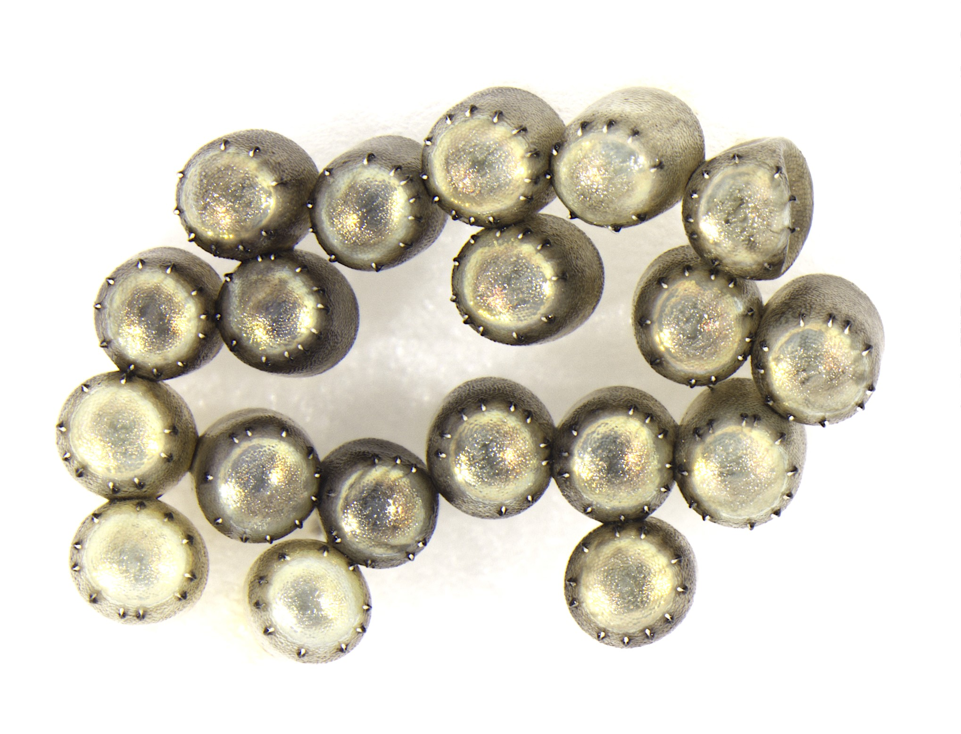
1) No choice
Physiological host test – Successful reproduction?
Confine eggs + wasp
Record behavior + emergence
Cermatulus nasalis hudsoni eggs
© Tom Saunders (CC-BY 4.0)
Hypsithocus hudsonae
Taken by Nick Martin © Plant & Food Research
Notes:
So the first part of my project is no-choice oviposition tests. These tests involve confining a parasitoid with a non-target egg mass and observing whether or not the parasitoid attacks and successfully develops in the eggs. This is a great way to quickly figure out a parasitoids physiological host range. I need to do this test with hypsithocus hudsonae.

Slide 7
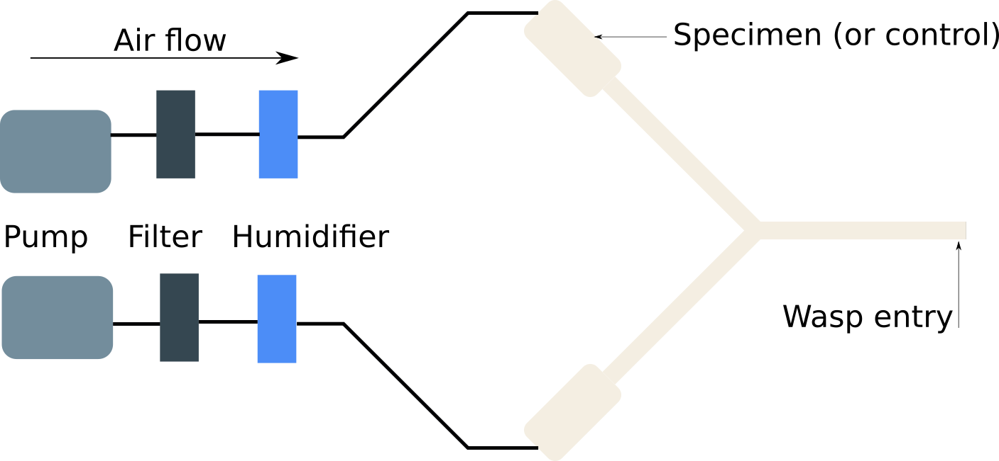
2) Y-tubes
Measure odor preferences
Flow rate, decision, duration, etc
Female adult + egg mass + host plant
Notes:
The second part involves using y-tube olfactometers. These are glass y-shaped tubes which humidified air is pumped through. In one of the chambers you have a non-target specimen, and in the other you have nothing, or you can have a diferent nt species. The wasp is placed in the other end and then you use certain criteria to decide which arm it has chosen.
I’m hoping to get some infertile bmsb egg masses to use as a positive control to copare the non-target tests.
But of course these things are never straight forward, you have to decide on the air flow rate, how a decision is defined, how long you give the wasp.

Slide 8
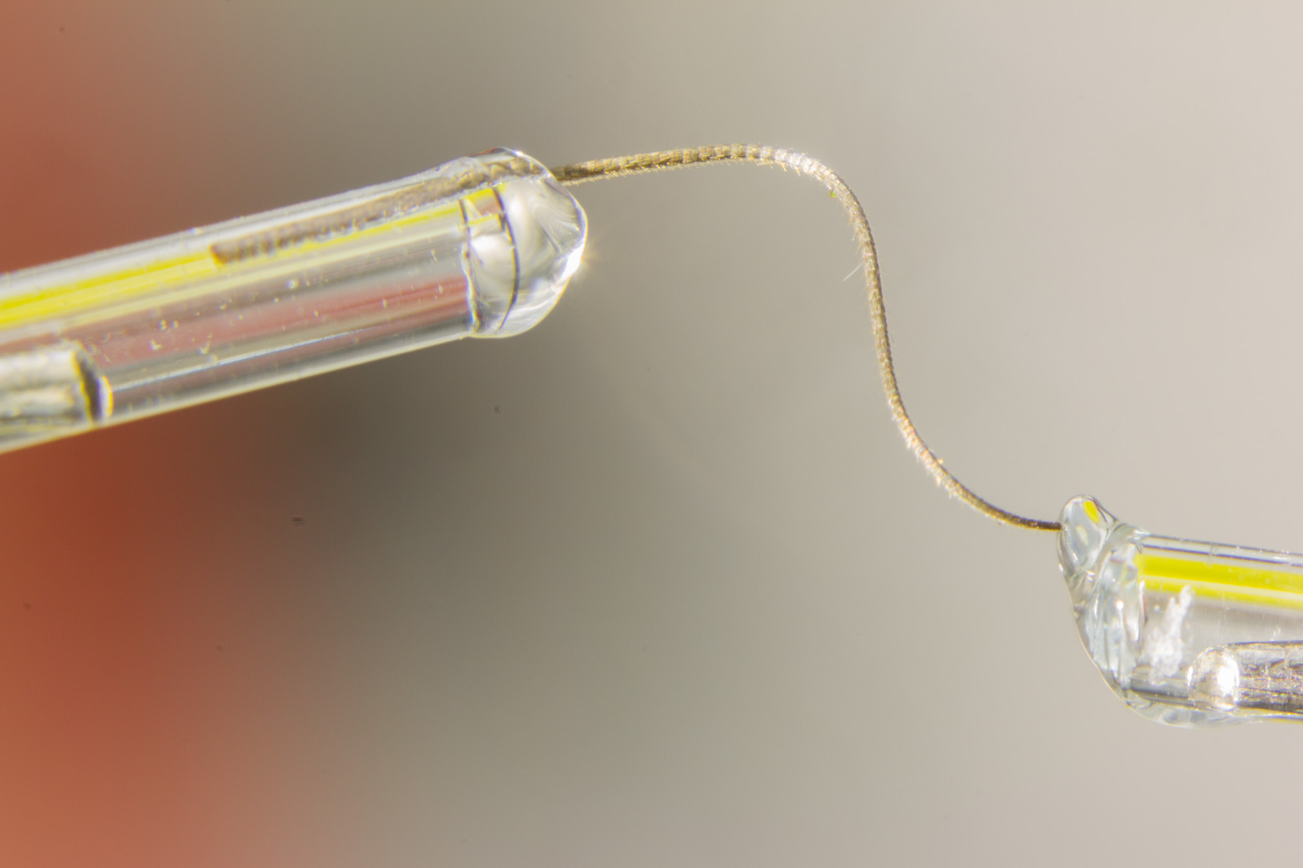
3) Electrophys.
GC-EAD: Which compounds elicit nervous response?
Do NZ stink bugs share compounds with BMSB?
Y-tube tests confirm response as attractive or repulsive
Notes:
The third part is electrophysiology. We can use a technique called coupled gas chromatography electroantennographic detection to figure outwhich individual compounds associated with stink bugs are interesting for the wasp. So first you wash the compounds off the body of the stink bug and inject the mixture into the GC. It heats up the mixture and fractions off each compound, which comes out of the machine at a different time. This flow of compounds is passed over the antennae of a wasp which is stuck between two electrodes. The neurons in the antennae fire in response to certain compounds, and this activity can be paired up with the exit of each compound.
So the idea is to see which individual compounds elicit activity, and then to use y tubes to figure out if the compound is attractive or repulsive. We can also see if any of these compounds are shared with BMSB or perhaps other preferred hosts.

Slide 9
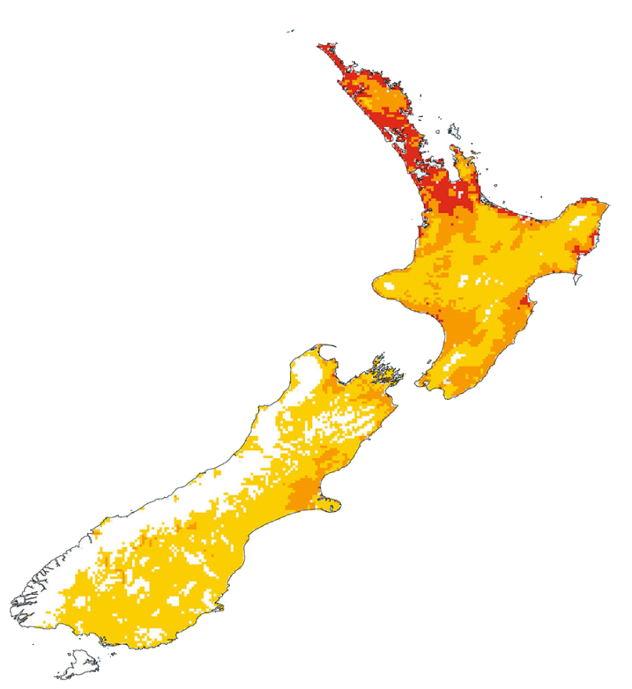
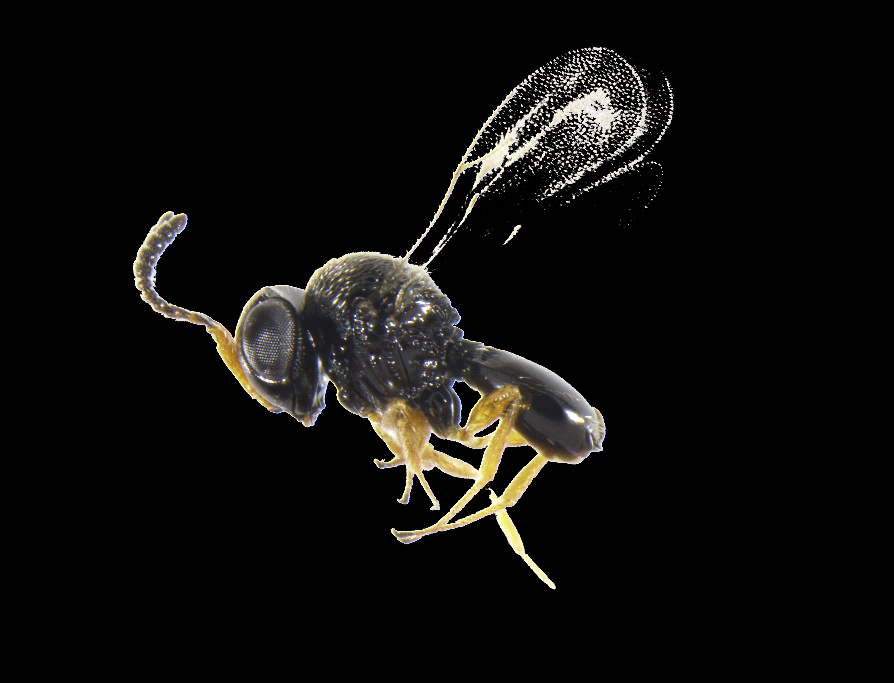
4) Sentinel eggs
T. basalis: An ecological homologue?
5x masses per site, ~15 sites
Measure attack rates on NT stinkbugs
Competition between the two?
Modified from Avila & Charles (2018)
doi.org/10/gdf4w8
(Article CC-BY 4.0)
Trissolcus basalis
Image © Tom Saunders (CC-BY 4.0)
Notes:
The fourth part of the project focuses on Trissolcus basalis, a species already present in NZ from the 1940s when it was imported to control green vegetable bug. I want to put out non-target stinkbug egg masses in the field and measure attack rates on these from Trissolcus basalis. Because Trissolcus basalis is closely related to the samurai wasp, it will give us an indication of the parasitism rates we could expect to see should the samurai wasp be introduced here. If attack rates are relatively high, then Trissolcus basalis would compete with the samurai wasp for non-target hosts which would lower the risk of impacts on these species from the samurai wasp.

Slide 10
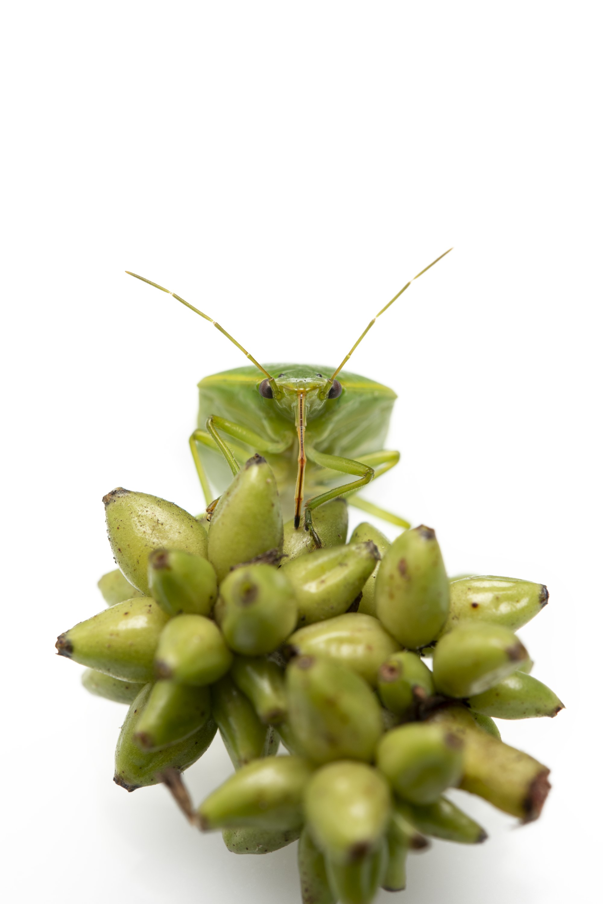
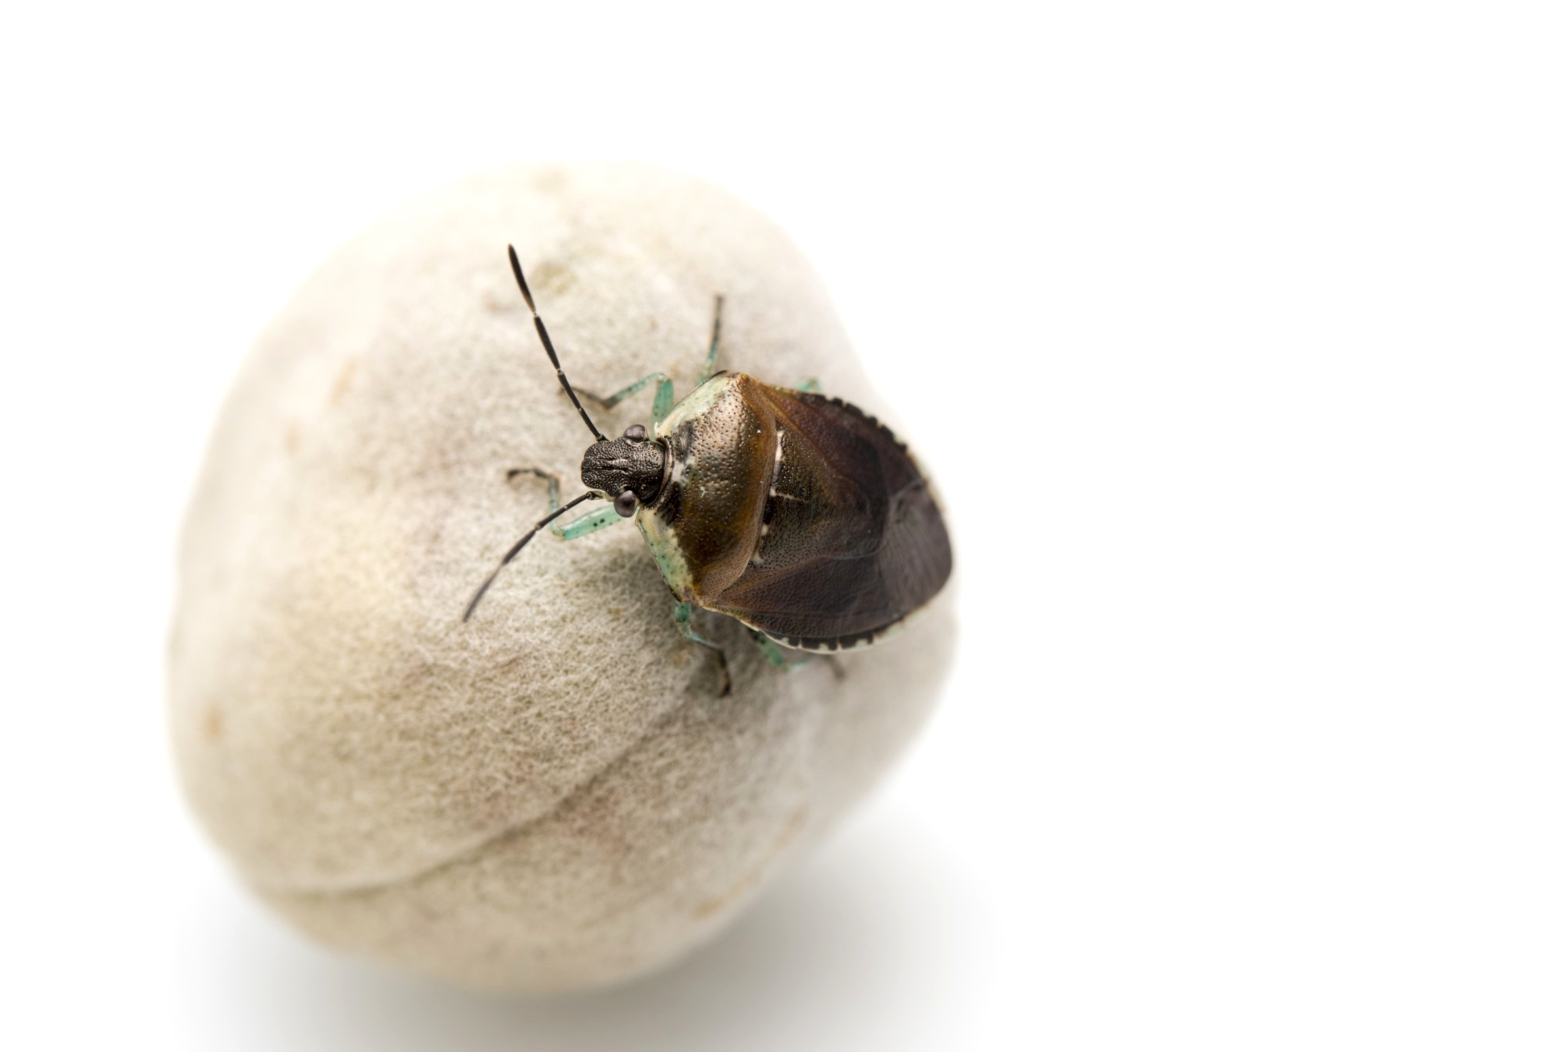
5) NT hosts
When T. japonicus is reared on non-target hosts:
Do its host preferences change, and how many generations does it take?
Are offspring less fit?
Is the sex ratio different?
Monteithiella humeralis
Image © Plant & Food Research
Glaucias amyoti
Image © Plant & Food Research
Notes:
The final part of the project centers around rearing the samurai wasp on non-target species. If we rear it on non-target nz stink bugs, what happen to the wasps host preferences, sex ratio, and reproductive success after a certain number of generations compared to a colony reared on bmsb eggs?
This has important practical implications for mass rearing the wasps for their ultimate release as biocontrol agents, but its also useful for understanding non-target impacts. If the wasp populations suffer fitness penalties then non-target hosts might be a dead end, and therefore long term impacts may be less likely.

Slide 11
Thanks!
How can I improve my project?
What haven’t I considered?
Get in touch
Blog: TomSaunders.co.nz
Twitter: @TomSaundersNZ
GregHolwell.com
@GonzaloAvilaNZ

