Slide 1
Okechukwu Okorie
Circularity: Bridging the Gap
Theme: Manufacturing

Slide 2
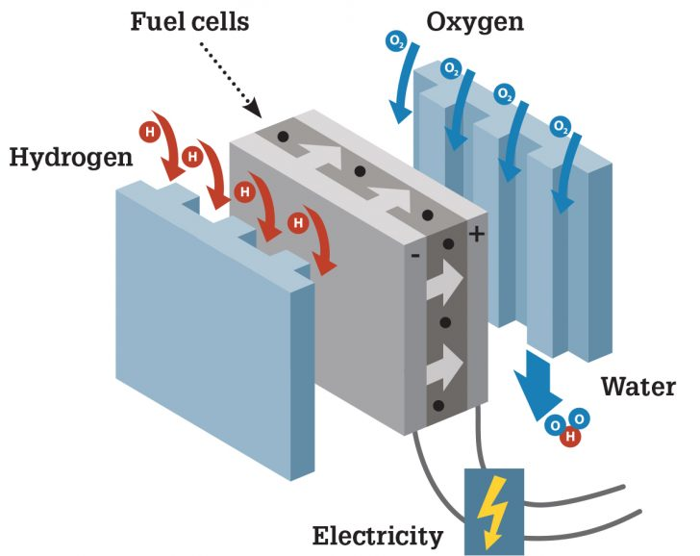
Circularity: Bridging the Gap
As Is: 9.1%
To Be: > 9.1%
© Circle Economy
Remanu-
facturing
Data-
Driven
Das et al, (2017)
THIS AREA OF YOUR SLIDE WILL BE COVERED BY A TIMER

