Slide 1
Uploading Data
How to use ZivaHub | Open Data UCT

Slide 2
Presented by Lesley Mostert
Department of Chemical Engineering, UCT
Academic Staff Meeting, 2018 November 02

Slide 3
also present Thomas King
from DLS (Digital Library Services)
to answer any super-technical questions

Slide 4
Disclaimer
This presentation does not deal with why one should upload data.
for the philosophy of open science and publication of data and the UCT and funder policies regarding this you can request another presentation

Slide 5
Basics

Slide 6
Start ZivaHub | Open Data UCT https://uct.figshare.com

Slide 7
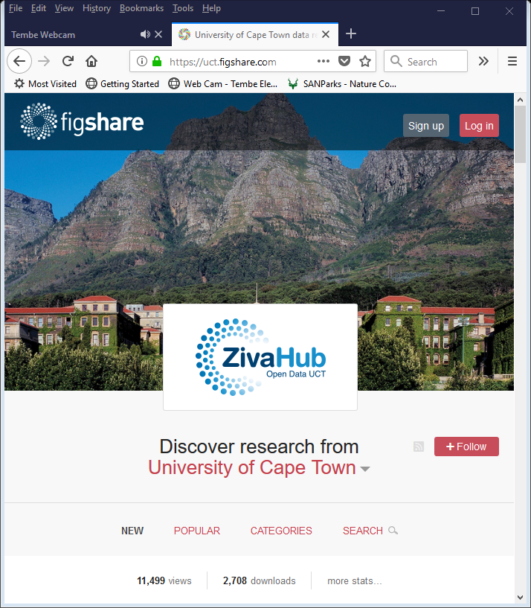
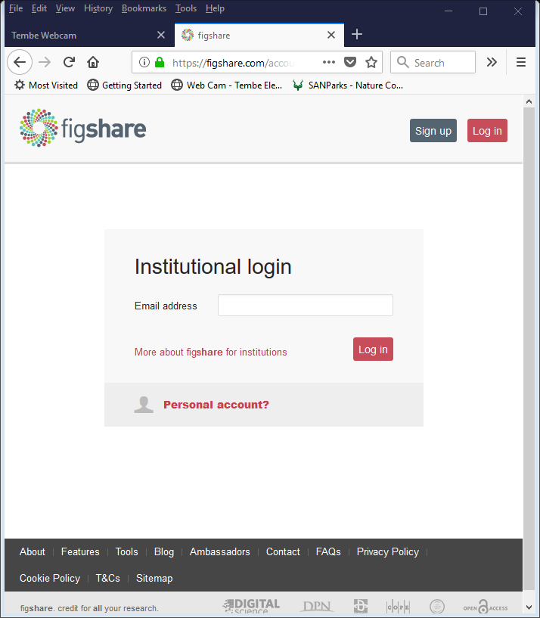
Log in to ZivaHub
X

Slide 8
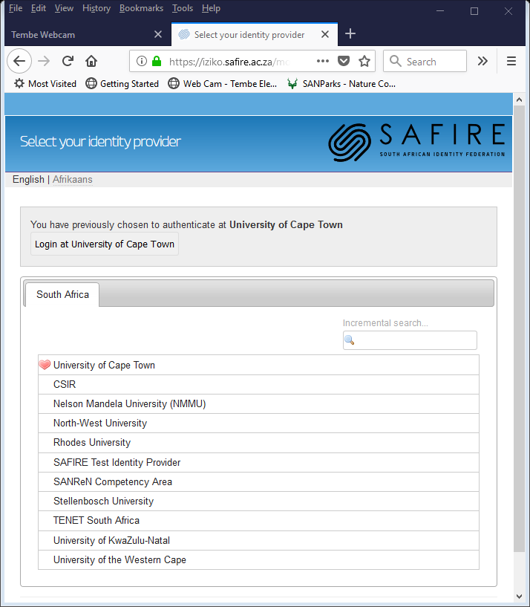
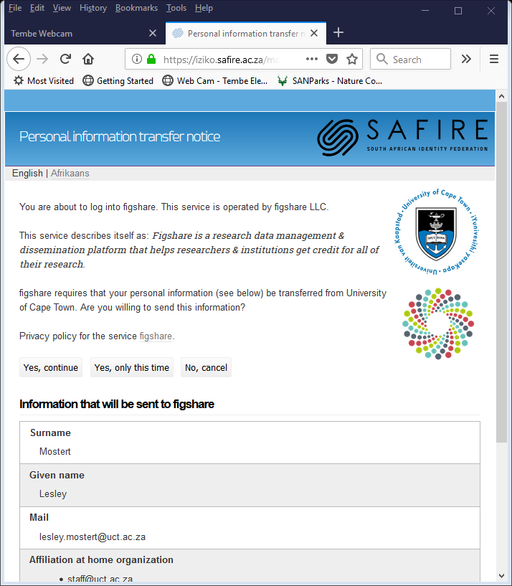
Log in to ZivaHub

Slide 9
your account is now active

Slide 10
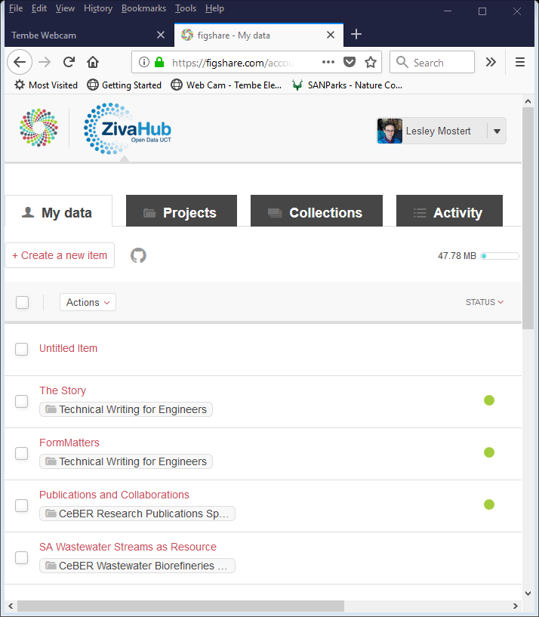
Edit your ZivaHub account
ALWAYS click “Save”

Slide 11
Explore ZivaHub | Open Data UCT https://uct.figshare.com

Slide 12
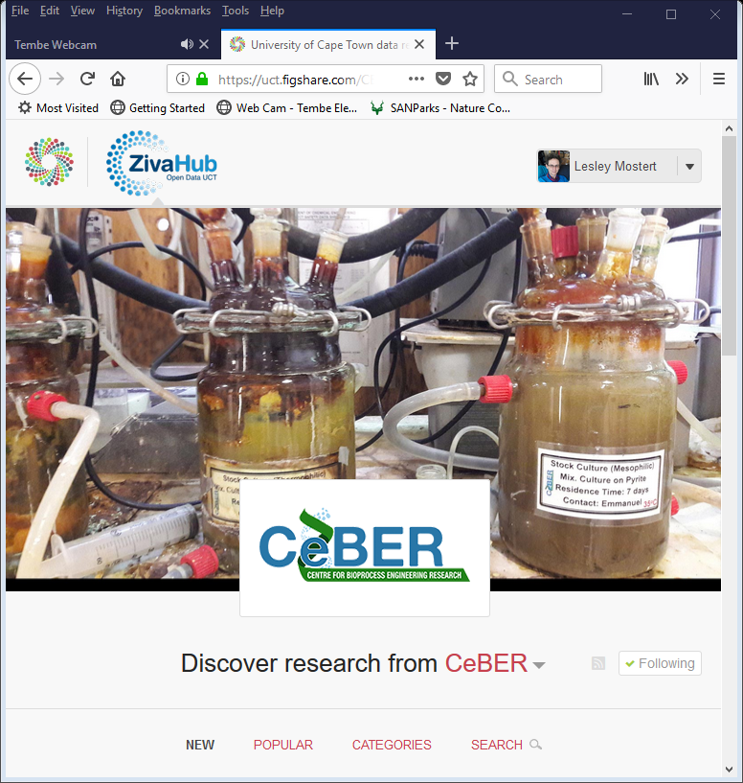
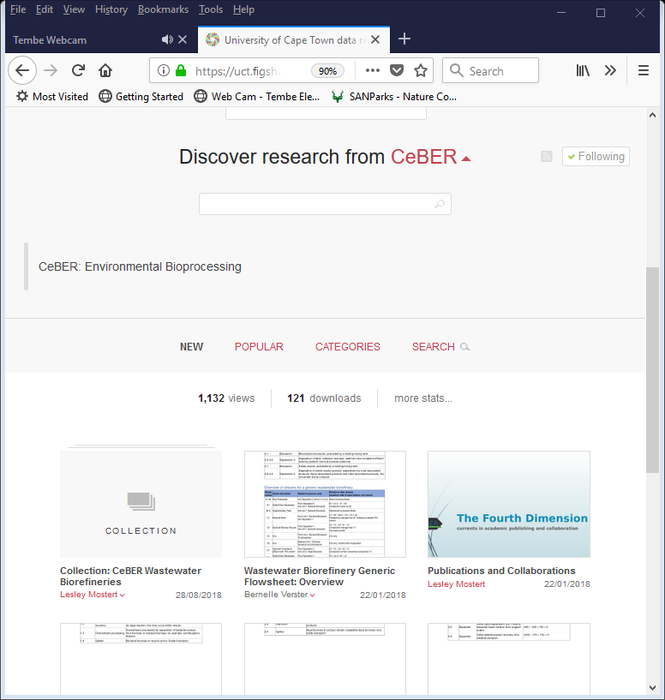
Faculties Departments and so on aka Groups and Subgroups

Slide 13
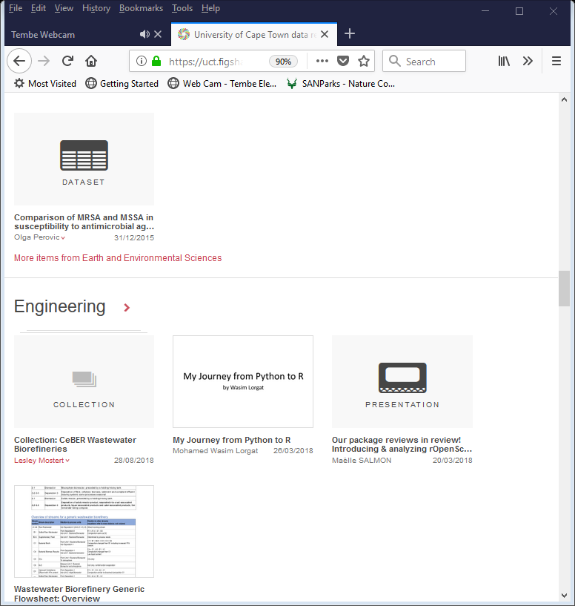
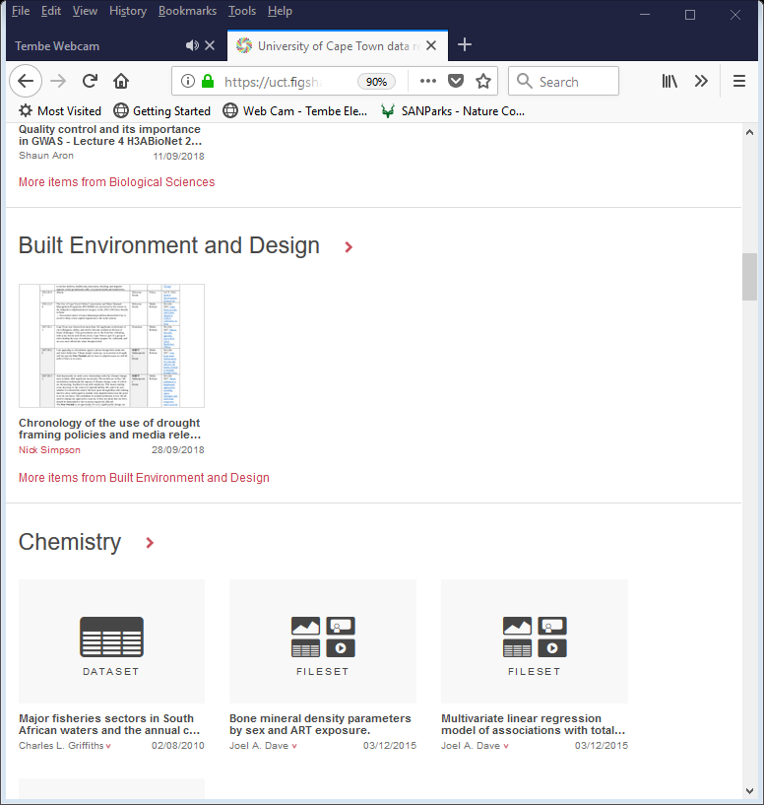
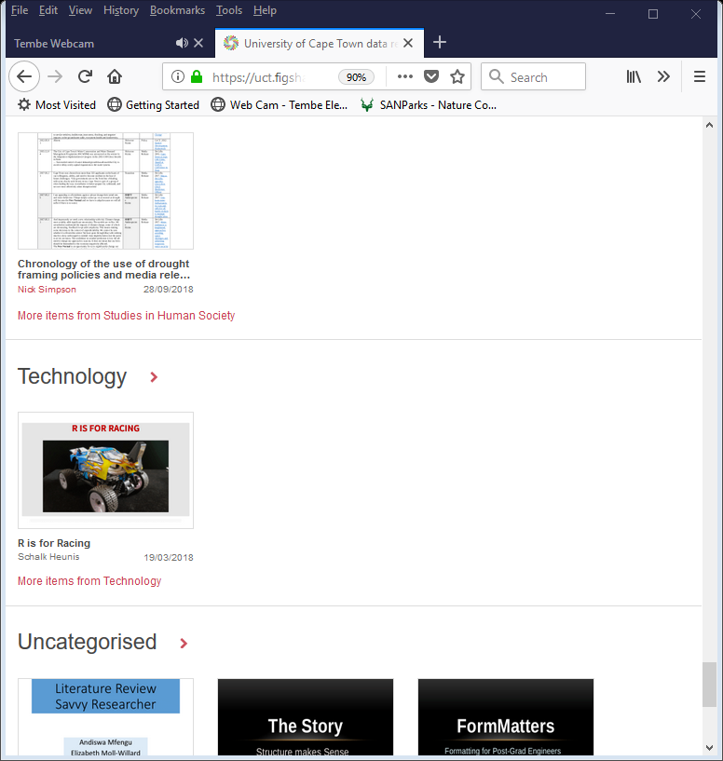
Metadata: Categories

Slide 14
what everyone is reading

Slide 15
Upload ZivaHub | Open Data UCT https://uct.figshare.com

Slide 16
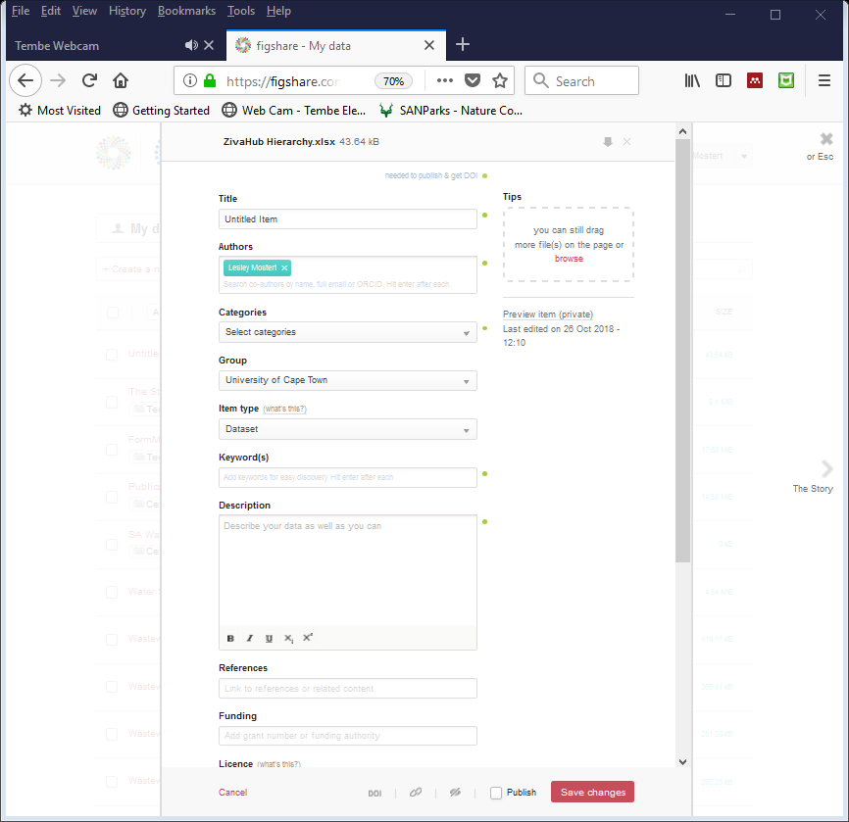
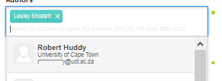
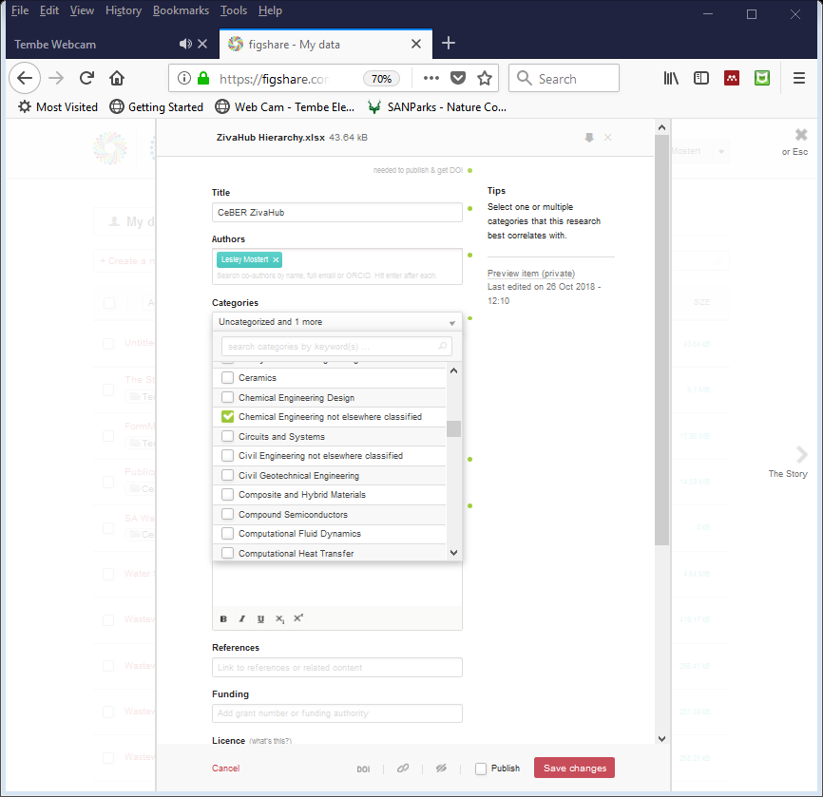
+ Create a new item
add metadata
start typing - enter
rearrange order
drag file
Australian and New Zealand Standard Research Classification (ANZSRC)
http://www.abs.gov.au/AUSSTATS/abs@.nsf/DetailsPage/1297.02008?OpenDocument

Slide 17
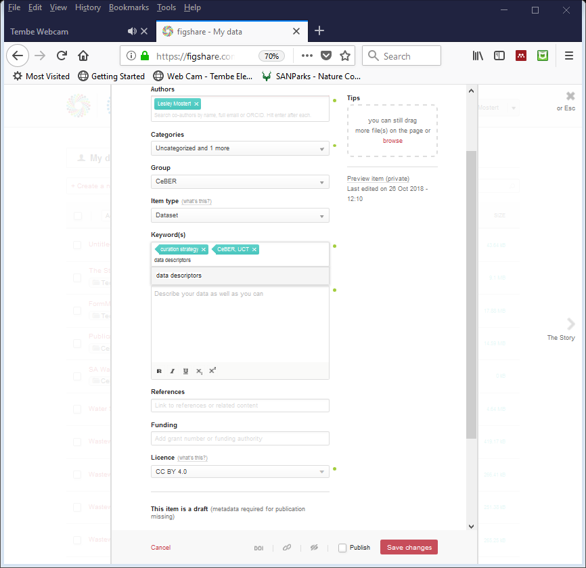
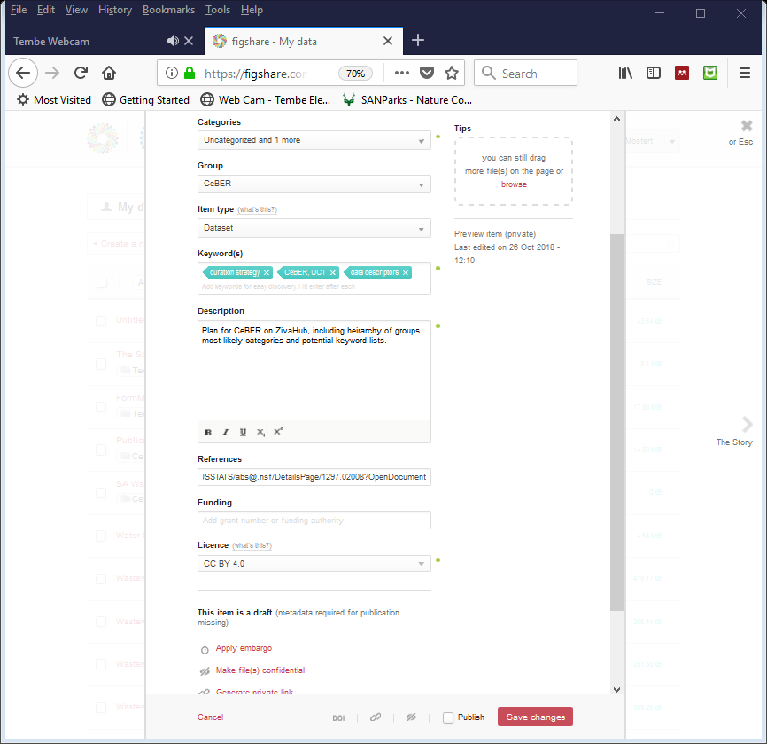
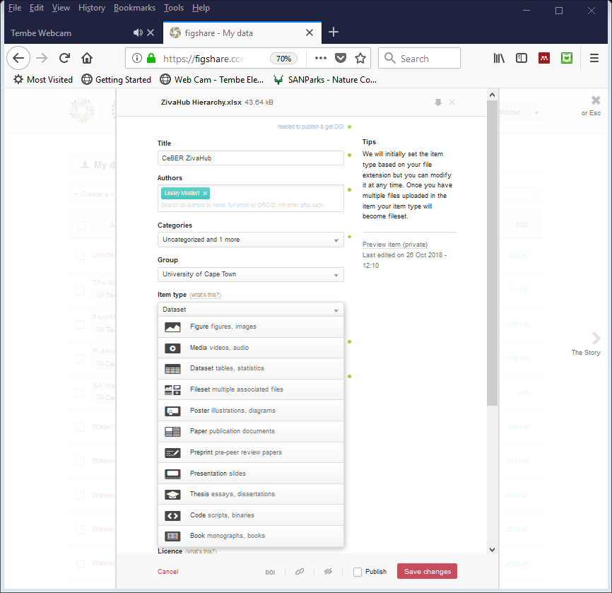
+ Create a new item
add metadata

Slide 18
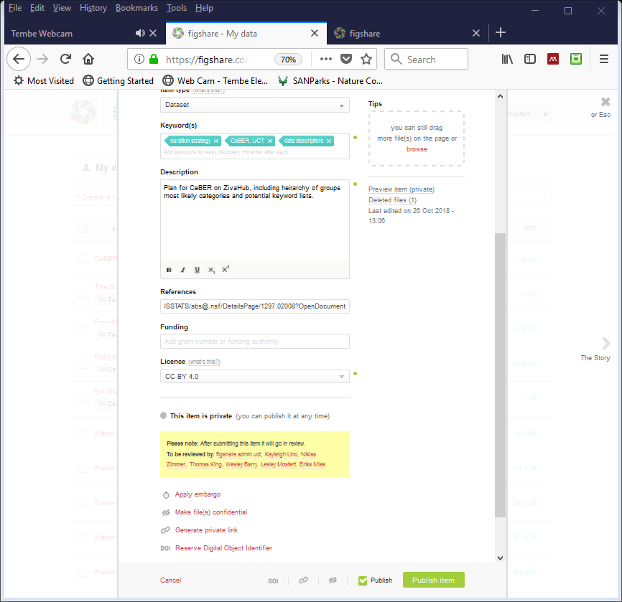
+ Create a new item
always save

Slide 19
Beyond Basics

Slide 20
Items ZivaHub | Open Data UCT https://uct.figshare.com

Slide 21
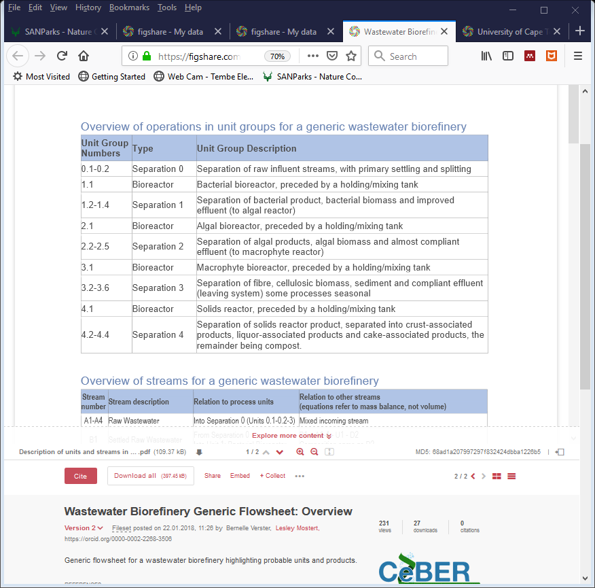
Item = Fileset + Metadata

Slide 22
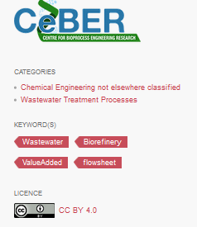
Item = Fileset + Metadata

Slide 23
Projects ZivaHub | Open Data UCT https://uct.figshare.com

Slide 24
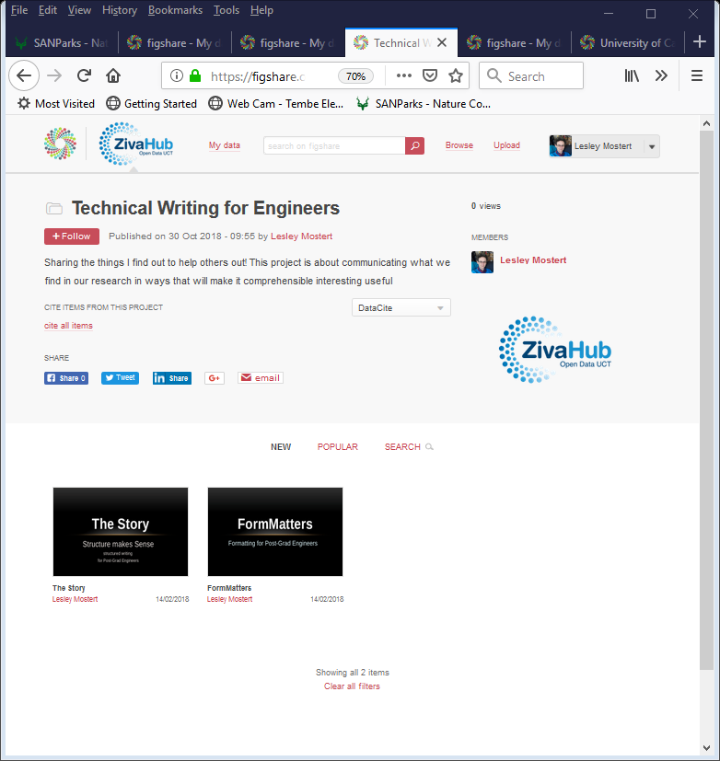
Projects:
multiple items
collaborators
can follow
can cite items

Slide 25
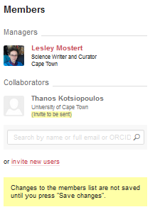
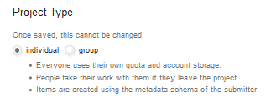
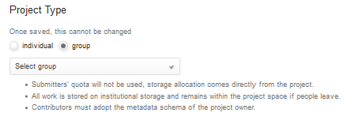
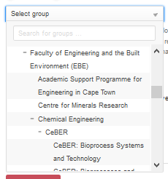
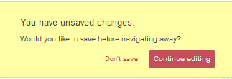
+ Create a new project

Slide 26
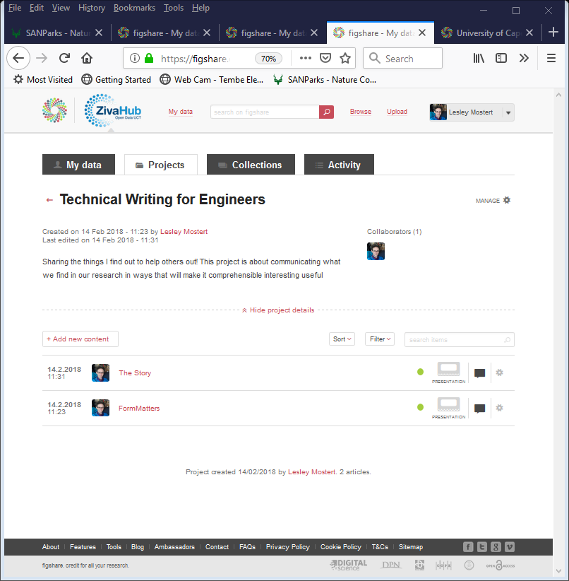
manage a project
public view
owner view

Slide 27
Collections ZivaHub | Open Data UCT https://uct.figshare.com

Slide 28
Collections
multiple items
from anywhere on figshare
can follow
can cite

Slide 29
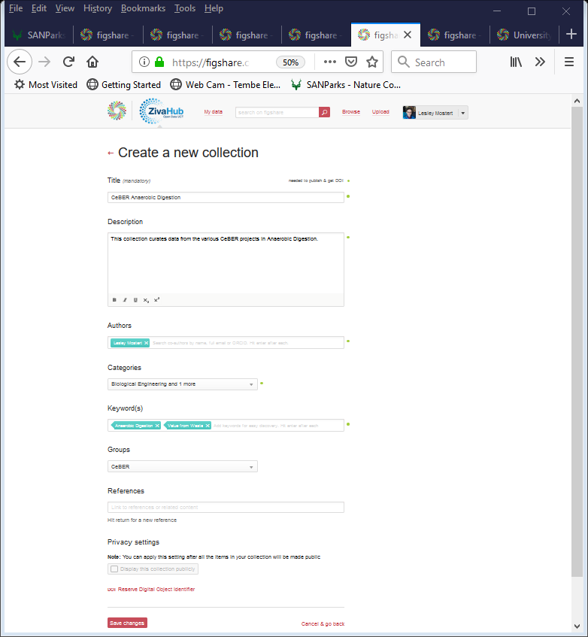
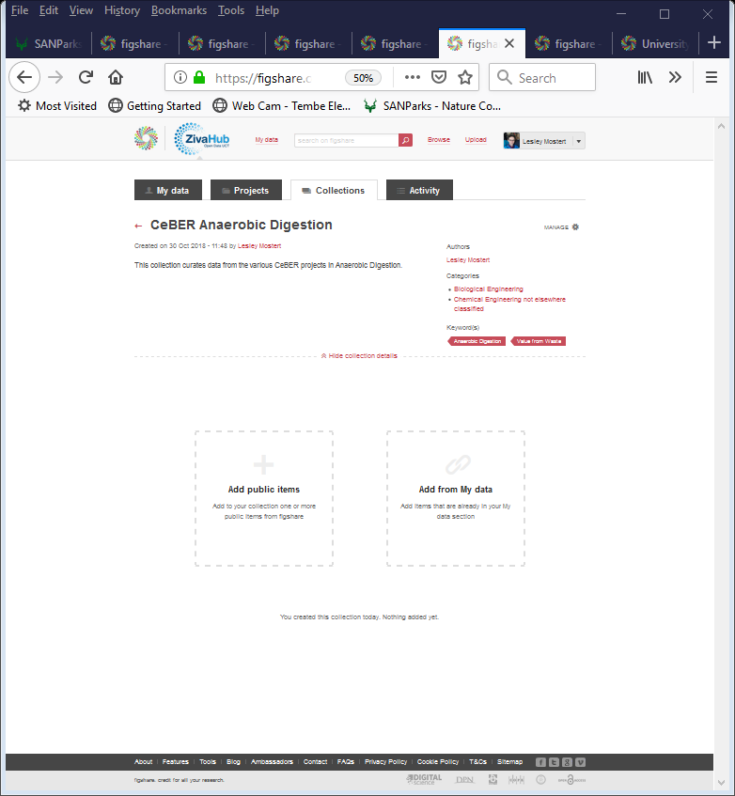
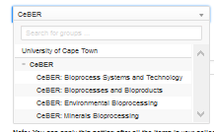
+ Create a new collection

Slide 30
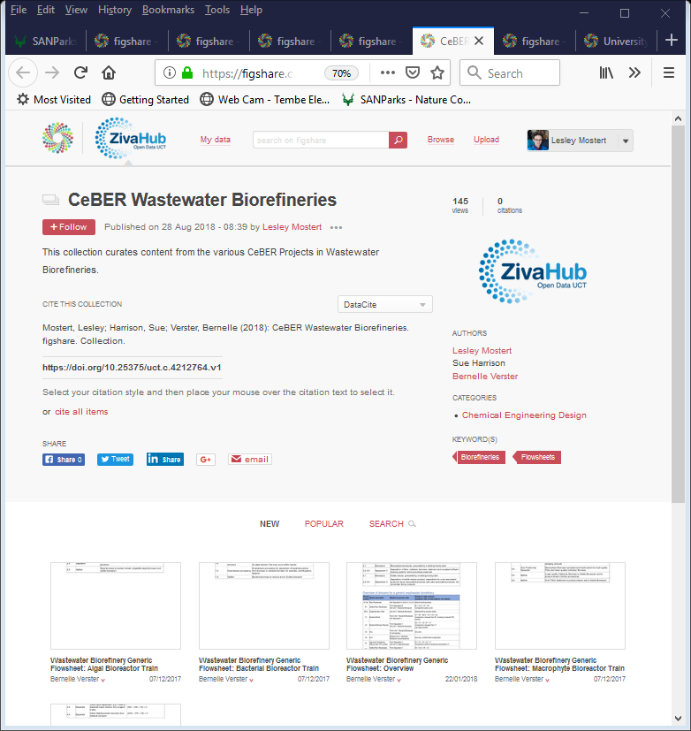
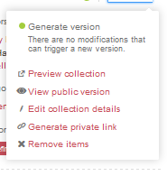
manage a collection
public view
owner view

Slide 31
Behind Basics

Slide 32
data
this is much more complex than you think

Slide 33
FAIR principles
To be Findable:
F1. (meta)data are assigned a globally unique and eternally persistent identifier. F2. data are described with rich metadata. F3. (meta)data are registered or indexed in a searchable resource. F4. metadata specify the data identifier.
TO BE ACCESSIBLE:
A1 (meta)data are retrievable by their identifier using a standardized communications protocol. A1.1 the protocol is open, free, and universally implementable. A1.2 the protocol allows for an authentication and authorization procedure, where necessary. A2 metadata are accessible, even when the data are no longer available.
TO BE INTEROPERABLE:
I1. (meta)data use a formal, accessible, shared, and broadly applicable language for knowledge representation. I2. (meta)data use vocabularies that follow FAIR principles. I3. (meta)data include qualified references to other (meta)data.
TO BE RE-USABLE:
R1. meta(data) have a plurality of accurate and relevant attributes. R1.1. (meta)data are released with a clear and accessible data usage license. R1.2. (meta)data are associated with their provenance. R1.3. (meta)data meet domain-relevant community standards.
https://www.force11.org/group/fairgroup/fairprinciples

Slide 34
meta-data type 1

Slide 35
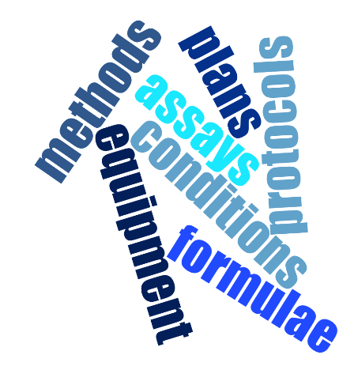
meta-data type 2

Slide 36
raw data
actual readings

Slide 37
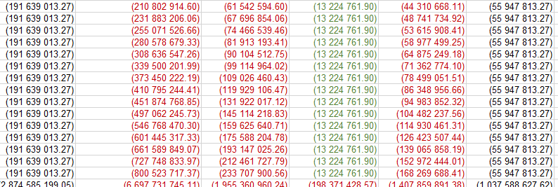
worked data
converted
calculated
collated
connected
extracted

Slide 38
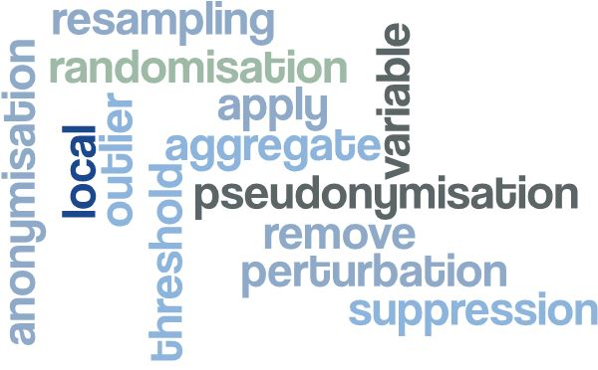
protected data

Slide 39
decisions
some things must be considered carefully

Slide 40
1. Data for Theses ZivaHub | Open Data UCT https://uct.figshare.com a suggestion
may need DLS
to collections in each group
Items with thesis data

Slide 41
Data for Theses ZivaHub | Open Data UCT https://uct.figshare.com a suggestion
thesis hand in
data prep & upload
correct thesis

Slide 42
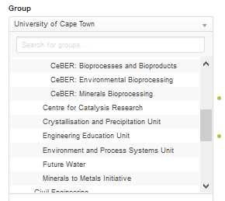
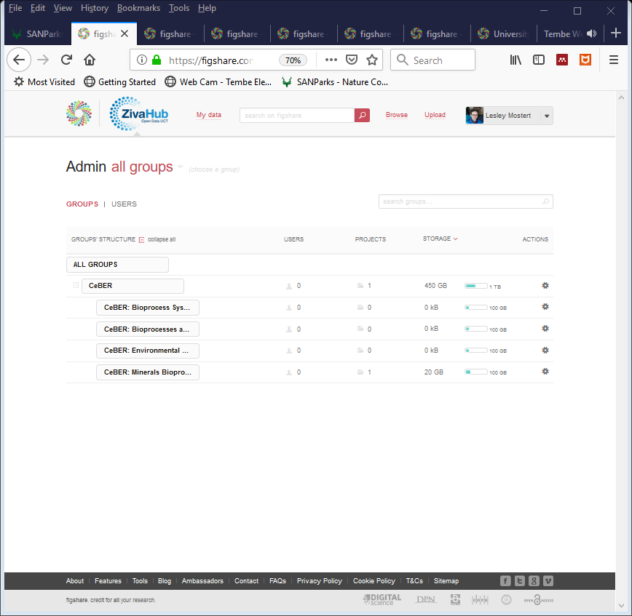
2. Groups ZivaHub | Open Data UCT https://uct.figshare.com

Slide 43
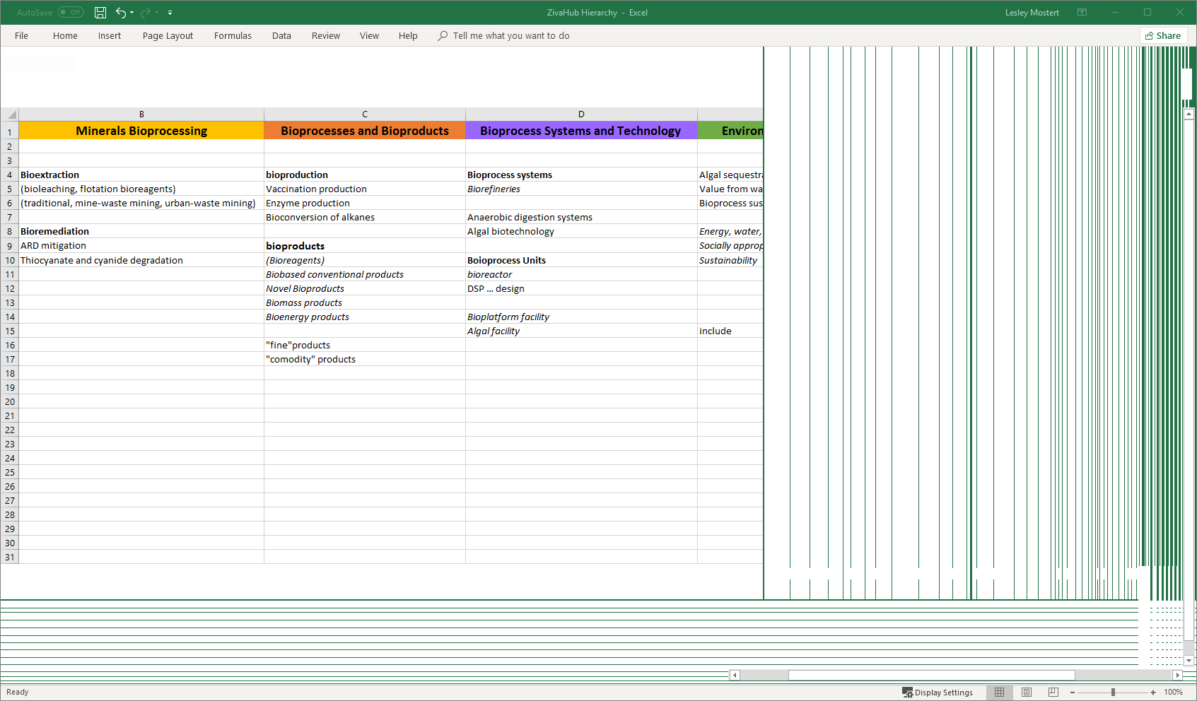
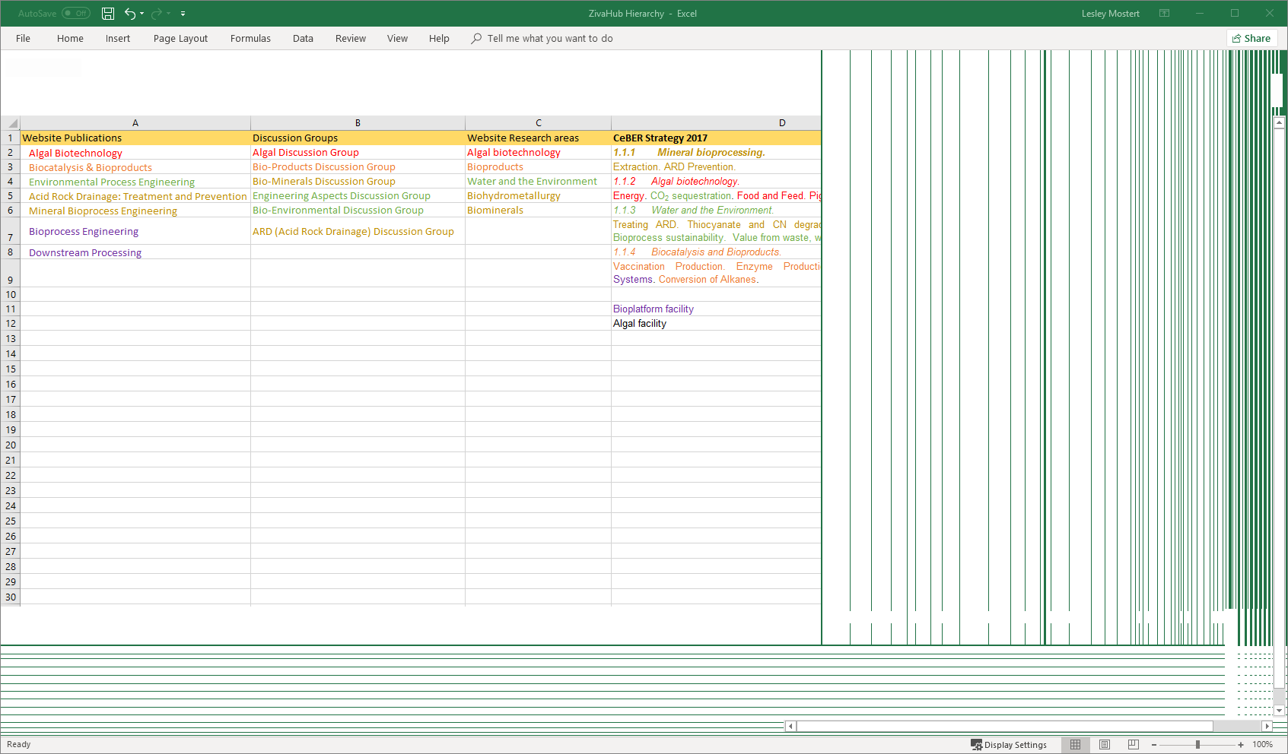
Groups ZivaHub | Open Data UCT https://uct.figshare.com

Slide 44
3. ZivaHub vs OpenUCT ZivaHub | Open Data UCT https://uct.figshare.com
OpenUCT
if it already has a doi
journal articles
conference papers
book chapters
ZivaHub
if it doesn’t have a doi yet
datasets
diagrams
conference presentations
conference posters
items which you may want to make separately accessible - be careful of copyright
suggestion

Slide 45
3. Other ZivaHub | Open Data UCT https://uct.figshare.com
project report
thesis
article
overlapping datasets
huge datasets
student access
Big Data
special arrangements with eResearch

Slide 46
Useful links
http://www.digitalservices.lib.uct.ac.za/dls/rdm-policy
https://mantra.edina.ac.uk/
http://www.dcc.ac.uk/
https://dmp.lib.uct.ac.za/

