Slide 1
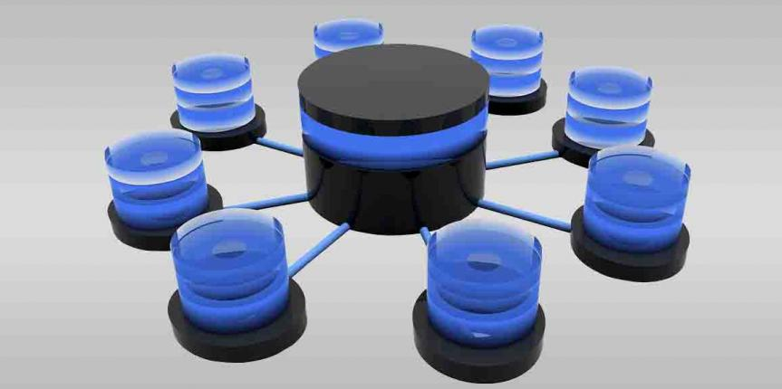
NRF CV Central

Slide 2
What is CV Central?
Scopus
NRF Submission
CV
Central
ORCID
University
It is not only about the NRF!!!
Notes:
WE chose CV for their benefit because biggest frustration

Slide 3
CV Central Architecture
UCT Converis
NRF Submissions
ORCID
SCOPUS
Other Institutions
Staging Area
Staging Area
Staging Area
ORCID
Interface
SCOPUS Interface
ORCID
SCOPUS
Staging Area / API
Staging Area / API
National ACCESS!!
CVC Web Services
Notes:
EG UCT Converis keeping NRF required fields in mind in customising Converis and Integrating with CVC to ensure minimum manual intervention.
Add slide circle before Arch image

Slide 4
CV Central Architecture
UCT Converis
NRF Submissions
ORCID
SCOPUS
Other Institutions
Staging Area
Staging Area
Staging Area
ORCID
Interface
SCOPUS Interface
ORCID
SCOPUS
Staging Area / API
Staging Area / API
CVC Web Services
System: A
System: B
System: C
System: D
System: E
Converis
Submissions
ORCID
Scopus
Other Institutions
Staging Area
XML or JSON
Staging Area
XML or JSON
Staging Area
XML or JSON
Staging Area
XML or JSON
Staging Area
XML or JSON
CVC Data Base
1A - Record 1 System A
1B - Record 1 System B
1C - Record 1 System C
1D - Record 1 System D
1E - Record 1 System E
1F (ABCDE) –Most comprehensive version of Record 1
CV Algorithm
Notes:
EG UCT Converis keeping NRF required fields in mind in customising Converis and Integrating with CVC to ensure minimum manual intervention.
Add slide circle before Arch image

Slide 5
Value of CV Central
To universities and researchers
Simplified integration – ORCID, Institutional repositories etc
Latest CV data available for researcher profile systems
Reduce duplication of effort
To the NRF
Simplified CV management as well as grant and rating application processes
Limited manual CV updates
Integration between systems

Slide 6
CV Central Current and Future Developments
Phase 1
Develop a CV database
Include a set of fields
Integrate with ORCID
Integrate with NRF Submissions
Demonstrate integration with 1 university
Integrate with Scopus
Phase 2
Integrate with other universities
Develop Font End
Develop BI reporting layer
ORBIT
Phase 3
Integrate with other bibliometric databases

Slide 7
Thank You

