Slide 1
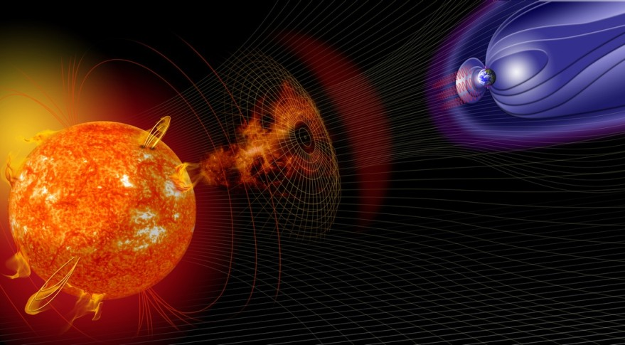










Space weather and the Magnetometer Network for Ireland (MagIE)
Geoscience 2018
Meeting the Challenges
Dr. Joan Campanyà i Llovet
Prof. Peter T. Gallagher
Dr. Seán P. Blake

Slide 2
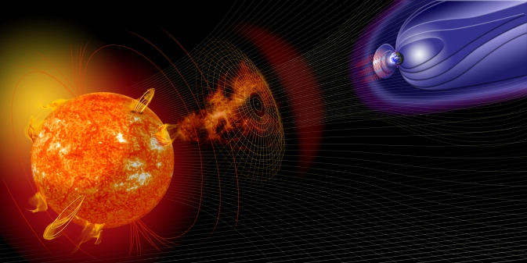
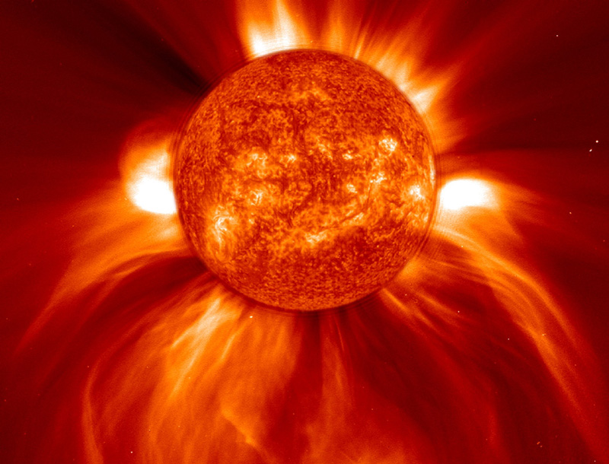
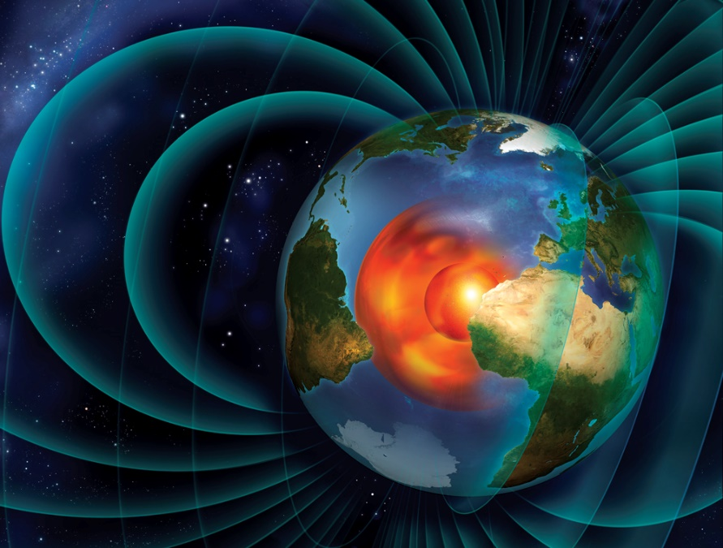
What is Space Weather?
NASA
Roen Kelly illustration
The Sun is the main source of time varying conditions in the solar system
We want to understand and constrain how the Earth react to Space Weather, and how this affects technology

Slide 3
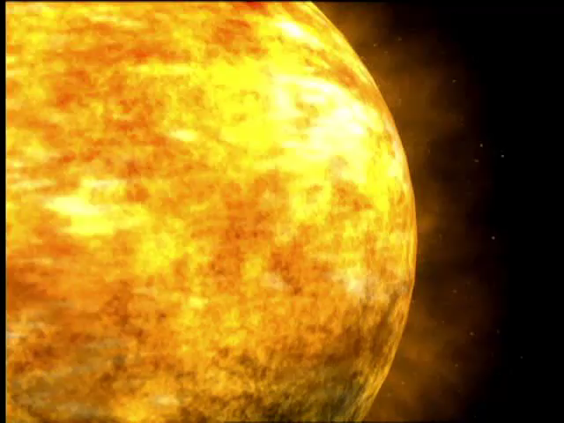
Video
from NASA

Slide 4
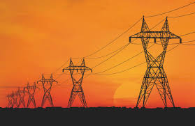
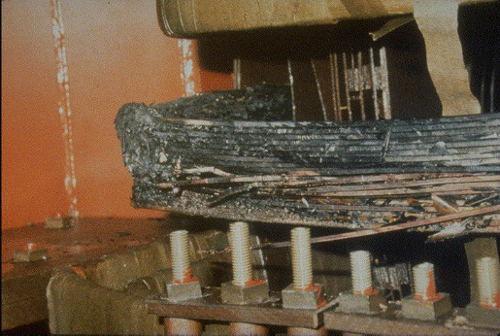
Space Weather as a Geohazard
Power Grids, Surveying and Drilling
Impact Power blackouts and damage to infrastructure and positioning errors
Examples
  Quebec Canada, 1989
  New Zealand, 2001
  South Africa, 2003
Extreme geomagnetic storms
  Carrington event 1859
  Evaluation of costs in the US now-a-days: 1-2 trillion € (Lloyd’s of London(2013))
Any evidence of large solar storms in recent years?
  Extreme solar storms in 2012, and 2017

Slide 5
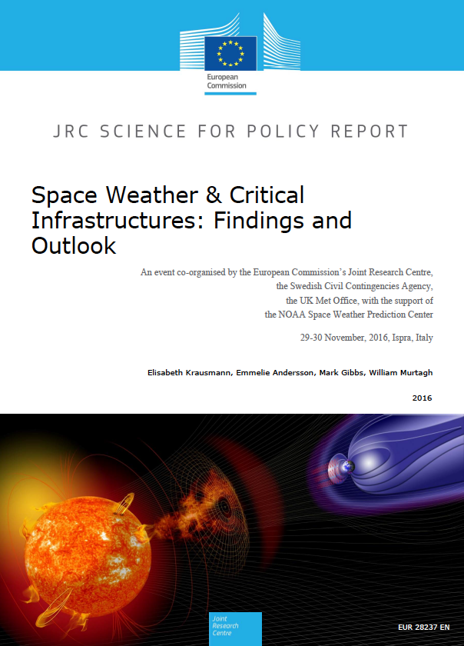
Risk
European Commission
Space Weather & Critical Infrastructures: Findings and Outlook,
JRC Science for Policy Report, 2016.
Main conclusions include
Extreme space weather event could overwhelm a single nation´s response capacity.
Some countries have recognized the thread of extreme space weather and have included in their strategic national risk assessment.
Significant knowledge gaps in physical and impact modeling persist. These gaps strongly affect early-warning capabilities and preparedness in industry.
Better communication between science and industry is needed to provide relevant, reliable and usable information to operators for decision making

Slide 6
Risk
UK national Risk Register of Civil Emergencies (2017)
Hazards, diseases, accidents, and societal risks
Space weather together with:
Emerging infectious disease
Heat wave
Poor air quality

Slide 7
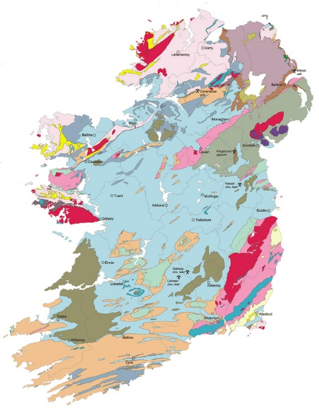
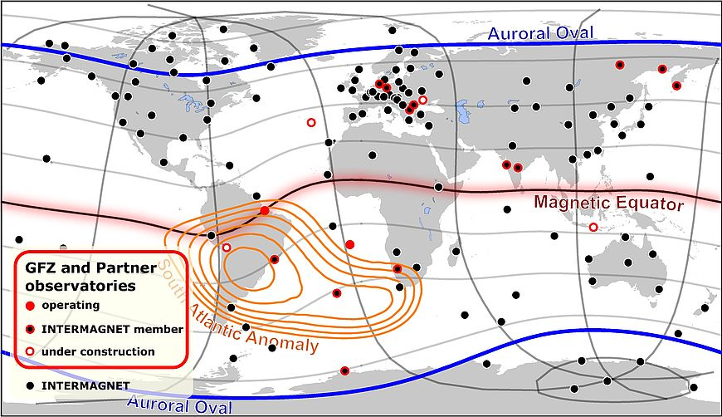
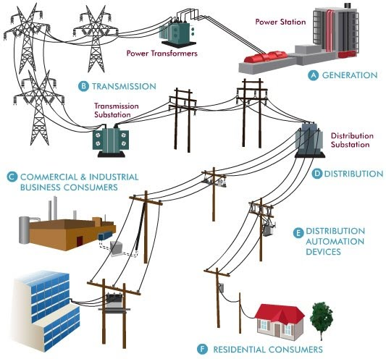
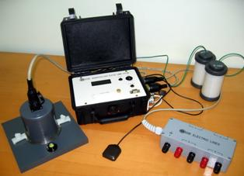
Understanding Space Weather effects
Geoelectric Fields
(Earth´s repsonse to
magnetic field variations)
Topology of the
power grid
elements
Magnetic field
variations
GFZ
GSI
LCISR
venturebeat
Magnetotelluric
Geophysical
Surveys
Magnetic Observatories
(e.g. INTERMAGNET)
Collaboration
with Industry

Slide 8
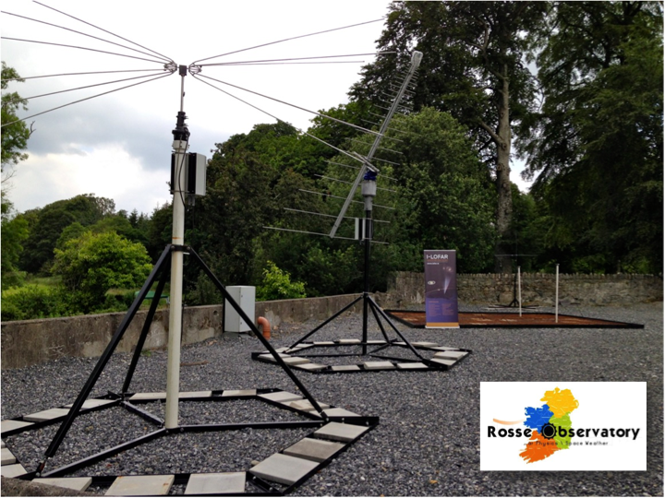
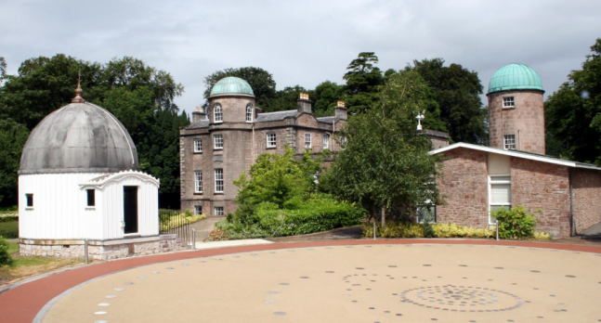
Understanding Space Weather effects
Irish Magnetometer Network
Valentia (VAL)
Birr (Bir)
Armagh (Arm)

Slide 9
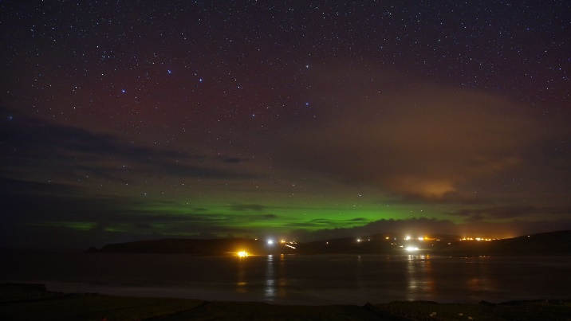
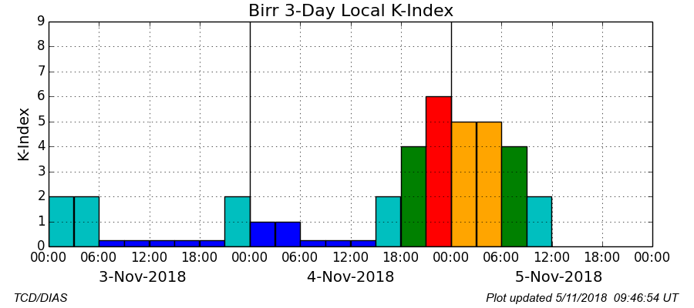
Understanding Space Weather effects
Irish Magnetometer Network
Valentia (VAL)
Birr (Bir)
Armagh (Arm)
Mayo
e-mail notifications

Slide 10
Understanding Space Weather effects
Geoelectric Fields in Ireland
SWEMDI
Space Weather Electromagnetic
Database for Ireland
Old LMT site
New LMT site
Magnetic observatory
Data available from
www.gsi.ie in 2019
Funded by GSI (Short call 2017)

Slide 11
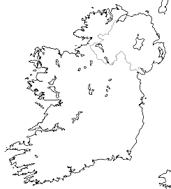
Understanding Space Weather effects
Geoelectric Fields in Ireland
SWEMDI
Space Weather Electromagnetic
Database for Ireland
Old LMT site
New LMT site
Magnetic observatory
Log10
[Ω·m]
(Preliminary Results)
0
1
2
3

Slide 12
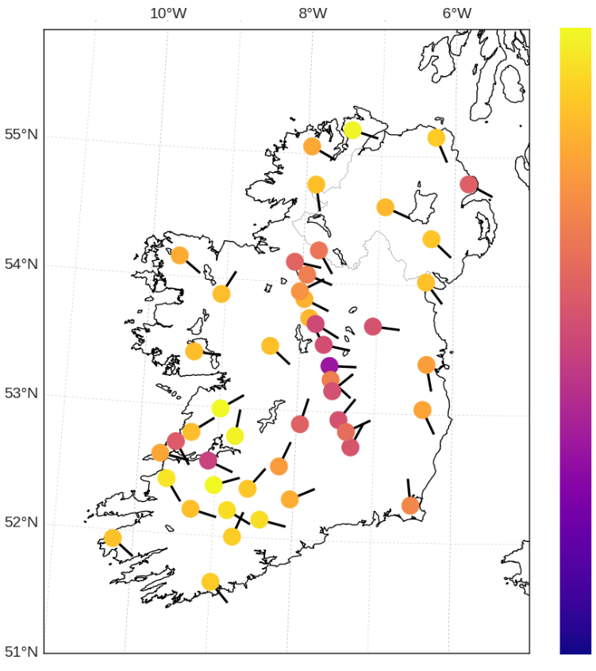
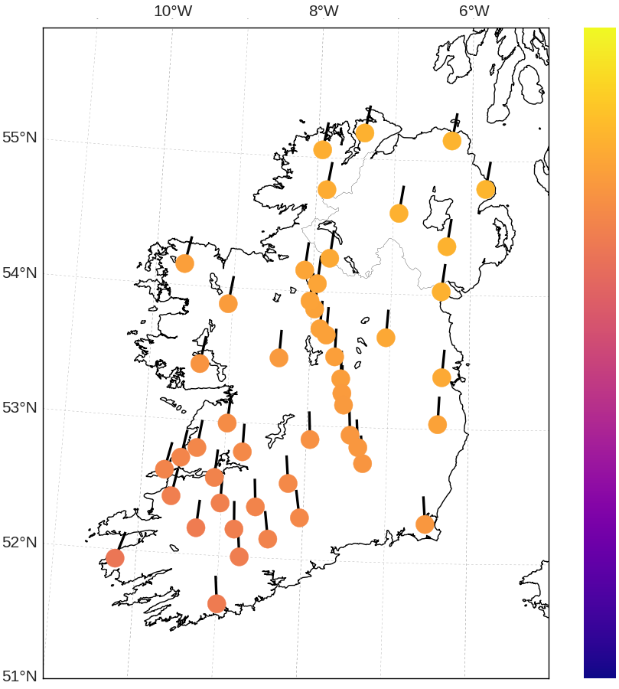
Understanding Space Weather effects
Geoelectric Fields in Ireland
Geoelectric fields
(22/06/2015 18:36 UTC)
SWEMDI
Space Weather Electromagnetic
Database for Ireland
E fields
log₁₀
[mV/km]
log₁₀
[nT]
B fields
3
2.5
2
2
1
1.5
Old LMT site
New LMT site
Magnetic observatory
0
1

Slide 13
Understanding Space Weather effects
Topology of the Power Grid
Blake et al. (2018)

Slide 14
Current Products
 | Magnetic Field Variations | Geoelectric fields | Impact in ground based infrastructure
Modelling
Monitoring Now-casting
Forecasting

Slide 15
Future Work
Magnetic Field Variations | Geoelectric fields | Impact in ground based infrastructure
Bring Bir and Arm to INTERMAGNET standards New magnetometers NW and SE Ireland Forecasting | Higher coverage of Ireland with MT data Electric observatory for validation (currently using UK observatories) Now-casting & Forecasting | New engagements with industry and stakeholders Sensors for validating modelling approaches Bespoke alarm system and mitigation risk strategies

Slide 16

Summary
Magnetic field
variations
Geoelectric Fields
Impact in ground
based infrastructure
 | Magnetic Field Variations | Geoelectric fields | Impact in ground based infrastructure
Modelling
Monitoring Now-casting
Forecasting
Current Products

