Slide 1
DSpace-CRIS Possibilities
Sean Carte
Durban University of Technology (DUT)
sean.carte@gmail.com

Slide 2
Outline
Introduction
DSpace 5.x
DSpace 6.0
An app to connect researchers
NRF & 4Science DSpace-CRIS Workshop
DSpace-CRIS Trial
Symplectic Elements
DSpace-CRIS Upgrade
DSpace-CRIS
Authentication
Authorities
Synchronisation
Using ORCID as a local profile URL
Conclusion
Notes:
Not a lot of content, but a lot of slides.

Slide 3
Introduction (background)
Notes:
<number>

Slide 4
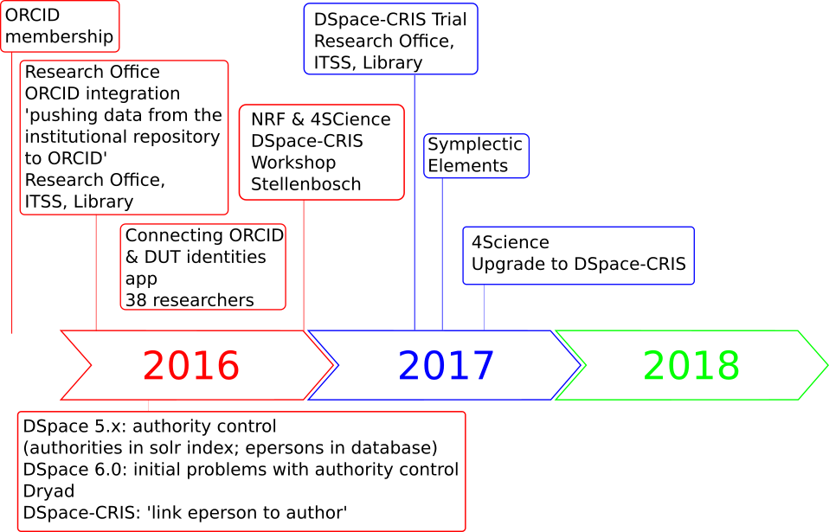
Timeline: ORCID integration at DUT
Notes:
DUT joined ORCID network prior to 2016
Research Office: integrate ORCID
… defined: push data from the IR to ORCID
Meeting: RO, ITSS, Library - IR, resp. E-Repository admin
DUT IR: DSpace 5 with Atmire’s XML UI, ‘Mirage 2’. DSpace 5 docs: ORCID integration ‘an attempt to lower the threshold for adoption of ORCID by members of the DSpace community’
scope: limited to authority control
ORCID integration required: beyond authority control.
DSpace 6.0 no deeper integration with ORCID,
non-functional authority control
alternatives DSpace-CRIS and Dryad, suggested by Matthew Buys - successful integrations
Dryad: inactive, out of date?

Slide 5
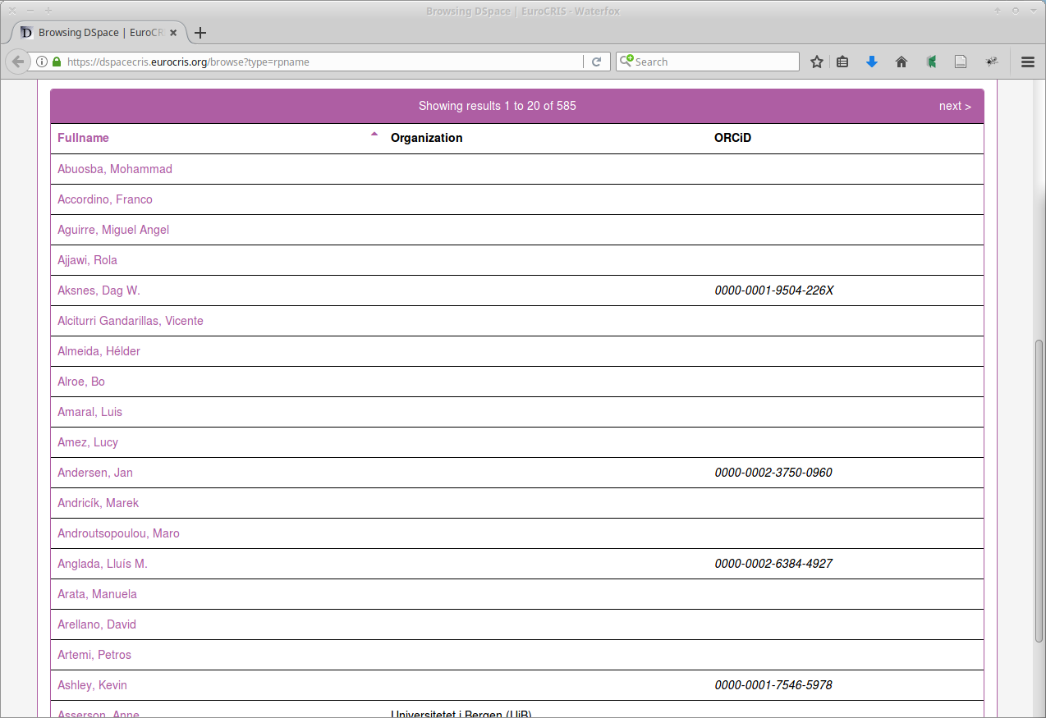
Researcher names and ORCID iDs
Notes:
dspace-tech mailing list - find associated DSpace eperson record, given an authority index record (ORCID iD)?
reply Andrea Bollini (4Science): DSpace records of epersons distinct from authors.
eperson record: authentication and authorisation; provides user accounts.
“People” require separate entity that does not necessarily have a one-to-one relationship with a user account.
DSpace-CRIS resolves this: Researcher Page stores various identifiers, including ORCID iDs
example where the researcher’s names were displayed alongside their ORCID iDs:
Clearly DSpace-CRIS offered the integration we required, worth further investigation.

Slide 6
Timeline: ORCID integration at DUT
Notes:
RO wanted researchers connected to ORCID, researchers’ authenticated ORCID iDs stored locally.
web app: users authenticate; user name, ORCID iD and access token in SQLite database. Later use in DSpace-CRIS. Drive ORCID reg - 38 researchers
Dec 2016 NRF, 4Science DSpace-CRIS workshop
- how DSpace-CRIS differs from standard DSpace
- potential for DUT as a research management system.
- add-on facilitate RDM using CKAN.
Interest in a system for RDM
- short course by UCT
trial DSpace-CRIS POC
problems with upgrade
sufficient Library to agree 4Science upgrade
RO acquiring Symplectic Elements to replace RIMS.
Library DSpace-CRIS upgrade - RDM possibilities
4Science competent, professional
Dev instance; testing; production
eight-hour support package
month of bug-free support
issues surfaced as features began to be used.
Issue: integration of ORCID
no longer a priority, this presentation
dev instance + ORCID sandbox server.
account on both, demo connecting DSpace user (eperson) with ORCID iD, then push data from DSpace to ORCID
instead of linking ORCID iD through existing researcher profile, additional researcher profiles
Reported to 4Science
Andrea Bollini resolved the issue,
hour’s video call, walked through process, now demo
features in upcoming release (based on Dspace
- further improvements to its ORCID integration.
configuration changes ORCID’s 2 API

Slide 7
DSpace-CRIS
Notes:
<number>

Slide 8
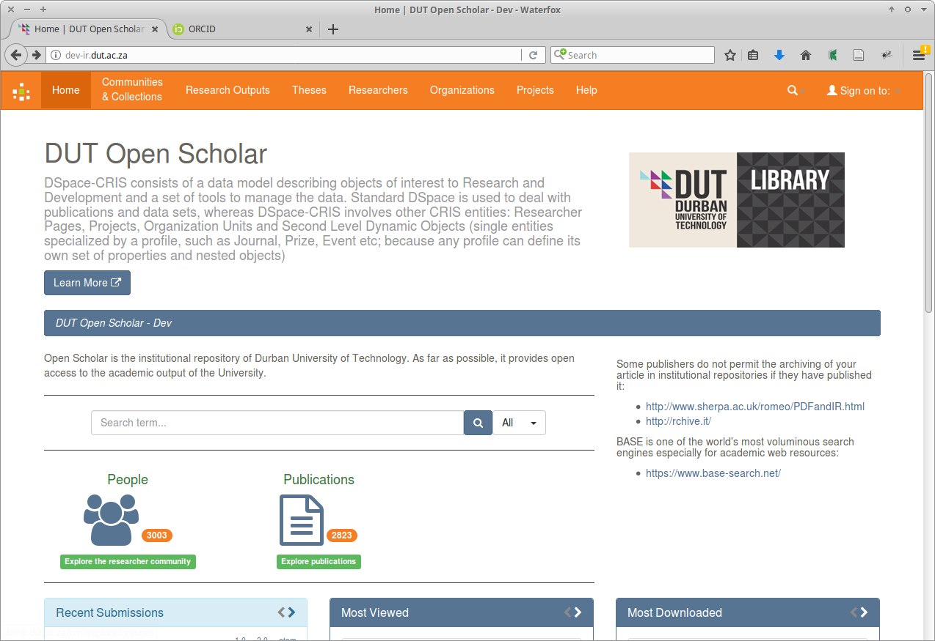
Development instance of DUT Open Scholar
Notes:
DSpace-CRIS wiki page on ORCID integration: ‘DSpace-CRIS provides the most advanced and complete integration between a CRIS / Repository system and ORCID, achieving most of the ORCID integration use cases’ (Bollini 2018).
The use cases identified on that wiki page are:
authentication (incl. profile claiming and creation of a local researcher profile),
submission lookup,
synchronisation,
using ORCID as a local profile URL.
Consider each of these in relation to DUT’s development instance of Open Scholar institutional repository,
DSpace-CRIS based on DSpace 5.8.

Slide 9
Authentication
Notes:
<number>

Slide 10
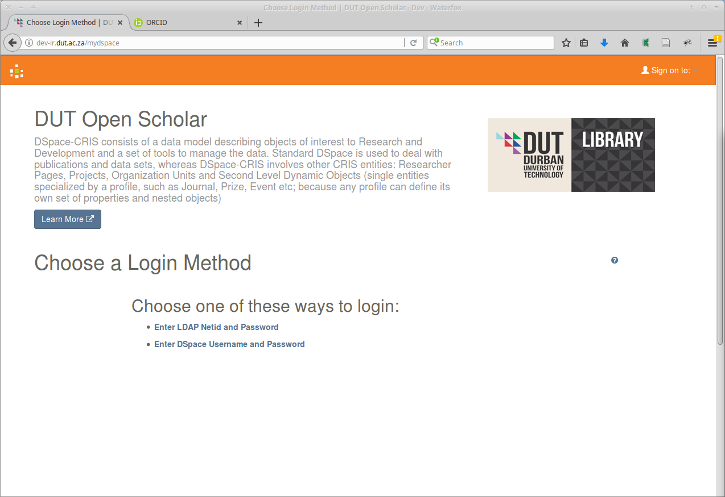
Authentication: login method
Notes:
First use case: Authentication
Open Access repository anon access to content,
authentication required so that the site can
ID user;
grant appropriate permissions
e.g.: content submission, subscr to alerts - new content.
DSpace multiple methods of authentication
DSpace username and password
LDAP

Slide 11
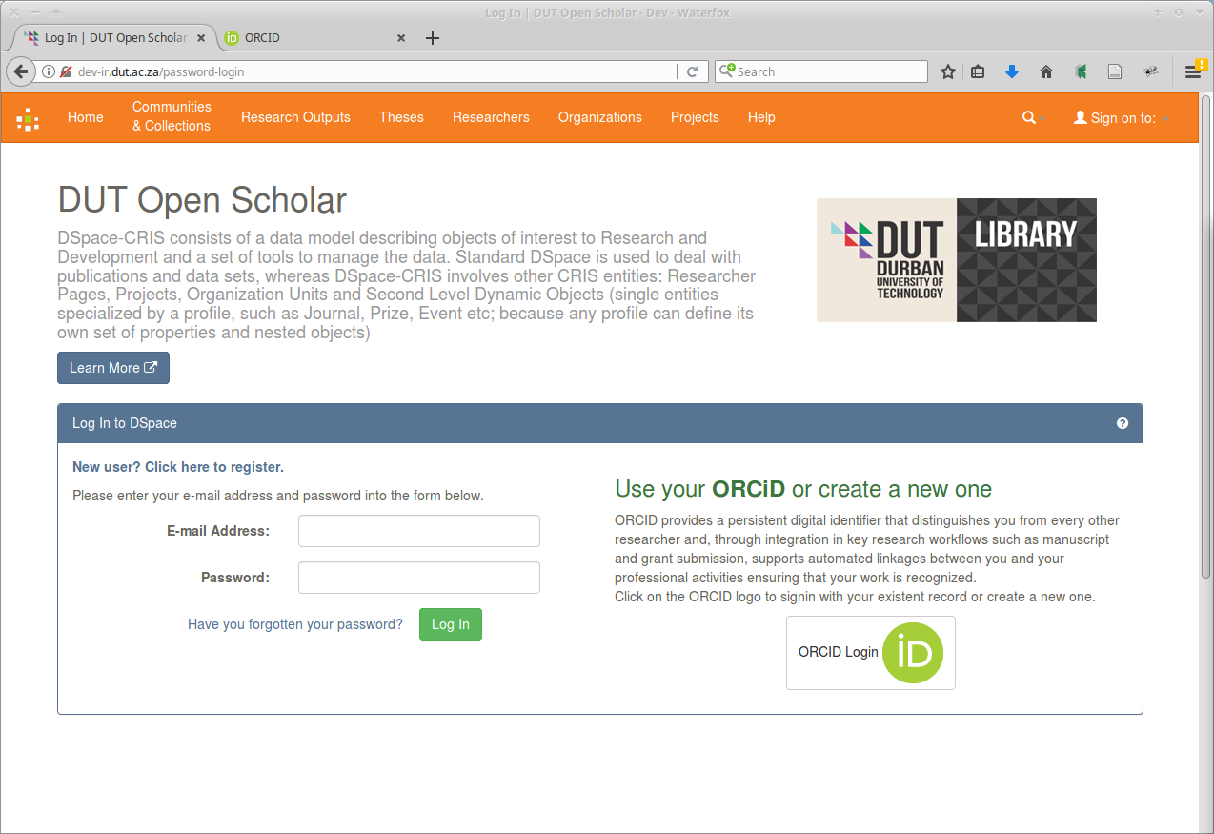
Authentication: ORCID login
Notes:
third authentication method - Dspace-CRIS:
ORCID Login.

Slide 12
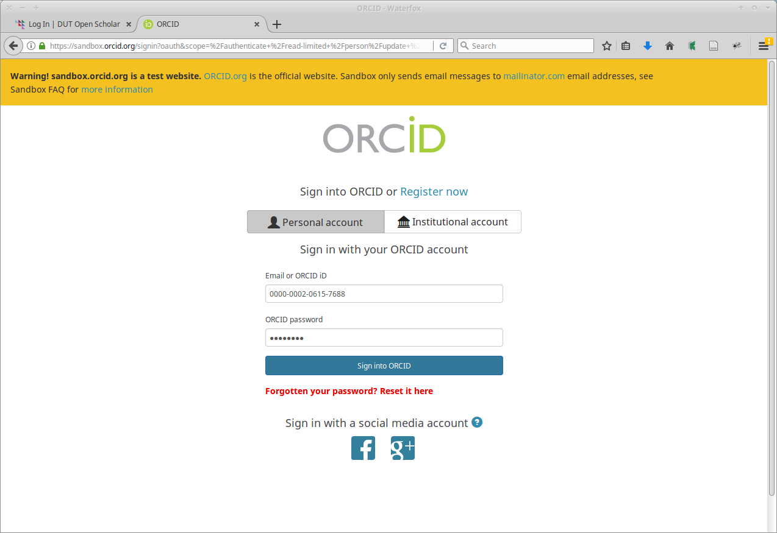
Authentication: ORCID oauth
Notes:
ORCID Login
redirect to the ORCID site
log in with email or ORCID iD.

Slide 13
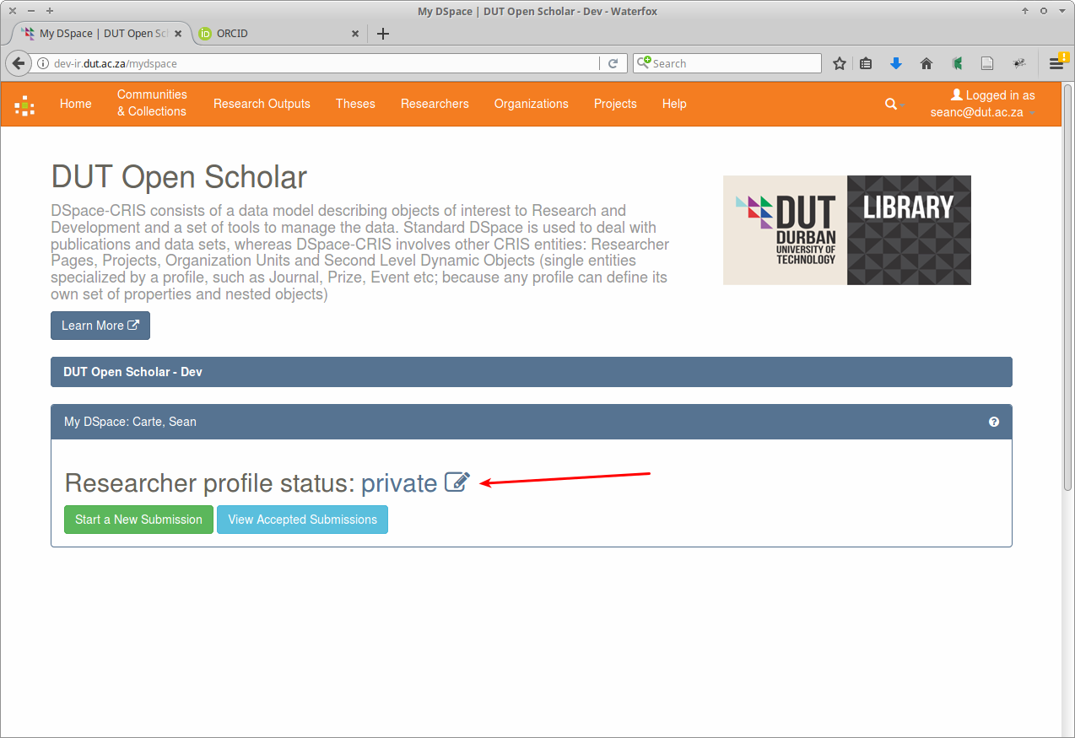
Authentication: My DSpace page
Notes:
successful login,
redirect to ‘My DSpace’ landing page on the DSpace-CRIS site
in-progress and completed submissions
submissions that require an action.
link to the researcher profile.

Slide 14
Researcher profiles
Notes:
<number>

Slide 15
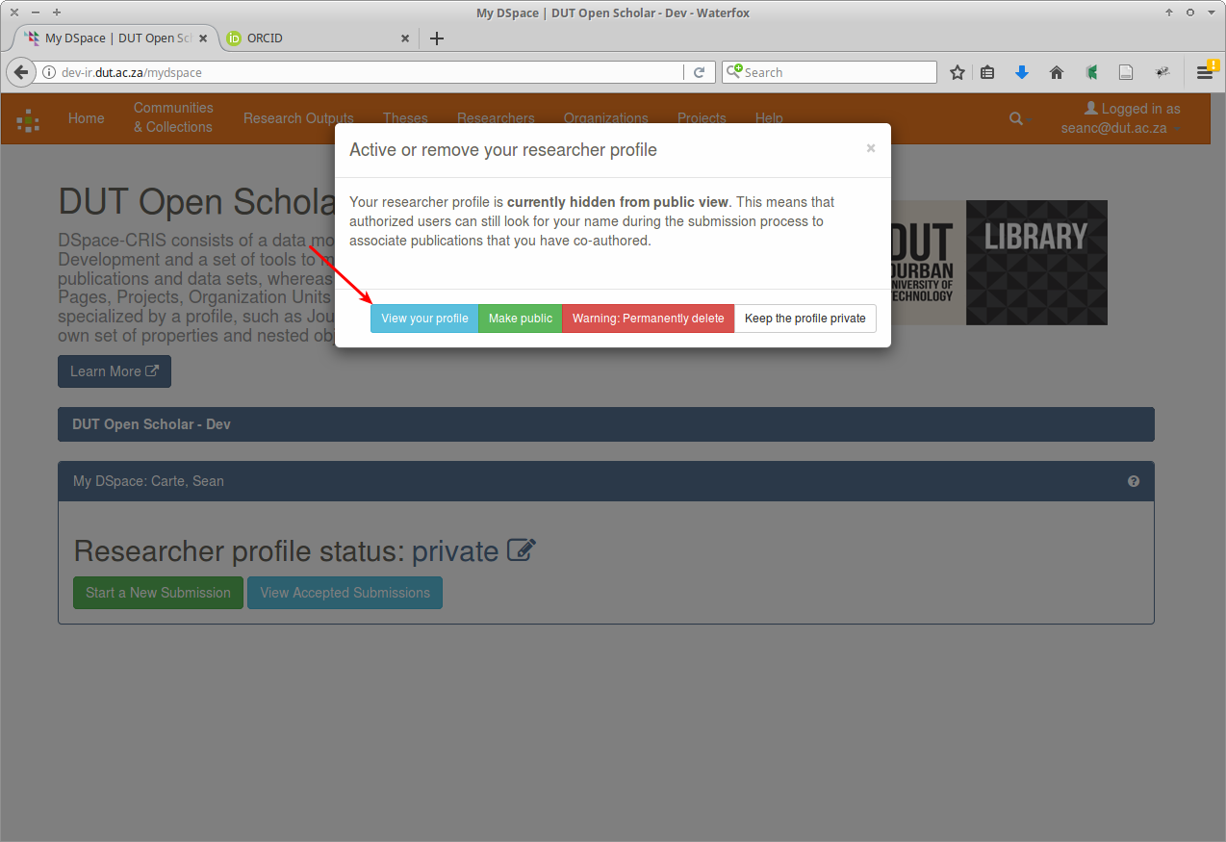
Researcher profiles: view profile
Notes:
The researcher profile - key element differentiates DSpace-CRIS from regular DSpace.
researcher profile associated with DSpace eperson ID
provides for additional information not belong in the eperson ID,
multiple identifiers, including ORCID iDs.
‘Researcher profile status’ icon
toggle status of profile - private and public,
delete
view

Slide 16
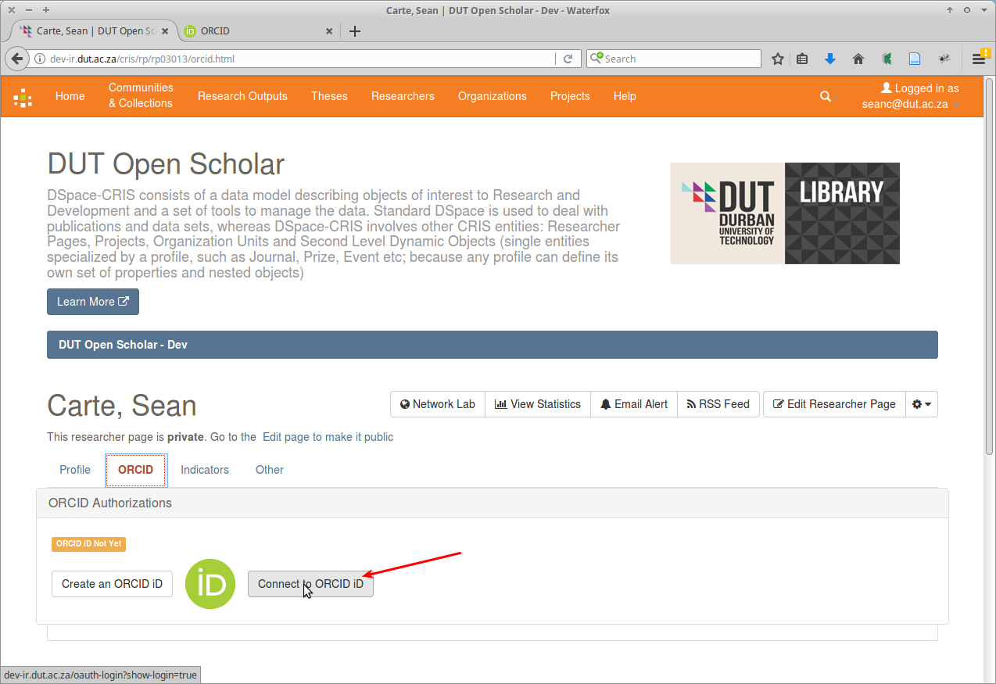
Researcher profiles: connecting to an ORCID iD
Notes:
previously demonstrated a log-in using ORCID for authentication. That used an existing researcher profile that was linked to the seanc@dut.ac.za DSpace eperson ID.
That connection previously established by connecting to ORCID iD from the researcher page.

Slide 17
Researcher profiles: ORCID oauth
Notes:
not already signed into ORCID,
redirected to the sign-in page.

Slide 18
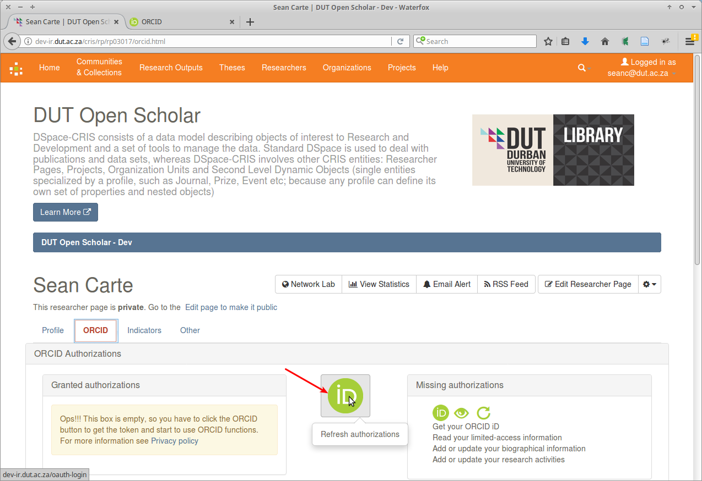
Researcher profiles: refresh authorisations
Notes:
need to grant authorisations to permit Dspace-CRIS access to your ORCID record so that it can:
- Get your ORCID iD
- Read your limited-access information
- Add or update your biographical information
- Add or update your research activities

Slide 19
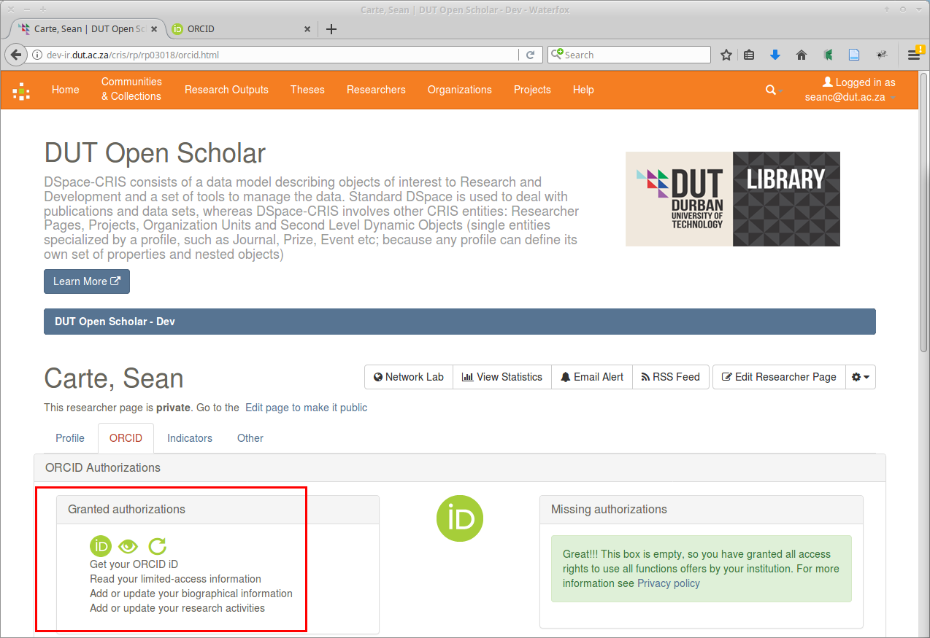
Researcher profiles: granted authorisations
Notes:
Refresh Authorisations button
RP lists granted authorisations
researcher profile connected to the ORCID iD
log into DSpace-CRIS using ORCID credentials
synchronisation possible.

Slide 20
Profile claiming
Notes:
Documentation:
profile claiming provides for the automated creation of DSpace user accounts using information from ORCID.
useful feature,
DUT’s researchers do not have ORCID iDs.

Slide 21
Authorities
Notes:
2nd use case: authorities
<number>

Slide 22
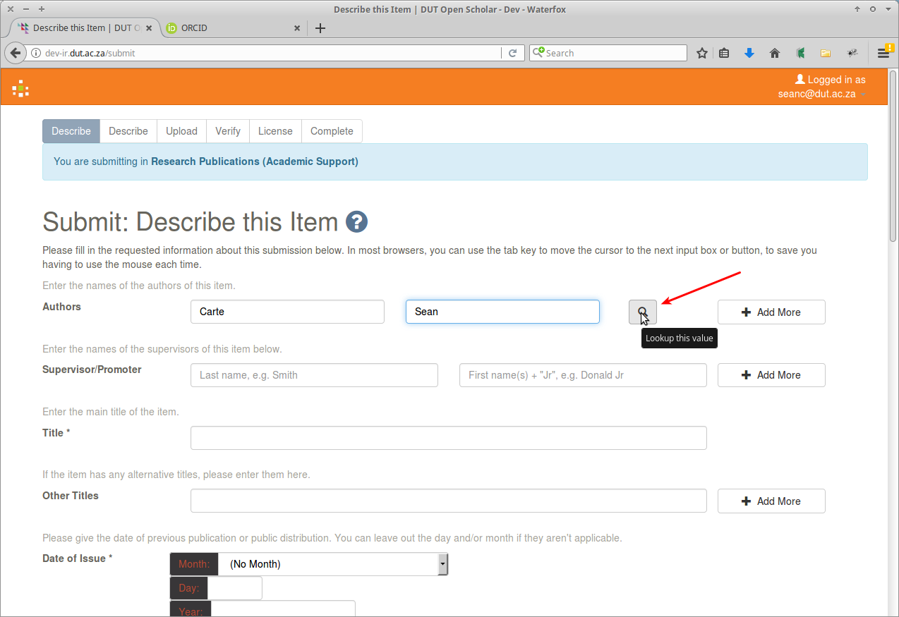
Authorities: submission
Notes:
Submission
authoritative list of names of authors

Slide 23
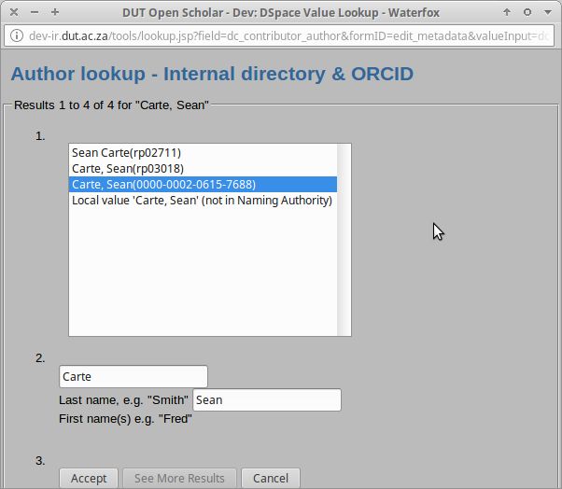
Authorities: lookup
Notes:
List matching entries from
- internal directory
- ORCID

Slide 24
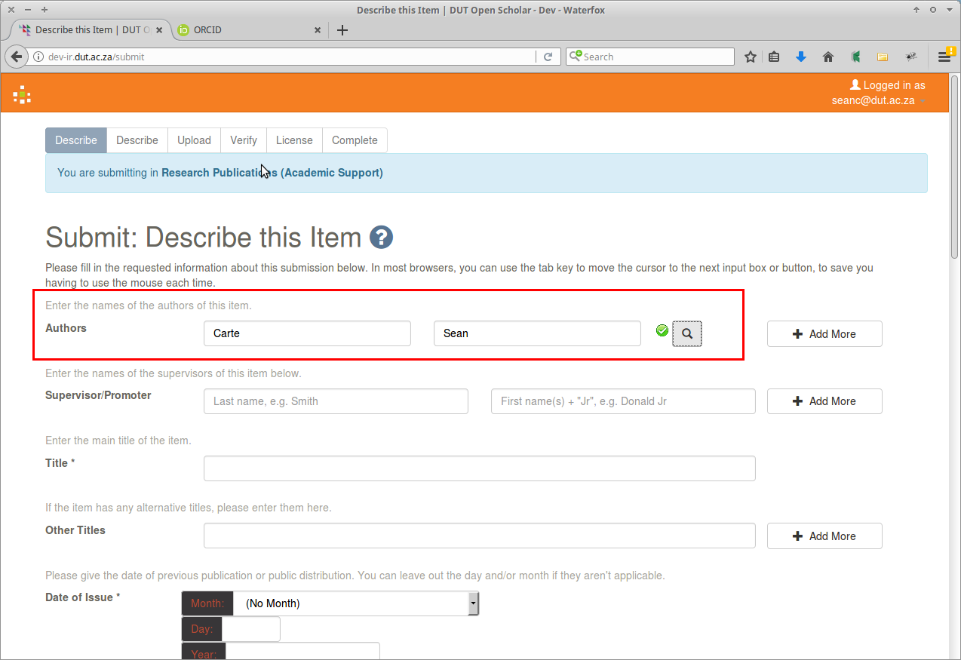
Authorities: authorised icon
Notes:
accepted,
Status indicated by green check icon.

Slide 25
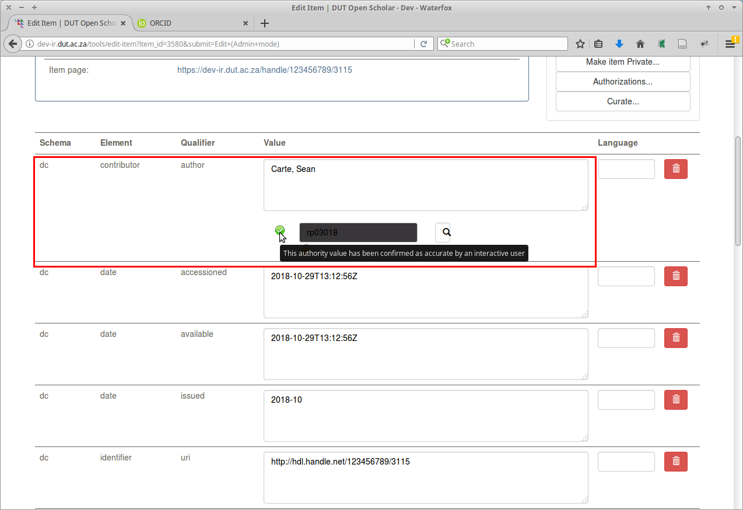
Authorities: editing metadata
Notes:
Icon - editing the metada.

Slide 26
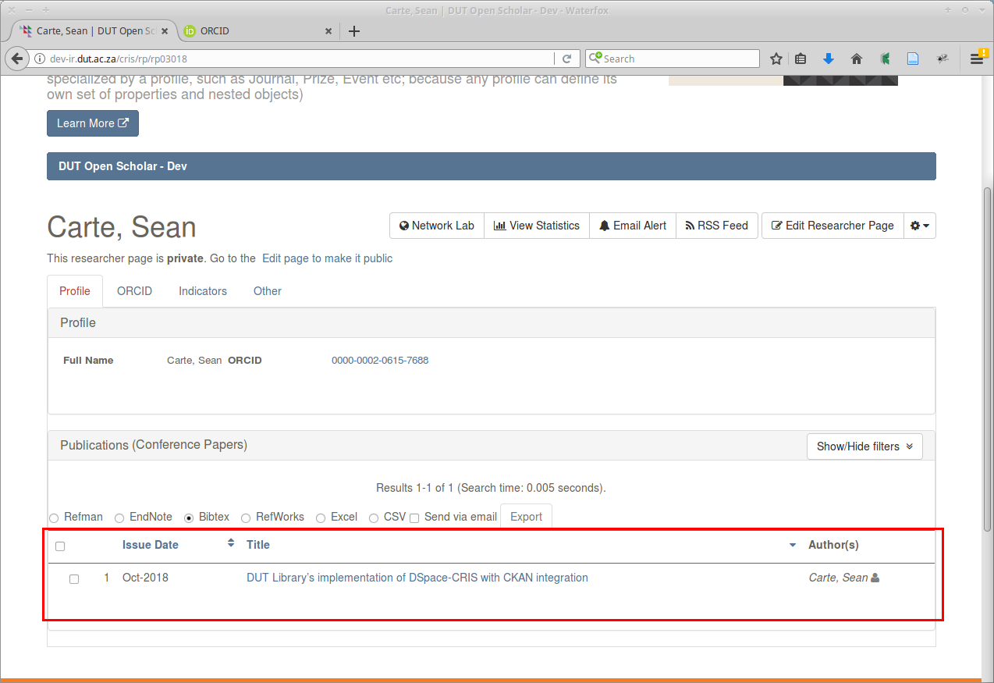
Authorities: publications
Notes:
Researcher page:
Accepted publications

Slide 27
Authorities: ORCID authorities
Notes:
Finding and accepting the researcher’s name from the list of authorities essential to ensure Dspace eperson related to researcher profile, which contains the researcher’s ORCID iD.
If step omitted, multiple researcher profiles
forthcoming version - utility combining researcher profiles.
cataloguer complained authoritative name entails accepting the formatting provided by the researcher.
displayed in the lists on the repository

Slide 28
Synchronisation
Notes:
3rd use case: synchronisation
Synchronisation during authority control
data is transferred from ORCID to DSpace-CRIS to supply the authorised names for lookup.
interest to DUT - synchronise publications from DSpace-CRIS to researcher’s ORCID profile.

Slide 29
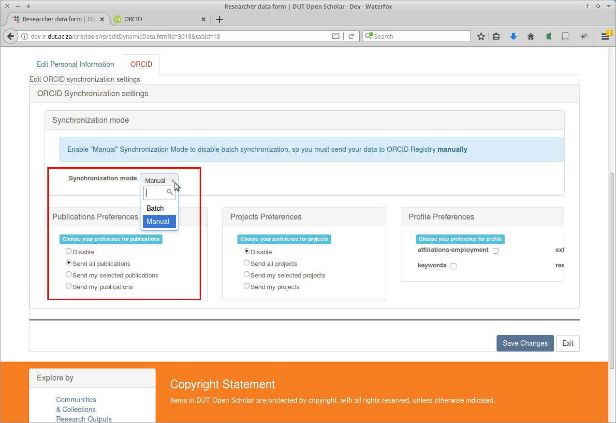
Synchronisation: synchronisation settings
Notes:
ORCID synchronisation settings.
Researcher options:
enable/disable
limit to set
automatic/manual

Slide 30
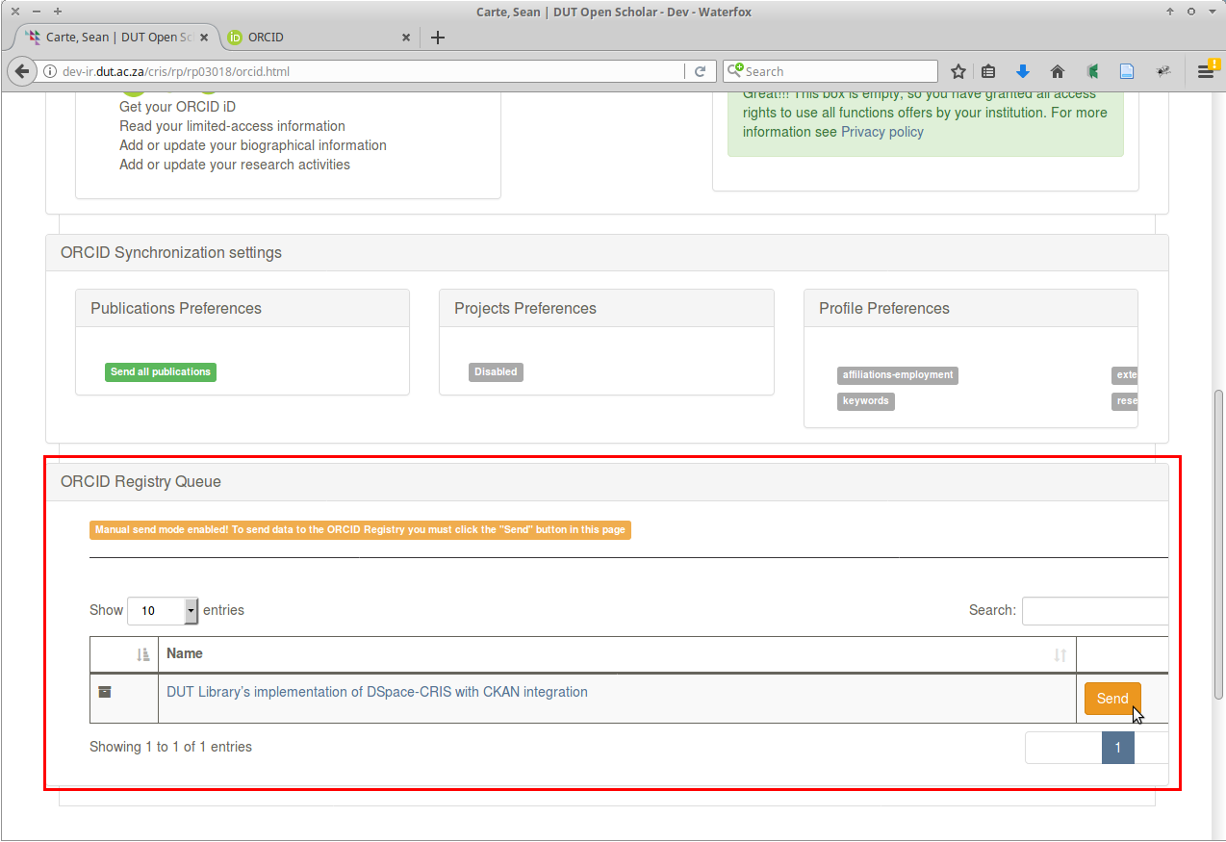
Synchronisation: ORCID registry queue
Notes:
Registry queue
Items available for transmission
‘Send’ button starts synchronisation.

Slide 31
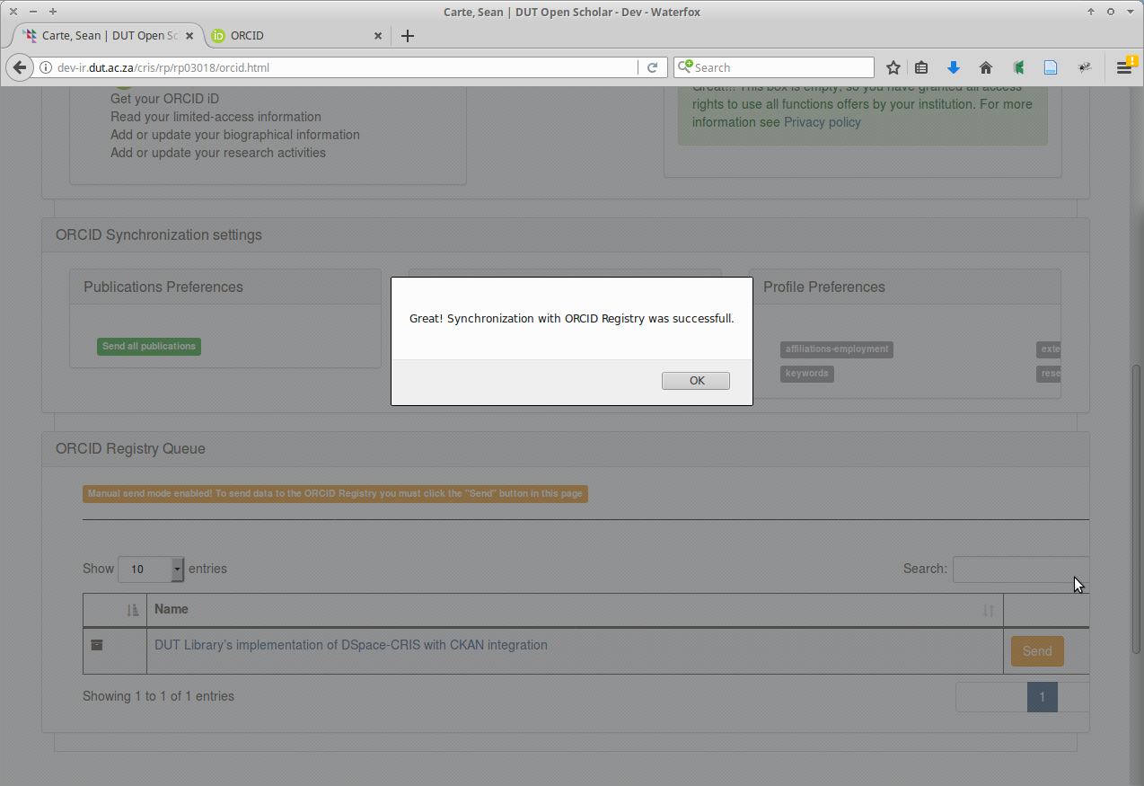
Synchronisation: alert
Notes:
Successful synchronisation
Alert
queue emptied.

Slide 32
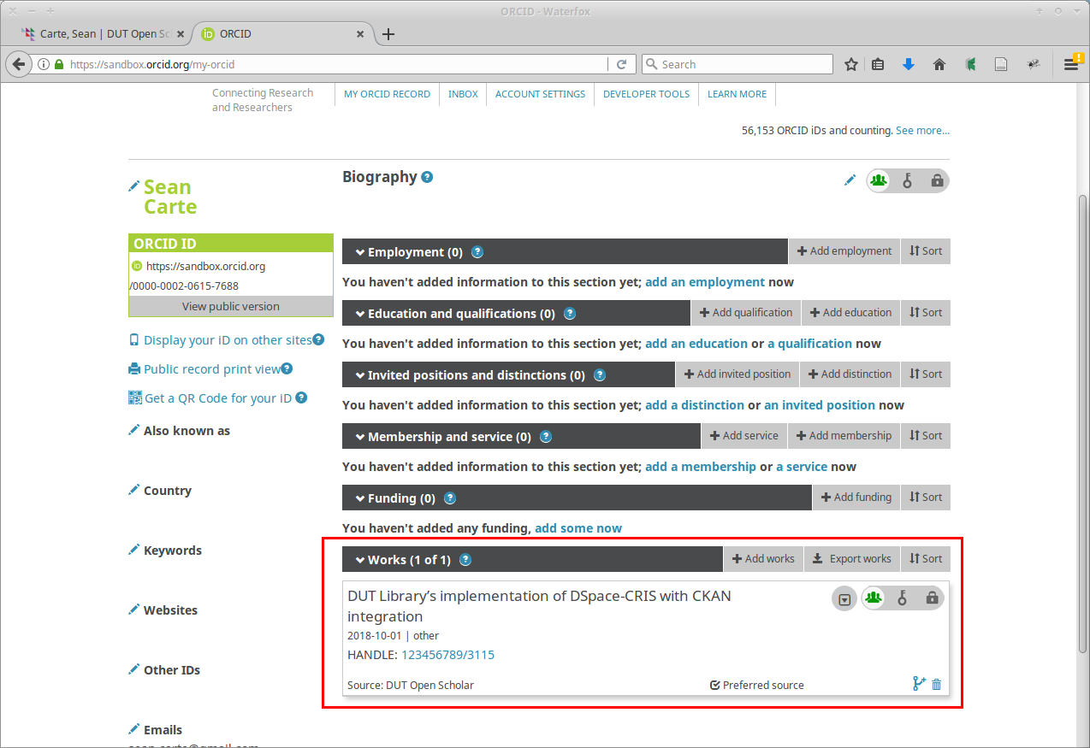
Synchronisation: item listed on ORCID
Notes:
‘Works’ section of ORCID biography page lists uploaded metadata.

Slide 33
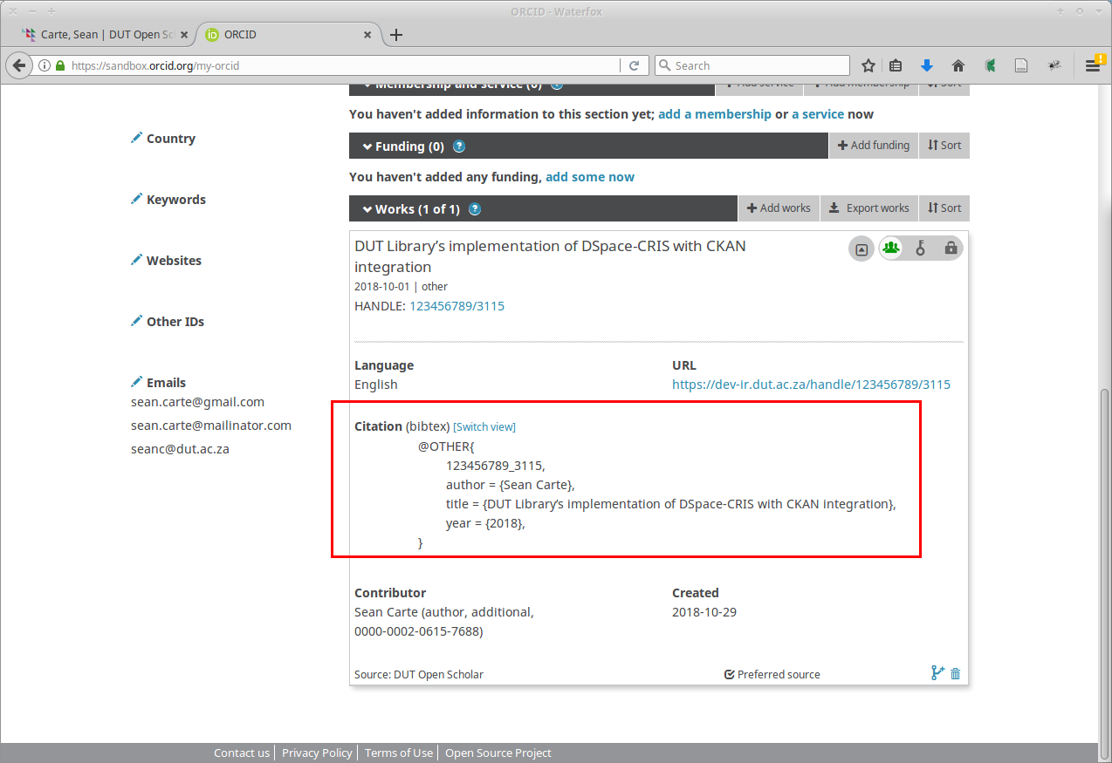
Synchronisation: bibtex citation
Notes:
Bibtex citation format is used, and can be customised.
<number>

Slide 34
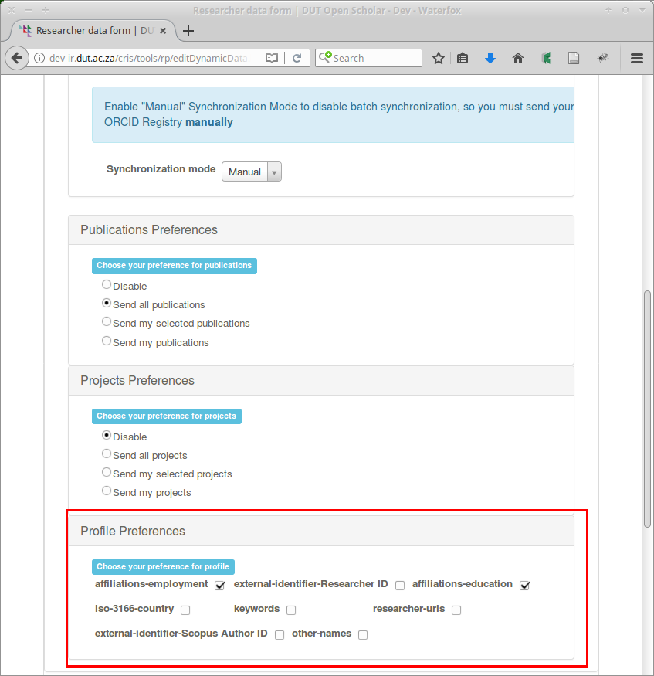
Synchronisation: profile preferences
Notes:
Other metadata relating to the researcher:
affiliation,
authorid,
education,
country,
keywords,
personalsite,
scopusid, and
Variants
Affiliations-employment
affiliations-education
set to be synchronised.

Slide 35
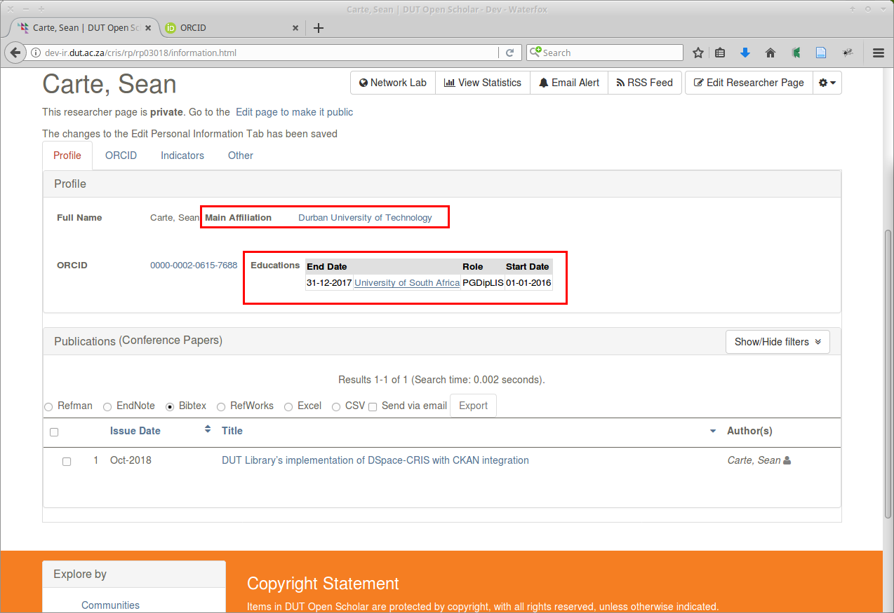
Synchronisation: affiliation and education
Notes:
profile page
set ‘Durban University of Technology’ as my main affiliation
Unisa diploma to education.

Slide 36
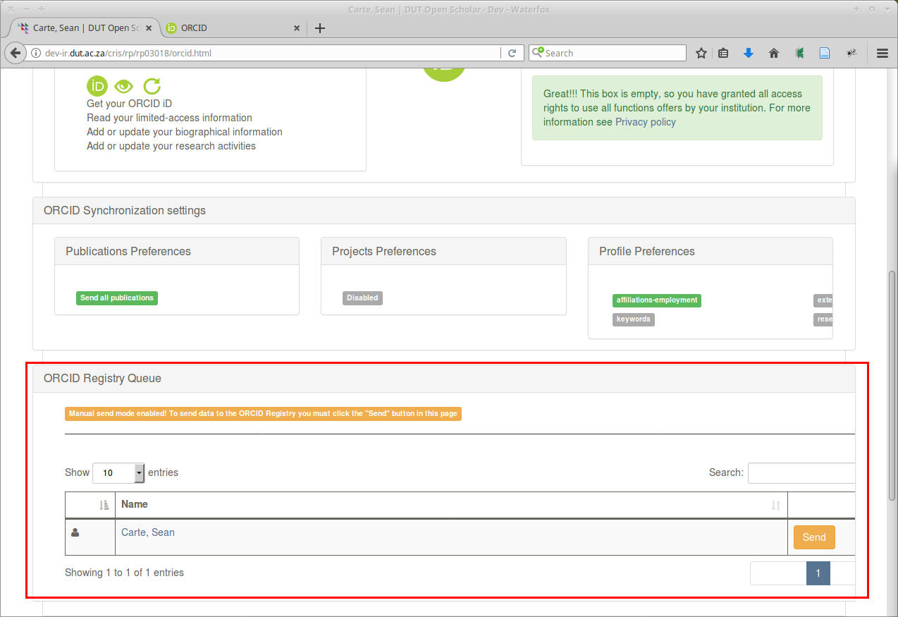
Synchronisation: profile data available
Notes:
ORCID registration queue
profile data available for synchronisation.

Slide 37
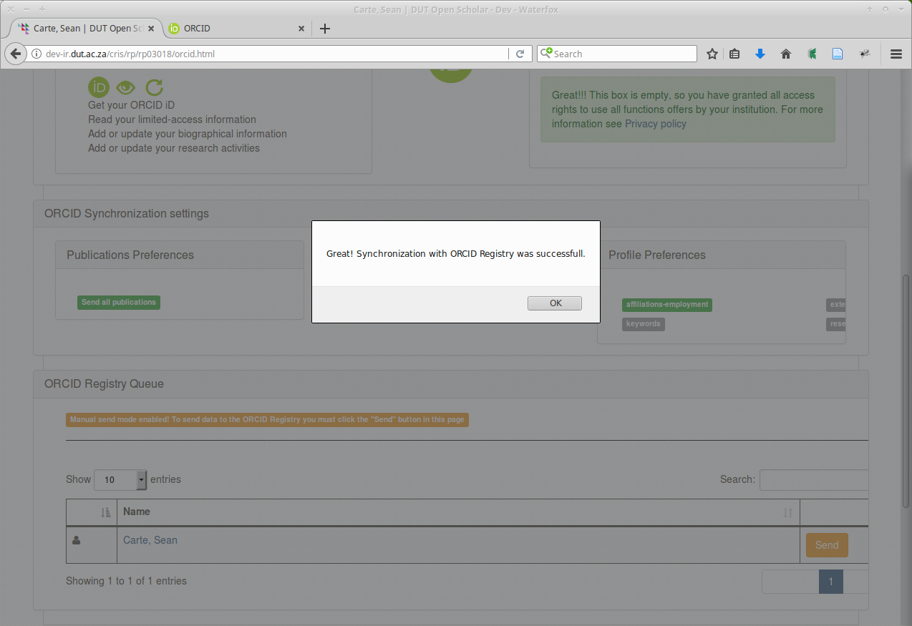
Synchronisation: alert
Notes:
Clicking ‘Send’ -> alert indicating success.

Slide 38
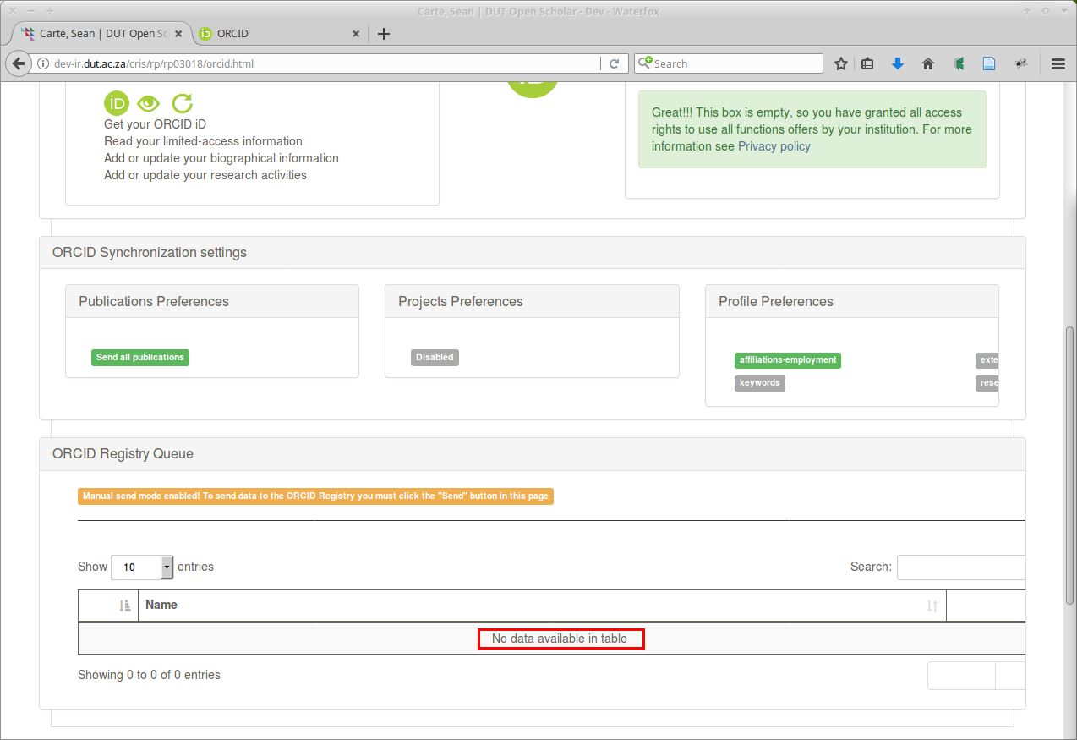
Synchronisation: empty registration queue
Notes:
… and an empty ORCID registration queue.

Slide 39
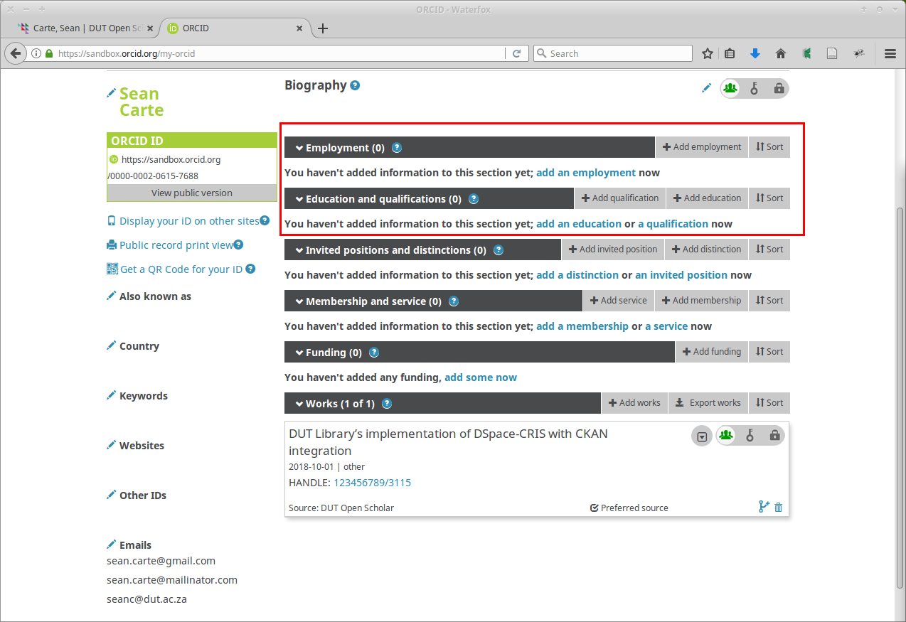
Synchronisation: ORCID biography page
Notes:
Disappointingly,
ORCID biography page does not reflect the updates.
addressed in the next release?
configuration issue?
I’ve done something stupid?

Slide 40
ORCID as a local profile URL
Notes:
4th use case: ORCID local profile URL
should allow the use of ORCID iDs in URLs to resolve to researcher profiles, e.g.: equivalent URLs
resolve to the researcher page, which is associated with ORCID iD
enable finding researcher pages using ORCID iD,
potentially useful for linking existing systems to DSpace-CRIS.
Unfortunately, ‘invalid identifier’ error message.

Slide 41
Conclusion
Notes:
‘A public good’
Defined - both non-rivalrous and non-excludable;
its use does not reduce its availability to others
no-one can be excluded from using it

Slide 42
Conclusion: FOSS
Richard Stallman’s ‘four essential freedoms’:
1. The freedom to run the program as you wish, for any purpose.
2. The freedom to study how the program works, and change it so it does your computing as you wish. Access to the source code is a precondition for this.
3. The freedom to redistribute copies so you can help your neighbor.
4. The freedom to distribute copies of your modified versions to others. By doing this you can give the whole community a chance to benefit from your changes. Access to the source code is a precondition for this.
Notes:
Free Open Source Software described by Richard Stallman’s ‘four essential freedoms’, fits the definition of a public good.
The ‘four essential freedoms’ relating to software are:
freedom to run the program.
freedom to modify it.
freedom to redistribute copies.
freedom to distribute copies of your modified versions
DSpace, DSpace-CRIS : free open source software.
fork of DSpace to add CRIS functionality
initially developed for Hong Kong University in 2009 by Cineca technicians for HKU Scholars Hub,
2013 Hong Kong University released the code to the DSpace community as open source.
actively developed by 4Science.

Slide 43
Conclusion: ‘Free’
Notes:
Lawrence Lessig slogan “Think free … as in free speech, not free beer’ to Richard Stallman. :
‘free’ in ‘free open source’ relates to freedom, not cost.
Mary Branscombe ‘free as in “free puppy”’
consider both the pedigree of the project
the responsibilities it entails.
FOSS = public good, benefit to the entire community.
not sustainable unless users contribute.
- be an active user - join the community,
- participate on mailing lists;
- share expertise
- file bug reports; or
- pay service providers involved in development
demonstrated three ways that DSpace-CRIS can be used to integrate ORCID in a repository:
Authentication, authority control, and synchronisation.
Problem 1: researchers involvement required
- link their repository and ORCID profiles
- grant the necessary permissions
- ensure that their names are properly recorded on the ORCID registry.
empowering researchers?
Problem 2: parts still not fully functional.
- Mea culpa; DUT has been using DSpace-CRIS for almost a year, but has yet to promote its features to its researchers.
If it were not for this workshop, the potential for ORCID integration provided by DSpace-CRIS would probably have remained undiscovered and continued to go unused.

Slide 44
References
Bollini, A. 2013. ‘ORCID Integration – DSpace’. DuraSpace Wiki. https://wiki.duraspace.org/display/DSPACE/ORCID+Integration?focusedCommentId=34660252#comment-34660252 (Accessed 31 October 2018).
Bollini, A. 2018. ‘ORCID Integration – DSpace-CRIS’. DuraSpace Wiki. https://wiki.duraspace.org/display/DSPACECRIS/ORCID+Integration (Accessed 31 October 2018).
Branscombe, M. 2017. ‘Open source: Free as in beer, puppy... or mattress?’ ZDNet. https://www.zdnet.com/article/open-source-free-as-in-beer-puppy-or-mattress/ (Accessed 2 November 2018).
Lessig, L. 2006, ‘Free, as in Beer’. Wired. https://www.wired.com/2006/09/free-as-in-beer/ (Accessed 2 November 2018).
Luyten, B. 2015. ‘ORCID Integration - DSpace 5.x Documentation’. DuraSpace Wiki. https://wiki.duraspace.org/display/DSDOC5x/ORCID+Integration (Accessed 30 October 2018).
Stallman, R. “Four Freedoms” – An Open Education Reader. n.d. https://openedreader.org/chapter/stallmans-four-freedom/ (Accessed 19 October 2018).
Wikipedia, the free encyclopedia. 2018. Sv ‘public good’. https://en.wikipedia.org/wiki/Public_good (Accessed 02 November 2018).
Notes:
<number>

