Slide 1
A Tale of Two Data Projects
Curation at the Qualitative Data Repository
Webinar, November 7, 2018
Sebastian Karcher and Dessi Kirilova
QDR, Syracuse University

Slide 2
Introduction to QDR
International audience
Hosted at Syracuse University
Online since 2014, NSF, RWJF, and Sloan funded
Curated qualitative & mixed-methods data
Currently 47 published data projects, growing
Since July 2018: Depositor pays, Institutional Membership available

Slide 3

QDR’s Mission
“QDR curates, stores, preserves, publishes, and enables the download of digital data generated through qualitative and multi-method research in the social sciences. The repository develops and disseminates guidance for managing, sharing, citing, and reusing qualitative data.”
http://qdr.syr.edu/

Slide 4
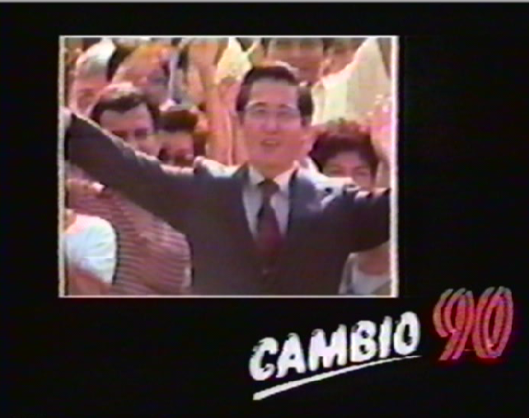
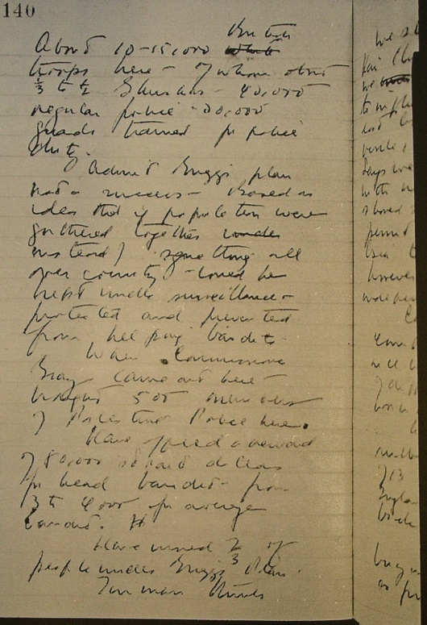
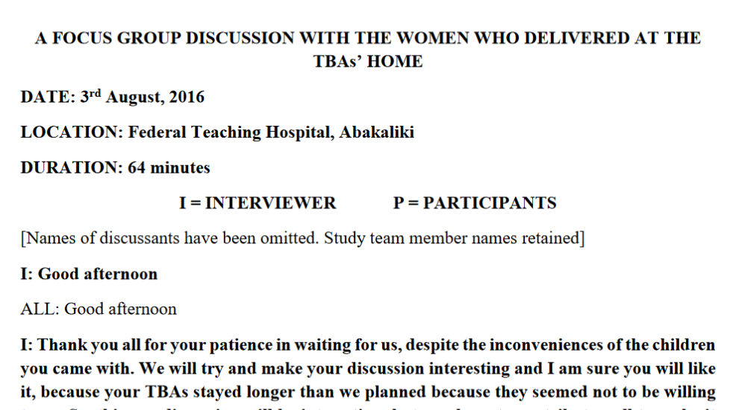
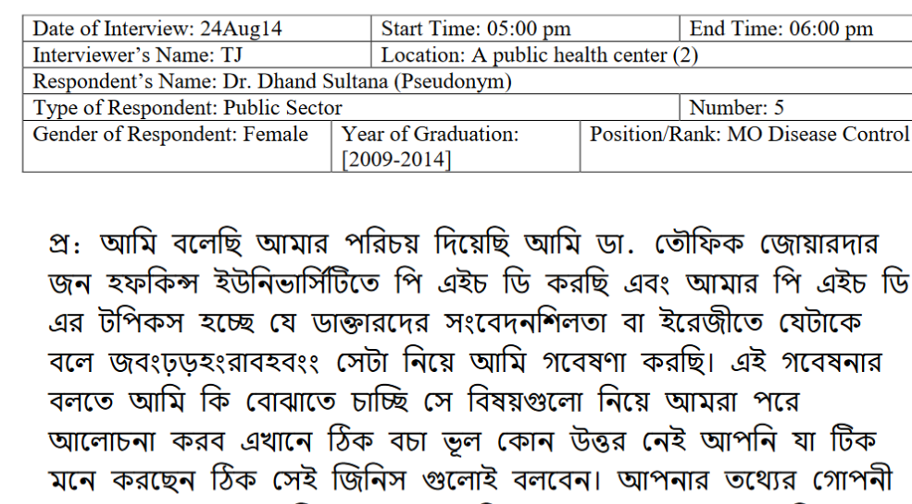
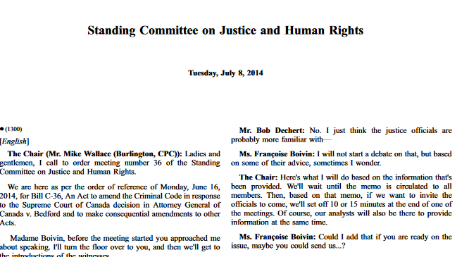
QDR’s Data

Slide 5
Curation at QDR
By subject specialists
Individualized solutions tailored to project details
Interactive, in dialog with depositor
Goals:
  Ensure legality / ethics
    Review of sensitivities / risk (human participant-related; copyright)
    Socio-technical solutions (e.g. differential, authenticated access)
  Enhance data & metadata
  Preserve and disseminate

Slide 6
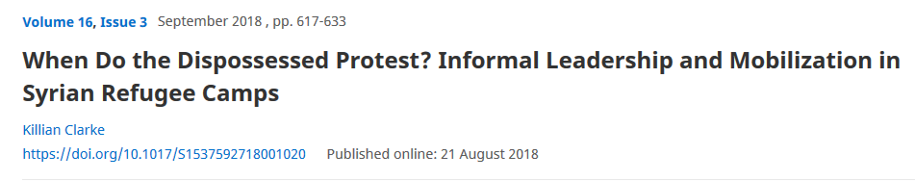
Project 1: Clarke (2018)
Supplementary Data to article in Perspectives on Politics, encouraged by journal’s editor
Why and when do refugees in camps/settlements protest? Common in Jordan, but not in Turkey and Lebanon

Slide 7
Clarke: The Data
“I develop this argument through structured comparison of three cases and within-case process tracing, using primary source documents from humanitarian agencies, contentious event data, and 87 original interviews conducted in the summer of 2015.”
1
2
3

Slide 8
Clarke: Data Challenges
Source Documents: Provenance and Copyright
Event Data: Preservation, conditions of use, ethics, and copyright
Original Interviews: Human participant protections
  Consent and common sense ruled out sharing

Slide 9
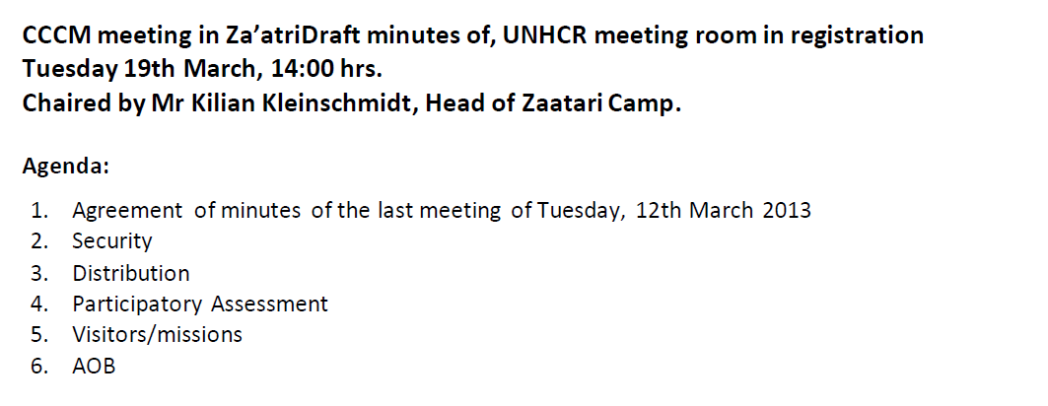
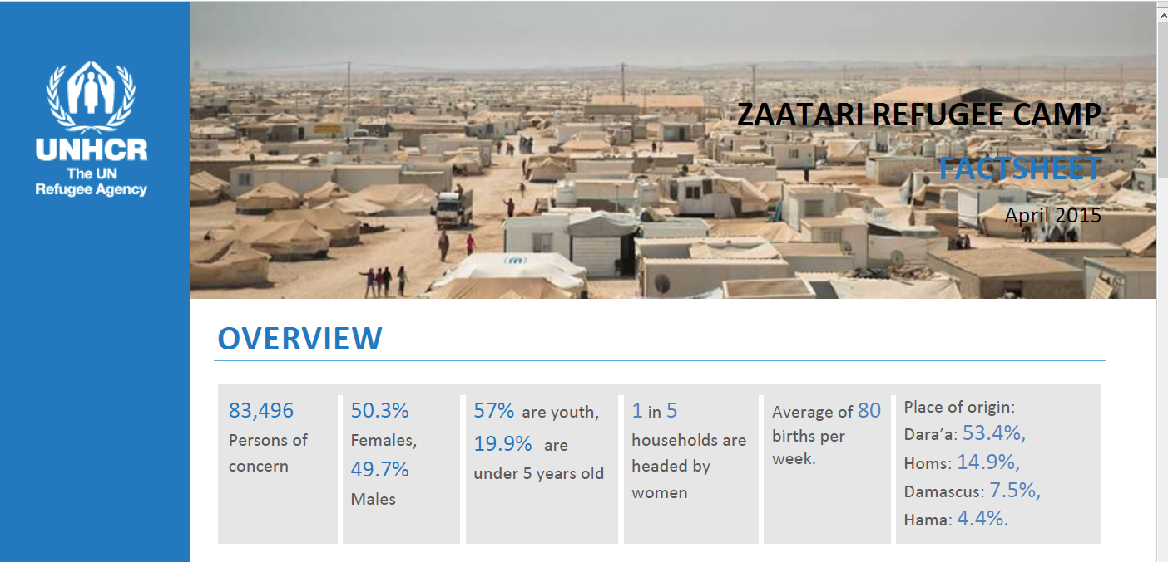
Clarke: Source Documents
UNHCR Reports

Slide 10
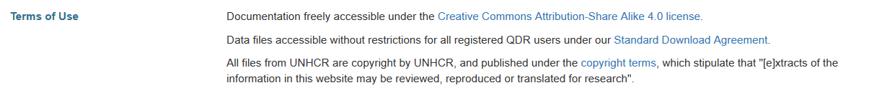
Clarke: Source Documents
Copyright?
UN and UNHCR documents are under copyright
All documents retrieved from: https://data2.unhcr.org/en/situations
Separate copyright statement (https://data2.unhcr.org/en/copyright/):
  “Extracts of the information in this website may be reviewed, reproduced or translated for research or private study but not for sale or for use in conjunction with commercial purposes.”
Archiving critical as some documents (already) no longer available
Usage conditions documented on QDR

Slide 11
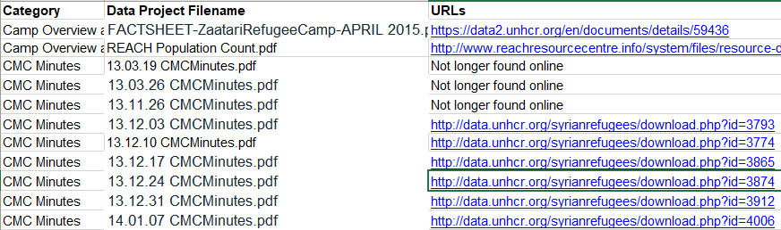
Clarke: Source Documents
Data inventory
Created in collaboration with depositor

Slide 12
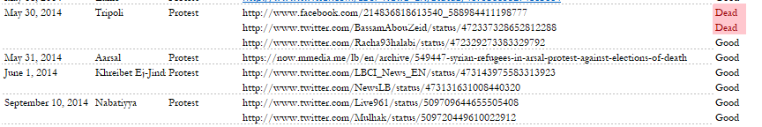
Clarke: Event data (social media)
Relatively small number of mainly Twitter and Facebook posts reporting protest events, often with links to articles
Initially deposited version

Slide 13
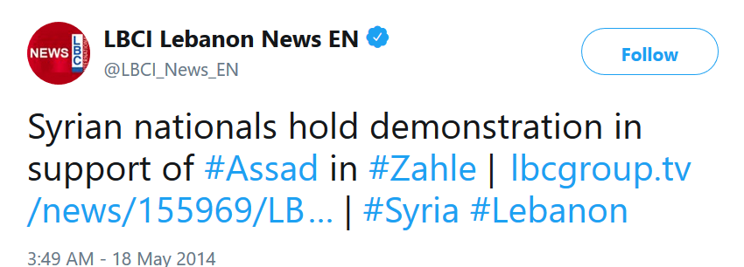
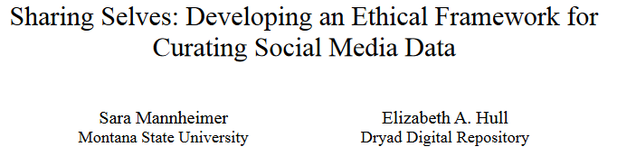
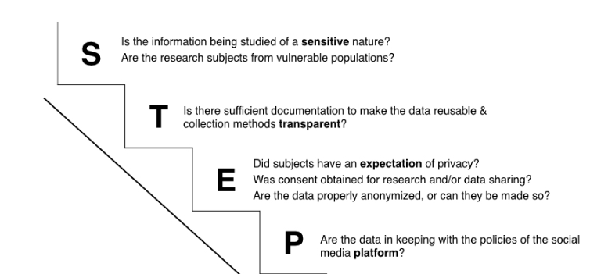
Clarke: Event Data Challenges
(Ethics, Copyright, Preservation)
https://doi.org/10.2218/ijdc.v12i2.518

Slide 14
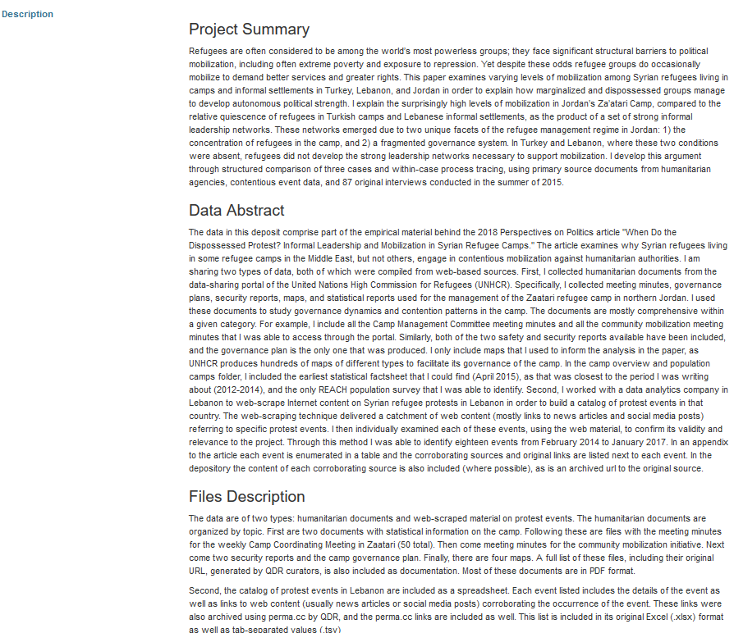
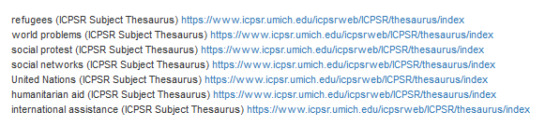
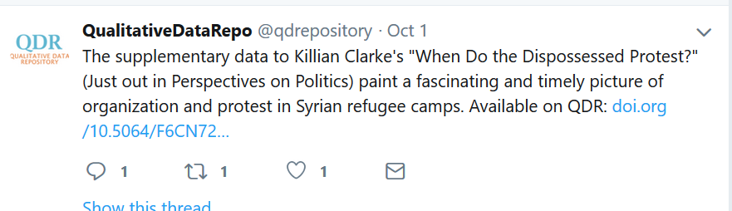
General Curation
Add keywords with controlled vocabulary
Dates (covered, collected, published)
Geography
Description of data (“Data Overview”)
Preservation copy of files
Promotion

Slide 15
Project 2: Loyle / NIRI (2018)
Large stand-alone thematic project
Institutional creator looking for
  permanent home for materials
  better findability by others and searchability by team
Studying the conflict in Northern Ireland (the “Troubles”) which ran from 1968 to 1998.
“While there has been a great deal said and written about what took place, nowhere has the raw material (the raw data) about what took place been made publicly available to individuals so that they could explore for themselves.”

Slide 16
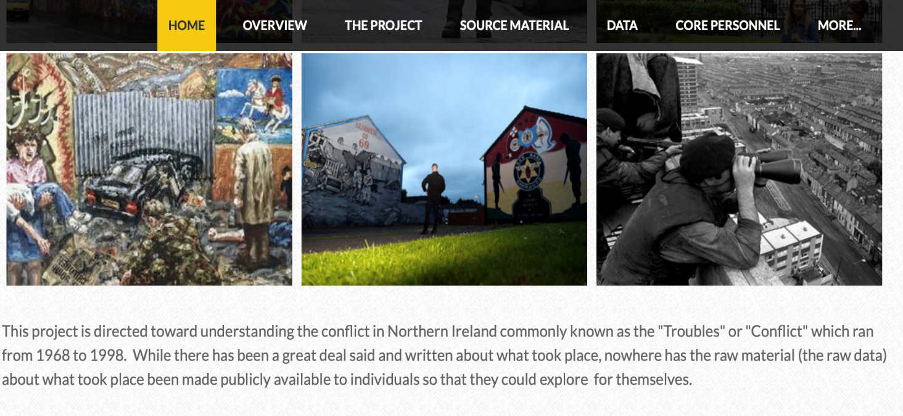
Loyle / NIRI: The Data
Eight distinct funds of diverse source documents:
contemporaneous testimonials collected by NGOs
interviews
violent and other political event data
lists of casualties
Irish and British archives
press articles

Slide 17
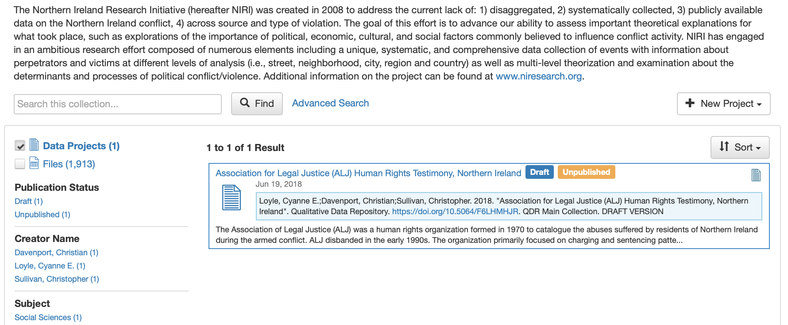
Loyle / NIRI:
Collection with sub-projects
ALJ project within larger NIRI collection
Testimonials about police treatment, political harassment and sentencing patterns gathered by human rights NGO (mission: record & make public)
Close to 2000 items
Notes:
-

Slide 18
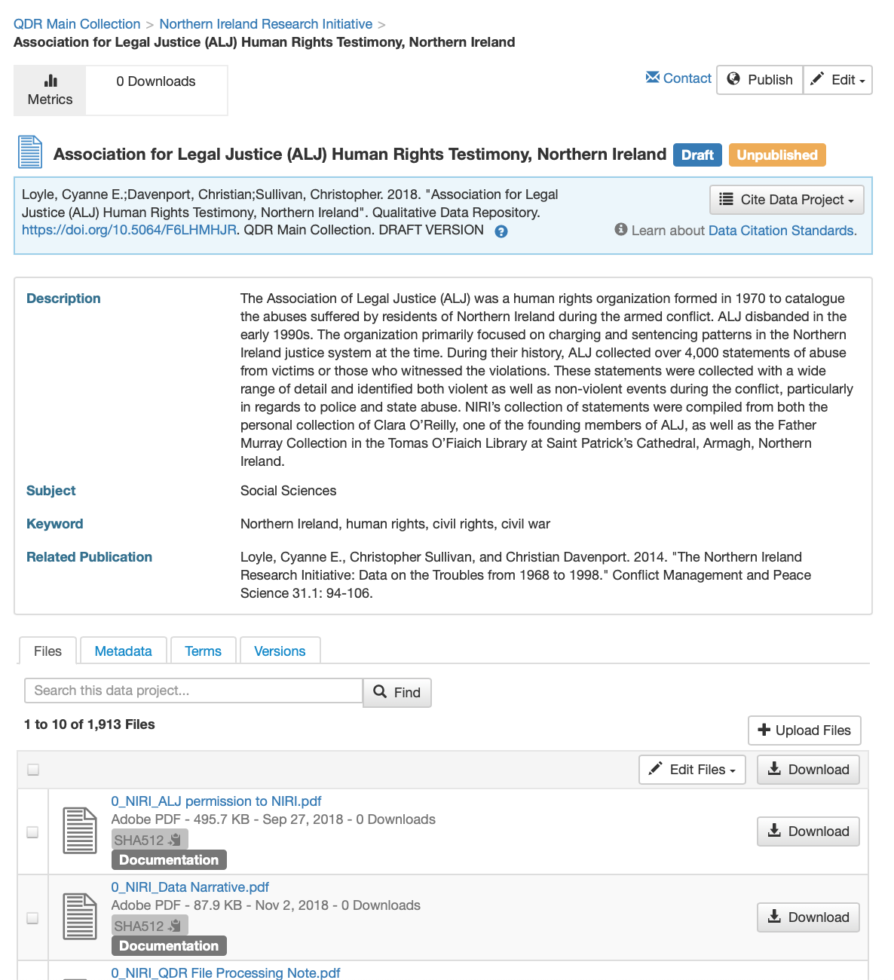
Loyle / ALJ: Human Participant Challenges
Depositor requested minimal de-identification (testimonies included direct identifiers)
Detailed discussions with depositor (current low level of risk; protection from “curious Googlers”)

Slide 19
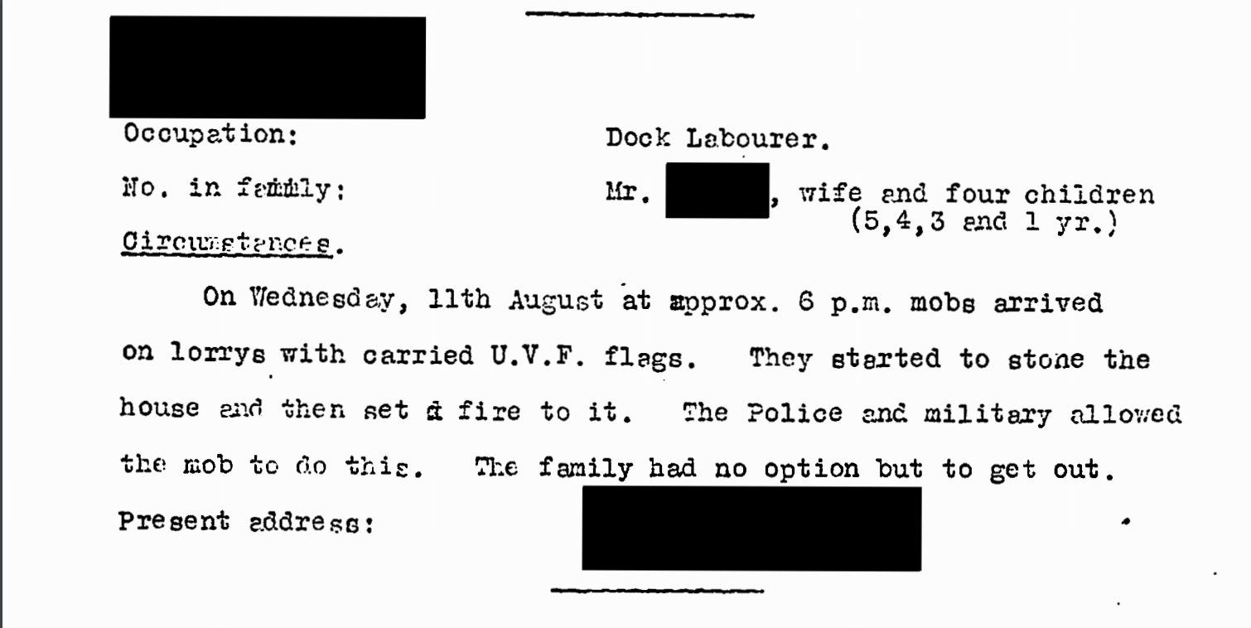
Loyle / ALJ: Human Participant Challenges
QDR performed manual in-text redaction using Adobe tool (removing names and addresses collected as administrative info)
Devised new naming convention not based on personal info and renamed files

Slide 20
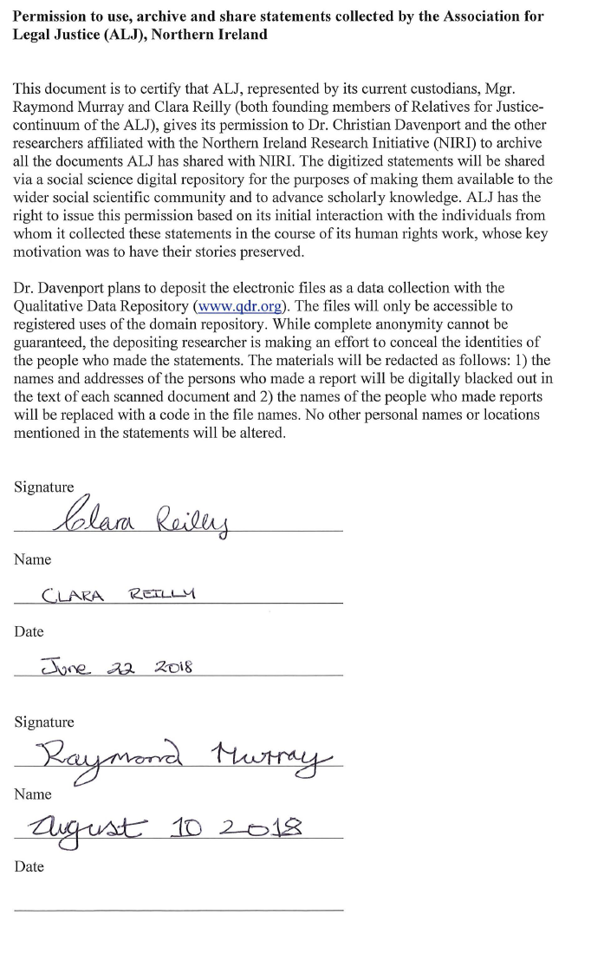
Loyle / ALJ: Additional Documentation
Greater contextualization
of project:
Proposed text seeking explicit permission for sharing from the NGO
Offered template for Data Overview to depositor
Described repository actions in File Processing note
Notes:
FILE PROCESSING NOTE:
The data were processed according to the Qualitative Data Repository's curation policy. All files were checked for integrity. JPEG images containing text data were converted to PDF. All PDF files were ordered and rotated as necessary and underwent Optical Character Recognition (OCR) using Adobe Acrobat Pro DC Version 2018.009.20050.
Personal identifiers from statements taken by the Association of Legal Justice (ALJ) were redacted as follows: names, addresses, dates of birth, and signatures, found at the top and bottom sections of the text were digitally blackened out. No other personal names or locations were redacted. All personal identifiers found in the metadata were removed. Personal names in the filenames were replaced with a code representing a date associated with the statement in the following format: YYYYMMDD.
For all files with the same associated date, the files were distinguished by a numbered suffix, i.e. YYYYMMDD_1, YYYYMMDD_2. For batched documents in which multiple statements were included in one single file, the individual statements were extracted into distinct files. These were distinguished by an alphabetical suffix, i.e. YYYYMMDD_A, YYYYMMDD_B. The batched versions of those files were retained and named according to regular coding. In addition, the prefix NIRI_ was added to all filenames using Rename Master Version 3.13.
Any identified duplicates in the data, including handwritten copies of typed documents, were removed. All files that corresponded to individual sections of the same statement were merged. An inventory catalog identifying duplicate, merged and batched files as well as matching original to new file names, was created and provided to the depositor.
File metadata was edited to include the filename, the depositor name, and the QDR Data Project identifier using AutoMetadata Version 1.0.0.20. All files in PDF format were archived and converted to PDF/A using Adobe Acrobat Pro DC Version 2018.009.20050.
The data were subjected to quality assurance protocols prior to publication.

Slide 21
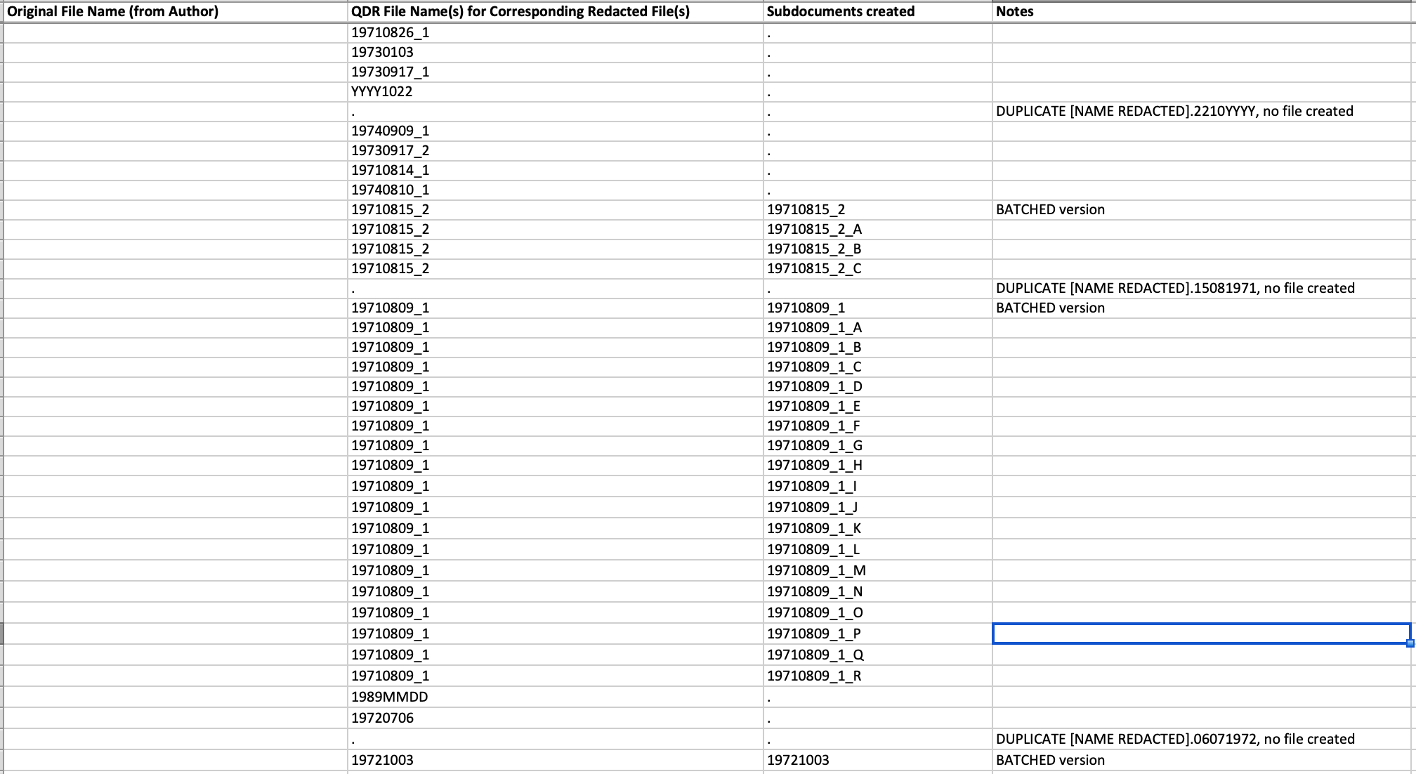
Loyle / ALJ: Data inventory
Changed in collaboration with depositor; not for publication
“Data cleaning” for qualitative data

Slide 22
QDR Curation Costs and Institutional Membership
Why Institutional Membership?
  Part of original QDR planning
  Sustainability via curation cost allows for free access to data
  Individual “depositor pays” irregular and often not budgeted, deters data sharing
  Draw on member input and expertise to improve and shape service

Slide 23
Institutional Membership Benefits
Curation and preservation for set of “standard” data projects
Institutional governance
Member only content & services (e.g. individualized DMP consultations & training)
Contribute to sustain important, non profit, scholarly infrastructure
Data freely available to everyone; QDR only obtains license to reproduce, no copyright

Slide 24
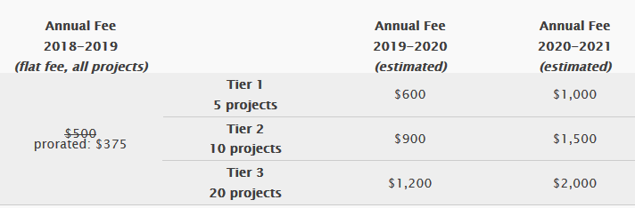
Institutional Membership Pricing

Slide 25
Beyond Institutional Membership
Stay in touch:
  qdr@syr.edu
  Twitter: @qdrepository
  Blog: https://qdr.syr.edu/qdr-blog
Available for “one-off” curation, consultation, and pricing for DMPs

