Slide 1
Tools for Reproducible Research
1 ECTS
Göteborg, November 28-29
"Piled Higher and Deeper" by Jorge Cham

Slide 2

Teachers
Rasmus
Leif
Viktor
Course content:
good practices for data analysis and management
how to use the version control system git to track edits and collaborate on coding
how to use the package and environment manager Conda
how to use the workflow manager Snakemake
how to use R Markdown to generate automated reports
how to use Jupyter notebooks to document your ongoing analysis
how to use Docker to distribute containerized computational environments
Snakemake

Slide 3
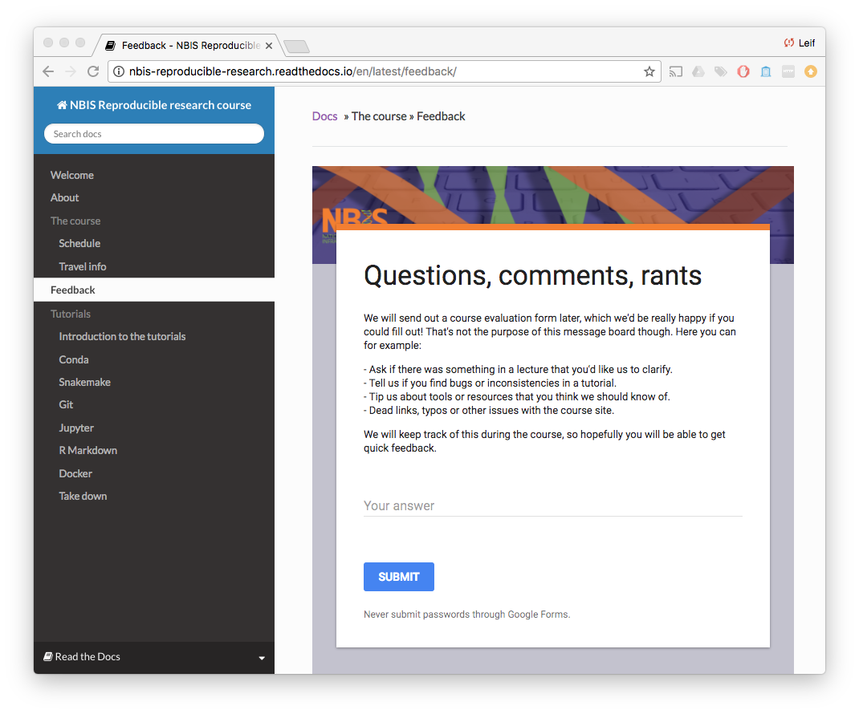
http://nbis-reproducible-research.readthedocs.io

Slide 4
Introduction to Reproducible Research

Slide 5
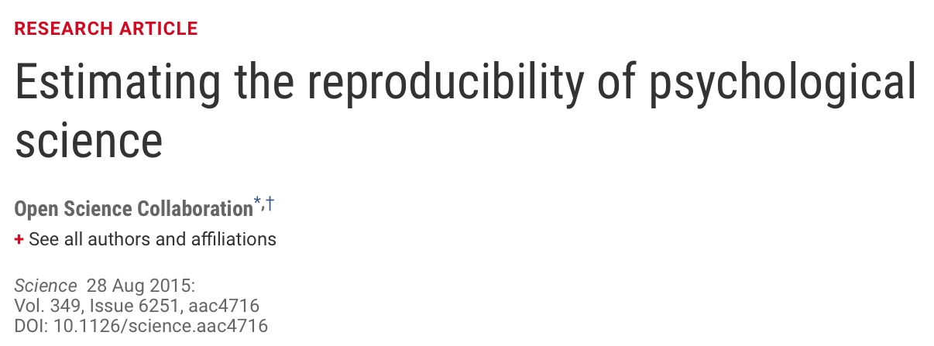
Why all the talk about
reproducible research?
The Reproducibility project set out to replicate 100 experiments published in high-impact psychology journals.
About one-half to two-thirds of the original findings could not be observed in the replication study.

Slide 6
Why all the talk about
reproducible research?
A survey in Nature revealed that irreproducible experiments are a problem across all domains of science¹.
Medicine is among the most affected research fields. A study in Nature found that 47 out of 53 medical research papers focused on cancer research were irreproducible².
Common features were failure to show all the data and inappropriate use of statistical tests.
[1] "1,500 scientists lift the lid on reproducibility". Nature. 533: 452–454
[2] Begley, C. G.; Ellis, L. M. (2012). "Drug development: Raise standards for preclinical cancer research". Nature. 483 (7391): 531–533.

Slide 7
Why all the talk about
reproducible research?
Replication of data analyses in 18 articles on microarray-based gene expression profiling published in Nature Genetics in 2005–2006:
Can reproduce…
…in principle
…with some discrepancies
Software not available
Cannot reproduce
Data not available
…from processed data with some discrepancies
Methods unclear
Different results
…partially with some discrepencies
Summary of the efforts to replicate the published analyses.
Adopted from: Ioannidis et al. Repeatability of published microarray gene expression analyses.
Nature Genetics 41 (2009) doi:10.1038/ng.295

Slide 8
What do we mean with
reproducible research?
 |  | Data
 |  | Same | Different
Code | Same | Reproducible | Replicable
 | Different | Robust | Generalisable
All parts of a bioinformatics analysis have to be reproducible:
Environment
Data
Results
”Why call the course Reproducible Research, when it could just as well be called Research?”
- Niclas Jareborg, NBIS data management guru
”The foundations of knowledge should be constituted by experimentally produced facts, which can be made believable to a scientific community by their reproducibility."
- Robert Boyle, 1627-1691
Source code

Slide 9
Where does your latest publication fit?
Decent | Getting there… | Well done!
Data available on request. All meta data required for generating the results available. | Data deposited in public repositories. Raw data available in unedited form. If the raw data needed preprocessing, scripts were used rather than modifying it manually. | Section in the paper to aid in reproduction. Used non-proprietary and machine-readable formats, e.g. .csv rather than .xls.
All code for generating results from processed data available on request. | All code for generating results from raw data is available. The code is publically available with timestamps/tags. | All code for generating results from publically available raw data is available. Code is documented and contains instructions for reproducing results. Seeds were used and documented for heuristic methods.
Key programs used are mentioned in the methods section. | List of all programs used, and their respective versions, available. | Instructions for reproducing the environment publically available.
Read more: Wilson et al. (2017) Good enough practices in scientific computing. PLoS Comput Biol 13(6)

Slide 10


What’s in it for me?
One year in submission loop and reviewer comments are finally back…
Before project
Improved structure and organization.
Forced to think about scope and limitations.
During project
Easier to rerun analyses and generate results after updating data, tools, parameters, etc.
Closer interaction between collaborators.
Much of the manuscript "writes itself".
After project
Faster resumption of research by others (or your future self), thereby increasing the impact of your work.
Increased visibility in the scientific community.
Didn't take course
Took course
I’ll just change
this and press ”rerun”.
What was I
thinking???
“It takes some effort to organize your research to be reproducible. We found that although the effort seems to be directed to helping other people stand up on your shoulders, the principal beneficiary is generally the author herself. This is because time turns each one of us into another person, and by making effort to communicate with strangers, we help ourselves to communicate with our future selves.”
Schwab et al. Making scientific computations reproducible.
Computing in Science Engineering (2000).

Slide 11
Data management

Slide 12

Data (mis)management in practice
Data acquisition
Analysis
First submission
Review
Second submission
Publication
Raw data
Meta data
Data arrives in cumbersome and proprietary format.
Gets converted to format of choice. Original files (and conversion settings) are lost.
Leads a quiet life on the HPC cluster, until the project expires and the data has to be urgently retrieved.
Ends its days on an external hard drive on the researcher's desk.
"Data available upon request".
In researcher's lab journal.
Hard-coded in various analysis scripts.
Mailed back and forth between collaborators in ever-changing (but nicely colored) Excel sheets.
Reformatted and included as PDF in the supplementary.

Slide 13
FAIR
Strive to make your data FAIR – Findable, Accessible, Interoperable, and Reusable for both machines and humans.
Wilkinson, Mark et al. “The FAIR Guiding Principles for scientific data management and stewardship”.
Scientific Data 3, 160018 (2016) doi:10.1038/sdata.2016.18

Slide 14
Data management plan
Plan
Create
Process
Analyze
Preserve
Share
Reuse
Check the requirements of your funding agency and field of research.
List the types of data that you expect to produce.
Decide what data require archiving, and determine how much storage space you will need (short and long term).
Provide metadata that allows others to understand, cite and reuse your data files.
Make clear how and when your data can be shared with scientists outside your group.
If your research involves sensitive data, explain any legal and ethical restrictions on data access and reuse.
Look for suitable data repositories used by your research community.
Check what data format and structure the chosen repository might request.
Adapted from Nature 555, 403-405 (2018), doi: 10.1038/d41586-018-03071-1
Life cycle for scientific data

Slide 15
Pair up and discuss!
Does your group have a data management plan in place?
Do you know "your" repositories and how to submit data to them?

Slide 16
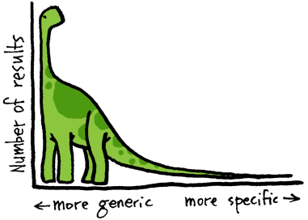

Data acquisition and deposit
Find the right repository for your data, and strive towards uploading data to its final destination already at the beginning of a project.
Structure metadata in the format needed by the repository already as the experiments are being performed.
Stick to non-proprietary and widely used file formats.
Only 12% of articles from NIH funded research mention data deposited in international repositories
Estimated 200000+ “invisible” data sets / year
Read et al. (2015) PLoS ONE 10(7) doi:10.1371/journal.pone.0132735
Scientific Data (Springer Nature) maintains a list of recommended repositories at www.nature.com/sdata/policies/repositories.
Dedicated repositories:
e.g. SRA, GEO, GenBank, UniProt etc.
Generalist ("long-tail data") repositories:
Research data that doesn’t fit in structured data repositories, e.g. Data Dryad, Figshare, Zenodo.
Each dataset can be assigned a Digital Object Identifier ( ); a persistent identifier used to uniquely identify objects.

Slide 17
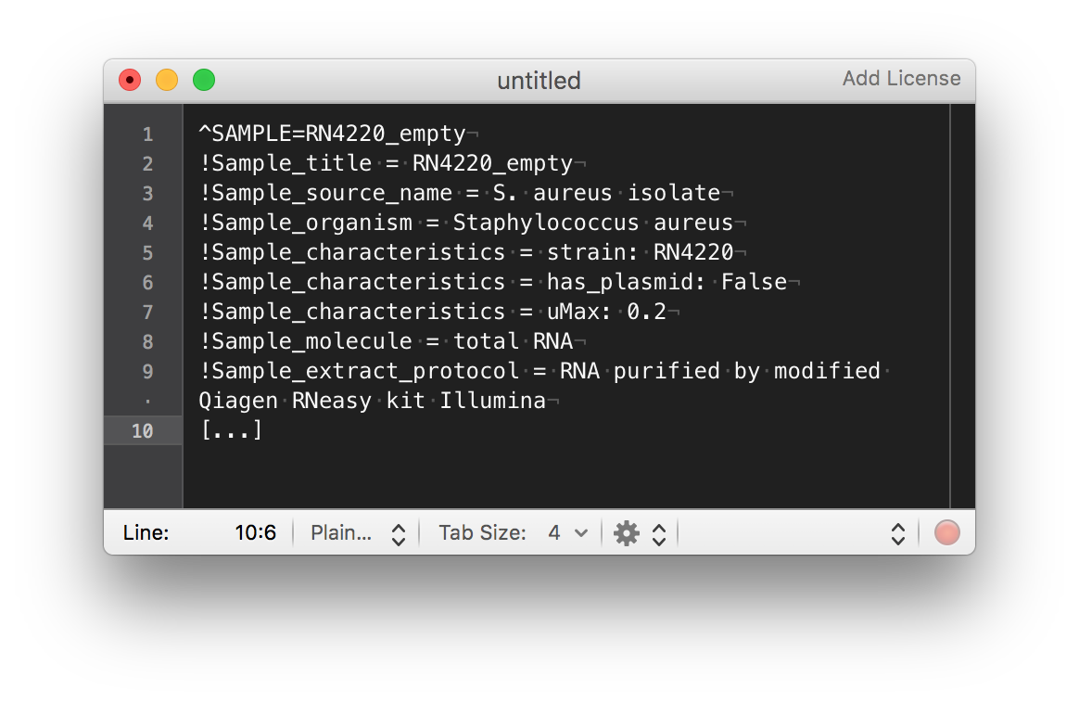
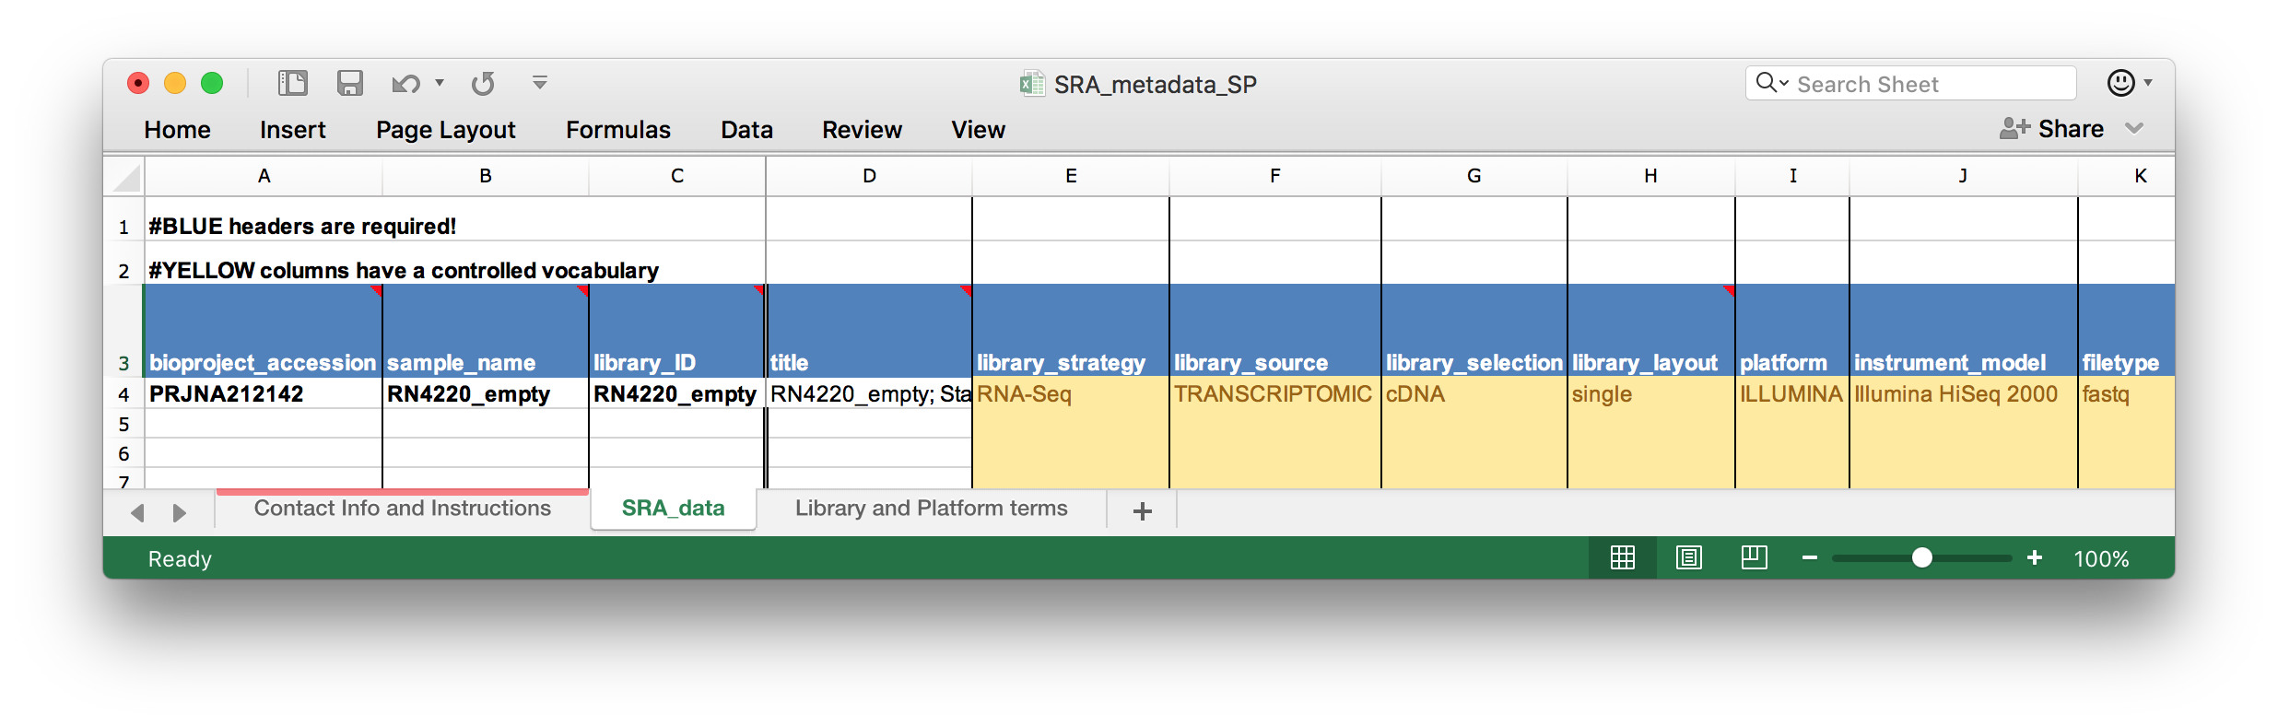
Data acquisition and deposit
Find the right repository for your data, and strive towards uploading data to its final destination already at the beginning of a project.
Structure metadata in the format needed by the repository already as the experiments are being performed.
Stick to non-proprietary and widely used file formats.
GEO (Gene Expression Omnibus) uses text files in SOFT format.
SRA (Sequence Read Archive) uses a template Excel sheet for metadata.

Slide 18
Data acquisition and deposit
Find the right repository for your data, and strive towards uploading data to its final destination already at the beginning of a project.
Structure metadata in the format needed by the repository already as the experiments are being performed.
Stick to non-proprietary and widely used file formats.
- | +
Binary | Text-based
Proprietary | Open
New kid on the block | Old as the hills
Compressed/encrypted | Uncompressed/unencrypted
Platform dependent | Interoperable
Complex | Simple
 | 🤢 | 🙄 | 😀
Raster graphic | wmf, psd | bmp, gif | tiff, png, jpeg
Vector graphic | ai, eps | pdf | svg
Document | doc | docx, tex | odt, utf-8, md
Archive | rar | 7z | zip, tar, gz
Tabular data | xls, rds, mat | xlsx, ods | csv

Slide 19
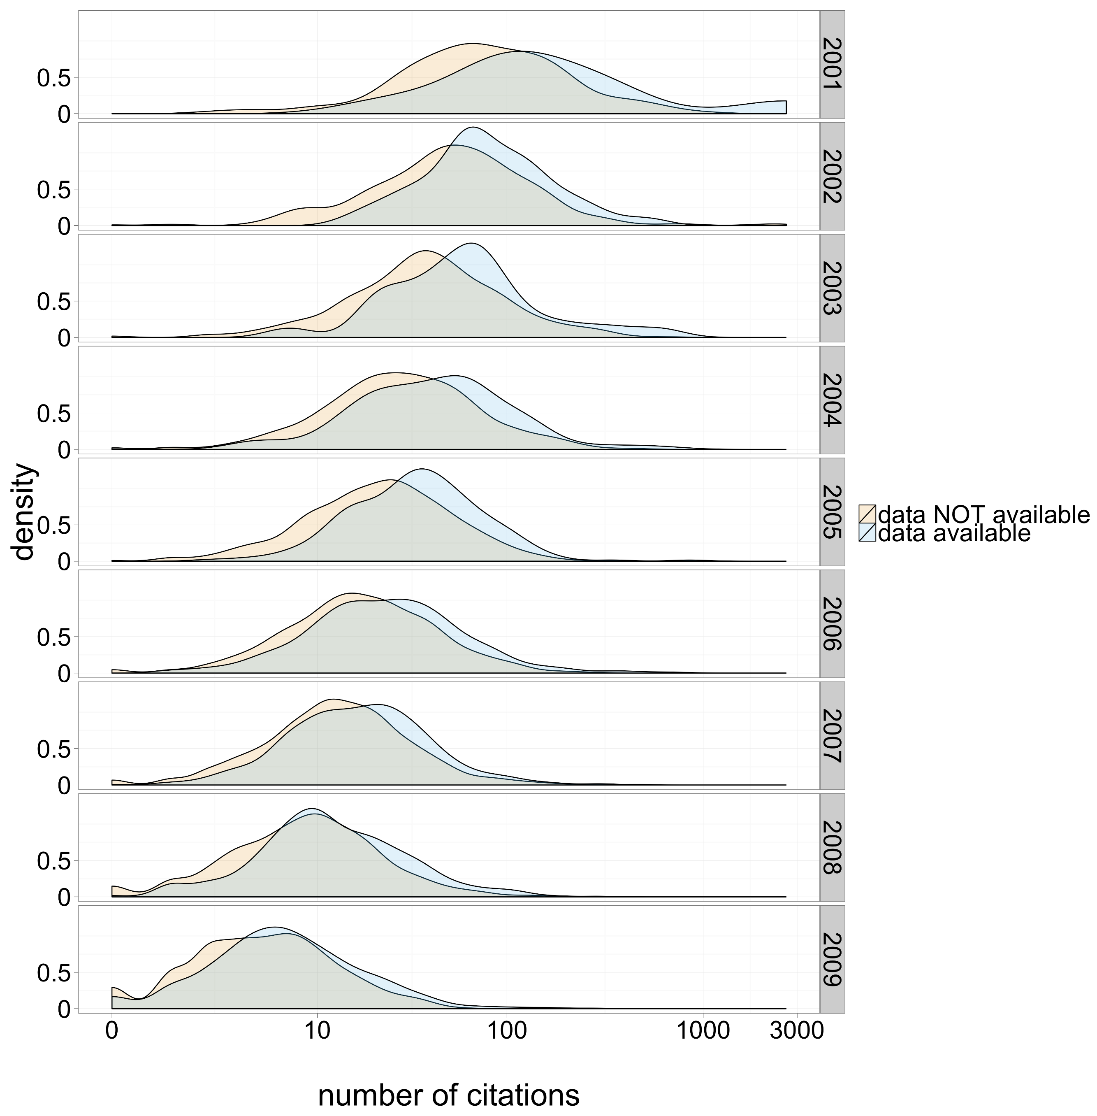
Data sharing
From 10,555 studies with gene expression microarray data:
Studies that shared data received 9% more citations (after accounting for other covariates).
Data reuse by other researchers continued for >6 years.
A very conservative estimate found that 20% of the datasets deposited between 2003 and 2007 had been reused at least once by third parties.
Piwowar and Vision (2013), Data reuse and the open data citation advantage, PeerJ 1:e175, doi:10.7717/peerj.175

Slide 20
Data sharing – Open access
Democracy and transparency
  Publicly funded research data should be accessible to all free of charge.
  Published results and conclusions should be possible to check by others.
Research
  Enables others to combine data, address new
  questions, and develop new analytical methods.
  Reduce duplication and waste.
Innovation and utilization outside research
  Public authorities, companies, and individuals
  outside academia can make use of the data.
Citation
  Citation of data will be a merit for the researcher
  that produced it.

Slide 21
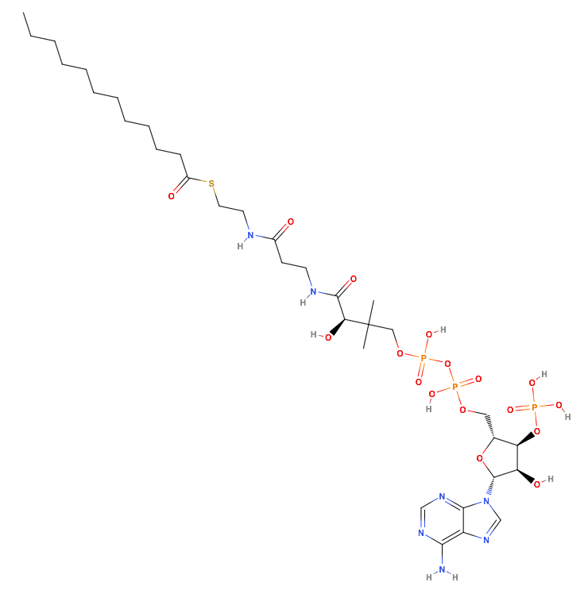
Data sharing – Ontologies
lauroyl-CoA
dodecanoyl-CoA
C12:0-CoA
lauroyl coenzyme A
coenzyme A, S-dodecanoate
dodecanoyl coenzyme A
C12:0 coenzyme A
dodecanoic acid coenzyme A
lauroylic acid CoA
Dodecanethioic acid, S-ester with coenzyme A
Coenzyme A, S-laurate (7CI,8CI)
12:0, lauroyl-CoA
1-undecanecarboxylic acid CoA
vulvic acid CoA
3'-phosphoadenosine 5'-(3-{(3R)-4-[(3-{[2-(dodecanoylsulfanyl)ethyl]amino}-3-oxopropyl)amino]-3-hydroxy-2,2-dimethyl-4-oxobutyl} dihydrogen diphosphate)
Who am I?
urn.miriam.chebi:15521 of course!
<scheme>.<registry>.<repository>:<id>

Slide 22
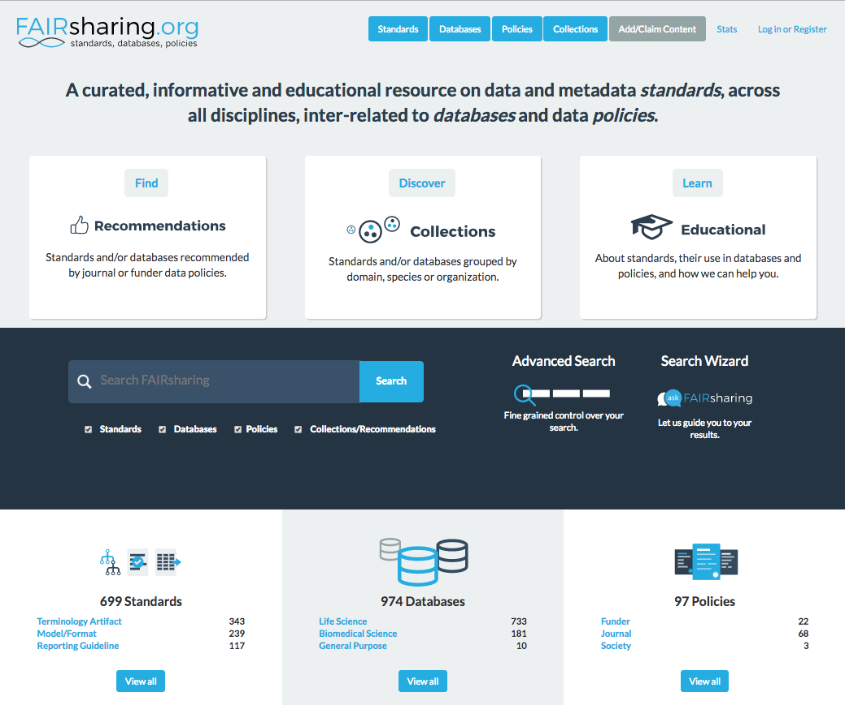
Data sharing – Ontologies

Slide 23
Project organization

Slide 24
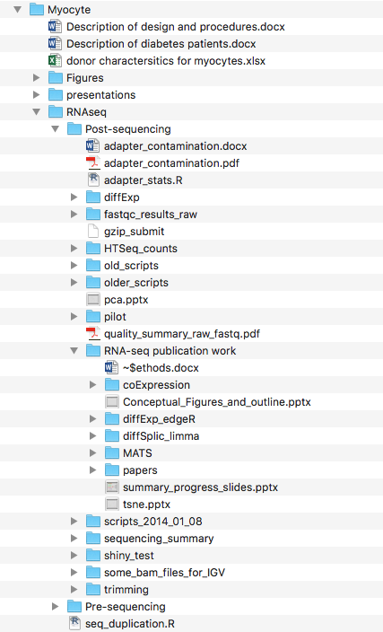
The project directory
The first step towards working reproducible: Get organized!
Divide your work into distinct projects and keep all files needed to go from raw data to final results in a dedicated directory with relevant subdirectories.

Slide 25
Pair up and discuss!
Do you organize your work in distinct projects?
How do you organize your files in this context?
Are you happy with the way you work today?

Slide 26
The project directory
project
|- doc/ documentation for the study
|
|- data/ raw and primary data, essentially all input files, never edit!
| |- raw_external/
| |- raw_internal/
| |- meta/
|
|- code/ all code needed to go from input files to final results
|- notebooks/ notebooks that document your day-to-day work
|
|- intermediate/ output files from different analysis steps, can be deleted
|- scratch/ temporary files that can be safely deleted or lost
|- logs/ logs from the different analysis steps
|
|- results/ output from workflows and analyses
| |- figures/
| |- tables/
| |- reports/
|
|- Snakefile project workflow, carries out analysis contained in code/
|- config.yml configuration of the project workflow
|- environment.yml software dependencies list, used to create a project environment
|- Dockerfile recipe to create a project container
Working in projects
Sublime Text
Noble WS (2009) A Quick Guide to Organizing Computational Biology Projects. PLoS Comput Biol 5(7): e1000424.
http://journals.plos.org/ploscompbiol/article?id=info:doi/10.1371/journal.pcbi.1000424
https://github.com/NBISweden/project_template

Slide 27
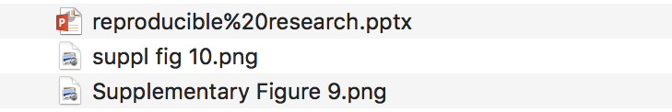
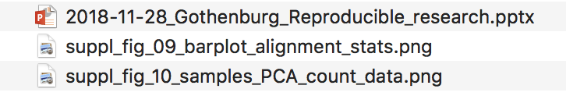
File naming system
Machine readable
Avoid special characters, e.g.: ~!@#$%^&*()`;<>?,[]{}‘”|
Avoid spaces, alternatives:
  file_name.txt
  file-name.txt
  filename.txt
  FileName.txt
Human readable
Know the content of a file without opening it, e.g.:
SRR1234.hg19.sorted.trimmed.bam
Control file ordering
Use dates if appropriate
Use 01, 02, rather than 1, 2
~ ! @ # $ % ^ & * ( ) ` ; < > ? , [ ] { } ‘ ” |
Bad examples:
Good examples:

Slide 28
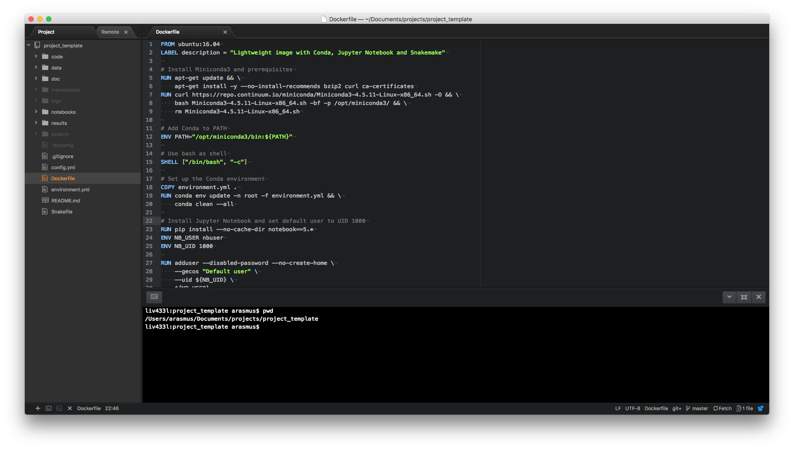
A project in Atom
Syntax highlighting, indentation, and autocomplete

Slide 29
A project in Atom
Integrated version control with Git

Slide 30
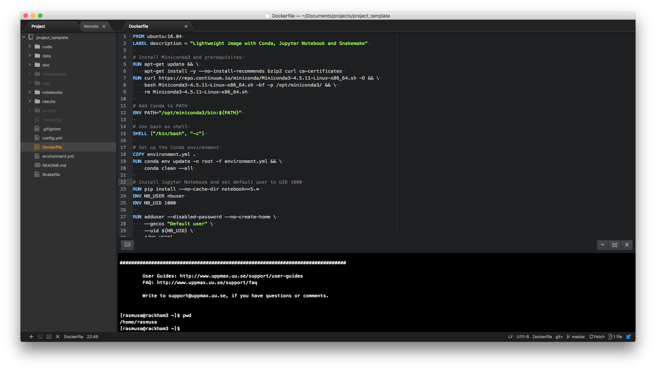
A project in Atom
Automatically sync files between local/remote

Slide 31
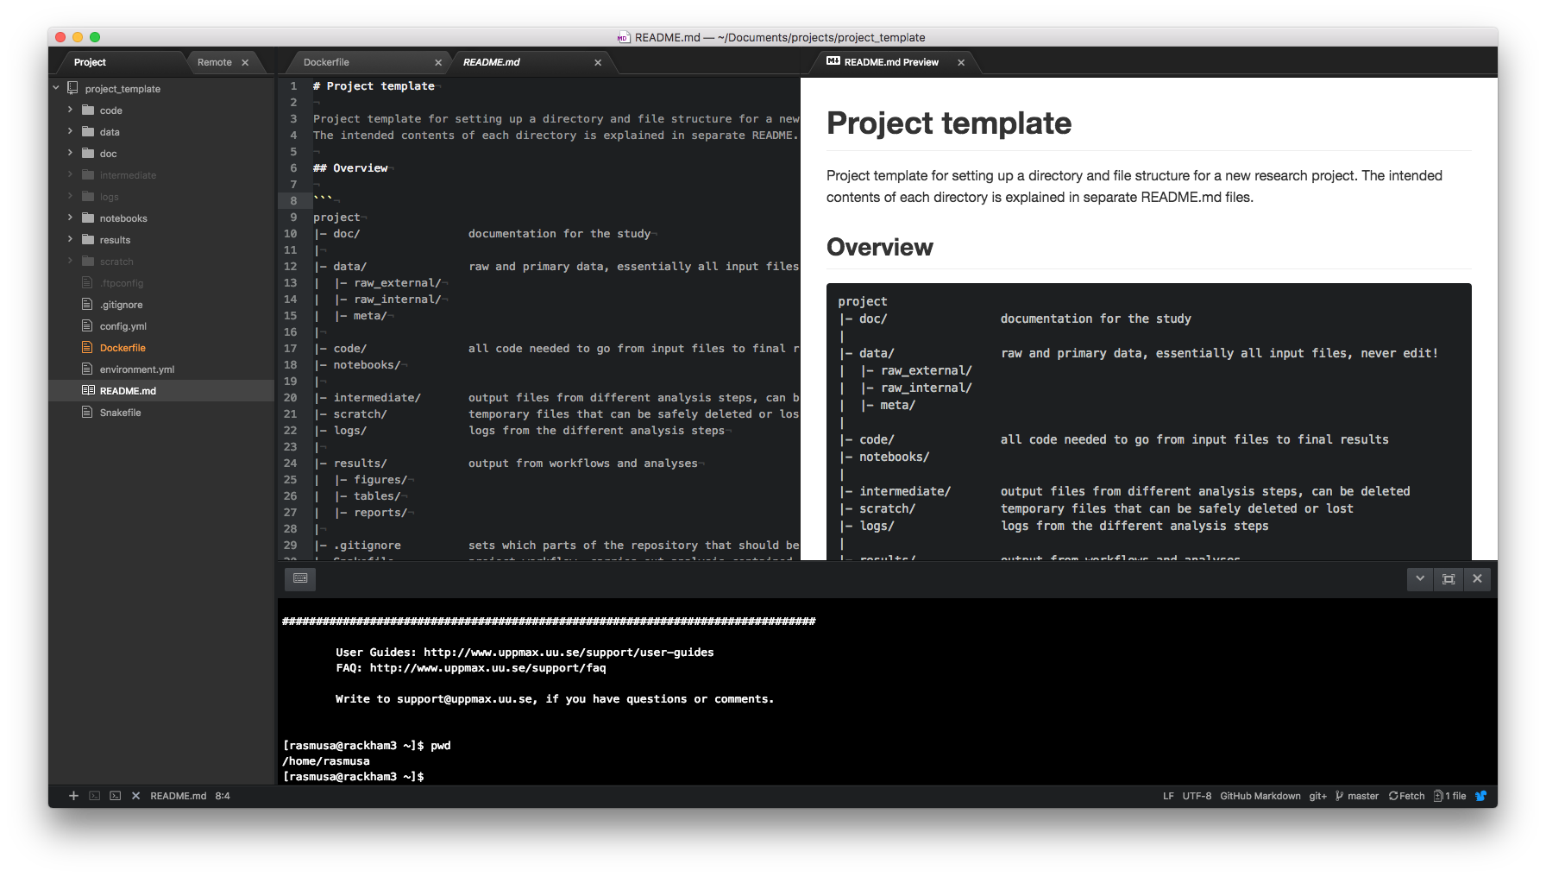
A project in Atom
Tons of plugins, e.g. for viewing different file formats

Slide 32
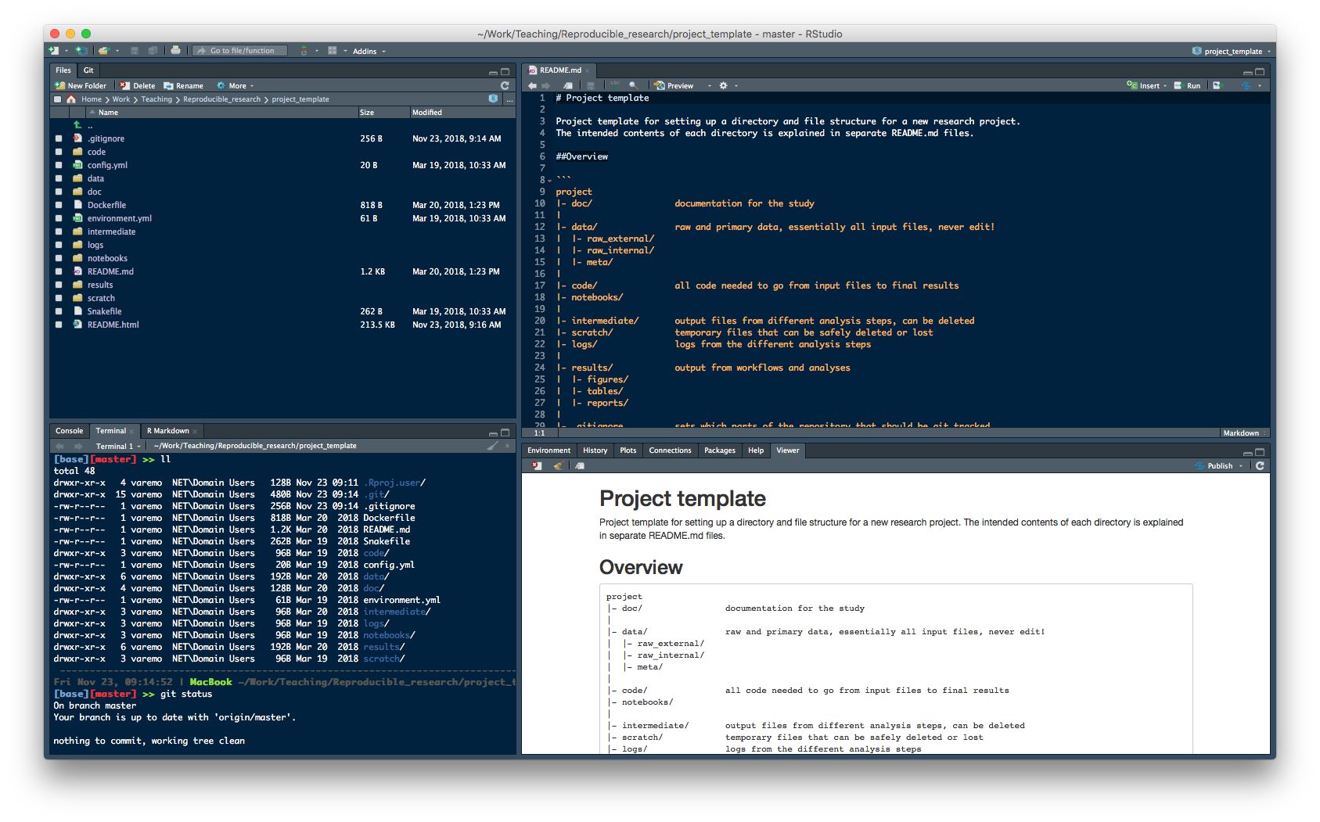
A project in RStudio
Rstudio

Slide 33
project
|- doc/
|
|- data/
| |- raw_external/
| |- raw_internal/
| |- meta/
|
|- code/
|- notebooks/
|
|- intermediate/
|- scratch/
|- logs/
|
|- results/
| |- figures/
| |- tables/
| |- reports/
|
|- Snakefile
|- config.yml
|- environment.yml
|- Dockerfile
Environment
Data
Results
Source code

Slide 34

Tools for Reproducible Research
Snakemake
Managing dependencies
Managing and executing analysis workflow
Versioning and collaborating on code (and some other files)
Connecting code and reporting
and…
Isolating and exporting environment

Slide 35
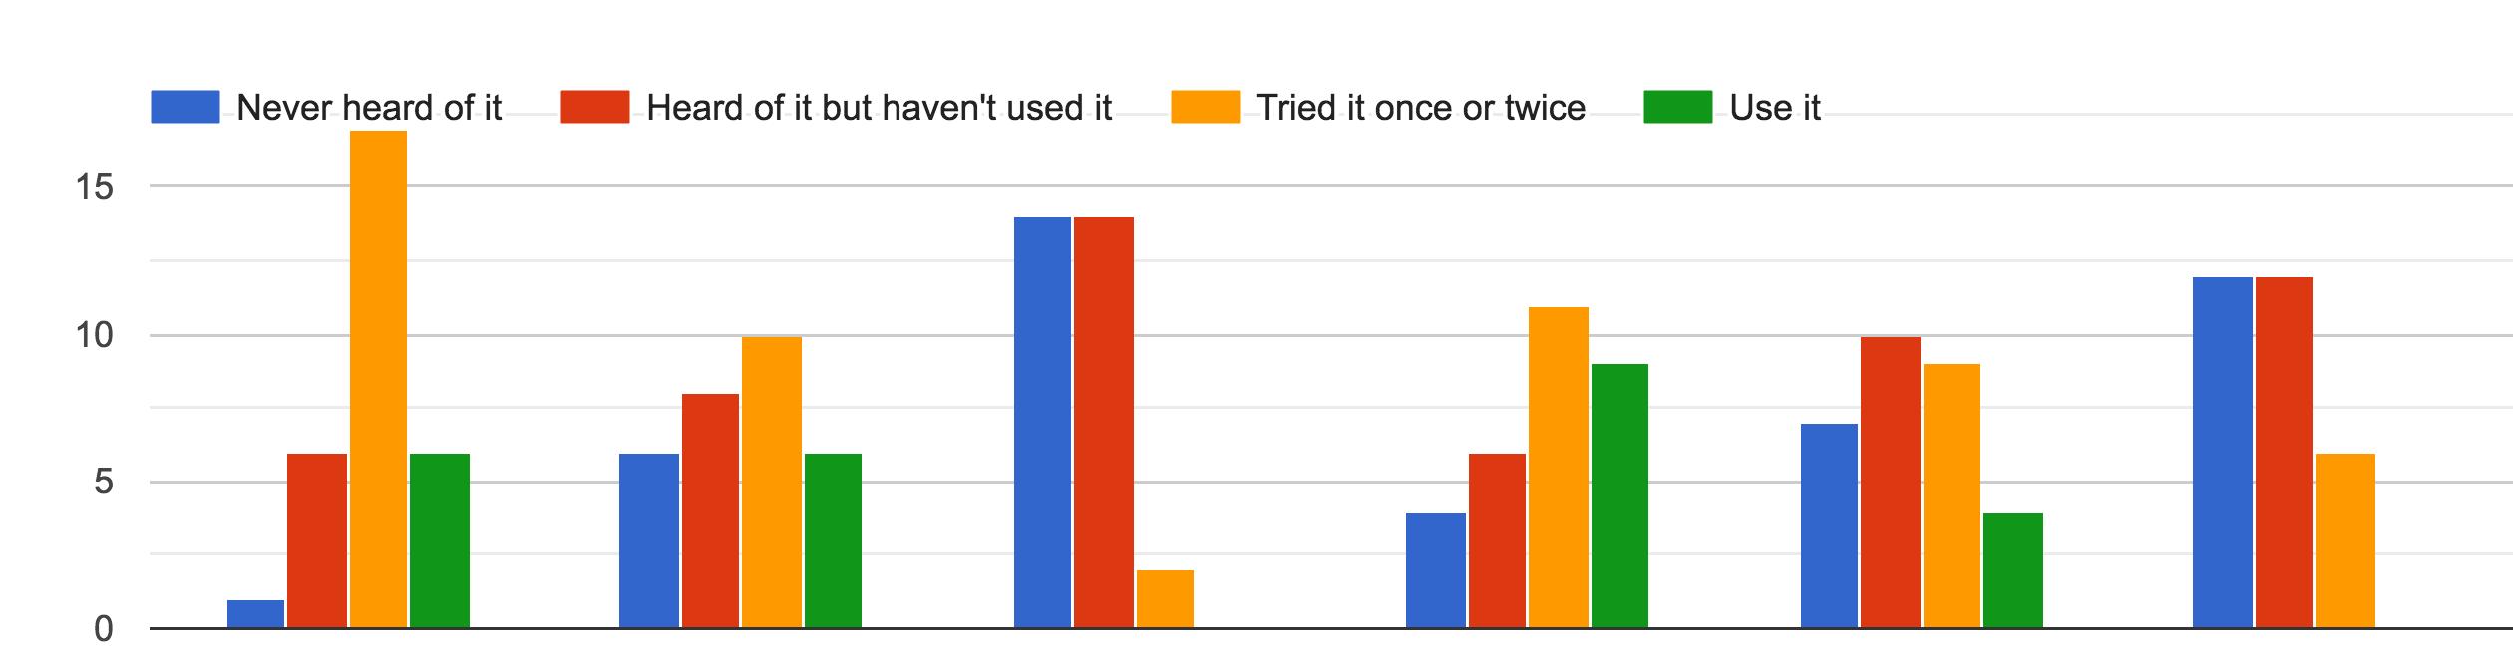
Student experience
Snakemake

Slide 36
Snakemake
Managing dependencies
Managing and executing analysis workflow
Versioning and collaborating on code (and some other files)
Connecting code and reporting
and…
Isolating and exporting environment

Slide 37
Full reproducibility requires the possibility to recreate the system that was originally used to generate the results.

Slide 38
What is Conda?
Conda is a package, dependency, and environment manager.
Works for software developed in any programming language.
Decent | Getting there… | Well done!
Manuscript.docx
Manuscript.docx
environment.yml
Methods
We used:
Bowtie2
Samtools
HTSeq
Methods
We used:
Bowtie2 (v2.3)
Samtools (v1.6)
HTSeq (v0.9)
channels:
- conda-forge
- bioconda
dependencies:
- bowtie2=2.3
- samtools=1.6
- htseq=0.9
User install manually
(including all needed dependencies).
Conda creates an environment with the listed packages and dependencies automatically.

Slide 39
Package manager
Conda package: compressed tarball (system-level libraries, Python or other modules, executable programs, or other components).
Conda keeps track of the dependencies between packages and platforms.
Conda packages are downloaded from remote channels.
conda install -c conda-forge matplotlib
$
$
>>>
Fetching package metadata ...........
Solving package specifications: ..........
Package plan for installation in environment /Users/varemo/Applications/miniconda2/envs/test-r2:
The following packages will be downloaded:
package | build
---------------------------|-----------------
sqlite-3.13.0 | 1 1.4 MB conda-forge
libpng-1.6.24 | 0 338 KB conda-forge
python-2.7.12 | 1 11.8 MB conda-forge
certifi-2016.8.31 | py27_0 218 KB conda-forge
freetype-2.6.3 | 1 782 KB conda-forge
functools32-3.2.3.2 | py27_1 16 KB conda-forge
numpy-1.11.1 | py27_0 3.1 MB defaults
pyparsing-2.1.8 | py27_0 89 KB conda-forge
pytz-2016.6.1 | py27_0 183 KB conda-forge
six-1.10.0 | py27_0 18 KB conda-forge
cycler-0.10.0 | py27_0 13 KB conda-forge
python-dateutil-2.5.3 | py27_0 236 KB conda-forge
setuptools-26.1.1 | py27_0 346 KB conda-forge
matplotlib-1.5.3 | np111py27_0 4.1 MB conda-forge
wheel-0.29.0 | py27_0 81 KB conda-forge
pip-8.1.2 | py27_0 1.5 MB conda-forge
------------------------------------------------------------
Total: 24.2 MB
The following NEW packages will be INSTALLED:
certifi: 2016.8.31-py27_0 conda-forge
cycler: 0.10.0-py27_0 conda-forge
freetype: 2.6.3-1 conda-forge
functools32: 3.2.3.2-py27_1 conda-forge
matplotlib: 1.5.3-np111py27_0 conda-forge
mkl: 11.3.3-0 defaults
numpy: 1.11.1-py27_0 defaults
pip: 8.1.2-py27_0 conda-forge
pyparsing: 2.1.8-py27_0 conda-forge
python: 2.7.12-1 conda-forge
Python-dateutil: 2.5.3-py27_0 conda-forge
pytz: 2016.6.1-py27_0 conda-forge
setuptools: 26.1.1-py27_0 conda-forge
six: 1.10.0-py27_0 conda-forge
sqlite: 3.13.0-1 conda-forge
wheel: 0.29.0-py27_0 conda-forge
The following packages will be UPDATED:
libpng: 1.6.17-0 r --> 1.6.24-0 conda-forge
Proceed ([y]/n)? Y
Pruning fetched packages from the cache ...
Fetching packages ...
sqlite-3.13.0- 100% |########################################################################| Time: 0:00:07 181.85 kB/s libpng-1.6.24- 100% |########################################################################| Time: 0:00:01 231.85 kB/s python-2.7.12- 100% |########################################################################| Time: 0:00:35 352.76 kB/s certifi-2016.8 100% |########################################################################| Time: 0:00:01 218.31 kB/s freetype-2.6.3 100% |########################################################################| Time: 0:00:02 380.05 kB/s functools32-3. 100% |########################################################################| Time: 0:00:00 99.19 kB/s numpy-1.11.1-p 100% |########################################################################| Time: 0:00:08 362.78 kB/s pyparsing-2.1. 100% |########################################################################| Time: 0:00:00 212.24 kB/s pytz-2016.6.1- 100% |########################################################################| Time: 0:00:00 230.51 kB/s six-1.10.0-py2 100% |########################################################################| Time: 0:00:00 79.97 kB/s cycler-0.10.0- 100% |########################################################################| Time: 0:00:00 99.54 kB/s python-dateuti 100% |########################################################################| Time: 0:00:00 327.75 kB/s setuptools-26. 100% |########################################################################| Time: 0:00:01 227.73 kB/s matplotlib-1.5 100% |########################################################################| Time: 0:00:10 422.37 kB/s wheel-0.29.0-p 100% |########################################################################| Time: 0:00:00 190.76 kB/s pip-8.1.2-py27 100% |########################################################################| Time: 0:00:03 441.97 kB/s Extracting packages ...
[ COMPLETE ]|###########################################################################################| 100%
Unlinking packages ...
[ COMPLETE ]|###########################################################################################| 100%
Linking packages ...
[ COMPLETE ]|###########################################################################################| 100%
python
import matplotlib

Slide 40
Environment manager
Conda environment: directory that contains a specific collection of Conda packages that you have installed.
Packages are symlinked between environments to avoid duplication.
conda create --name env1 –c bioconda fastqc
fastqc --version
-bash: fastqc: command not found
source activate env1
fastqc --version
FastQC v0.11.5
source deactivate
conda create --name env2 –c bioconda python=3 snakemake
python --version
Python 2.7.12 :: Continuum Analytics, Inc.
snakemake --version
-bash: snakemake: command not found
source activate env2
python --version
Python 3.4.3 :: Continuum Analytics, Inc.
snakemake --version
3.7.1
$
$
$
$(env1)
$(env1)
$
$
$
$
$(env2)
$(env2)
$(env2)

Slide 41
Defining and sharing environments
environment.yml
Create an environment from specifications in a file.
All additional dependencies will be included.
The environment.yml file can be shared with others and used to recreate the environment on other systems.
channels:
- conda-forge
- bioconda
dependencies:
- fastqc=0.11
- sra-tools=2.8
- snakemake=4.3.0
- multiqc=1.3
- bowtie2=2.3
- samtools=1.6
- htseq=0.9
- graphviz=2.38.0
$
conda env create --name project_a -f environment.yml
Update existing environment after adding new packages to environment.yml:
conda env update –f environment.yml
$
Export existing environment as new yaml file (also includes dependencies):
conda env export > environment_full.yml
$

Slide 42
project
|- doc/
|
|- data/
| |- raw_external/
| |- raw_internal/
| |- meta/
|
|- code/
|- notebooks/
|
|- intermediate/
|- scratch/
|- logs/
|
|- results/
| |- figures/
| |- tables/
| |- reports/
|
|- Snakefile
|- config.yml
|- environment.yml
|- Dockerfile
Environment
Data
Results
Source code

Slide 43
The tutorials
A few practical notes…

Slide 44
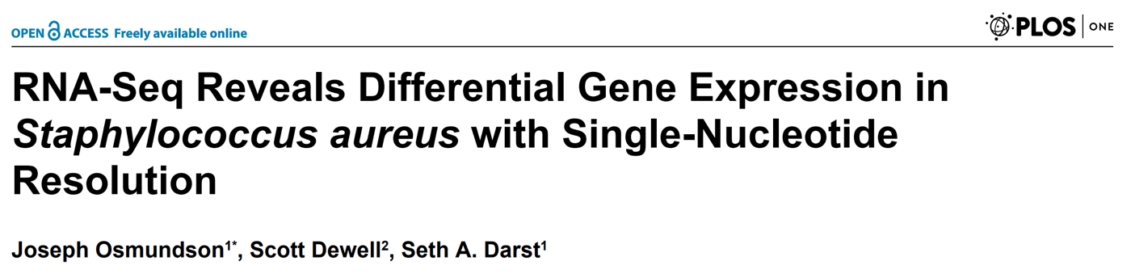
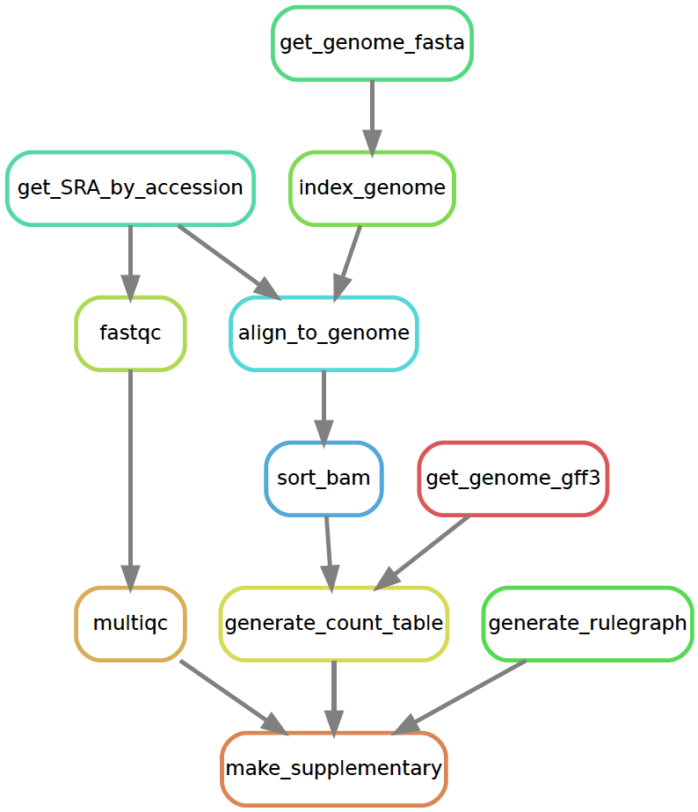
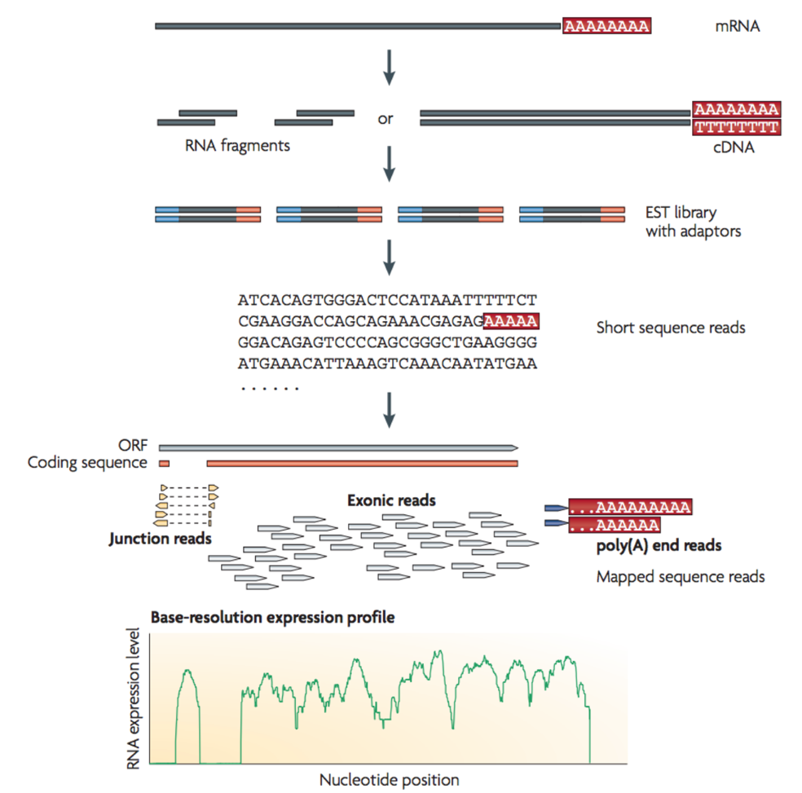
The analysis workflow
Methicillin-resistant Staphylococcus aureus (MRSA):
  is resistant to broad spectrum beta-lactam antibiotics
  lead to difficult-to-treat infections in humans
Lytic bacteriophages have been suggested as potential therapeutic agents, or as the source of novel antibiotic proteins or peptides.
One such protein, gp67, was identified as a transcription-inhibiting transcription factor with an antimicrobial effect.
To identify S. aureus genes repressed by gp67, the authors expressed gp67 in S. aureus cells.
RNA-seq was performed on S. aureus strains:
  RN4220 with pRMC2 with gp67
  RN4220 with empty pRMC2
  NCTC8325-4
Scanning electron micro-graph of a human neutrophil ingesting MRSA

Slide 45

The tutorials
Environment management
Set up and manage the project environment
Start here!
Version control
Track and backup your project history
Workflow management
Move from separate scripts to a connected analysis
Do it all!
Workflow
Reproducible
environment
Interactive
notebooks
Snakemake
Reports
Connect code, output and text in fancy reports
Notebooks
Document your exploratory analysis
Containerization
Make your project self-contained and distributable

Slide 46
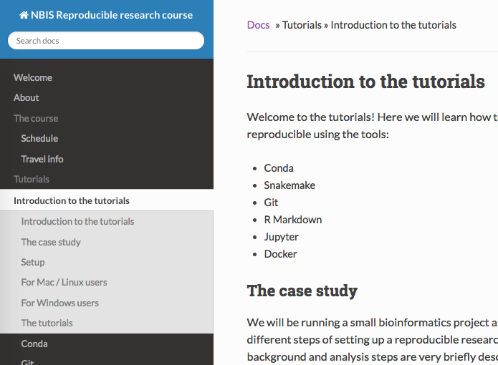
Getting started
Clone course git repository to get all files needed for tutorials!
Each tutorial will run in a specific subdirectory within reproducible_research_course, make sure you are running from the right place!
Exception: the git tutorial will be run in a user-created directory outside of reproducible_research_course.
Start here!
http://nbis-reproducible-research.readthedocs.io

Slide 47
Snakemake
Managing dependencies
Managing and executing analysis workflow
Versioning and collaborating on code (and some other files)
Connecting code and reporting
and…
Isolating and exporting environment

Slide 48
As projects grow or age, it becomes increasingly difficult to keep track of all the parts and how they fit together.
“Snakemake is a workflow management system that aims to reduce the complexity of creating workflows by providing a fast and comfortable execution environment, together with a clean and modern specification language in python style.”

Slide 49
Snakemake
dataD
Scalability
dataC
script1
Figure 1
dataB
dataA
script2A
fileA
script2B
filesC,D,E
script2C
Figure 2
Reproducibility

Slide 50
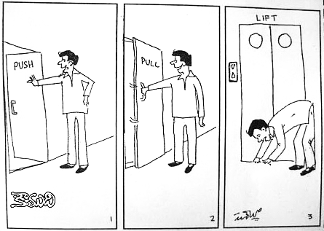
Snakemake
Workflow management systems come in different flavors.
Explicit syntax ("Push")
"Here are my inputs, please perform these operations in this order on them."
Implicit syntax ("Pull")
"I need this output, could you please figure out which operations to perform and in which order?"

Slide 51
Snakemake
Explicit approach using Bash
trim_and_zip.sh
$bash trim_and_zip.sh
Trimming sample: a Compressing sample: a Trimming sample: b Compressing sample: b
for sample in *.fastq
do
id=$(echo ${sample} | sed 's/.fastq//')
# Trim fastq file
echo “Trimming ${id}“
seqtk trimfq -b 5 -e 10 $sample > \
${id}.trimmed.fastq
# Compress fastq file
echo “Compressing ${id}“
gzip -c ${id}.trimmed.fastq > \
${id}.trimmed.fastq.gz
# Remove intermediate files
rm ${id}.trimmed.fastq
done

Slide 52
Snakemake
$snakemake {a,b}.trimmed.fastq.gz
Provided cores: 1 Rules claiming more threads will be
scaled down. Job counts: count jobs 2 gzip 2 trim_fastq 4 rule trim_fastq:
input: a.fastq
output: a.trimmed.fastq
wildcards: prefix=a 1 of 4 steps (25%) done
rule gzip:
input: a.trimmed.fastq
output: a.trimmed.fastq.gz
wildcards: prefix=a.trimmed.fastq Removing temporary output file a.trimmed.fastq. 2 of 4 steps (50%) done rule trim_fastq:
input: b.fastq
output: b.trimmed.fastq
wildcards: prefix=b 3 of 4 steps (75%) done rule gzip:
input: b.trimmed.fastq
output: b.trimmed.fastq.gz
wildcards: prefix=b.trimmed.fastq Removing temporary output file b.trimmed.fastq. 4 of 4 steps (100%) done
Implicit approach using Snakemake
Snakefile
rule trim_fastq:
input: "{prefix}.fastq"
output: temp("{prefix}.trimmed.fastq")
shell:
"seqtk trimfq -b 5 -e 10 {input} > {output}"
rule gzip:
input: "{prefix}"
output: "{prefix}.gz"
shell:
"gzip -c {input} > {output}"

Slide 53
Snakemake
Snakemake figures out how rules can be pieced together to generate some requested output.
Here we ask for supplementary.pdf, which is an R Markdown report generated by the rule make_supplementary.
$snakemake supplementary.pdf --rulegraph | dot -Tpdf > rulegraph.pdf

Slide 54
Snakemake
Snakemake keeps track of when files were generated and by which rules.
Dotted rule boxes show that supplementary.pdf already exists and that it's newer than its dependencies (recursively).
$snakemake supplementary.pdf --dag | dot -Tpdf > dag.pdf

Slide 55
Snakemake
Here Snakemake detects that a file used in align_to_genome is newer than downstream files, so it reruns the necessary rules.
$touch intermediate/NCTC8325.1.bt2
$snakemake supplementary.pdf --dag | dot -Tpdf > dag.pdf

Slide 56
Snakemake
Forcing a rule (get_genome_fasta here) to be rerun also leads to rerunning all rules that depend on it.
Note that we also change the parameter "genome_id" to use another genome to align to. This causes get_genome_gff3 to be rerun as well.
$snakemake supplementary.pdf --config genome_id=ST398
-f get_genome_fasta --dag | dot -Tpdf > dag.pdf

Slide 57
Snakemake
Anatomy of a Snakemake rule
import os
rule trim_fastq:
input: "{prefix}.fastq"
output: temp("{prefix}.trimmed.fastq")
params:
leftTrim=5,
rightTrim=10
log: "logs/trim_fastq.log"
version: "0.1"
message: "Trimming {input[0]}."
shadow: True
threads: 8
priority: 90
resources: mem=64
conda: "envs/seqtk.yaml”
singularity: "docker://quay.io/biocontainers/seqtk"
run:
if (os.stat(input[0]).st_size > 0):
shell("seqtk trimfq -t {threads} –b {params.leftTrim}
-e {params.rightTrim} {input} > {output} 2> {log}")
else:
raise IOError(input[0]+" is empty.")

Slide 58
Snakemake
Command line interface
# execute the workflow with target a.trimmed.fastq.gz
snakemake a.trimmed.fastq.gz
# execute the workflow with the first rule as target
snakemake
# dry-run, print shell commands and reason for execution
snakemake -n –p -r
# visualize the DAG of jobs using the Graphviz dot command
snakemake --dag | dot -Tsvg > dag.svg
# execute the workflow with 8 cores
snakemake --cores 8
# run the workflow on a SLURM cluster
snakemake --cluster-config cluster.yml --cluster \
"sbatch -A {cluster.account} -t {cluster.time}"

Slide 59
Snakemake
Things can get rather complex...

Slide 60
Snakemake
project
|- doc/
|
|- data/
| |- raw_external/
| |- raw_internal/
| |- meta/
|
|- code/
|- notebooks/
|
|- intermediate/
|- scratch/
|- logs/
|
|- results/
| |- figures/
| |- tables/
| |- reports/
|
|- Snakefile
|- config.yml
|- environment.yml
|- Dockerfile
Environment
Data
Results
Source code

Slide 61
Snakemake
Managing dependencies
Managing and executing analysis workflow
Versioning and collaborating on code (and some other files)
Connecting code and reporting
and…
Isolating and exporting environment

Slide 62
What is Git?
Widely used system for file version control.
Keeps copies of files and code from every stages in their lifecycle.
Kind of like Dropbox, but you decide when each version is saved (and a lot more advanced features).
Each file has a distinct history with specific incremental changes (each with a reference code).
  Revert files to previous state.
  Compare changes over time.
  See who modified what.
Makes you fearless.
Runs on command line, but there also exists GUI and integration in e.g. text editors.
Mainly for text files, not for binary files or large files.
Versioning, backup, and sharing!

Slide 63
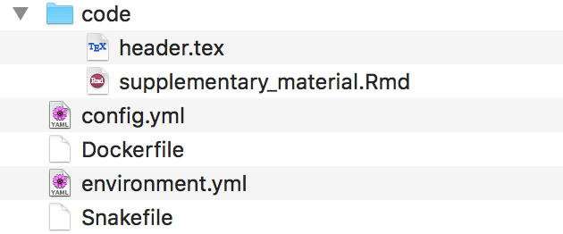
How does it work in practice?
Nomenclature
Repository
Commit
Push
Pull
Directory with all files, will include a .git folder
A specific version of the repository
Upload local changes to remote repository
Download changes from remote repository
git log
git log
a2c36bs Add heatmap figure
6152ff6 Format figure label
0abd0cb Update multiqc version
8dhfls8 Add snakemake 4.4.0
kfhs7s6 Add Snakefile
a2c36bs Add heatmap figure
6152ff6 Format figure label
0abd0cb Update multiqc version
8dhfls8 Add snakemake 4.4.0
kfhs7s6 Add Snakefile
2kd7f0f Fix alignment command
2kd7f0f Fix alignment command
Local
Remote
Working directory
environment.yml
M
Snakefile
A
?
A
Staging area
✓
Edit environment.yml
Add a new file Snakefile
git add environment.yml
git commit –m “Add snakemake 4.4.0”
git add Snakefile
git commit –m “Add Snakefile”
git push
git pull
Pull
✓
Push
Git repository
Current state
History of all files
Push

Slide 64
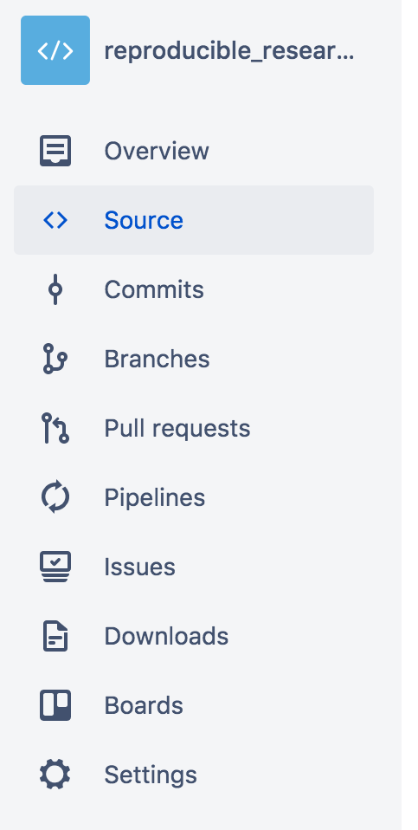
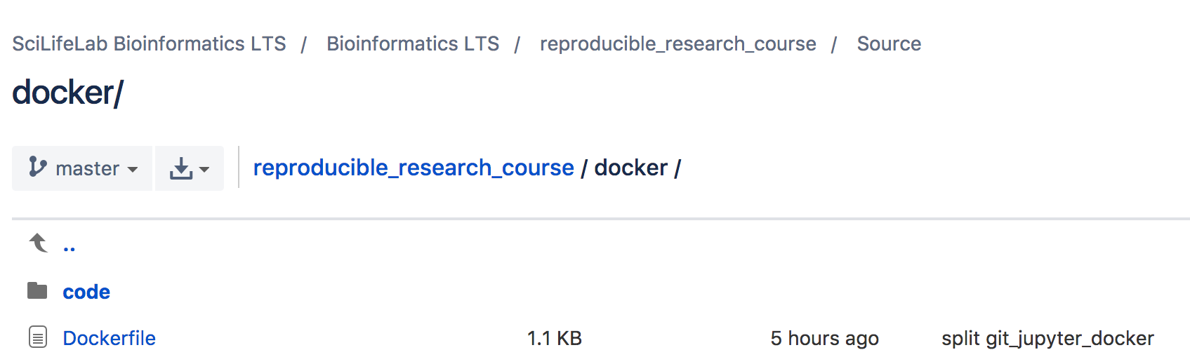
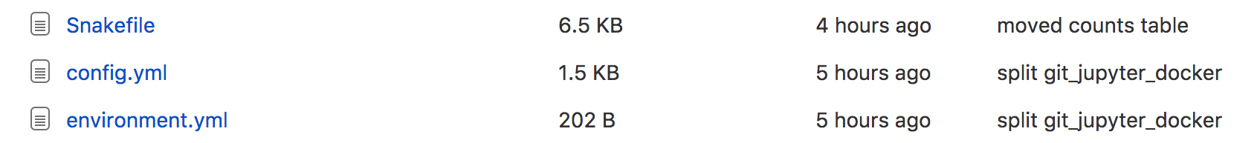

Slide 65
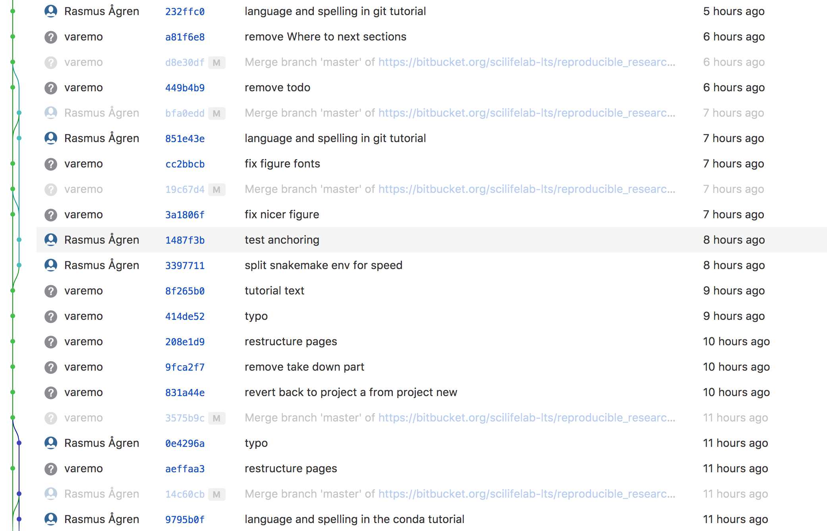

Slide 66
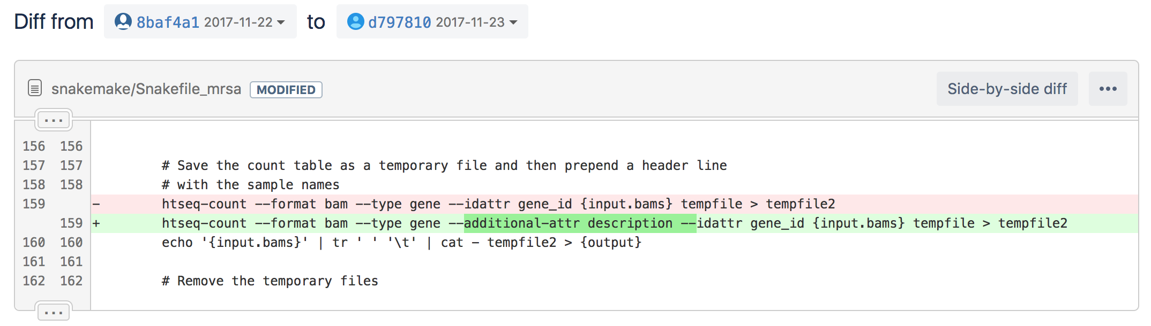

Slide 67
During the working day…
Pull collaborator's latest work to get your local repository up to date.
Carry on with your work and edit files.
Commit often!
  Each commit should be related to a distinct change/addition/task.
  Write descriptive commit messages.
Push your changes to the remote repository.
If you know several people are actively working on the same repository, push and pull often!
Remote repository
Local

Slide 68
project
|- doc/
|
|- data/
| |- raw_external/
| |- raw_internal/
| |- meta/
|
|- code/
|- notebooks/
|
|- intermediate/
|- scratch/
|- logs/
|
|- results/
| |- figures/
| |- tables/
| |- reports/
|
|- Snakefile
|- config.yml
|- environment.yml
|- Dockerfile
Environment
Data
Results
Source code

Slide 69
Snakemake
Managing dependencies
Managing and executing analysis workflow
Versioning and collaborating on code (and some other files)
Connecting code and reporting
and…
Isolating and exporting environment

Slide 70
Typical guidelines for keeping a notebook of wet-lab work
Record everything you do in the lab, even if you are following a published procedure.
If you make a mistake, put a line through the mistake and write the new information next to it.
Use a ball point pen so that marks will not smear nor will they be erasable.
Use a bound notebook so that tear-out would be visible.
If you're testing a specific hypothesis, write it down beforehand.
When you finish a page, put a corner-to corner line through any blank parts that could still be used for data entry.
All pages must be pre-numbered.
Use a ball point pen so that marks will not smear nor will they be erasable.
Write a title for each and every new set of entries.
Each page should be numbered and dated consistently.
It is critical that you enter all procedures and data directly into your notebook in a timely manner.
The investigator and supervisor must sign each page.
Properly introduce and summarize each experiment.

Slide 71
Typical guidelines for keeping a notebook of dry-lab work

Slide 72
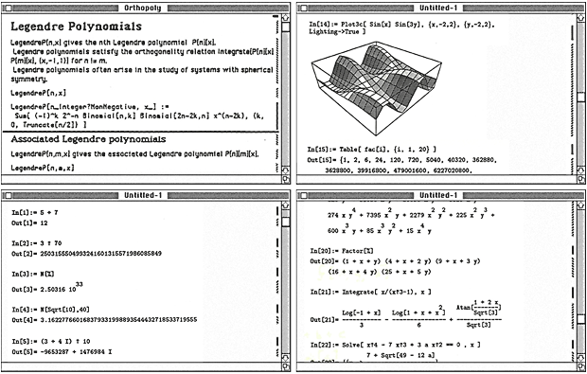
Literate programming
Instead of imagining that our main task is to instruct a computer what to do, let us concentrate rather on explaining to human beings what we want a computer to do.
Donald Knuth (1984)
Literate computing
A literate computing environment is one that allows users not only to execute commands interactively, but also to store in a literate document the results of these commands along with figures and free-form text.
Millman KJ and Perez F (2014)
Wolfgang Mathematica notebook (1988)

Slide 73
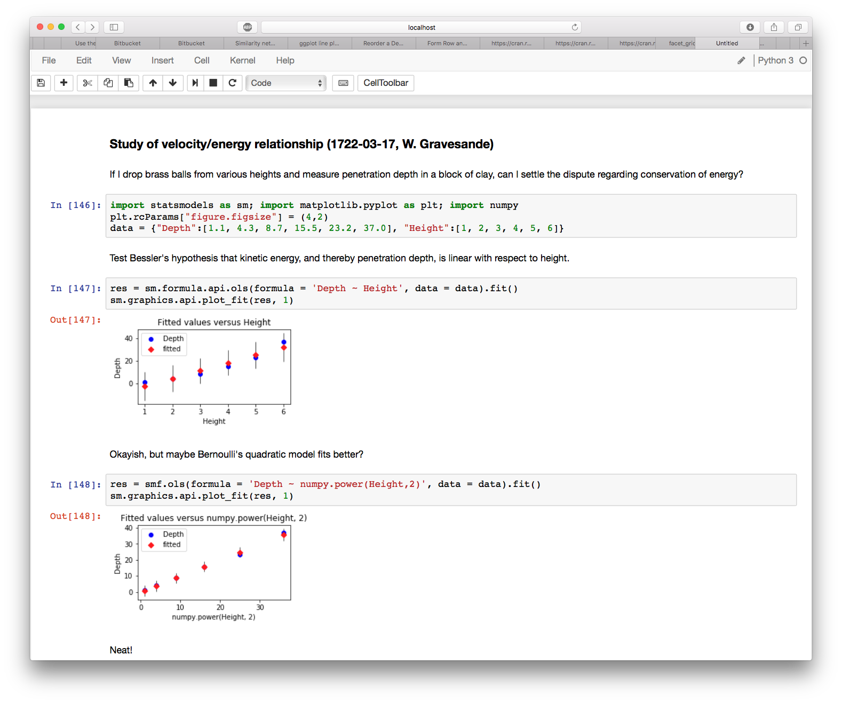
The Jupyter Notebook is a web application for interactive data science and scientific computing.
In-browser editing for code, with automatic syntax highlighting, indentation, and tab completion/introspection.
The ability to execute code from the browser, with the results of computations attached to the code which generated them.
Mix and match languages to suit your needs (e.g. scikit-learn + ggplot2).

Slide 74
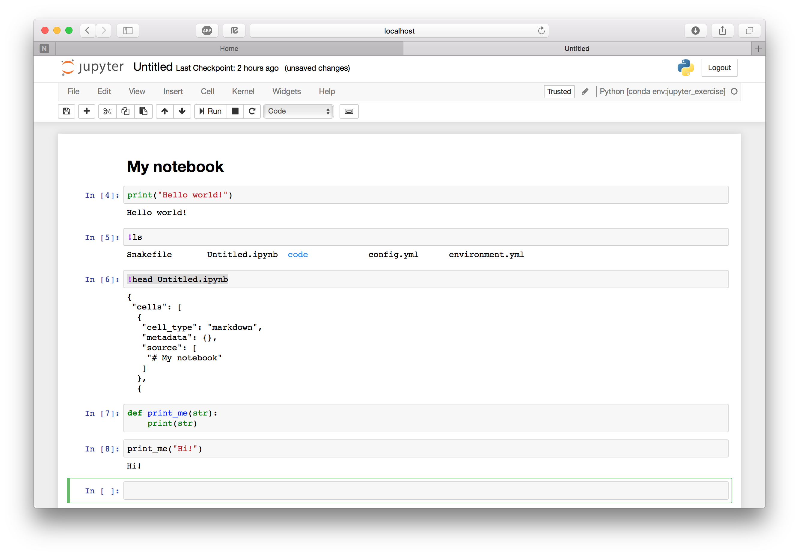
Runs as a local web server →
Load/save/manage notebooks →
Markdown cell with a header →
Code cell with some Python code →
Run shell command to list files →
The notebook itself is a JSON file →
You can define and call functions →

Slide 75
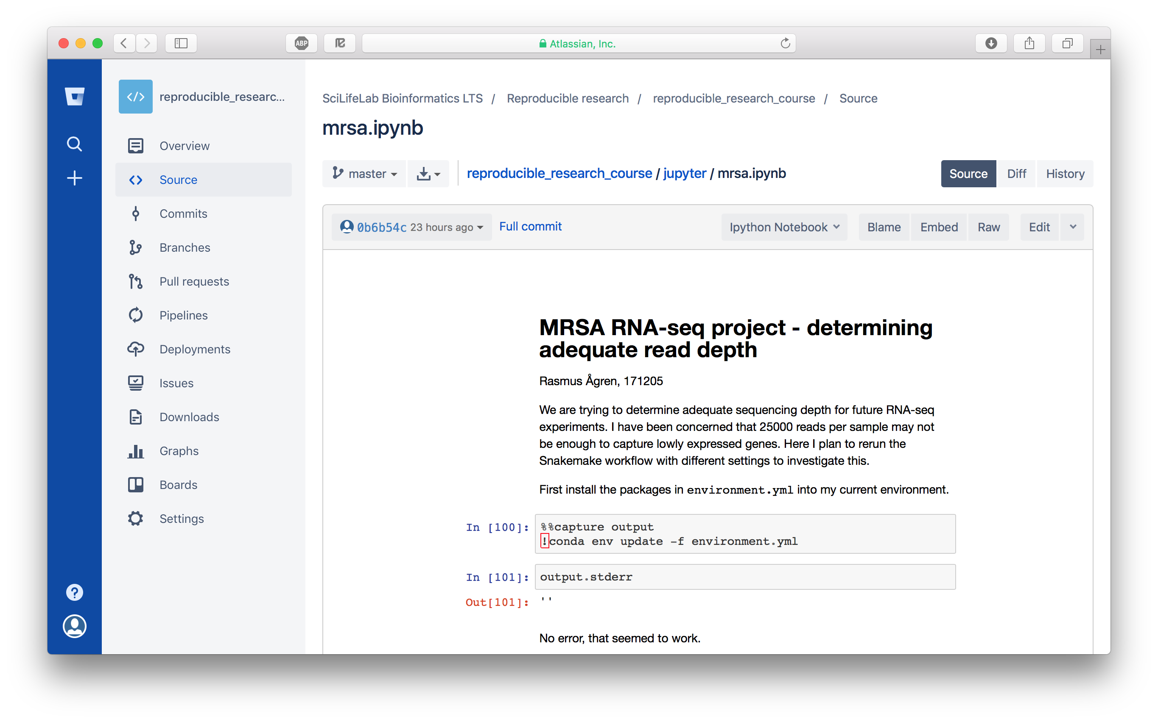
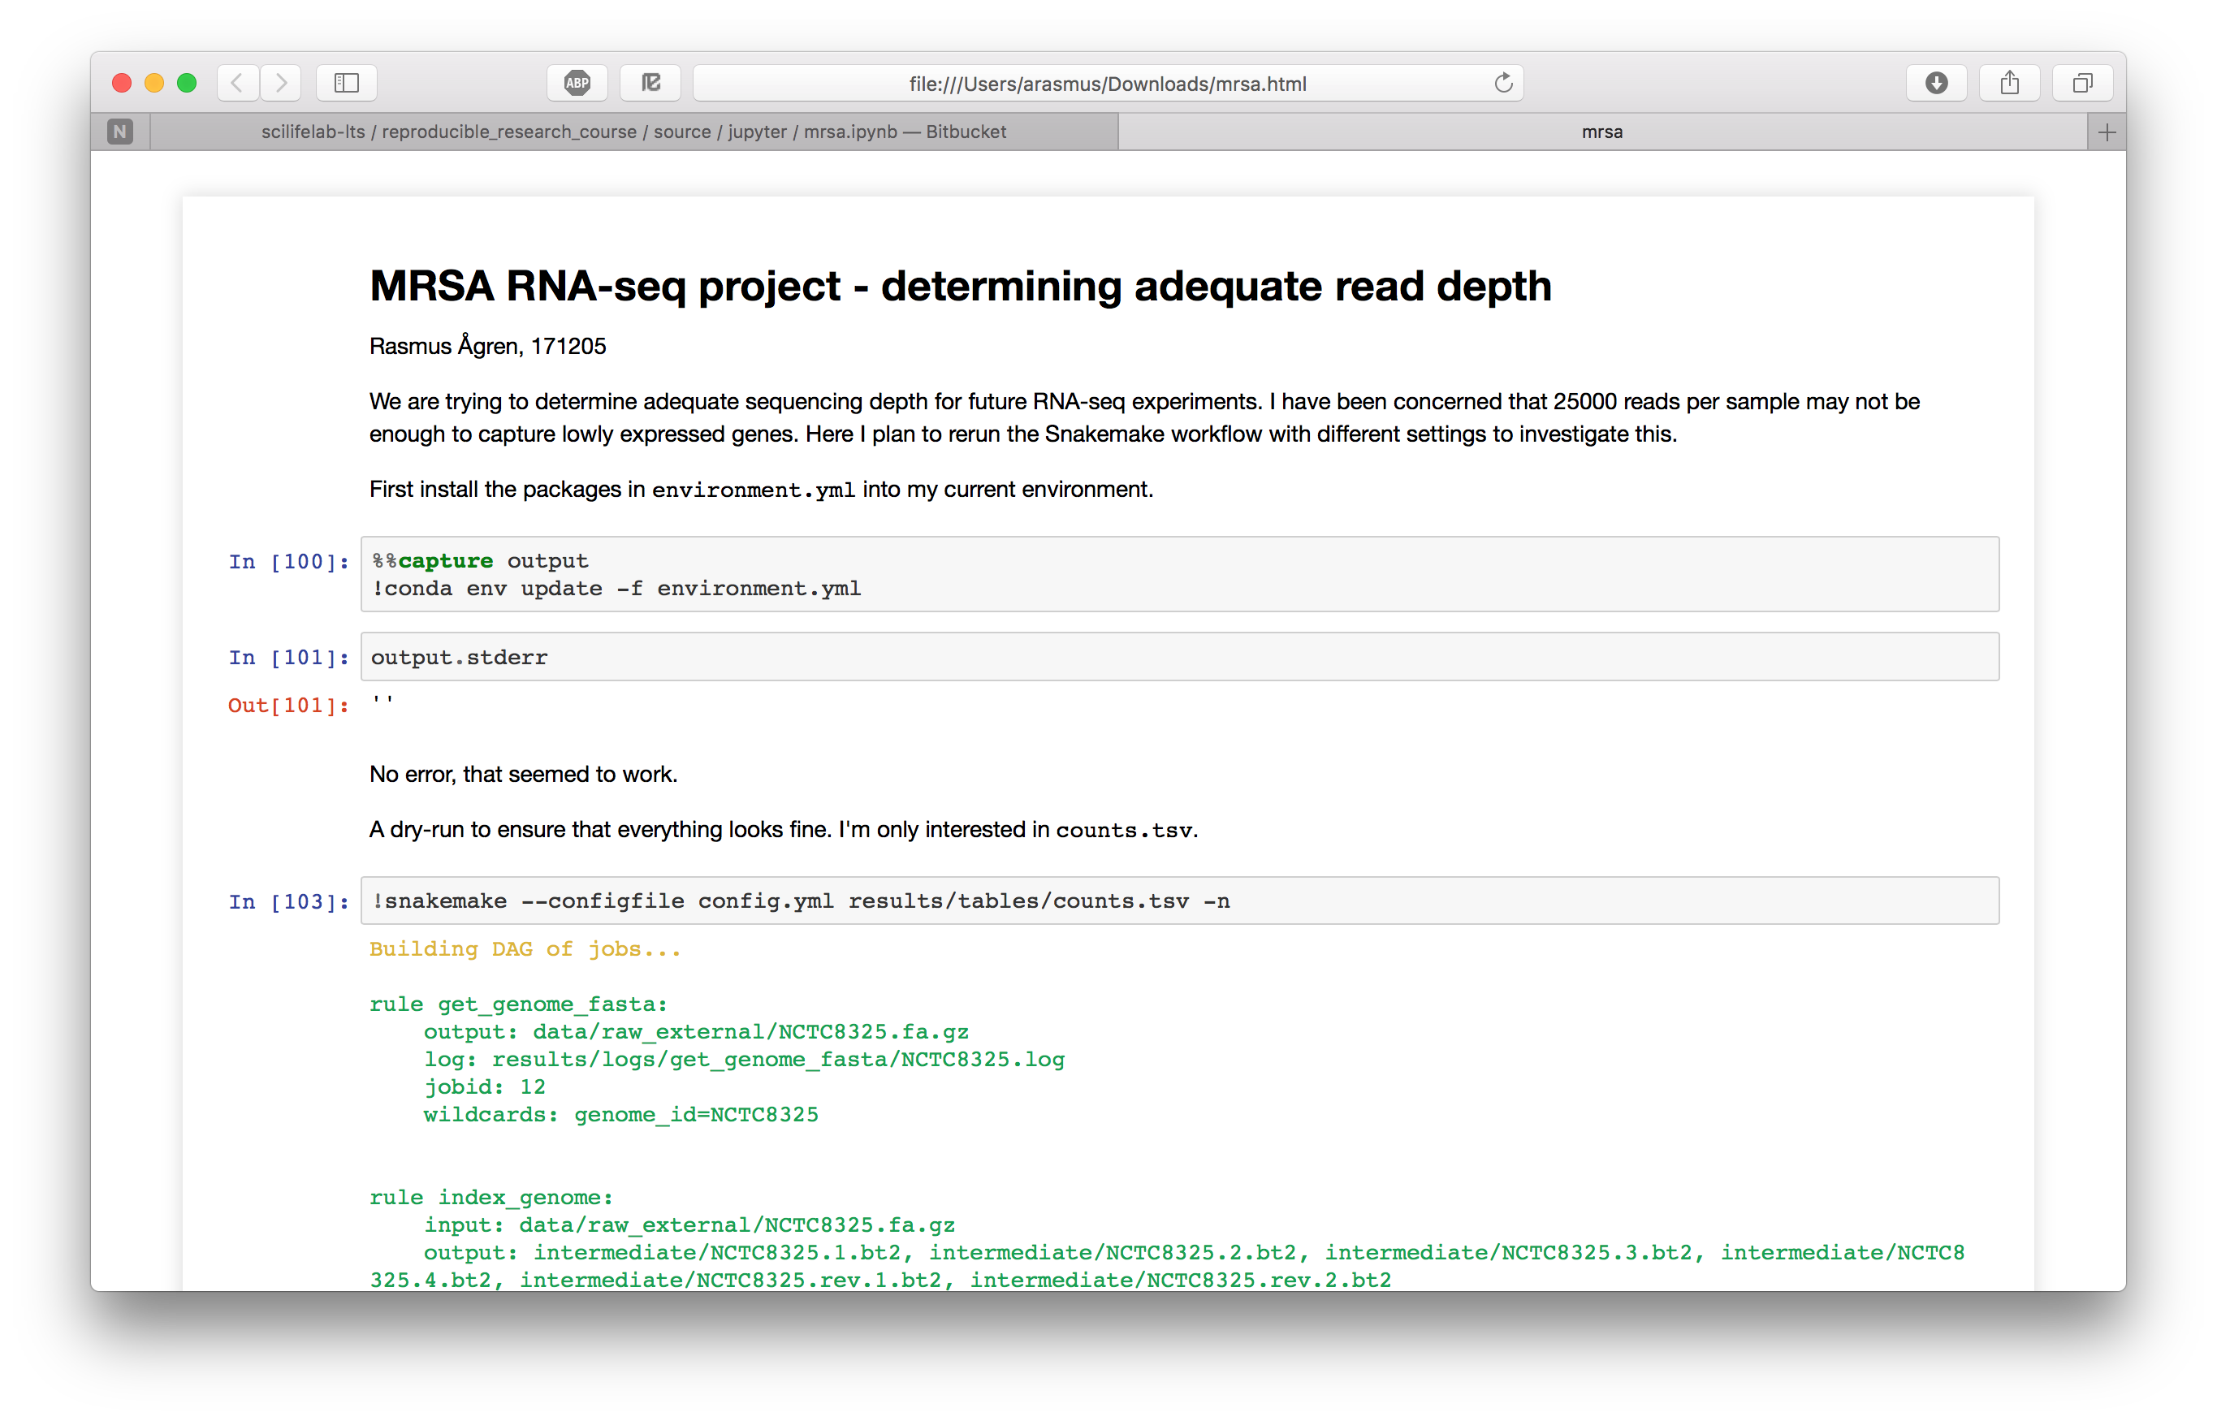
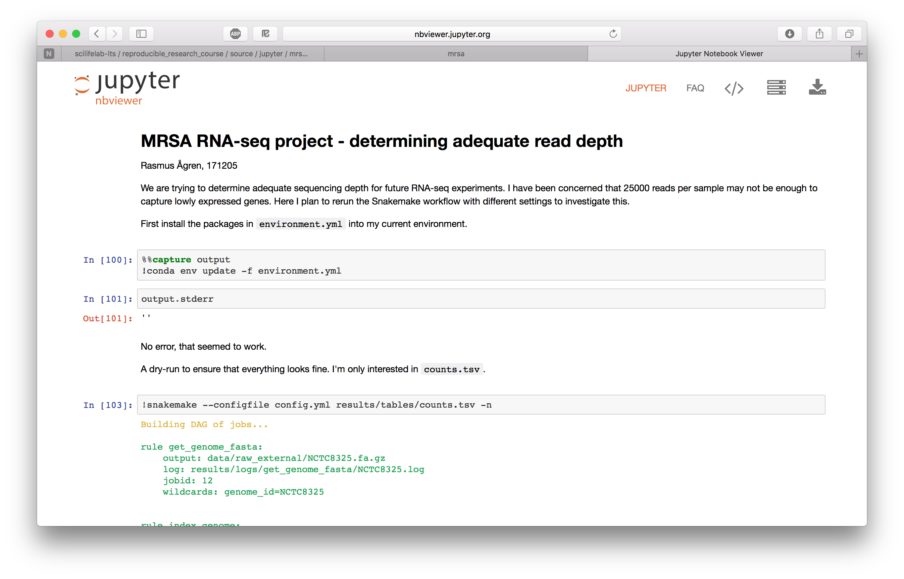
Sharing is caring
Put the notebook on GitHub/Bitbucket and it will be rendered there..
.. or export to one of many different formats, including HTML and PDF ..
.. or paste a link to any Jupyter notebook at nbviewer.jupyter.org and they will render it for you.

Slide 76
JupyterLab
JupyterLab is a full-fledged IDE, similar to e.g. Rstudio.
conda install –c conda-forge jupyterlab

Slide 77
project
|- doc/
|
|- data/
| |- raw_external/
| |- raw_internal/
| |- meta/
|
|- code/
|- notebooks/
|
|- intermediate/
|- scratch/
|- logs/
|
|- results/
| |- figures/
| |- tables/
| |- reports/
|
|- Snakefile
|- config.yml
|- environment.yml
|- Dockerfile
Environment
Data
Results
Source code

Slide 78
Snakemake
Managing dependencies
Managing and executing analysis workflow
Versioning and collaborating on code (and some other files)
Connecting code and reporting
and…
Isolating and exporting environment

Slide 79
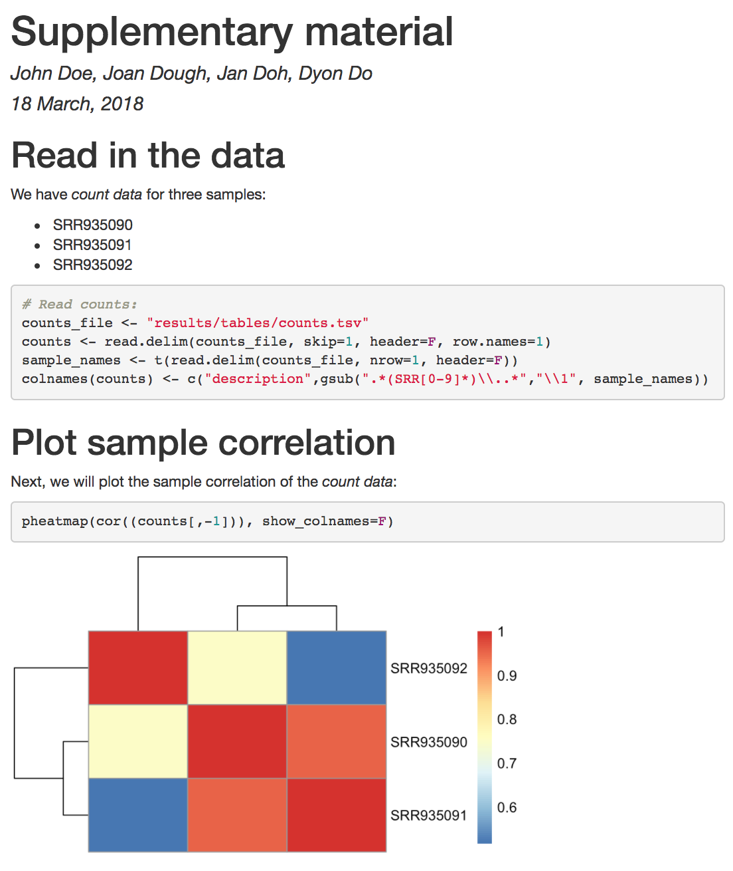
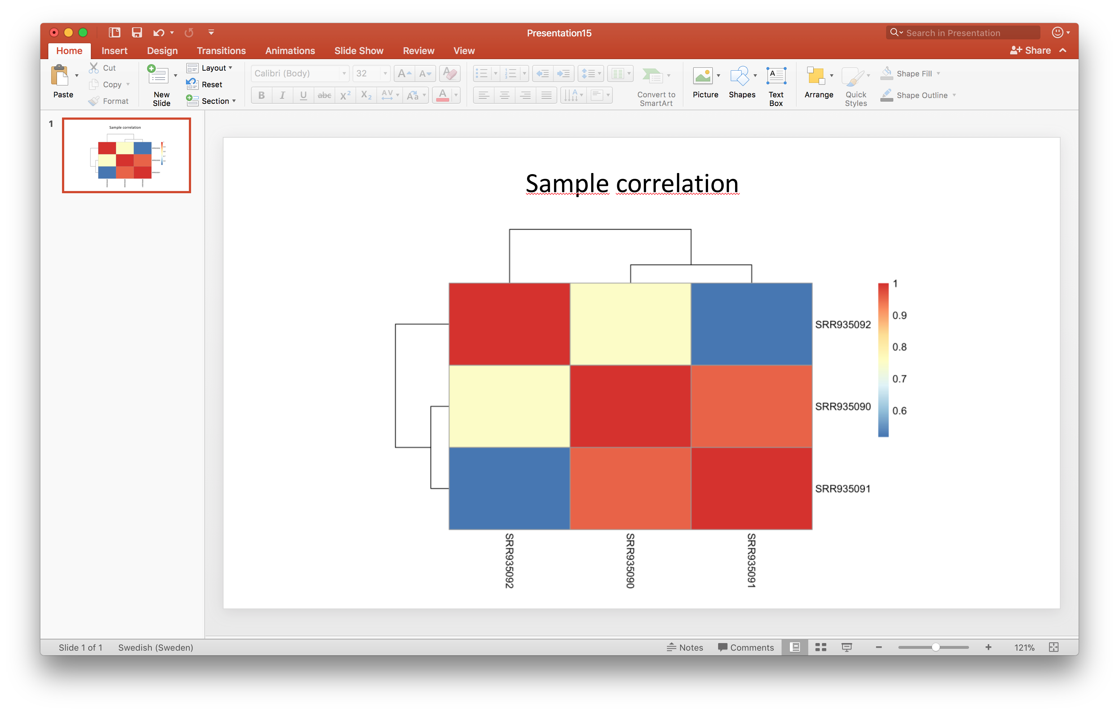
What data did I use for this figure??
R Markdown makes your analysis more reproducible by connecting your code, figures and descriptive text.
You can use it to make reproducible reports, rather than e.g. copy-pasting figures into a Word document.
You can also use it as a notebook, in the same way as lab notebooks are used in a wet lab setting.

Slide 80
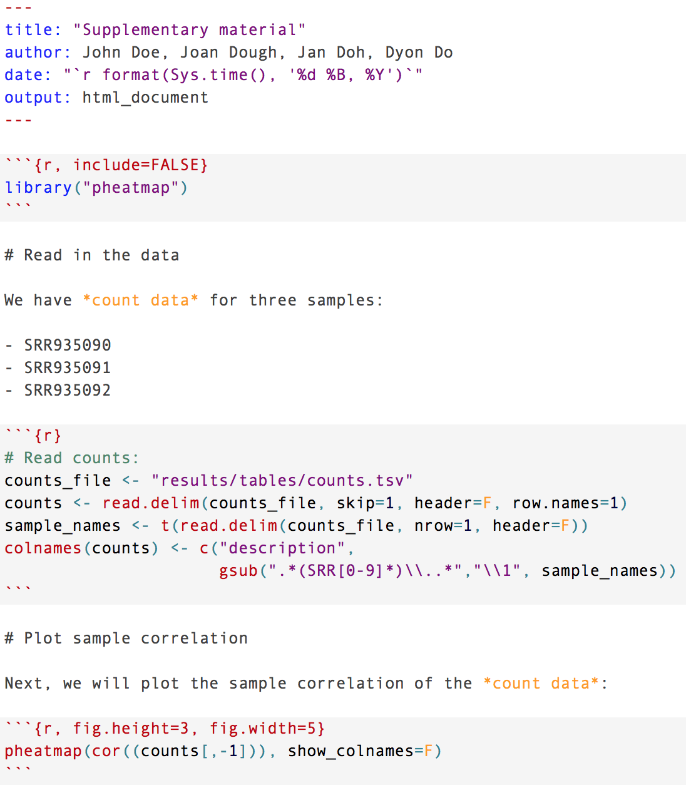

Slide 81
Header in YAML format
Document-wide options
Output format
Parameters

Slide 82
Header in YAML format
Document-wide options
Output format
Parameters
Code chunks
Evaluate R code and show output
Also Bash, Python, Rcpp, SQL, Stan
Chunk options

Slide 83
Header in YAML format
Document-wide options
Output format
Parameters
Code chunks
Evaluate R code and show output
Also Bash, Python, Rcpp, SQL, Stan
Chunk options
Markdown text
Freely add and format text using markdown

Slide 85
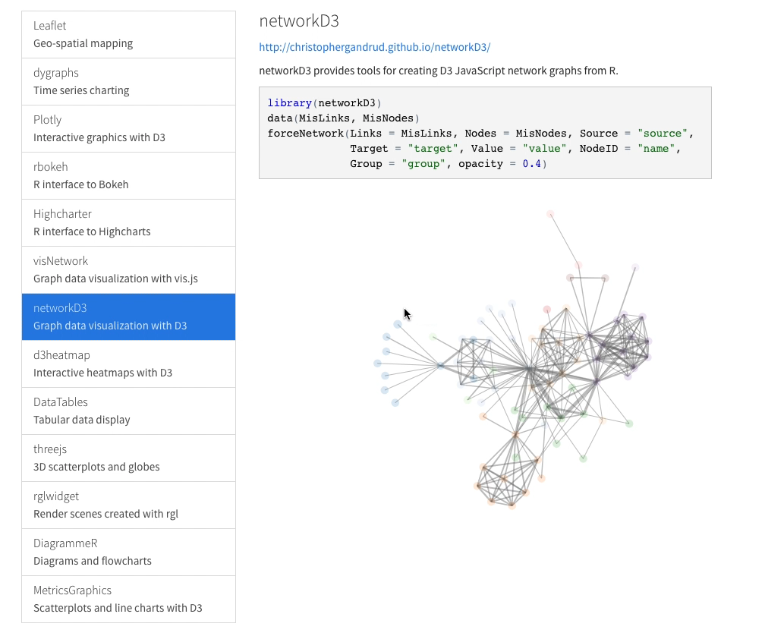
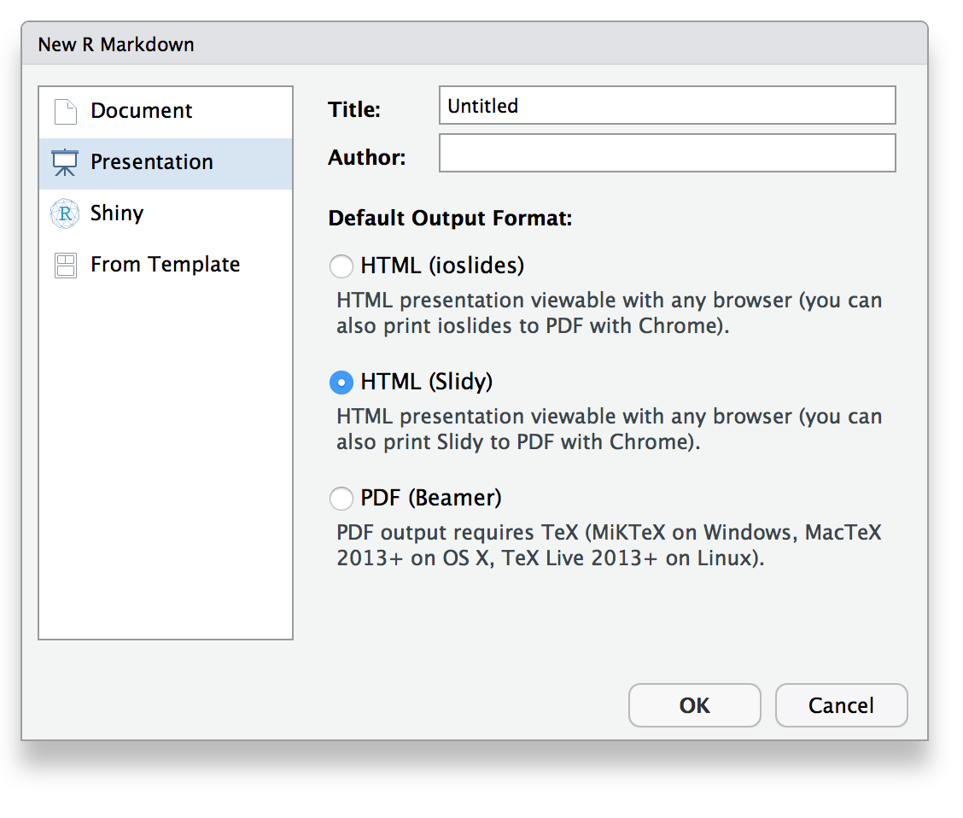
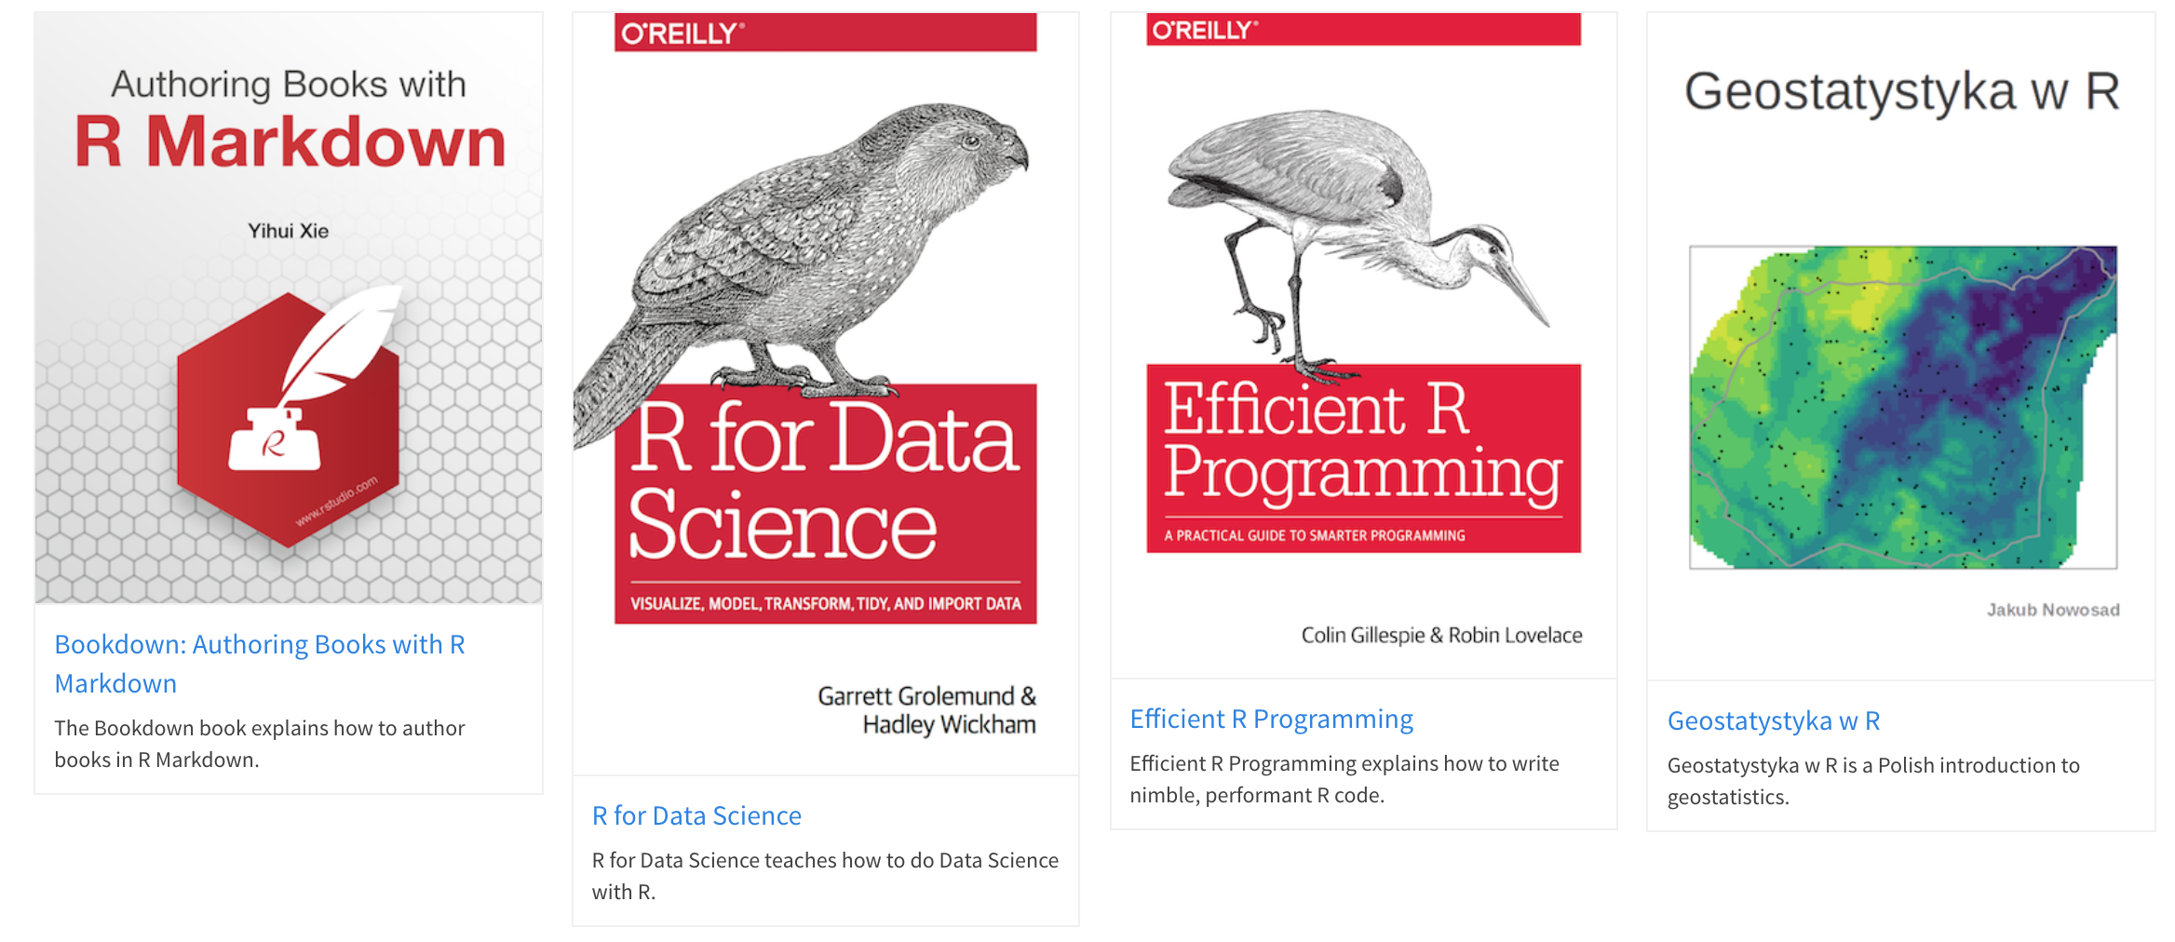
Output formats
Documents/reports (HTML, PDF, MS Word, Tufte handouts)
Presentations (Powerpoint, Beamer, Slidy, ioslides, reveal.js)
Interactive documents and dashboards (HTML widgets, Shiny)
Books and websites
Other templates…
Can require different markdown syntax depending on output!

Slide 86
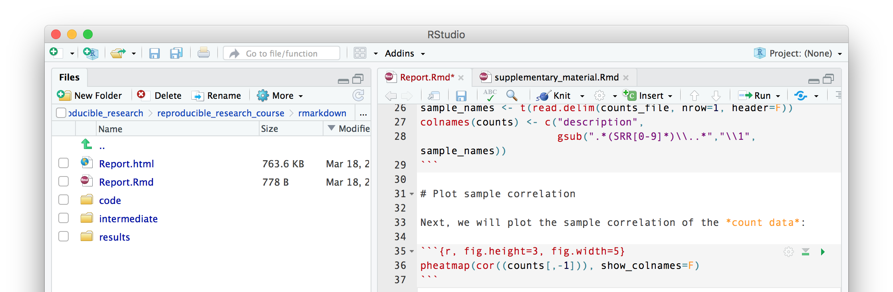
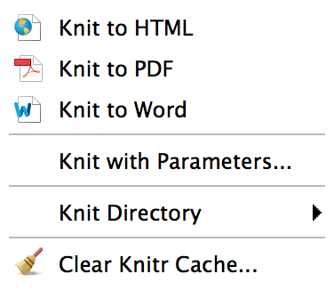
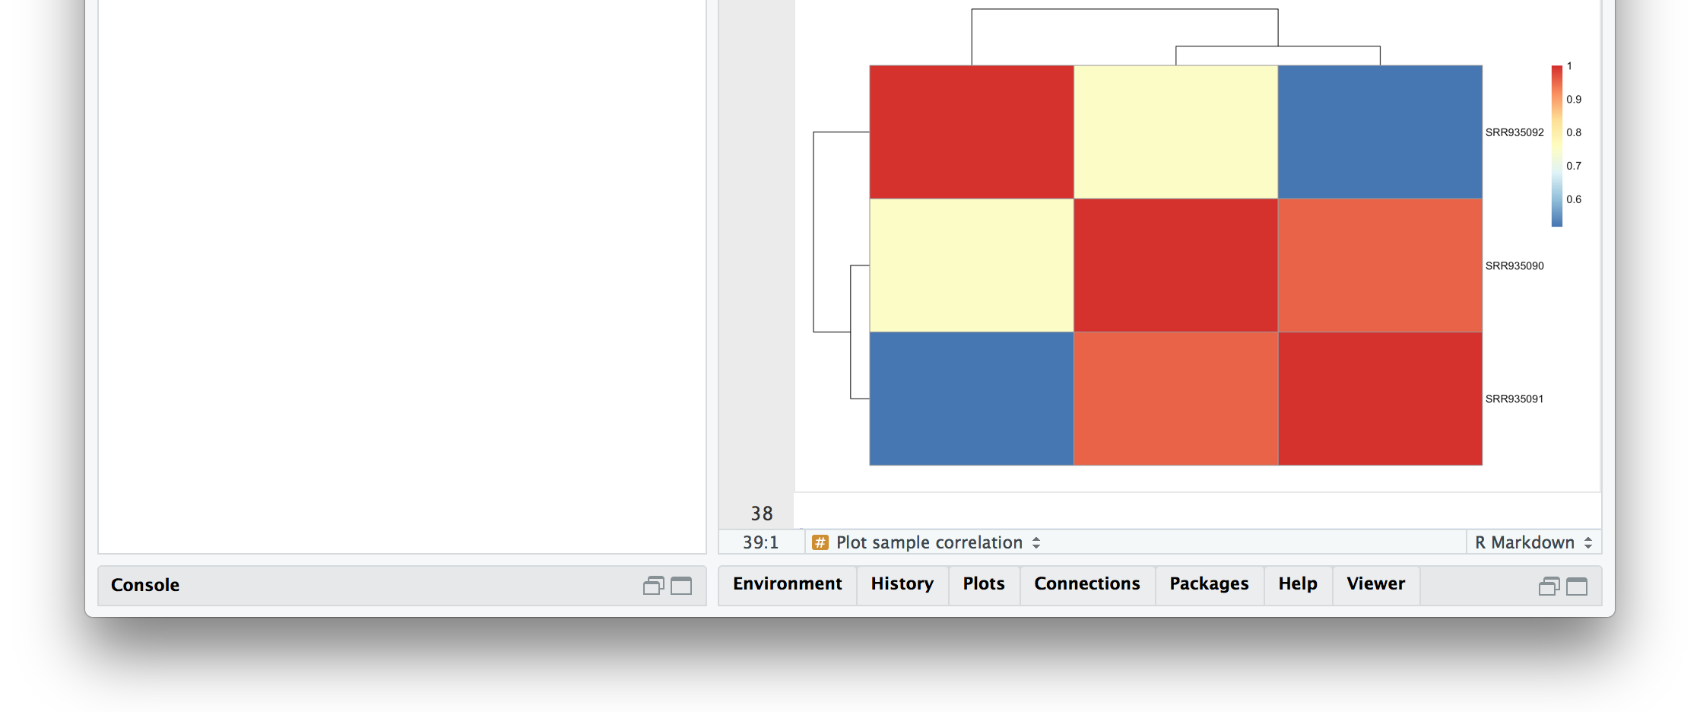
R Markdown in RStudio
Evaluate inline
Render from menu
Render from R console or terminal
R –e "rmarkdown::render('Report.Rmd')"
$

Slide 87
project
|- doc/
|
|- data/
| |- raw_external/
| |- raw_internal/
| |- meta/
|
|- code/
|- notebooks/
|
|- intermediate/
|- scratch/
|- logs/
|
|- results/
| |- figures/
| |- tables/
| |- reports/
|
|- Snakefile
|- config.yml
|- environment.yml
|- Dockerfile
Environment
Data
Results
Source code

Slide 88
Snakemake
Managing dependencies
Managing and executing analysis workflow
Versioning and collaborating on code (and some other files)
Connecting code and reporting
and…
Isolating and exporting environment

Slide 89
Results should be possible to reproduce regardless of platform and with minimal effort.
“Docker provides a way to run applications securely isolated in a container, packaged with all its dependencies and libraries."

Slide 90
Bremges et al., "Deeply sequenced metagenome and metatranscriptome of a biogas-producing microbial community from an agricultural production-scale biogas plant", GigaScience (2015) 4:33, doi:10.1186/s13742-015-0073-6

Slide 91
$uname –a
Darwin dhcp-140-26.vpn.chalmers.se 15.6.0 Darwin Kernel Version 15.6.0: Thu Sep 1 15:01:16 PDT 2016; root:xnu-3248.60.11~2/RELEASE_X86_64 x86_64
$docker pull ubuntu:16.04
16.04: Pulling from library/ubuntu 22dc81ace0ea: Pull complete
1a8b3c87dba3: Pull complete
91390a1c435a: Pull complete
07844b14977e: Pull complete
b78396653dae: Pull complete
Digest: sha256:e348fbbea0e0a0e73ab0370de151e7800684445c509d46195aef73e090a49bd6
Status: Downloaded newer image for ubuntu:16.04
$docker run -it ubuntu:16.04
root@407b0fd13fe5:/#
uname -a
Linux 407b0fd13fe5 4.9.60-linuxkit-aufs #1 SMP Mon Nov 6 16:00:12 UTC
2017 x86_64 x86_64 x86_64 GNU/Linux

Slide 92
Dockerfile
FROM ubuntu:16.04
# Install prerequisites
RUN apt-get update && \
apt-get install -y --no-install-recommends \
bzip2 curl ca-certificates
# Install Conda
RUN curl https://repo.continuum.io/miniconda.sh -O && \
bash miniconda.sh -bf -p /opt/miniconda3/ && \
rm miniconda.sh
# Add conda to PATH
ENV PATH="/opt/miniconda3/bin:${PATH}”
# Install git and nano from conda-forge
RUN conda install -c conda-forge git nano
# Use bash as shell
SHELL ["/bin/bash", "-c"]
# Set workdir
WORKDIR /home
Build
Docker image
Docker container
Docker container
Docker container

Slide 93
Mounting volumes
Local project directory
Docker image file system
project
|- doc/
|
|- data/
| |- raw_external/
| |- raw_internal/
| |- meta/
|
|- code/
|- notebooks/
|
|- intermediate/
|- scratch/
|- logs/
|
|- results/
| |- figures/
| |- tables/
| |- reports/
|
|- Snakefile
|- config.yml
|- environment.yml
|- Dockerfile
|- bin/
|- boot/
|- dev/
|- etc/
|- home/
| |- data/
| |- raw_external/
| |- raw_internal/
| |- meta/
|- lib/
|- lib64/
|- media/
|- opt/
|- proc/
|- root/
|- run/
|- sys/
|- tmp/
|- usr/
|- var/
|- bin/
|- boot/
|- dev/
|- etc/
|- home/
|- lib/
|- lib64/
|- media/
|- opt/
|- proc/
|- root/
|- run/
|- sys/
|- tmp/
|- usr/
|- var/
$docker run -it -v $PWD/data:/home/data ubuntu:16.04

Slide 94
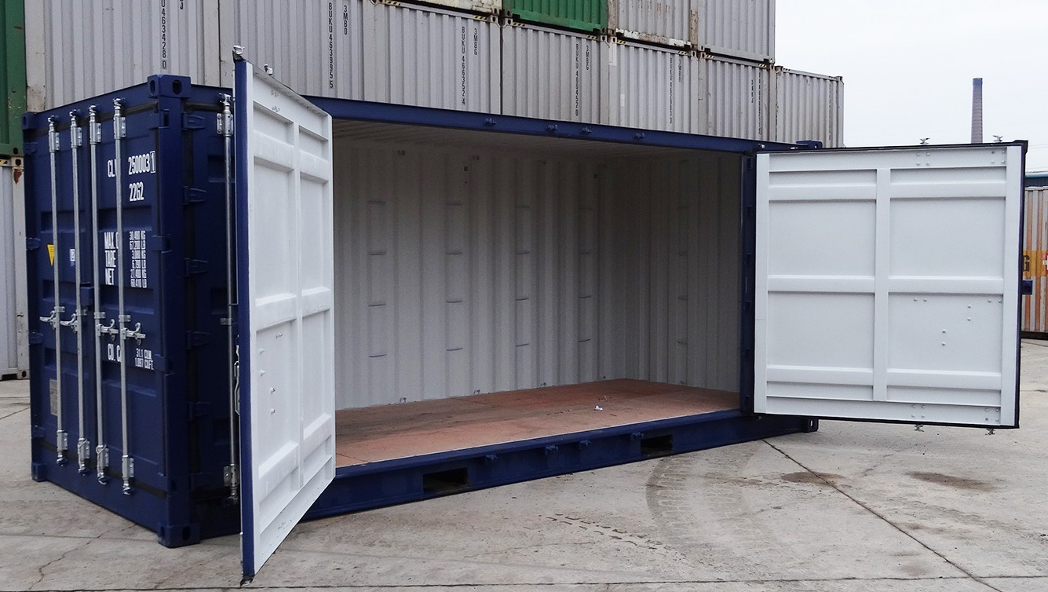
What can I use Docker for?
As an advanced environment manager.
To package your code with the environment it needs.
To package a whole workflow, e.g. to accompany a manuscript.
Environment
Environment
Code
Environment
Code
Data
$docker run -it
-v $PWD:/home
my_image /bin/bash
$docker run
-v $PWD/data:/home/data
-v $PWD/results:/home/results
my_image snakemake report.pdf
$docker run
-v $PWD/results:/home/results
my_image snakemake report.pdf

Slide 95
A Docker image
docker hub
OS kernel
From host system
Dockerfile
}
$docker push
FROM debian:latest
RUN conda install star
ADD config.yml
…
ob3b79cf: Base image
6f0d2f5e: Star installed
Read-only layers of diffs
$docker pull
1904ae78: Config added
C471fd60: …
me$ docker run image_id
9c774b63ce: Container x
Writable layer
you$ docker run image_id

Slide 96
project
|- doc/
|
|- data/
| |- raw_external/
| |- raw_internal/
| |- meta/
|
|- code/
|- notebooks/
|
|- intermediate/
|- scratch/
|- logs/
|
|- results/
| |- figures/
| |- tables/
| |- reports/
|
|- Snakefile
|- config.yml
|- environment.yml
|- Dockerfile
Environment
Data
Results
Source code

Slide 97
Putting it all together

Slide 98
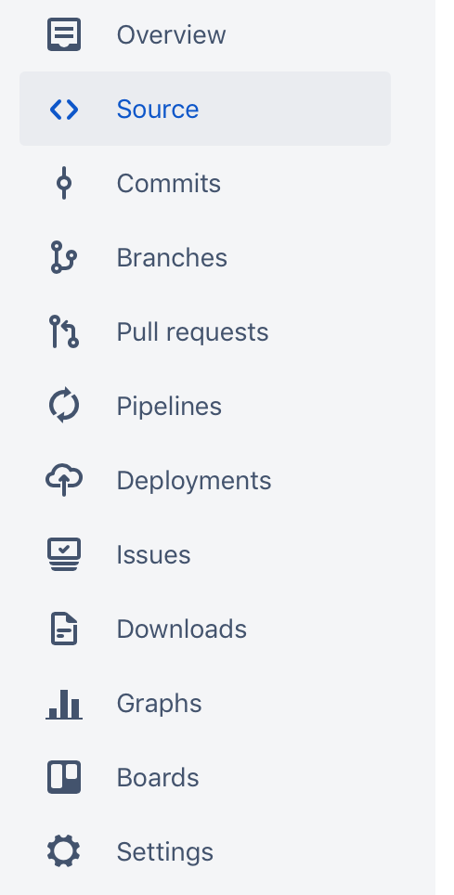
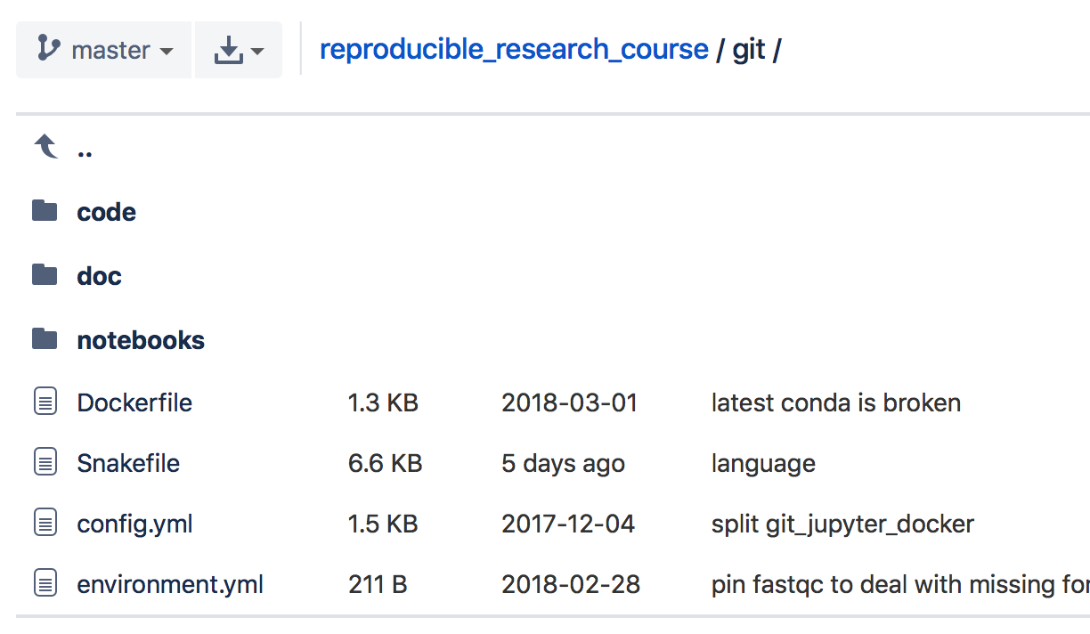
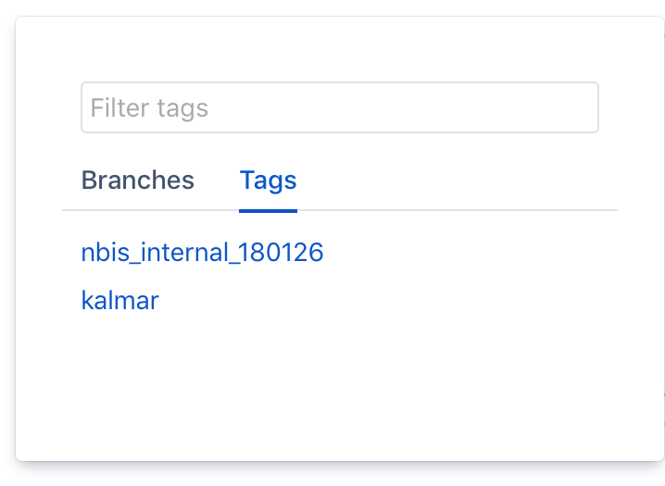
my_research_project/
my_research_project /
Contains all the code
Contains documentation, e.g. the project manuscript
submission_nature_2016-11-23
resubmission_pnas_2017-01-10
resubmission_JNRBM_2017-03-21
publication_JNRBM_2017-06-09
Contains notebooks, e.g. from Jupyter Notebooks
Recipe for making a Docker image
Contains the Snakemake rules (that may use the code in code/)
Configuration / settings for the Snakemake workflow
Conda environment definitions (software and versions)
Options for reproducing:
Git clone and run workflow.
Git clone, activate conda env, and run workflow.
Git clone, docker build, and run workflow in container.
Docker pull and run workflow in container.

Slide 99
What is reasonable for your project?
Choose the right ambition level…
Snakemake
Minimal: code for reproducible results
Good: versioned and structured repository
Better: ambition to organize dependencies
Best: export everything!

Slide 100
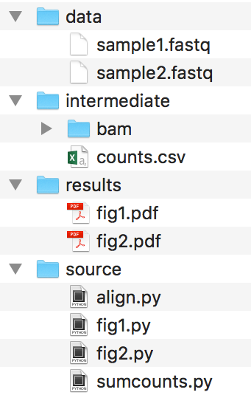
Reproducible research for bioinformatics projects
Leif Wigge (leif.wigge@scilifelab.se)
Rasmus Ågren (rasmus.agren@scilifelab.se)
Bioinformatics long-term support (LTS)
Everything can be a project
Divide your work into distinct projects and keep all files needed to go from raw data to final results in a dedicated directory with relevant subdirectories (see example).
Many software support the “project way of working”, e.g. Rstudio and the text editors Sublime Text and Atom.
Take control of your research by making it reproducible!
By moving towards a reproducible way of working you will quickly realize that you at the same time make your own life a lot easier! The added effort pays off by gain in control, organization and efficiency.
Below are all the components of a bioinformatics project that have to reproducible.
Connect your results with the code
Rmarkdown and Jupyter notebooks blur the boundaries between code and its output. They allow you to add non-code text (markdown) to your code. This generates a report containing custom formatted text, as well as figures and tables together with the code that
generated
them.
Environment
http://rmarkdown.rstudio.com/
http://jupyter.org/
Tip! Learn how to use git, a widely used system (both in academia and industry) for version controlling and
collaborating on code.
Master your dependencies
Full reproducibility requires the possibility to recreate the system that was originally used to generate the results.
Conda is a package, dependency, and env-ironment manager that makes it easy to install (most) software that you need for your project.
Your environment can be exported in a simple text format and reinstalled by Conda on another system.
https://git-scm.com/
Treasure your data
Consider your input data static. Keep it read-only!
Don’t make different versions. If you need to preprocess it in any way, script it so you can recreate the steps (see box below).
Backup! Keep redundant copies in different physical locations.
Strive towards uploading it to its final destination already at the beginning of a project (e.g. specific repositories such as SRA, GEO, or GenBank, or general repositories such as Dryad or Figshare).
Data
Results
https://conda.io
Source code
For the advanced
Conda cannot always completely recreate the system, which is required for proper repro-ducibility.
A solution is to package your project in an isolated Docker container, together with all its dependencies and libraries.
A vision is that every new bioinformatics publication is accompanied by a publically available Docker container!
Singularity is an alternative to Docker which runs better on HPC clusters.
Organize your coding
Write scripts/functions/notebooks for specific tasks (connect raw data to final results)
Keep parameters separate (e.g. top of file, or input arguments)
For the advanced
As projects grow, it becomes increasingly difficult to keep track of all the parts and how they fit together. Snakemake is a workflow management system that keeps track of how your files tie together, from raw data and scripts to final figures. If anything changes (script code, parameters, software version, etc) it will know what parts to rerun in order to have up to date and reproducible results.
Avoid generating files interactively on the fly or doing things by hand (no way to track how they were made).
data
script1
Figure 1
Snakemake
Singularity
data
script2A
fileA
script2B
filesC,D,E
script2C
Figure 2
https://snakemake.readthedocs.io/
https://www.docker.com/
http://singularity.lbl.gov/

Slide 101
alternatives?
Version control | Environment / package managers | Workflow managers | Literate programming | Containerization / virtualization
Git – Widely used and a lot of tools available + GitHub. | Conda – General purpose environment and package manager. Community-hosted collections of tools at bioconda or conda-forge. | Snakemake – Based on Python, easily understandable format, relies on file names. | Jupyter – Create and share notebooks in a variety of languages and formats by using a web browser. | Docker – Used for packaging and isolating applications in containers. Dockerhub allows for convenient sharing. Requires root access.
Mercurial – Distributed model just like Git, close to sourceforge. | Pip – Package manager for Python, has a large repository at pypi. | Nextflow – Based on Groovy, uses data pipes rather than file names to construct the workflow. | Rmarkdown – Developed by Rstudio, focuses on generating high-quality documents. | Singularity – Simpler Docker alternative geared towards high performance computing. Does not require root.
Subversion – Centralized model unlike git/mercurial; no local repository on your computer and somewhat easier to use. | Apt/yum/brew – Native package managers for different OS. Integrated in OS and might deal with e.g. update notifications better. | Make – Used in software development and has been around since the 70s. Flexible but notoriously obscure syntax. | Zeppelin – Developed by Apache. Closely integrated with Spark for distributed computing and Big Data applications. | Shifter – Similar ambition as Singularity, but less focus on mobility and more on resource management.
 | Virtualenv – Environment manager used to set up semi-isolated python environments. | Galaxy - attempts to make computational biology accessible to researchers without programming experience by using a GUI. | Beaker – Newcomer based on Ipython, just as Jupyter. Has a focus on integrating multiple languages in the same notebook. | VirtualBox/VMWare – Virtualization rather than containerization. Less lightweight, but no reliance on host kernel.

