Slide 1
OPeNDAP¹ and HDF5² in the Cloud: Techniques and Best Practices for Serving HDF5 data
Winter ESIP 2019
Elena Pourmal
Technical Project Lead
epourmal@hdfgroup.org
James Gallagher
Technical Project Lead
jgallagher@opendap.org
This work was supported by NASA/GSFC under Raytheon Co. contract number NNG15HZ39C.
This document does not contain technology or Technical Data controlled under either the U.S. International Traffic in Arms Regulations or the U.S. Export Administration Regulations.
1 Open-source Project for a Network Data Access Protocol
2 Hierarchical Data Format 5

Slide 2
Outline
Considerations for HDF5 files
HDF5 and netCDF-4 interoperability
CF¹ conventions
HDF5 best practices
General considerations
Advanced HDF5 features
Considerations for Amazon S3² access via OPeNDAP
Reduce initial latency
Optimize transfer time
Reduce post-transfer processing
1 Climate Forecast Conventions
2 Amazon Simple Storage Service

Slide 3
Considerations for HDF5 files

Slide 4
HDF5/ netCDF-4¹ Interoperability
To assure maximum interoperability with netCDF-4 use the following:
Hierarchical HDF5 file (no loops and multiple parents in a file structure)
Creation order on links and attributes
Simple numeric datatypes
Gzip compression
Dataset with dimension scale attached to each dimension
1 Network Common Data Form, version 4

Slide 5
HDF5/ netCDF-4 Interoperability (cont’d)
Attributes
Scalar or one-dimensional attributes
Avoid using these datatypes:
Fixed size strings
Compound datatype
Long double
Use UTF-8¹ encoding for names encoding
Attribute name should begin with a letter and be composed of letters, digits, and underscores
See Unidata documentation
1 Unicode Transformation Format 8-bit

Slide 6
HDF5/ netCDF-4 Interoperability (cont’d)
How to achieve netCDF-4 compatibility?
Use netCDF-4 library
Use augmentation and editing tools
Tools modify the existing HDF5 file!

Slide 7
Augmentation and Editing Tools
Use tools to make HDF5 file netCDF-4 compatible
HDF-EOS5¹ augmentation tool
Adds dimension scales
HDF5 JPSS² augmentation tool
Hides unsupported data (region references)
Adds dimension scales
Adds geolocation information
HDF5 editing tool (attributes only)
Add/modify attributes to make them CF compliant
1 Hierarchical Data Format - Earth Observing System library and file format, version 5
2 Joint Polar Satellite System

Slide 8
Climate and Forecast (CF) Metadata
HDF5 attributes
long_name
units
coordinates
scale_factor
To learn more
ESDS-RFC-028v1.3 “Data Interoperability Recommendations for Earth Science”, Charles S. Zender, Peter J.T. Leonard, July 2016
423-ESO-036 “Dataset Interoperability Recommendations: Part 2” (DRAFT)

Slide 9
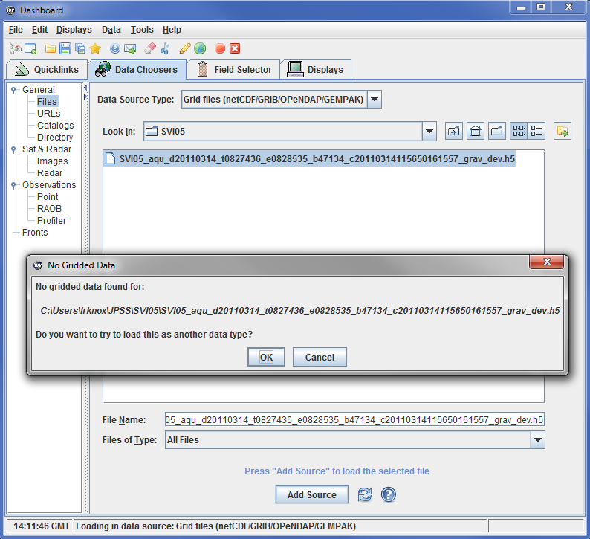
Example: Visualizing JPSS data with IDV¹
Before
1 Integrated Data Viewer

Slide 10
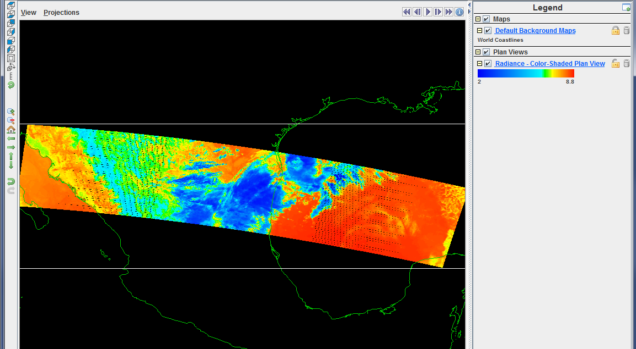
Example: Visualizing JPSS data with IDV
After augmentation and adding CF scale_factor and units attributes

Slide 11
Example: CF attributes
long_name
units

Slide 12
HDF5 Best Practices
If possible, use the latest HDF5 library releases
Bug fixes
Security updated
Storage, memory usage and performance optimizations
Check new features and read how to move to the latest releases without breaking your code.

Slide 13
HDF5 Best Practices
Many optimizations are not available by default
To reduce storage size for HDF5 files with many objects and allow better access time set file format to HDF5 1.8.
To reduce access time and storage overhead for chunked datasets set file format to HDF5 1.10.
Constant look-up speed for chunked datasets with fixed size dimensions

Slide 14
HDF5 Best Practices (cont’d)
Avoid data duplication by using
HDF5 virtual datasets
Aggregate data stored in different arrays (HDF5 datasets)
Shared attributes, datatypes, dimensional and compression information
HDF5 objects can share attributes and other characteristics saving space in the file
Contact help@hdfgroup.org to help you with organizing data in HDF5

Slide 15
Considerations for S3 access via OPeNDAP

Slide 16
Hyrax in the Cloud
Hyrax now serves data from S3
HDF5 data files are subset directly
Only those values needed are read
This applies to netCDF4, too
Extendable to other formats, but…
Other file types are read from S3 and cached on spinning disk
Metadata are cached on spinning disk

Slide 17
Considerations for S3 access via OPeNDAP
Reduce initial latency
Optimize transfer time
Reduce post-transfer processing

Slide 18
Reduce Initial Latency
Reuse connections to S3
S3 is accessed using HTTP¹
But HTTP uses TCP socket connections
Open HTTP connections before they are needed
Re-Open connections that time-out
Use HTTP 2!
This has nothing to do with HDF5 or legacy data. All software that make repeated use of S3 should do this
1 Hypertext Transfer Protocol

Slide 19
Optimize Transfer Time
Decompose data transfers into parallel operations
S3 transfer rates do degrade with parallel access, but overall transfers are still faster
Single thread transfer rate: 10MB/s
Six (6) thread transfer rate: 5 MB/2*
For data stored in a contiguous block, break it into ‘virtual’ shards/chunks
Notes:
* Palankar, et al. 2008 – look for a more recent paper

Slide 20
Parallel Transfer
Example: 60MB data transfer
Initial latency (e.g. 1s)
Post processing (4s)
Tx @10 MB/s (6s)
11 s
Tx @ 5 MB/s (2s)
Initial latency (still 1s)
Post - done in parallel (.7s)
Note that data access is embarrassingly parallel – chunks/shards that do not overlap can be inserted without blocking
3.7 s

Slide 21
Reduce Post-Transfer Time
Perform post processing operations in parallel
But, do not use compression if possible
For web services, provide data using its storage byte-order, not the server’s – rely on the client to correct it
This eliminates ‘touching’ all of the data values.

Slide 22
This work was supported by NASA/GSFC under Raytheon Co. contract number NNG15HZ39C.
in partnership with

