Slide 1

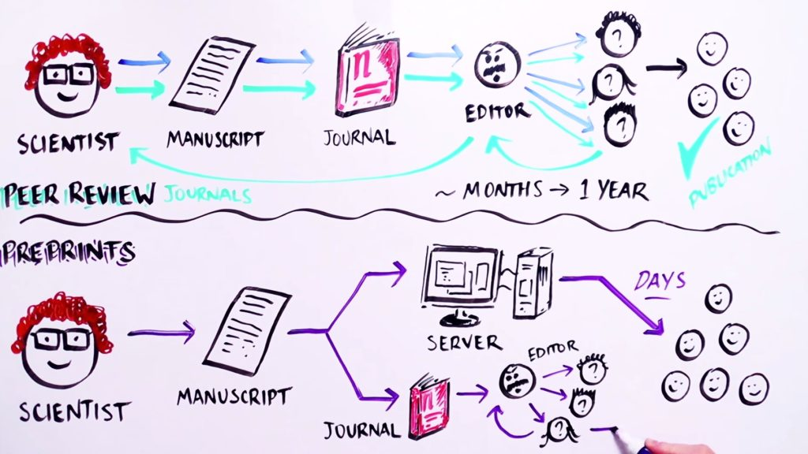
Deborah J. Sweet, PhD
Vice President of Editorial
Cell Press
Notes:
Image credit: IBIOLOGY via YOUTUBE

Slide 2

Launched June 2018
Collaboration with SSRN First Look, part of the MedRN section
Opt-in for all papers submitted to Lancet family journals
Basic checks before posting:
Funding source and declaration of interests
If a trial, registration number is included
Must be registered prospectively
Must have ethical approval or state why it would be exempt
→ Elements check performed by freelance Lancet editor

Slide 3
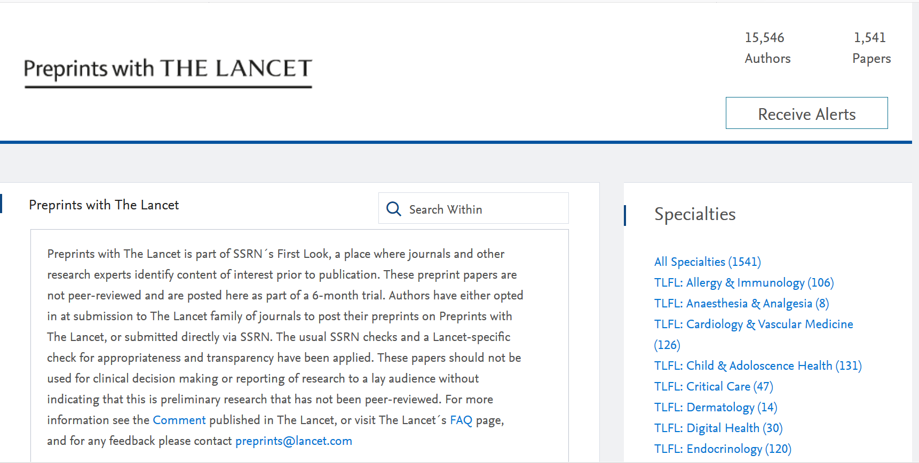
Notes:
3

Slide 4
Data presented cover 27 weeks of experience (launch to Dec 31, end of full 6 month initial pilot)
Notes:
4

Slide 5
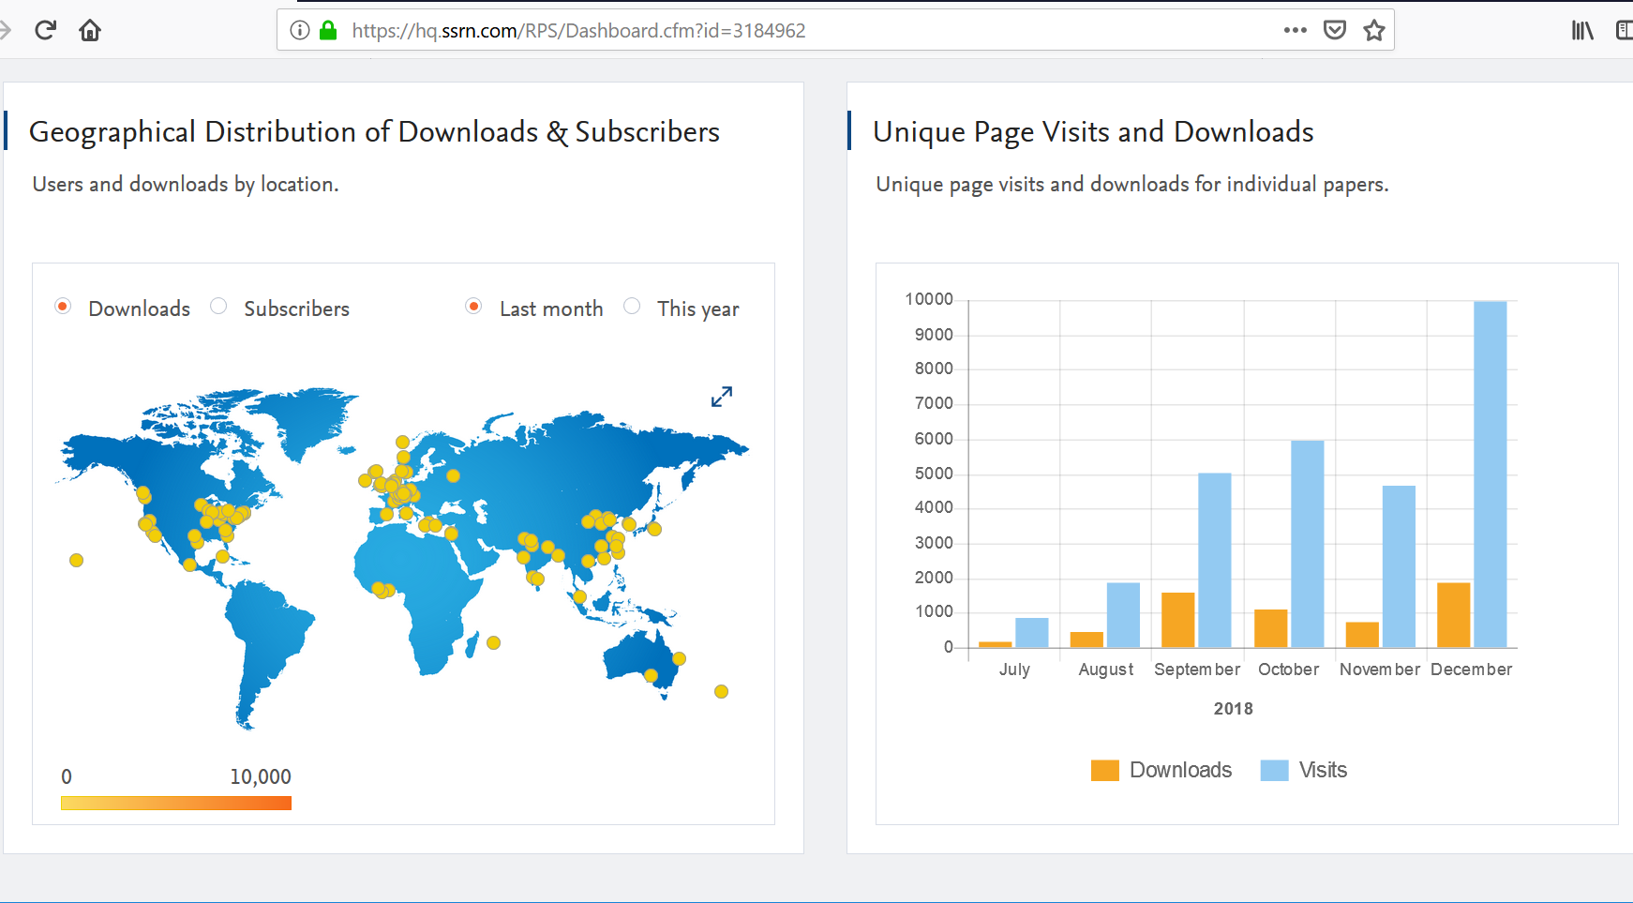
Dashboard – Preprints with The Lancet
Notes:
5

Slide 6
Conclusions:
- opt-ins between 22 -48% of all research papers
(30.8% average for Lancet family)
- all types of papers
- from all countries (perhaps slightly more from Asia
and Europe)
- only two comments on two papers so far

Slide 7
Launched March 2017
Offered to authors whose papers are chosen for in-depth peer review by Cell Press journals
A preview of papers sent for peer review by Cell Press
Author opt-in, allows authors to surface papers and make them available to the community early in the review process
Initially launched on Mendeley, since June 2018 hosted on SSRN
Posted articles are citable though DOI registration and single article links

Slide 8
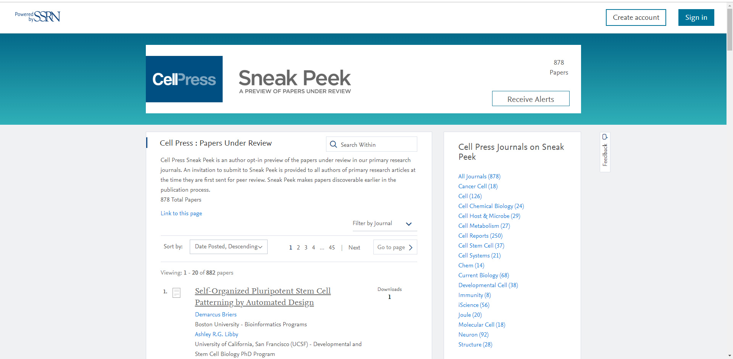
Notes:
8

Slide 9

Data presented cover Jul-Dec 2018, same time frame as for Preprints from The Lancet

Slide 10
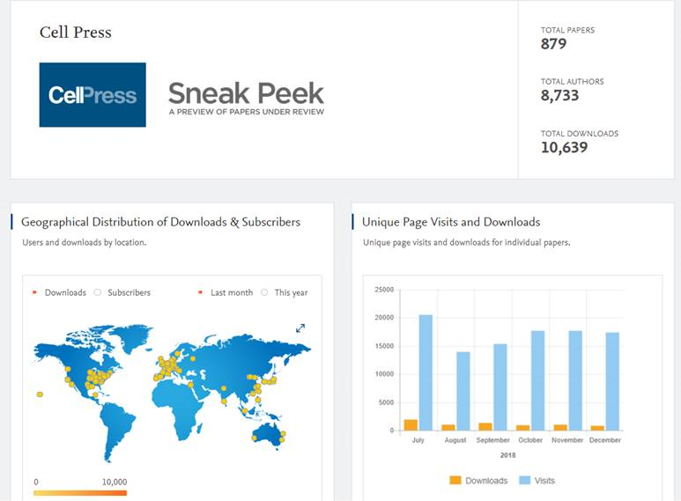

Slide 11
Conclusions:
on average the authors of 4.8% of all research papers sent out to review opt-in to Sneak Peek
broad range of topic areas and paper types
limited commenting
highest opt-in at OA journals

