Slide 1
The Gates Open Access Experience
Biomedical Transparency Summit 2019
Ashley Farley, Associate officer of knowledge & Research Services
Bill & Melinda Gates Foundation

Slide 2
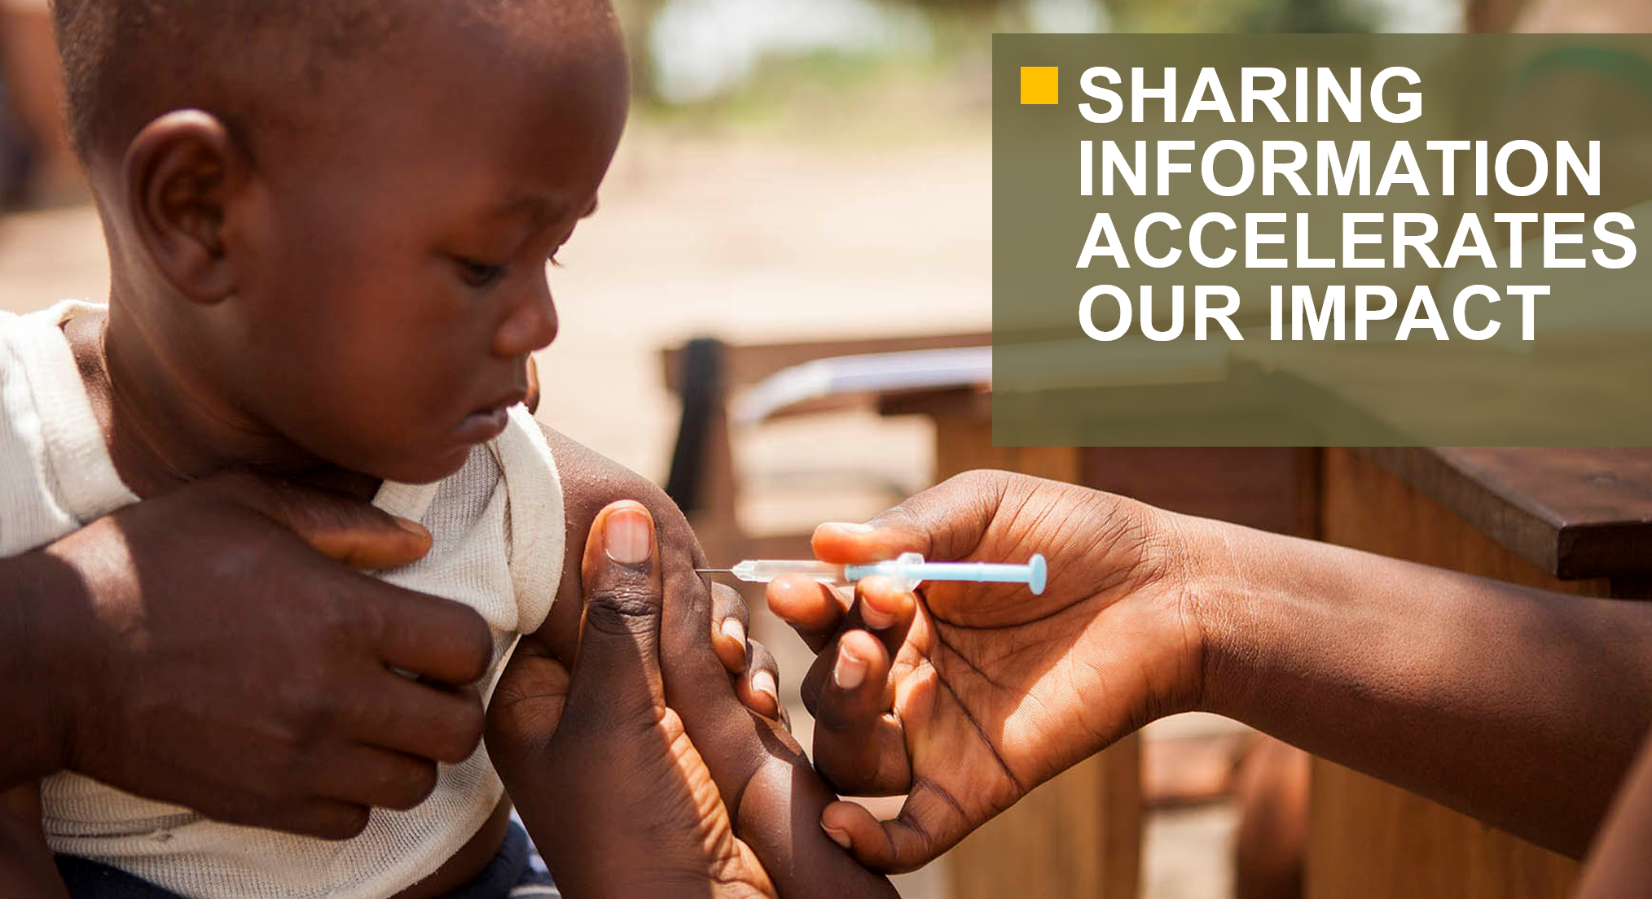
Why Open Access is important to the Foundation
Barrier-free access to foundation-funded research advances innovation and helps create a world where everyone has the opportunity to lead a healthy and productive life.
Notes:
Open Access is a fundamental element of the Gates Foundation’s commitment to information sharing and transparency.
By freely sharing high quality research as soon as it is available, we and our partners can develop more efficient and effective strategies to tackle the problems we are trying to solve.
Open Access levels the playing field for scientists across the world, and increases global contribution

Slide 4
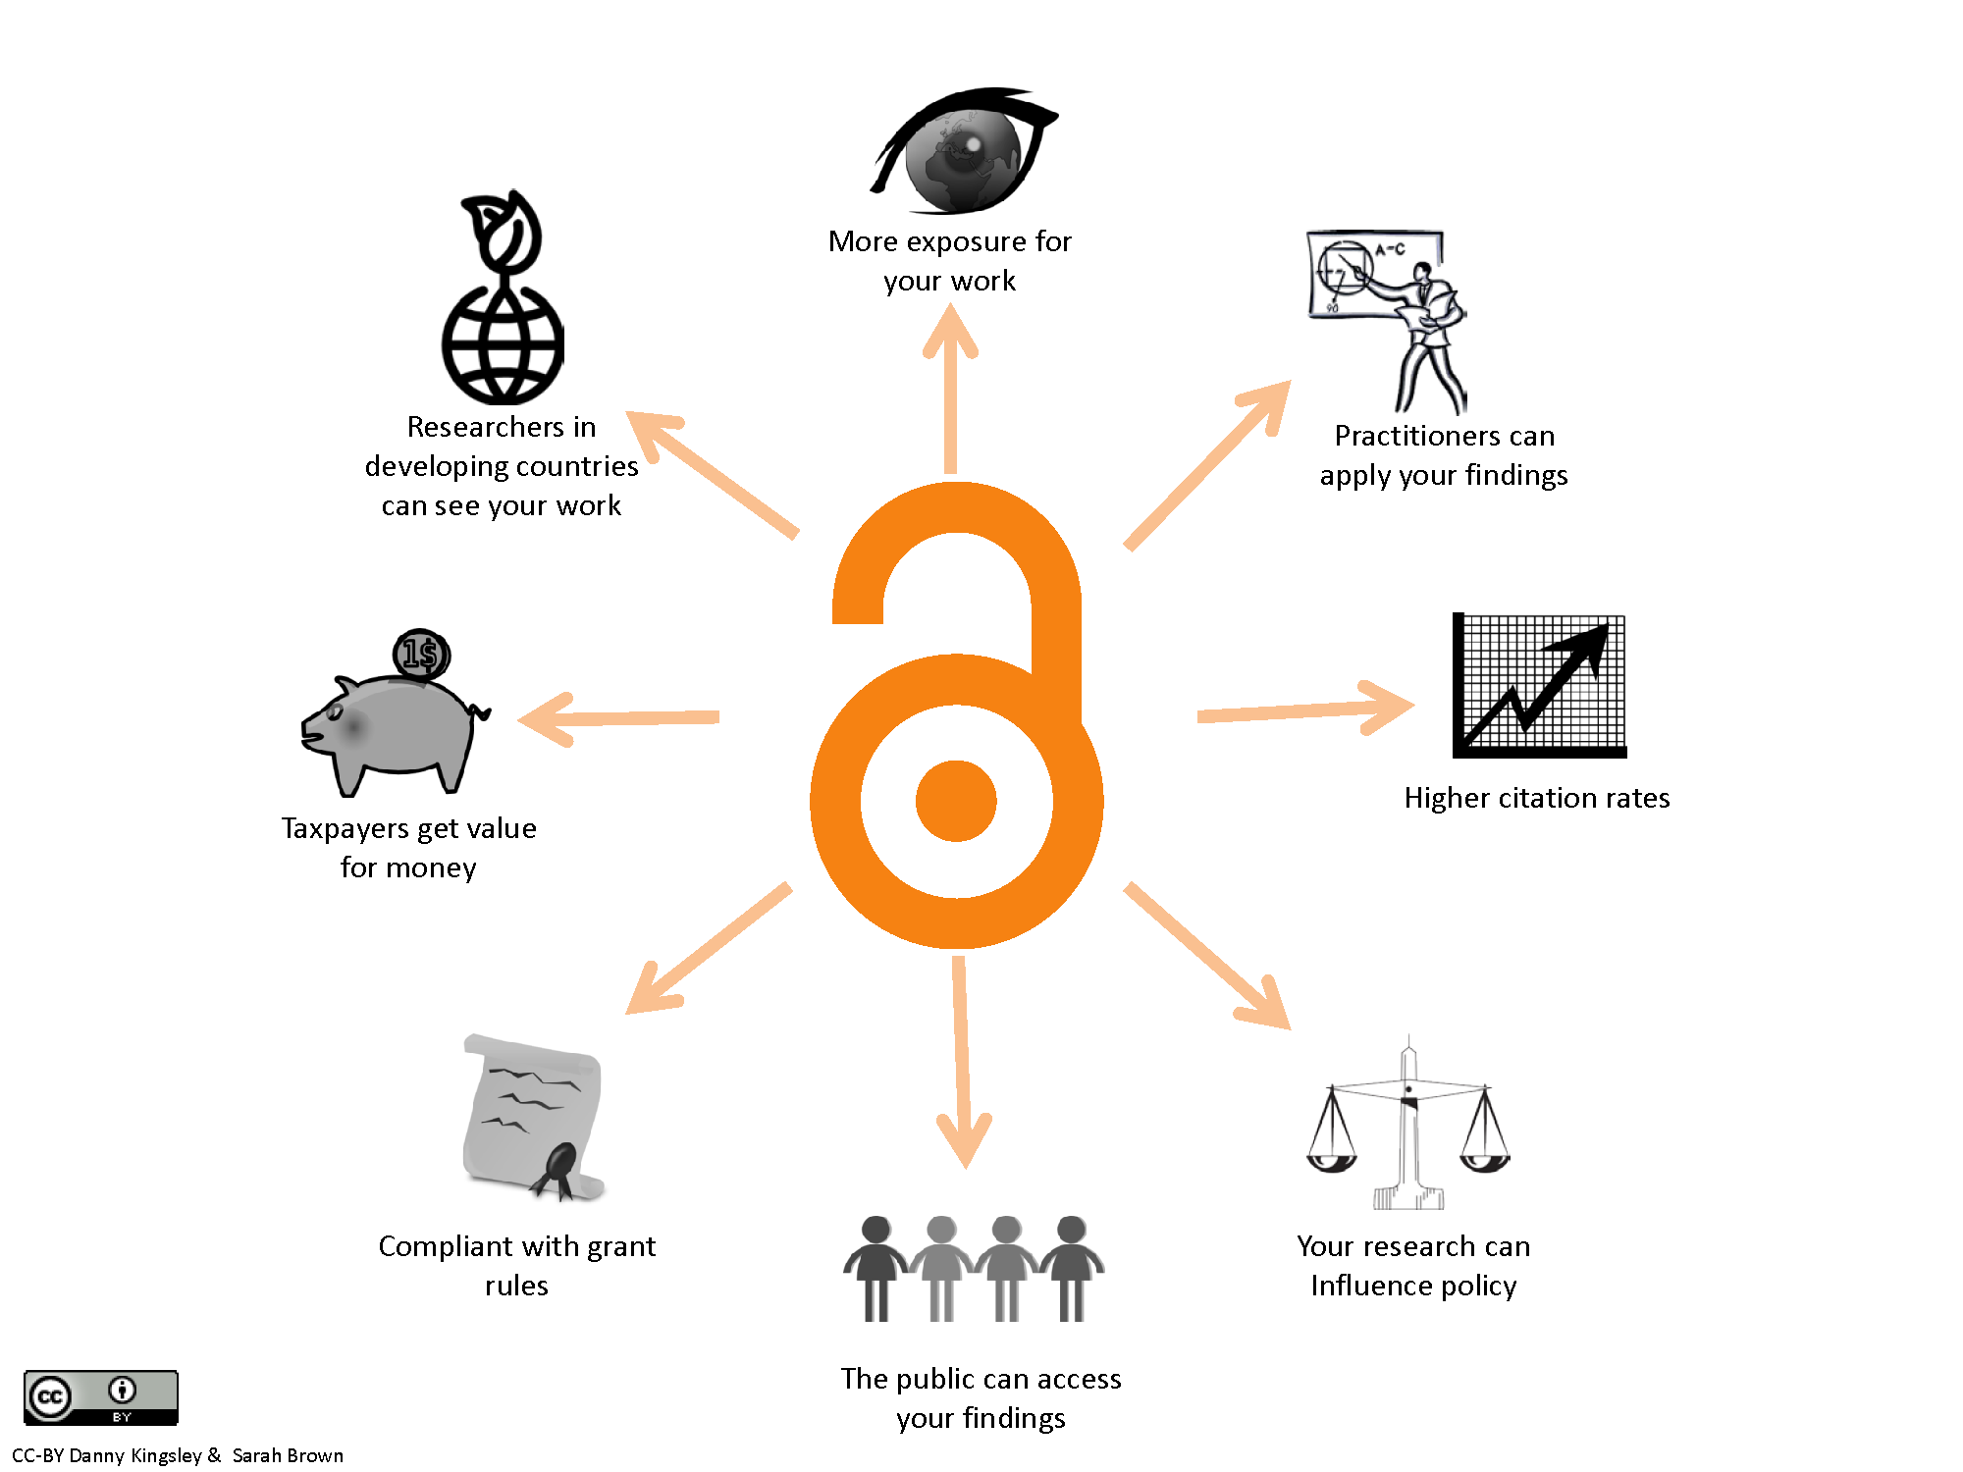
What do we think Open Access accomplishes
Notes:
Open Access is a fundamental element of the Gates Foundation’s commitment to information sharing and transparency.
By freely sharing high quality research as soon as it is available, we and our partners can develop more efficient and effective strategies to tackle the problems we are trying to solve.
Open Access levels the playing field for scientists across the world, and increases global contribution

Slide 5
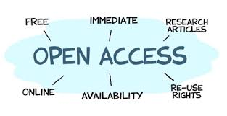
What Open Access means to the Foundation
Open Access terms
CC-BY license
Immediately available – no embargo
Underlying data is open
As a Plan S adopting funder our policy will adopt these principles in the next year
Twitter: @ashleydfarley
Notes:
As with Open Science the definition of Open Access can vary. This is the foundation’s definition and the requires of our Open Access Policy. This applies to all grant agreements signed after January 1st 2015.
We believe that the CC-BY license is critical to encouraging further use of research.
*Go through the requirements*
One of the best aspects of the policy is that it’s clear and simple. 4 requirements and fees covered by the foundation. These fees stem from a central budget that we manage, so that the fees do not come out of individual grant budgets. This takes away the burden of grantees needing to guess the potential cost of open access publications. It ensures that more grant dollars go to doing the research and not the reporting of it. We do not limit the number of articles that can arise from a single grant. Nor do we impose a timeline – even closed grants can benefit from the policy. While grant agreement after January 1st 2015 must comply we welcome all older grants to take advantage of the policy as well.
Publications are discoverable and accessible on line: Publications, defined as “Peer-Reviewed Journals” will be deposited in PubMedCentral. As of October 2015, PubMed Central attracts 1.2 unique users per day who download 2 million articles.
Publications will be on Open Access terms: This requires a licensing agreement which allows the article to be copied, built upon or transformed for any purpose with proper attribution.
Foundation will pay necessary fees: Most publishers charge fees to publish under open access terms.
Publication will be accessible and open immediately: Until January 1, 2017, a publication may place an embargo on an article for up to 12 months. After January 1, 2017, articles must be available for free immediately upon publication.

Slide 6
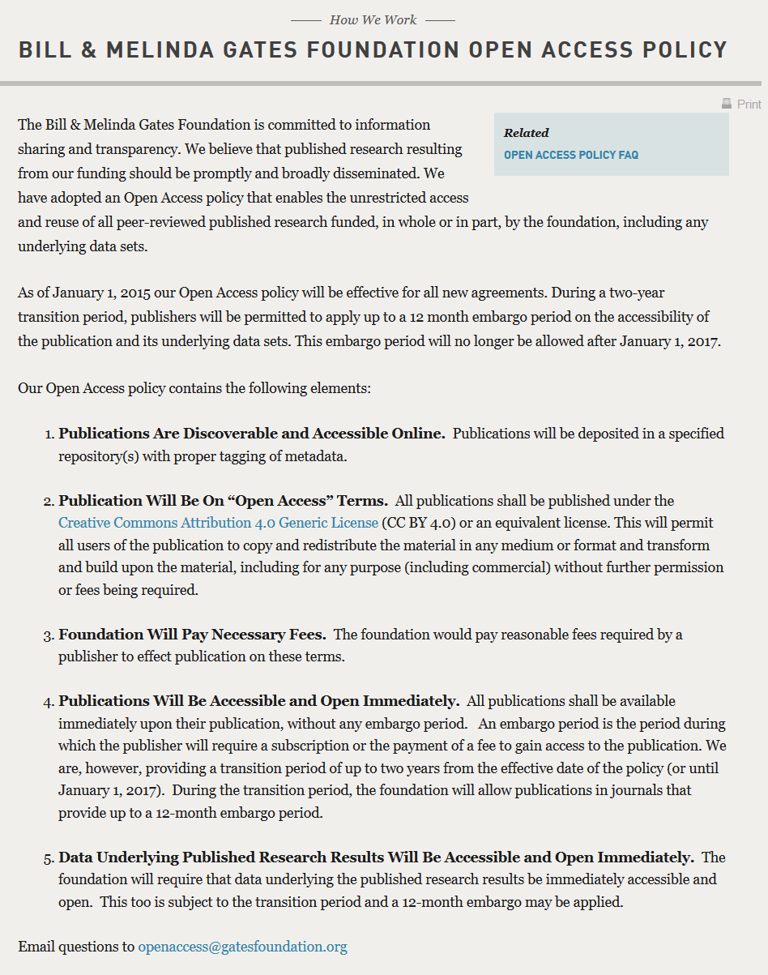
Policy Transparency
Building trust with grantees starts at the grant making process

Slide 7
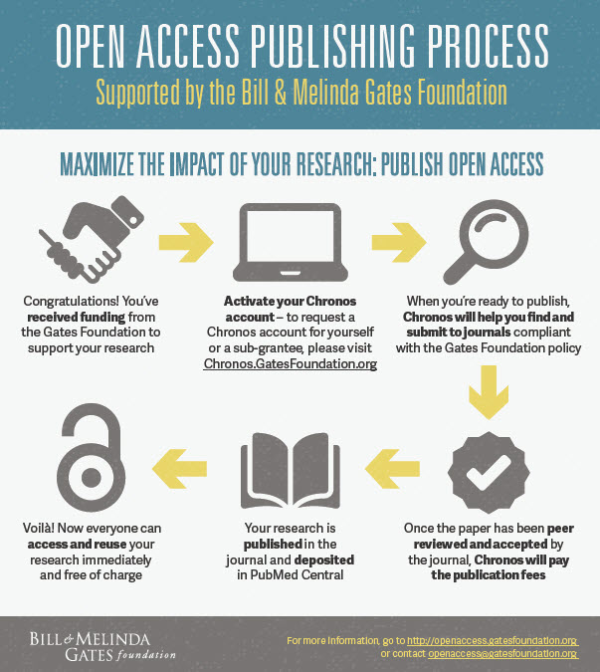
Policy Infrastructure
Chronos provides clarity to our researchers so they can focus on the research, not the process of publishing it.
Provides the foundation with better publication data.
Notes:
A policy is only as good as the mechanisms that that bring it to life
We didn’t want to have the compliancy discussion at the end of publication
We also wanted to easy track research outputs without adding an administrative burden to grantees or staff
Thus we created Chronos which combines the publishing and payment process
We cover the costs for all grantees – subgrantees publishing results from Gates foundation grants – this take away the administrative and financial burden of the current model

Slide 8
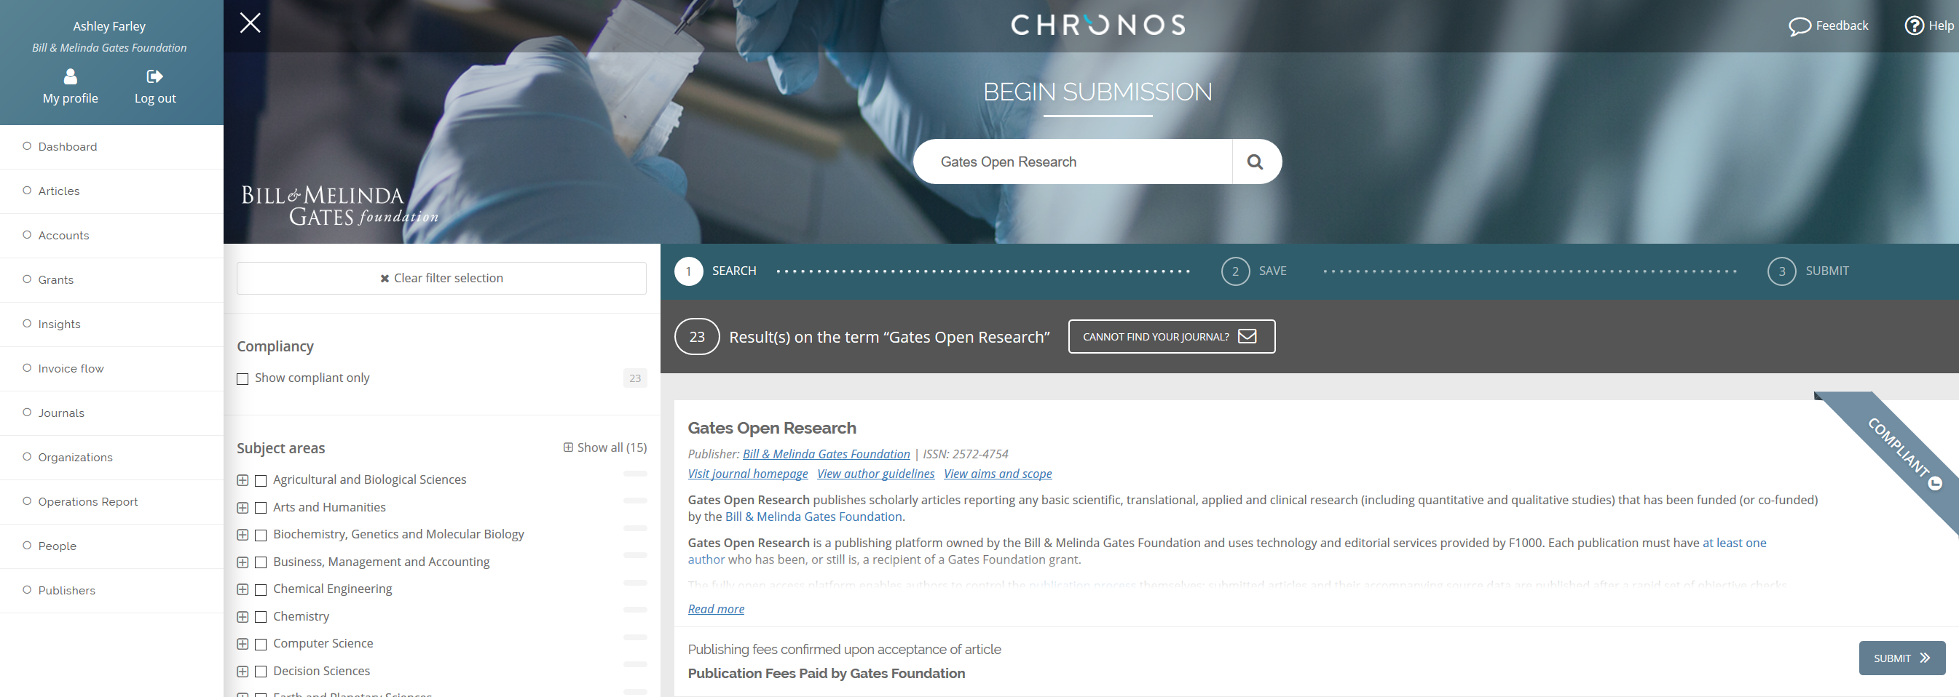
Chronos – Complaint Journals

Slide 9
Chronos – Non Compliant Journals

Slide 10
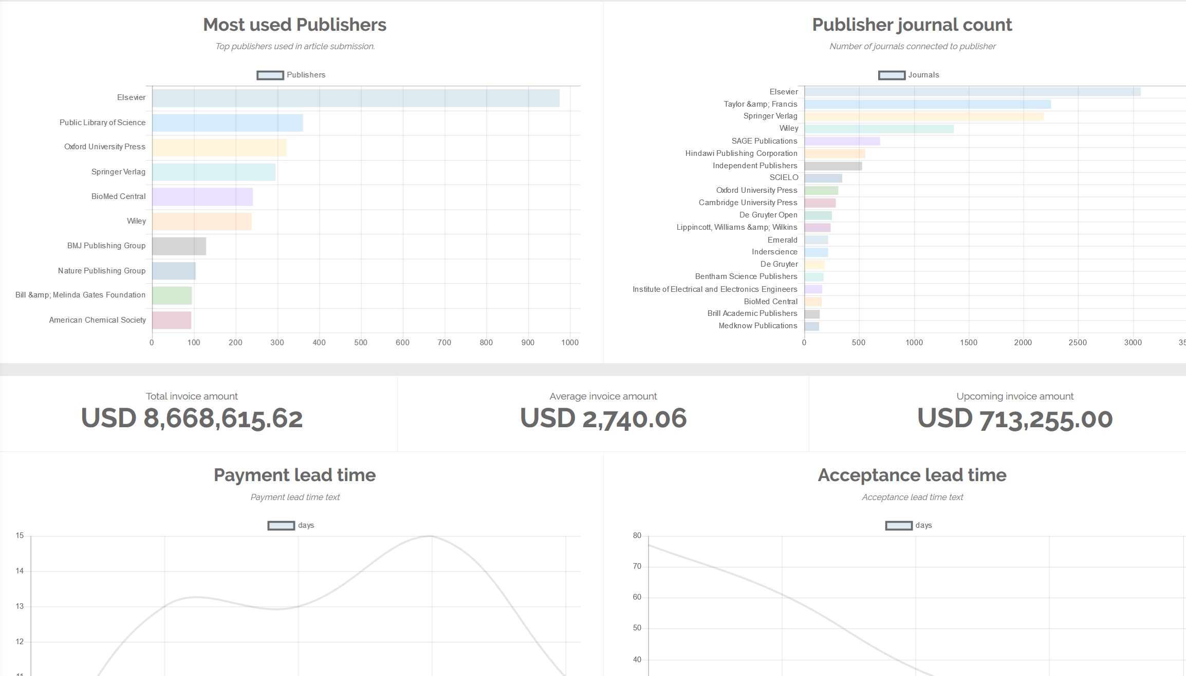

Slide 11
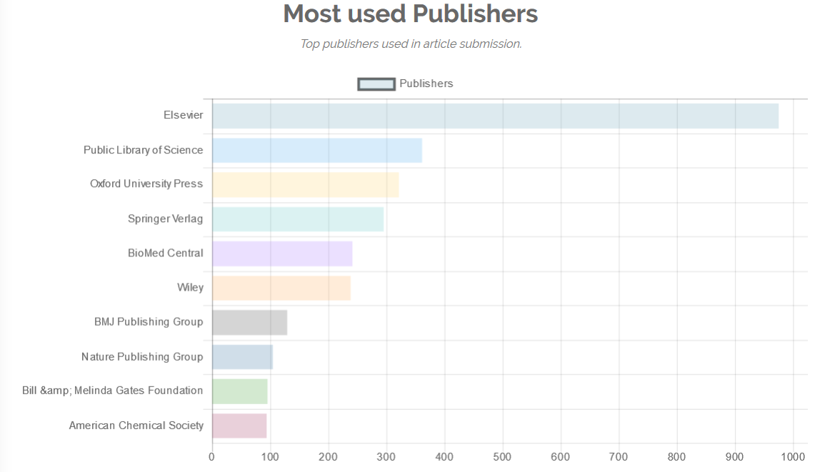
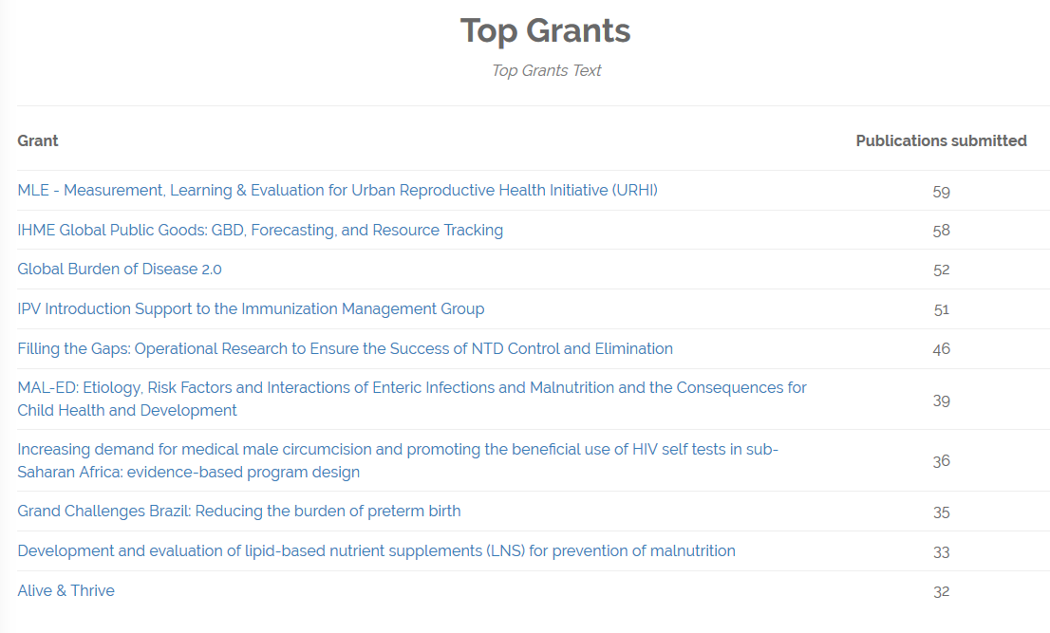
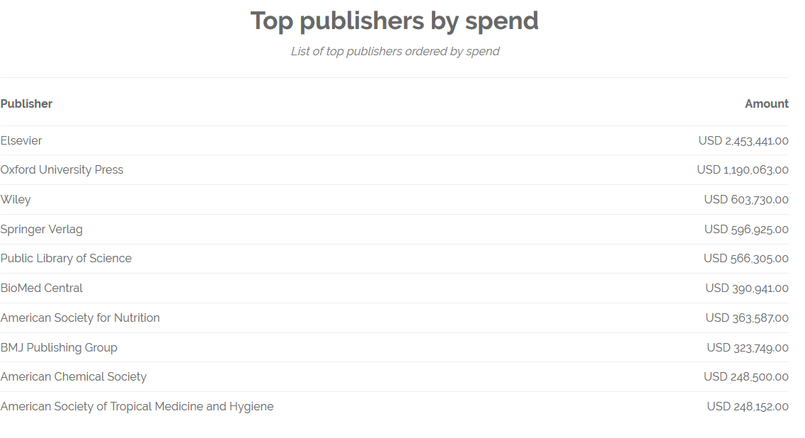

Slide 12
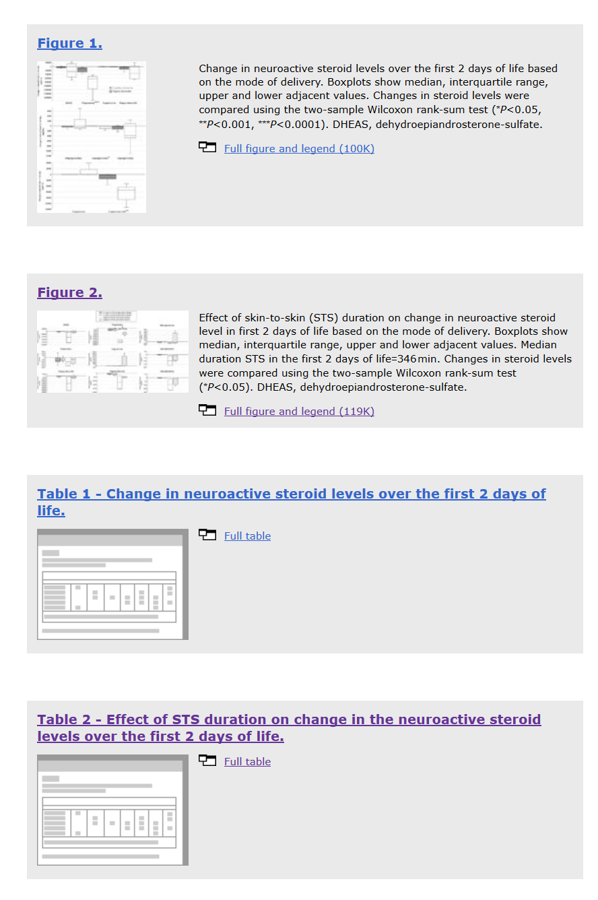
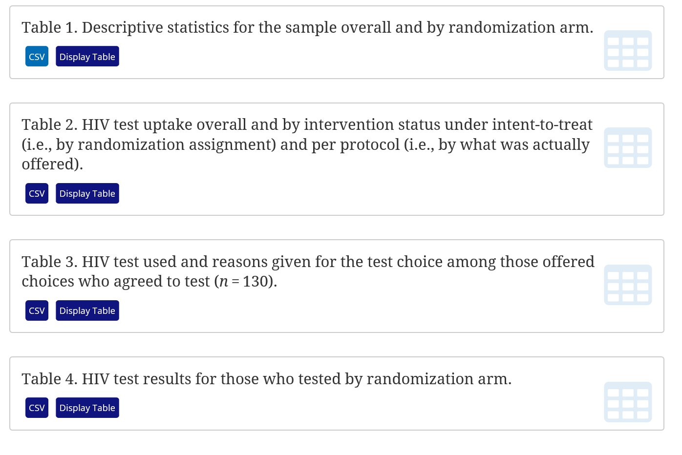
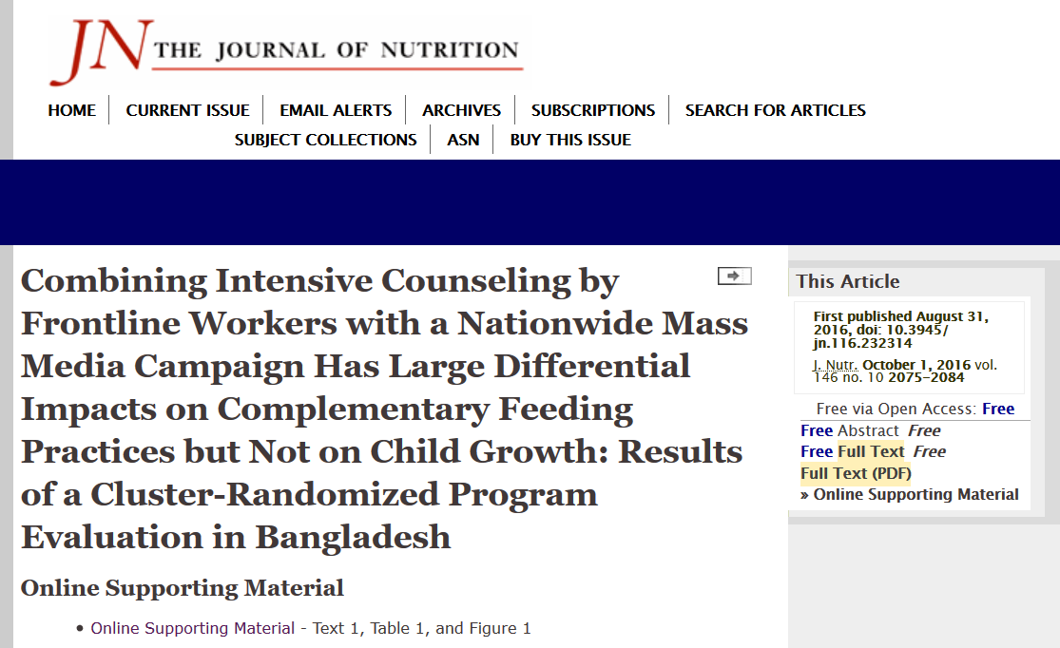
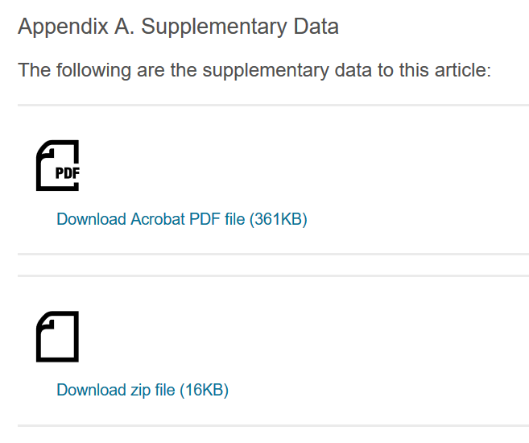
Examples of Other Underlying Data
Data only available as static figures/tables on publisher site – not easily reusable or citable
Data sets that are only available from the publisher site – not searchable or citable
Data only available as “Online Supporting Material” downloaded in a Word document – not discoverable, citable, or machine readable
Notes:
4 random examples of underlying data from Open Access articles – each publisher manages data in a different way. Some are more efficient than others but interoperability, accessibility, and machine-readable capability are lacking.

Slide 13
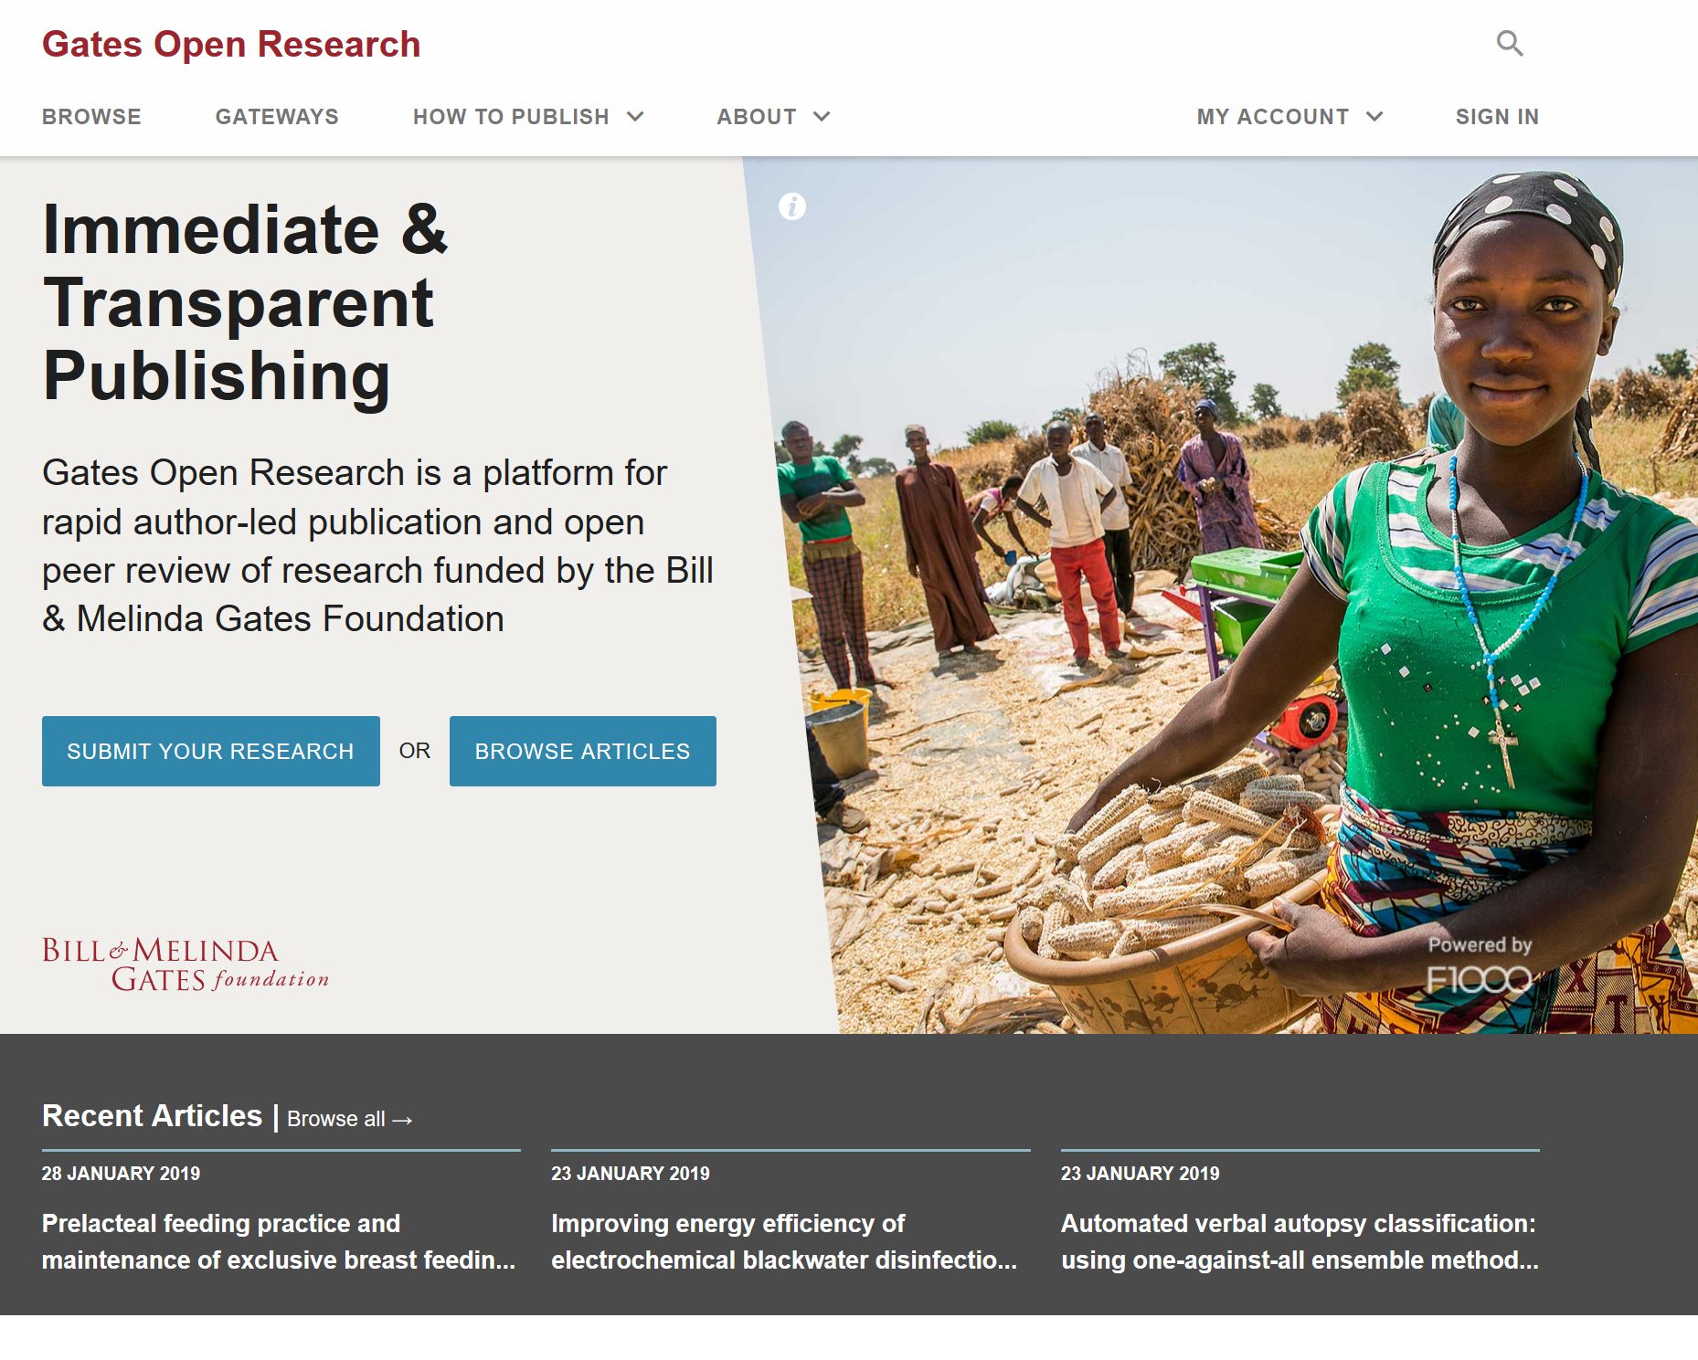

Slide 14
The Benefits of Publishing in Gates Open Research
Fast – articles can be published within a week
Inclusive – all Gates-funded research outputs are suitable: research articles, methods, software, data sets, protocols, negative and confirmatory results etc.
Open – fulfils the foundation’s OA requirements
Reproducible - source data published alongside article
Transparent – open, author-led publishing and peer review
Easy – all costs are directly covered by the Gates Foundation through full integration with Chronos

Slide 15
How does it work?
Post-publication peer review:
Peer review after publication (no ‘Editor’, in-house pre-pub checks)
Fully transparent peer review (referee names, report and rating)
Access to source data
Versioning (also in PubMed) for revisions, corrections, updates
Passed peer review
PubMed

Slide 16
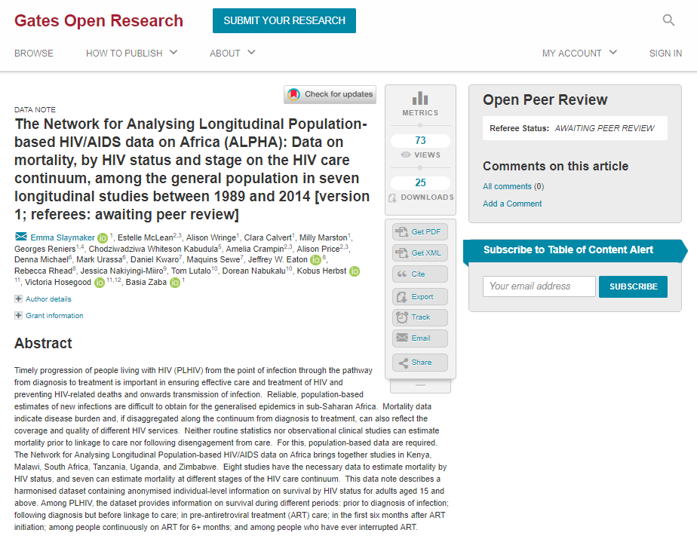
Publication without delay
Usage data
Version and peer review status
Article immediately citable

Slide 17
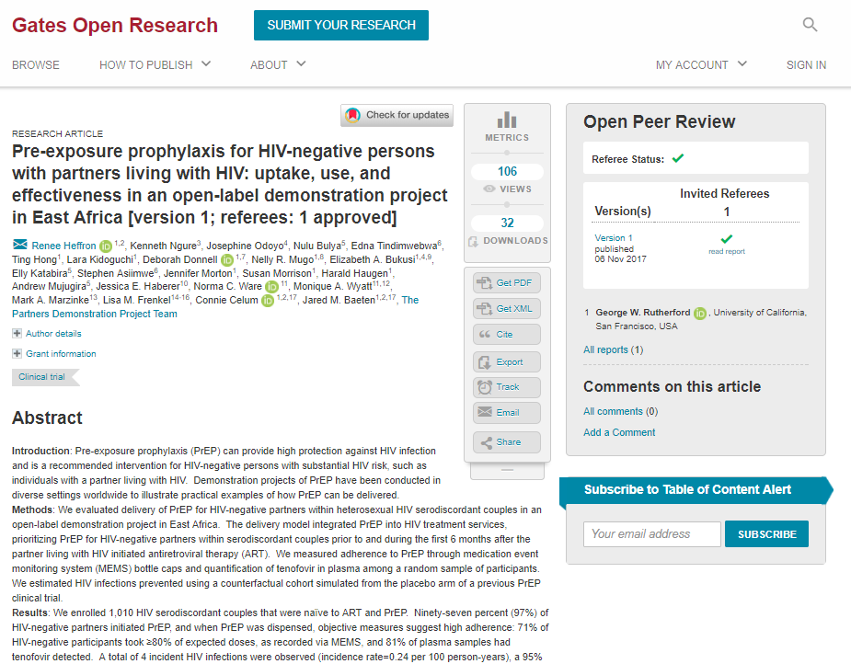
Post-publication peer review
Transparent peer review

Slide 18
Open peer review
Referee ratings:
Approved
Approved with reservations
Not approved
Minimal requirements for indexing:
or
[…]

Slide 19
Reproducibility
Data and software policy:
Access to source data underlying results
Data must be hosted in a stable open repository (e.g. Open Science Framework, Dataverse, Zenodo)
Data must be clearly described and formatted
Data must be openly available (with some exceptions)
Source code for new software must be provided (Software tool articles)

Slide 20
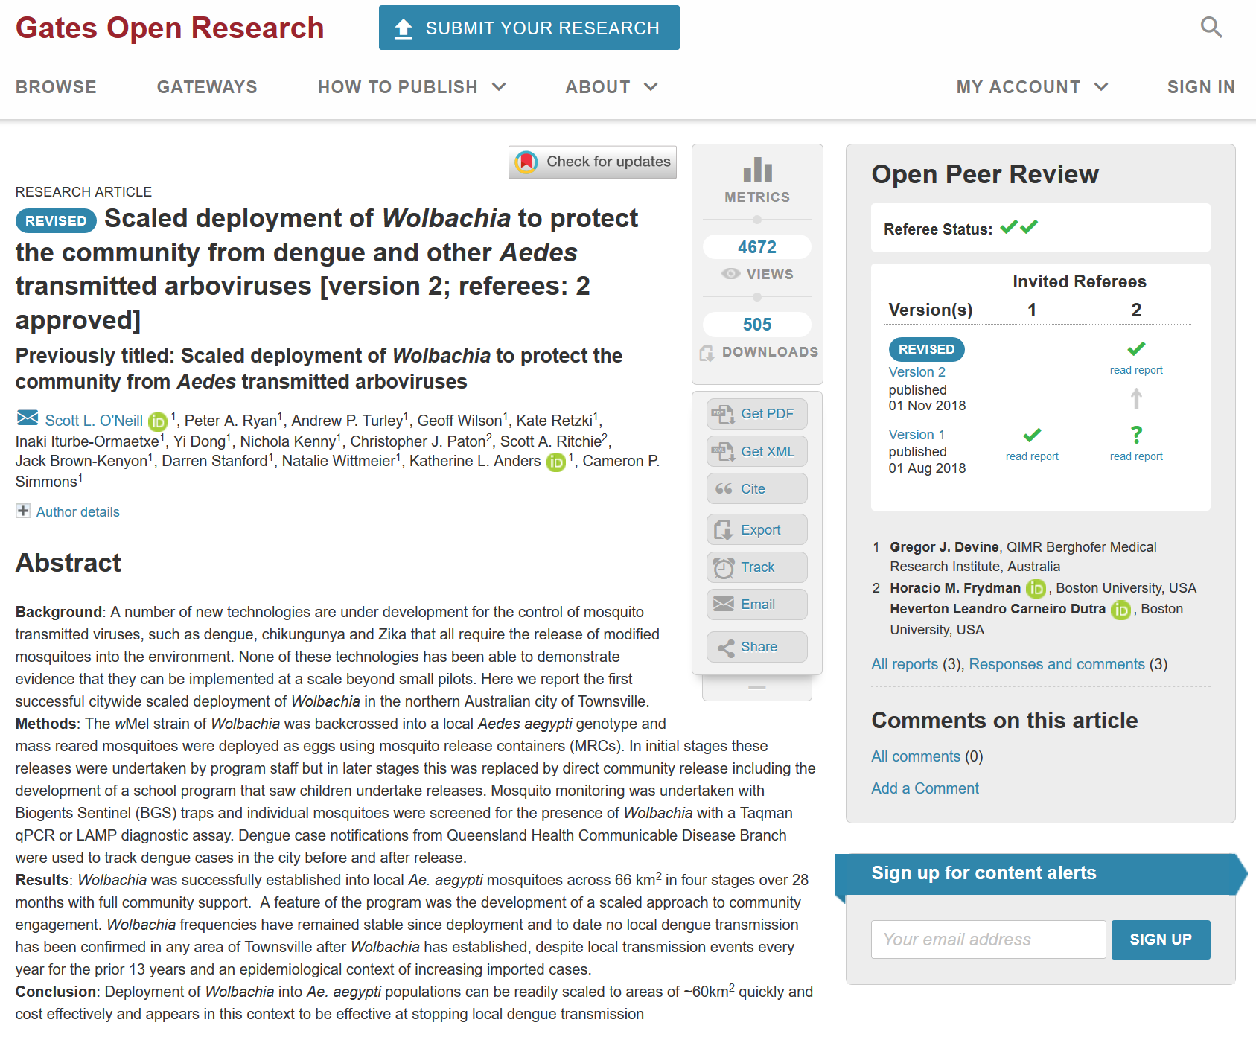

Slide 21
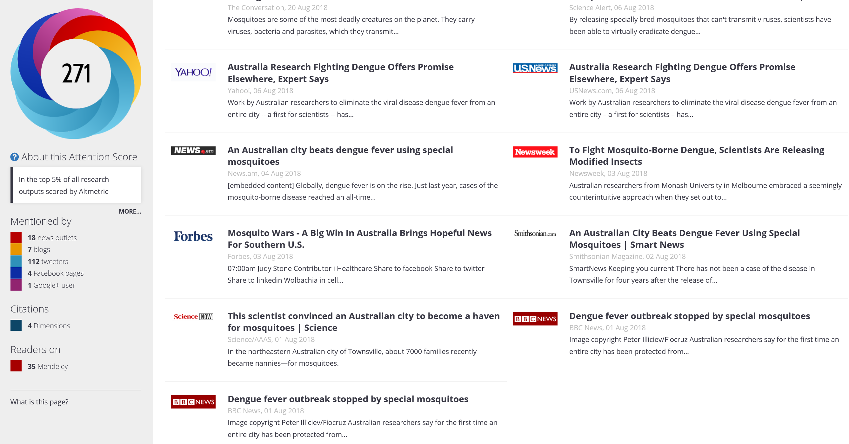

Slide 22
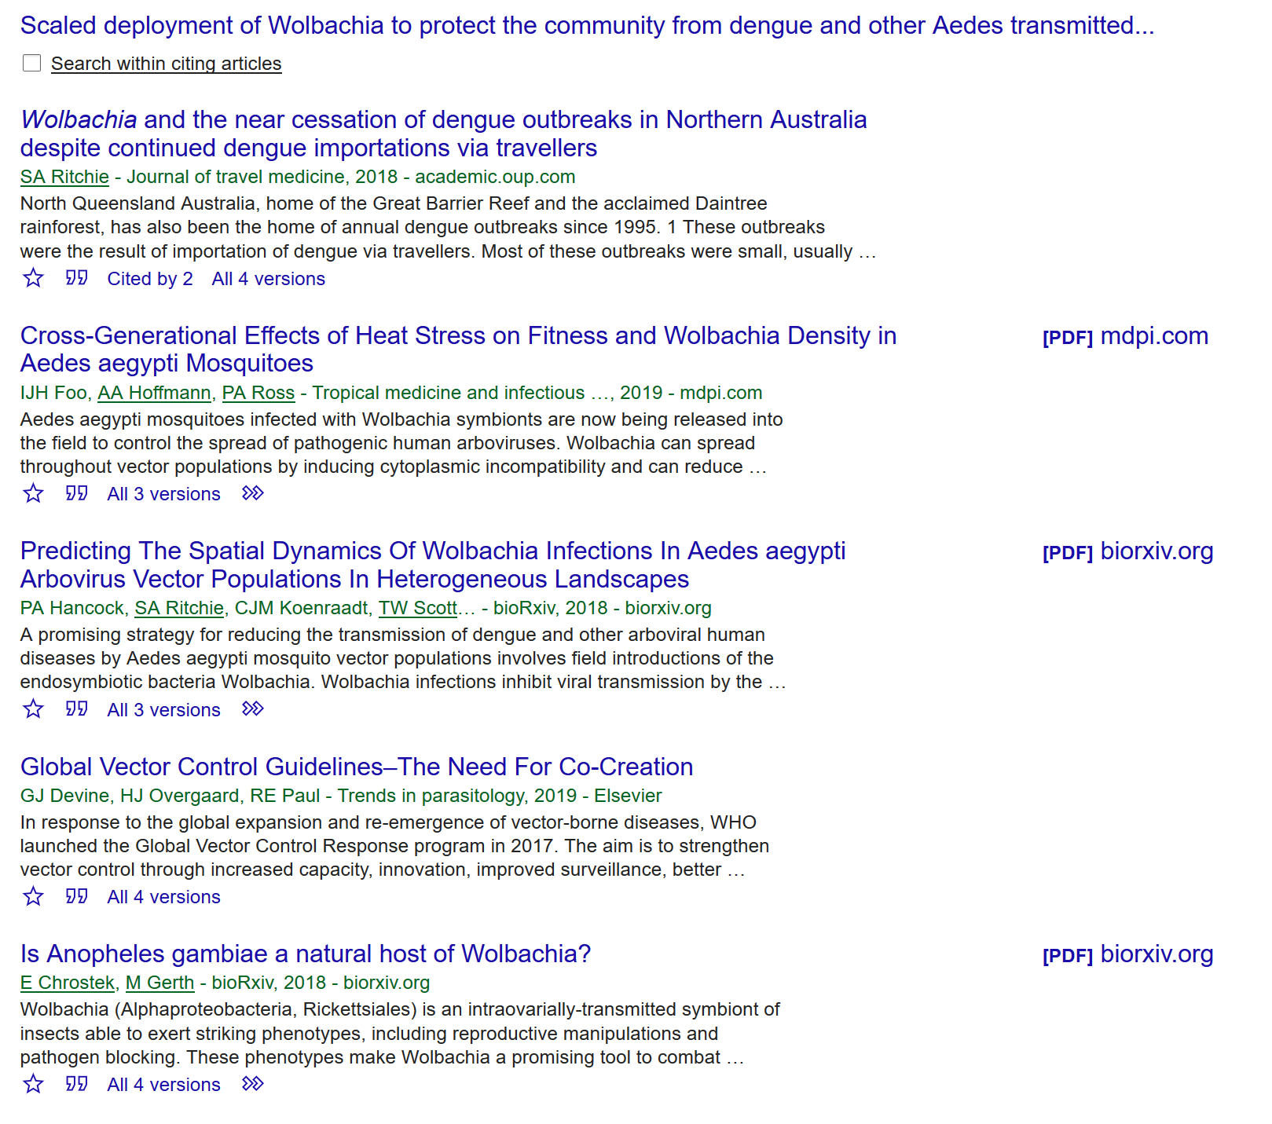

Slide 24
What I have learned about transparency in Open Access
Trust is important!
We need time & resources
Open Access community needs to work together
Twitter: @ashleydfarley

Slide 25
Trust
TomVMorris
Twitter: @ashleydfarley
Notes:
While open access to research is building momentum there are several obstacles limiting the progress made – several of these are focused on fear. I get it and I’m not saying these fears aren’t unfounded, but it’s important to acknowledge. The biggest obstacle is career advancement – if you are published in so-called “high impact” journals, how are tenure committees going to view you?
There is also the fear that being open can lead to someone else discovering something more amazing that you did. Or someone could discover that you have made a mistake.
Yet, if the researcher never releases the data and doesn’t make the discovery themselves – then than discover isn’t made. Or could take much longer to be reached by other research efforts.
Making mistakes is human – it’s part of the process. Failure shouldn’t exclude anyone from being part of the process.
Radical thinking – experience with Gates Open Research

Slide 26
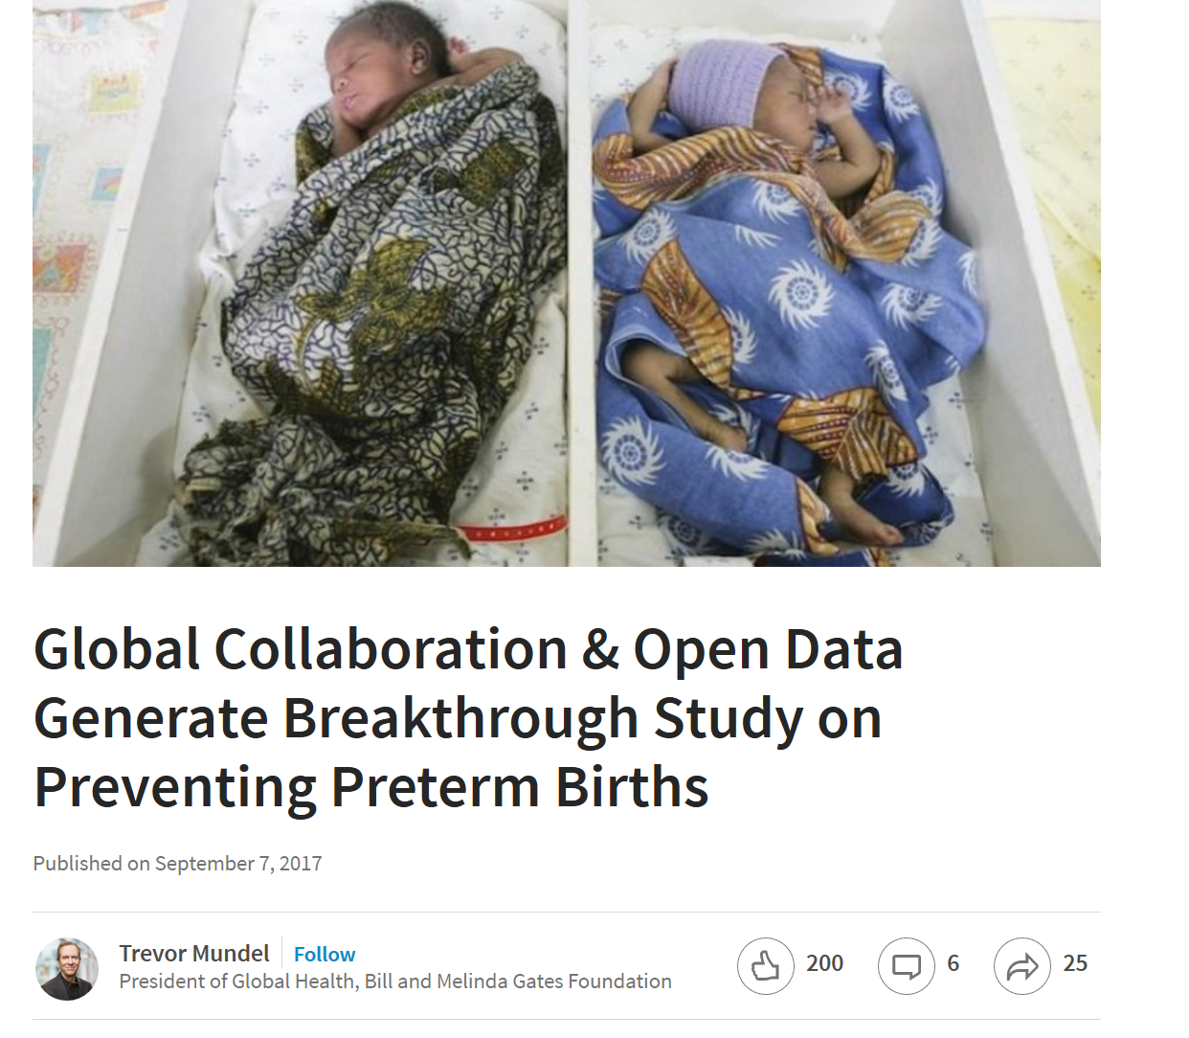
Why Open + Time is so Important
“If we have extensive and freely available data sets, medical researchers are much better positioned to identify underlying causes of preterm birth and effective treatments for them.”
Twitter: @ashleydfarley
Notes:
https://www.linkedin.com/pulse/global-collaboration-open-data-generate-breakthrough-study-mundel
If we have extensive and freely available data sets, medical researchers are much better positioned to identify underlying causes of preterm birth and effective treatments for them.
The New England Journal of Medicine published a study that shows how international collaboration and open data sharing have produced a major scientific breakthrough. For the first time, we have robust data on genetic pathways that can lead to a woman’s risk for preterm birth.
The study, “Genetic Associations with Gestational Length and Spontaneous Preterm Birth,” examines a massive DNA analysis of more than 50,000 pregnant women around the globe, resulting in the identification of six gene regions that influence the length of pregnancy and the timing of birth.
Much of the data used in this study, and critical data sets needed for replication to ensure the findings were independently confirmed, came from open access data sources such as the NIH supported dbGaP. If we have extensive and freely available data sets, medical researchers are much better positioned to identify underlying causes of preterm birth and effective treatments for them.
I often stress the promise of open data and shared learnings in accelerating scientific discoveries, and I’m excited that the findings from this particular study will be part of a March of Dimes Prematurity Research Center database that will allow researchers to study the importance of these genes not only in isolation, but in context with other potential factors in preterm birth currently under investigation.

Slide 27
Twitter: @ashleydfarley
Notes:
This quote is prominently displayed at the Gates foundation as a reminder of the power of collaboration. I believe that collaboration is a critical part of the discussion of Open Science.
I would like to focus heavily on the “community alignment” portion of this talk title.

Slide 28
Notes:
https://www.flickr.com/photos/newtown_grafitti/9932746336
Change is hard and often it feels that the system is taking forever to see noticeable change. But it’s hopeful and the future is bright. Everyone in this room has the power to start taking the steps to build towards a more open and impactful future. Thank you

