Slide 1
How can researchers maximize transparency?
Eight recommendations on publishing for the CBMRT roadmap
2019-02-15
CBMRT Transparency Summit
Jessica Polka
@jessicapolka, @ASAPbio_

Slide 2
Knowledge grows only as fast as shoulders to stand on
Photo by calafellvalo - CC BY-NC-ND

Slide 3
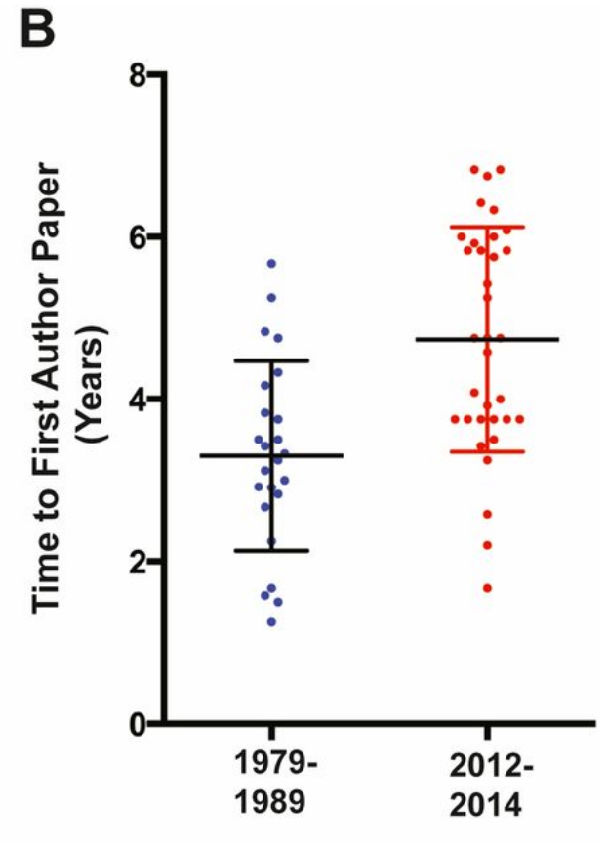
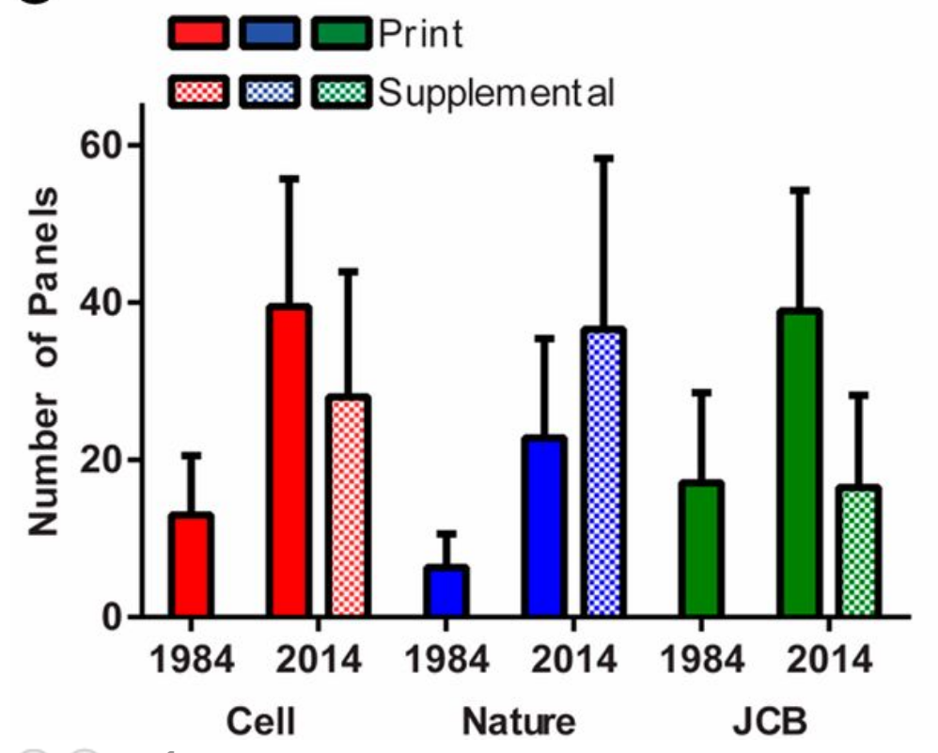
Publication in cell biology is taking longer and longer
Ron Vale (2015) http://www.pnas.org/content/112/44/13439

Slide 4
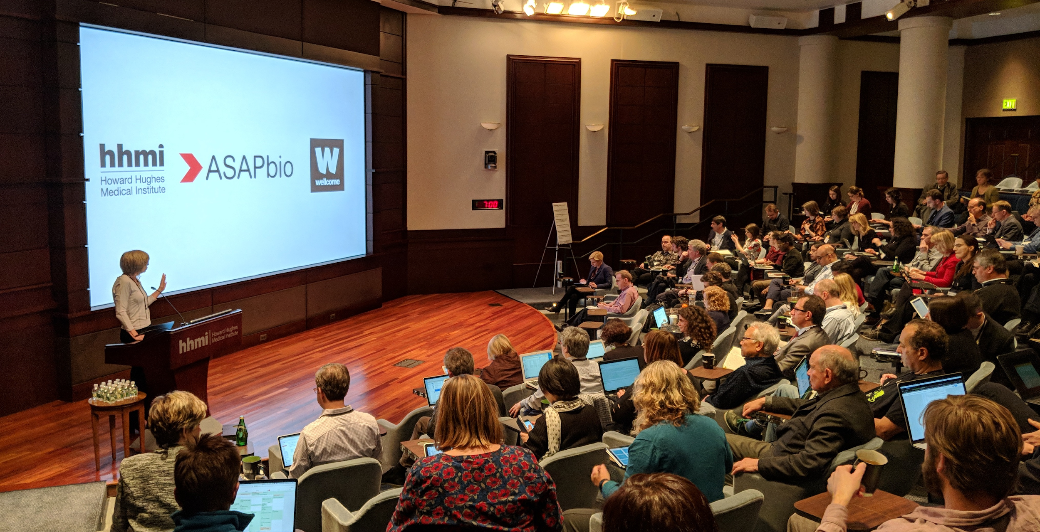
ASAPbio is a 501(c)(3) promoting transparency & innovation in life sciences publishing

Slide 5
Tackling one slice of the research cycle
Assessment
Discovery
Outreach
Analysis
Publication
Writing
Adapted from 101innovations.wordpress.com/

Slide 6
Existing roadmaps
101 Innovations in Scholarly Communication
Lettie Conrad’s ecosystem gaps @JROST
Alerts, recommendations
Translation
Pre-pub & post-pub review
https://figshare.com/articles/NPOS_Workflow-perspective-Bosman-Kramer_pptx/5065534/1
https://docs.google.com/presentation/d/1VlPToLvF71ZIWvqClO-A21d2u9grO9pQf17G_z76ge0/edit#slide=id.p
Open Science MOOC
https://opensciencemooc.eu/

Slide 7
8 recommendations for increasing researcher transparency in publishing

Slide 8
Get coauthors comfortable with preprinting
1

Slide 9
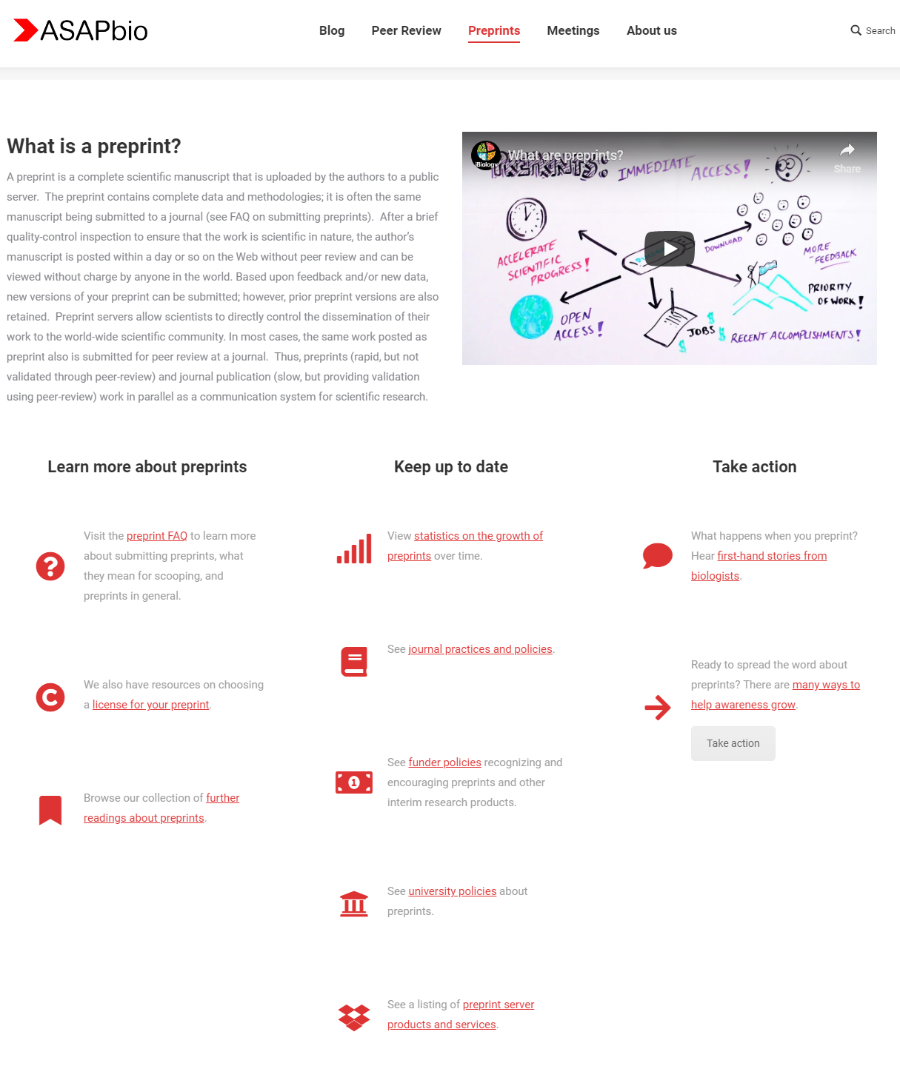
Resources at asapbio.org/preprint-info

Slide 10
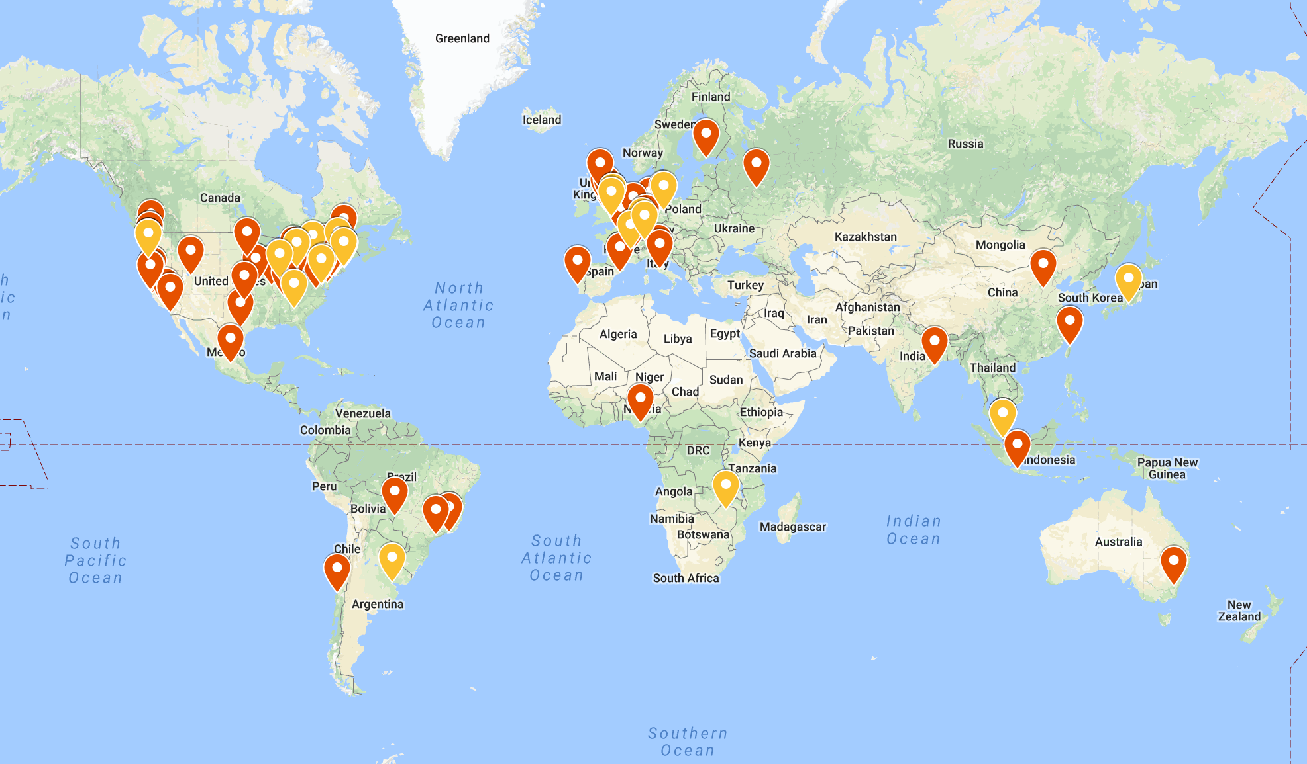
Ambassadors promoting preprint awareness
asapbio.org/asapbio-ambassadors

Slide 11
Choose an appropriate preprint server
2

Slide 12
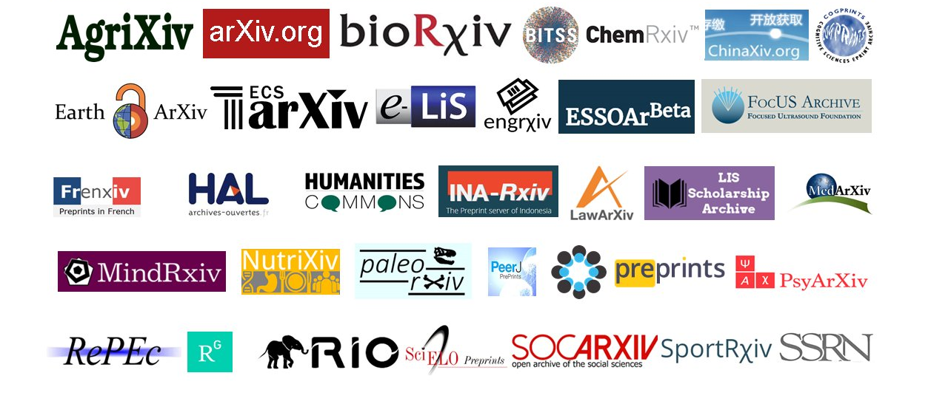
Preprints for all disciplines, languages, & communities
Image compiled by Jeroen Bosman (@jeroenbosman) via Bianca Kramer (@MsPhelps)

Slide 13
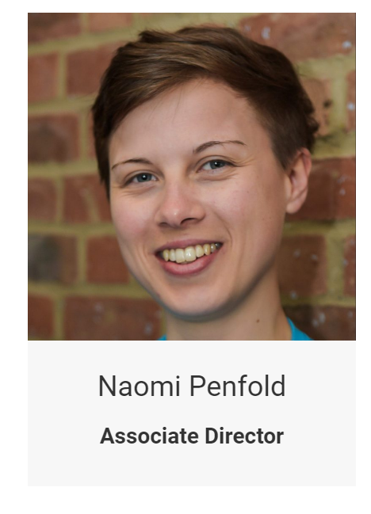
Also consider:
ASAPbio is building a directory of preprint servers
Screening & moderation policies
Preservation
Licensing
Formats
Ownership/governance
Commenting
Indexing/machine access

Slide 14
Make preprints open, not just free
3

Slide 15
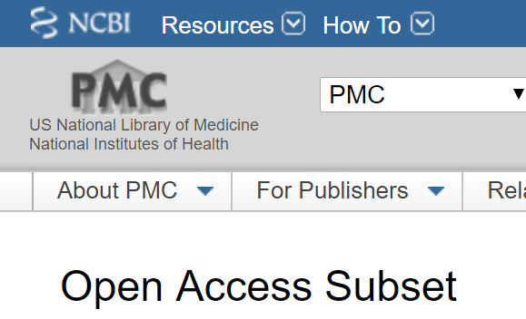
The majority of “free” literature is not open
2,080,010
out of
5,384,701
* any CC license as of 2019-02-14

Slide 16
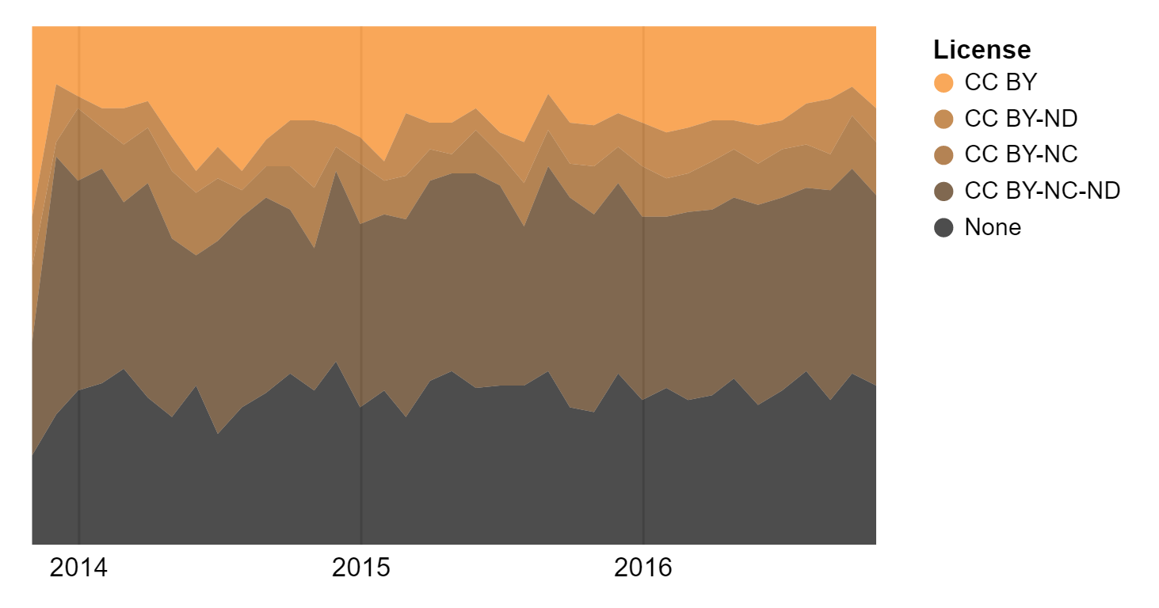
The majority of preprints are not open access
18%
7%
9%
37%
30%
https://blog.dhimmel.com/biorxiv-licenses/

Slide 17
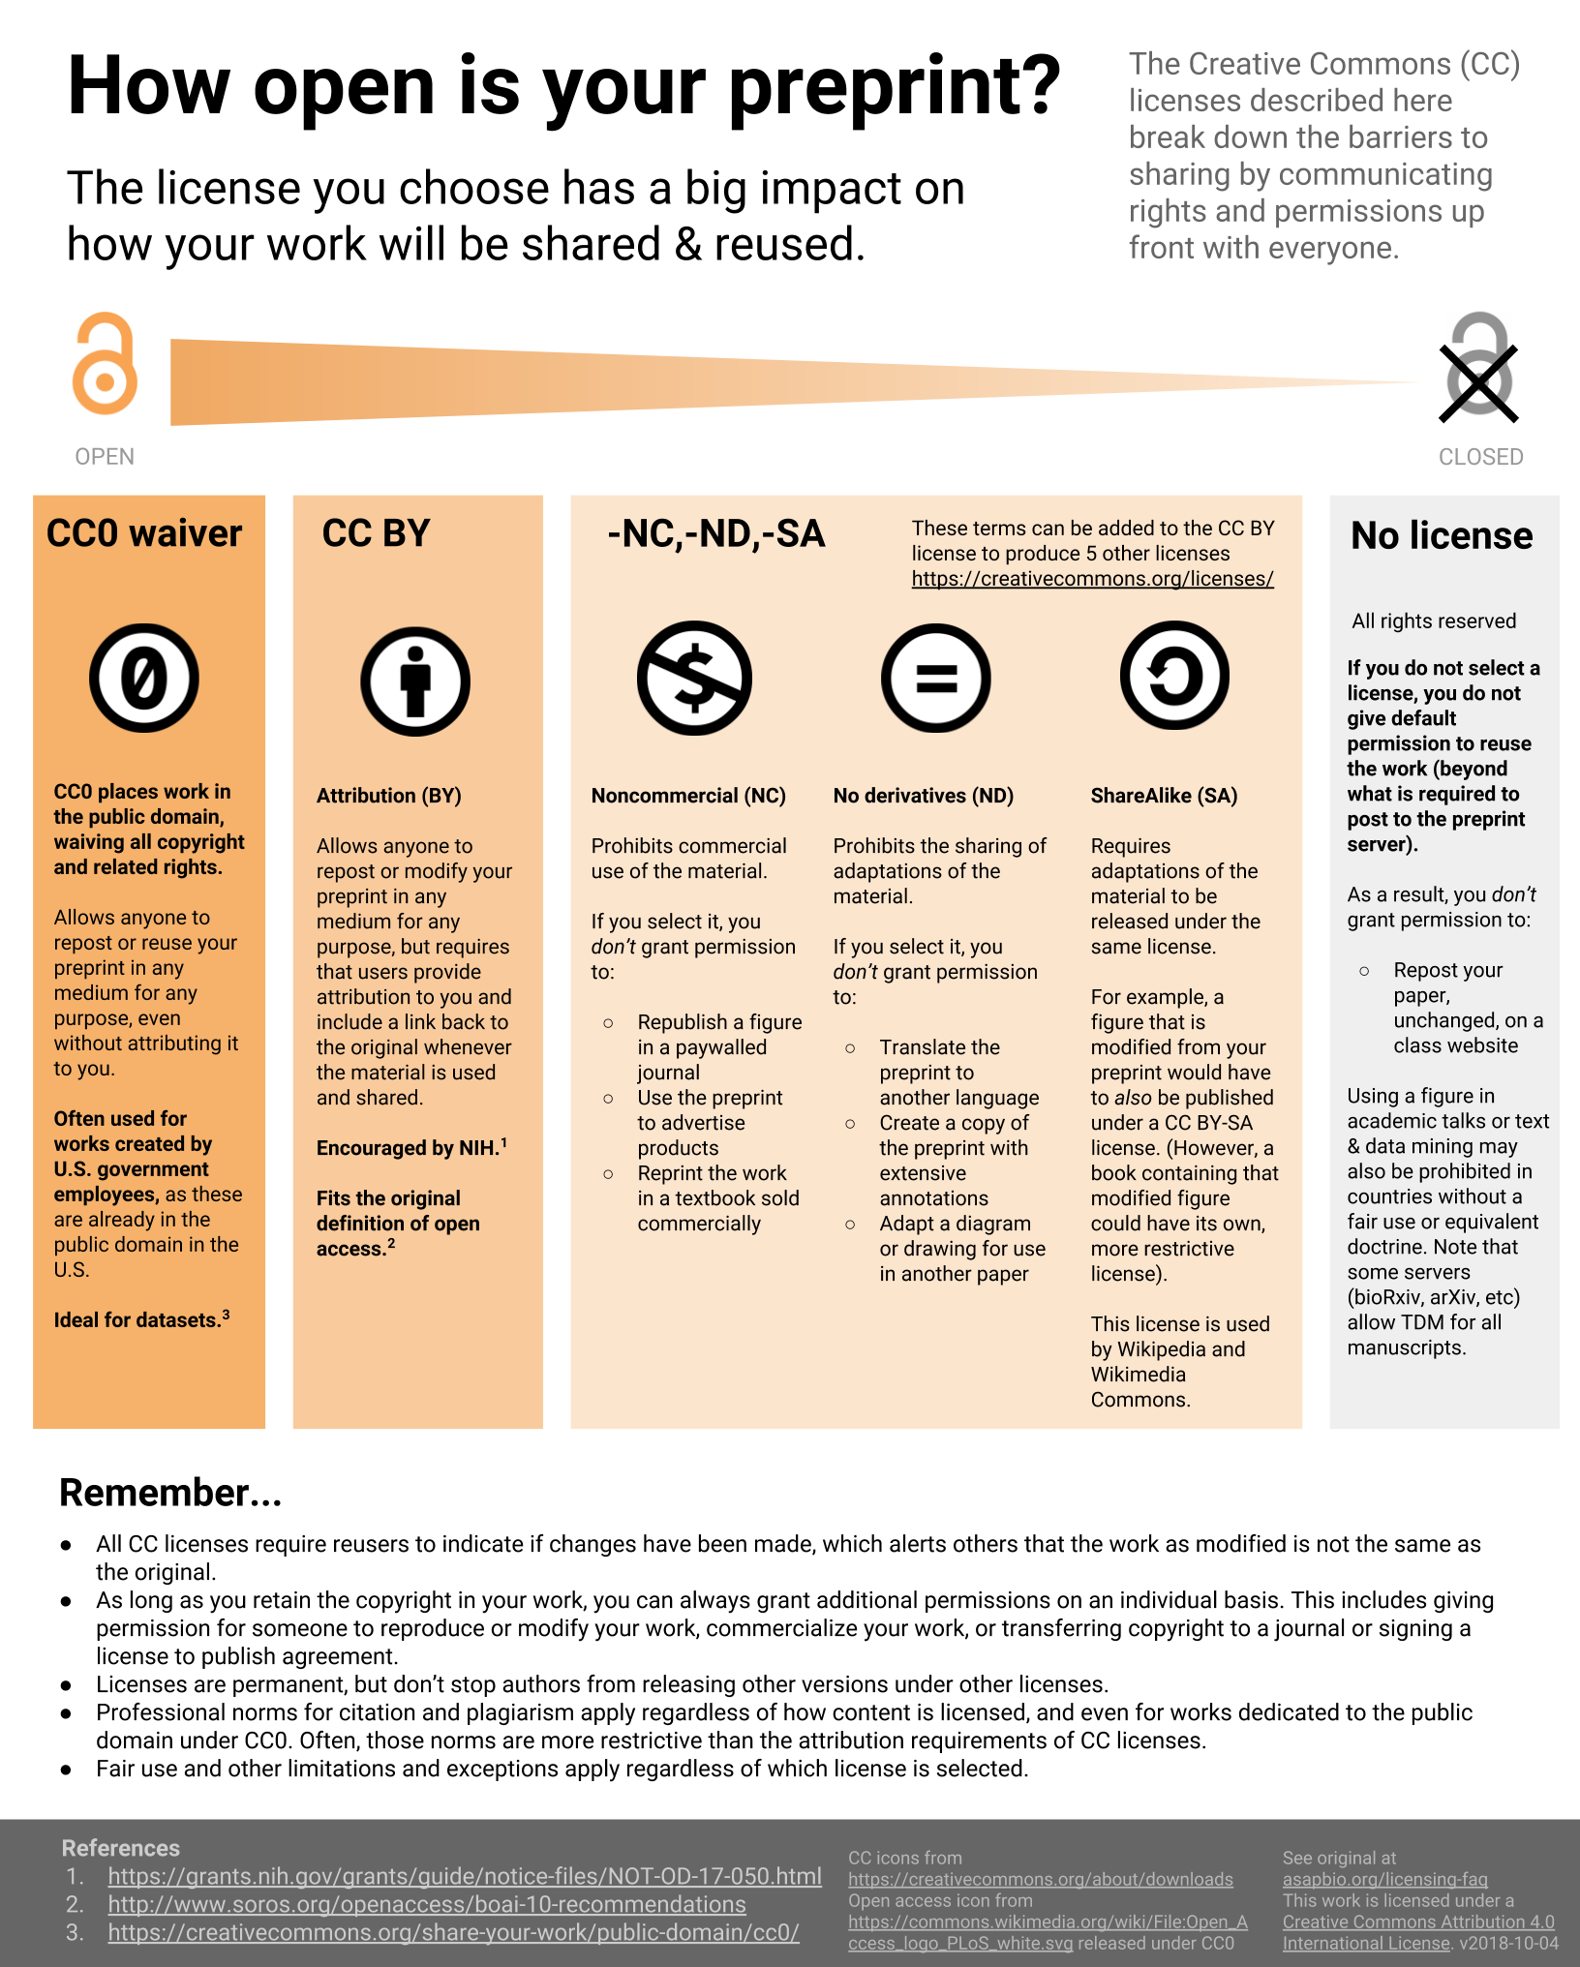
http://asapbio.org/licensing-faq

Slide 18
Choose journals that permit preprinting (your way)
4

Slide 19
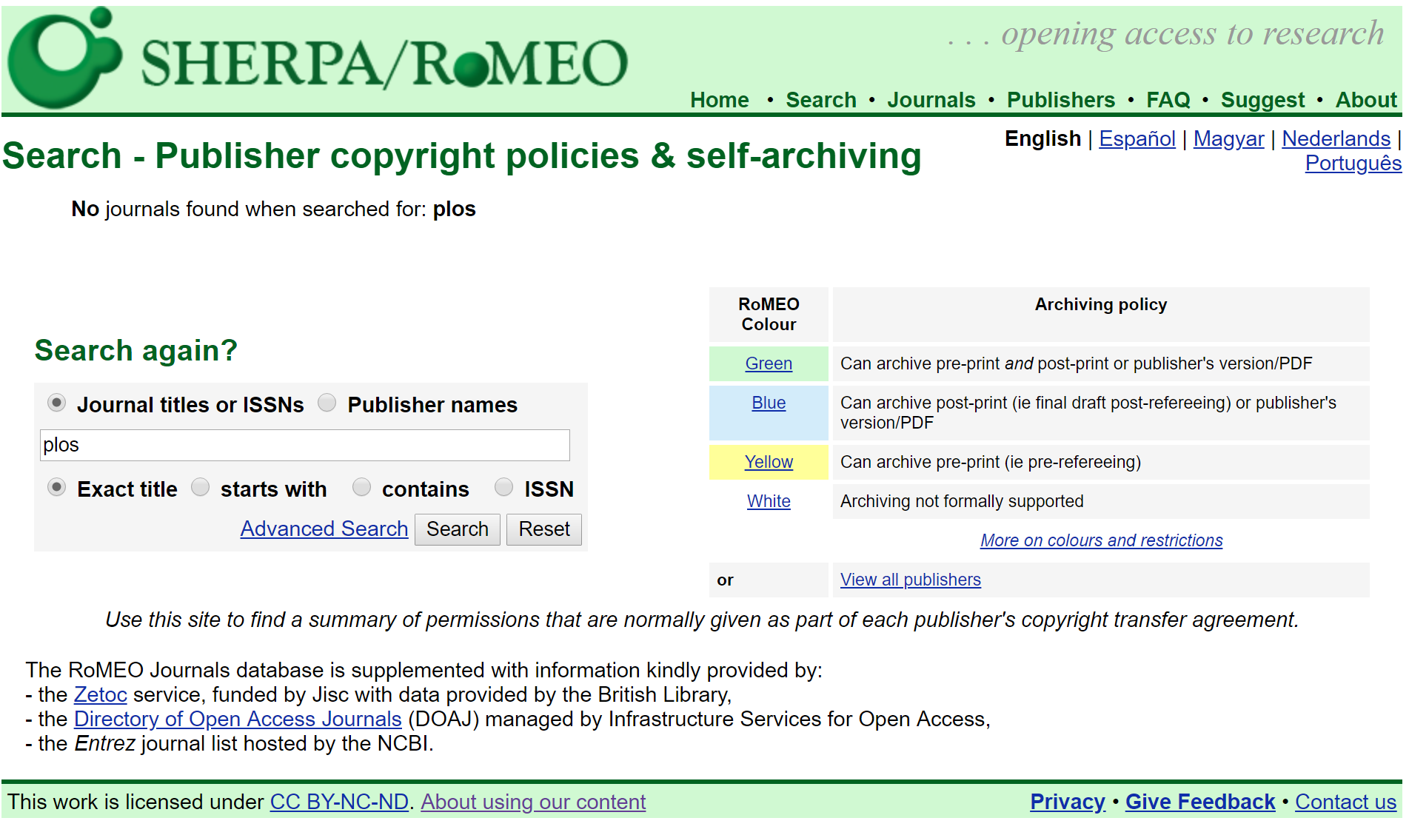
SHERPA/RoMEO is a fantastic start
sherpa.ac.uk/romeo/search.php

Slide 20
...but journal policies are much more nuanced
eg, what types of servers are allowed?
The Royal Society of Chemistry journals allow deposition with “non-commercial repositories” such as ArXiv and ChemRxiv - http://www.rsc.org/journals-books-databases/journal-authors-reviewers/processes-
Development “supports authors who wish to post primary research manuscripts on community preprint servers such as bioRxiv.” - http://dev.biologists.org/content/journal-policies#preprint
Biophysical Journal “will consider for publication manuscripts that have been posted informally on a private website or on arXiv or bioRxiv, but will not consider manuscripts that have been posted on other preprint servers or "virtual journal" websites.” - https://www.cell.com/pb-assets/journals/society/biophysj/PDFs/author-guidelines.pdf?code=cell-site

Slide 21
...and can be conflicting
“Authors must update their manuscripts on pre-print servers diligently so the current version matches the version under consideration at Synthetic Biology.”
https://academic.oup.com/synbio/pages/Policies#PREPRINT
At the Journal of Clinical Oncology, “no revisions should be posted to the preprint server during the manuscript's peer review process.”
http://ascopubs.org/jco/site/ifc/journal-policies.xhtml

Slide 22
Choose journals that conserve reviewer energy
5

Slide 23
15 million hours are wasted each year on duplicate peer review
https://www.aje.com/en/arc/peer-review-process-15-million-hours-lost-time/
http://nprc.incf.org/
https://www.manuscriptexchange.org/

Slide 24
Choose journals that enable all reviewers to get credit
6

Slide 25
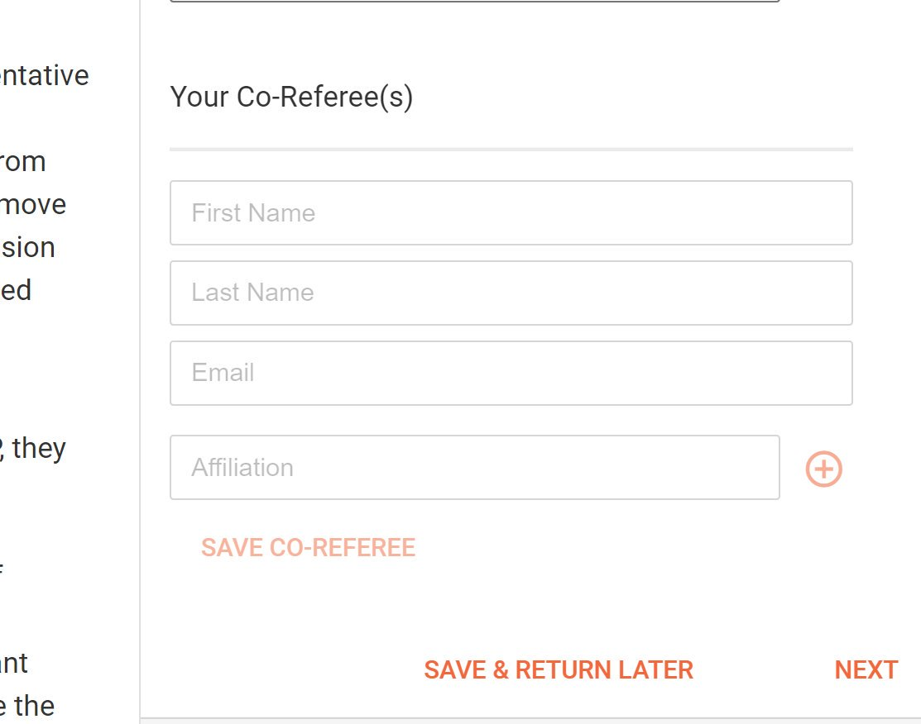
Ghost reviewing is widespread
In an eLife survey of 51 PhD students, 37% “performed their review without the assistance of their advisor.”
Which journals are prompting reviewers to list co-reviewers?
Identifies new reviewing pool
Gives credit to trainees, where it is most needed
Honest attribution of work
Some journals (here F1000Research) provide a space to list coreviewers in the review form

Slide 26
Choose journals that publish peer review
7

Slide 27
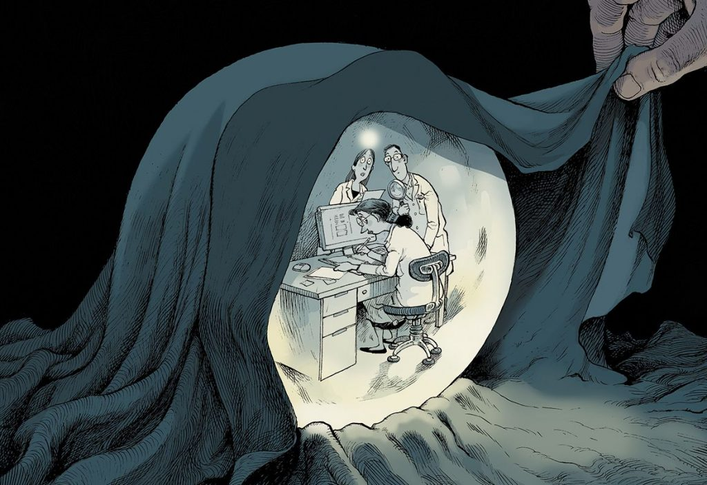
Publish (anonymous) peer reviews
Encourages constructive reviewer behavior
Peer review is scholarship
Earns the trust of readers
Makes journal decisions more transparent
Opens a door for reviewer recognition
Helps trainees
Enables the study of peer review
Read article
Illustration by David Parkins

Slide 28
>300 signatories, including some that commit to publishing peer review in the future
Journal(s) | Publisher | Contact | Expected implementation date
PLOS Biology | PLOS | Veronique Kiermer | Q2 2019
PLOS Computational Biology | PLOS | Veronique Kiermer | Q2 2019
PLOS Genetics | PLOS | Veronique Kiermer | Q2 2019
PLOS Medicine | PLOS | Veronique Kiermer | Q2 2019
PLOS Neglected Tropical Diseases | PLOS | Veronique Kiermer | Q2 2019
PLOS ONE | PLOS | Veronique Kiermer | Q2 2019
PLOS Pathogens | PLOS | Veronique Kiermer | Q2 2019
Obstetrics & Gynecology | Wolters Kluwer Health | Rebecca Benner | October 2018
Journal of Cell Biology | Rockefeller University Press | Rebecca Alvania & Jodi Nunnari | Late 2018
Proceedings of the Royal Society B | Royal Society | Spencer Barrett | Early 2019
Development | Company of Biologists | Claire Moulton | Early 2019
Journal of Cell Science | Company of Biologists | Claire Moulton | Early 2019
4open | EDP Sciences | Claus Roll | Early 2019
#PublishPeerReview
Molecular Biology of the Cell | ASCB | David Drubin | January 2019
Journal of Neuroscience Research | Wiley | Eric Prager | January 2019
Progress in Neurobiology | Elsevier | Bahar Mehmani | Dec-18
asapbio.org/letter

Slide 29
Transpose
A collaborative initiative to build a database of journal policies on peer review and preprints
Supporting organizations
476
Journals
341
Verified by editors
Funding
transpose-publishing.github.io

Slide 30
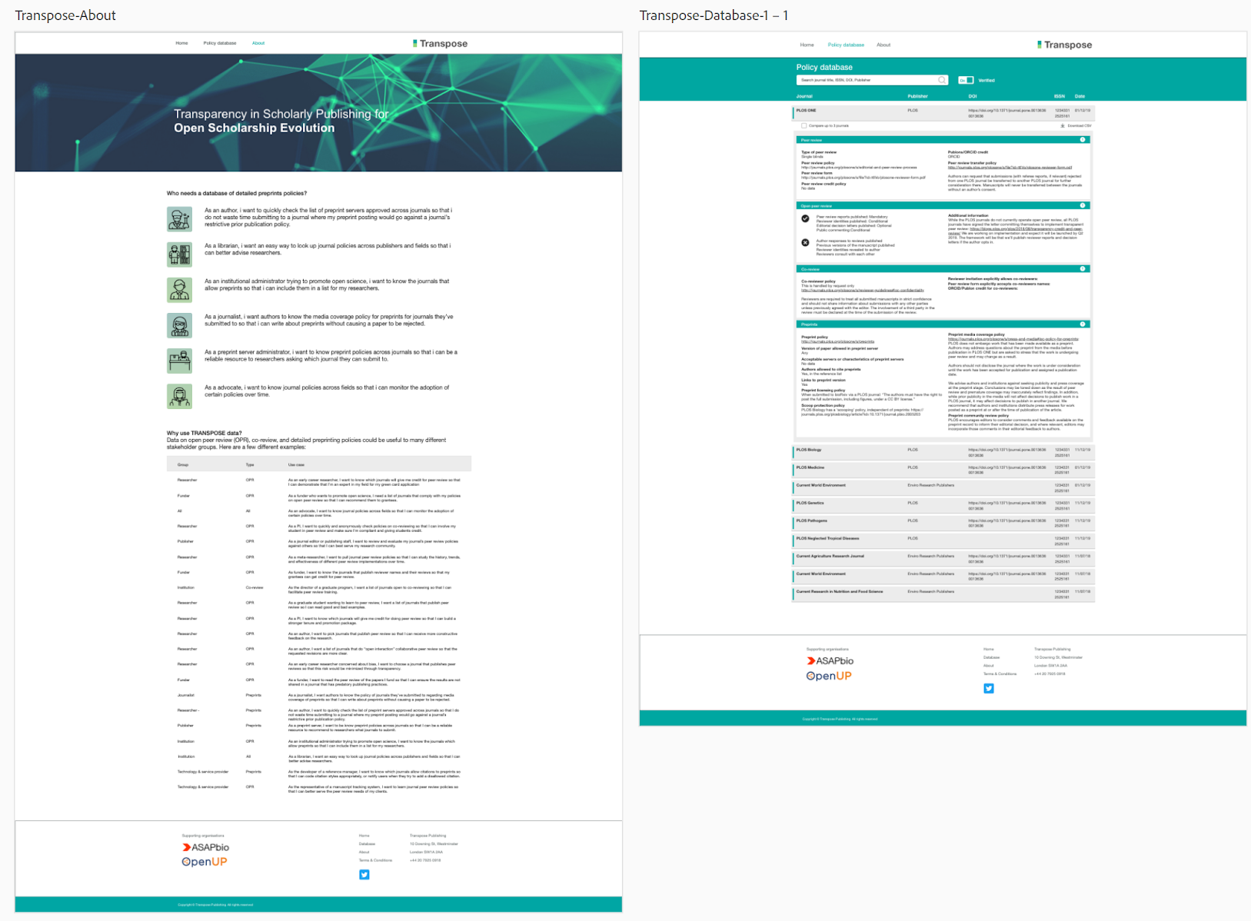
Coming soon
On the roadmap
Model policy checklists and templates
Landscape study
Crossref metadata
transpose-publishing.github.io | @TRANSPOSEsci

Slide 31
Look beyond the journal system
8

Slide 32
New ways of evaluating outputs
Learn more
http://asapbio.org/preprint-journal-clubs
More details in this spreadsheet

Slide 33
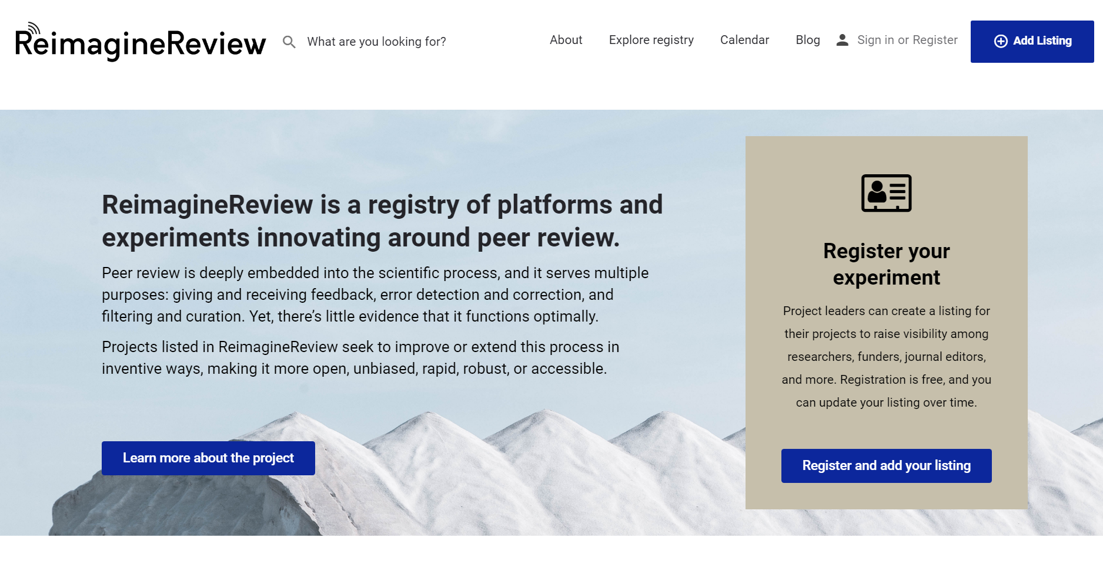
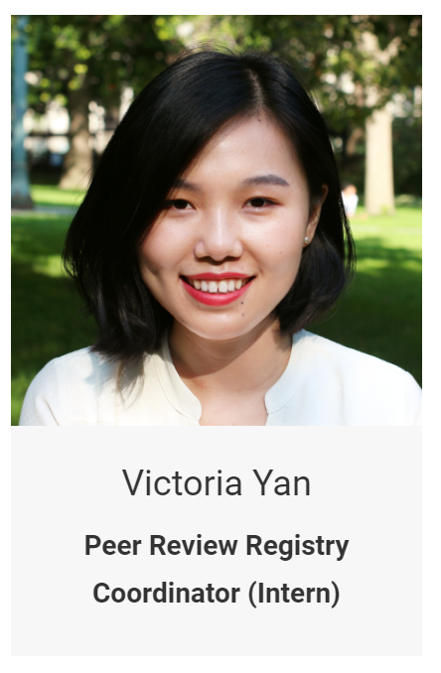
Coming soon

Slide 34
8 recommendations for the CBMRT roadmap
Get coauthors comfortable with preprinting
Choose an appropriate preprint server
Make preprints open, not just free
Choose journals that permit preprinting (your way)
… that conserve reviewer energy
… that enable all reviewers to get credit
… that publish the content of peer review reports
Look beyond the journal system

Slide 35
Thank you
Ron Vale (Founder/President)
Cynthia Wolberger (Vice President)
James Fraser (Secretary & Treasurer)
Prachee Avasthi
Phil Bourne
Daniel Colón-Ramos
Tony Hyman
Heather Joseph
Jennifer Lin
Kristen Ratan
Harold Varmus
Dick Wilder (non-voting)
Naomi Penfold
Victoria Yan
These slides
goo.gl/qqTRAv

