Slide 1

Literature searching: skills and tools
Maria Levchenko
levchmar@ebi.ac.uk
www.europepmc.org

Slide 2
Contents
Literature research tools
Keyword search basics
Filtering and sorting
Finding data and evidence
Search cookbook: using syntax
Saving a search

Slide 3
Literature research tools

Slide 4
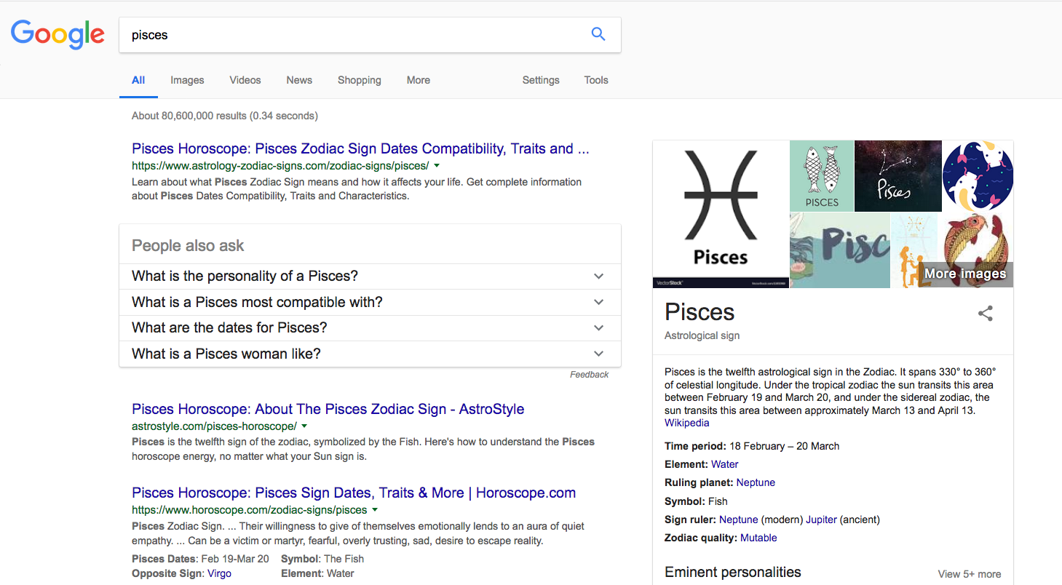
What you search

Slide 5
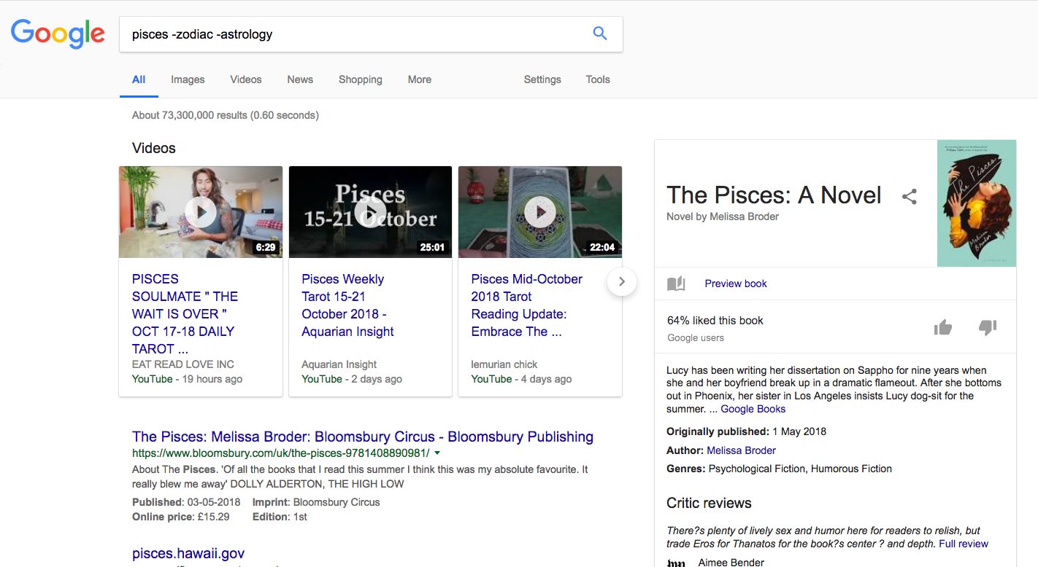
What you search

Slide 6
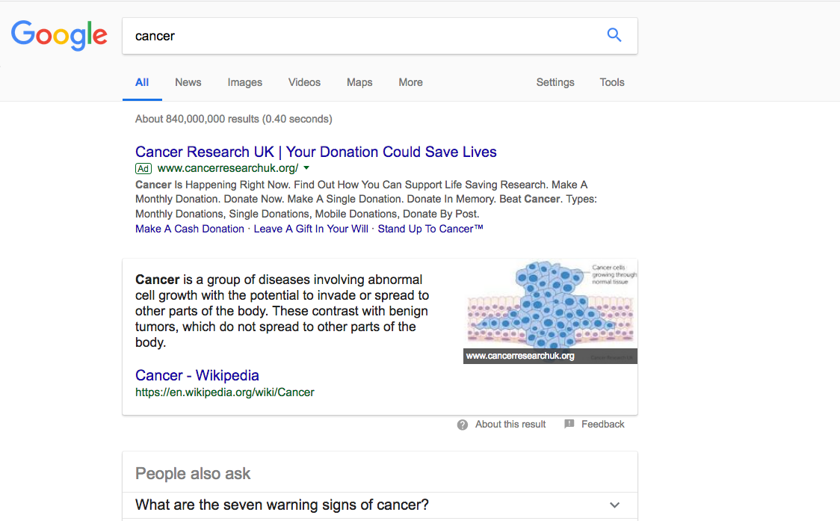
Where you search

Slide 7
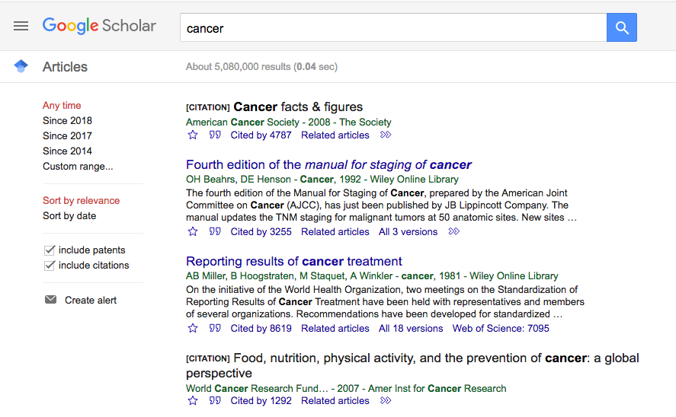
Where you search

Slide 8
What is Europe PMC?
Public database for biomedical research literature

Slide 9

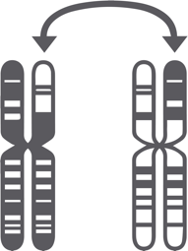

What is Europe PMC?
~35 million
biomedical abstracts
~3 million
genomic variants
~150 000
protein structures
in PDBe
in dbVar
in Europe PMC
image by
Jason D. Rowley

Slide 10
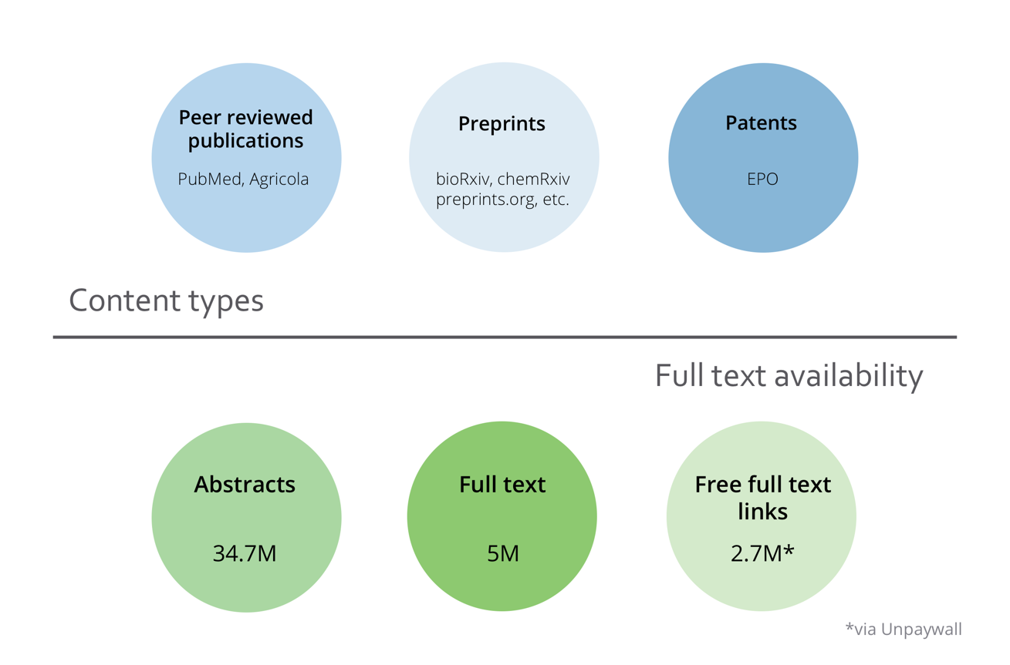
Content in Europe PMC

Slide 11
Content in Europe PMC

Slide 12
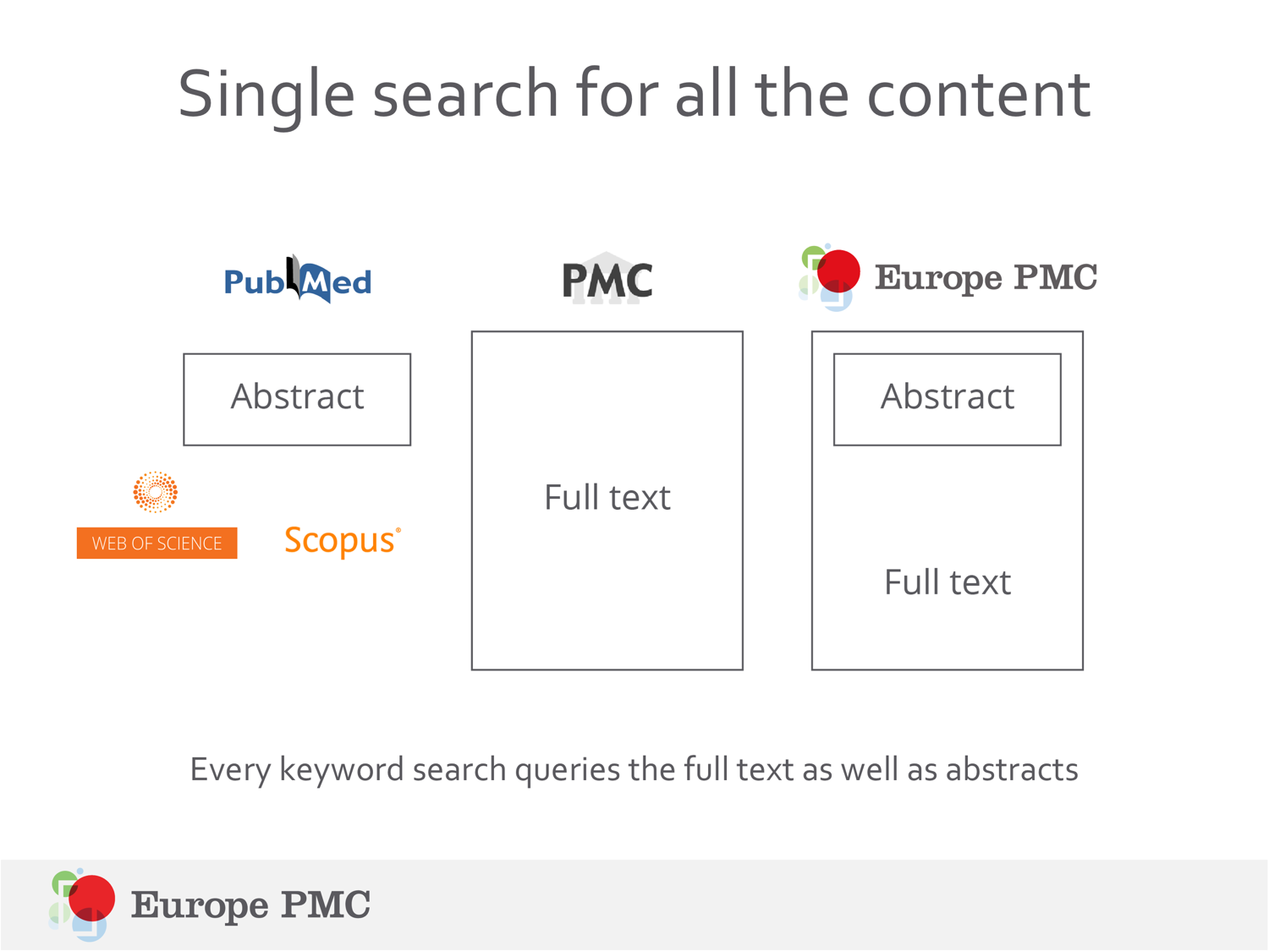
Single search for all the content
Every keyword search queries the full text as well as abstracts

Slide 13
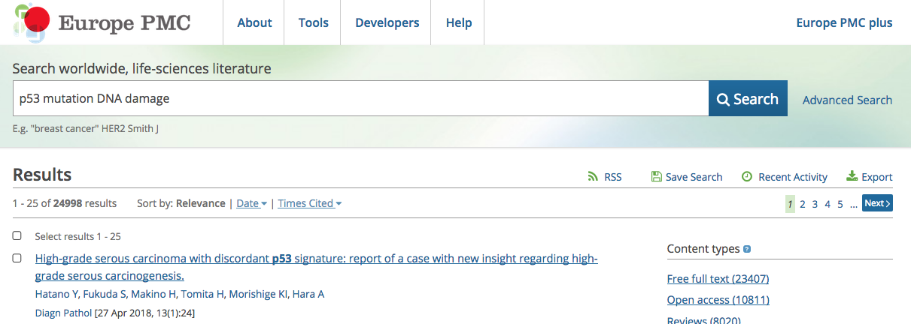

Slide 14
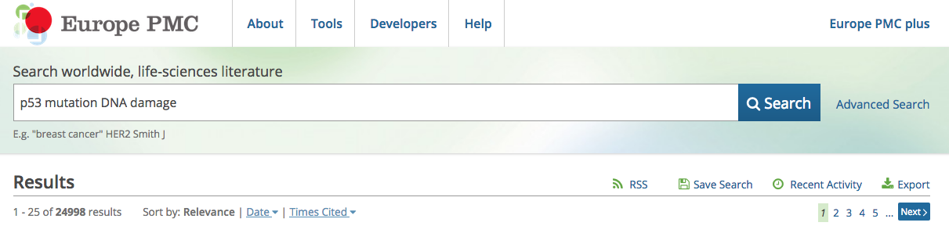
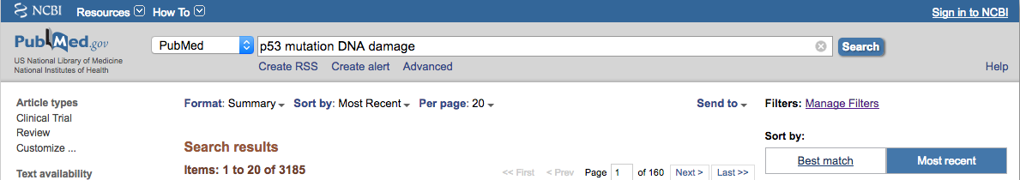

Slide 15
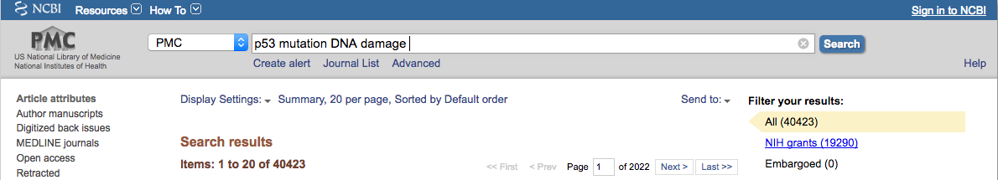

Slide 16
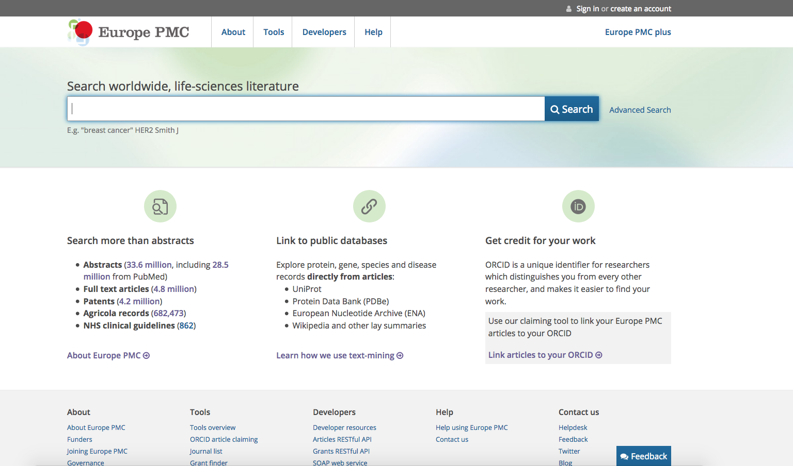
https://europepmc.org/

Slide 17
One minute challenge
Your tools matter!
Try out a couple of search queries related to your topic on Europe PMC, PubMed, and Google Scholar
How much do your search results differ between the three resources?
Is there a difference in the number of results?
Is there a difference in the order of results?
europepmc.org/
ncbi.nlm.nih.gov/pubmed/
scholar.google.co.uk/

Slide 18
Keyword search basics

Slide 19
Booleans: AND OR NOT

Slide 20
Booleans: AND, OR, NOT
You can use Booleans (AND, OR, NOT) for any query
p53 AND mutation OR dna AND damage
p53 NOT mutation AND dna AND damage
Use AND, OR, NOT; don’t use and, or, not

Slide 21
Booleans: AND, OR, NOT
You keywords in the search are automatically combined using AND operator – no need to put it manually.
p53 mutation DNA damage = p53 AND mutation AND dna AND damage

Slide 22
Booleans: AND, OR, NOT
Combine keywords and operators using brackets
p53 mutation NOT (dna OR damage)
=
p53 AND mutation NOT dna NOT damage
p53 mutation NOT dna OR damage
=
p53 AND mutation NOT dna OR damage

Slide 23
One minute challenge
p53 mutation NOT (dna AND damage)
p53
p53
p53
p53
mutation
mutation
mutation
mutation
DNA
DNA
damage
damage
Which of these documents will be in your search results?

Slide 24
One minute challenge
p53 mutation NOT (dna AND damage)
p53
p53
p53
p53
mutation
mutation
mutation
mutation
DNA
DNA
damage
damage

Slide 25
Synonyms and exact matches

Slide 26
Synonyms and aliases
DNA damage = genotoxic stress
Heart arrest = asystole
TEAD-4 = TEF-3, TEF3, TEFR-1, EFTR-2, HRTEF-1B, TCF13L1, RTEF1, TEA Domain Transcription Factor 4, TEA Domain Family Member 4, Transcription Factor 13-Like 1, Transcription Factor RTEF-1, Transcriptional Enhancer Factor 1-Related, Related Transcription Enhancer Factor 1B, Transcriptional Enhancer Factor TEF-3, Transcriptional Enhancer Factor 3

Slide 27
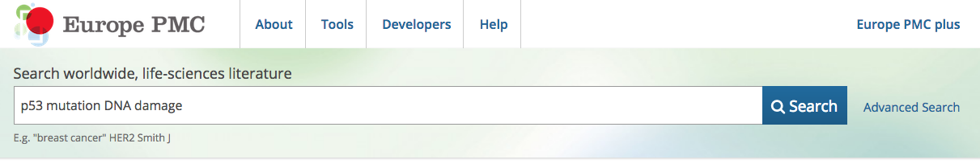
Synonyms

Slide 28
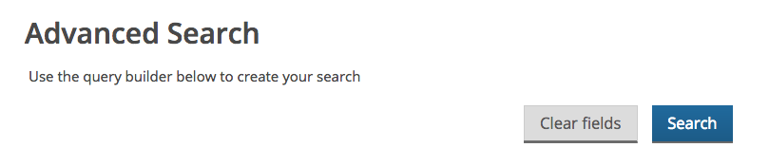
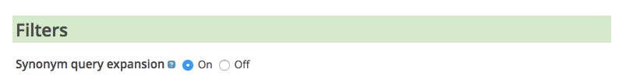
Synonyms
Includes MeSH vocabulary

Slide 29
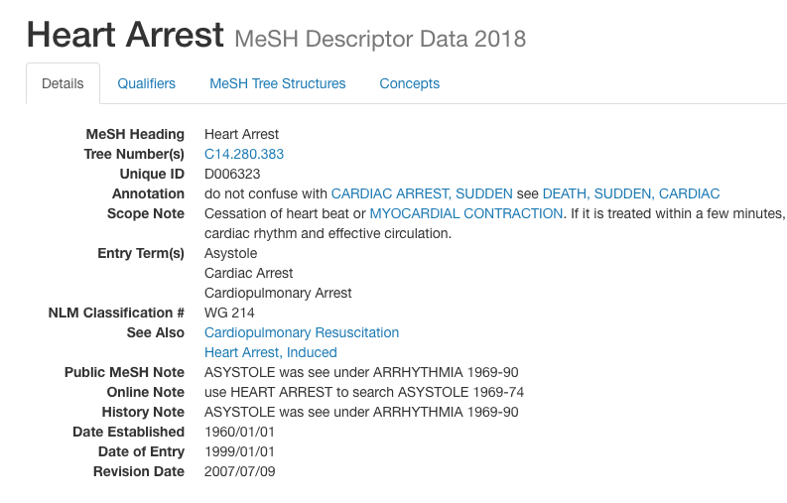
Synonyms

Slide 30
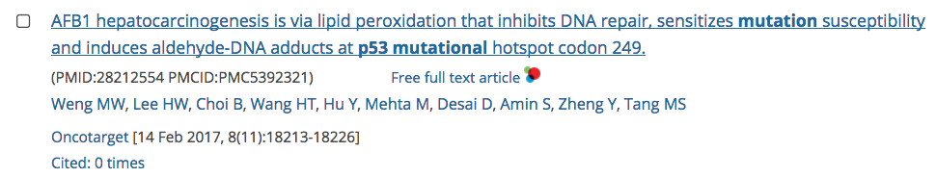
Exact match and phrase search
Even with synonyms off, your search includes word derivatives.
Example: search for mutation includes mutations, mutated, mutational

Slide 31
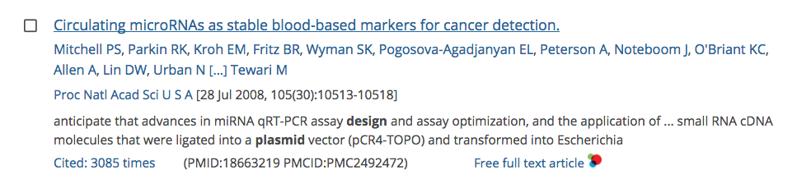
Exact match and phrase search
Keywords string search will bring results where keywords appear in different parts of the document
Example: search for plasmid design includes …design…plasmid

Slide 32
Exact match and phrase search
Use double quotes for exact match/phrase search
Example: p53 mutation VS “p53 mutation”

Slide 33
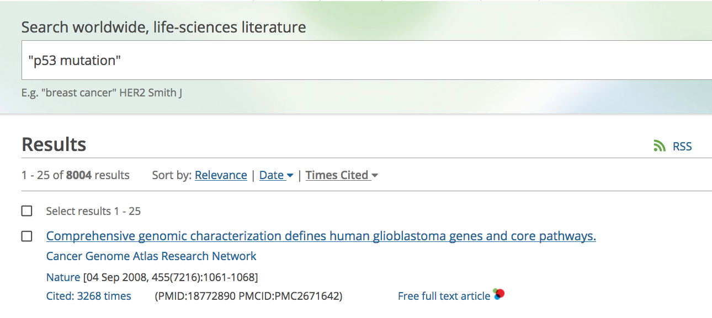
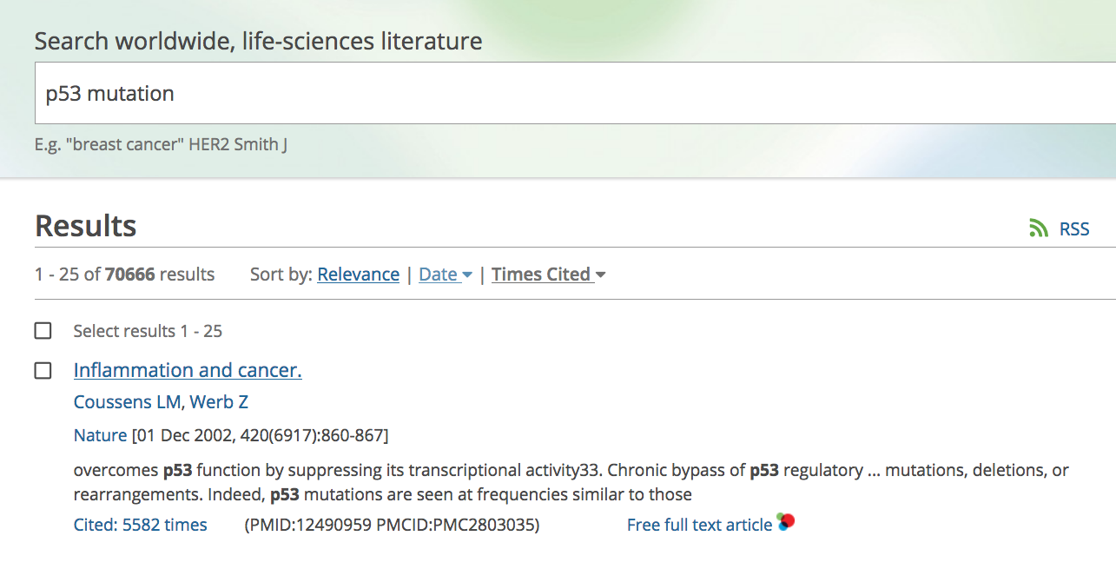

Slide 34

One minute challenge
Find the hedgehog
Try searching for articles on hedgehog. Are there results for hedgehog the animal? How can you refine your search?

Slide 35
Bibliographic information

Slide 36
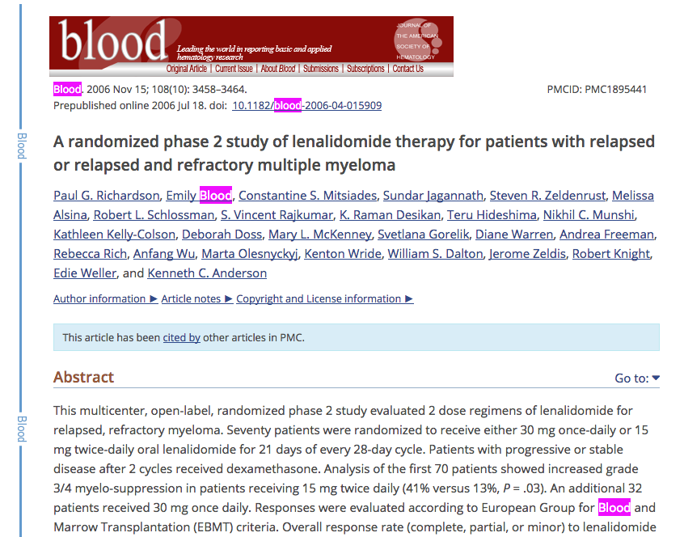

Slide 37
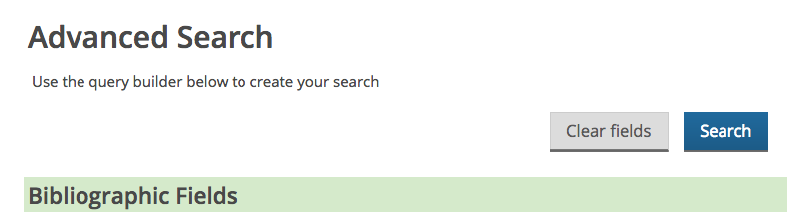
Advanced search options

Slide 38
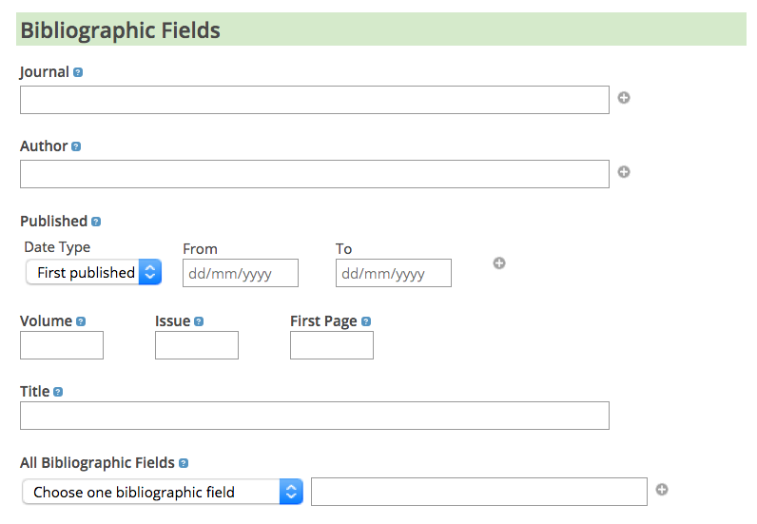
Blood
Blood

Slide 39
Searching in different parts of the article

Slide 40
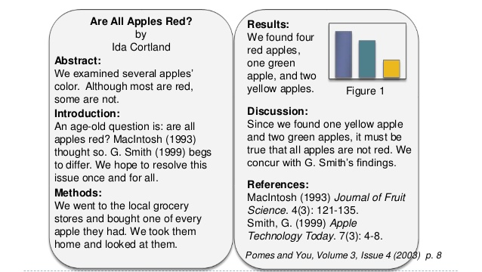
Anatomy of a scientific paper
Via https://www.slideshare.net/hcsc2016/how-to-read-a-scientific-paper-52437563

Slide 41
Content in Europe PMC
Title, abstract, keywords, authors, affiliations, journal info
Title, abstract, keywords, authors, affiliations, journal info, introduction, results, methods, discussion, references, figure legends…
Title, abstract, keywords, authors, affiliations, journal info

Slide 42
If only abstract is available

Slide 43
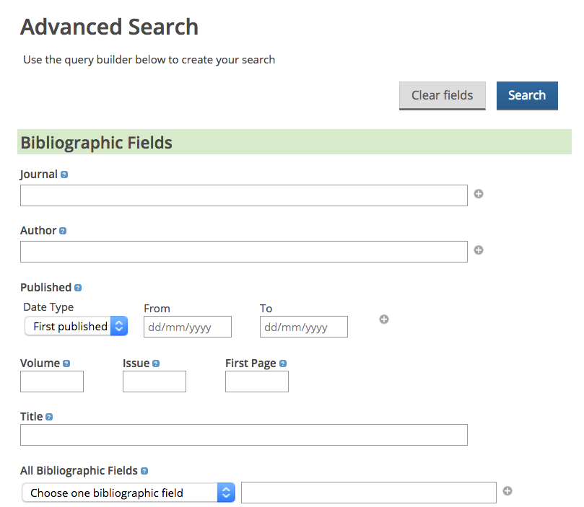

Slide 44
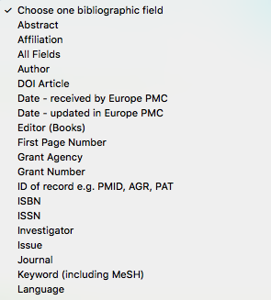
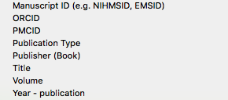

Slide 45
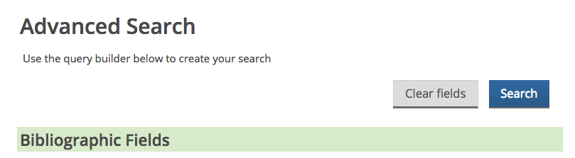
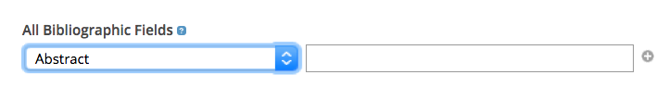

Slide 46
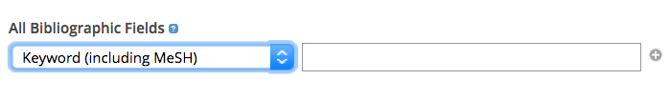
OR

Slide 47
OR
Can be a phrase: “DNA damage”

Slide 48
If full text is available

Slide 49
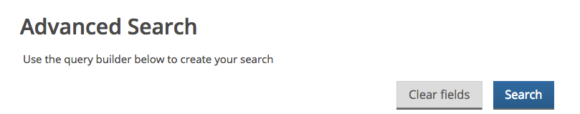
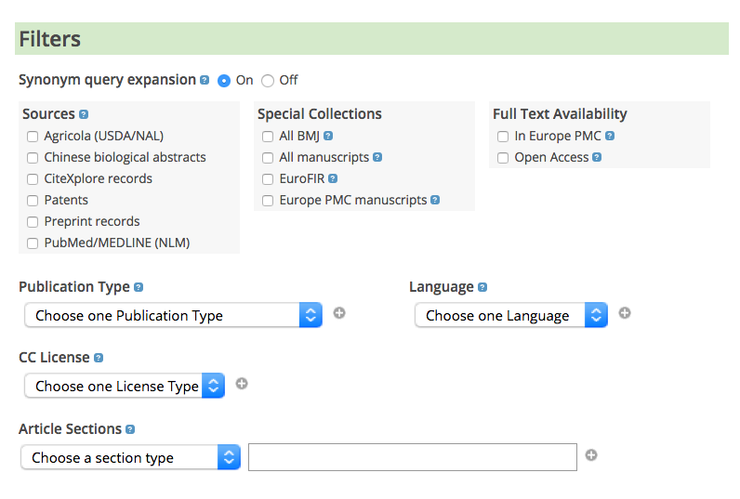

Slide 51
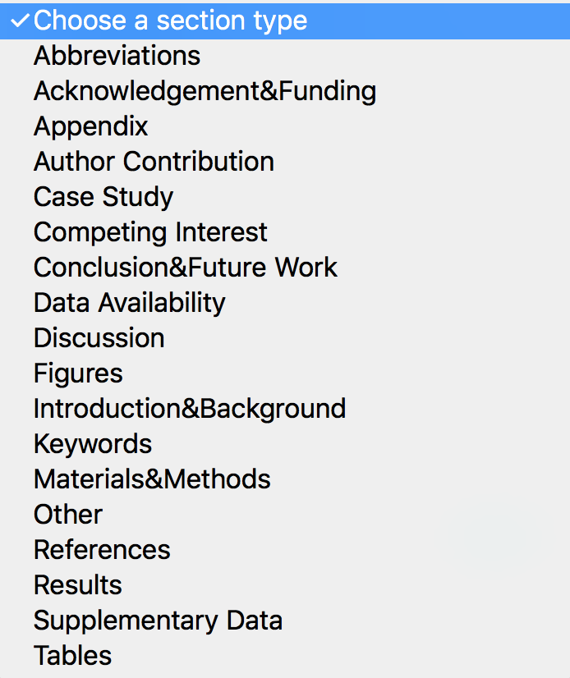


Slide 52
Search within article sections only applies to articles with full text in Europe PMC!

Slide 53
Advanced search vs exact match

Slide 54
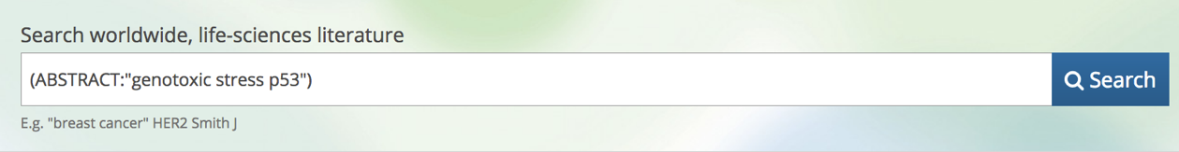
Advanced search options
When using advanced search for fields (e.g. abstract), your search is not an exact match.
:

Slide 55
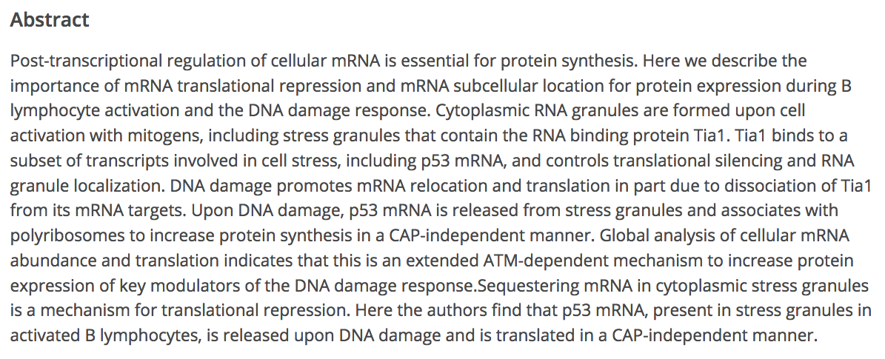
Advanced search options
When using advanced search for fields (e.g. abstract), your search is not an exact match.
*In this example the synonyms are on

Slide 56
One minute challenge
How do you find the articles that mention your database of choice (e.g. ArrayExpress) in their Data sections?

Slide 57
Managing results: sorting and filtering

Slide 58
Sorting

Slide 59
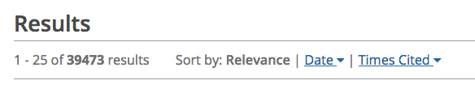
Managing results: sorting

Slide 60
Managing results: sorting
What is relevance?

Slide 61

Relevance sorting
Relevance is a default sort order
How many times each of the keywords appears in the paper?
Do we find keywords in the abstract or title?
Is the paper new or old?

Slide 62
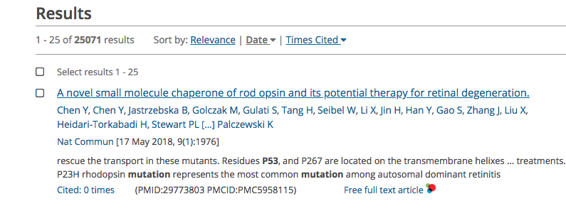


Date sorting

Slide 63
One minute challenge
Find the oldest paper that mentions Staphylococcus aureus

Slide 64
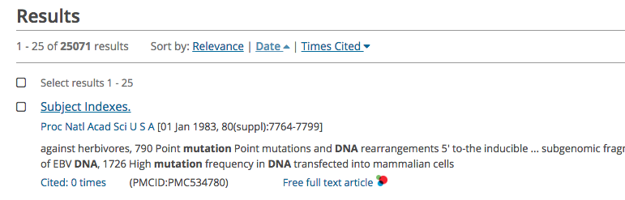


Date sorting

Slide 65
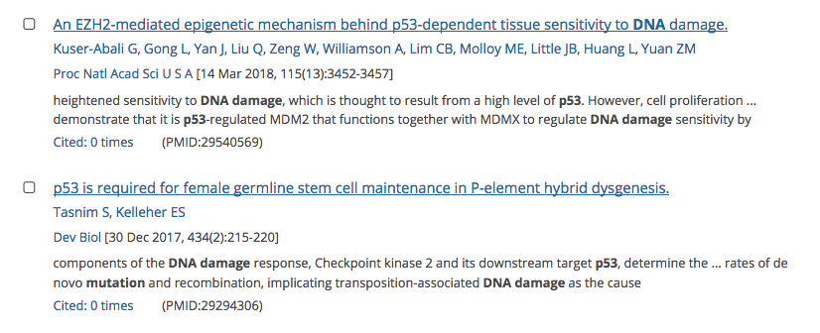
Snippets

Slide 66
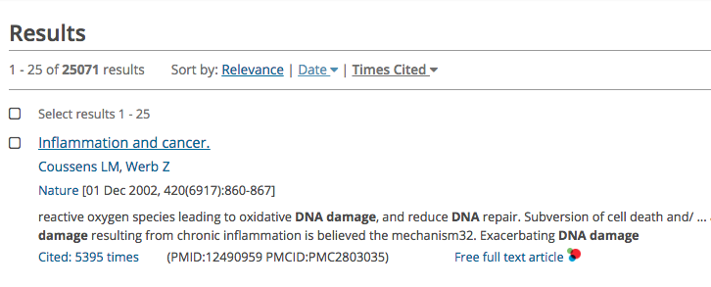


Times cited sorting

Slide 67
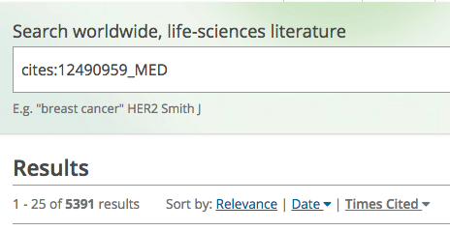
Citation search

Slide 68
One minute challenge
Based on what you have learned today find all publications that cite both publications:

Slide 69
Using filters

Slide 70
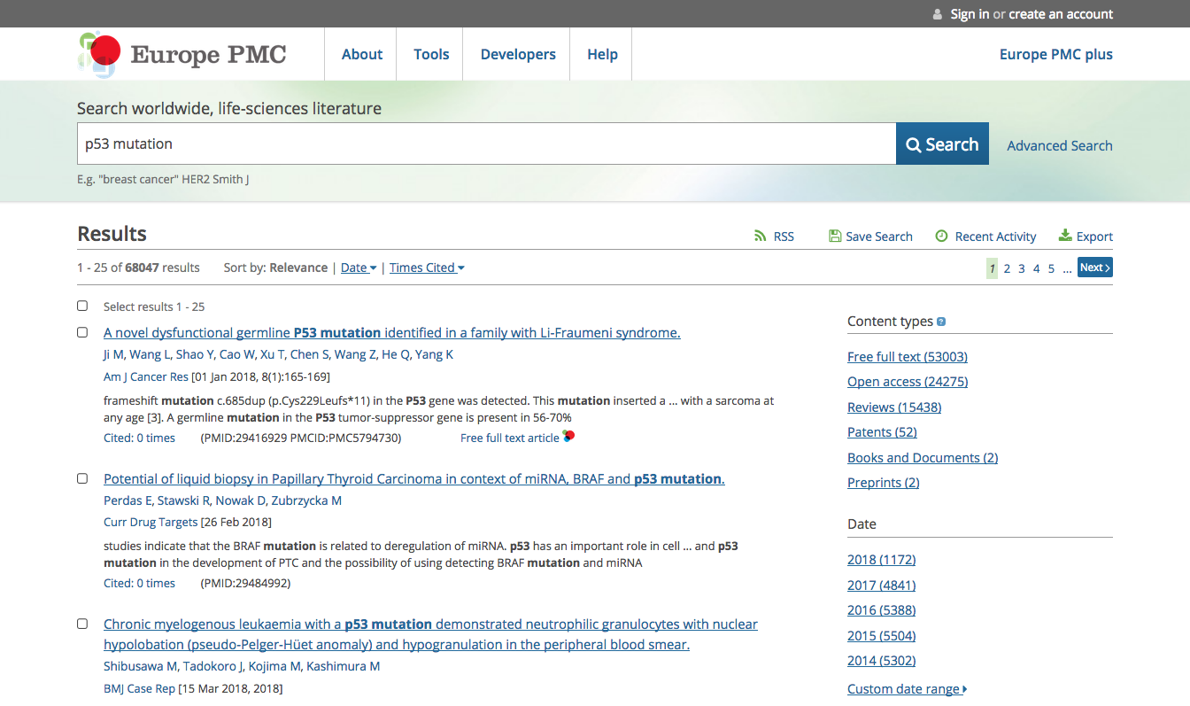
Managing results: filtering

Slide 71

Filters

Slide 72
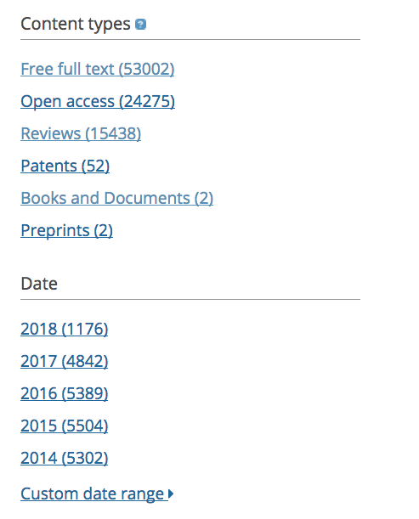

Filters

Slide 73
Full text availability

Slide 74
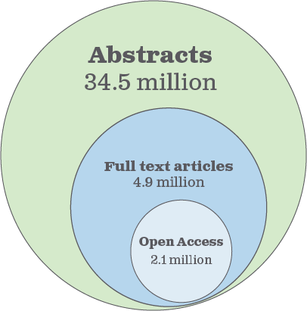
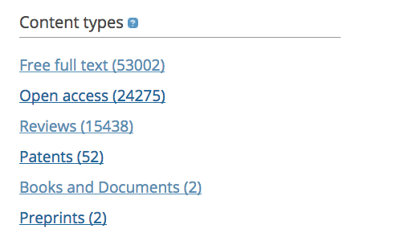
Content filters

Slide 75
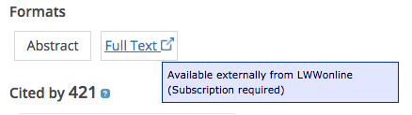
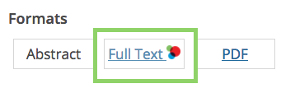
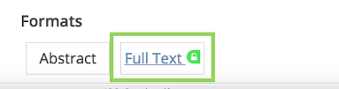
Full text
You may need to pay
subscription to read
Free full text
in Europe PMC
Free full text
via Unpaywall

Slide 76

Free full text vs Unpaywall links
Using these filters will exclude articles with Unpaywall links or preprints
Only for peer-reviewed articles with full text in Europe PMC!

Slide 77
Excluding publication types

Slide 78

Content filters

Slide 79
One minute challenge
Based on what you have learned today find a way to exclude reviews from your search*
*think Booleans and filters

Slide 80
Excluding old publications

Slide 81
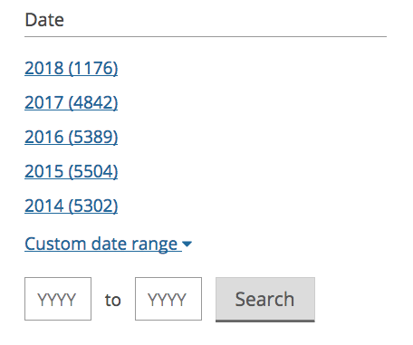
Date filters

Slide 82
Finding data and evidence

Slide 83
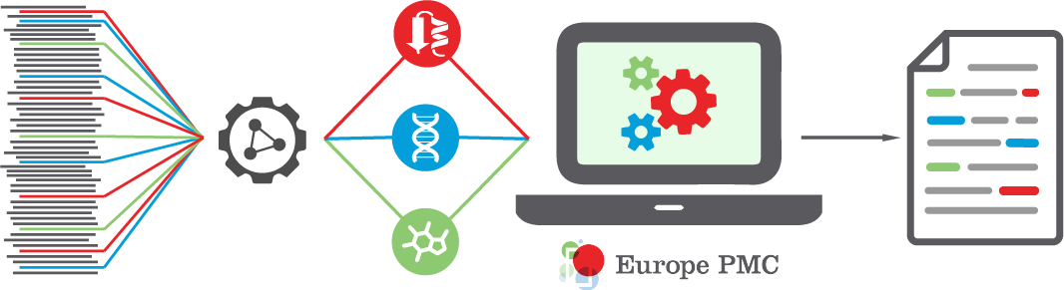
Europe PMC Annotations platform

Slide 84

Annotation types

Slide 85


Text-mined entities
https://europepmc.org/articles/PMC4014462

Slide 86
Text-mined entities

Slide 87

Text-mined entities

Slide 88

One minute challenge
How many genetic mutations does this paper report?
In which section of the article are the mutations mentioned?
https://europepmc.org/articles/PMC4014462

Slide 89
Reporting annotations

Slide 90




Annotations feedback

Slide 91

Annotations feedback

Slide 92

Annotations feedback

Slide 93

Annotations feedback

Slide 94
One minute challenge
Find one article with an incorrect annotation for “bear” as an organism and report it.

Slide 95
Data citations

Slide 96

Data citations
Data DOI
Accession numbers

Slide 97

Europe PMC text-mines accession numbers for various life science databases

Slide 98


Slide 100
This article mentions a PDB accession number in the text
This article has been curated into ArrayExpress

Slide 101
Searching for articles citing a specific data type

Slide 102



Slide 103


Slide 105



Slide 106
Searching for a specific dataset

Slide 107

Searching for a specific dataset

Slide 108

Searching for a specific dataset
https://europepmc.org/Help#databasecitations
Syntax - ACCESSION_ID:XXX

Slide 109



Searching for a specific dataset

Slide 110

One minute challenge
Find out how many articles have cited a structure of HIV-1 GP120 core complexed with CD4 and a neutralizing human antibody
PDB accession number 1gc1
Compare this number with the number of citations for the paper that described the structure

Slide 111
Search cookbook: using syntax

Slide 112

Search syntax
www.europepmc.org/Help#articlemetadata

Slide 113


Search syntax
ACCESSION_TYPE:uniprot

Slide 114
One minute challenge
Using syntax find articles that have been curated by uniport and cite a protein structure deposited in PDBe.

Slide 115
Saving a search

Slide 116


Saving a search

Slide 117

Europe PMC account

Slide 118


Europe PMC account

Slide 119
One minute challenge
Create a search for articles that mention a protein of choice (e.g. p53) in the abstract published in August 2018.
Save your search. Run it from your account.
Edit the search to retrieve articles from September.

Slide 120
Questions?

