Slide 1
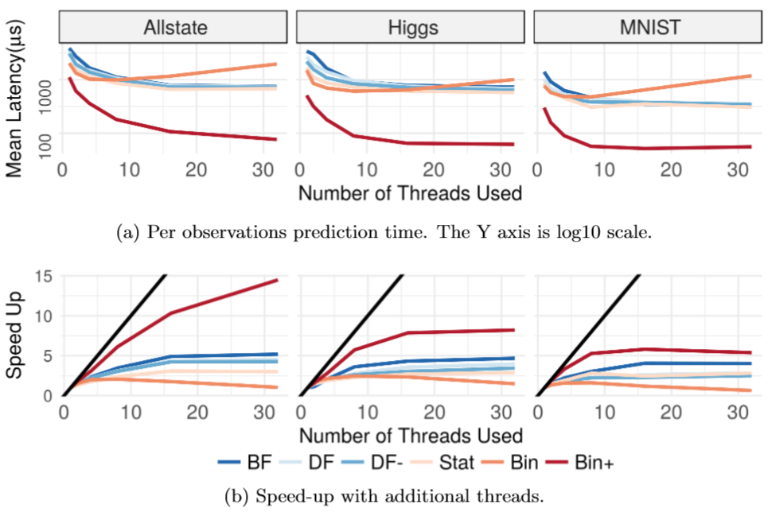
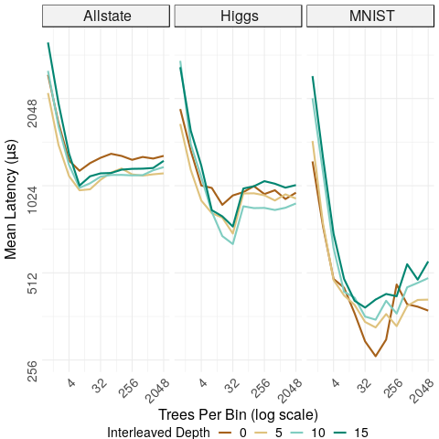
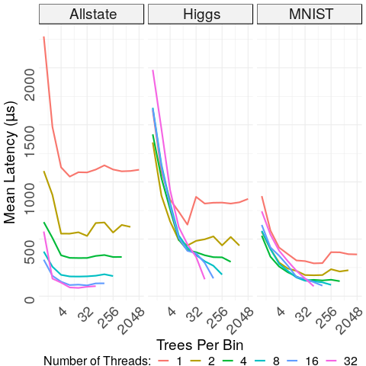
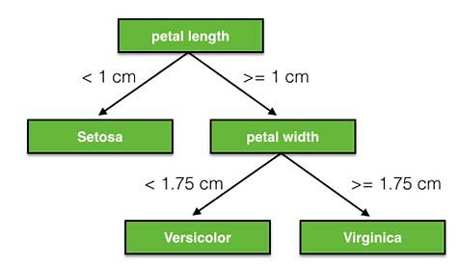
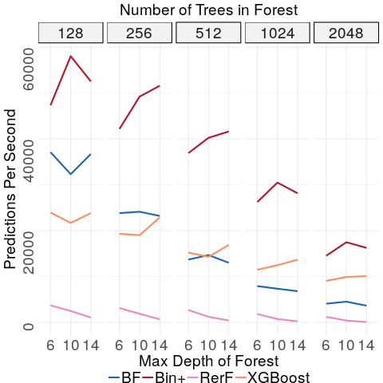
Forest Packing: Fast Parallel Decision Forests
James Browne, Disa Mhembere, Tyler M. Tomita, Joshua T. Vogelstein, Randal Burns
Computer Science Department, Johns Hopkins University
Abstract
Methodology
Results
Conclusion
Decision Forests:
Well suited to extract knowledge from massive data sets
Popular for their interpretability and ease of use
Trivially parallelizable allowing for high inference throughputs
Problem:
Large Model size and random memory access patterns cause high inference latency, an untenable property for many real time applications
Approach:
Regroup trees into a hierarchical structure
Pack nodes of multiple trees into contiguous memory blocks
Collocate likely paths based on leaf cardinality
Re-order tree traversal to use out-of-order execution
Results:
Increases performance and parallel scalability of classification in ensembles by a factor of ten over an optimized C++ implementation and a popular R-language implementation.
Conclusion:
Decision forests can be optimized for low latency real time applications
Forest Packing (Bin+):
Post training reorganization of nodes and trees in model
Two categories of improvements
Memory access optimizations
Inference algorithm modifications
Designed for and tested on Classification Random Forests, but techniques are applicable to other decision forests
Memory Access Optimizations:
Progression of improvements
Each layout incorporates previous improvements
Inference Algorithm Modification:
Motivated by modern CPU enhancements
Memory-level parallelism
Out-of-order execution
Typical Inference Order (Figure 2)
Process one tree until complete, then move to next tree
Instruction dependency prevents efficient processing
Each node is potential cache miss
Prefetched Round Robin Inference Order (Figure 3)
Processes one node per tree in a bin
Prefetches next node per tree
Allows for instruction level parallelism and memory level parallelism
Forest Packing is the combination of all memory and algorithmic optimizations described in “Methodology”
Increases CPU utilization allowing more work with less resources
Lower latency by an order of magnitude allows throughput comparable to batched performance
Single Thread Run Time Analysis (Figure 4):
Prediction performed on 25000 observations of Higgs Dataset
Hyperparameter Exploration (Figure 5):
Optimal settings for packing a forest depend on processor architecture and dataset characteristics
Interleaved depth controls how many levels of each tree are intertwined, excessive depth results in Stat like behavior
Number of trees in a bin controls how much work is given to each thread, insufficient trees per bin reduces preloading time and increases cache misses
Mutli-Threaded Performance:
Increasing bin size allows for more instruction level parallelism, but limits thread level parallelism (Figure 6)
Efficient memory use and prefetching allows order of magnitude performance improvement (Figure 7)
Comparison of Forest Packing Throughput to Batched Systems (Figure 8):
Higher throughput than unoptimized forests
Performant for models with various characteristics
Number of trees
Maximum depth of forest
Forest Packing uses memory layout optimizations and traversal modifications to achieve an order of magnitude reduction in decision forest inference latency
Forest Packing scales well with additional resources
Decision Forest inference is a memory bound operation when using many trees and/or large trees
Typical acceleration methods trade high throughput for high latency, whereas Forest Packing excels in both measures
1
BF
1
DF
1
DF-
Lower is better
Lower is better
2
4
3
5
2
4
3
5
α
3
2
4
6
7
8
9
6
7
8
9
β
α
α
β
1
2
3
4
5
6
7
8
9
1
3
5
9
8
4
7
6
2
1
2
4
3
a
β
Breadth First (BF):
Matches access pattern of batched inference
Depth First (DF): Higher memory fetch utilization for serial inference
Depth First- (DF-): Shares leaf nodes, stored at end of memory block
Higher is better
Fig 4: CPU Metrics Compared to Bin+. First three metrics shows Forest Packing (Bin+) does more work, remaining metrics show Bin+ is more efficient
1
Stat
1A
Bin
1B
Fig 7: Multi-Thread Performance. (a) Forest Packing (Bin+) has lower latency than other optimized methods (b) Bin+ more efficiently uses additional resources
α
3
2
4
α
3A
2A
4A
β
2B
4B
β
3B
α
β
1
α
α
β
β
α
α
β
β
α
Frequently Asked Questions
Introduction
2
3
4
α
β
1A
1B
2A
3A
4A
3B
2B
4B
α
β
Decision Forests:
Broad class of data mining algorithms including Random Forest and Gradient Boosted Forest
Flexible
Supervised – Unsupervised
Classification – Regression
Features can be Numeric – Categorical
Density Estimation
Manifold Learning
Interpretable (Figure 1)
Decision Forests Have High Latency Inference:
Uncorrelated paths through forest
Model size larger than CPU cache
1+2 = Difficult to optimize (1) slow random access memory pattern (2)
Previous Methods to Accelerate Inference:
Hyperparameter tuning reduces model performance
Maximum depth
Minimum parent node size
Number of trees
Graphics Processing Units (GPUs) require full trees and slow memory transfer
Predication reduces branch mispredictions but, alone, is minimally affective
Batching inference trades high throughput for poor latency (typical Inference Method)
Statistical (Stat):
Likely paths stored contiguously
Bin:
Multiple trees with intertwined levels in contiguous memory
What effect does Forest Packing have on the predicted classification?
What is instruction level parallelism and how does it effect tree traversal?
Is this technique applicable to other ensemble methods?
How can Forest Packing perform more work in less time?
How do dataset characteristics affect inference time?
Lower is better
Fig 1: Decision Tree. Basic building block of decision forests, simple and interpretable
2
1
4
5
3
6
Fig 5: Effects of bin size and interleaved levels on performance. Ideal depth and level of interleaving are dataset dependent
Fig 6: Effects of bin size on parallel performance. Increased bin size increases instruction level parallelism, limits usable threads
Higher is better
Fig 2: Typical Inference Order. Red lines denote cache misses – potentially lengthy operations which stall a CPU
Fig 8: Throughput Comparison. Forest Packing has higher throughput than some batched systems for various model characteristics
3
1
2
4
5
6
Acknowledgements
Fig 3: Prefetched Round Robin Inference Order. Blue lines denotes prefetch instruction. Processing in round robin order gives memory time to load
Supported by NSF grants IOS-1707298 and ACI-1649880; DARPA grants HR001117S0016-L2M-FP-054 and N66001-15-C-4041; and NIH/NINDS grants 1R01NS092474-01 and 1U01NS090449-01.
Email: jbrowne6@jhu.edu Source: https://githu b.com/jbrowne6/forestpacking

