Slide 1
Public Health, Epidemiology, and Models
MMED
African Institute for the Mathematical Sciences
Muizenberg, South Africa
May, 2019
Jim Scott, Ph.D, M.A., M.P.H.
https://doi.org/10.6084/m9.figshare.5038769.v3

Slide 2
Goals
Define Public Health and understand the need for it
Example: smallpox
Define Epidemiology
Examples
Discuss the role of modeling in public health and epidemiology
History of modeling (if time)

Slide 3
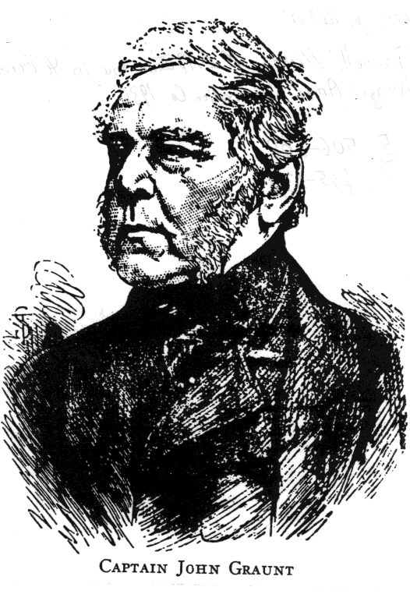
John Graunt
Published analysis of London mortality data in 1662
Recognized patterns and trends such as male-female disparities and high infant mortality

Slide 5
Notes:
Quick calculation show life expectancy is around 19 years. Median is somewhere between 6 and 16. What are they dying from?

Slide 6
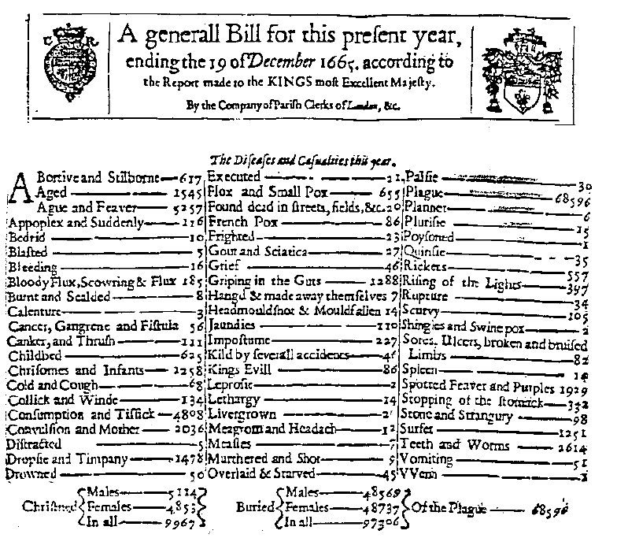
In 1632
Plague: 8
Buried:
9535

Slide 7
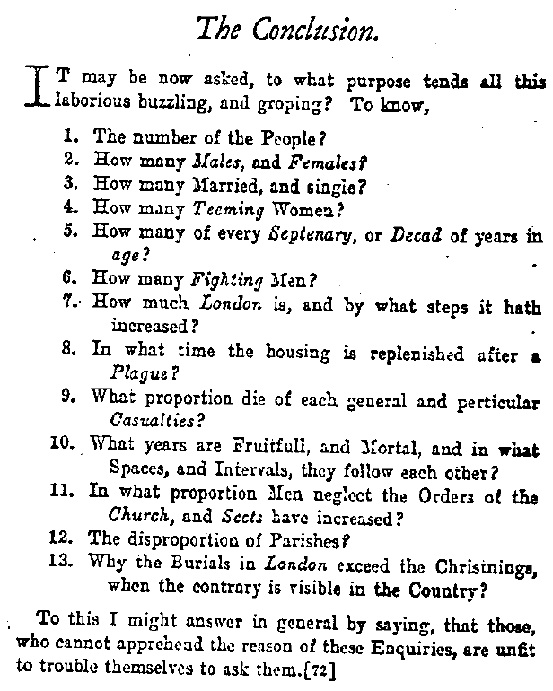

Slide 8

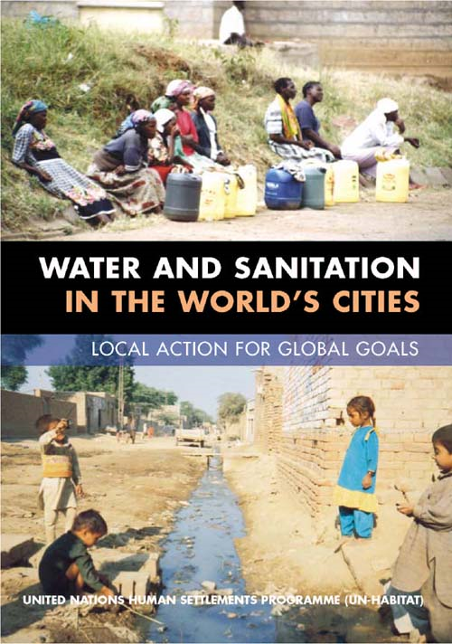
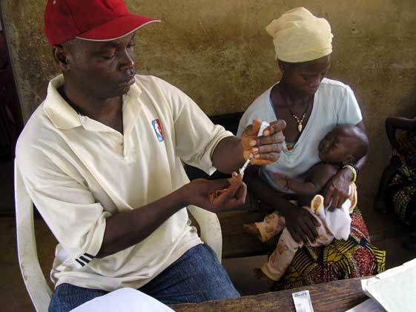

What is ?

Slide 9

Public Health
“The science of preventing disease, prolonging life, and promoting physical health and efficiency through organized community efforts… ” - Winslow
  Prevention is job #1
  Works at the population level
Notes:
Key concepts here:
features prevention
Interdisciplinary
Basis in “right to health” philosophy (social justice)
Government plays a role – population level

Slide 10
History
“I believe the history of public health might be written as a record of successive redefinings of the unacceptable.”
- Sir Geoffrey Vickers
Notes:
Key concepts here:
features prevention
Interdisciplinary
Basis in “right to health” philosophy (social justice)
Government plays a role – population level

Slide 11
History
A Summarized History of International Public Health (Merson, Black, Mills, 2nd ed.)

Slide 12
Public Health Improvements
Cleaner Food
Smallpox
Eradication
Cleaner Water
Vector
Control
Improved
Sanitation
Tobacco
Control
Vaccinations
Family
Planning
Education
Better
Nutrition
Improved
Hygiene
Cleaner Air

Slide 13


Public Health vs. Medicine
Public Health
Medicine
Assess health of populations (surveillance)
Policy development
Assure that services are available
Prevent disease
Assess health of individuals (diagnosis)
Develop treatment plan (regimen)
Administer treatment
Cure the patient

Slide 14

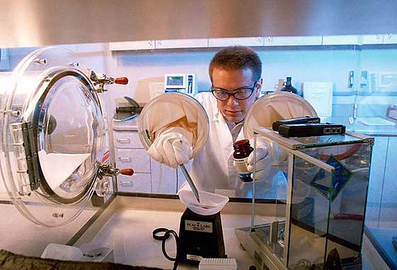
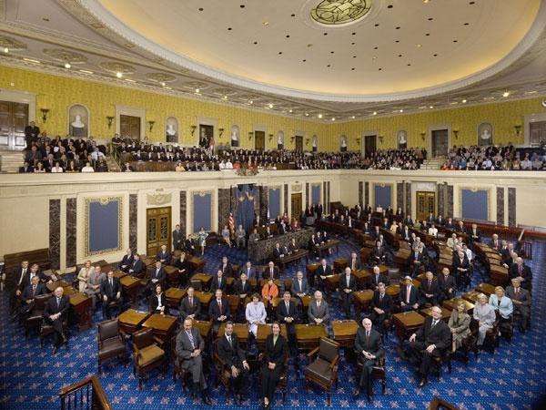
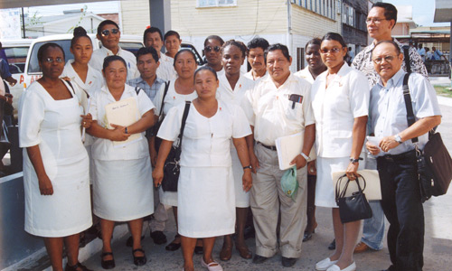
How Does Public
Health Work?
14
Notes:
Different ways of seeing PH in action
Lab
PH workers
Gov
Works at Pop level
Preview: 3 main function

Slide 15
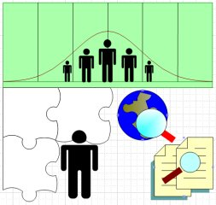
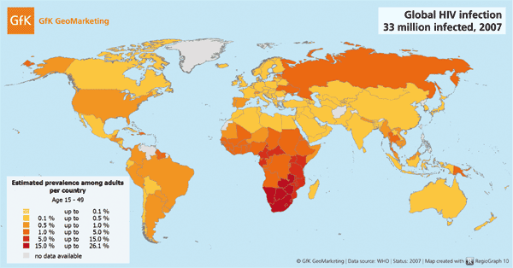
Primary Functions
Assessment :
  Epidemiology and Statistics
Notes:
3 functions at gov level
Surveillance, identifying causes, collecting and interpreting data, forecasting, research, and evaluation

Slide 16

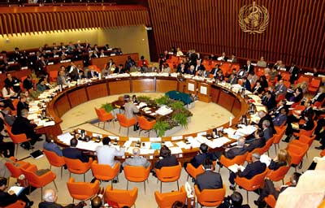

Primary Functions
Policy Development
  Government and International Organizations
e.g. The World Health Organzation
Notes:
Both public and private
Decision making is big task
Set goals, formulate plan
Debate, how to allocate resources
Planning, Advocacy, Training

Slide 17



Primary Functions
Assurance
  Implementation and maintenance
  Governments and Public Health Infrastructure
Notes:
Seeing policy through
Ensure basic services are provided
Developing responses
Exercising authority

Slide 18

Prevention and Intervention
Five Steps
  Define the problem
  Determine risk factors
  Develop interventions
  Implementation
  Maintenance
Notes:
How it’s enacted (put into action)
Assessment (Define Prob – Determine RF)
Policy (Develop interventions – action plan)
Assurance (implementation/maintenance)
Example of Smallpox

Slide 19

Example: smallpox
The problem:
  1966: 10 – 15 million cases of smallpox in 50+ countries
  1-2 million deaths annually
  ~ 30% case-fatality ratio
  Higher in children
  Survivors scarred for life
Source: Millions Saved: Proven Successes in Global Health, Center for Global Development, 2004
Notes:
Step 1: define problem
Surveillance – data collection - epidemiology

Slide 20
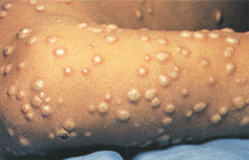
Example: smallpox
Natural History/Risk Factors
  Variola virus
  Airborne / contact with an infected person
  Non-infectious for up to 17 days
  Flu-like symptoms – high fever
  Rash
Notes:
Risk factors – Natural history
More epi and data collection: incubation, duration, mortality

Slide 21
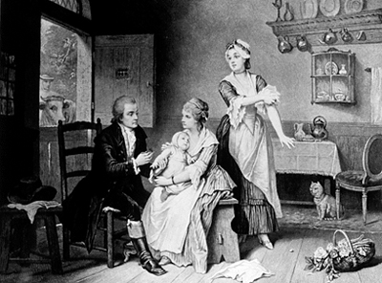

Example: smallpox
Intervention: vaccination
  In existence since 18th century – Edward Jenner
  Improved vaccine in 1920s
  1959: Global eradication program endorsed by the WHO
Notes:
Orginally rejected – promoted by Soviet Union (25million doses donated)
Why: human to human, easy to diagnose (not many missed), survivors immune, good vaccine (freeze dried)
Eradication is plausible

Slide 22
Example: smallpox
Implementation
  1959: 1 fulltime WHO medical officer, 1 assistant
  National vaccination campaigns
  1965: World Health Assembly – “eradication of smallpox is a main objective of the WHO”
  1967: Smallpox Eradication Program
  1970’s: focused ‘containment’ teams
  1973: 5 countries remaining
  1977: last endemic case
Notes:
NVC – had moderate success
Expanded program after 1965
Last case in Somalia

Slide 23
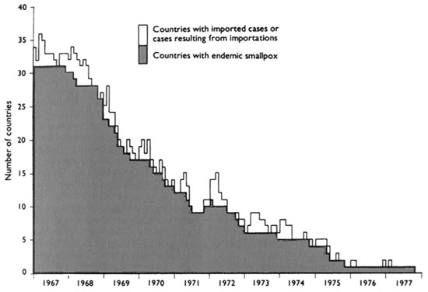
The Decline of Smallpox
Source: Vaccines, 3rd ed. ,W.B. Saunders Co. 1999
Notes:
Last few countries were tough
Similar with Polio (Afghanistan, Pakistan, India, Nigeria)…Angola, Chad,
Harder with Polio…why? Shed into environment…some with asymptomatic symptoms

Slide 24
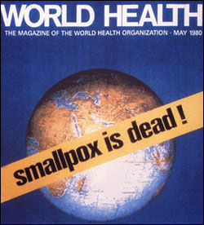
Example: smallpox
Assessment
  2 years of surveillance and searching
  May 1980: Smallpox declared “eradicated”

Slide 25


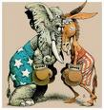

Barriers to Public Health
Barriers to public health
  Economic
  Moral/religious
  Individual freedom
  Political
Notes:
Smallpox was a success…but PH is hard…why?
Barriers
1 - $ difficult to attach value to disease prevented – competing interests…much more spent on health care
2 – Some interventions go against religious practices (funeral practices, circumcision (HIV), etc).
3 – Person liberties – smoking, wearing helmets, seatbelts
4 – Politics

Slide 26
Summary
Public Health
  Prevention
  Populations
  Challenging
Epidemiology: where does it fit in?
Notes:
Won’t remember all that…at least remember this…
Where does epidemiology fit in?

Slide 27
Epidemiology: where does it fit in?
Assessment
Policy Development
Assurance
Epidemiology
Notes:
Contributes to all phases of PH
“Science of Public Health”

Slide 28
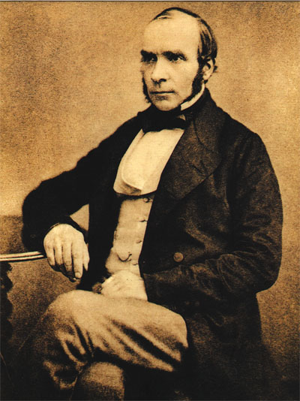
Definition of Epidemiology
“The study of the
  distribution and
  determinants
  of health-related states or events
  in specified populations, and the application of this study to control health problems”
  - J. Last, Dictionary of Epidemiology
Notes:
Distribution: time, place, etc.
Determinants: risk factors (e.g. genetics, environment, behavior)
Health related states: diseases, afflictions(nausea), hospitalizations, exposure, death
Populations: Primary science of public health…we’re dealing with just individuals, but groups of people
Don’t do studies to see what person ‘x’s risk is for developing disease….we do studies to see what the risk is, on average, that people with attributes common to x will develop disease. Then epidemiologists design interventions to stop disease (e.g. determing disease is caused by an infectious agent; subsequently develop and test vaccine).
Distribution of disease is NOT random and it’s NOT “equal”

Slide 29

OR….
The…
  Who
  What
  When
  Where
  Why
  and How
  ……of Disease
Descriptive Epidemiology
Analytic Epidemiology
Notes:
Descriptive: Prevalence, Incidence, Place, Time, Populations
Analytic: Risk Factors/Causes
Not a new idea…

Slide 30
Hippocrates, 5th century B.C.E.
Slide courtesy of Warren Winkelstein
Notes:
Future doctors, probably will read stuff by this guy…maybe take an oath…
Been around for a long time –
- Seasonality – Locality – Environment - Behaviors

Slide 31
Five Goals of Epidemiology
Describe Disease in the Population
  Surveillance, observation, research, experiments
  Person, place, and time
Determinants
  Physical, biological, social and behavioral factors that influence health
Natural History of Disease
  Symptoms, pathogenisis, incubation
Design/Implement interventions
  Control disease
Inform Policy
  Use findings to promote, protect, and restore health – “Big Picture”

Slide 32
Examples
Describe Disease in the Population
- Surveillance
- Distribution of disease
Determinants of Disease
- Outbreak investigations
- Observational studies
- Experimental studies (RCTs)
Interventions
- Mathematical modeling
Notes:
Interventions: What will the effects of a particular intervention be? What parameters are most important in transmission of disease? Investigate hypothetical scenarios
Determinants: Risk factors Causes
Examples…

Slide 33
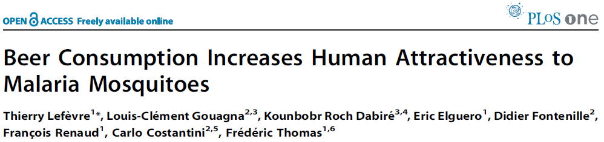

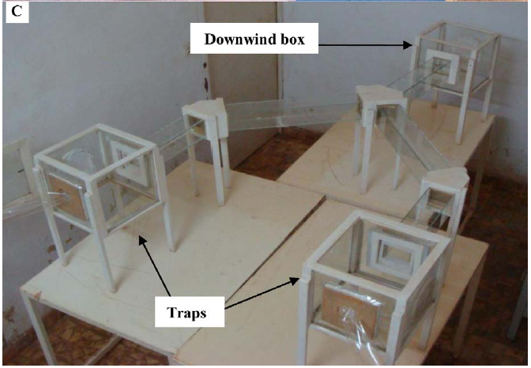
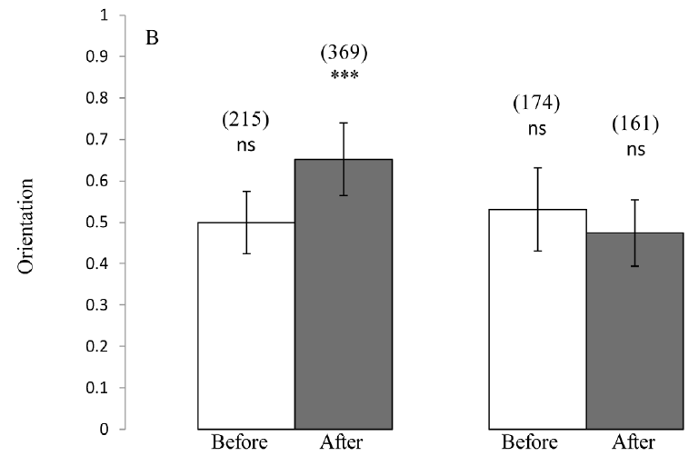
Determinants
Notes:
Volunteers (Burkina Faso) were randomly assigned to beer (“dolo”) or water group. Before and after drinking. Mosquitoes, 50 at a time, placed in downwind box…flew to either human odor or outdoor air. Human odor was one of four BW BB AW AB.
OR 1.7 (1.3, 2.2)
Intervention?
PH barrier – personal liberty, morals

Slide 34
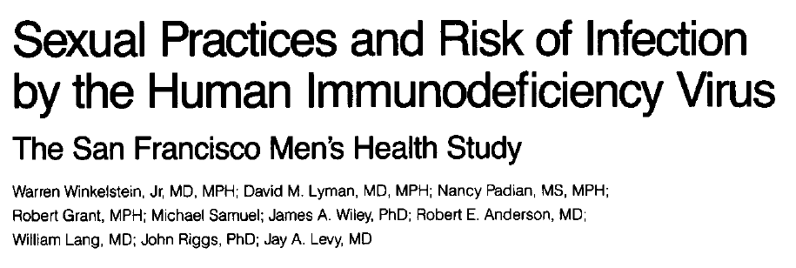

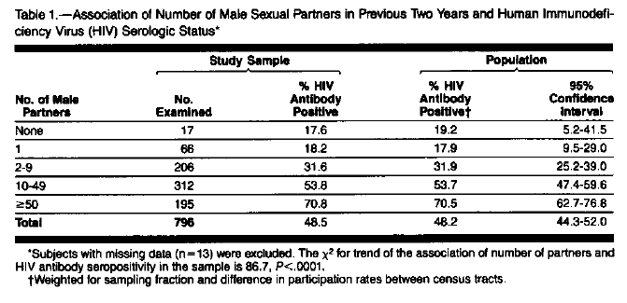
Determinants
Notes:
Early HIV Study – 1987
Risk factors for being HIV positive
# of sex partners appears to be associated with HIV prevalence
One of first population based studies.
Intervention?
PH Barrier – personal liberty, morals

Slide 35
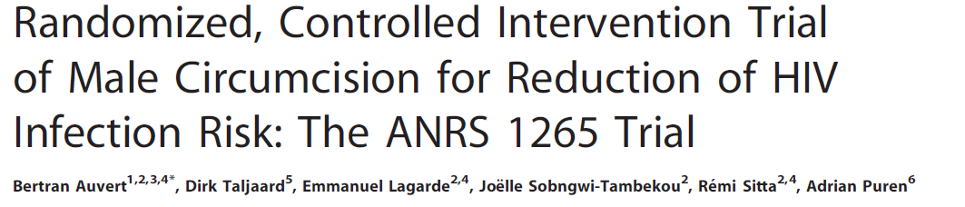
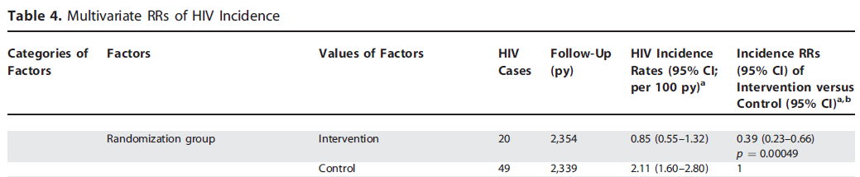
Intervention Design
0.85 vs 2.11, a reduction in HIV incidence of approximately 60%
Notes:
Risk Factor: Circumcision (protective)
RCT – provides causal evidence (because of randomization)
Cohort study – associative evidence
Intervention?
PH Barrier – personal liberty, religious beliefs, $

Slide 36
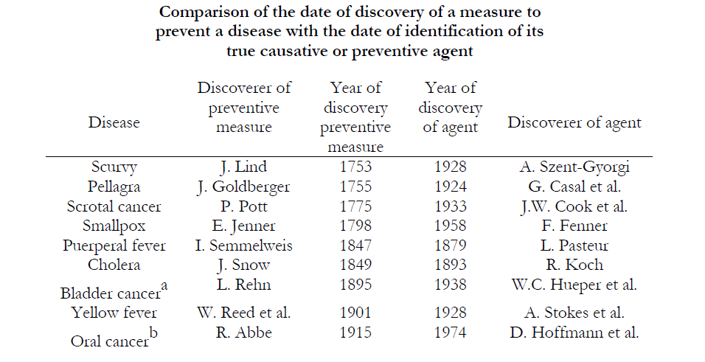
Informing Policy
Notes:
…just wanted to point out..
-Don’t need to know causative agent of disease in order to implement interventions…
-This is good…because we often don’t know causative agent until much later on….
-Can’t always do RCT’s to investigate possible causative agent
-Why? (Ethics, not possible to randomize or mask/blind participants/investigators).
-Don’t always need them (e.g. smoking and lung cancer)

Slide 37
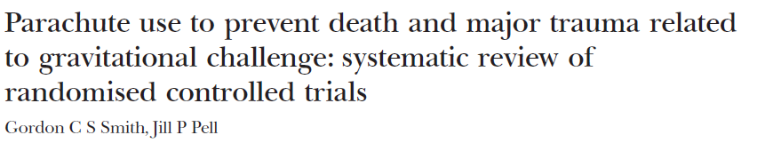
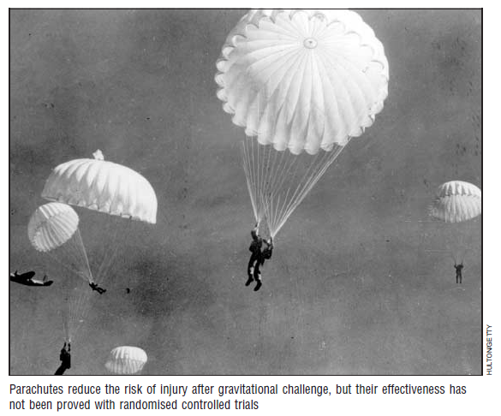

Informing Policy
Results “We were unable to identify any randomised controlled trials of parachute intervention.”
Conclusion “We think that everyone might benefit if the most radical protagonists of evidence based medicine organised and participated in a double blind, randomized, placebo controlled, crossover trial of the parachute.”
Notes:
Example!
Are parachutes useful in prevention of death?

Slide 38
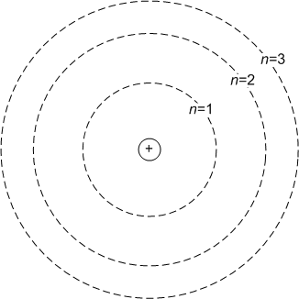

Where does modeling fit in?
Source: Google Images
Notes:
Example of a useful model – Bohr model of the atom
Doesn’t perfectly reflect reality, but it’s simple and provide a lot of intuition.

Slide 39
A Natural Fit for Public Health
Models allow us to gain insight into public health questions (e.g. Universal testing)
  Differences between:
    What factors increase the risk of HIV transmission? (Analytic Epidemiology)
    In what populations is HIV incidence/prevalence the highest? (Descriptive Epidemiology)
    By how much could we expect the incidence of HIV to decrease in South Africa if 80% of all sexually active people used condoms 80% of the time? (Public Health Impact)
Notes:
How can we use models to improve health and prevent disease in populations?
First – need to understand difference in these types of questions.
1 – Analytical epi
2 – Descriptive epi
3 – Difficult to do epi study – perfect for modeling, though. Need mechanistic model

Slide 40
Models should be useful
1) Simple as possible
  Avoid unnecessary complexity
  Only add complexity when the research question demands it
2) Based on what is known
  Biological systems
  DATA
Implies we must know relevant:
- biology
- statistics (how to make
sense of data)
Notes:
Simple – e.g. if there no evidence that age is important in the transmission process – then you shouldn’t account for age in model (others: male/female, timeframe, season, etc.)
Based on what is known –

Slide 41
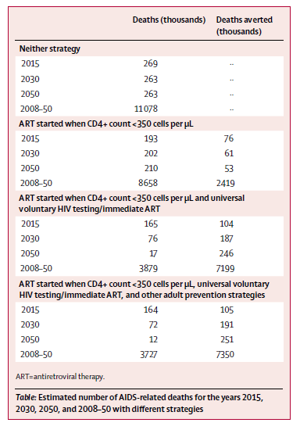
Informing Policy
Universal voluntary HIV testing with immediate antiretroviral therapy as a strategy for elimination of HIV transmission: a mathematical model
Reuben M Granich, Charles F Gilks, Christopher Dye, Kevin M De Cock, Brian G Williams
Lancet 2009; 373
Notes:
Implementing Test and Treat to control HIV.
Difficult to do a RCT
Can create a model to explore different scenarios to get reasonable idea of what might happen.
[stop/break]
Modeling is not new….

Slide 42
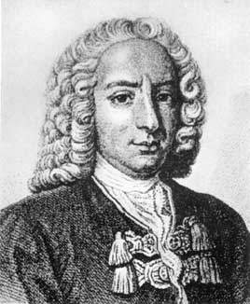
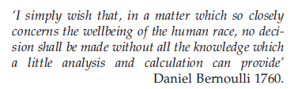
Modeling is not new
This process has been in practice since at least 1760
  What do I mean by “process”
Daniel Bernoulli
Commons.wikipedia.org
Notes:
Process:
-Research question
-Model + data
-Answer
1760 – David Bernoulli - Smallpox

Slide 43
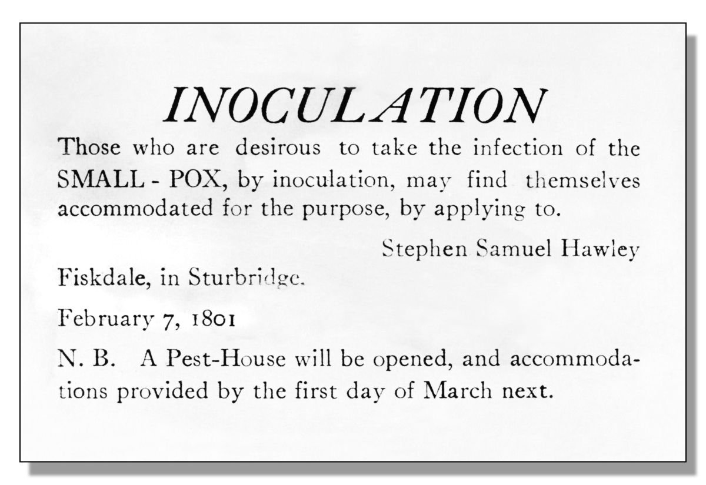
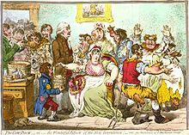
Bernoulli and Smallpox
Inoculation as prevention…but not without costs!
Is inoculation worth the risk?
Commons.wikipedia.org
en.wikipedia.org
Notes:
What would happen if everyone was inoculated?
(not with a vaccine…but with actual virus (from people that survived)
- Overall benefit to population? Costs?

Slide 44
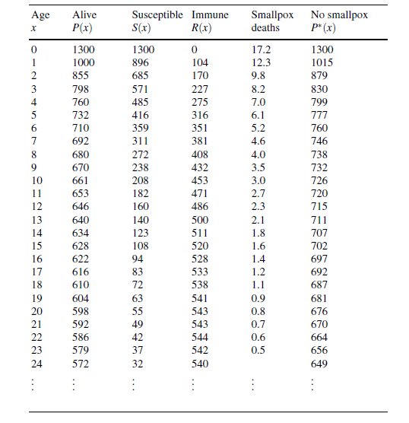
The first counterfactual?
Bernoulli worked out solutions for a system of differential equations (impressive at the time!)
Determined:
  Life expectancy with
  inoculation
  Life expectancy without
  inoculation

Slide 45
Results
Inoculating everyone at birth increased overall life expectancy by about 3 years
Effective as long as the probability of dying from smallpox right after inoculation is less than ~ 11%
Bernoulli estimated this risk to be ~1%
Despite these results, inoculations were never performed on a large scale (in France)

Slide 46
Some historical figures and ideas
William Farr (1840) Curve fitting
P.D. En’ko (1889) Discrete time model
W. H. Hamer (1906)
J. Brownlee (1906)
R.A. Ross (1911)
A. McKendrick (1932)
W. Kermack (1932)
Many others
Notes:
Hamer “mass action” – incidence is related to the product of # infected and Susceptibles
Brownlee – quantifying infectivity – it changes over time and leads to epidemics dying out (Reff)
Ross – Threshhold effect – don’t need to eliminate all mosquitoes to eliminate Malaria
Kermack&McKendrick – SIR type models
Not new…but mostly recent…

Slide 47
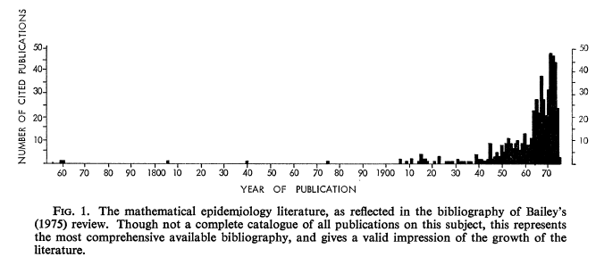
Much of modeling is “new”
Source: Fine, PEM. John Brownlee and the Measurement of Infectiousness.
J.R. Stastist. Soc. A, Vol. 142, No. 3 (1979)

Slide 48
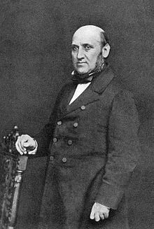
Some historical figures and ideas
William Farr (1840): Fitting curves to mortality data
Predicted smallpox deaths
Descriptive technique
Notes:
X1/x2 / x3/x4 = K
X3/x4 / x5/ x6 = K
X6 = K x4 x5 / x3
Xs are weekly cause specific mortality rates.

Slide 49
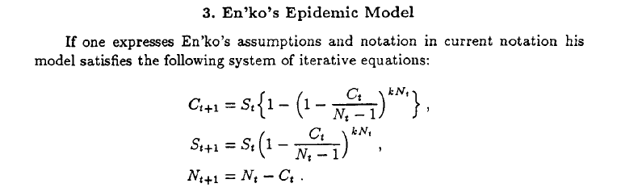
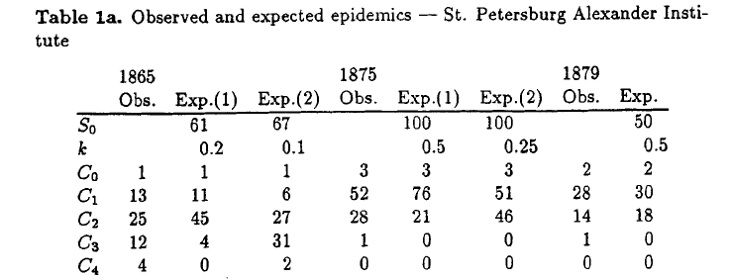
Some historical figures and ideas
P.D. En’ko (1889)
Formulated discrete time models and fit them to observed measles epidemics
Source: Dietz K. The first epidemic model: A historical note on P.D. En’ko.
Austral J. of Statist., 30A, 1988.
Notes:
Binomial chain model – sim to Reed Frost
Demonstrated epi. threshold

Slide 50
Some historical figures and ideas
William Hamer (1906): Recurrence of measles
Discrete time model
Incidence is related to the product of prevalence times susceptibles
“Mass Action”
Notes:
The first?
C(t+1) = Ct * St* / m
Cases in future is = to current number of cases * susceptibles / m

Slide 51
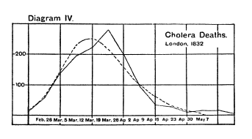
Some historical figures and ideas
John Brownlee (1907)
Sought to quantify “infectivity”
Suggested infectivity changes over time
Source: Fine, PEM. John Brownlee and the Measurement of Infectiousness.
J.R. Stastist. Soc. A, Vol. 142, No. 3 (1979)
Notes:
C(t+1) = Ct * p * q^t p= initial infectivity q^t= exponential decrease in infectivity over time.
Admired Farr’s work – tried to build on it.
Didn’t agree with mass action

Slide 52
Some historical figures and ideas
Ronald Ross (1907): Suggested malaria could be eradicated by reducing mosquitoes
Used models to explore this claim
Not necessary to eliminate all mosquitoes
First to explore “mass action” in continuous time (e.g. dy/dt = ky(1 – y), y = prevalence)
  “As a matter of fact all epidemiology, concerned as it is with the variation of disease from time to time or place to place, must be considered mathematically, however many variables are implicated if it is to be considered scientifically at all.” R. Ross.
Fine, PEM. John Brownlee and the Measurement of Infectiousness.
J.R. Stastist. Soc. A, Vol. 142, No. 3 (1979)
Notes:
Threshhold concept

Slide 53
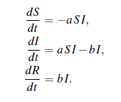
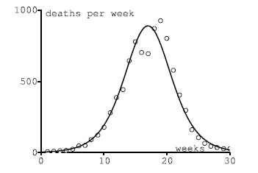
Some historical figures and ideas
A. McKendrick (1927) & W. Kermack (1927)
Deterministic epidemic models
Epidemic threshold
  dI/dt = I(t) (aS(t) – b)
  If S(0) < b/a then dI/dt < 0
  - infection dies out
  If S(0) > b/a then dI/dt >0
  Infection spreads
Ro = Basic reproductive ratio
Notes:
A = ‘beta’ b = ‘gamma’ Ro = a/b = beta/gamma
Duration of infectiousness = 1/b, transmission rate = a, Ro = a/b
“average number of secondary cases arising from an average primary case in an entirely susceptible population”
Chain of transmission breaks down due to the decline of infectives
- fig, dR/dt as a function of time and the data for the number of deaths per week during a plague in bombay 1905.

Slide 54
Mathematics
Technology
Biology
YOU
Public Health
Epidemiology
Statistics

Slide 55
Hippocrates
Slide courtesy of Warren Winkelstein

Slide 56
Summary
Public health:
  Prevention
  Works at population level
Epidemiology is a key science of public health
  Describes the distribution and determinants of disease in human populations
  Informs policy
We can use models to help answer public health questions
  Simplicity is good
  Based on what is known
  Data dependant
Modeling is not new

Slide 57
Title: Public Health, Epidemiology, and Models. DO 10.6084/m9.figshare.5038769.v3
Jim Scott
https://doi.org/10.6084/m9.figshare.5038769.v3

