Slide 1
Shared Open Source Infrastructure with the Libero Community

Slide 2
Why eLife is building open source technology for publishing
Shared Open Source Infrastructure

Slide 3
What is eLife?
A non-profit backed by research funders to drive reform in research communication
We invest heavily in open-source technology development and innovation on behalf of the community
Notes:
howard hughes medical institute, wellcome trust, max planck institute, wallenberg foundation
Invest heavily in … for the benefit of the community

Slide 4
Libero Publisher
Notes:
A good publishing infrastructure is a key element of platform for research communication

Slide 5
eLife’s motivations
Leverage the power of web technology to accelerate research and discovery
Support open-access publishing
Build a community-owned infrastructure for research communication

Slide 6
What are the infrastructure options for a publisher?
Shared Open Source Infrastructure
Notes:
Current state of the publishing infrastructure landscape

Slide 7
Buy
Build
Notes:
Software vendor
Build your Solution

Slide 8
Buy
You risk a strong dependence on a single provider
There is reduced competition for feature customisations
There can be a lack of transparency

Slide 9
Build
Requires a big upfront investment
Maintenance and keeping up with the standard can be difficult
Need to keep up with fast moving technology

Slide 10
Shared open source infrastructure

Slide 11
Building an end-to-end solution
Libero Reviewer
Libero Producer
Libero Publisher
Submission
Peer review
Typesetting
Hosting
Publishing
Notes:
Libero publisher, the final piece of puzzle

Slide 12
eLife’s involvement in the open source world
Shared Open Source Infrastructure

Slide 13
eLife’s development community

Slide 14
Building an end-to-end solution
Libero Reviewer
Libero Producer
Libero Publisher
Submission
Peer review
Typesetting
Hosting
Publishing

Slide 15
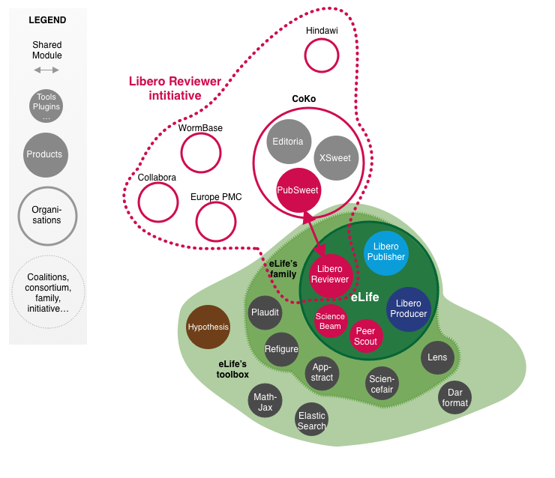
eLife’s Libero Reviewer collaboration
Notes:
Went live with this first slice of Lib Review this year
Science Bean and Peer Scout are new independent modules using AI that we developed with our data scientist Daniel Ecer

Slide 16
Building an end-to-end solution
Libero Reviewer
Libero Producer
Libero Publisher
Submission
Peer review
Typesetting
Hosting
Publishing
Notes:
Libero publisher, the final piece of puzzle

Slide 17
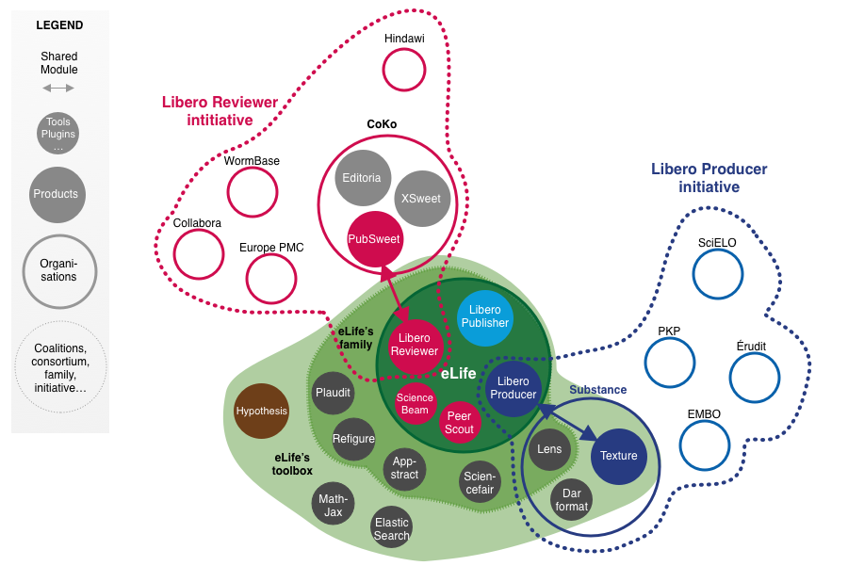
eLife’s Libero Producer collaboration

Slide 18
Building an end-to-end solution
Libero Reviewer
Libero Producer
Libero Publisher
Submission
Peer review
Typesetting
Hosting
Publishing
Notes:
Libero publisher, the final piece of puzzle

Slide 19
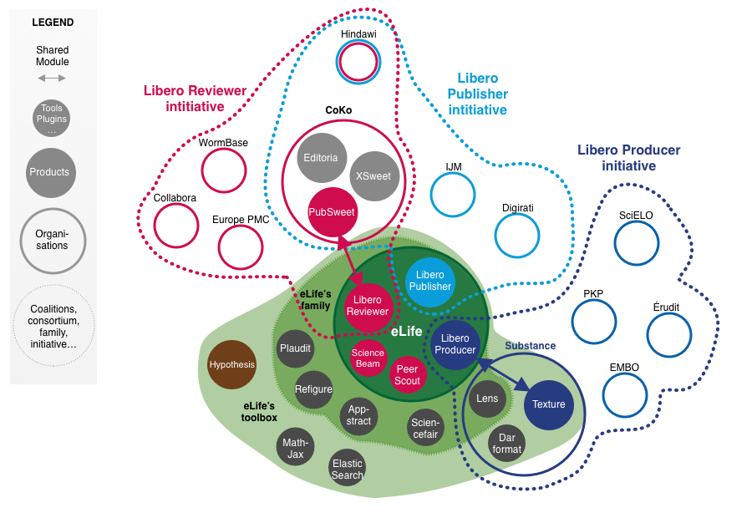
eLife’s Libero Publisher collaboration
Notes:
So here we have 3 different approaches to shared open-source infrastructure

Slide 20
How do we build open source software?
Shared Open Source Infrastructure
Notes:
Since october

Slide 21
We listen to content providers
A strong need for cost-effective solution
Desire for a modern user experience (UX/UI)
A need for more flexible, modular options

Slide 22
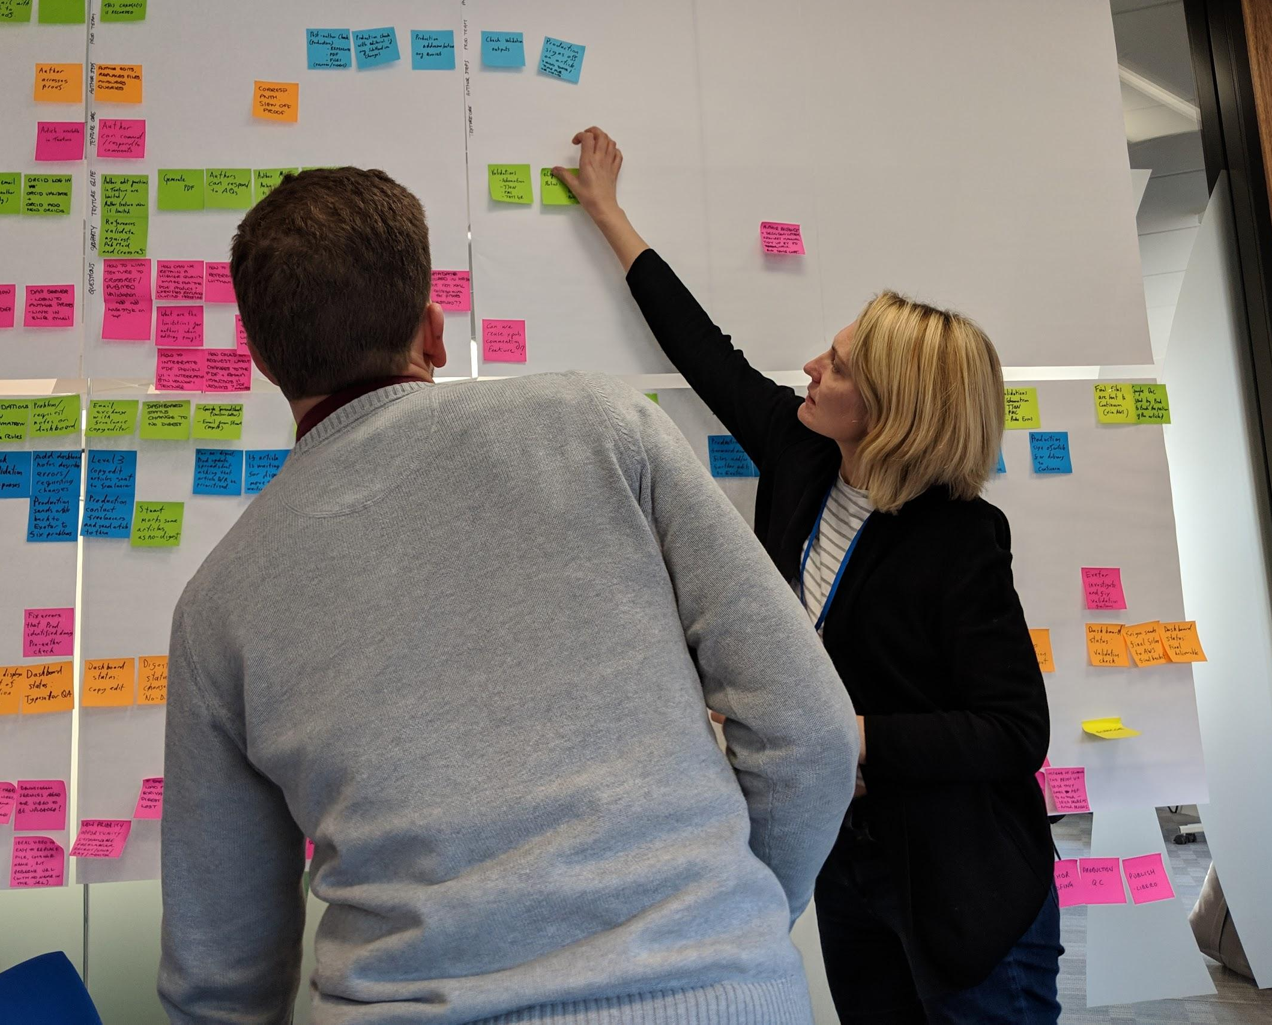
How do we build tools that are easy to use?
We run workshops with users
and stakeholders
Workshops: we run with users and stakeholders
Short feedback loops: we iterate on feedback and adapt our design
User tests: we make sure that our solution works well

Slide 23
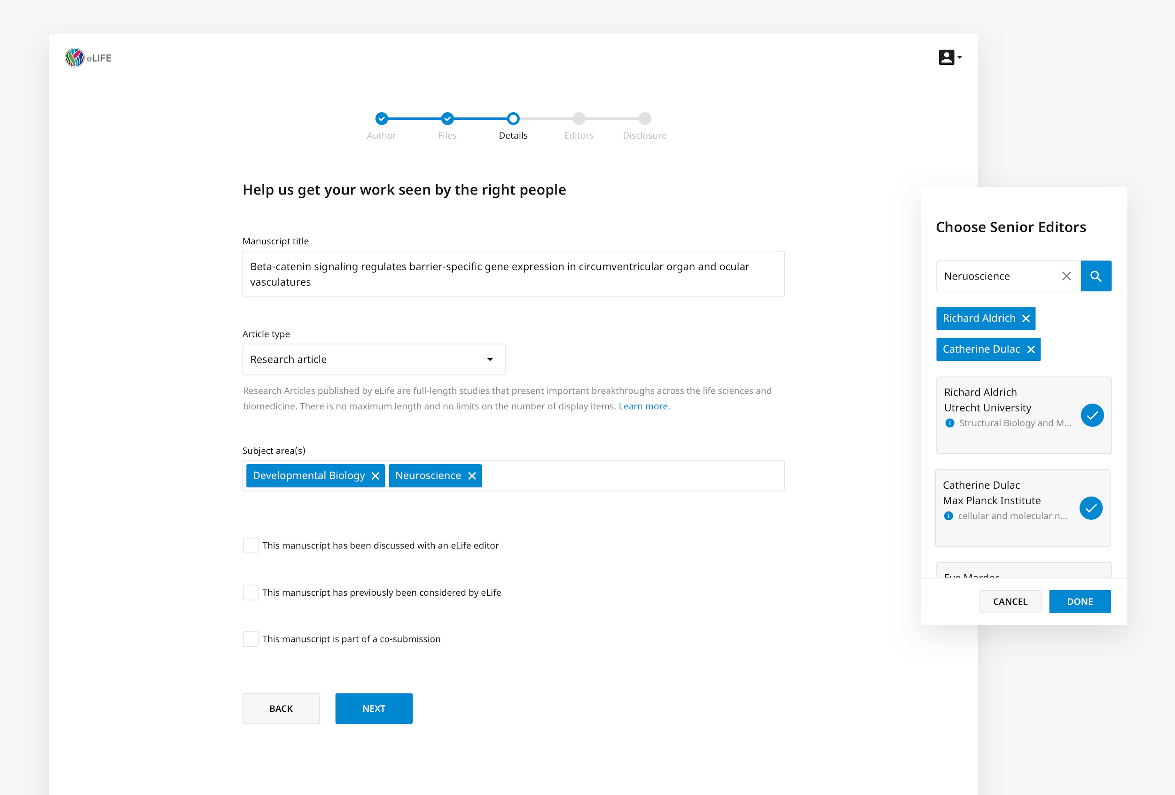
...to build user interfaces
that are intuitive and
save time

Slide 24
Can I have a look?
Shared Open Source Infrastructure
Notes:
Current state of the publishing infrastructure landscape

Slide 25
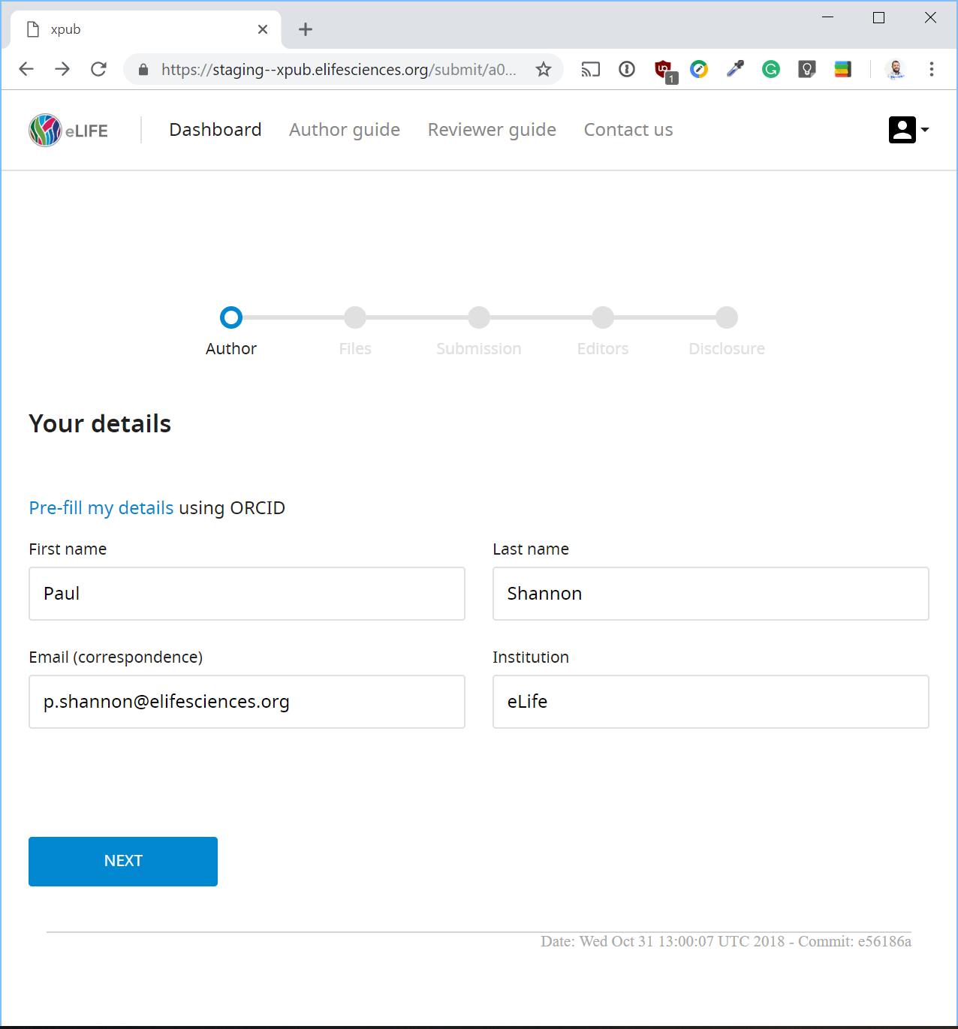
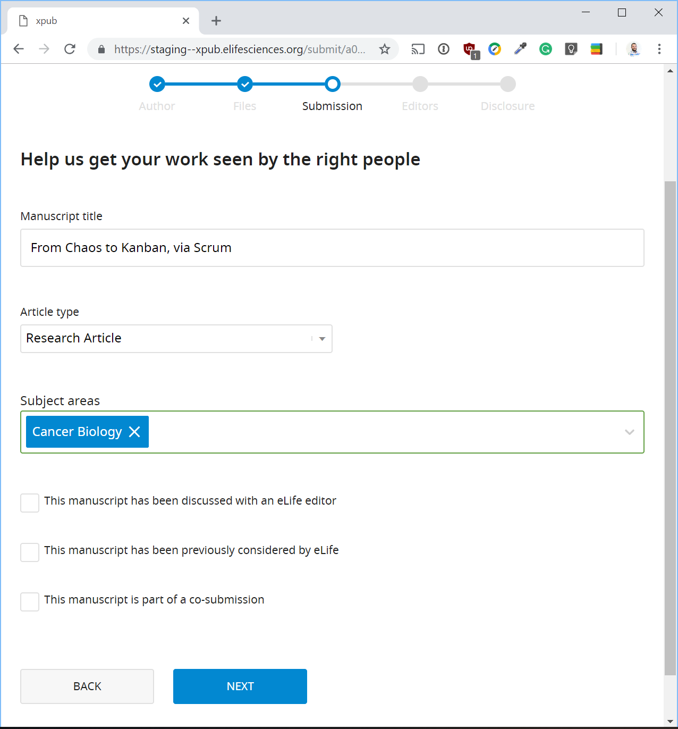
Libero Reviewer

Slide 26
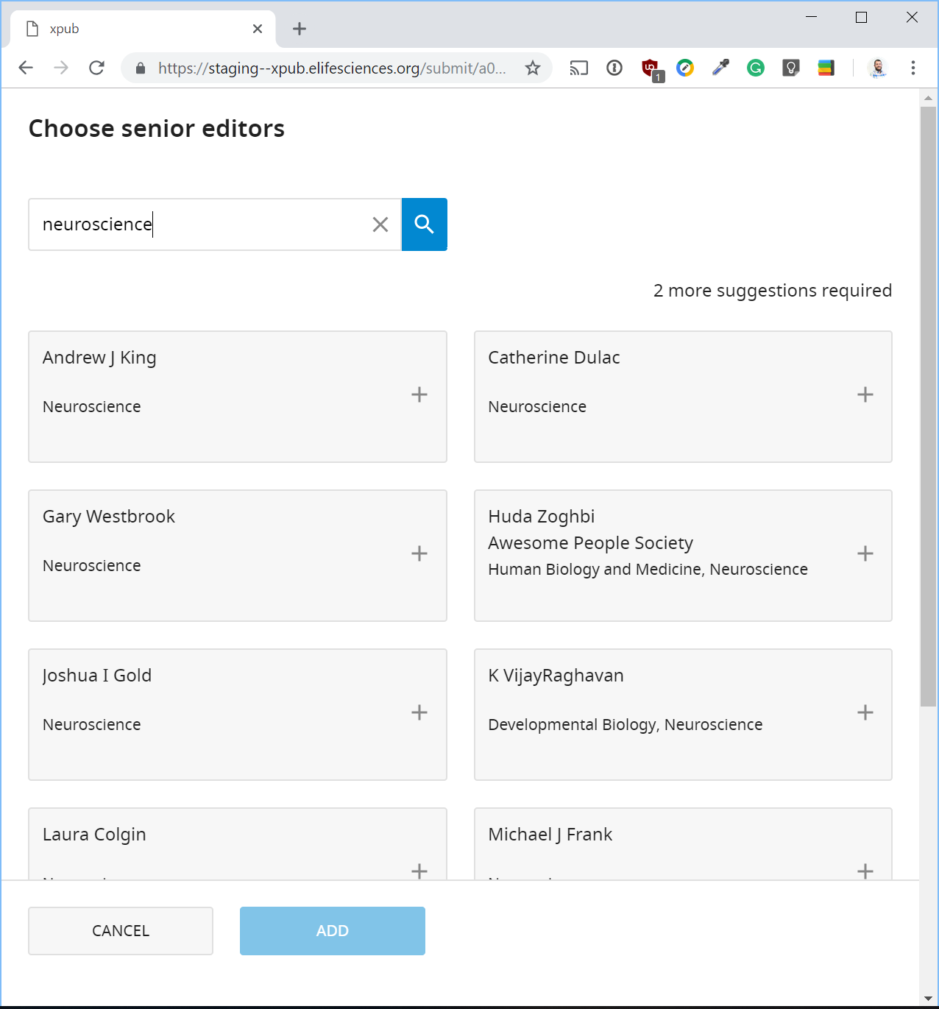
Libero Reviewer

Slide 27
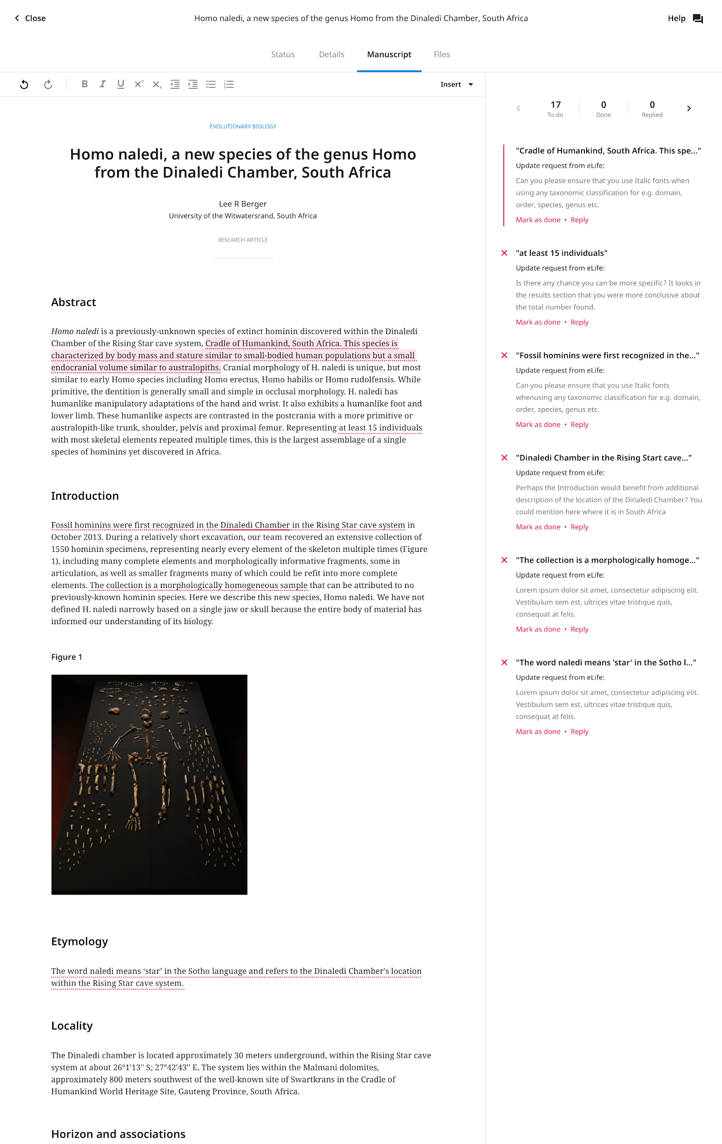
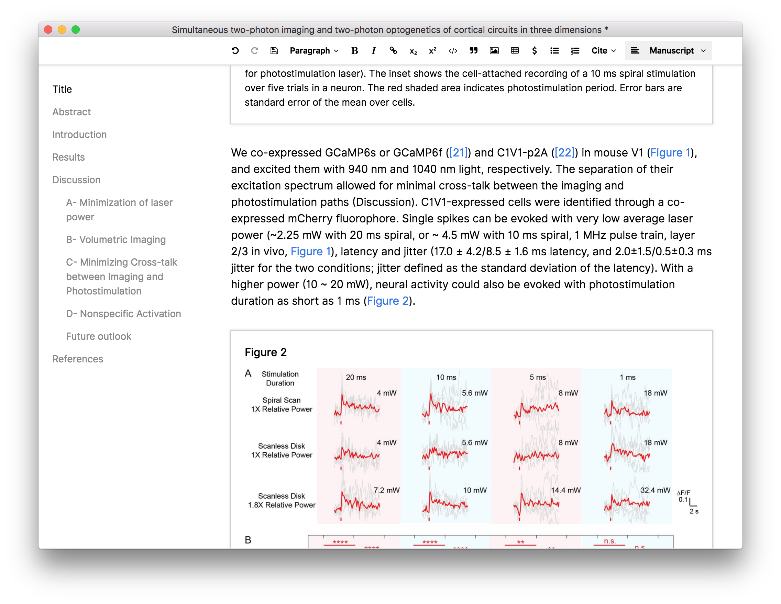
Libero Producer

Slide 28
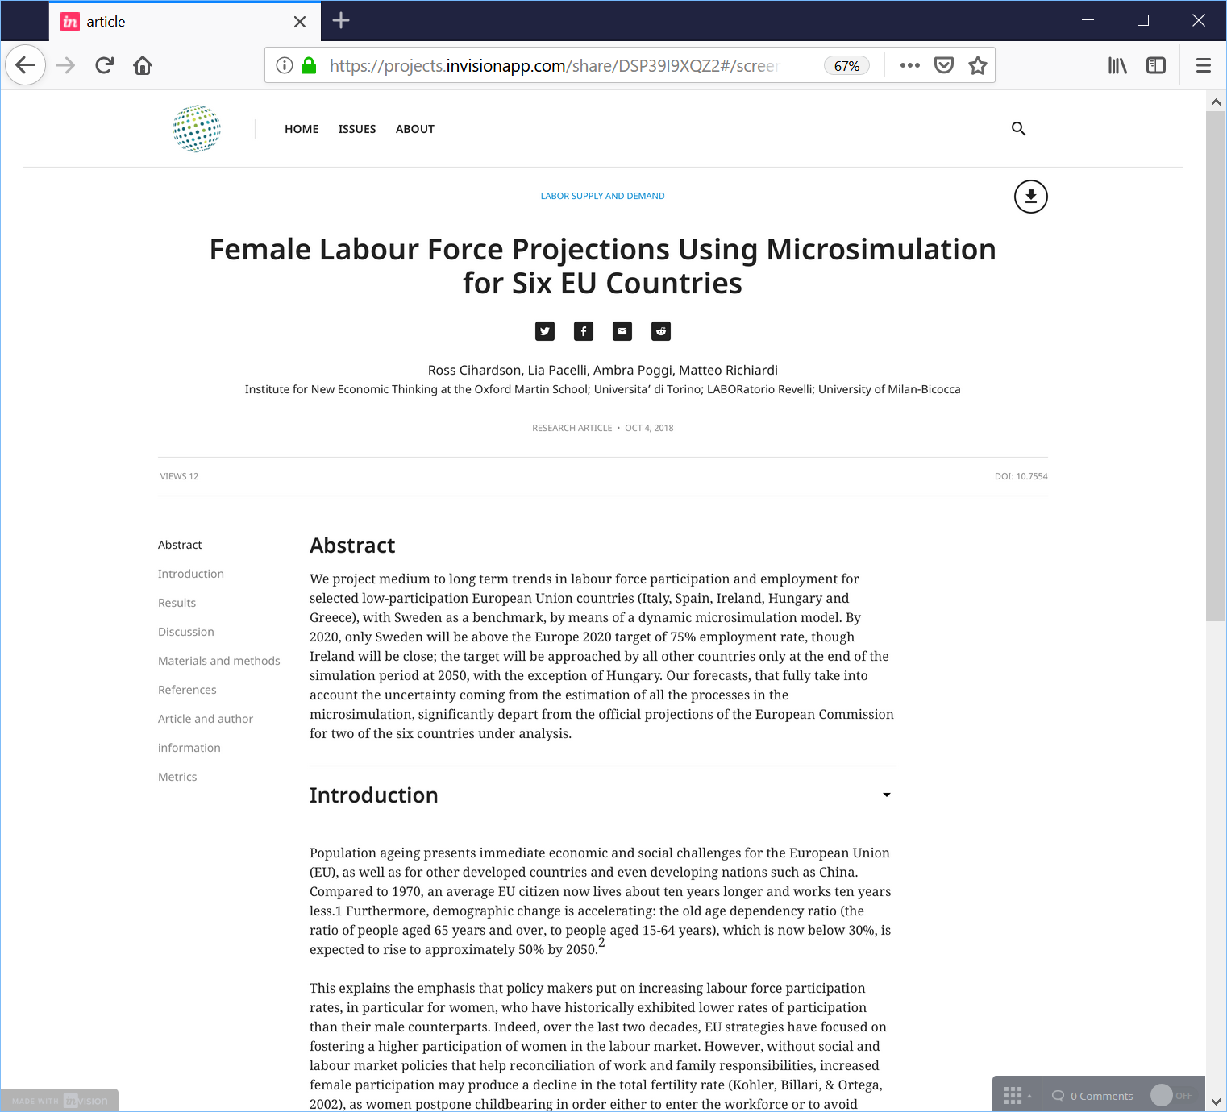
Libero Publisher

Slide 29
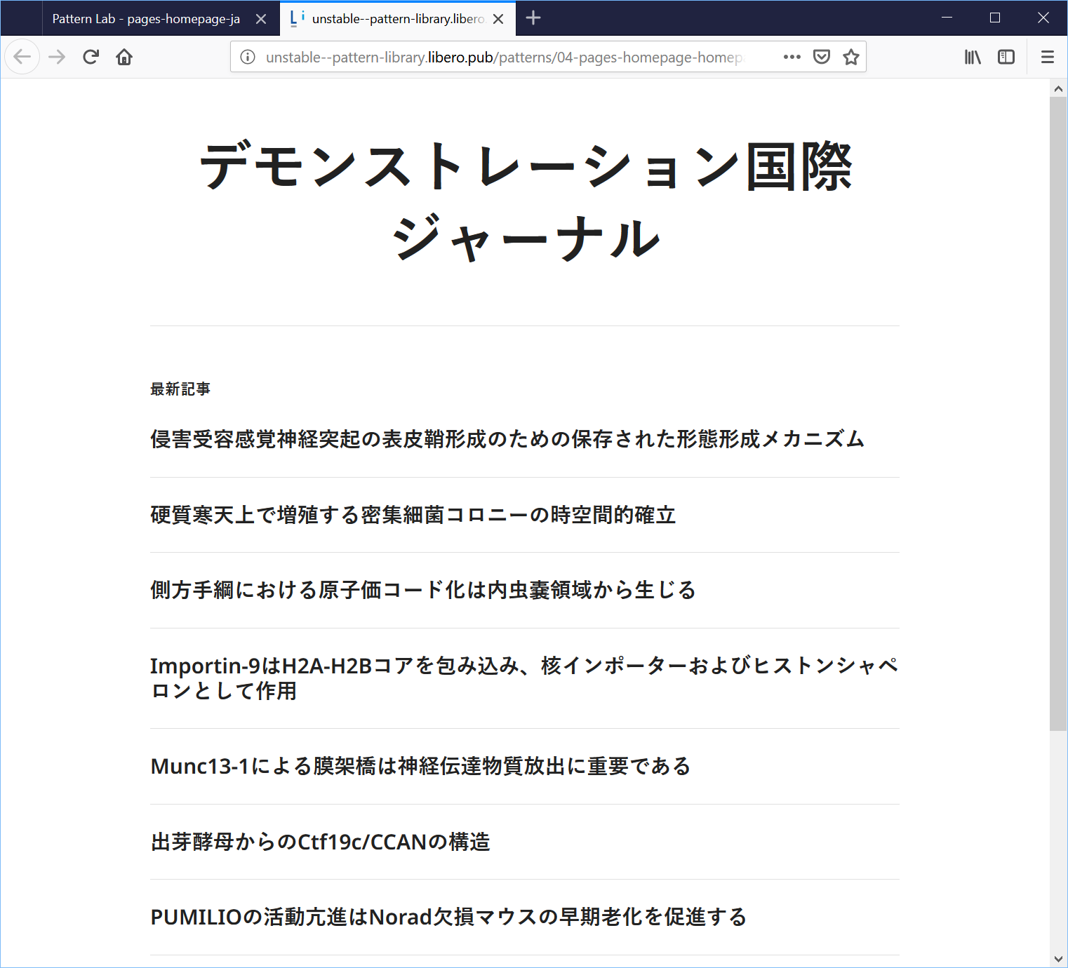
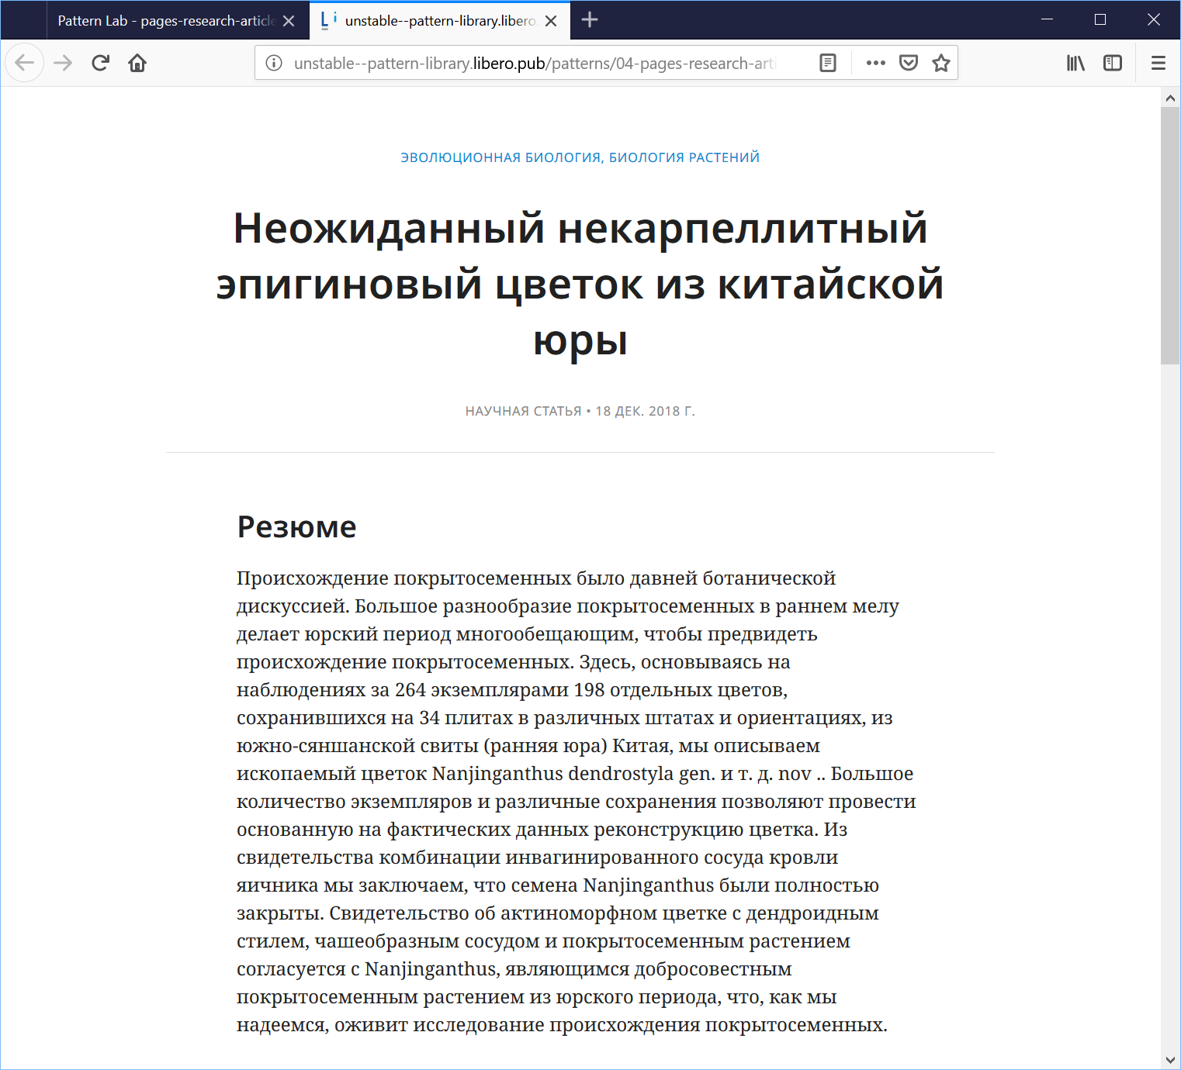
Libero Publisher

Slide 30
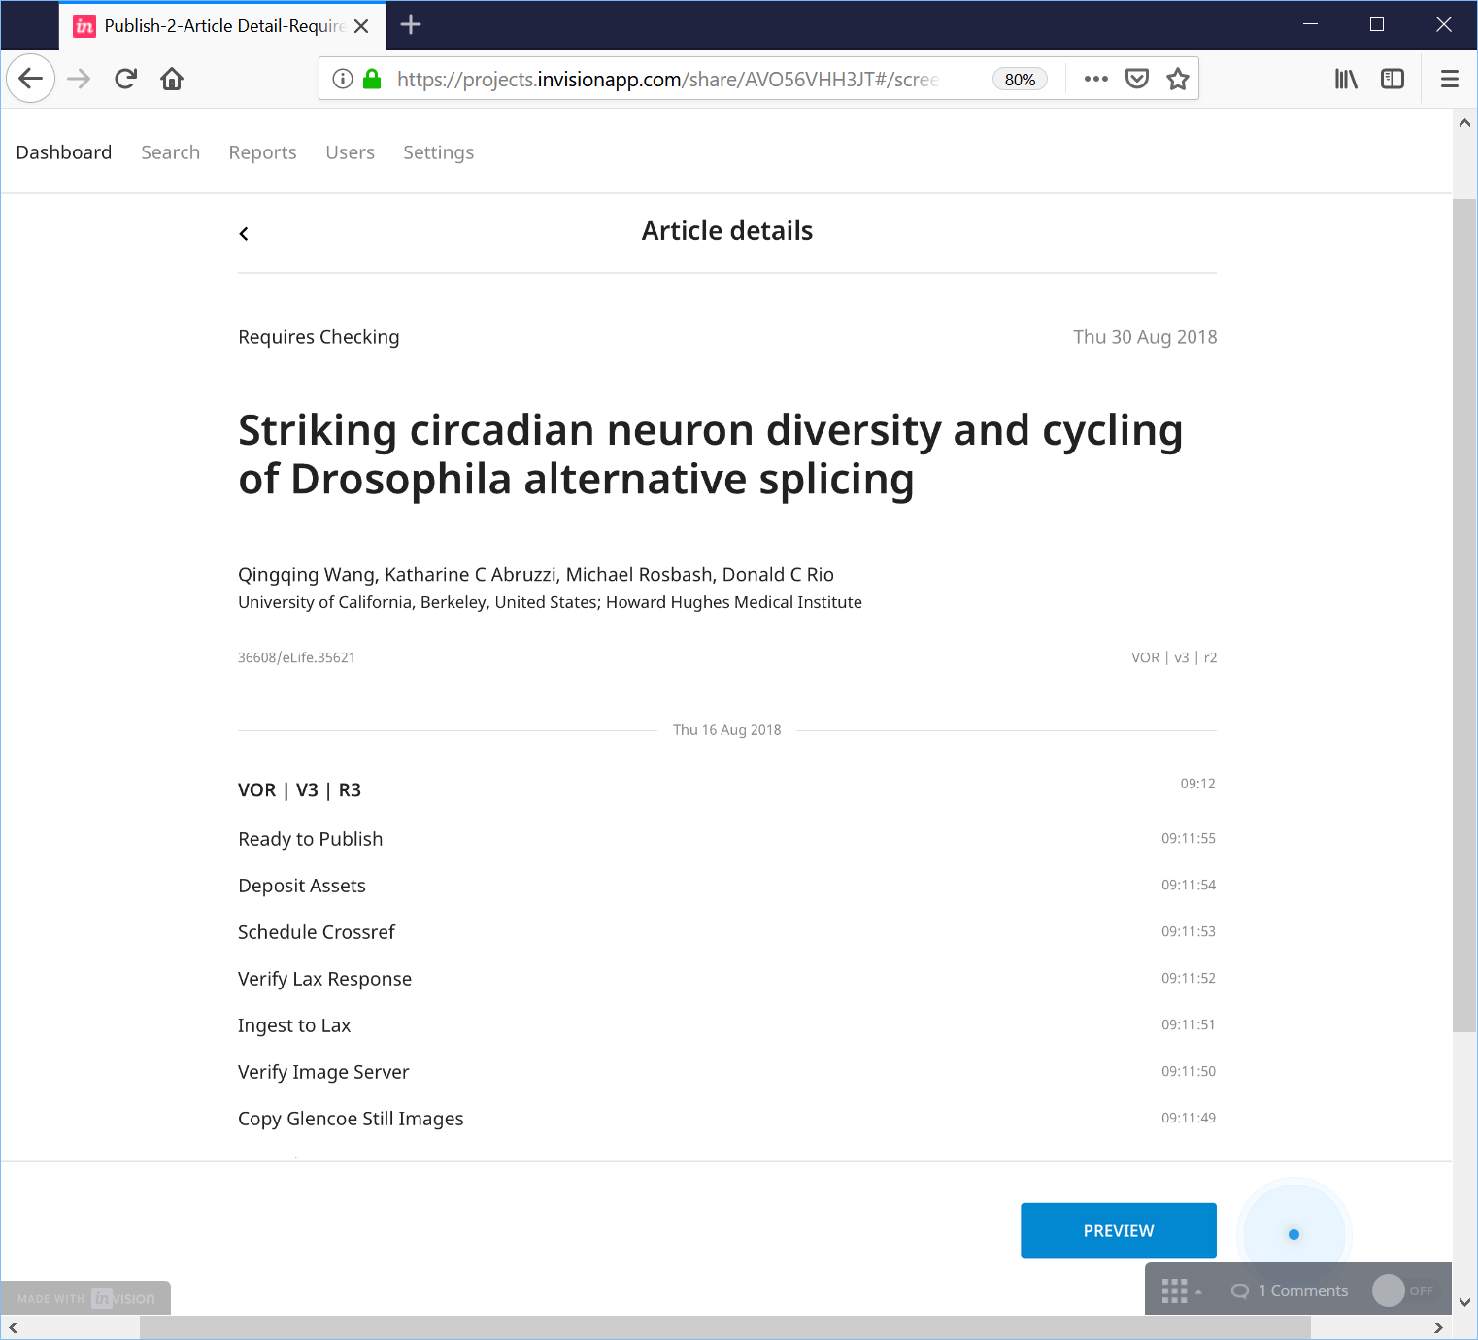
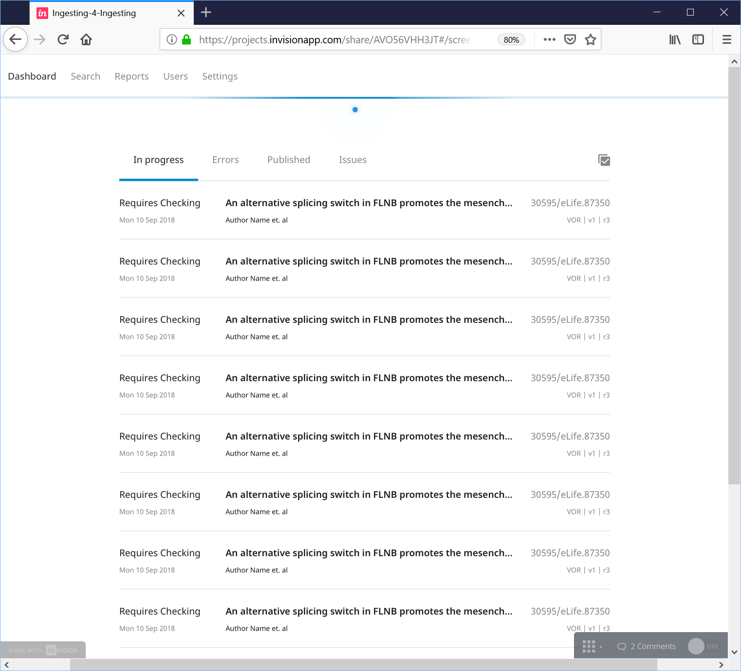
Libero Publisher

Slide 31
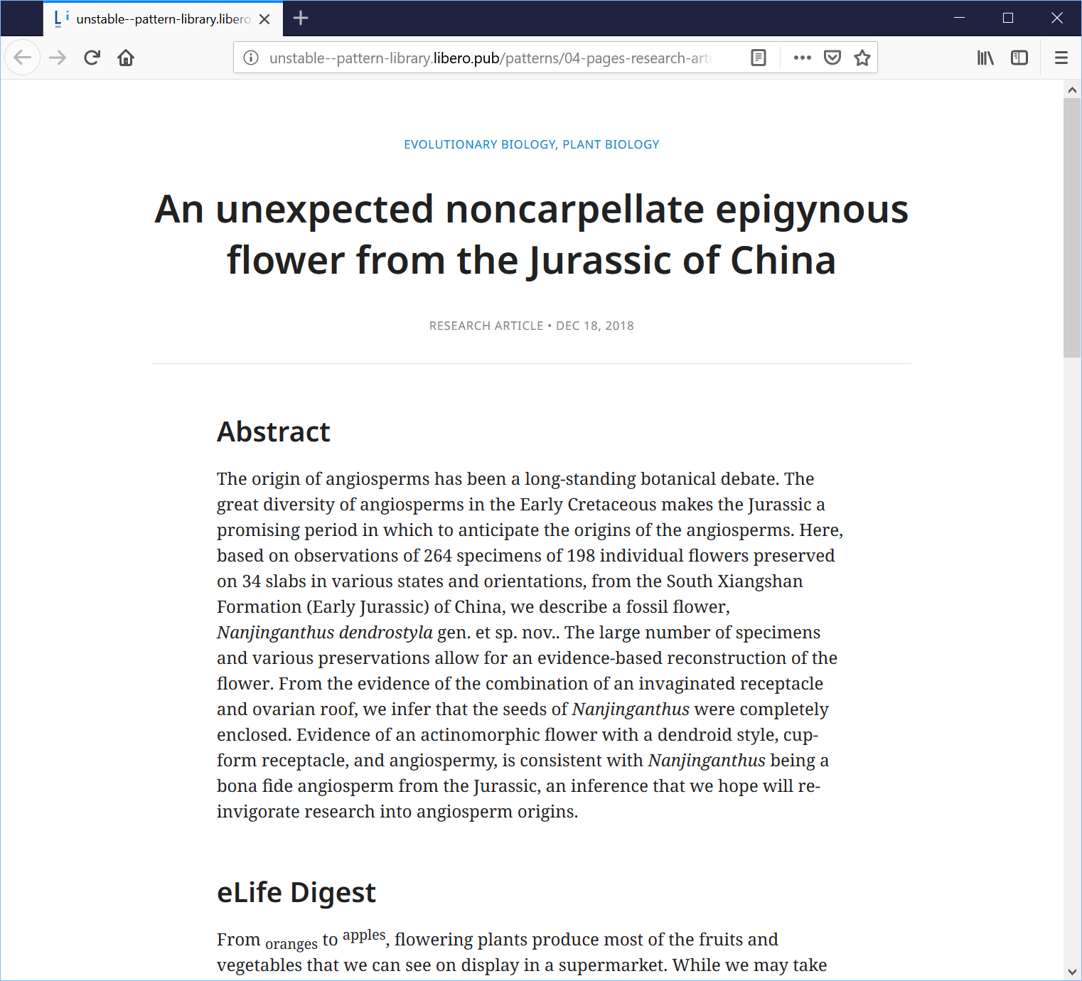
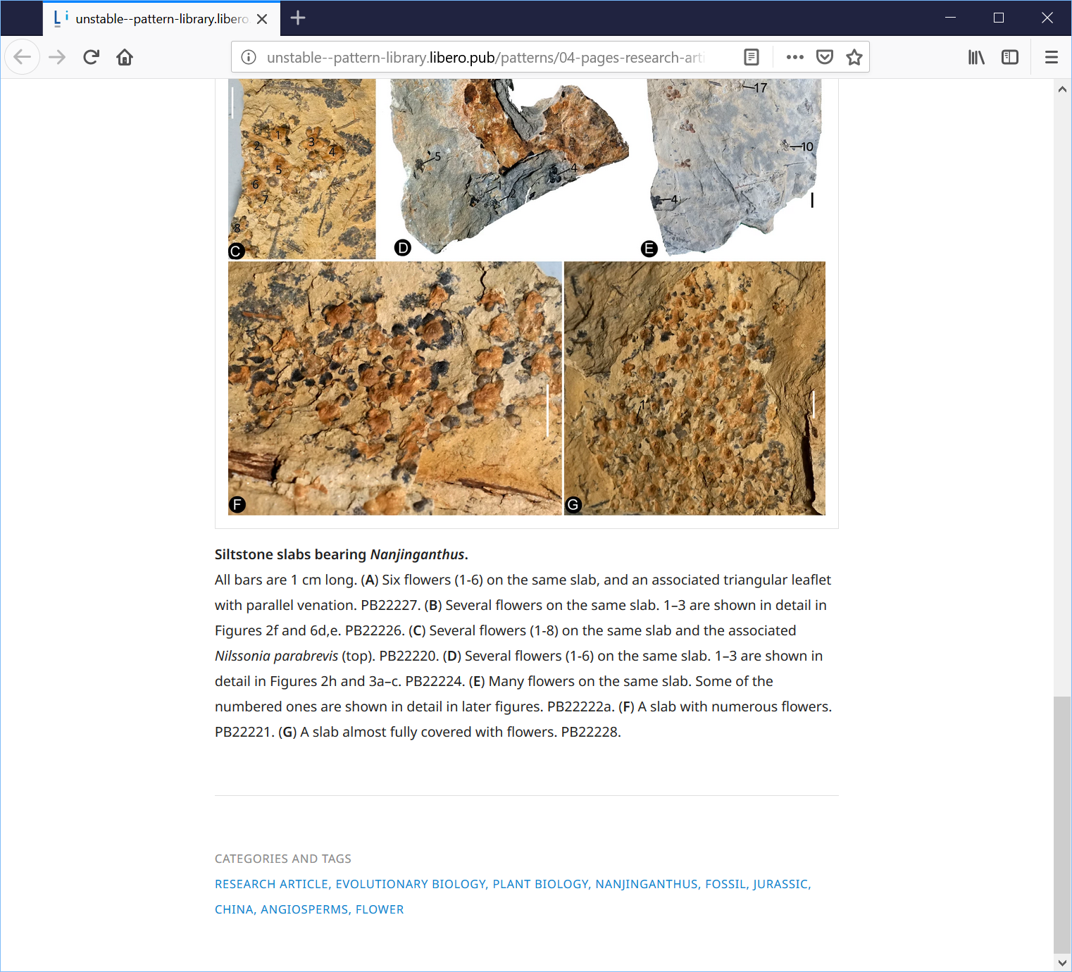
Libero Publisher

Slide 32
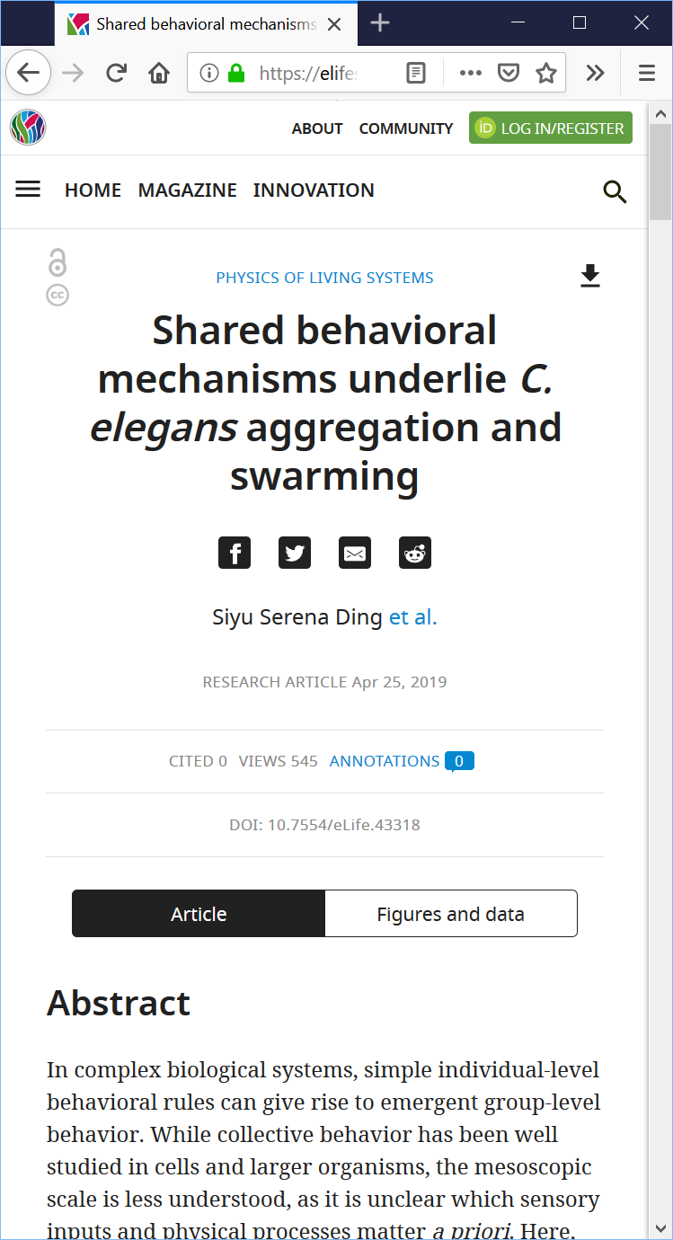
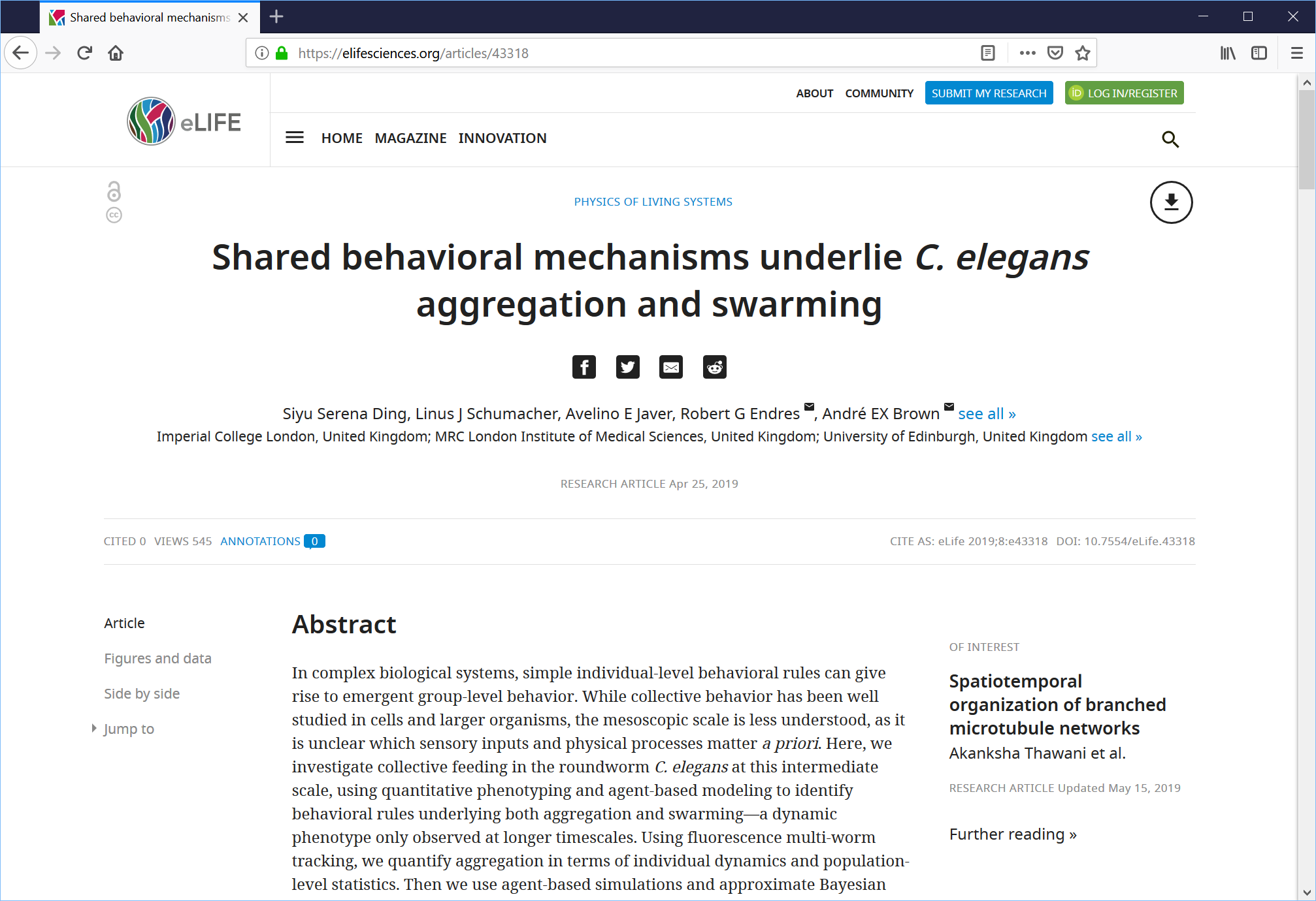
Libero Publisher

Slide 33
I do not have a tech team, can I still use your tools?
Shared Open Source Infrastructure

Slide 34
Options
Libero is developer-friendly which means you can easily find software professionals to help get you set up
We use open languages like PHP, Python and JavaScript, and well-known open frameworks like Symfony and React
Attention has been paid to the developer experience so code changes are kept to a minimum for a basic configuration

Slide 35
Options
Will be supported by an ecosystem of open source service providers that can provide turnkey implementations of our platforms
Transparent and competitive pricing
Diverse providers in different geographic locations with varied expertise across open source, hosting, publishing and software development

Slide 36
Service provider model
Libero Community
Code base maintenance
Implementation, customisations &
customer service
Service
Provider
Service
Provider
Service
Provider
Libero Suite users
University Press
University Press
Publisher
Publisher
Publisher
Society
Society
Society

Slide 37
How can you join the conversation and get started with your open source projects?
Shared Open Source Infrastructure

Slide 38
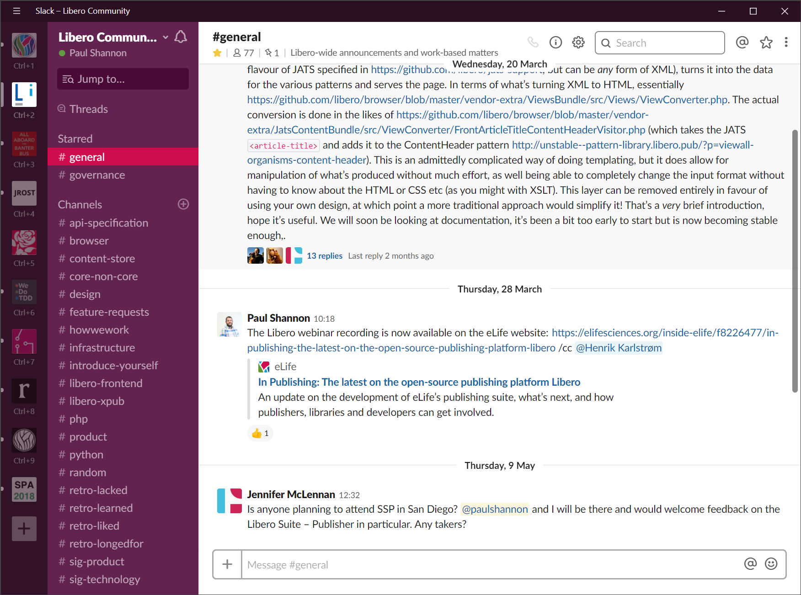
Talk to the community
https://libero.pub/join-slack/
or contact us by email: hello@libero.pub
Notes:
You can email us at ….

Slide 39
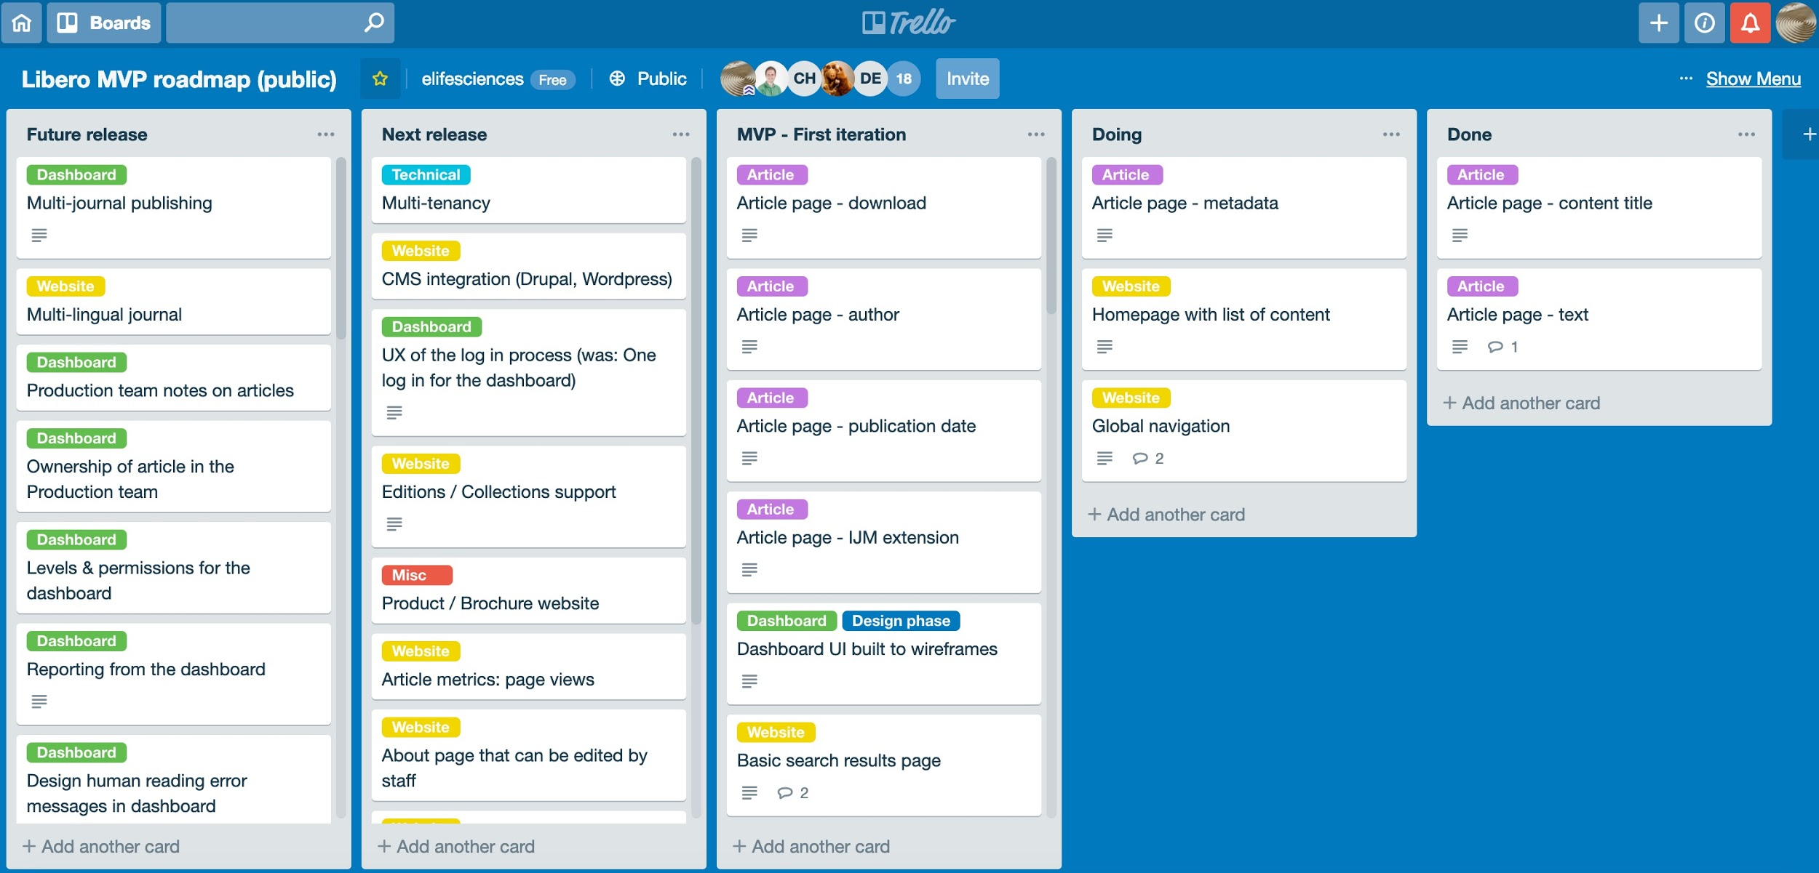
See our product roadmap
https://elifesci.org/roadmap

Slide 40
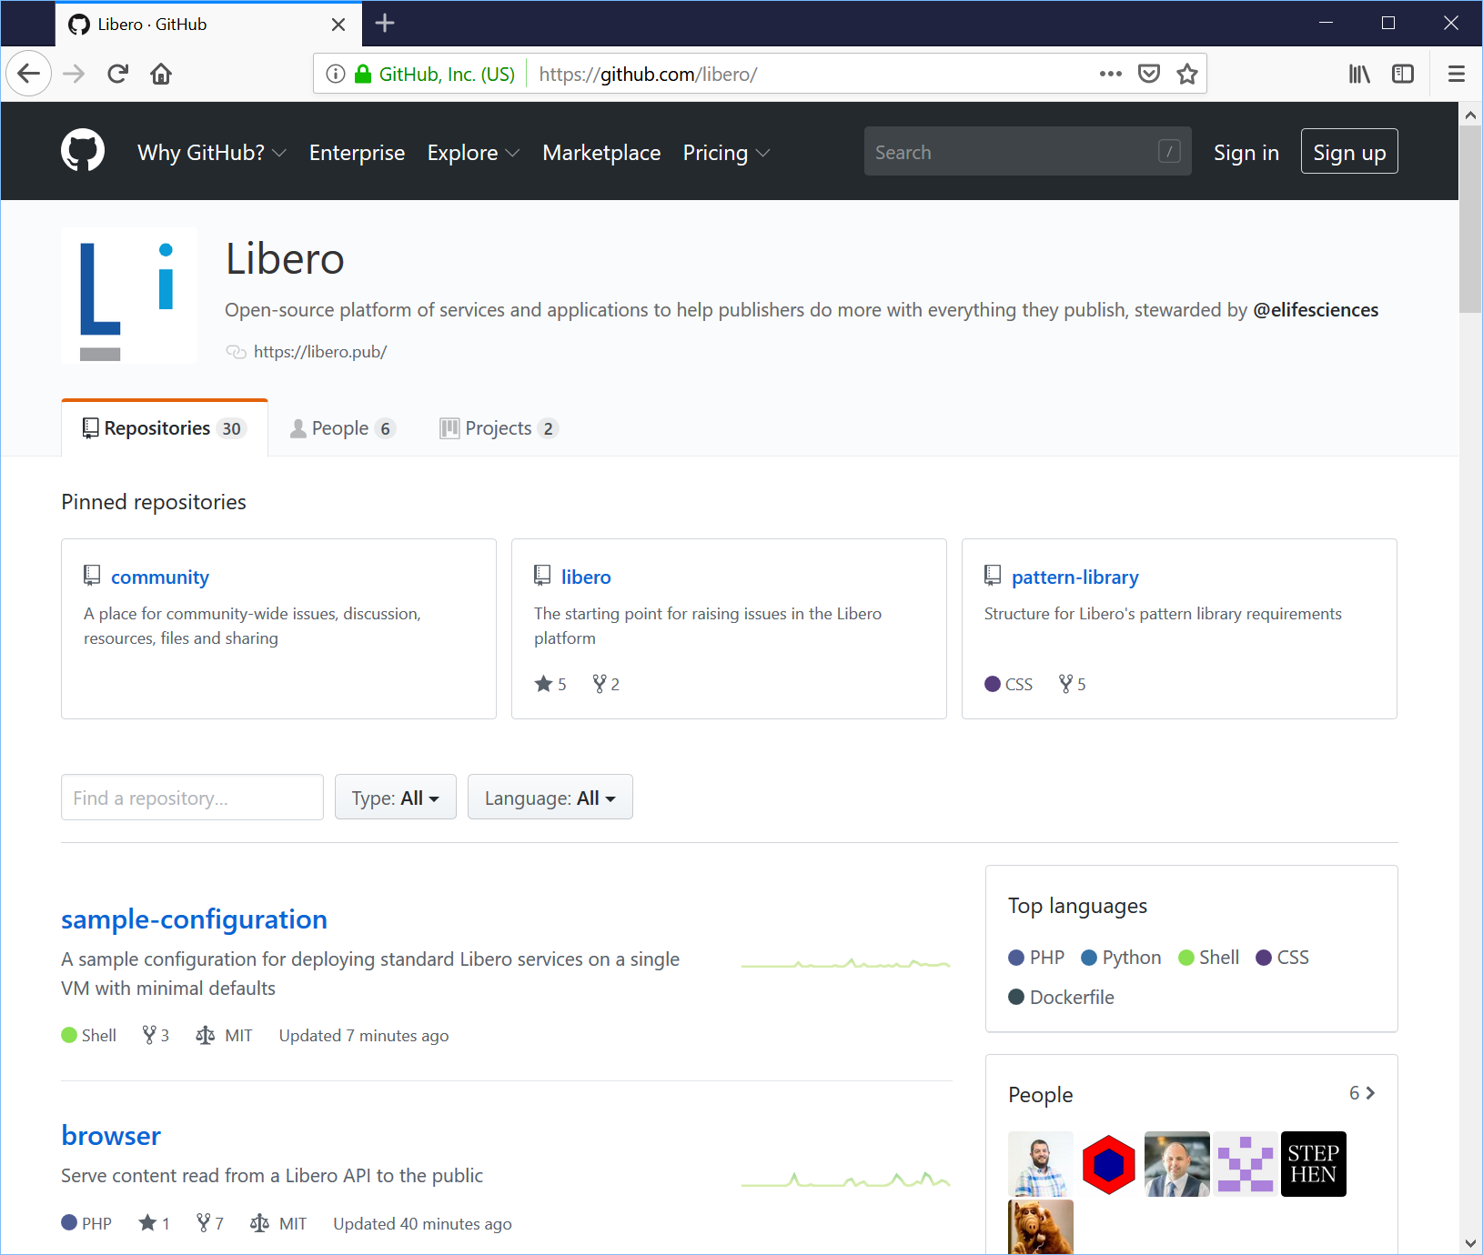
Libero Publisher code:
https://github.com/libero
Other products’ code:
https://github.com/elifesciences

Slide 41
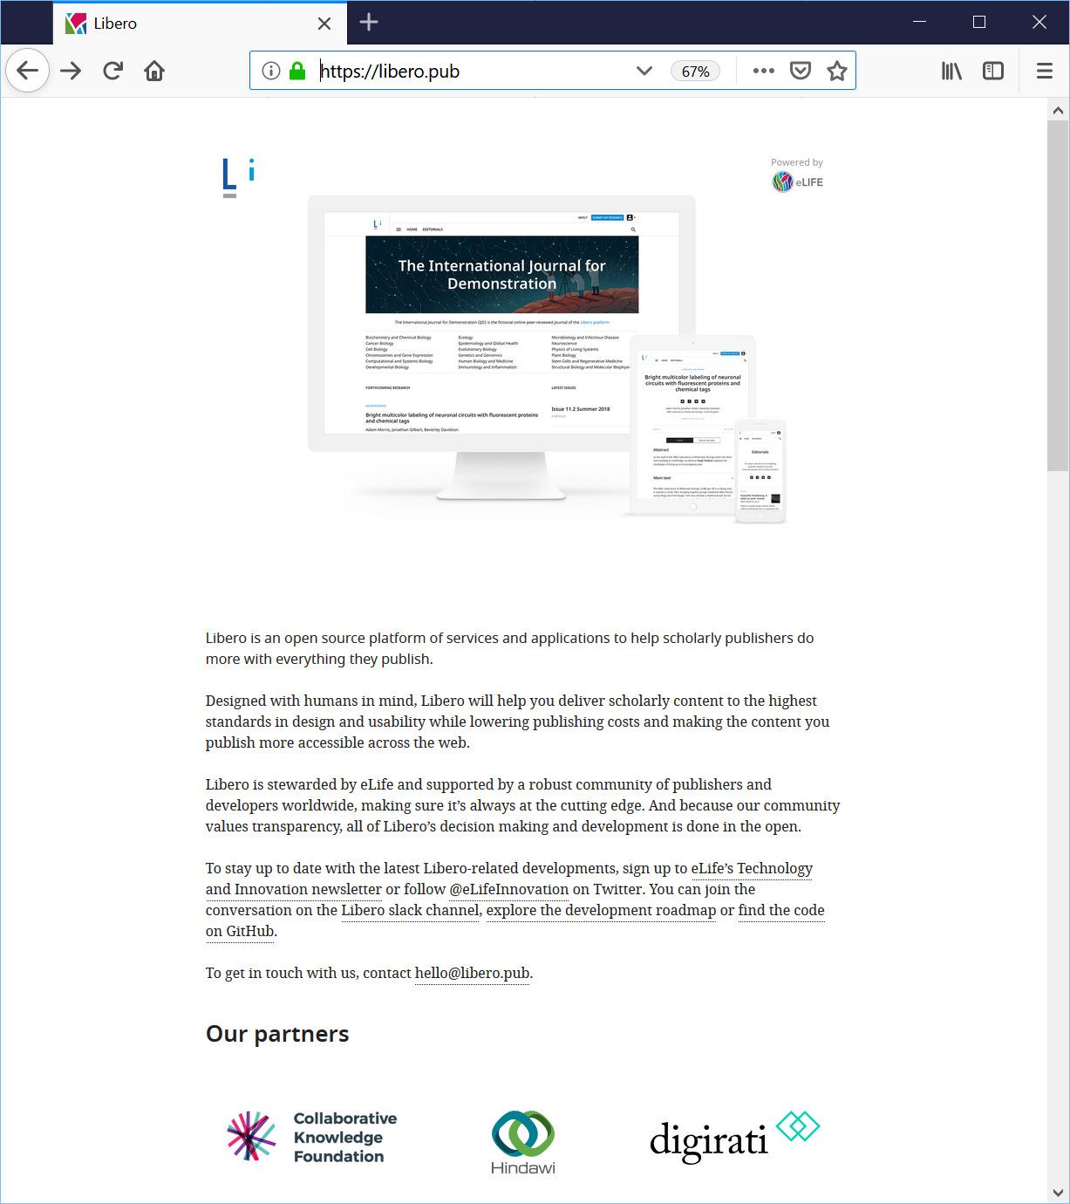
Visit our product website
We’re constantly evolving https://libero.pub with new guides and links to the relevant repositories

Slide 42
Join our events
Open source technology in publishing Community Call
Open source Community Sprints
Subscribe to our technology and innovation newsletter and follow us on Twitter: @eLifeInnovation

Slide 43
Our conclusion to this approach
Shared Open Source Infrastructure

Slide 44
Benefits of a community-owned approach
Future-proof: No one is dependent on any one organisation
Customer-owned: Your instance of the platform belongs to you; you can change it any time and move it
Best of both worlds: You can adapt the code, and have plenty of qualified support available

Slide 45
Thank you
hello@libero.pub https://libero.pub https://libero.pub/join-slack/ https://elifesci.org/roadmap

