Slide 1
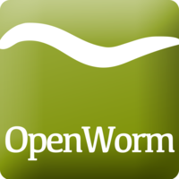
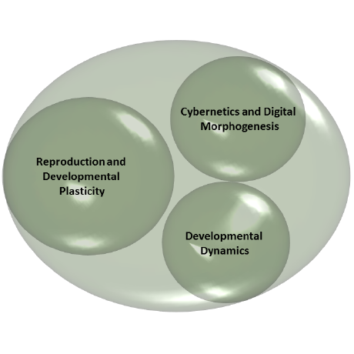
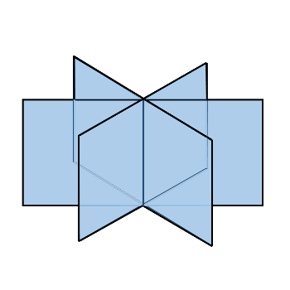
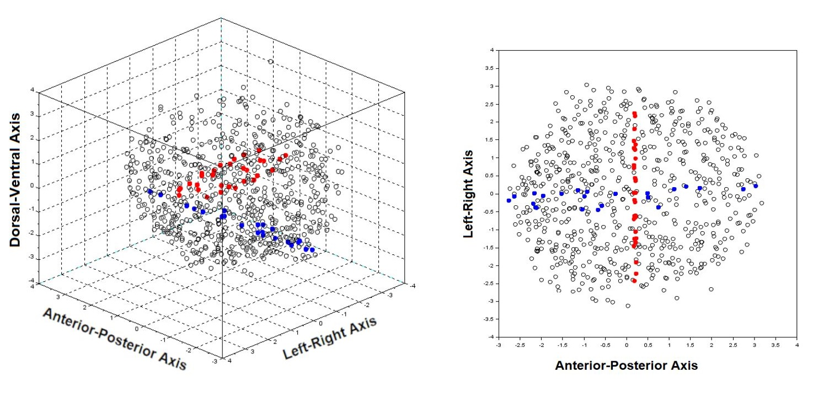
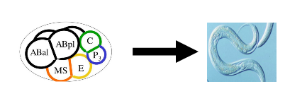
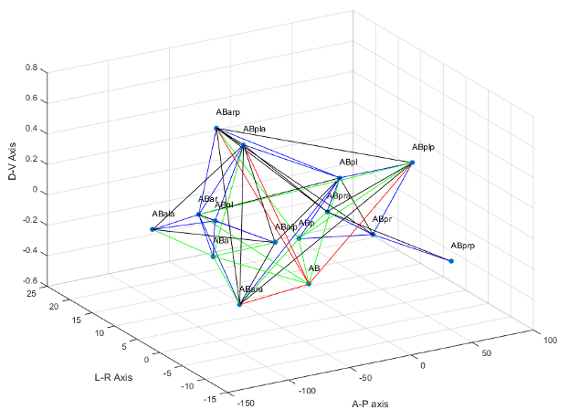
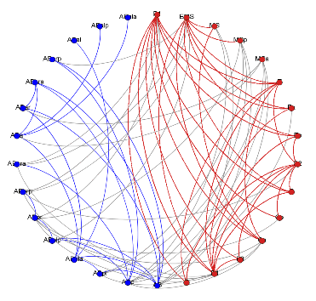
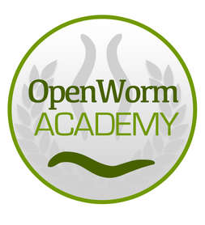
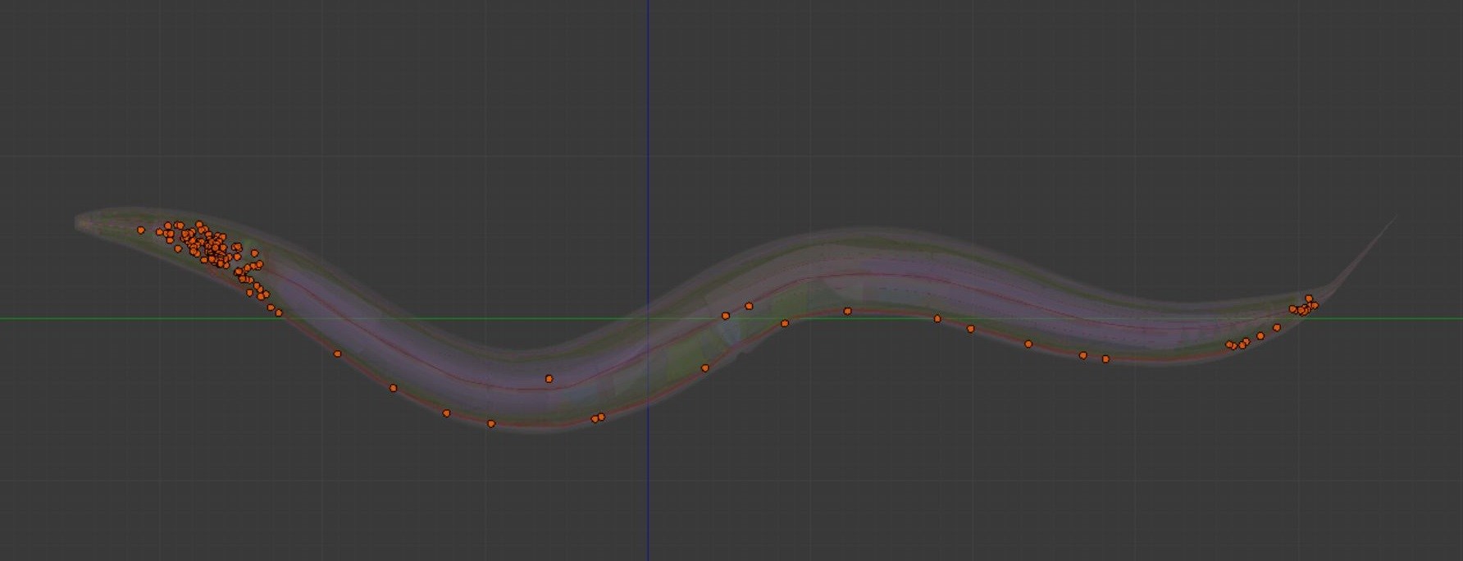
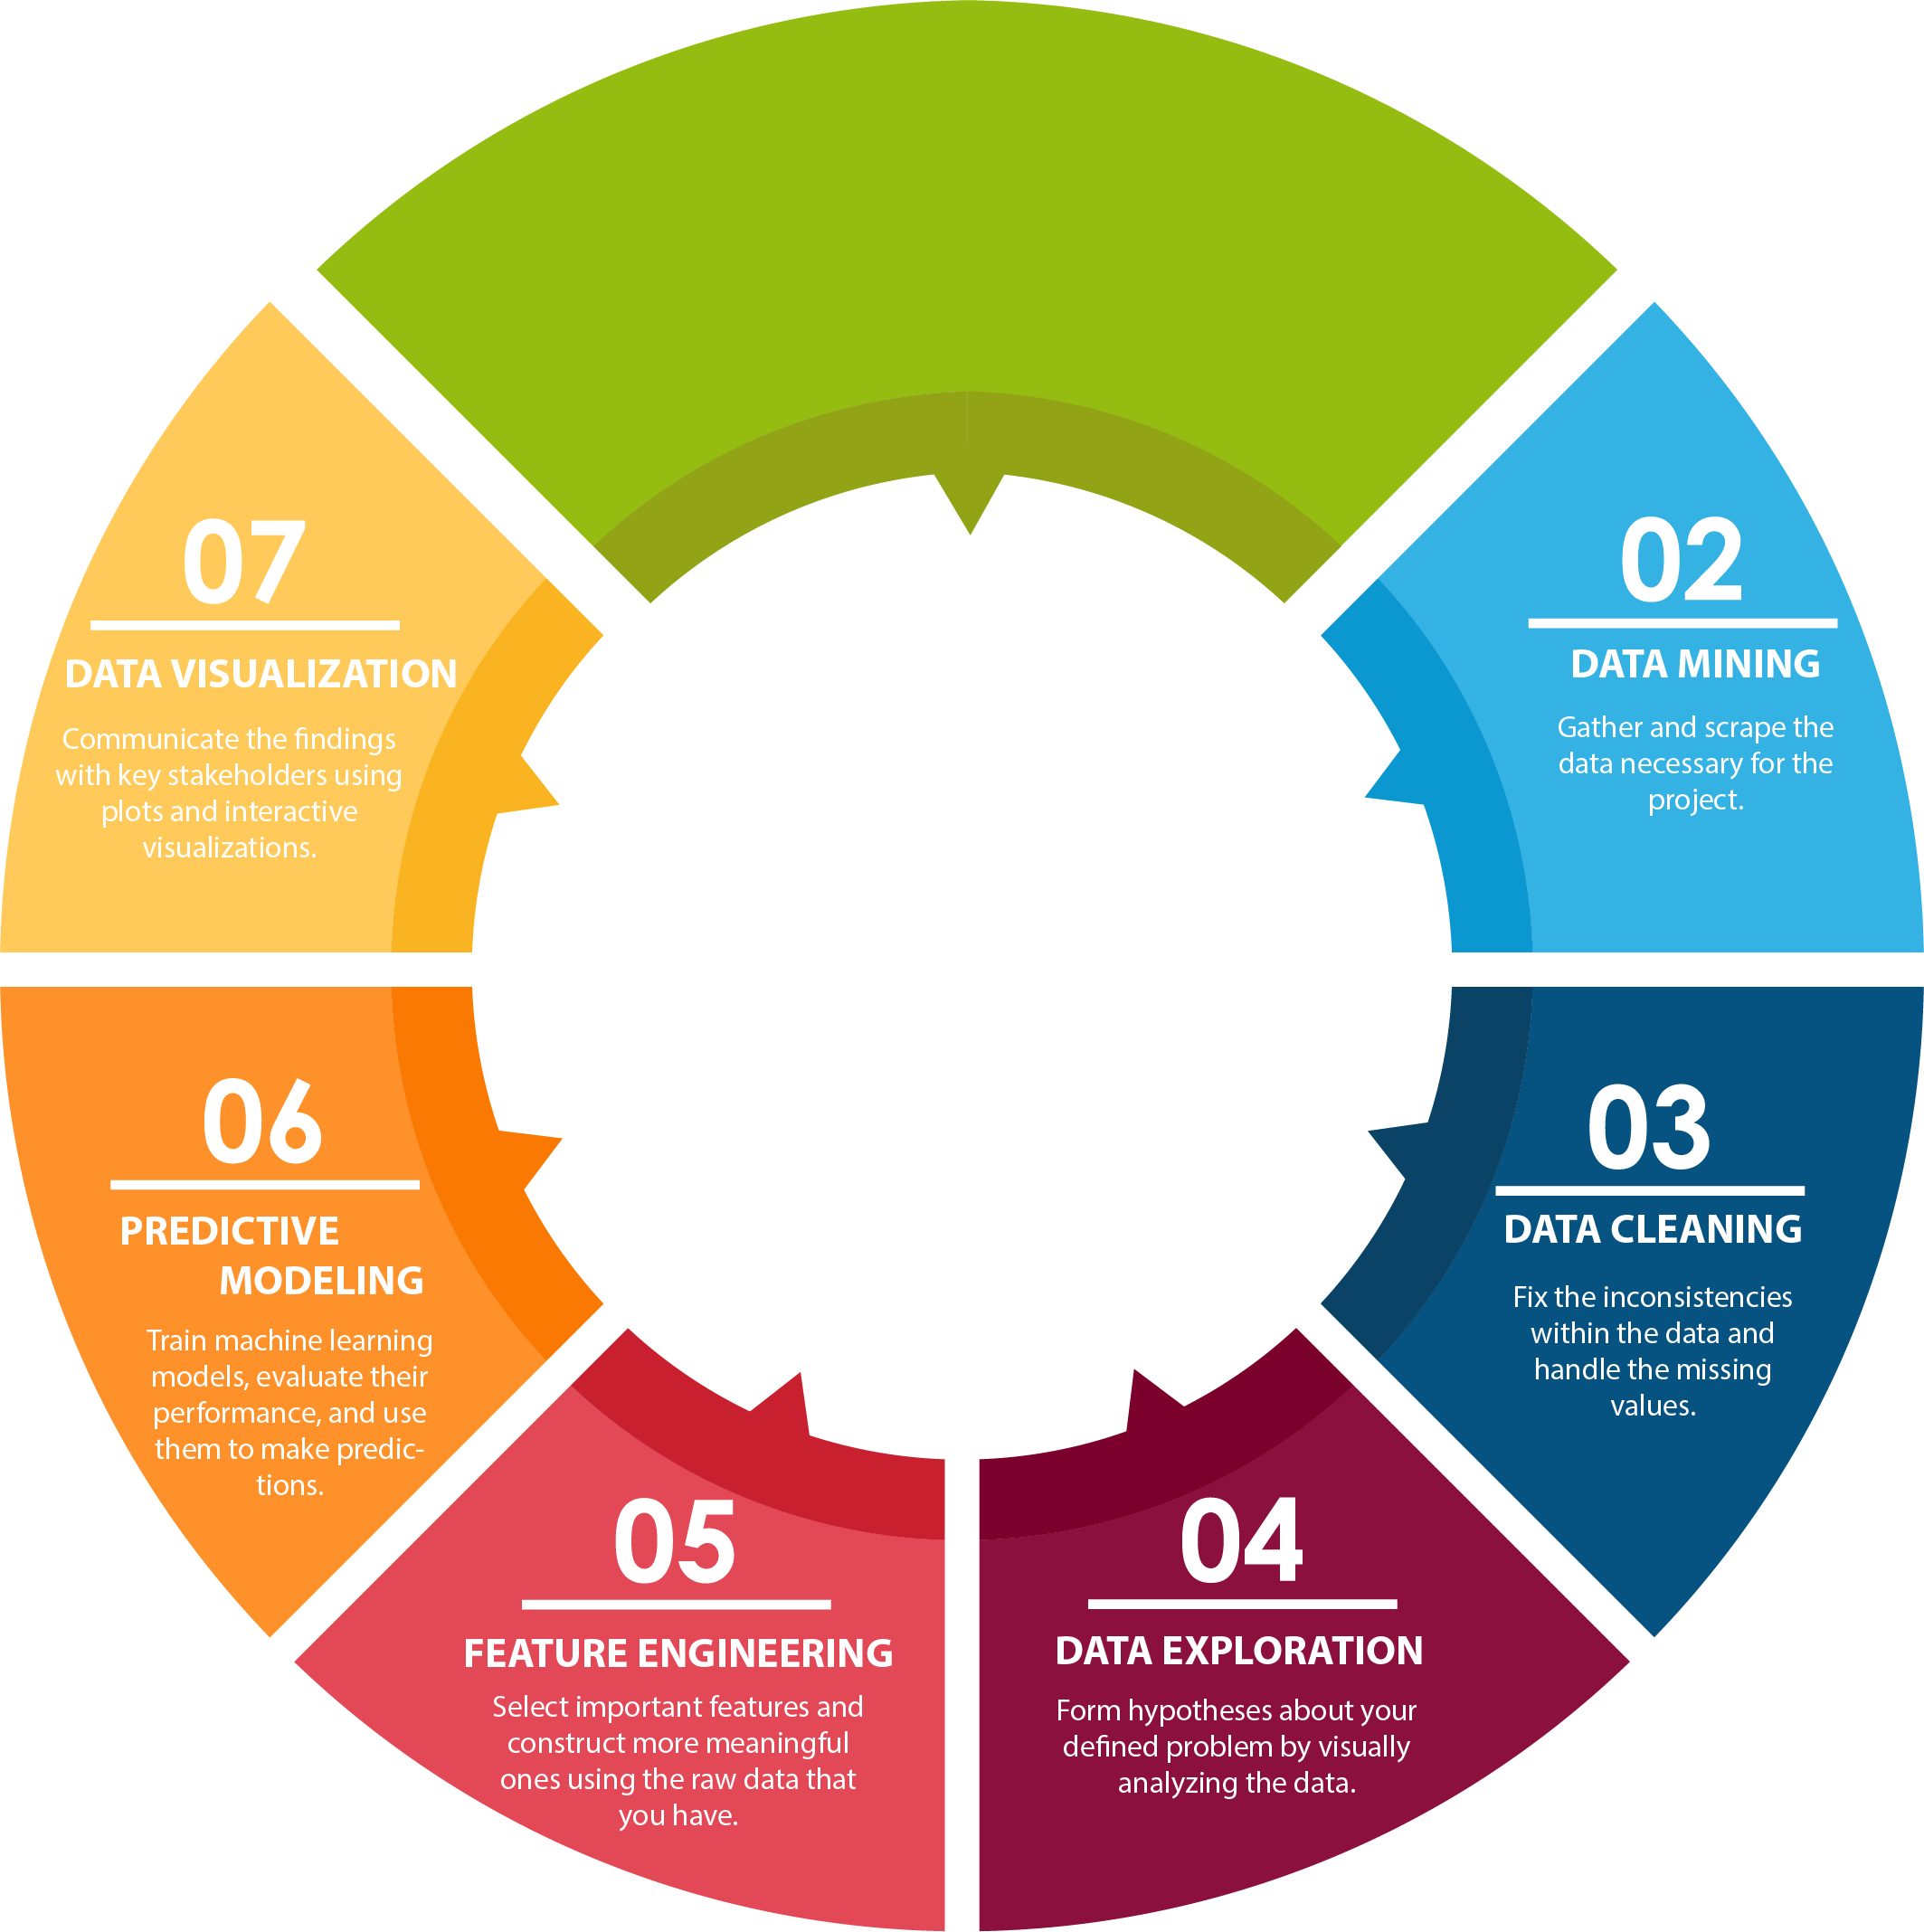
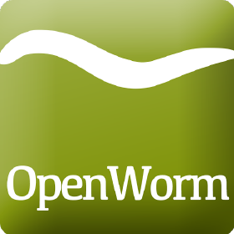
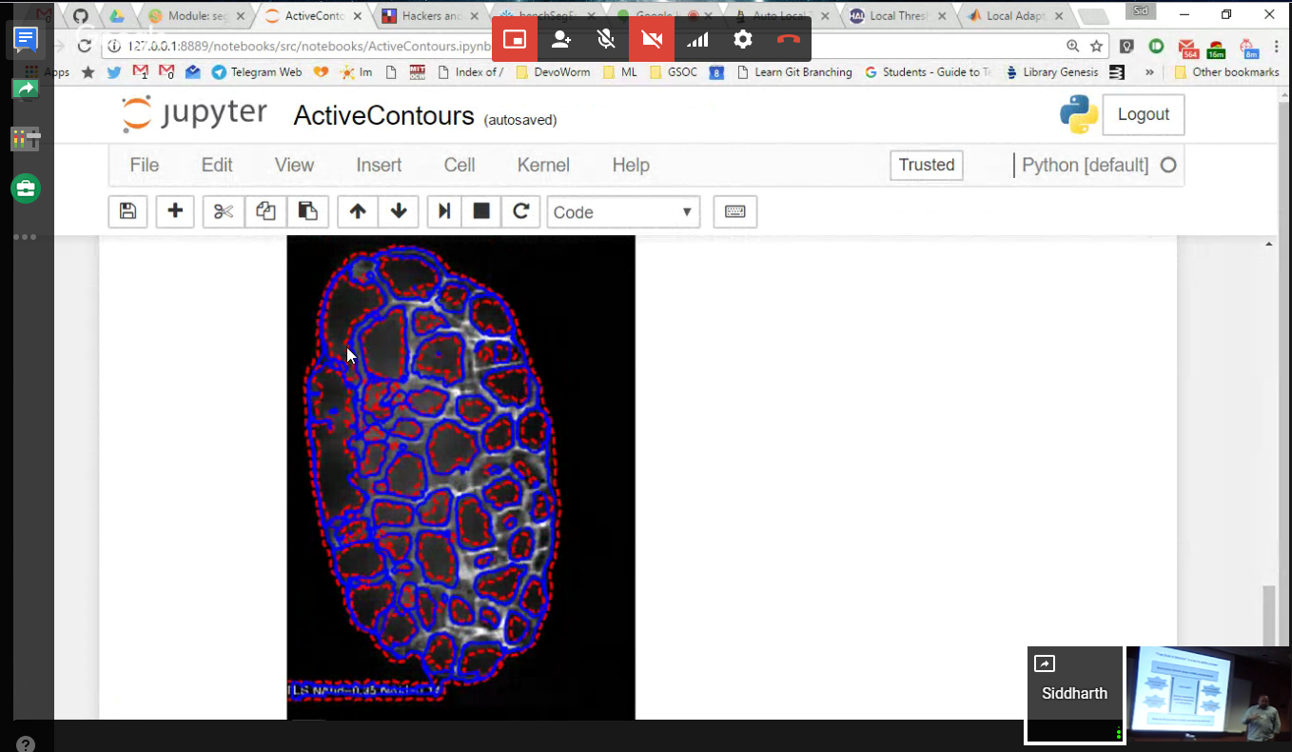
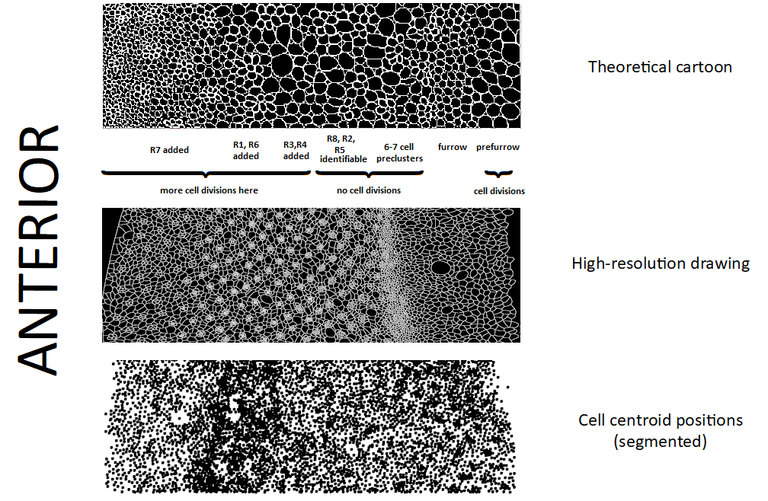
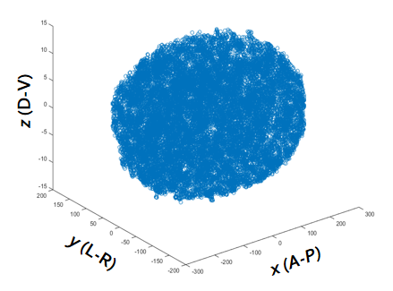
A New Kind of Developmental Biology
Bradly Alicea
OpenWorm Foundation, DevoWorm group,
Orthogonal Research and Education Lab
Quantitative, high-throughput data generated by new measurement technologies.
Public access to these multiple data types (behavioral, cellular, genomic).
Biological Data
Science
Theoretical
Advances
Participatory
Education
Distributed Developmental Science
Github: http://www.github.com/devoworm
Devozoo (open data): http://devoworm.github.io
Web: http://devoworm.weebly.com
Embryogenetic Networks and Developmental Connectomics
Participatory Education and Contribution Structure
As presented at Find Your Inner Modeler II
Data Reuse, Extraction, and Discovery
Digital Morphogenesis
Comparative Development
(Drosophila melanogaster)
Openly-available Primary, Secondary, and Tertiary Datasets
devoworm.github.io/devozoo.htm
Segmented microscopy data, public repositories, literature mining.
Systems Science of Biological Dynamics (SSBD) database: http://ssbd.qbic.riken.jp/

