Slide 1
Understanding Global Impact Trends with Innovative Data and Metrics Michael Taylor Head of Metrics Development Digital Science

Slide 2
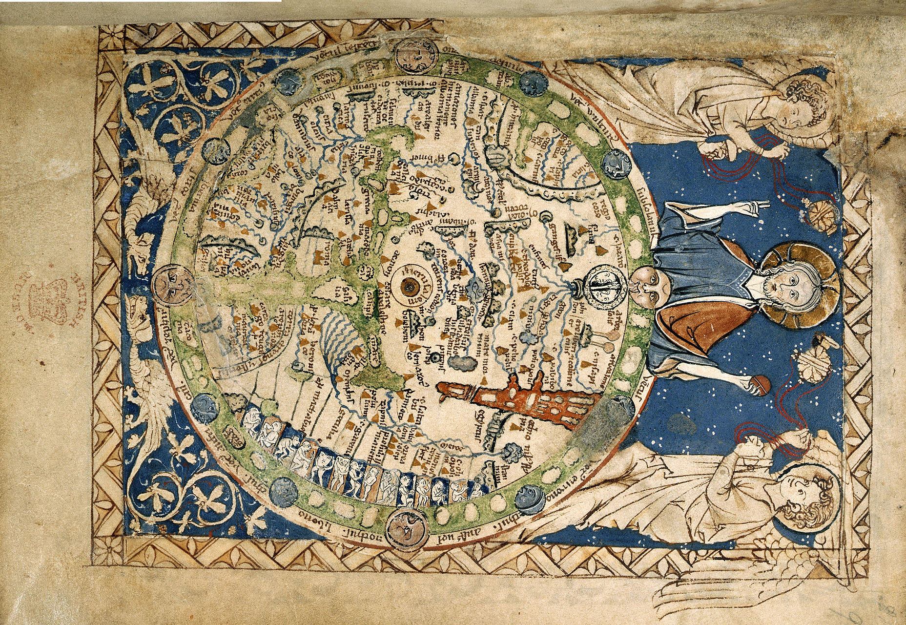
Introduction – “The Map and the Territory”
Italy
Mesopotamia
Maps are not exact models of the territory
They are limited by knowledge, technology, cultural and international perspective
https://en.wikipedia.org/wiki/Psalter_world_map
Nile delta

Slide 3
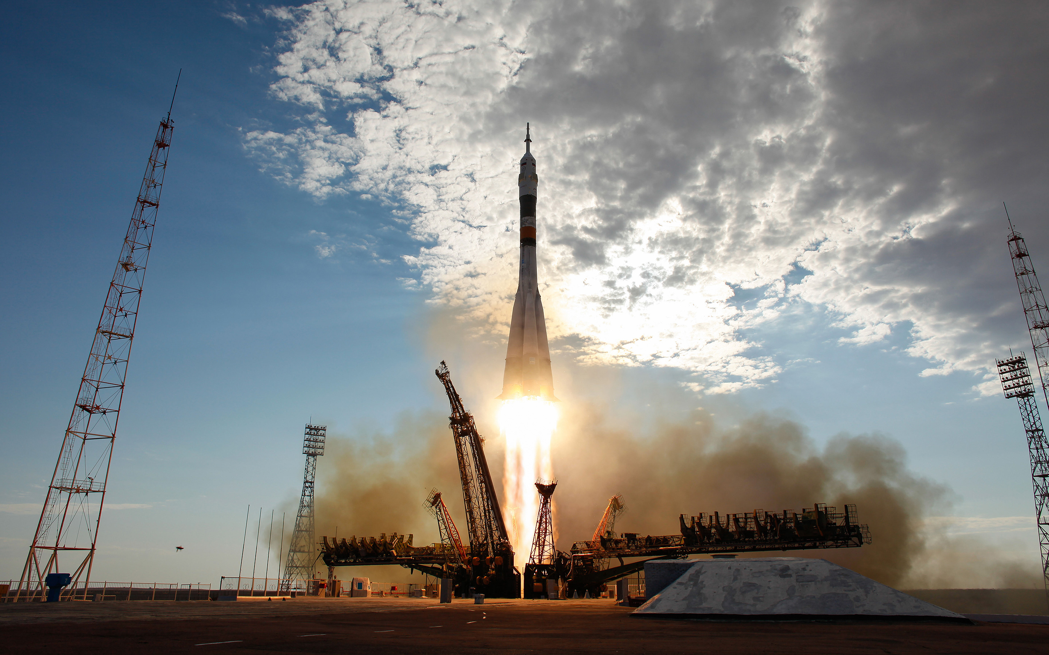
Metrics are not telemetry
Research isn’t ‘launched’ with precise target – we have questions and objectives
Researchers are aware of how they are being measured, and will react to measurement systems
Researchers have human ambitions and desires
Researchers are rooted in time, location and culture

Slide 4
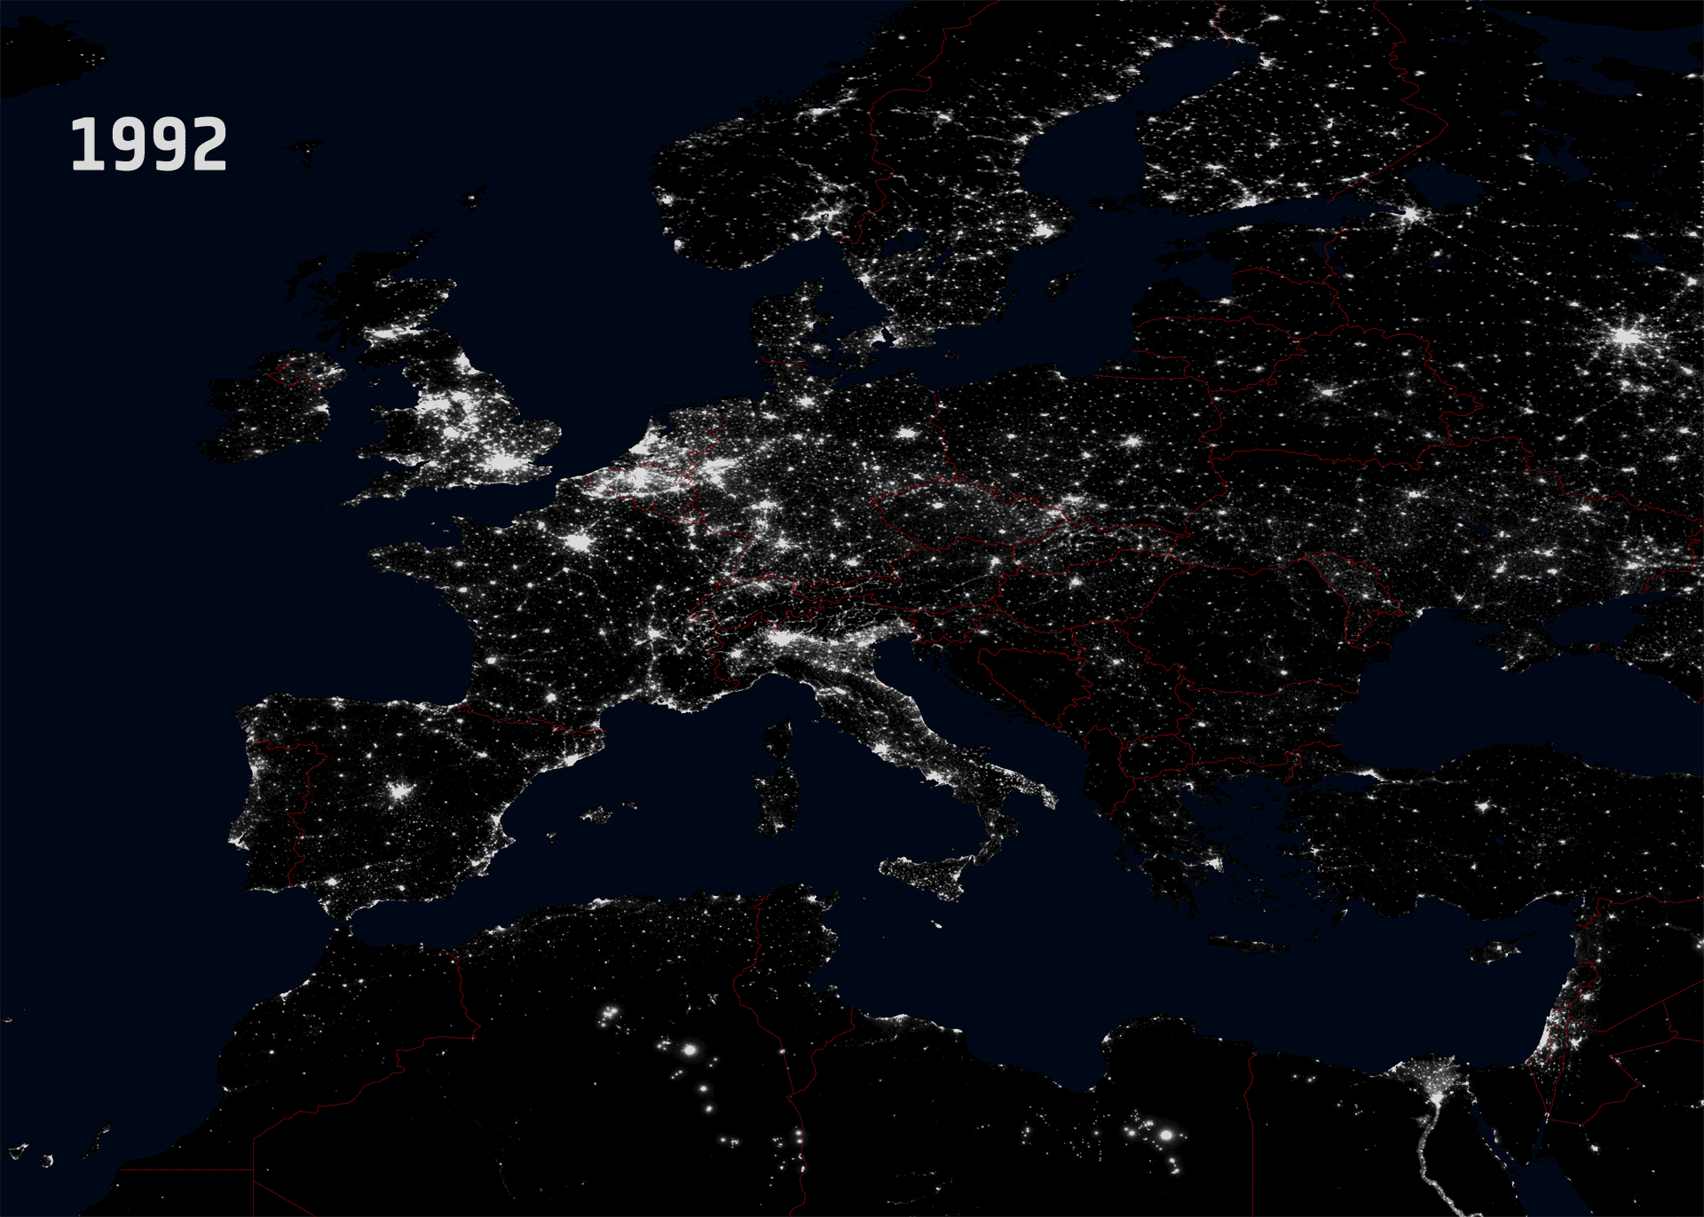
The ‘map’ is necessarily partial
Our infrastructure is only partially shared
ORCID and DOIs are open and international: but some parts of the world and research lag behind (and place different cultural focus on the importance of personal attribution)
Languages and countries are not universally indexed
Qualitative information supports quantitative analysis

Slide 5
Concluding thoughts from the introduction
Absence of evidence is not evidence of absence
Metrics (when used internationally, and between disciplines) have to be accompanied by dialogue, and dialectic.
Metrics can be qualitative, as well as quantitative.
Metrics need to be sympathetic to international and cultural differences.

Slide 6
Themes in metrics creation
The common practice is to use metrics of comfort, reputation and antiquity
Metrics such as H-Index and Journal Impact Factor can be read easily, and many people believe they are comfortable with their use
These metrics have dominated, despite criticism and methodological weakness
The ‘metrics’ that drive Google and Amazon search results are complex, closed – and highly used, whether understood or not
The challenge for metrics creation is to find a middle route – metrics that are as usable as G, and the challenge for providers is to provide the context and utility

Slide 7
Context and utility
Research is not a linear pipeline, but is part of society:
Funded by society
Answering societal needs
Questions of broader context require broader sources of data:
Patents
Clinical case studies
Policy papers
Open data / publications
Mainstream media
Blogs

Slide 8
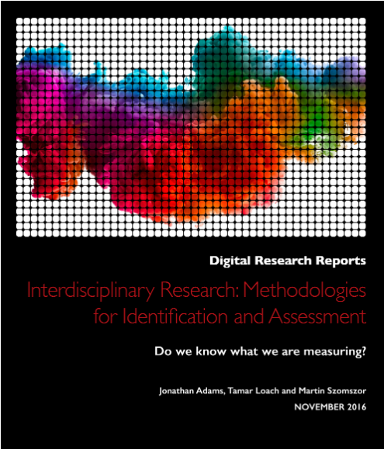
Questions of interdisciplinarity and internationality: making existing data work harder
My big project for 2018 focus on metrics for internationality and interdisciplinarity
Two particular pieces of work have lead us to investigate the meaning and impact of interdisciplinary work:
Builds on the work by Professor Jonathan Adams of Digital Science Consultancy - http://bit.ly/2yI5hox
Professor Robert Frodeman - Sustainable Knowledge, a Theory of Interdisciplinarity, Palgrave http://www.palgrave.com/us/book/9781137303011

Slide 9
What is ‘interdisciplinarity’, ‘transnationality’ etc
There is considerable movement towards funding interdisciplinarity, but the evidence for whether it is effective is scarce
The evidence for the success of international collaboration is stronger
Research partnership with NIH, also seeking partnerships with non-biomedical organization, and to duplicate the work with international organizations
Focus is on identify the different stages at which disciplines and nations are mixed and combined (after Frodeman):
The mix of the author team - "multidisciplinarity" / “multinationality”?
The mix of the reference list - "interdisciplinarity“ / “internationality”?
The mix of the citing articles - "transdisciplinarity“ / “transnationality”?
Our research is made possible by the machine learning classification systems used by Dimensions, and GRID, our open institutional taxonomy

Slide 10
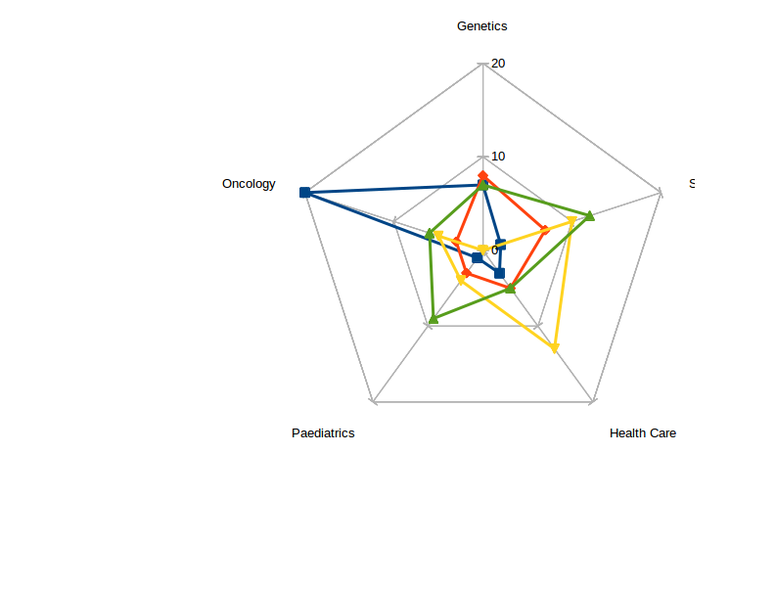
How will we use metrics, what stories and analytics do they support?
We expect to research the richness and depth of the disciplinarity, and benchmark these against the field of the article, the funding of the research, the publishing journal
Paper publishing next year, with metrics eventually appearing on Dimensions
These measures have the promise of indicating not only if there's a difference in impact, but also which are the important features
From the start, we are looking not only with an academic perspective, but how can this be incorporated into our platforms - how can we demonstrate utility for our users?

Slide 11
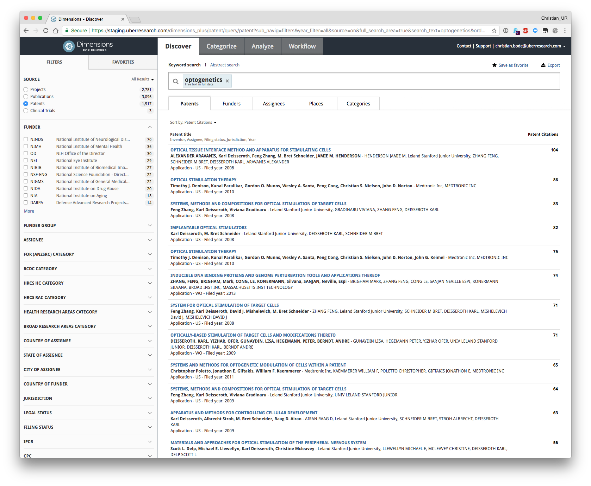
Broader impact with patent analysis in Dimensions:
Evidence of industrial impact can be found in patent analysis.
The creation of patents, the citation of patents, the citation of research by patents
The degree of collaboration between industry and academia
Digital Science is expanding its Dimensions platform to include patents next year
The launch will cover US, EP, WIPO, DE, CA, IN, AU, GB, FR, Hong Kong patent offices, and 35 million patents
Russia and others will be added in 2018

Slide 12
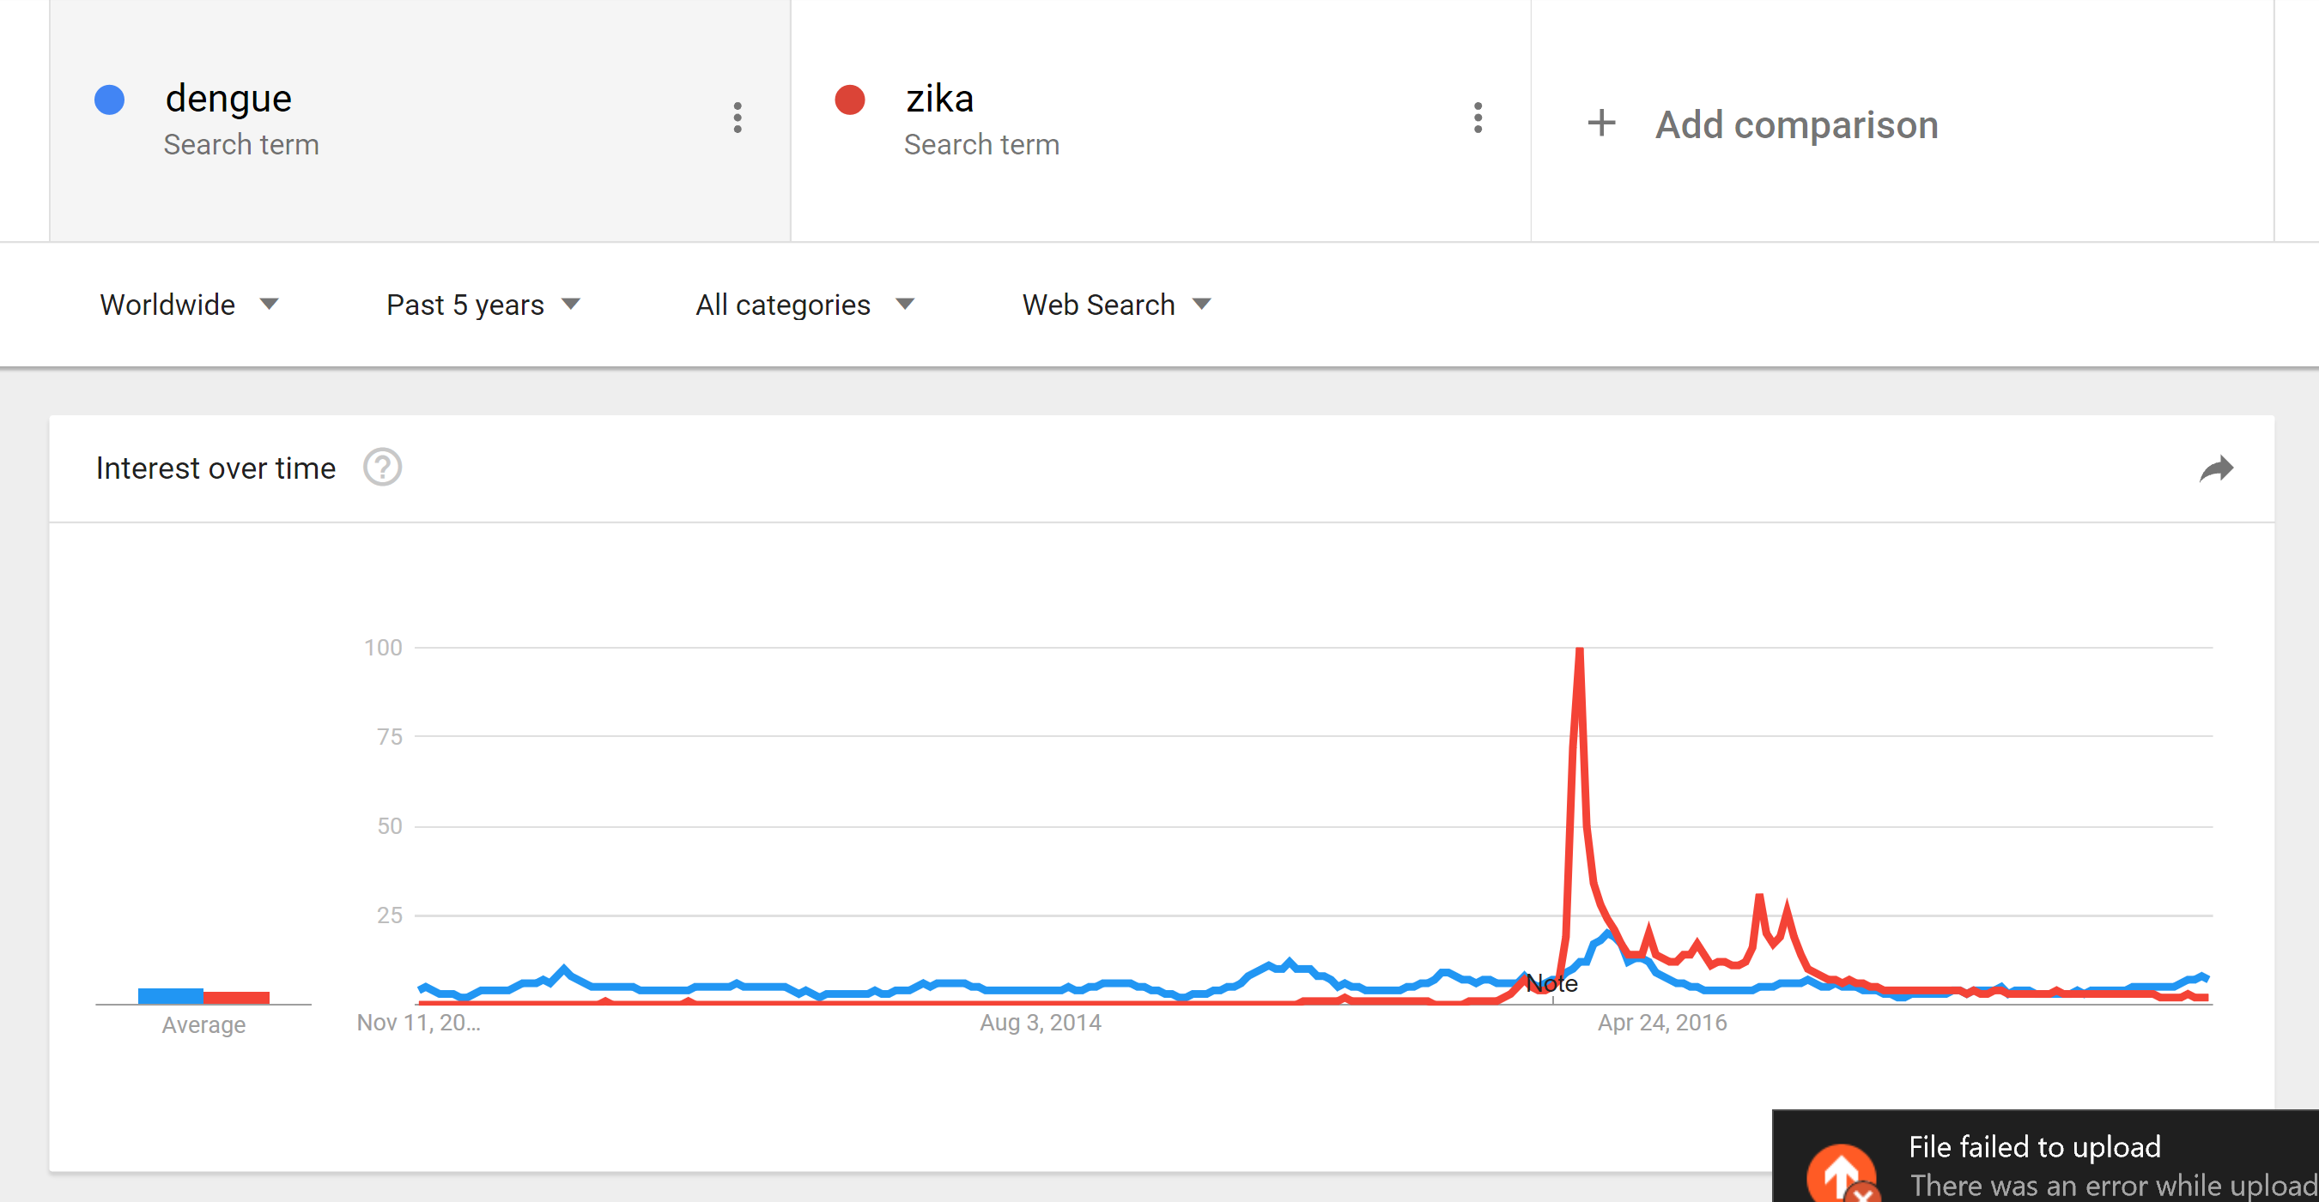
Understanding the funding context and broader impact with Dimensions and Altmetric
Using throughout data comparing the research into dengue and zika, and the impact from publications with Brazilian-affiliated researchers

Slide 13
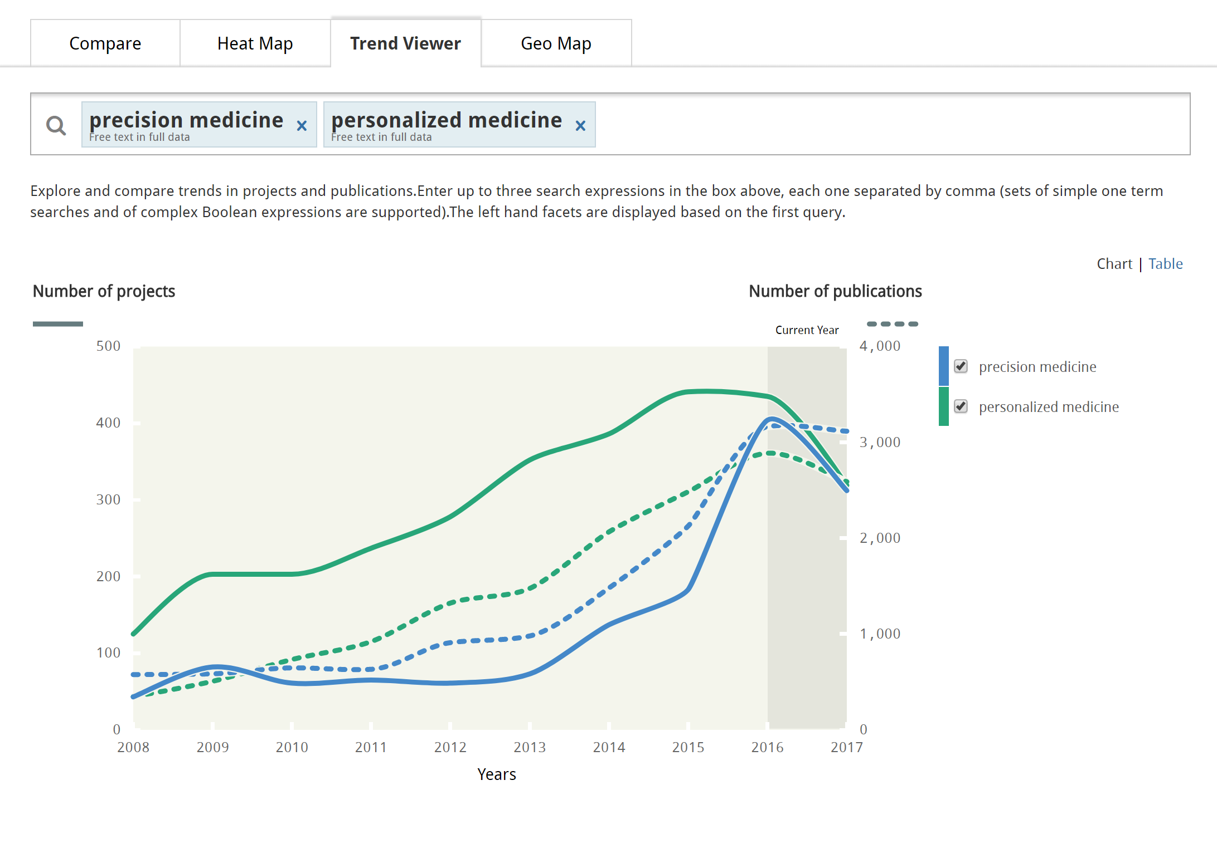

Slide 14
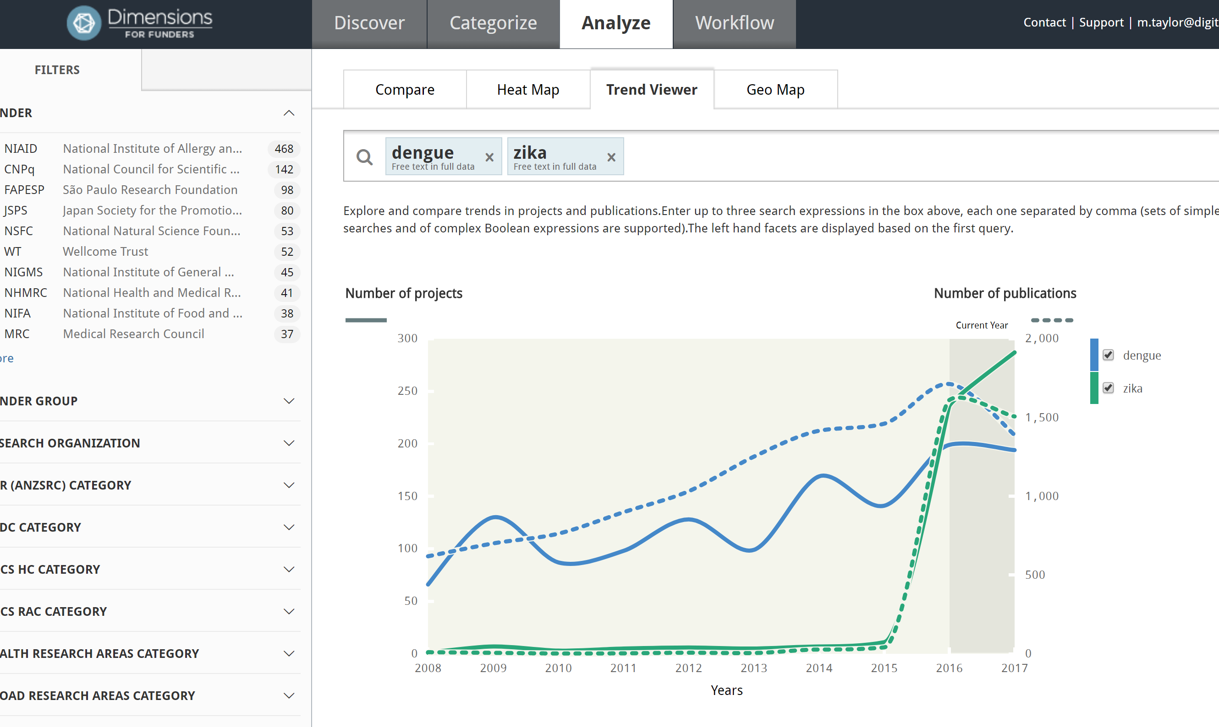
Dengue and zika: funding and publications

Slide 15
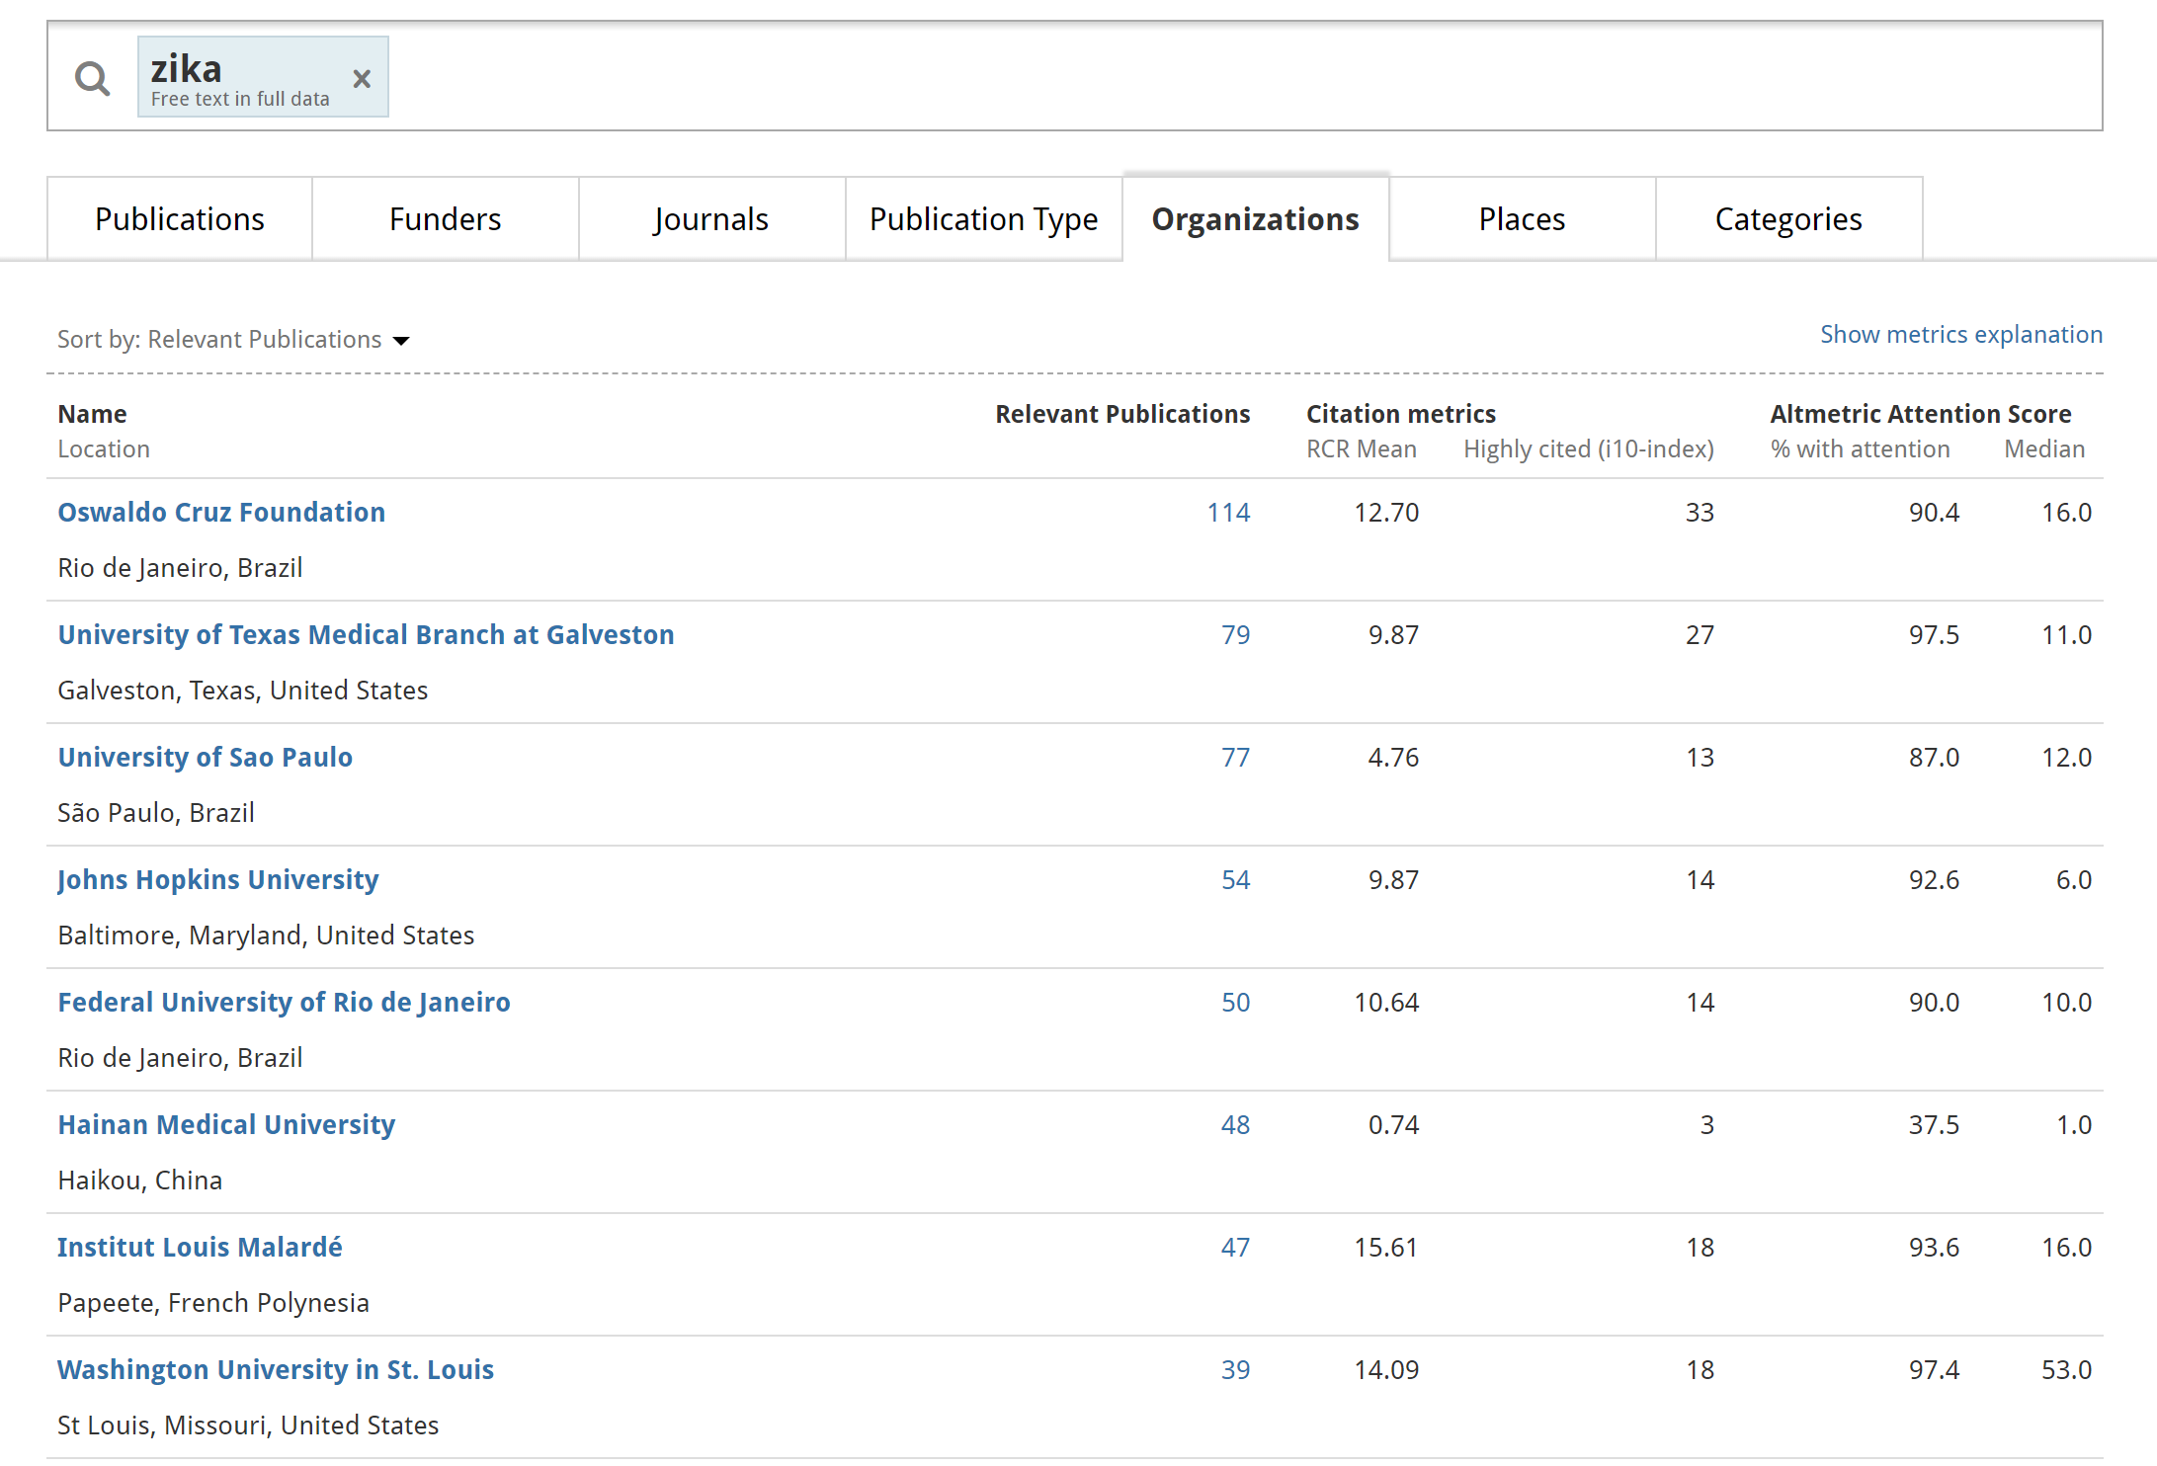
Top zika institutions

Slide 16
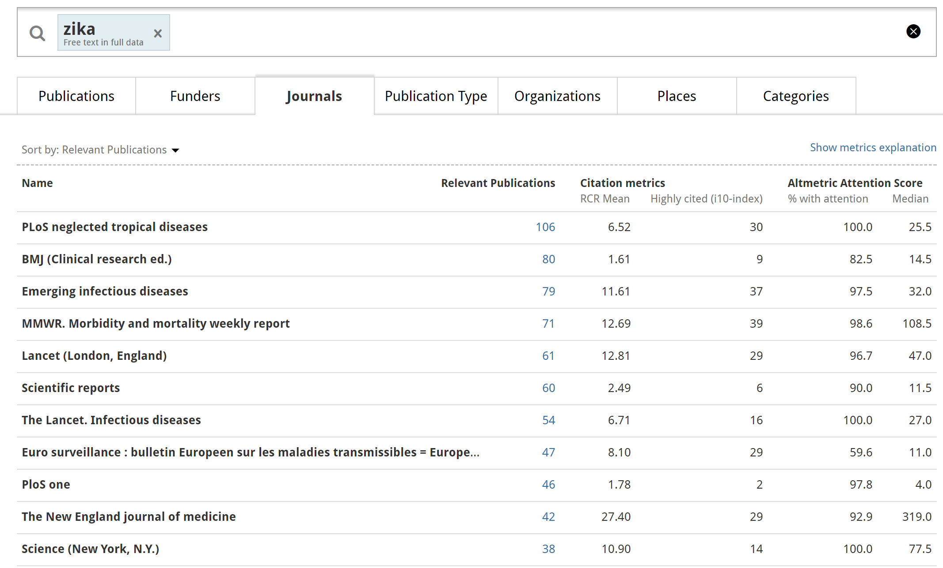
Top zika journals

Slide 17
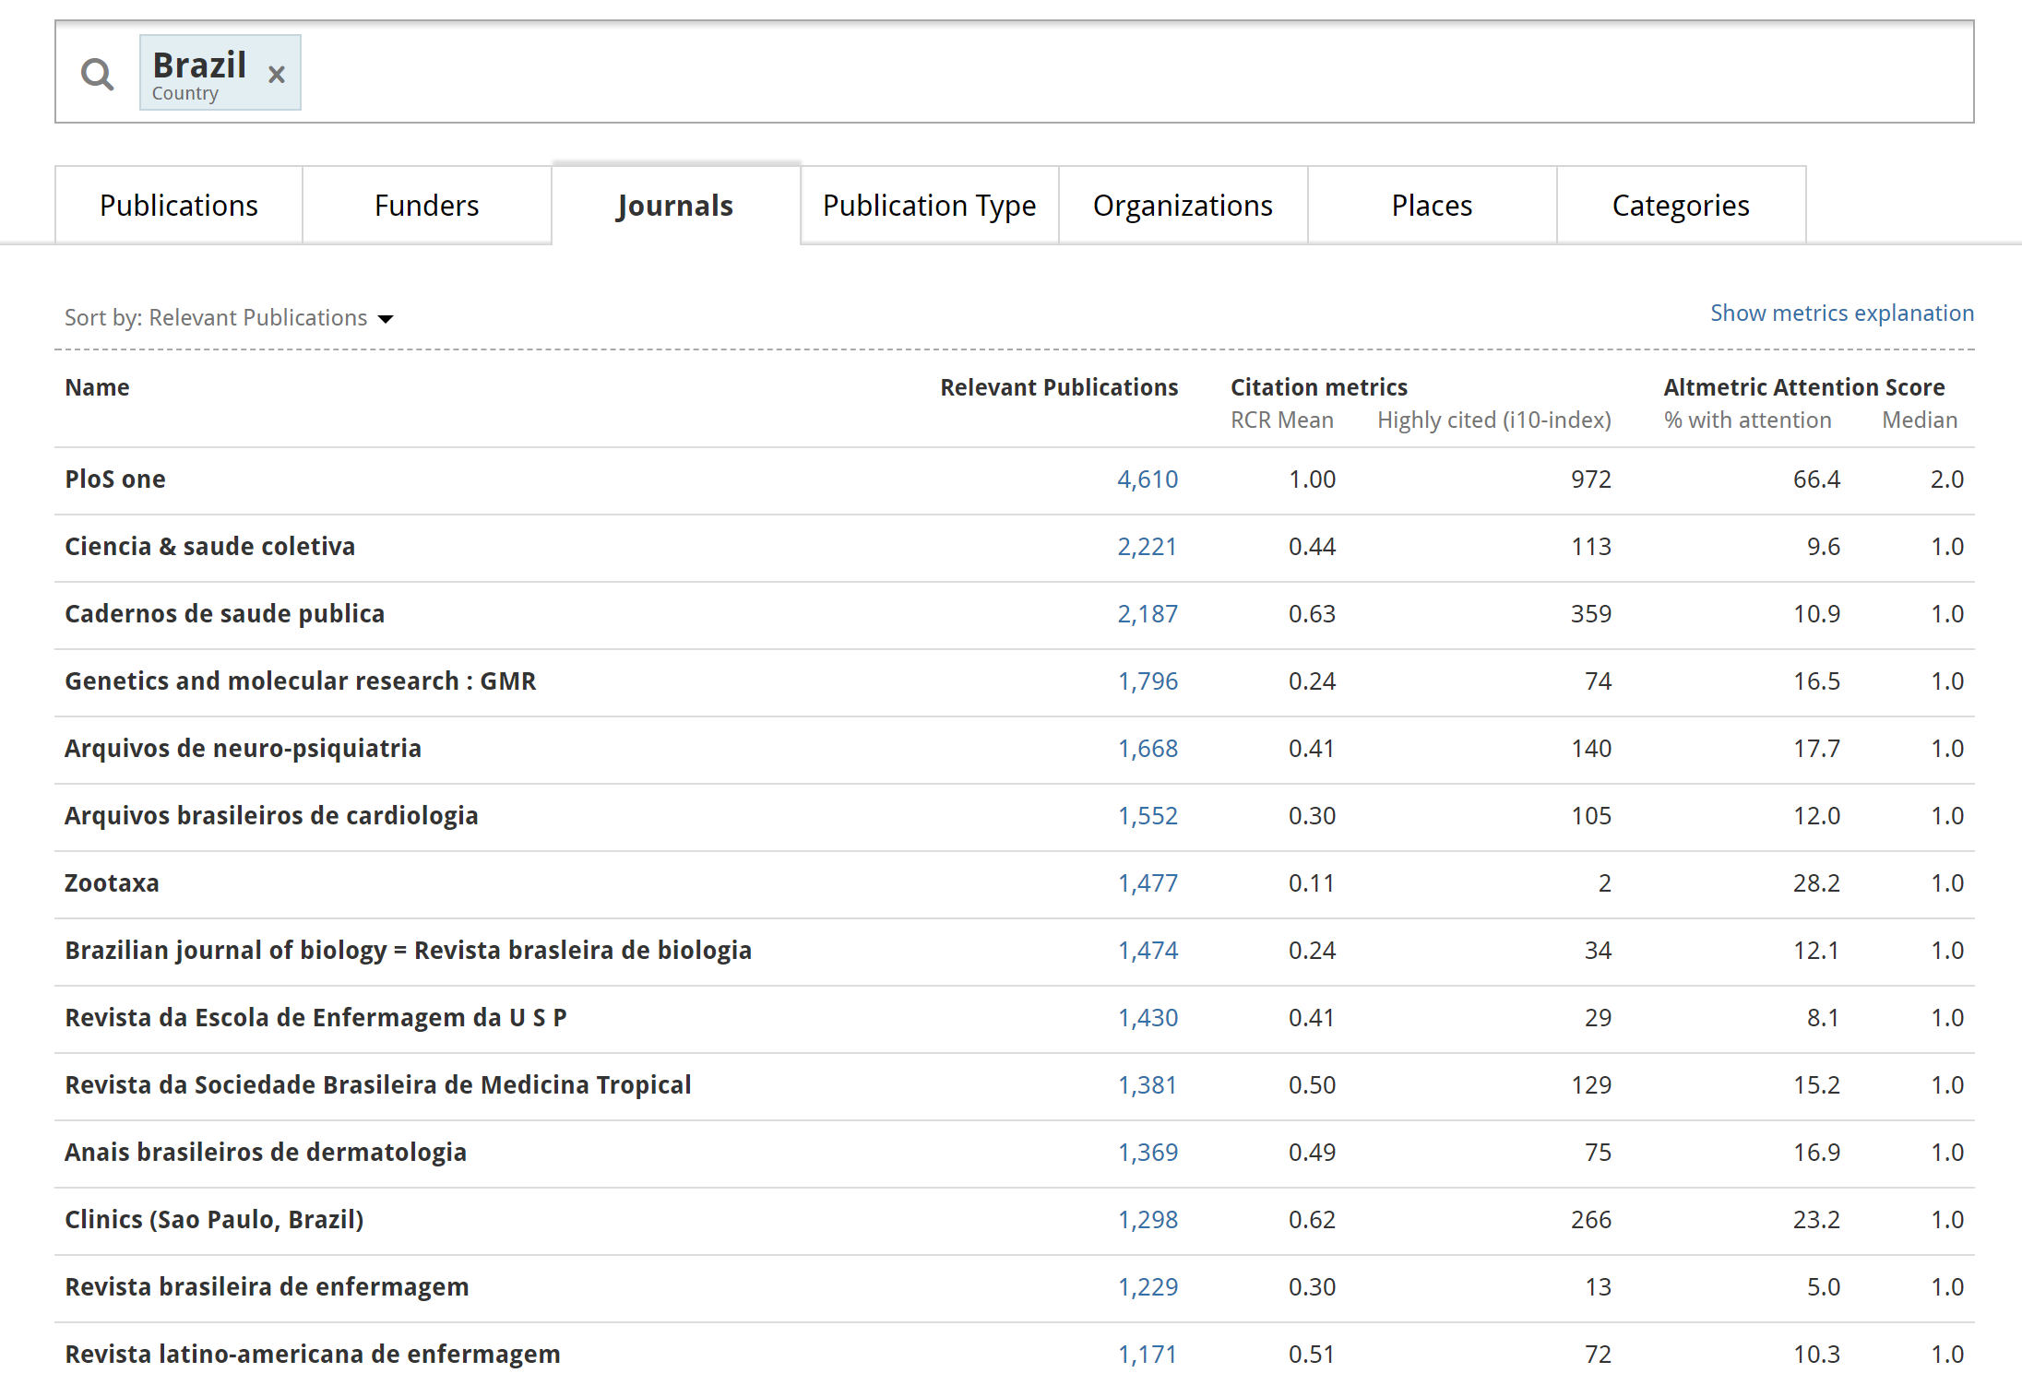
Top Brazilian journals

Slide 18
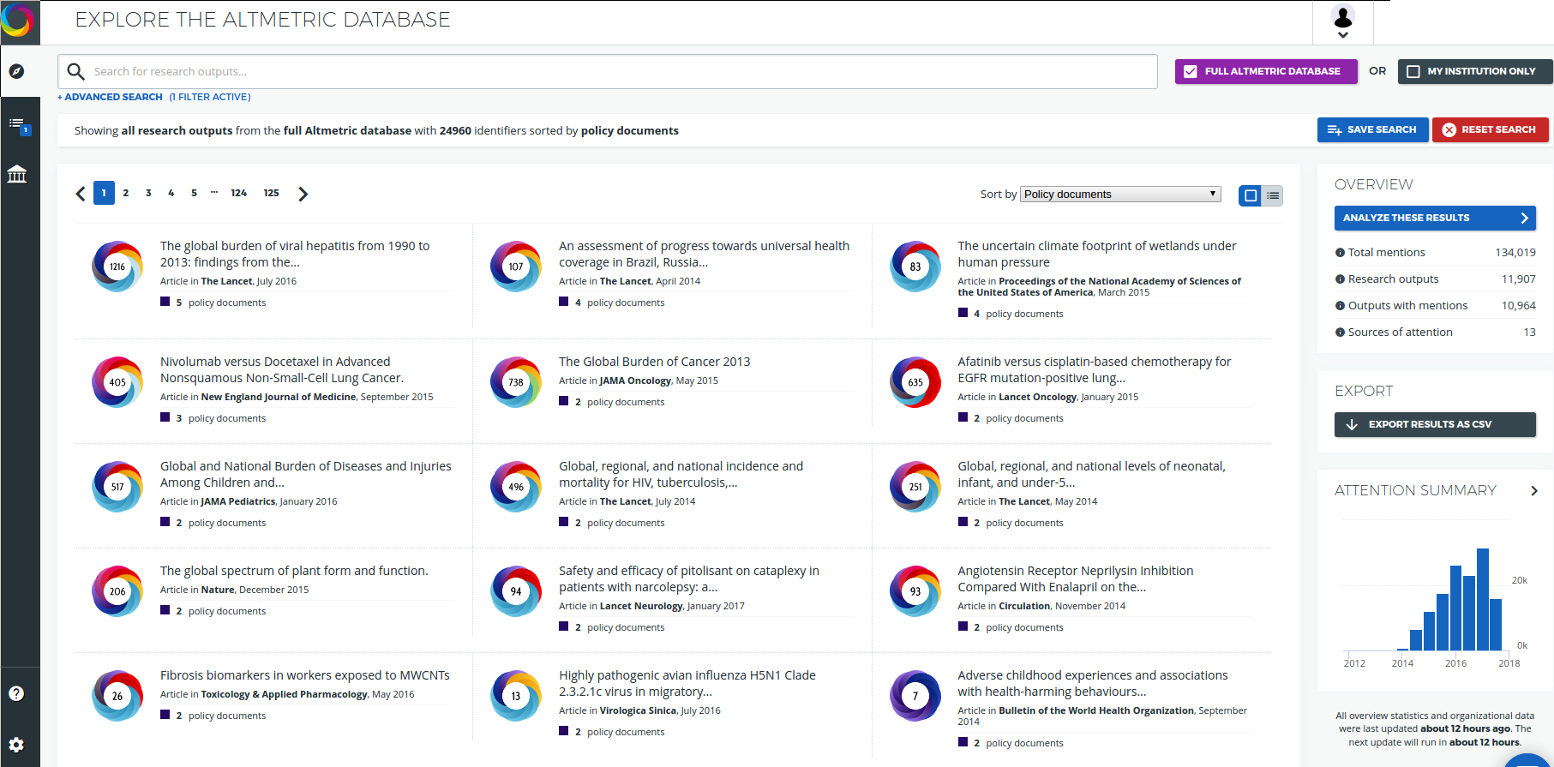
Broader impact with Altmetric Explorer
Altmetrics (aka ‘alternative metrics’) have been part of the research community for twenty years (‘webometrics’) – although the term is new
Altmetric discovers highly impactful documents that link or cite scholarly research
Eg, policy papers, mainstream media, blogs, Wikipedia, social media

Slide 19
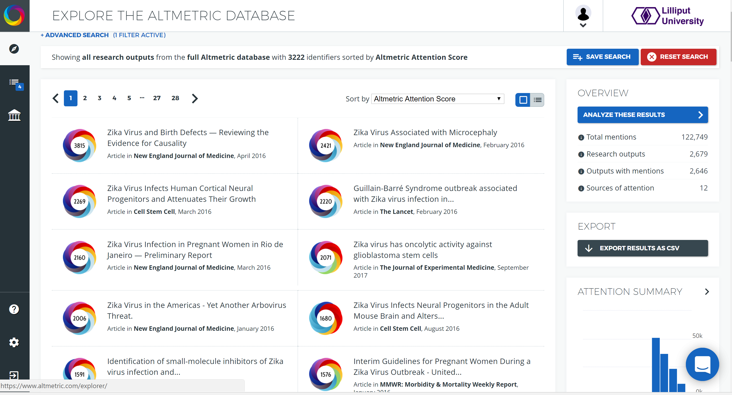
Broader impact with Altmetric Explorer

Slide 20
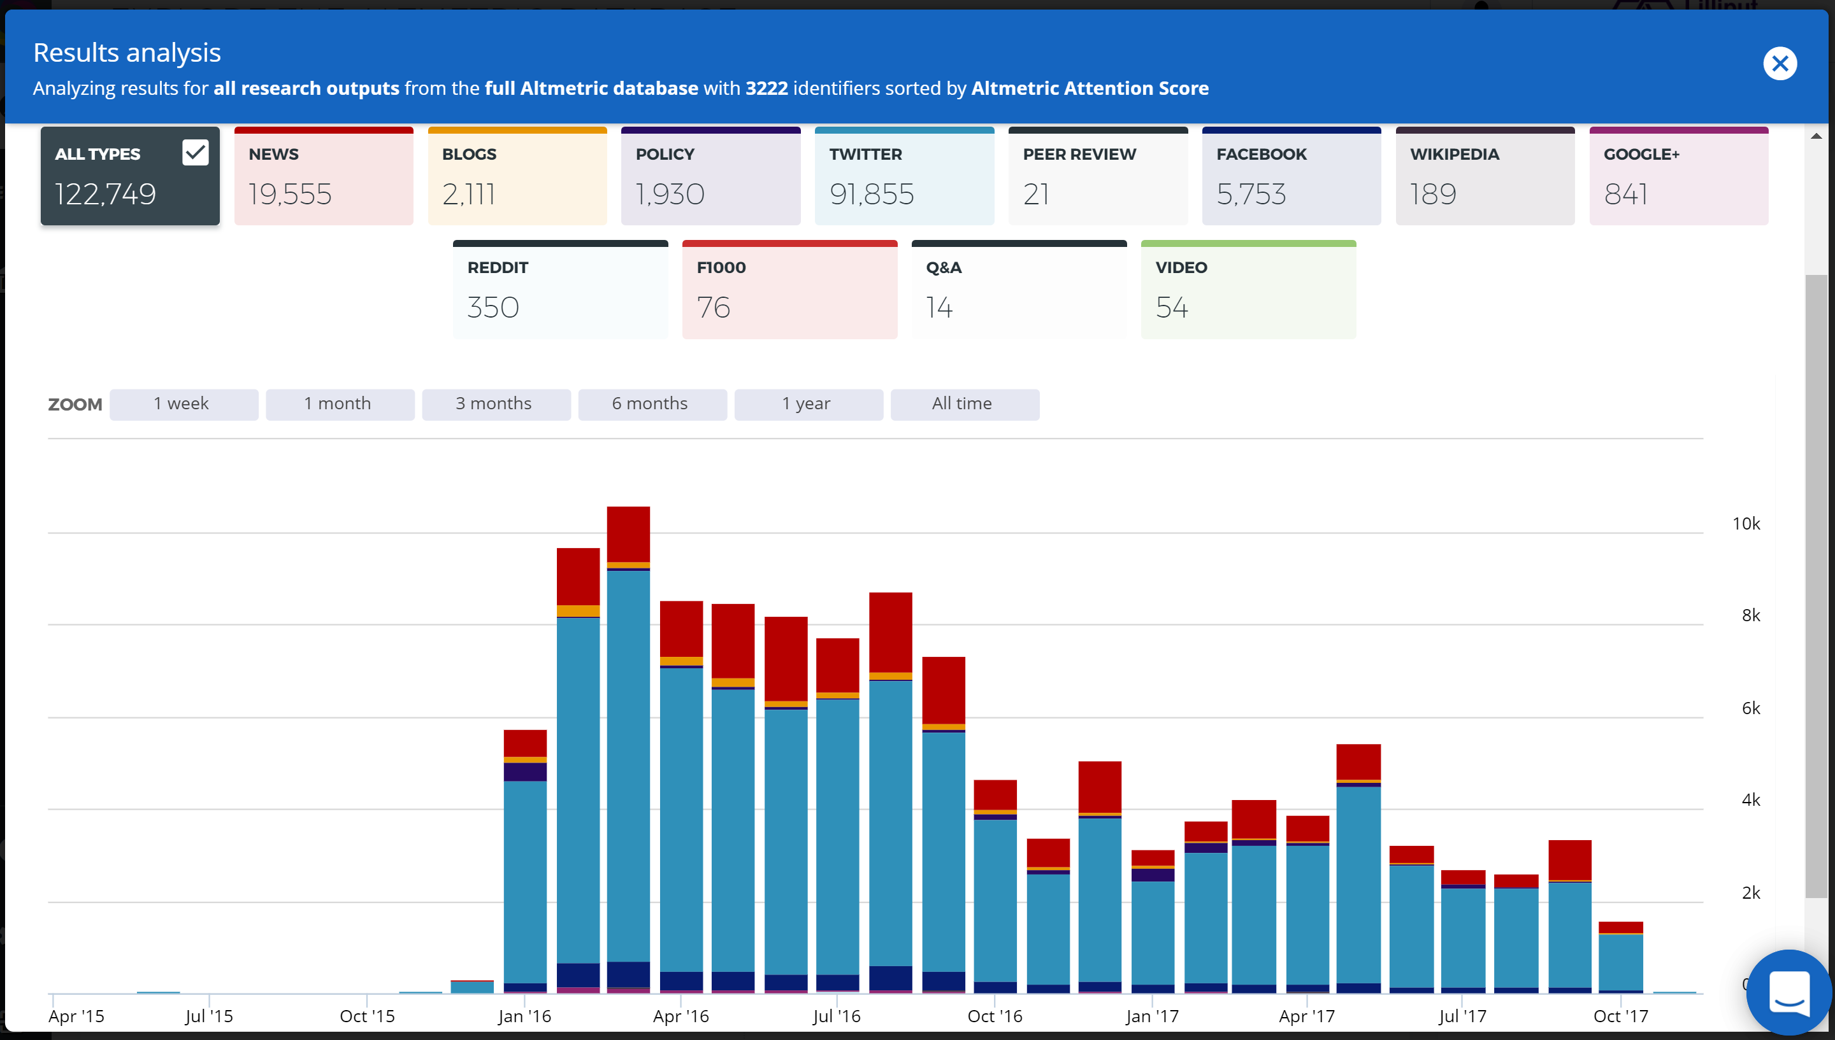
Broader impact with Altmetric Explorer

Slide 21
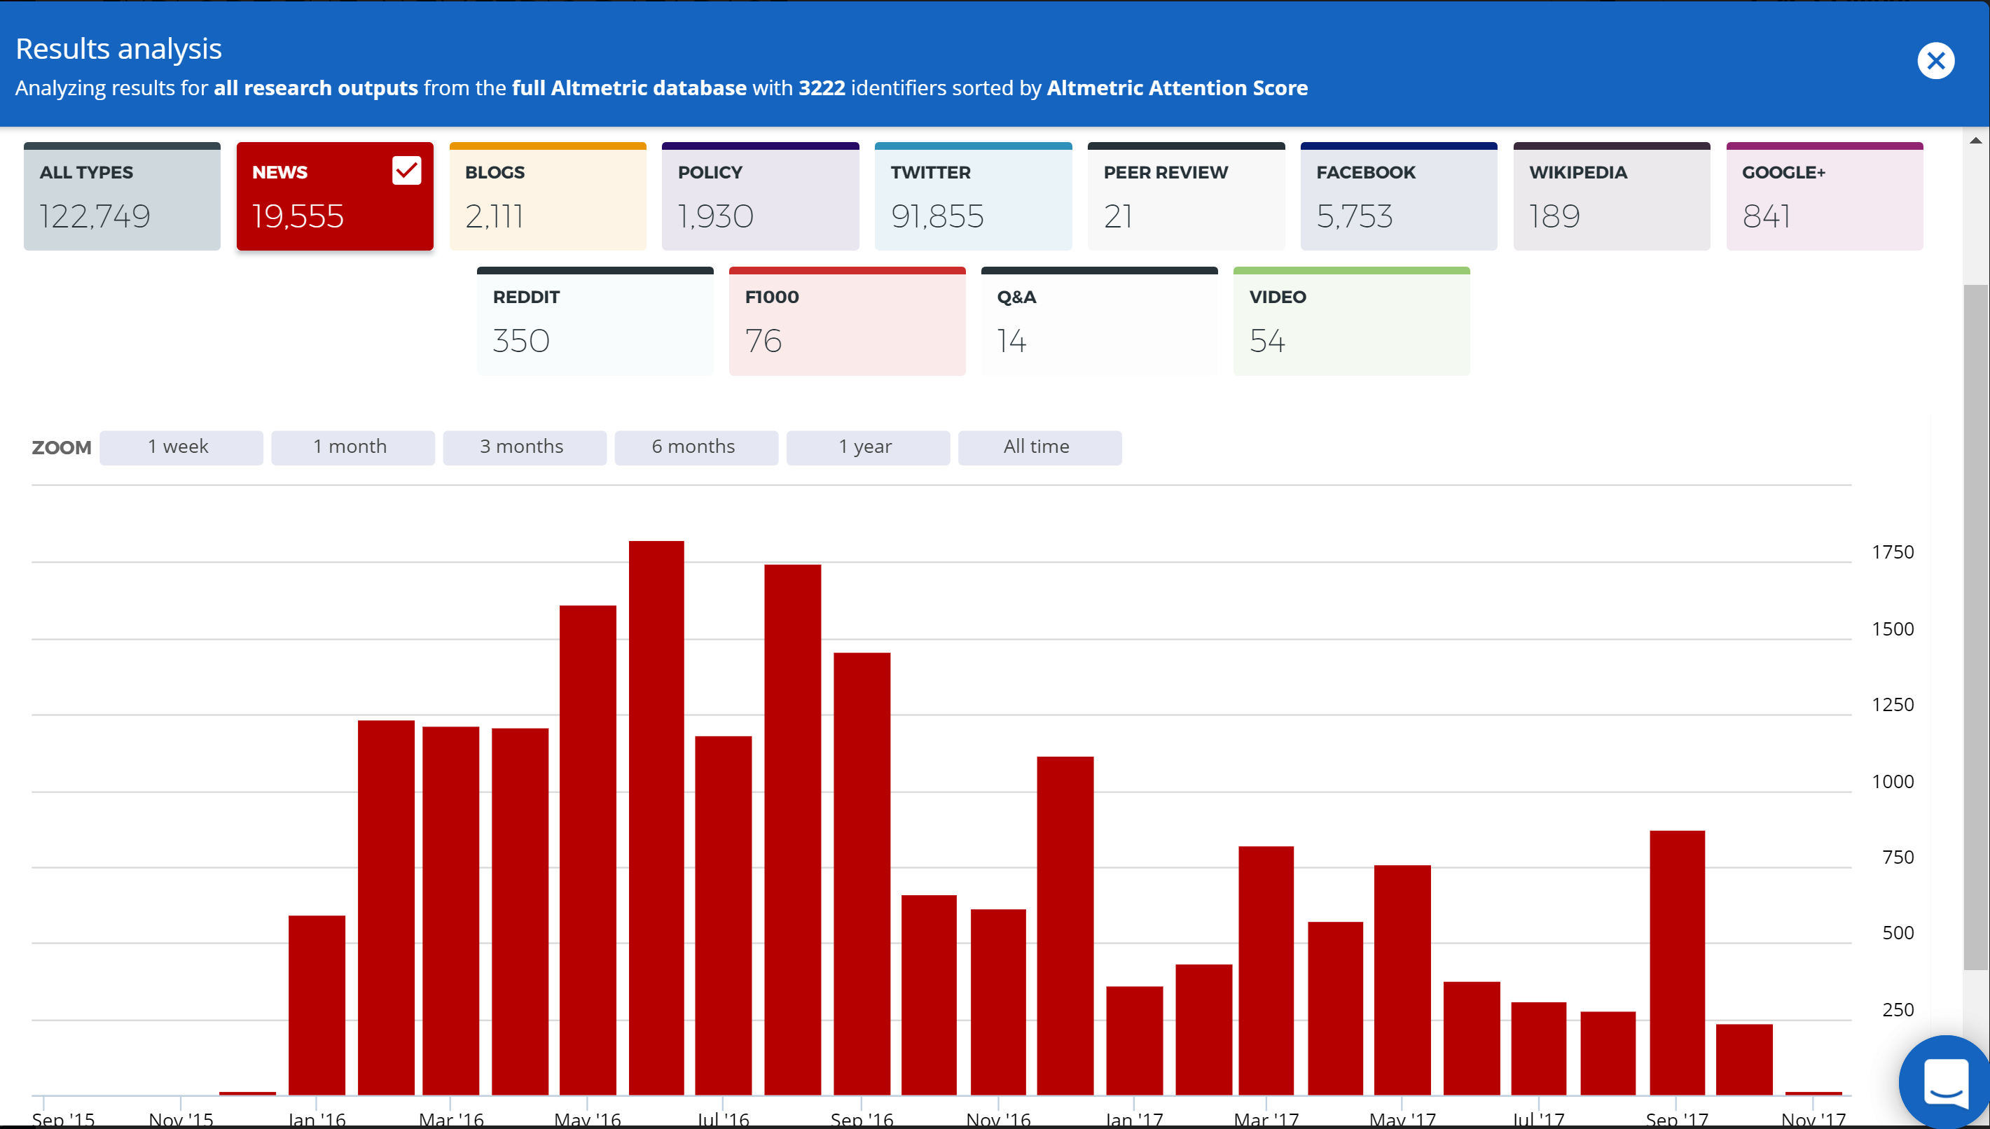
Broader impact with Altmetric Explorer

Slide 22
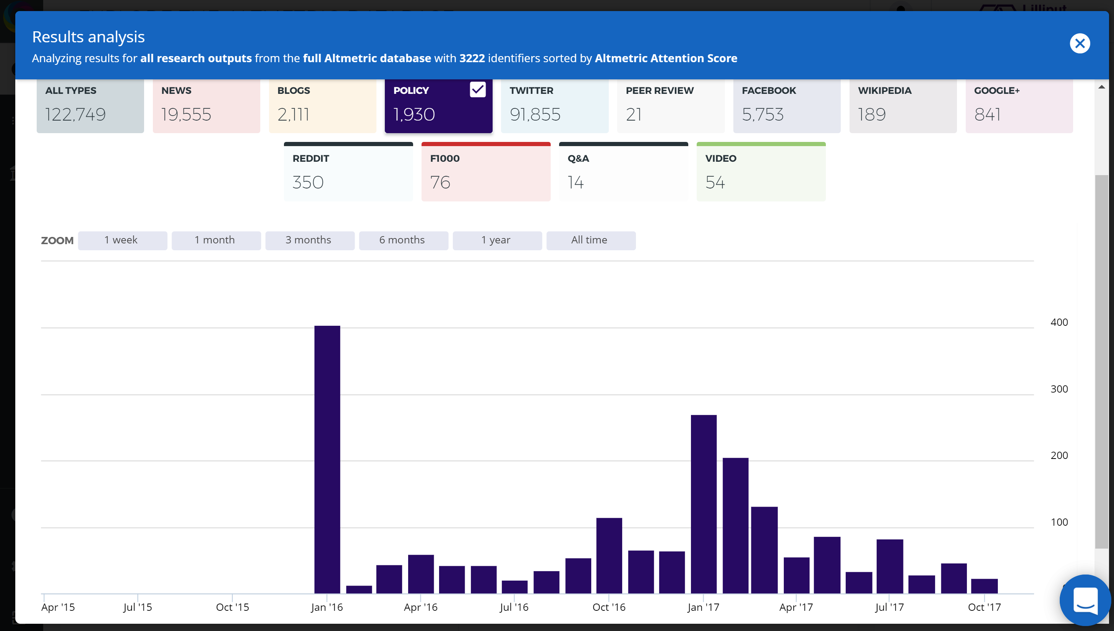
Broader impact with Altmetric Explorer

Slide 23
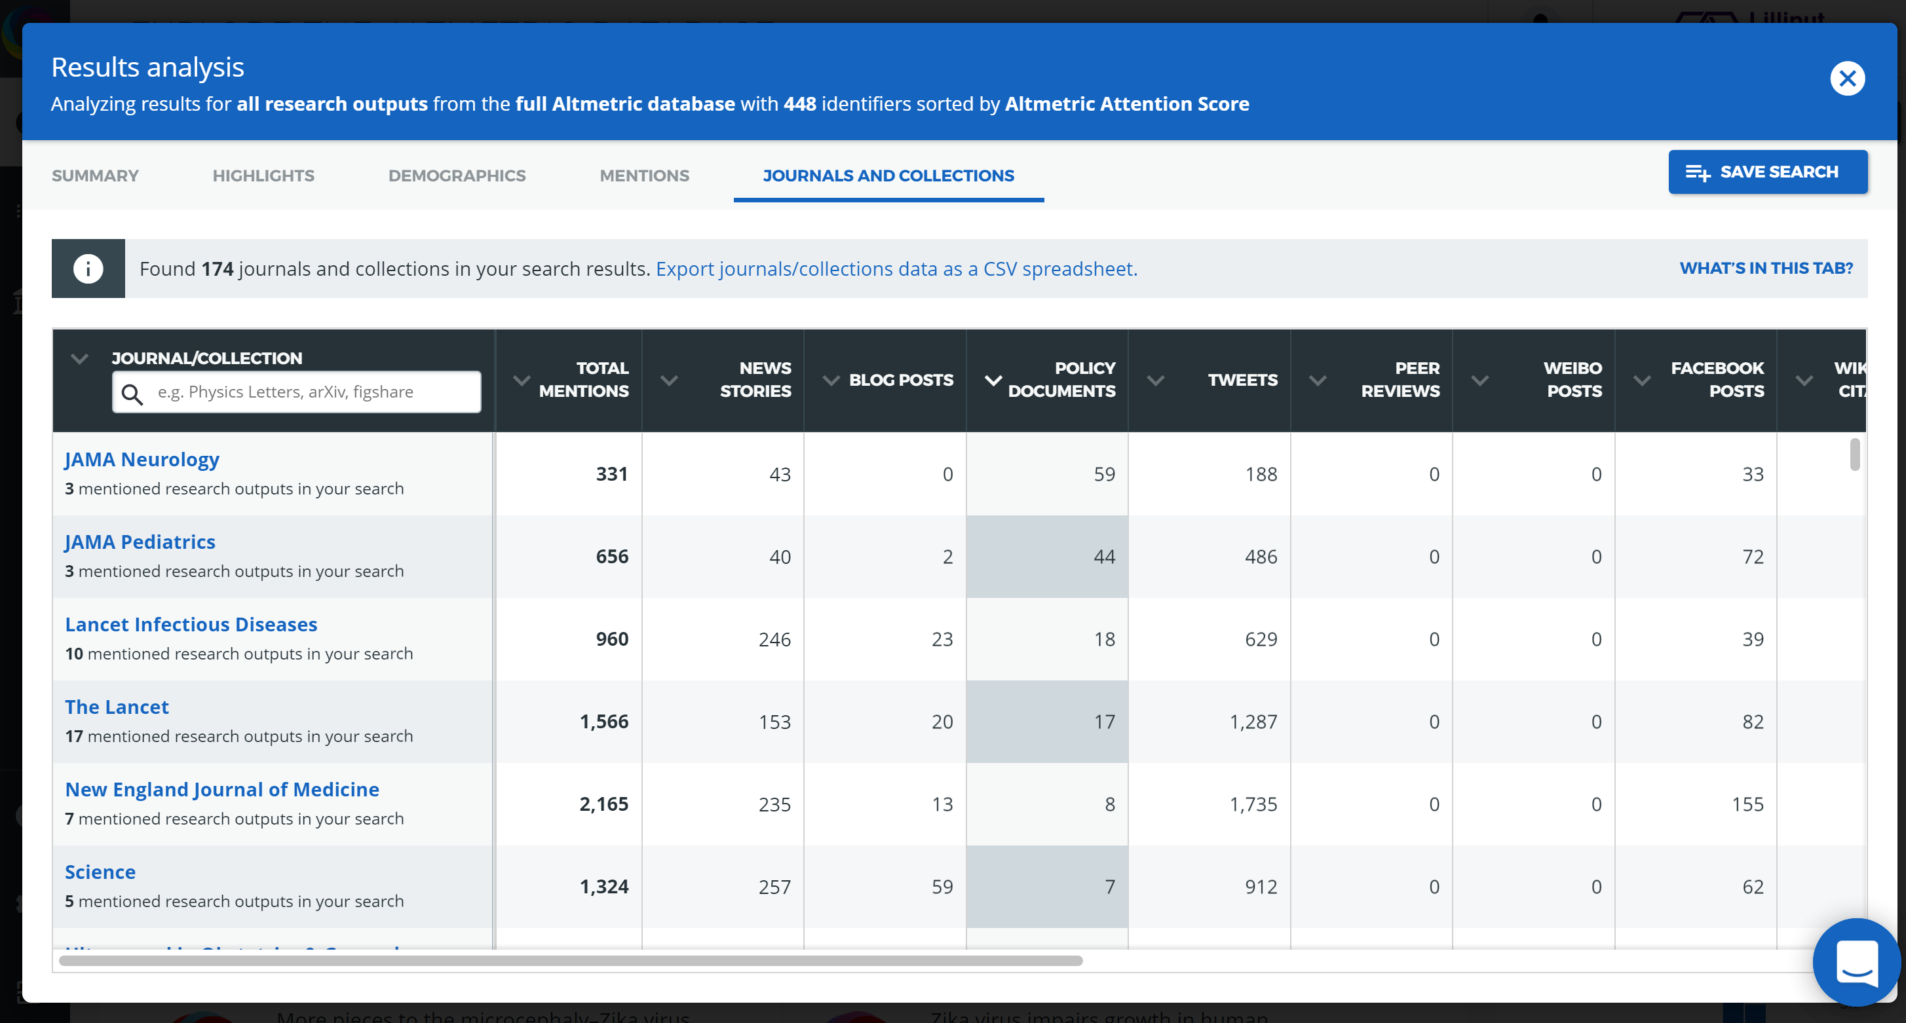
Broader impact with Altmetric Explorer

Slide 24
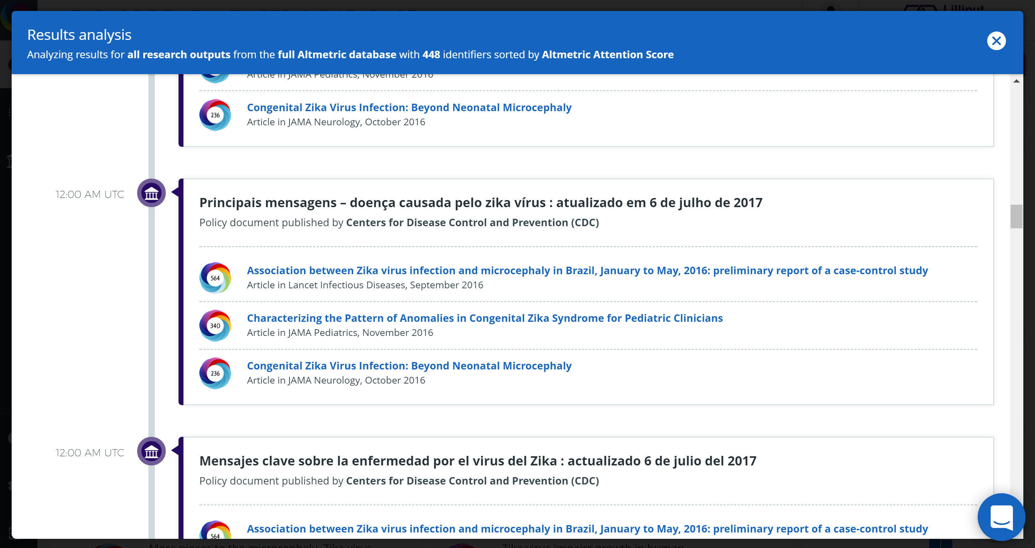
Broader impact with Altmetric Explorer

Slide 25
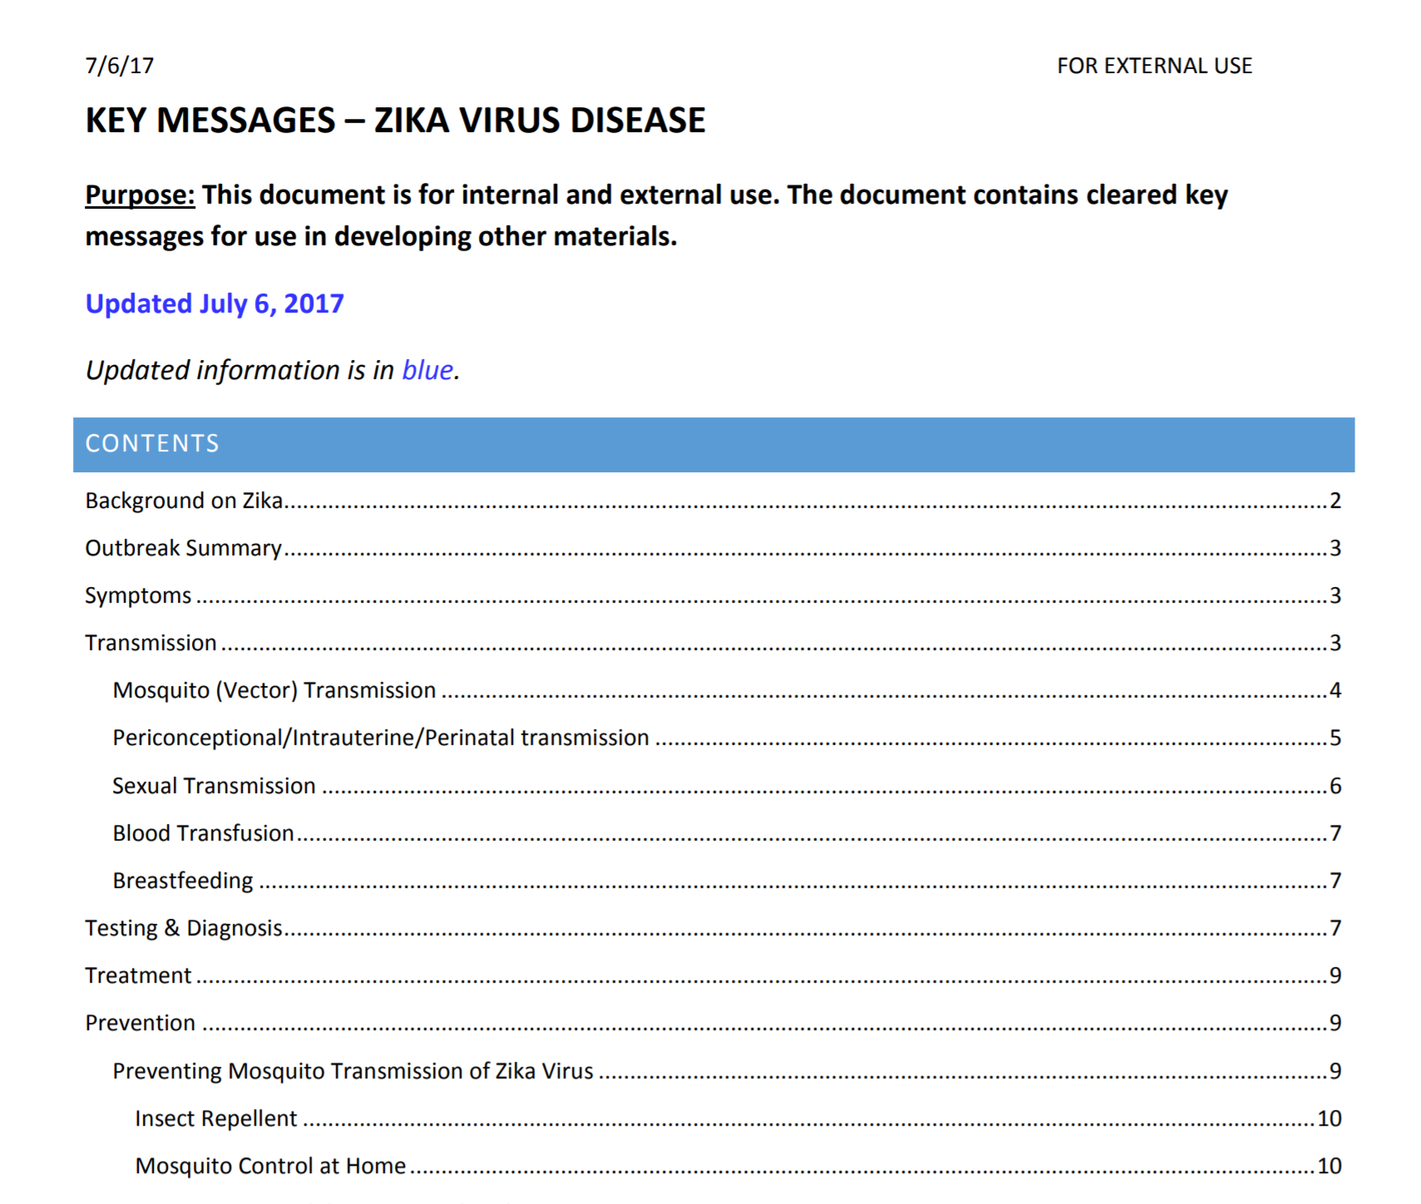
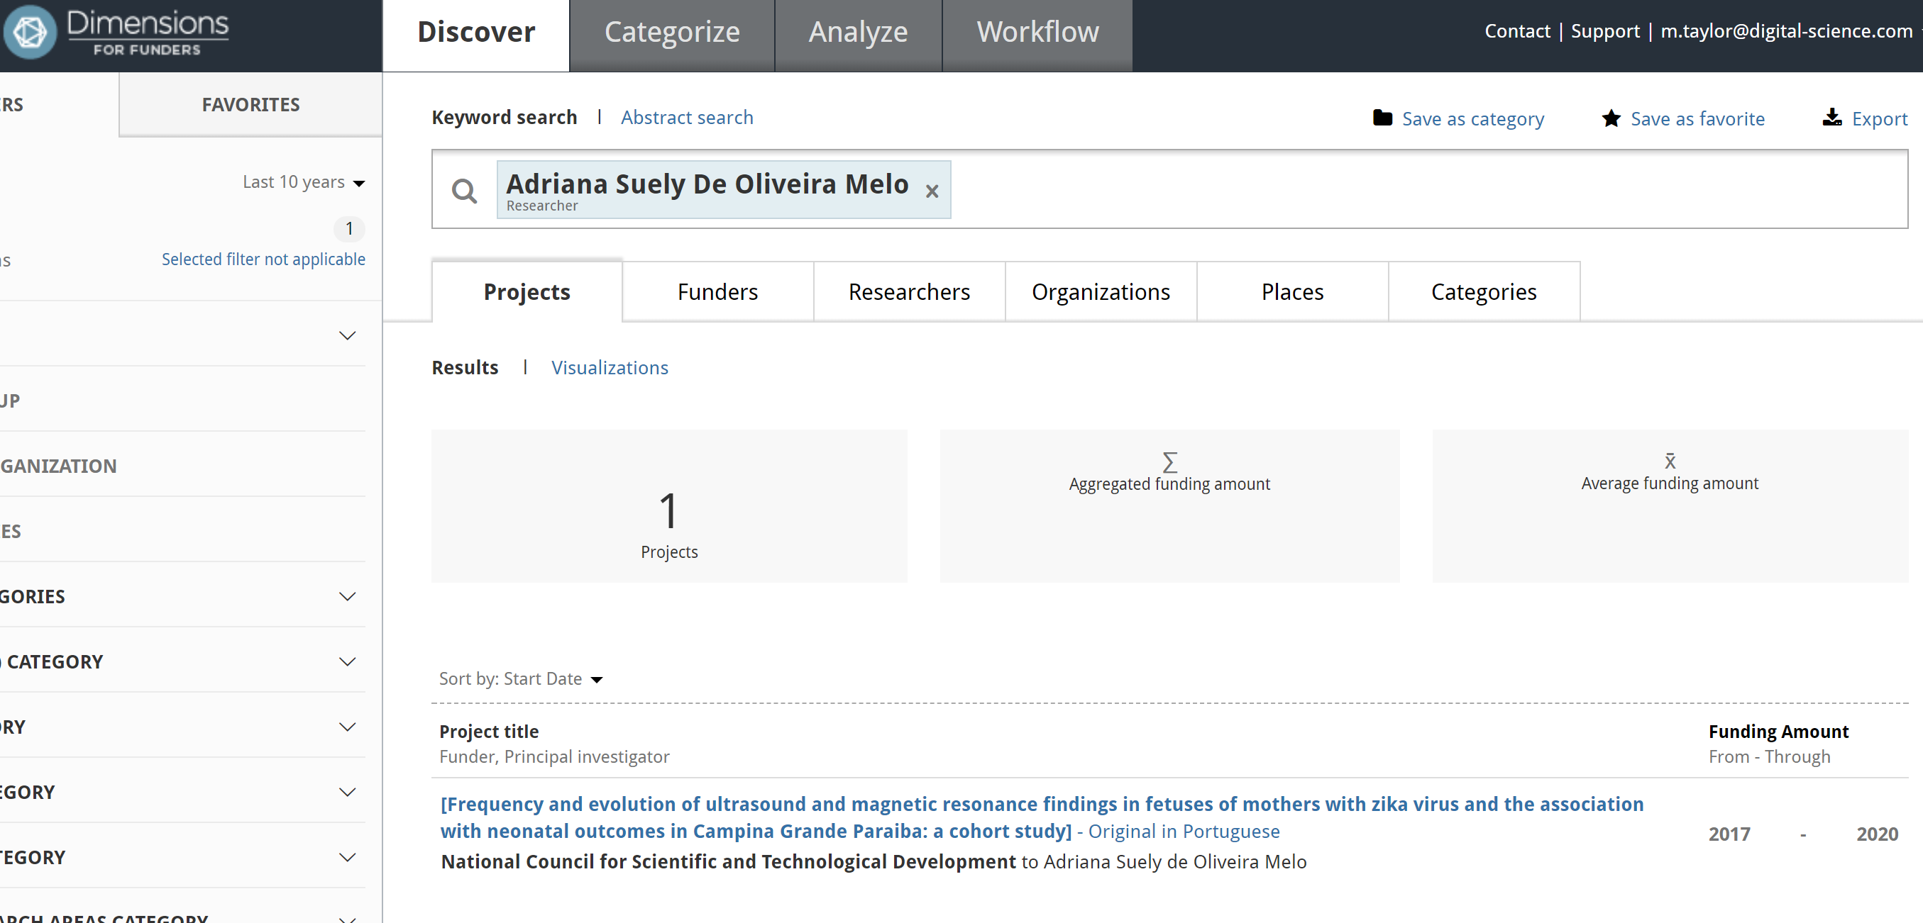
Broader impact with Altmetric Explorer

Slide 26
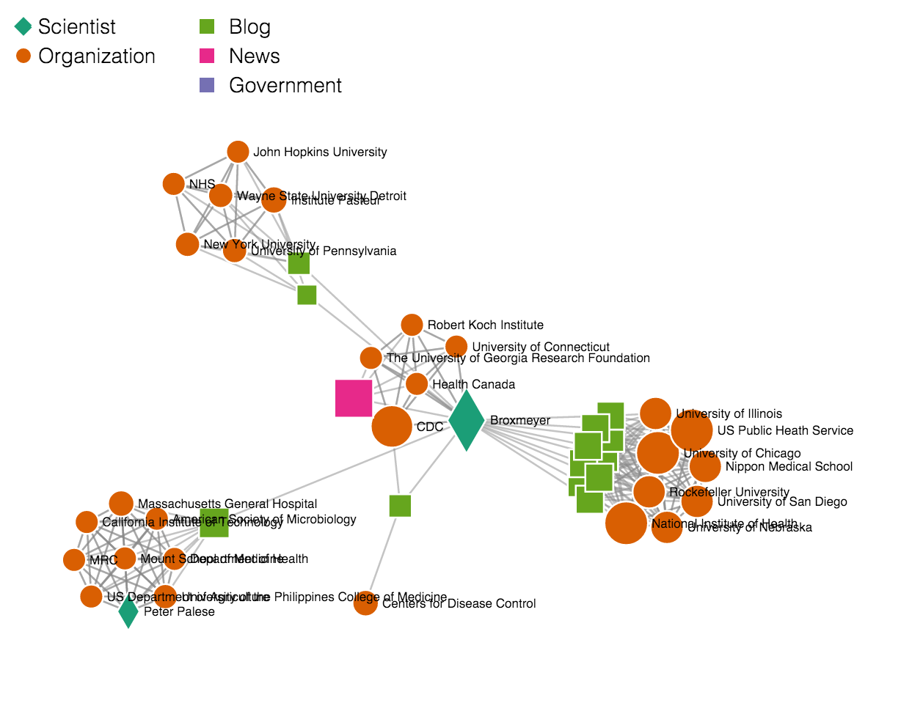
Combining complex novel metrics and broader data
SOPHIA was an experiment with University Ireland in creating complex, heterogenous graph networks; computing complex metrics but surfacing the results in easy-to-use user-interfaces
Evidence is that complex networks can provide real insights into trends that go beyond a ‘spreadsheet’ analysis
Experiments used interactive network charts, word clouds, graphs and connectivity wheels
https://link.springer.com/article/10.1007/s13278-017-0466-x

Slide 27
In conclusion
Metrics have strengths and weaknesses, and need context and analysis to support their use
Assumptions on international / discipline analysis can often be misleading
There is a tension between ‘simple, everyone understands’ metrics and complex, sophisticated tools (Alta Vista vs Google, 25 years later…)
We can calculate complexity: but can we make it usability and of utility?
There is much work to be done, and insights to be won, through existing data, and with new technologies
We are at the beginning of understanding ‘broader impact’, moving from a partial to a fuller view depends on commercial investment, open science and well-adopted infrastructure
Insights into the mechanics of scholarly communication are in an early stage

