Slide 1
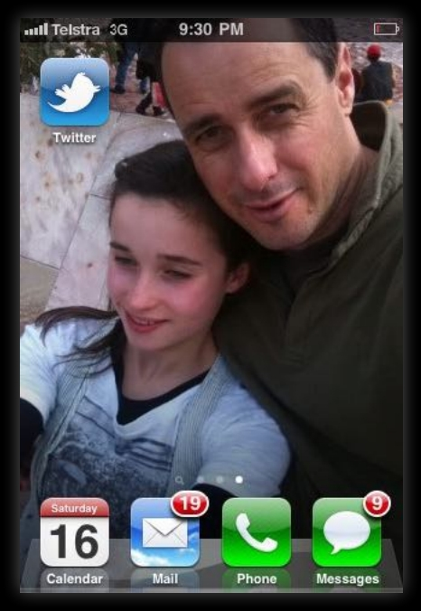

Slide 2
Phd. Candidate
University of Wollongong
Information Systems & Technology
Faculty of Informatics
Innovation in Business & Social
Research

Slide 3
Director
Streamfolio
EDUPOV Pty Ltd
Perth, Western Australia

Slide 4
http://mobilizethis.wikispaces.com

Slide 5
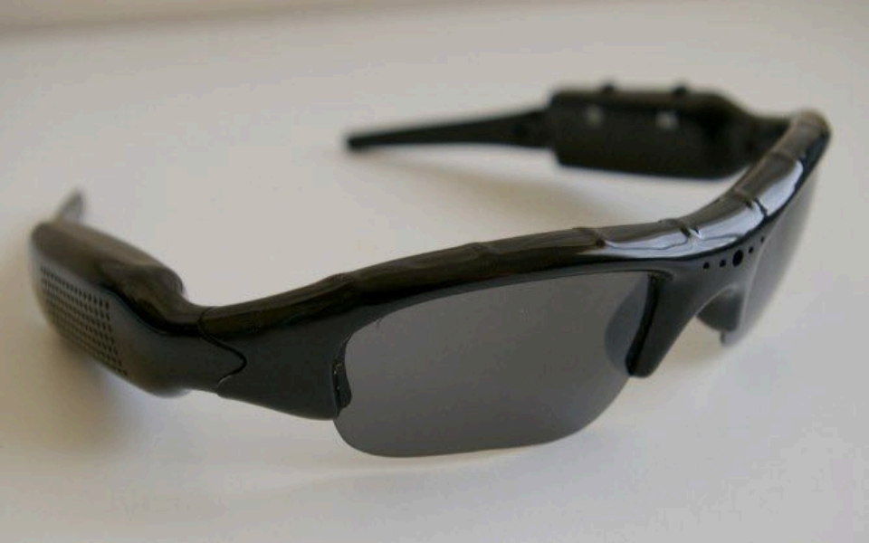
image | woodchipmedia.com

Slide 6
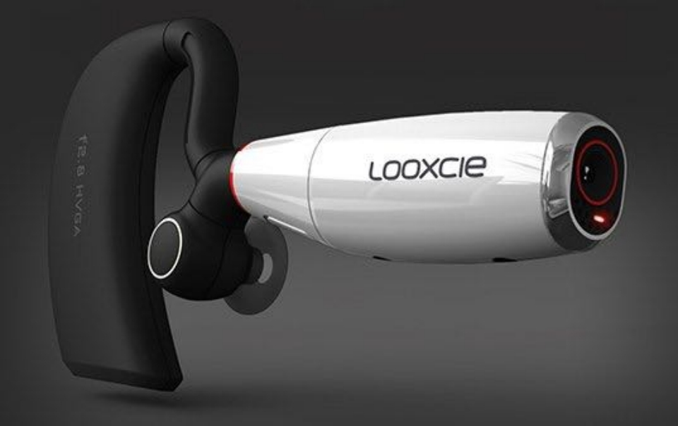
image | looxcie.com

Slide 8
“... It poses as an inevitable
“happening”...that is, POV in education
and training is both shocking and
unbelievable to consider however, it is
going to happen, it is now possible and it
is constructively usable.”
October 12 th , 2010

Slide 9
“….I don’t want a laptop for
my kid. I’ll just have a
successful teacher please”
deangroom (@deangroom)
16/10/10 2:12 PM

Slide 10
“….Until society abandons
'paper quals' to order 'life' -
schools must get the best
paper - outcomes. Games fill
in the rest at home.”
deangroom (@deangroom)
16/10/10 8:17 PM
@Darcy1968

Slide 13
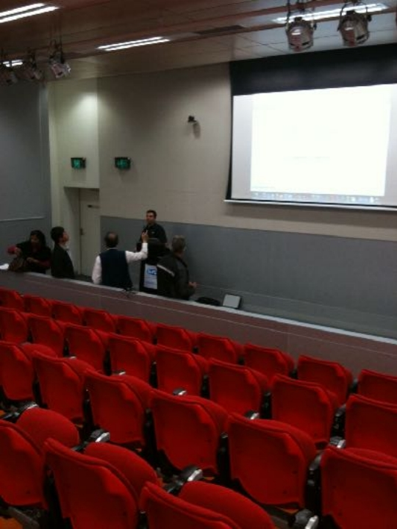

Slide 15
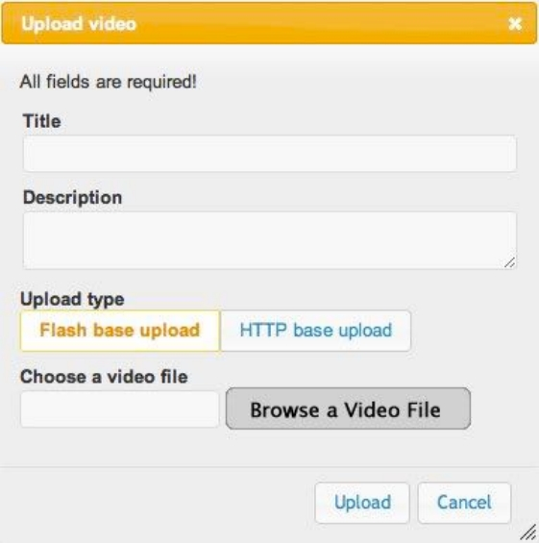

Slide 16
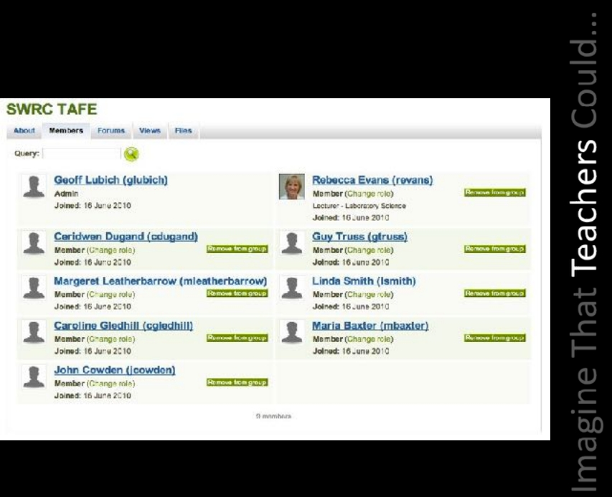

Slide 17
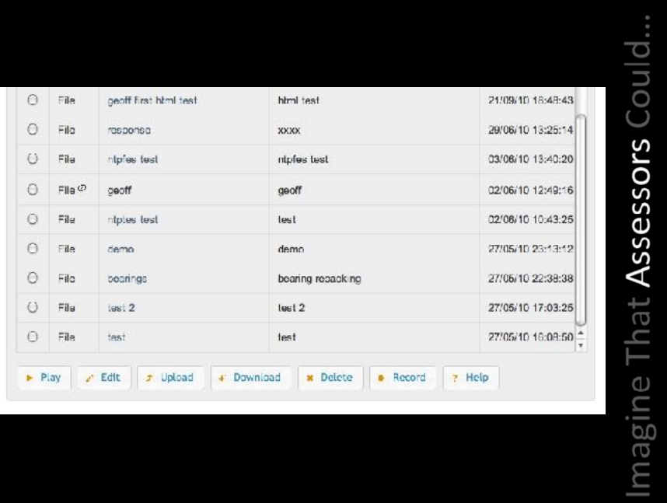

Slide 19
What risks are inherent with allowing
students to upload rich media video
evidence using any internet
connection ?

Slide 20
What advantages are there in
enabling teachers with technologies
that allow
e-portfolio video based competency
assessment ?

Slide 21
What do these technologies mean
for our current models of
assessment, validation and
auditing ?

