Slide 1
Important bids
Future ISMPMI childcare petition tiny.cc/ICMPMI_childcare
Slides: tiny.cc/R4E_ICMPMI_slides
Handout: tiny.cc/R4E_ICMPMI_handout
Benjamin Schwessinger, Australian National University, MPMI Glasgow 2019

Slide 2
Previous & Current Funders
@CodeOceanHQ
@Addgene
@ISMPMI
@protocolsIO
@mozilla
@eLife

Slide 3
Reproducibility for Everyone
Introduction to Reproducibility
Benjamin Schwessinger, Australian National University, MPMI Glasgow 2019

Slide 4
Have you ever had problems reproducing your own or someone else’s research?
Notes:
Question:
Have you ever had problems reproducing your own or someone else’s research?
Answers:
Yes, my own research.
Yes, someone else’s research.
Yes, both.
No, I have never had problems reproducing published results.

Slide 5
Have you ever had problems reproducing your own or someone else’s research?
#1 Yes, my own research.
#2 Yes, someone else’s research.
#3 Yes, both.
#4 No, I have never had problems reproducing published results.
Notes:
Question:
Have you ever had problems reproducing your own or someone else’s research?
Answers:
Yes, my own research.
Yes, someone else’s research.
Yes, both.
No, I have never had problems reproducing published results.

Slide 6
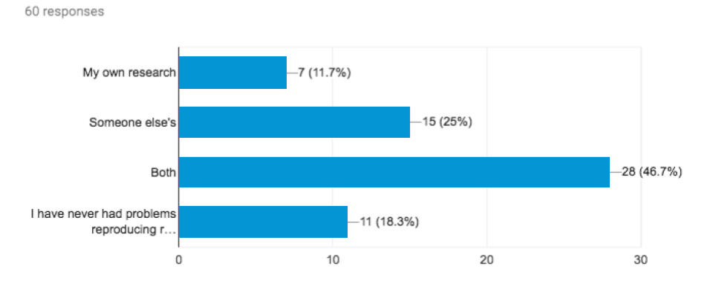
Have you ever had problems reproducing your own or someone else’s research?

Slide 7
Goals and Objectives
Introduction
‘Reproducibility’ framework
‘Reproducibility’ tools
Starting point for a ‘lifelong’ journey

Slide 8
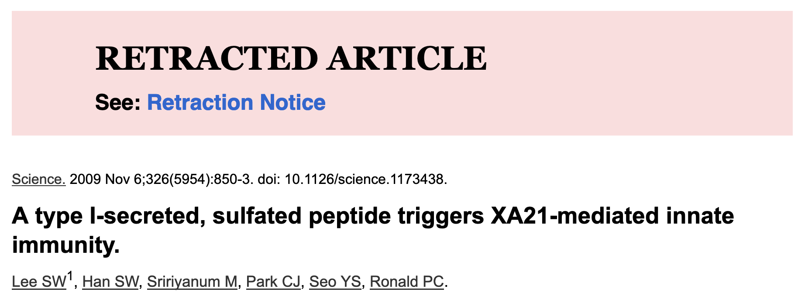

Slide 9
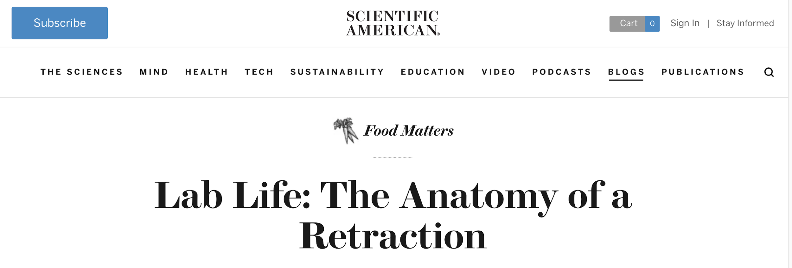
Miss labelled stocks
Irreproducible biological assays
Lack of detailed protocols
Insufficient laboratory notebook entries
Inconsistent results
https://blogs.scientificamerican.com/food-matters/lab-life-the-anatomy-of-a-retraction/

Slide 10
“The fourth law of thermodynamics” - @pkedrosky
The amount of energy necessary to refute b*(&$#@#$@! is an order of magnitude bigger than to produce it.

Slide 11
What does reproducibility mean?
Introduction

Slide 12
What does reproducibility mean?
Introduction
Reproducible research: Authors provide all the necessary data and the computer codes to run the analysis again, re-creating the results.
Replication: A study that arrives at the same scientific findings as another study, collecting new data and completing new analyses.
Barba, 2018 (https://arxiv.org/abs/1802.03311)
Schloss, 2018 (10.1128/mBio.00525-18)

Slide 13
Different modes of ‘reproducibility’
Methods | Same experimental system | Different experimental system
Same Methods | Reproducibility | Replicability
Different Methods | Robustness | Generalizability
Schloss, 2018 (10.1128/mBio.00525-18)
Barba, 2018 (https://arxiv.org/abs/1802.03311)
Notes:
The minimum unit is really that you as the original author can reproduce your results and so all the tools we present are foremost for you as research to become more reproducible in your own work. Only if you can reproduce your own results can others build on it. Also you are your most likely future collaborator. What we of course all aim for is at least robustness and hopefully replicability.

Slide 14
Is reproducibility all that matters?
Introduction

Slide 15
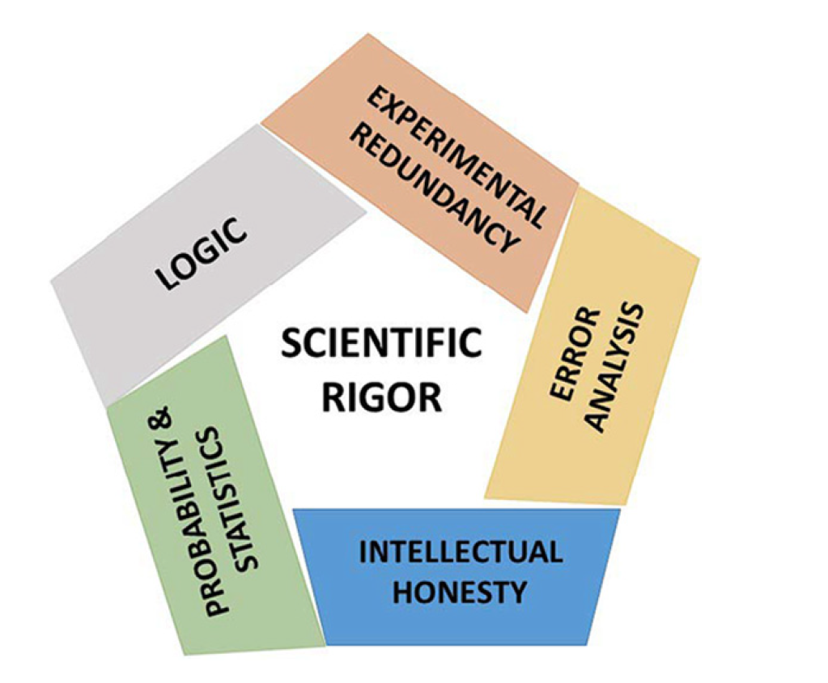
Introduction
Casadevall and Fang, 2016 (10.1128/mBio.01902-16)

Slide 16
Introduction
Every little bit helps!
No one is perfect!
Transparent and open science!
Everyone starts somewhere!
Casadevall and Fang, 2016 (10.1128/mBio.01902-16)

Slide 17
Factors decreasing reproducibility
Notes:
(Lenny can now set up the workshop goal - science works but can be faster; this workshop is about simple tools & tips to help you save time for yourself and later others)
Now connect with the audience pulling in data from the survey
First up introducing the concept of reproducible workflows will improve your own research
That every little helps. You don’t need to become a superhero overnight.

Slide 18
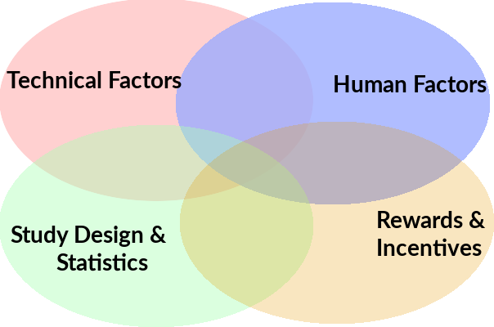
Factors decreasing reproducibility
Introduction

Slide 19
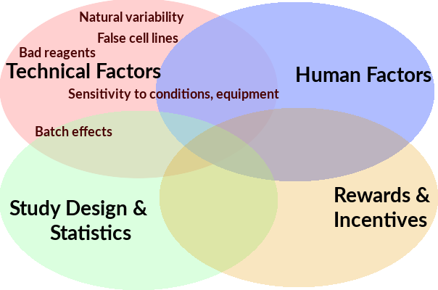
Introduction

Slide 20
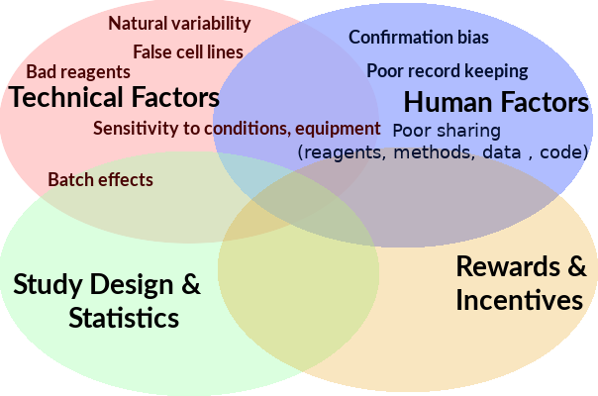
Introduction

Slide 21
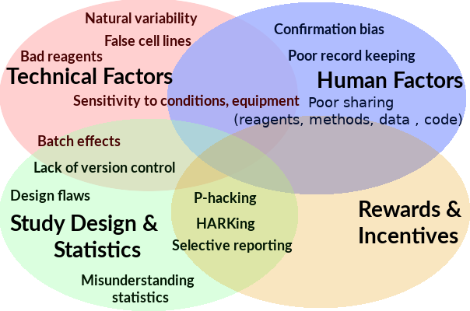
Introduction

Slide 22
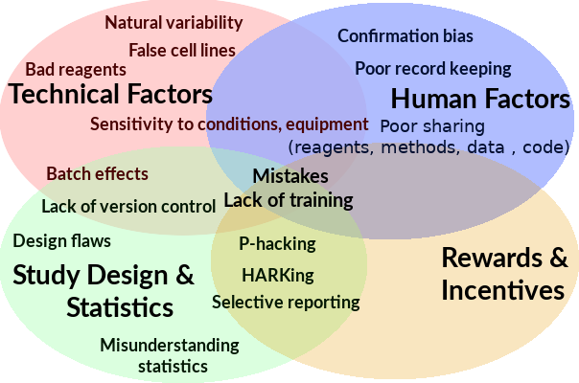
Introduction

Slide 23
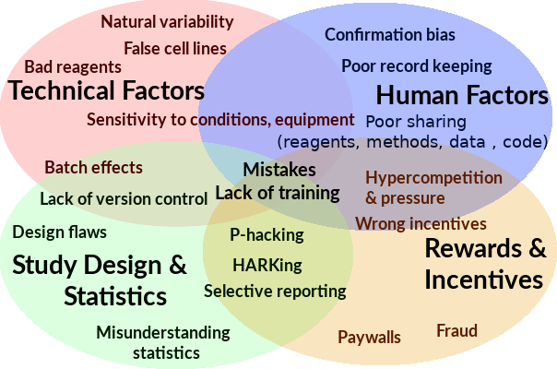
Introduction

Slide 24
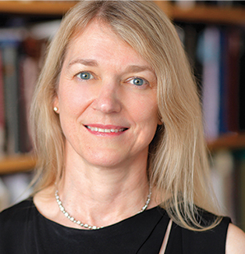
What can we do by
the end of the century?
Cori Bargmann, HHMI Investigator & President CZI Science:
“82 years ago, there were no antibiotics….
We can expect a lot from the next 82 years.”

Slide 25
What can we do by
the end of the century?
Estimate of over $1 billion USD lost a year on irreproducible studies in US alone.
Cori Bargmann, HHMI Investigator & President CZI Science:
“82 years ago, there were no antibiotics….
We can expect a lot from the next 82 years.”
Freedman et al., 2015 (doi.org/10.1371/journal.pbio.1002165 )

Slide 26
What are the major improvements that could lead to more reproducibility?
Notes:
Questions:
What are major improvements that could lead to more reproducibility?
Answers (multiple possible):
Better and more detailed methods, description of performed analysis, and record keeping
More publicly available data including meta-data
increased statistical power in experiments
less pressure to publish (reach p < 0.05)
Fewer incentives to be first rather than right
Better 'wet lab' reagent sharing e.g. plasmids, antibodies, etc.
Better ‘dry lab’ analysis sharing e.g. code sharing

Slide 27
What are the major improvements that could lead to more reproducibility?
#1 More detailed methods, analyses, and record keeping.
#2 More publicly available data including meta-data.
#3 Increased statistical power.
#4 Fewer incentives to be first rather than right.
#5 Better 'wet lab' reagent sharing.
#6 Better ‘dry lab’ analysis sharing.
Notes:
Questions:
What are major improvements that could lead to more reproducibility?
Answers (multiple possible):
Better and more detailed methods, description of performed analysis, and record keeping
More publicly available data including meta-data
increased statistical power in experiments
less pressure to publish (reach p < 0.05)
Fewer incentives to be first rather than right
Better 'wet lab' reagent sharing e.g. plasmids, antibodies, etc.
Better ‘dry lab’ analysis sharing e.g. code sharing

Slide 28
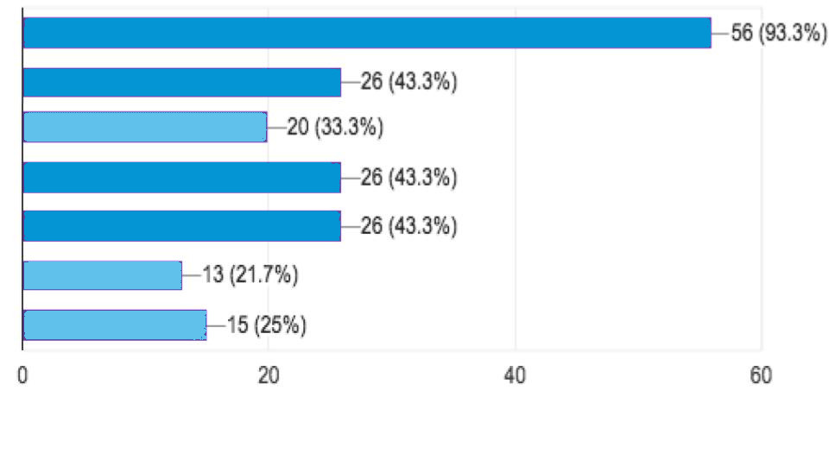
Introduction
What are the major improvements that could lead to more reproducibility?
More detailed methods, analysis and record keeping
More publicly available data including meta-data
Fewer incentives to be first rather than right
Better reagent sharing e.g. plasmids, antibodies...

Slide 29
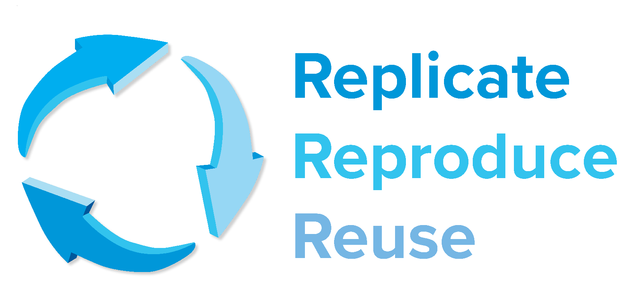
“Respondents said that the most important element that would enable the better reproducibility
of published research would be that authors describe methods and analyses in detail.”
Samota and Davey, 2018 (https://doi.org/10.1101/581033 )

Slide 30
‘Wet lab’ Protocol Sharing

Slide 31
Allegory of Biology Method Drawing exercise (5 min):
Use a pen and a piece of paper.
2. Imagine a beautiful owl. Everyone knows how a owl looks like.
3. Draw the owl. Briefly. The owl has a round head, an oval body, some feed with claws, shimmering feathers and two big eyes.
4. Digitalize the owl and share it with us on twitter using #ICMPMI2019
5. Be amazed by wonders.

Slide 32
amazing
https://medium.com/@tpoi

Slide 33
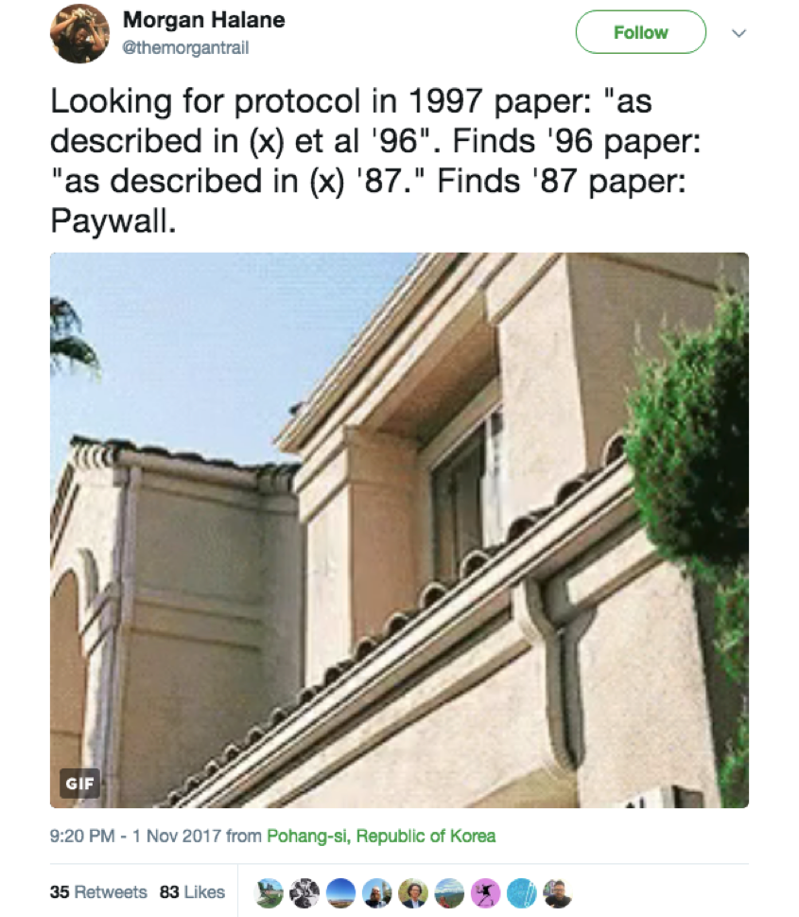
Description
Unavailable

Slide 34
Description
Unavailable

Slide 35
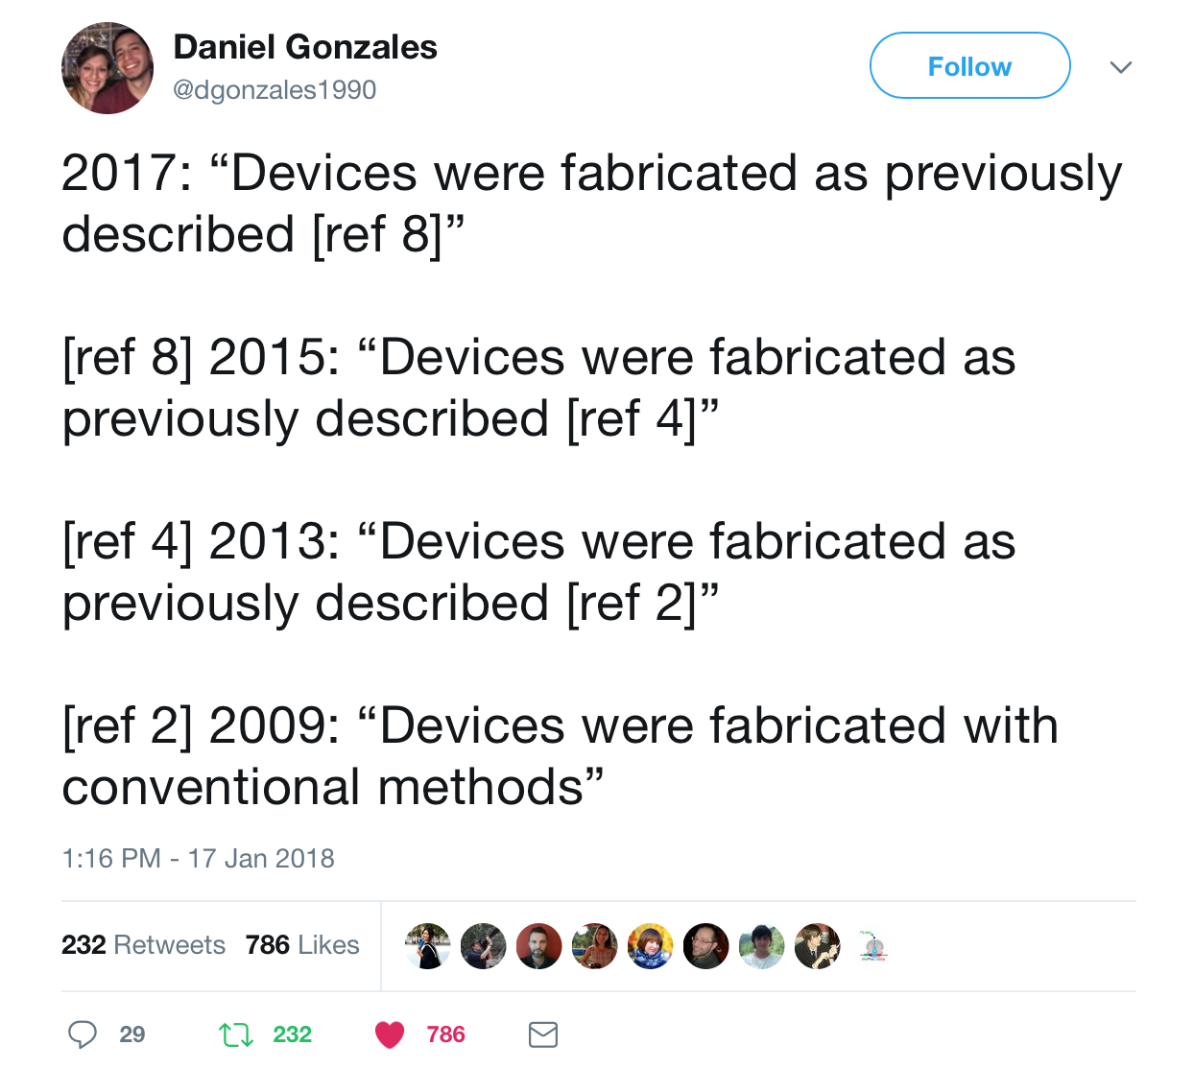
Description
Ambiguous

Slide 36
Detail & Digitize Protocols
brief, modular, self-contained scientific publication
Abstract to put methodology in context
as much detail as possible
duration/time per step
reagent amount
vendor name
catalogue number
expected result
software package
secret sauce

Slide 37
Data Management

Slide 38
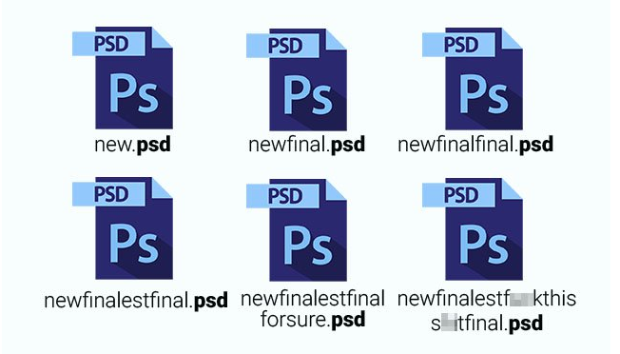
Are you familiar with these feelings?
Data Management
I cannot find this file!
What did I call it again??
Was it the wild type picture or the mutant one?
Where is my file??
finalfinalREALFINAL!.psd
What version was it??
Where is my RAW!!! data???

Slide 39
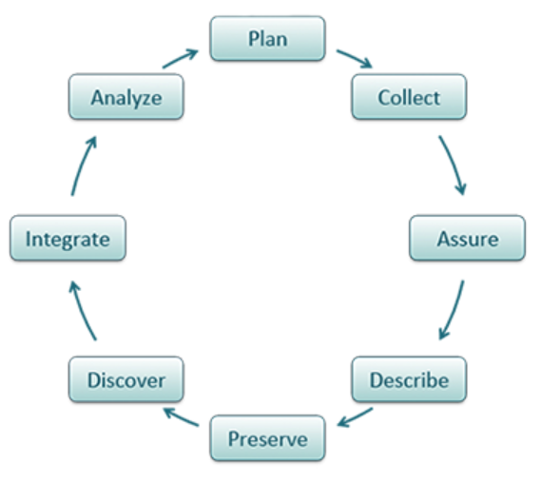
Think about...
Data Management
What data? Meta-data?
How will you organize, documente, standardize, store, protect, share, and archive?
Who will be responsibility?
When will this be done within the project and beyond?
http://guides.lib.purdue.edu/c.php?g=353013&p=2378292
https://www.dataone.org/best-practices
https://dmptool.org/

Slide 40
Data Management
Project directory structure
Specific content in each category for Project #1
Project_1
methods
raw_data
readme
analysis
analysis_method_1
2017
2018
analysis_method_2
scripts
manuscript
text
version_1
readme and/or ELN link
Raw data,
Data analysis, and Manuscript
Inspired by ‘Bioinformatic data skills’
by Vincent Buffalo

Slide 41
Data Management
Project directory structure
Project_1
methods
raw_data
readme
analysis
analysis_method_1
2017
2018
analysis_method_2
scripts
manuscript
text
version_1
readme and/or ELN link
Always keep raw data!
Always Backup Data
(3x and synchronized: 3 unique locations - cloud, server,
personal drive)

Slide 42
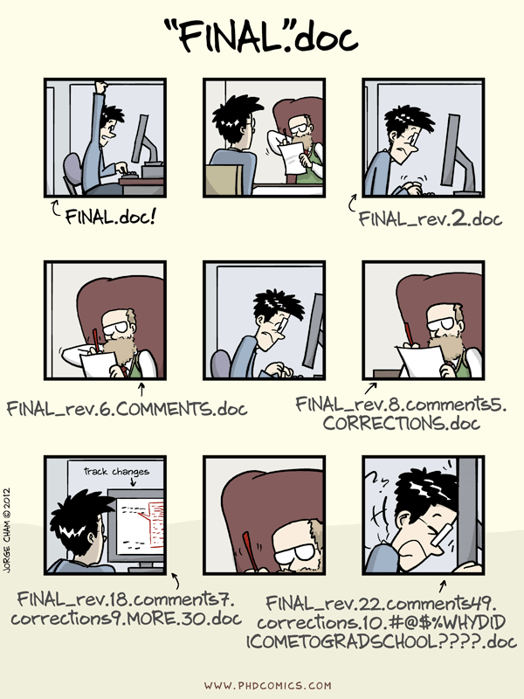
Data Management
Notes:
Question:
What did you call the last file you saved?
Answers:
Document 1
Final version BS
20190619_ASM2019_talk
Cover letter Nature
Cover letter mBio

Slide 43
What did you call the last file you saved?
Data Management
#1 Document 1
#2 Final version BS
#3 20190715_ISMPMI2019_talk
#4 Cover letter Nature
#5 Cover letter MPMI
#6 Just submit to biorxiv
Notes:
Question:
What did you call the last file you saved?
Answers:
Document 1
Final version BS
20190619_ASM2019_talk
Cover letter Nature
Cover letter mBio

Slide 44
File naming conventions
Data Management
Include date in yyyy-mm-dd format
Use meaningful abbreviations
Have group identifiers
Document your decisions
Be consistent
http://guides.lib.purdue.edu/c.php?g=353013&p=2378292
http://kbroman.org/dataorg/

Slide 45
File naming conventions
Data Management
Example
20130825_DOEProject_Ex1Test1_Data_Gonzalez_v3-03.xlsx
Project
Experiment
Type
ID
Version
Specific
http://guides.lib.purdue.edu/c.php?g=353013&p=2378292

Slide 46
FAIR Data
FAIR Data
Findable
Accessible
Interoperable
Reusable
https://fairsharing.org/

Slide 47
Electronic Lab Notebooks

Slide 48
Have you used electronic notebooks?

Slide 49
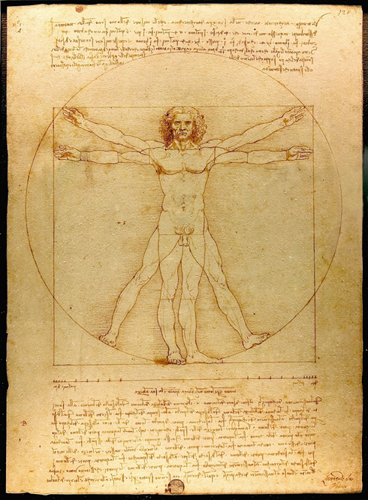
Paper Lab-notebooks - in use since the 15th Century!
Good record keeping is important for:
Dissemination of ideas, findings,
Legally binding records that protects intellectual property
Not searchable!
Can be easily damaged, misplaced
Not easy to back up
Hard to share with collaborators
🔥
Leonardo da Vinci’s notebook,
Codex Arundel c. 1458-1518
British Library

Slide 50
Cost considerations - Available Products
Paid for - Bio-Itech, LabArchives, LabGuru
Paid (with free version) - SciNote, Benchling
Open source - Open wet ware, ELOG
Free - Open Science Framework (OSF.io), LocalWiki
Kanza, 10.1186/s13321-017-0221-3

Slide 51
Why should you use an Electronic Lab Notebook?
Search
Easily searchable both in online and offline searches
Export
Data can be exported as PDF (must backup regularly)
Share
Easily shareable with collaborators and broader community
Embed
Can embed high res images, protocols, & more
Access
Easily accessible globally (depend on connectivity)
Mobile
Use the mobile app to quickly upload images

Slide 52
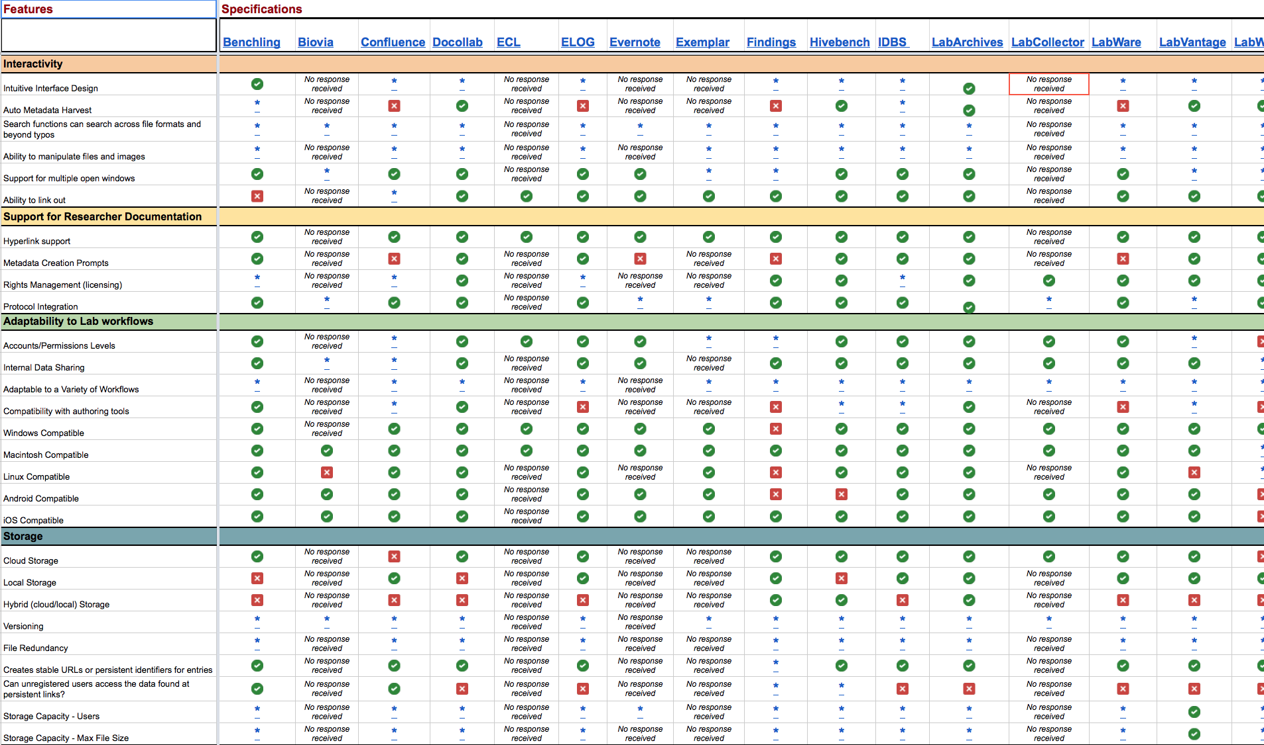
One size does not fit all
Available lab notebooks
Parameters
to consider
ELN Features
Matrix
https://datamanagement.hms.harvard.edu/electronic-lab-notebooks

Slide 53
Basic features of an Electronic Lab Notebook

Slide 54
General tips on electronic record keeping
Back-up data regularly
Maintain a physical observation notebook in parallel
Mobile apps provide added portability
If using free ELNs, check privacy and data ownership policies

Slide 55
Bioinformatics Tools

Slide 56
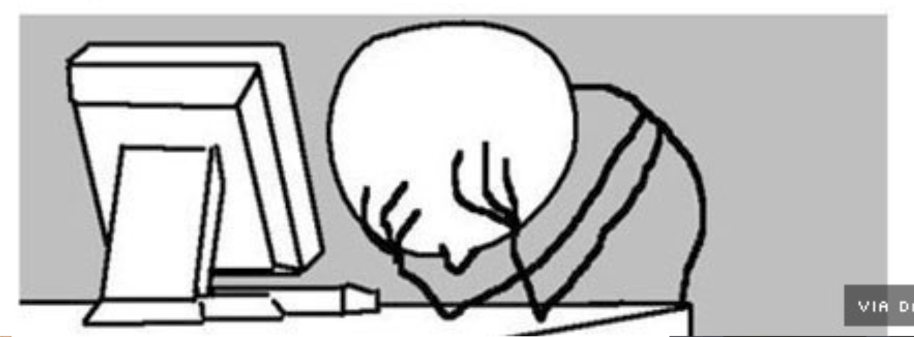
What version of the program, data, etc…?
Why did I do this?
https://carpentries.org ‘Bioinformatic data skills’ Vincent Buffalo

Slide 57
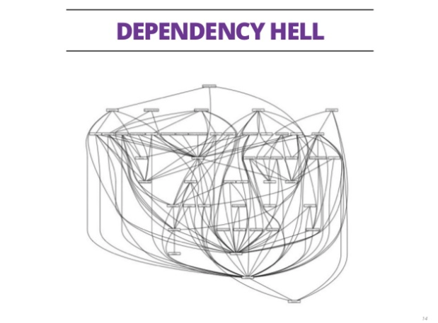
What version of the program, data, etc… did I use?
Dependency dilemma (files require other files)
Why did I do this?
https://carpentries.org ‘Bioinformatic data skills’ Vincent Buffalo

Slide 58
Notebooks
Keep track of analysis
Interactive coding
Interactive data exploration
Embedded visualization
Easy access to docstrings
Mix of code and documentation
https://jupyter.org/
https://www.rstudio.com

Slide 59
Notebooks
Easily shared
Widgets available (customization)
Compatible with >40 programming languages
Interactive plots
Can run remotely on server
https://jupyter.org/
https://www.rstudio.com

Slide 60
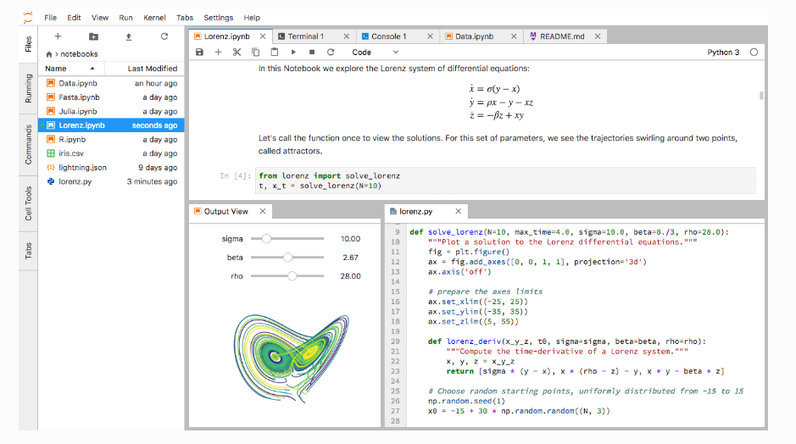
Notebooks - Example
Rule et al. 2018 (https://arxiv.org/abs/1810.08055)

Slide 61
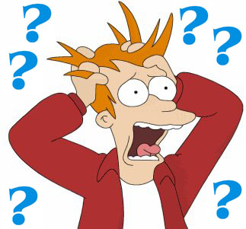
How to install all these software packages?
Version conflict
Dependency dilemma

Slide 62
Version Control
Manages formal versioning and diffs of documents
Documents version history
Illustrates changes between versions (diffs)
Github lets you share code easily
Github lets you collaborate on your code more easily
`
Version-control
system that
uses forks and pull requests.
Git-based repository with
a social media component.

Slide 63
Package, dependency & environment managers
Handles installs & dependencies
Allows multiple independent environments
Easily configurable
Runs on all three major operating systems
Open Source
You can package your own work & contribute
https://conda.io/ https://bioconda.github.io/

Slide 64
It’s really that simple...
...most of the time
https://conda.io/ https://bioconda.github.io/

Slide 65
Containers
Docker runs images as containers that are:
Self-contained with all code, programs, libraries included.
No subsequent installation required
Isolated
Portable including dissemination
Lightweight
https://docs.docker.com

Slide 66
Containers
Turns a GitHub repo with data and notebooks into a collection of interactive notebooks
run in the cloud
executable
Configuration, preservation, and reuse of executable code using containers for researchers
https://tinyurl.com/jupyter-binder2-0 https://tinyurl.com/eLife-binder2-0

Slide 67
Containers
Biocontainers
Docker
Get local blast
Run local blast
https://docs.docker.com/ http://biocontainers.pro

Slide 68
Allegory of what can go wrong in your career (10 min group discussion):
Ben is really excited to join a new team that is investigating ligand receptor interaction and downstream signaling analysis. However,
The previous Postdoc started a new job and refuses to respond to his emails.
The technician on the project was only involved in the data acquisition steps.
Unfortunately, the lab notebook went missing in a recent move to a new floor.
The methods section in a previous paper reads like this -
Materials and Methods
Plants were grown on appropriate media, leaves were dipped into elicitor solution, leasing size measured and some leaves photographed. Images were analyzed using WinRhizo (Arsenault, J-L., et al. 1995) and data presented as graphs.

Slide 69
Allegory of what can go wrong in your career (10 min group discussion):
Ben is really excited to join a new team that is investigating ligand receptor interaction and downstream signaling analysis. However,
The previous Postdoc started a new job and refuses to respond to his emails.
The technician on the project was only involved in the data acquisition steps.
Unfortunately, the lab notebook went missing in a recent move to a new floor.
The methods section in a previous paper reads like this -
What went wrong? How can you prevent these issues?
Materials and Methods
Plants were grown on appropriate media, leaves were dipped into elicitor solution, leasing size measured and some leaves photographed. Images were analyzed using WinRhizo (Arsenault, J-L., et al. 1995) and data presented as graphs.

Slide 70
Data and reagent sharing

Slide 71
Have you ever used other people’s resources? What was it?

Slide 72
Have you ever shared resources like protocol, plasmids, or plant lines?

Slide 73
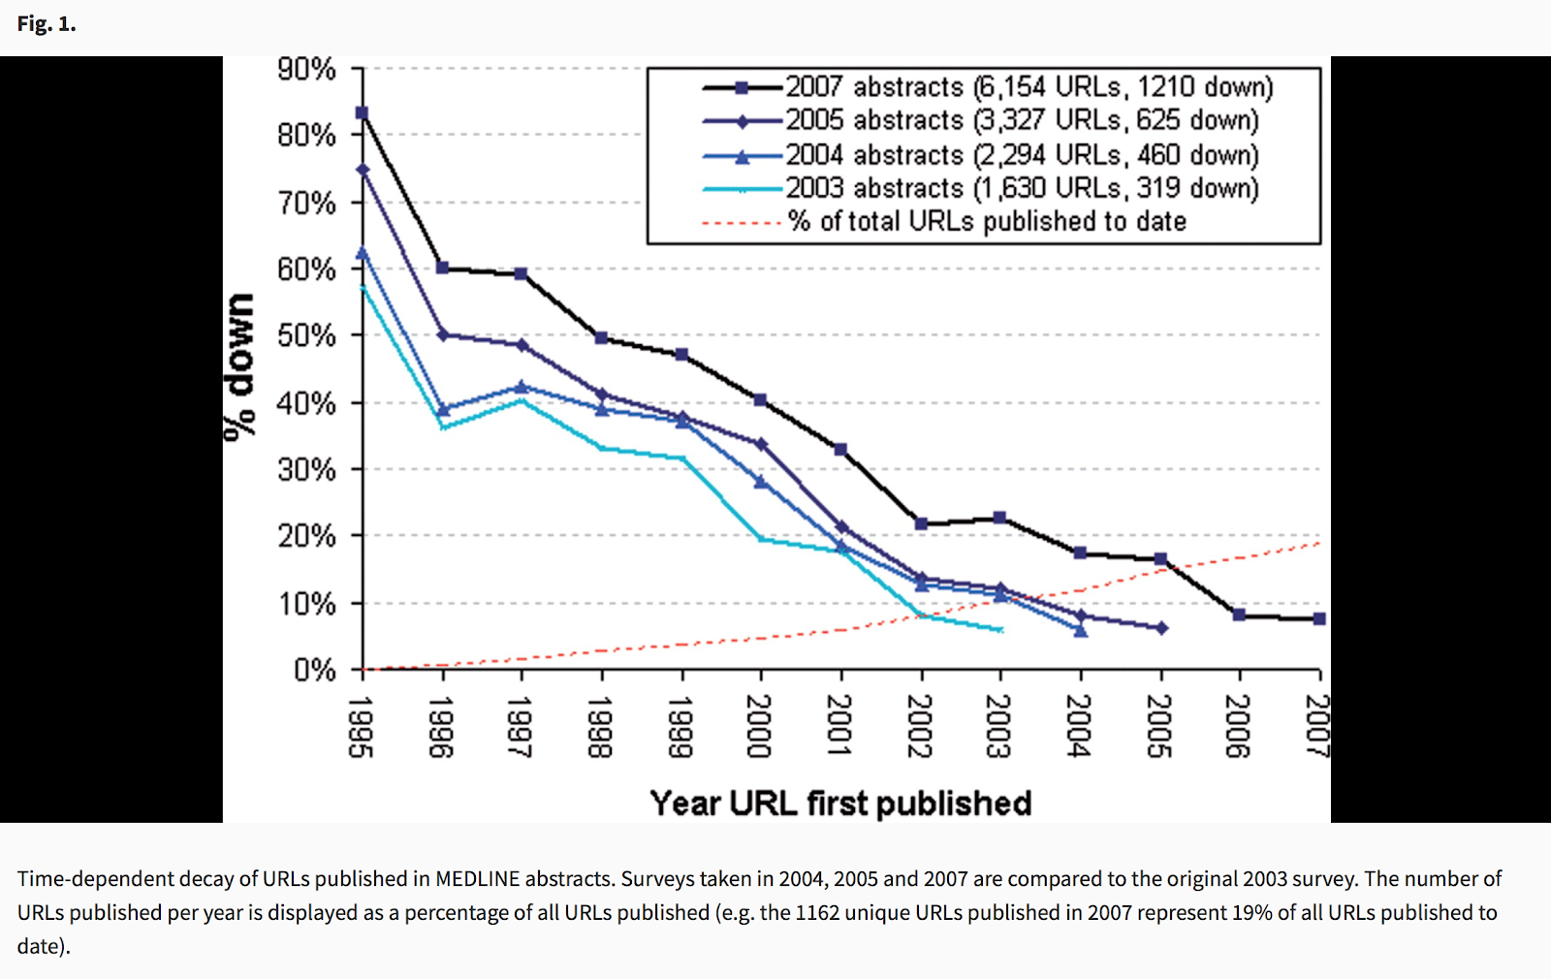
Data sharing
Jonathan D. Wren; URL decay in MEDLINE—a 4-year follow-up study, 2008 Bioinformatics
https://doi.org/10.1093/bioinformatics/btn127

Slide 74
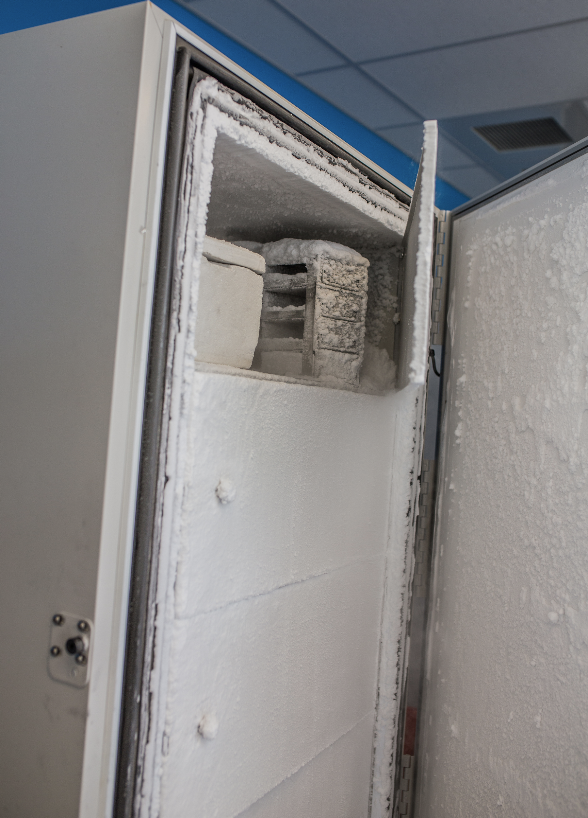
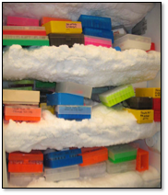
Problems with wet-lab reagent availability
???
???
Scientist creates & publishes on a reagent
Scientist leaves the lab and stores reagent in freezer
Other scientists request the reagents, but none of the remaining remembers know where they are

Slide 75
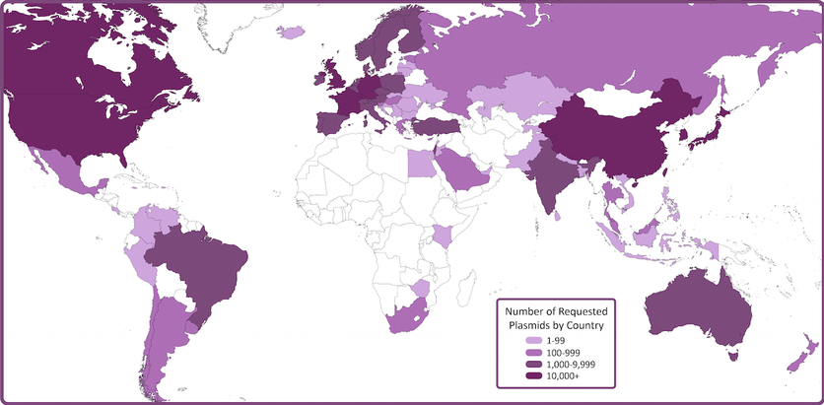
Functions of reagent repositories
They:
Verify reagents
Curate reagents
Facilitate and track shipping
Protect IP
Process is easier if you:
Record how a reagent was created
Provide associated publications
Provide associated protocols
(All of these are facilitated by other tools discussed in this workshop)

Slide 76
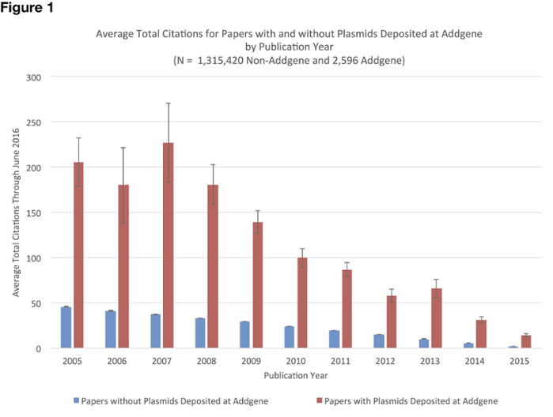
Incentivizing reagent sharing
DIRECT
Archiving
Reducing time spent sending out reagents
Occasional monetary benefits
INDIRECT
Creation of educational content
Direct promotion
Analysis of reagent distribution

Slide 77
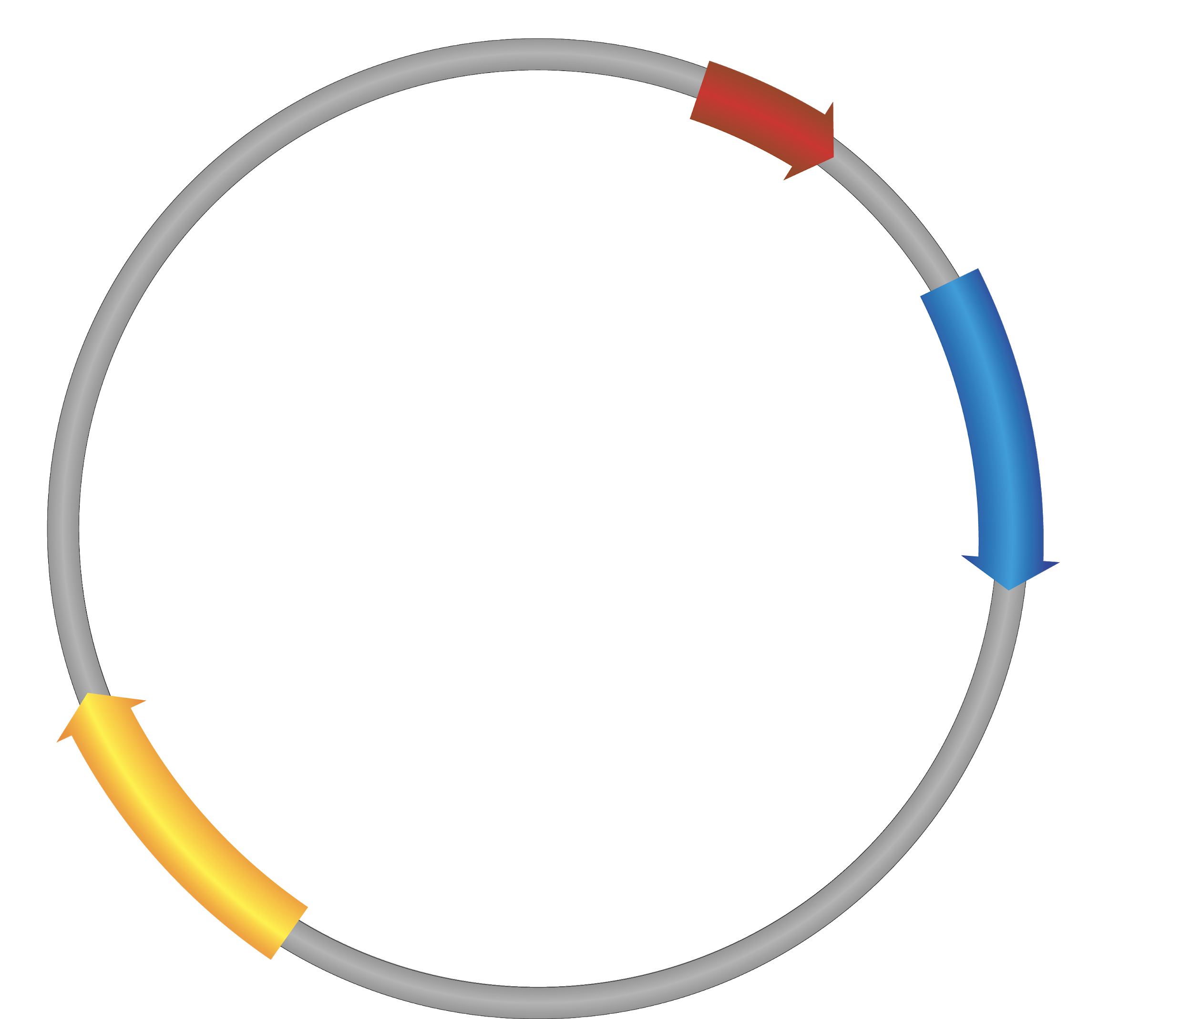
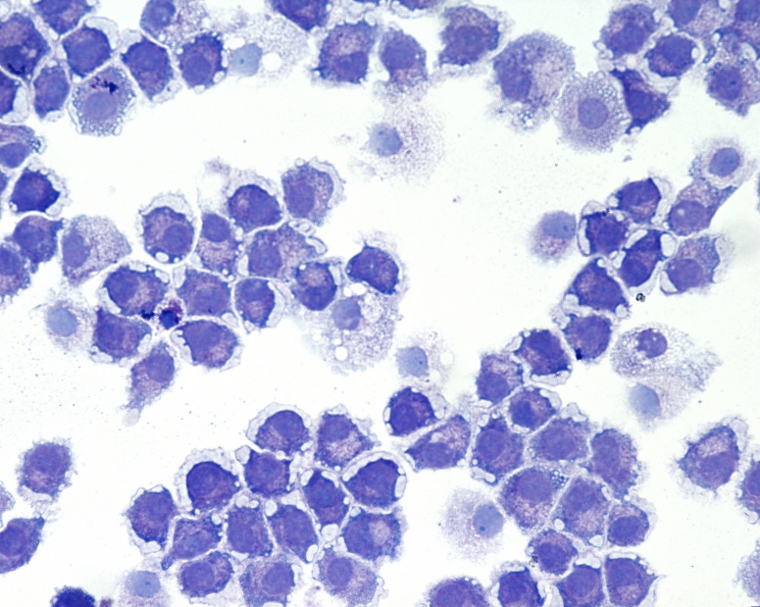
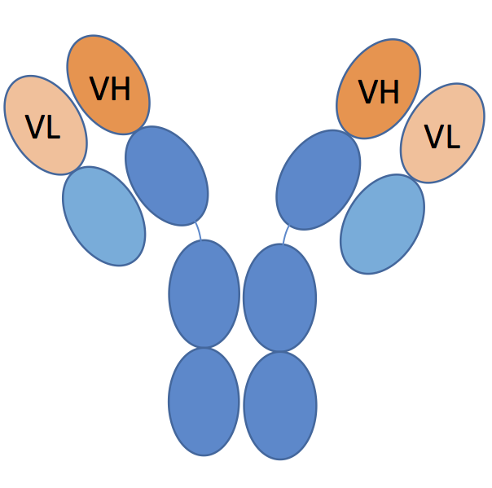
Examples of reagent repositories
Addgene
DNASU
ATCC
Nottingham Arabidopsis Stock Centre
Stock Centers - TAIR
Developmental Studies Hybridoma Bank

Slide 78
What to share?
Data & code necessary to validate findings & reproduce results
Data & code that might be valuable to other researchers/policy makers
Data & code which cannot be (easily) re-generated
Why share?
Funder or publisher mandates
Citation benefits (Piwowar 2013, https://doi.org/10.7717/peerj.175)
Preserve long-term access to data
How to share?
Choose open, persistent, and non-proprietary file formats
Create and share documentation to enable reuse
Include data citations of source data
Create rich metadata

Slide 79
Data Repository
Use a data repository not your website. They provide:
Persistent identifiers for your data (like DOI)
Unique & citable
Prevents “link rot”
Persistent access
Preservation
Backup
Management of access
Versioning
Licensing
Data License
Consider Creative Commons licenses for data & text
Either CC-0 or CC-BY
Guidance on data licenses available through Digital Curation Center:
http://www.dcc.ac.uk/resources/how-guides-license-research-data
Code License
Consider open source license such as MIT, BSD, or Apache license
Guidance on software licenses by Karl Broman (http://kbroman.org/steps2rr/pages/licenses.html) and Open Source Initiative (https://opensource.org/licenses)

Slide 80
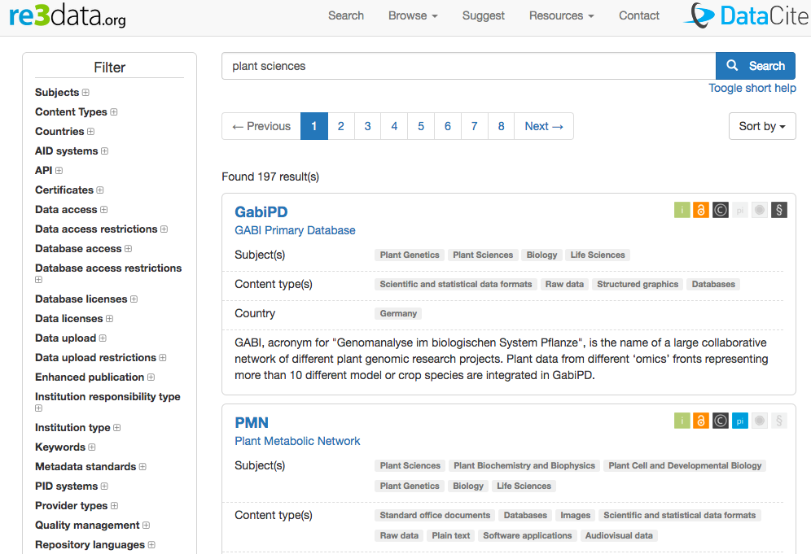
Mandated vs. Disciplinary Repositories
Identify mandated / disciplinary repository:
Funder specified repository
Institutionally specified data repository
Domain or discipline-specific data repository
Find & compare disciplinary repositories through Repository of Research Data Repositories https://www.re3data.org/

Slide 81
General Purpose Repositories
In addition to a specified data repository, you can make a deposit to a general purpose repository:
DataDryad http://datadryad.org/ (curated digital repository; free to access, $120 to publish dataset up to 20GB)
Figshare https://figshare.com/ (free digital repository, 5GB per file limit)
Zenodo https://zenodo.org/ (free digital repository; 50GB per dataset limit)

Slide 82
Data Analysis & Visualization

Slide 83
Have you seen a bar graph at this conference?

Slide 84
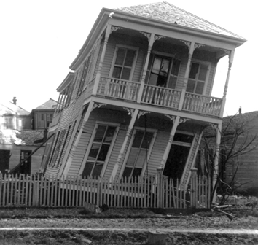
Data presentation is the foundation of our collective scientific knowledge...
Figures are especially important. They often show data for key findings.

Slide 85
Effective figures should...
Immediately convey information about study design
Illustrate important findings
Allow the reader to critically evaluate the data
Weissgerber et al. 10.1074/jbc.RA117.000147

Slide 86
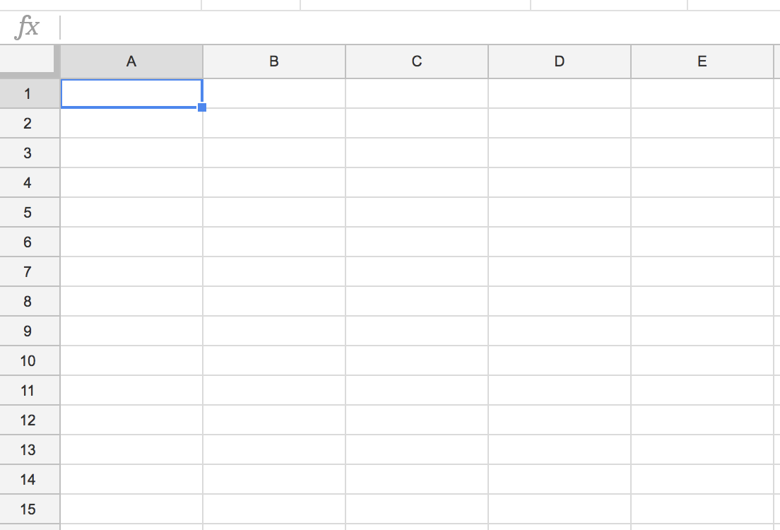
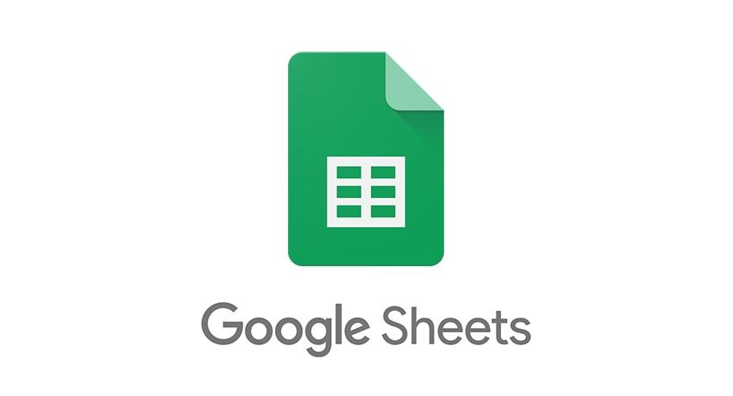
Flaws of the usual
Reproducible workflows?
Problems can be avoided by using macros or dashboards
However, who uses these?
Excel rename genes
Ziemann et al., 2016 - https://doi.org/10.1186/s13059-016-1044-7
20% of papers in leading genomic journals contain gene list errors
Default Plots are often Bar Charts and Line Plots

Slide 87
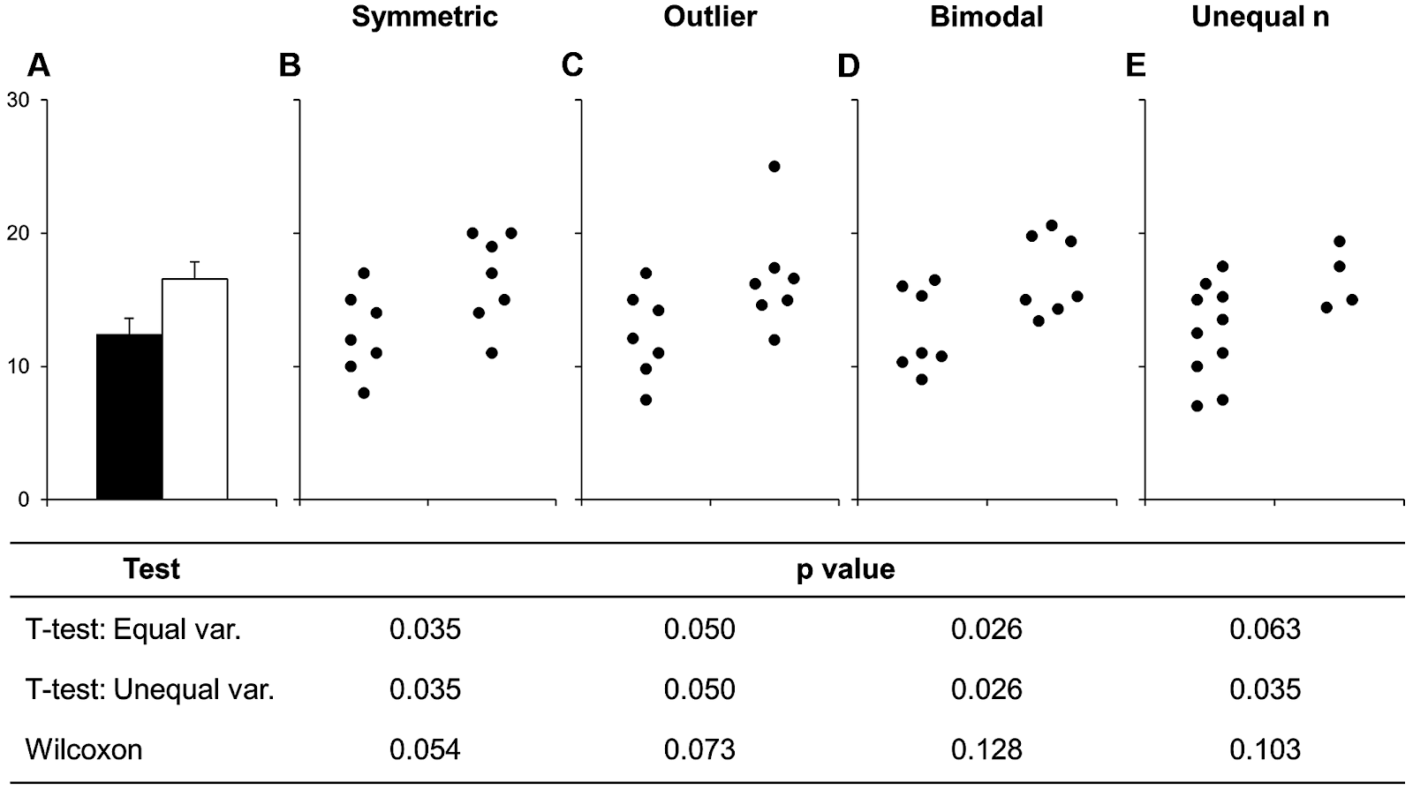
Data visualisation & reproducibility
Weissgerber et al. 10.1074/jbc.RA117.000147

Slide 88
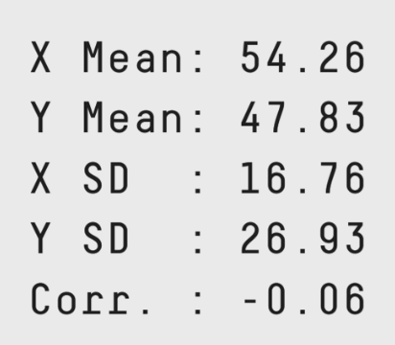
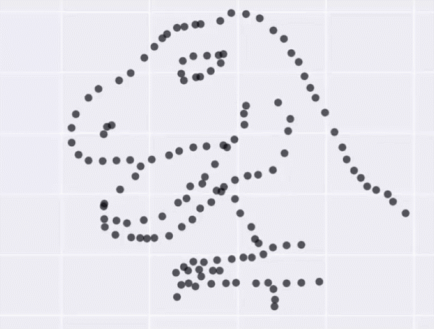
Same Stats, Different Graphs: Generating Datasets with Varied Appearance and Identical Statistics through Simulated Annealing
https://www.autodeskresearch.com/publications/samestats

Slide 89
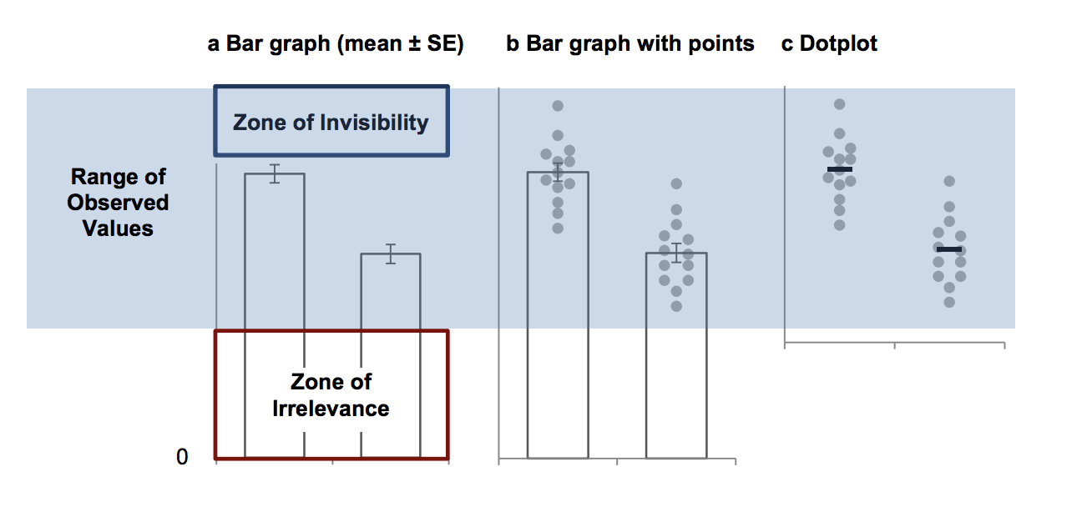
No bar graphs - even for normally distributed data
Weissgerber et al., 2017 JBC, http://www.jbc.org/content/292/50/20592.full

Slide 90
Choosing the right plot
Outcome variable | Dotplot | Boxplot with points | Boxplot | Violin plot (with or without points) | Bar graph
Sample size | Continuous | Continuous | Continuous | Continuous | Counts & proportions
Sample size | Small | Medium | Large | Medium to Large | Any
Data distribution | Any | Any | NOT for bimodal data | Any | N/A
Weissgerber et al., 2017 JBC, http://www.jbc.org/content/292/50/20592.full

Slide 91
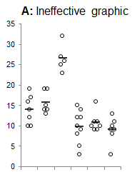
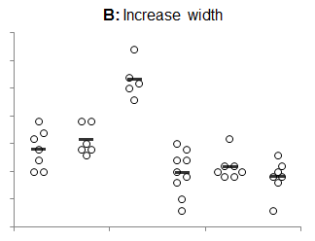
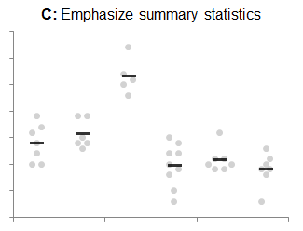
Effective dotplots: Emphasise summary statistics
Tracey Weissgerber Personal Communication

Slide 92
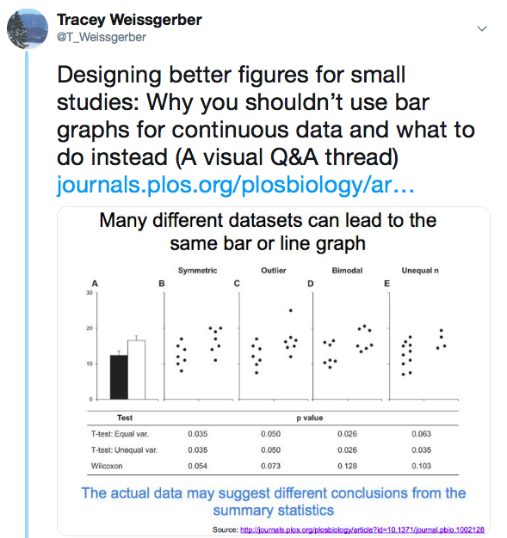
Q&A Twitter Thread
For tips, tricks and free resources.
See Tracey Weissgerber’s Twitter
https://twitter.com/t_weissgerber
This thread is pinned at the top of her feed
https://twitter.com/T_Weissgerber/status/1087646461548998657

Slide 93
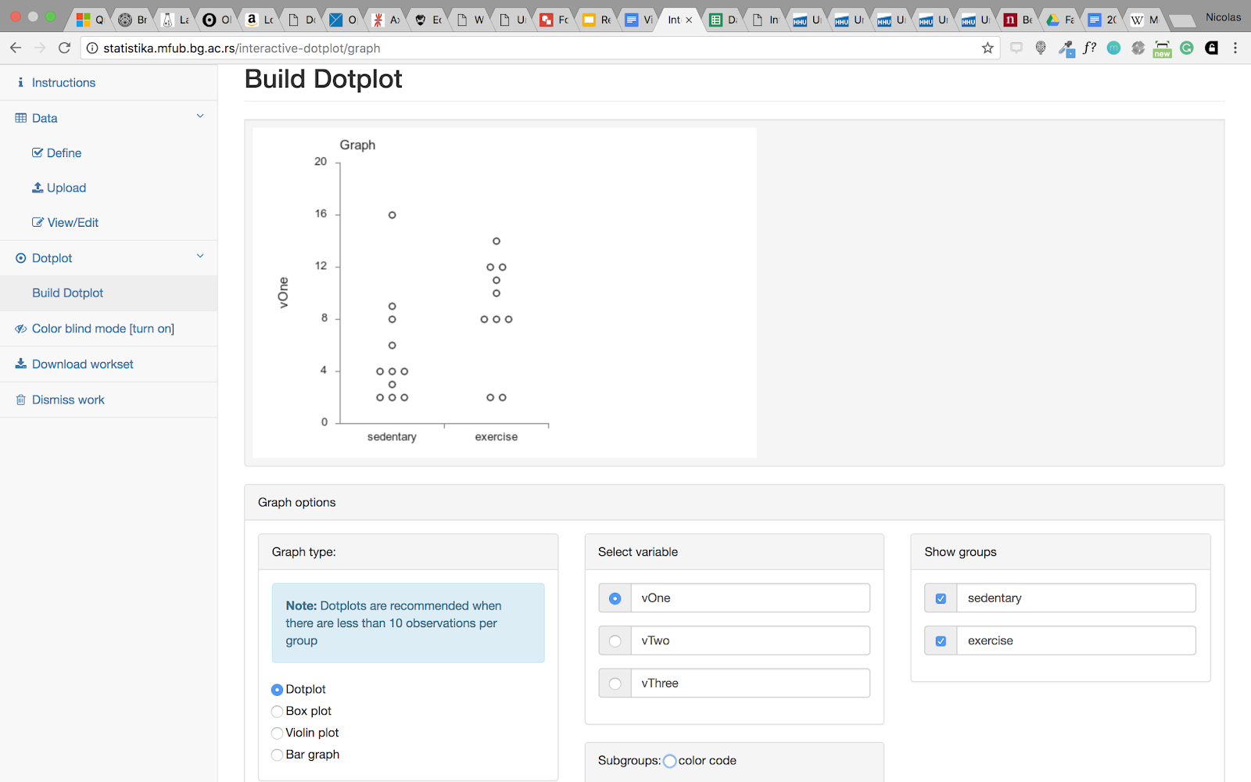
One step further: Interactive plots
Interactive Dot Plot: http://statistika.mfub.bg.ac.rs/interactive-dotplot/
Interactive Line Graph: http://statistika.mfub.bg.ac.rs/interactive-linegraph/

Slide 94
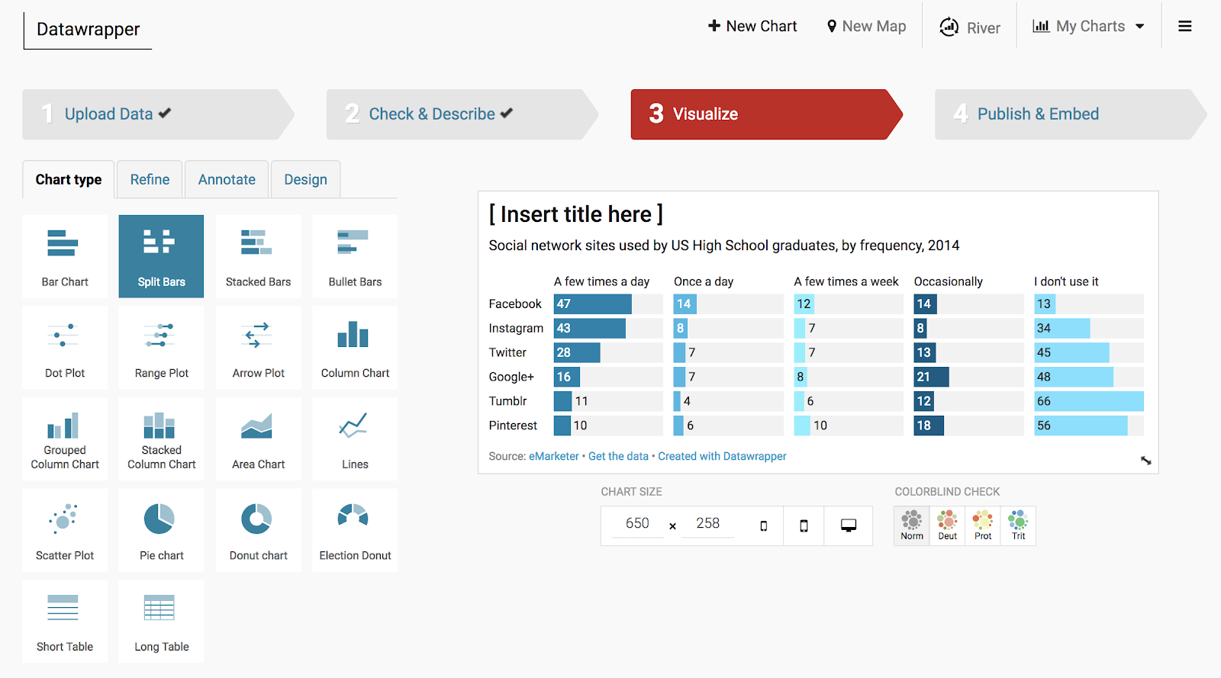
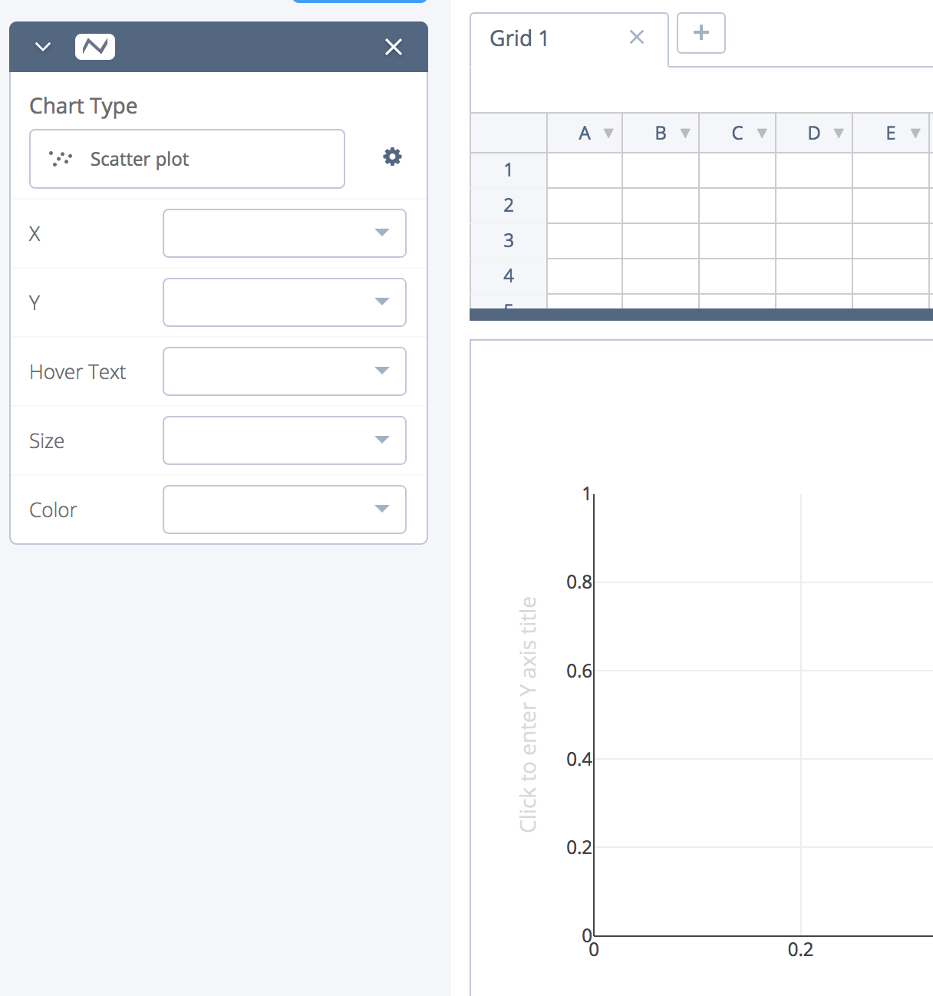
Some intermediate options
https://plot.ly/create/#/ https://www.datawrapper.de/

Slide 95
Summary
Reproducible research practices enable you to:
Organize experiments productively
Accurately analyze results
Share results with future researchers
Share techniques
Share reagents with future researchers
Accelerate science!
The tools discussed here should provide you with the framework to make you research more reproducible and will save you time and resources in the long term

Slide 97
Important bids
Future ISMPMI childcare petition tiny.cc/ICMPMI_childcare
Slides: tiny.cc/R4E_ICMPMI_slides
Handout: tiny.cc/R4E_ICMPMI_handout
Benjamin Schwessinger, Australian National University, MPMI Glasgow 2019

Slide 98
Previous & Current Funders
@CodeOceanHQ
@Addgene
@ASPB
@protocolsIO
@mozilla
@eLife

