Slide 1
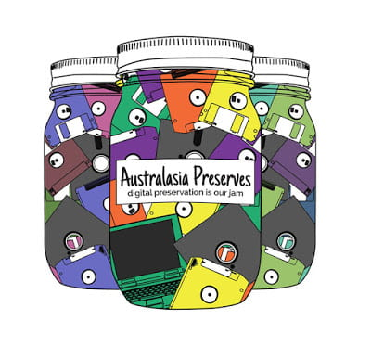
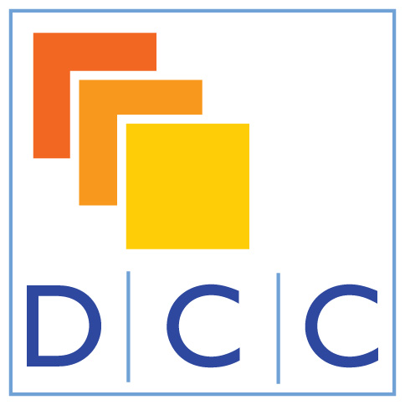
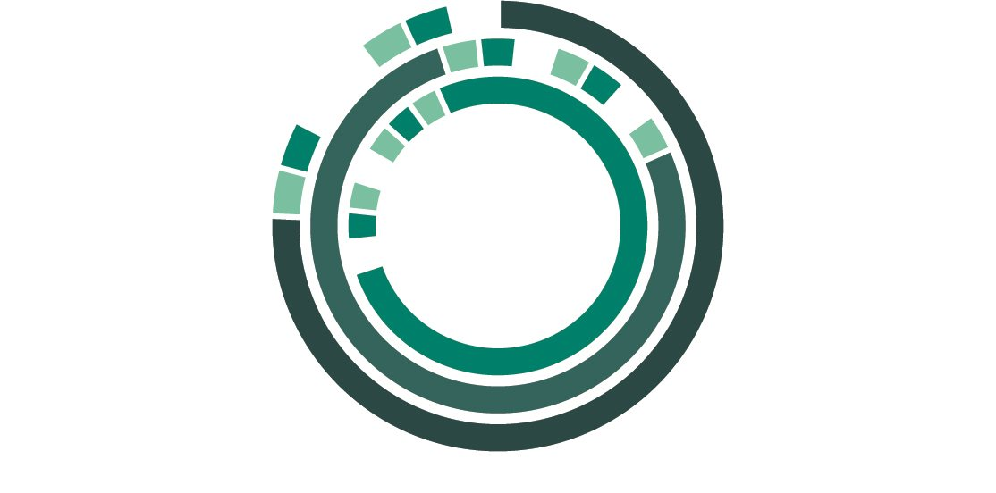
Developing Digital Preservation Skills through the AusPreserves Community of
Practice
First Digital Preservation Carpentry ideas and case developed
May 2018
AusPreserves further discussion
March 2019
February 2018
AusPreserves Starts
February 2019
International Digital Curation Conference DP Workshop
November 2019
Next iteration SLNSW as part of World Digital Preservation Day
Matthew Burgess @matthewpburgess Carey Garvie @CareyLou14
Lachlan Glanville @transmissionary Valerie Love @valerielovenz
Peter Neish @peterneish
Fiona Tweedie @FCTweedie
Jaye Weatherburn @jayechats
Notes:
A timeline
February 2018: The Australasia Preserves community of practice was formed
AusPreserves enables sharing of digital preservation knowledge and expertise, and fosters opportunities to develop personally and professionally through an active online forum, monthly virtual meet-ups, locally organised events and networking opportunities, and working groups.
May 2018: Mozilla Global Sprint
Members of the AusPreserves community took part in the 2018 Mozilla Global Sprint which the Library Carpentry community use to improve and develop library carpentry lessons. An initial discussion took place around the need for a digital preservation carpentry lesson and what it would look like. This was presented back to the AusPreserves community and a survey was sent out to AusPreserves and received 122 reponses detailing what people wanted to learn, background skills and whether they would like to contribute to lesson development. Form this a small group (including most of the people on this slide) formed to develop a lesson with the aim of teaching it at IDCC the following year.
February 2019: IDCC 2019 Digital Preservation Workshop
The workshop reached maximum capacity. The content included a mix of jargon-busting, talking to slides, hands on computer activities using bagger and a build-your-own-workflow session with cards, pens and blu-tac. The feedback was excellent and we learnt a lot from testing and validating the lesson content. Again this was presented back to AusPreserves and a group formed to look at how to develop further. This group was made up of two sub-groups: one was charged with expanding the content to a two-day workshop, the other would look at digital preservation and education more broadly and at the higher level principles.
November 2019: World Digital Preservation Day
Matthew Burgess will be teaching this at the State Library of New South Wales to coincide with World Digital Preservation Day. This is what were are currently aiming for.
While the training was initiated through the library carpentry community, it has moved away somewhat from the initial carpentry-based model. In some ways it is more of a flipped carpentry. The idea of the carpentries is that researchers have a good idea of the questions they want to ask, but lack the computational skills to do this efficiently - carpentry teaches the tools so that the participant can then go and build a script or workflow or whatever in order to answer their research questions. In our training there is still a practical component, but the intent is different. A large part of the content is around principles and processes in digital preservation and filling in some of the more technical details. The hands on carpentry-style parts help to reinforce the this content. For example, using a command-line tool to extract some metadata or generate a checksum hopefully makes the rest of the content more real and practical.
All content will be made available openly under a cc-by licence.
Australasia preserves logo courtesy of Matthew Burgess CC BY-NC-SA 4.0

