Slide 1
Explore Atlantic Storms:
Jupyter Notebooks Hurricane Activity
https://sched.co/Qc3g
ESIP Summer Meeting 2019, Data in Action with Jupyter Notebooks and other Earth Science Tools, Wednesday, July 17, 2019
Shelley Olds, UNAVCO
LuAnn Dahlman, NOAA
Sean Gordon, HDF Group
Keith Maull, UCAR
Source: NOAA National Environmental Satellite, Data, and Information Service (NESDIS), NOAA Environmental Visualization Laboratory

Slide 2
You CAN hack this:
Learn to modify & run code to display and analyze data using Jupyter Notebooks
Source: NOAA National Environmental Satellite, Data, and Information Service (NESDIS),
NOAA Environmental Visualization Laboratory
ESIP Summer Meeting 2019, Data in Action with Jupyter Notebooks and other Earth Science Tools, Wednesday, July 17, 2019

Slide 3
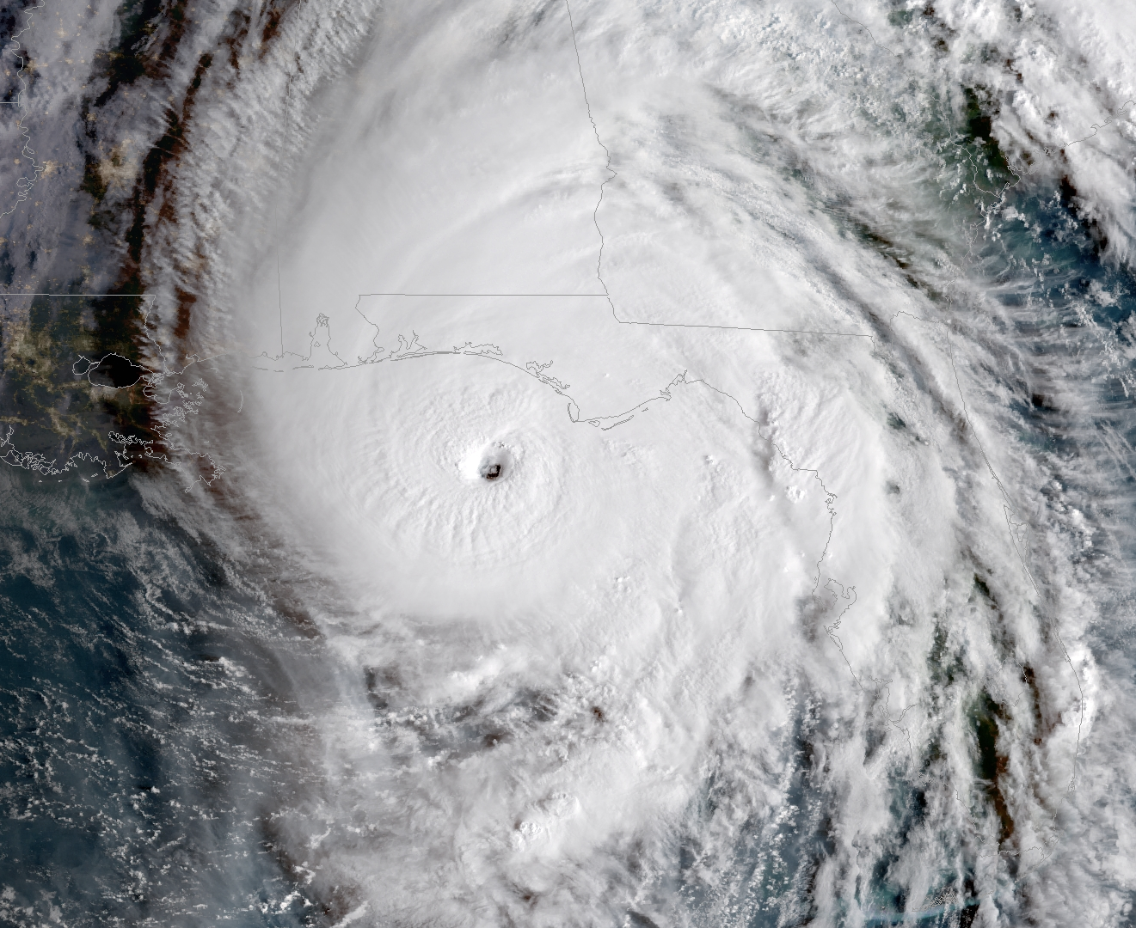
Summer Workshop Goals
Provide you with geoscience tools available online & a coding example within a Jupyter environment that you and your students can modify and enhance to foster curiosity and experimentation.
Notes:
NOAA Environmental Visualization Laboratory

Slide 4
Introductions … who are we
Menti… &
Vote with your feet…. along a line….
Have you been to Jupyter?
I’ve created geoscience Jupyter Notebooks
I’ve used Jupyter notebooks
Is it college lined or gridded?
1
3
Curriculum design background:
I breathe and eat pedagogy
Give me some good models, I can make it work
Uh, what’s a learning objective?
Programming background:
I live and breathe code
Give me some good examples, I can modify it
Python is a type of snake, right?
2

Slide 5
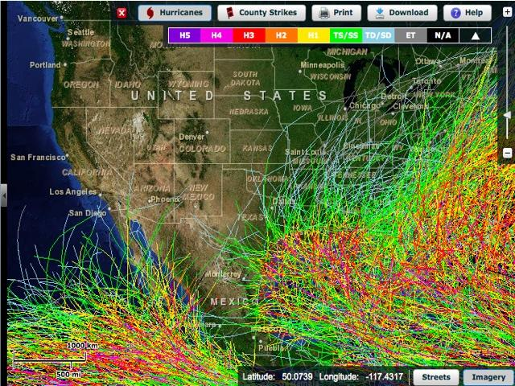
Exploring Historical Hurricane Tracks ...
https://coast.noaa.gov/hurricanes/
Notes:
Putting hurricane data on the map:
https://serc.carleton.edu/earthlabs/hurricanes/4.html

Slide 6
Exploring Historical Hurricane Tracks ...
Potential Advantages
Potential Drawbacks
Notes:
Putting hurricane data on the map:
https://serc.carleton.edu/earthlabs/hurricanes/4.html

Slide 7
Exploring Historical Hurricane Tracks ...
Potential Advantages
Fairly easy to use
Quickly dive in
Explore in detail individual storms
Potential Drawbacks
Basins can be confusing
Danger of point-click
Might not be answering the questions students have
Notes:
Putting hurricane data on the map:
https://serc.carleton.edu/earthlabs/hurricanes/4.html

Slide 8
Objectives: to build skills to
Find Jupyter notebooks by searching Github
Feel comfortable opening & running Jupyter Notebook
Build confidence in changing parameters in code cells (fail & break the code in a safe environment)
Build familiarity with decyphering code (decomposition)
Recognize patterns in code (pattern recognition), like LEGO blocks
Ask and answer your own questions - conversations with data
Notes:
Session Goals are to show demystify code
How coding is often grouped into blocks that fit together, like LEGO blocks
That you too can modify (hack) the code in a notebook
You can fail safely and try again
Learn about hurricanes
Make your own questions about exploring hurricanes

Slide 9
Jupyter … notebooks, lab, hub, collaboratory
Let’s jump in! Head to…
Github.com
Search for this repository:
ExploreAtlanticStorms

Slide 10
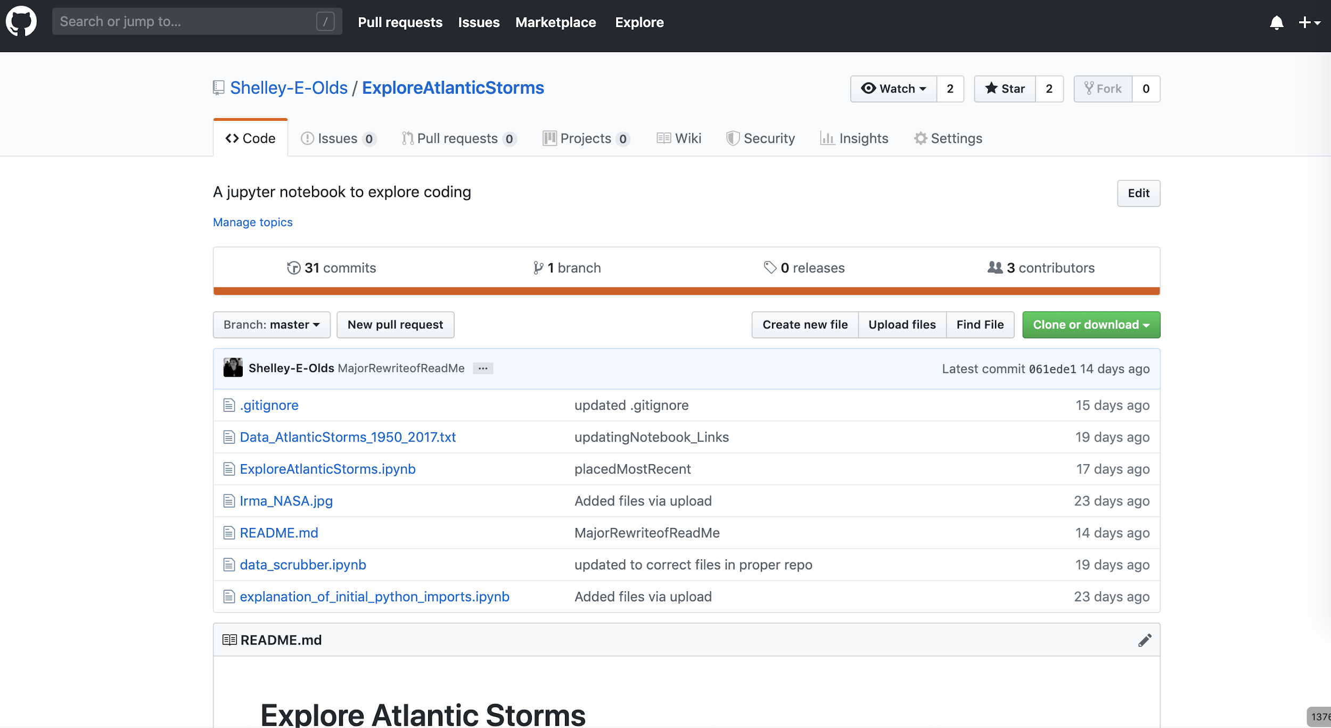
Quick walkthrough of a GitHub repository

Slide 11
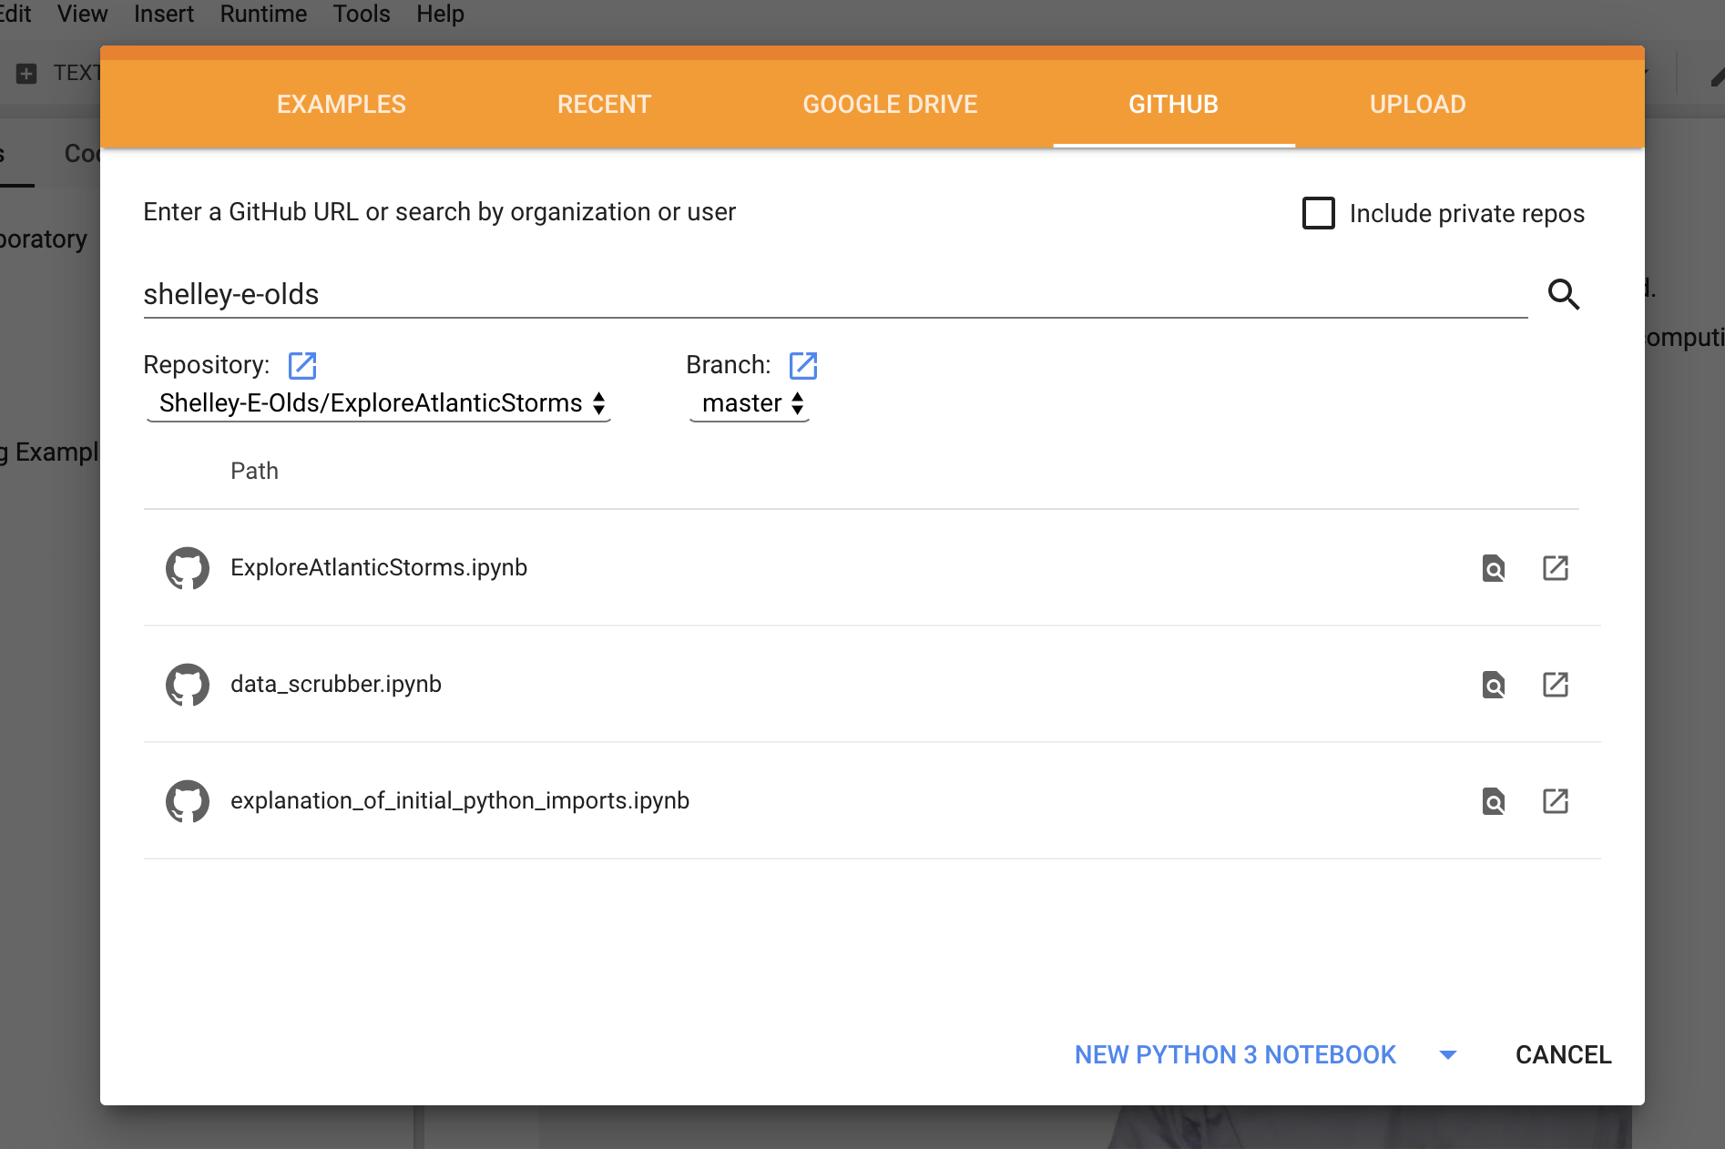
Let’s open the notebook in Google Colaboratory
https://colab.research.google.com/
File > Open notebook...
Select the Github Tab
Enter shelley-e-olds
Select ExploreAtlanticStorms.ipynb
Work in progress: data columns, coding solutions, more questions to explore & examples of printing for debugging

Slide 12
Wrap up
Finding more Jupyter notebooks - using Github
“Real” Jupyter Environments
Feedback: Menti

Slide 13
Thank you!

