Slide 1
Data to Action with Jupyter Notebooks and other Earth Science Tools
Source: NOAA National Environmental Satellite, Data, and Information Service (NESDIS), NOAA Environmental Visualization Laboratory
ESIP Summer Meeting 2019, Data in Action with Jupyter Notebooks and other Earth Science Tools, Wednesday, July 17, 2019
Margaret Mooney, CIMMS
Shelley Olds, UNAVCO
Ilya Zaslavsky, SDSC
LuAnn Dahlman, NOAA
Sean Gordon, HDF Group
Keith Maull, NCAR

Slide 2
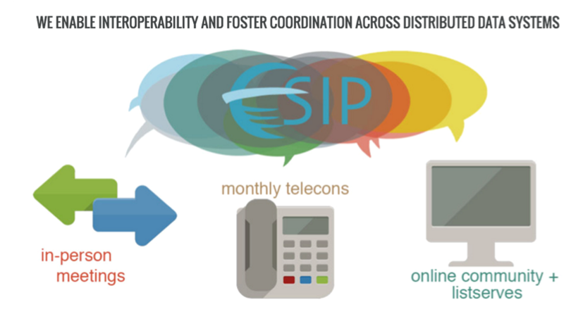
The Earth Science Information Partners (ESIP) Federation: Our community spans the range from researchers and instrument builders, to data providers and stewards, to communicators and educators.
Our common interest: Promote the use and understanding of Earth Science data.

Slide 3
ESIP’s Education Committee
Curriculum developers, instructors, evaluators, and educators in ESIP who promote the use of Earth Science data for learning
Notes:
Some of the projects represented by people who work with the education committee

Slide 4
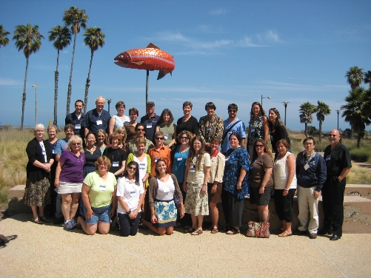
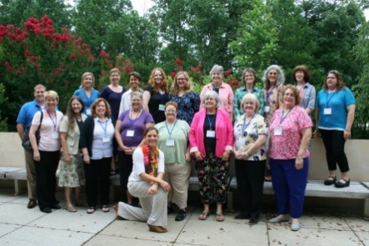
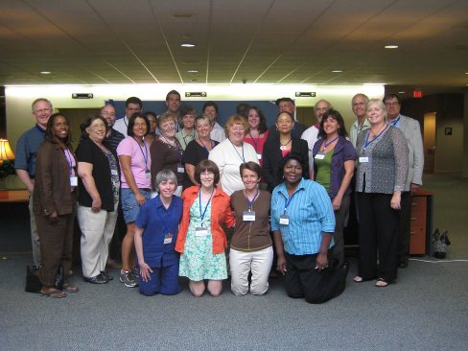
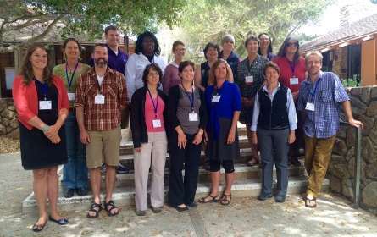
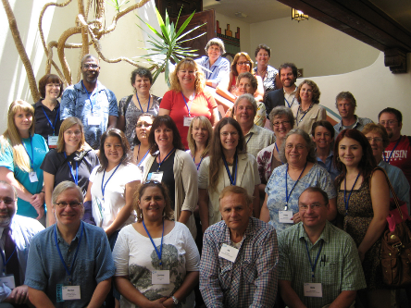
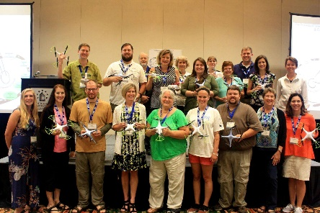
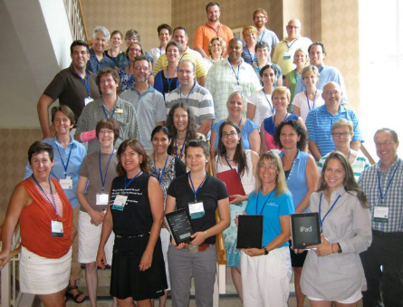
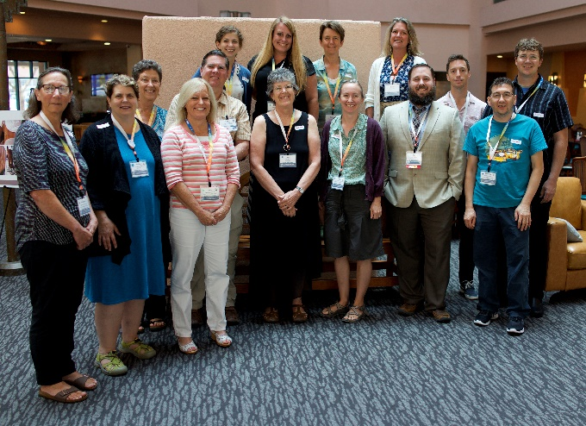
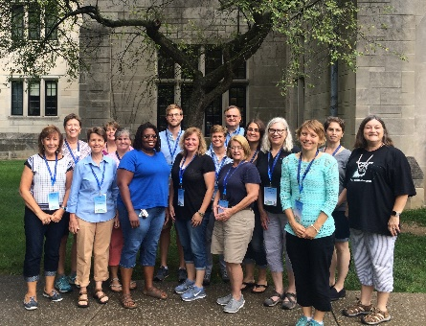
Agenda
2009
2013
1:00 pm - Introductions, ESIP Overview & Intro to Coding with Jupyter Notebooks
1:15 pm - GOES-16/17 RGB Activity w/ NOAA CIMSS
1:30 pm Jupyter Notebooks Hurricane Activity
3:00 pm - Break
3:30 pm - SuAVE Survey Analysis via Visual Exploration
4:45 pm - Wrap-up and Evaluations
5:30 pm (optional) - Research Showcase
2010
2015
2010
2016
2011
2017
2012
2012
2018

Slide 5
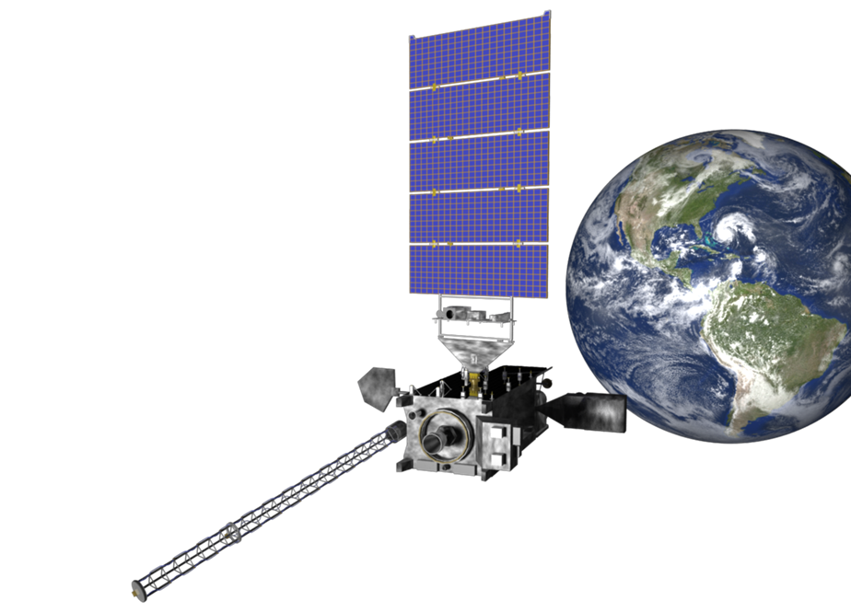
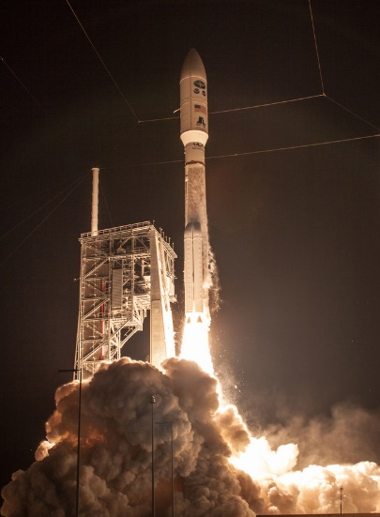
GOES-16/17 RGB Activity
Margaret Mooney
Cooperative Institute for Meteorological Satellite Studies (CIMSS)
University of Wisconsin-Madison
ESIP Education 2019

Slide 6
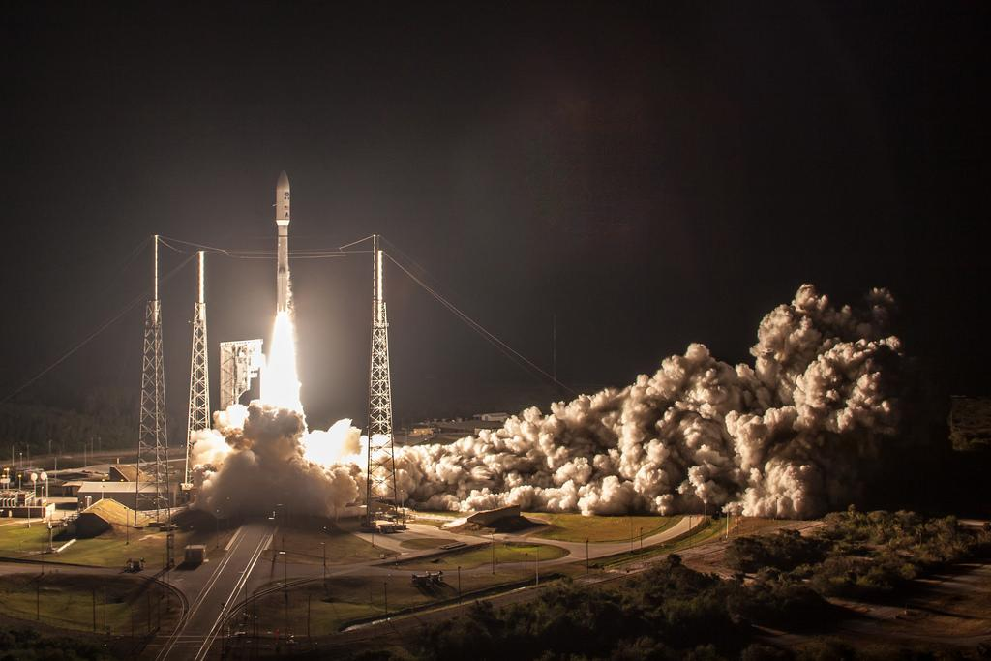
GOES-R launched in November 2016, was renamed
GOES-16 when it reached geostationary orbit, & became the operational GOES-East satellite in November 2017.
Photo credit: NOAA

Slide 7
GOES-S launched on March 1st 2018!
Was renamed GOES-17 soon after and became our operational GOES-West satellite late fall 2018.

Slide 8
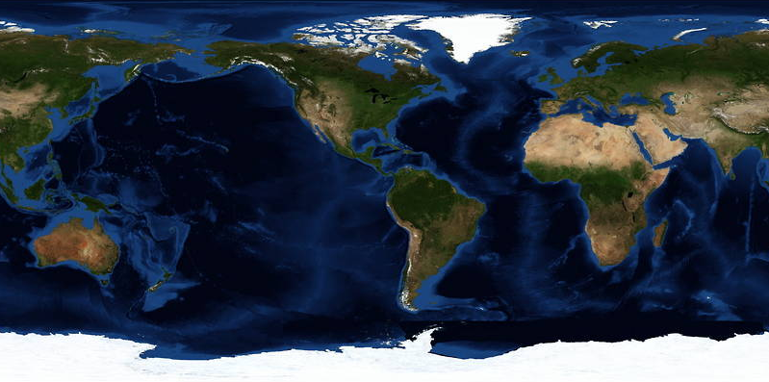
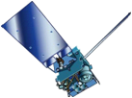
U.S. GOES Constellation Geostationary Operational Environmental Satellites
GOES-West
GOES-17
GOES-East
GOES-16
Standby
GOES-14
105° West
2 operational satellites
1 standby

Slide 9
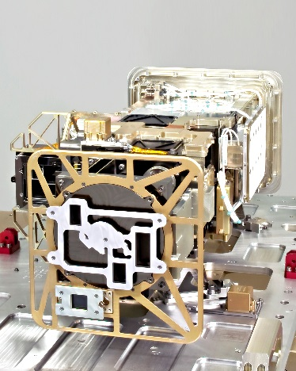
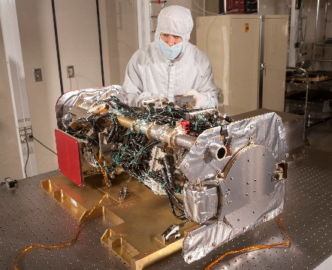
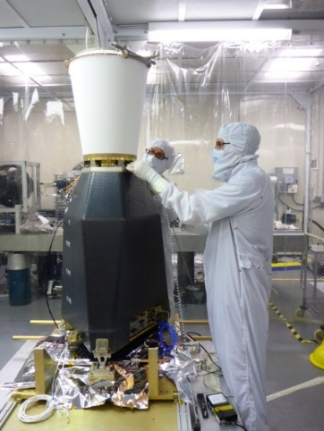
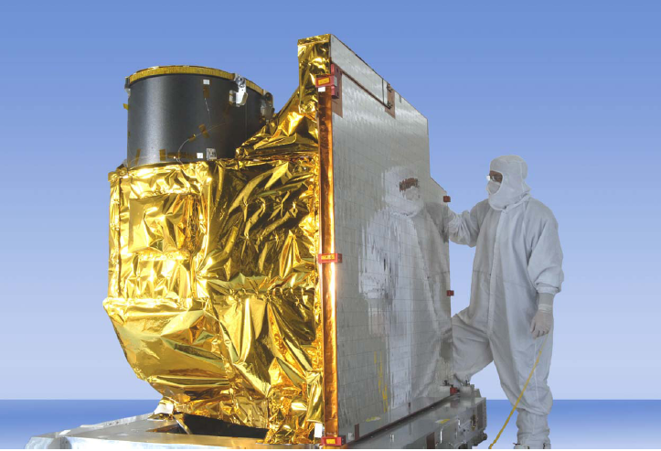
GOES-R Series Spacecraft
Extreme Ultraviolet and X-Ray Irradiance Sensor (EXIS)
Space Environment In Situ Suite (SEISS)
Solar Ultraviolet Imager (SUVI)
Magnetometer
Geostationary Lightning Mapper (GLM)
Advanced Baseline Imager (ABI)

Slide 10
GOES-R Series Spacecraft
Geostationary Lightning Mapper (GLM)
Advanced Baseline Imager (ABI)

Slide 11
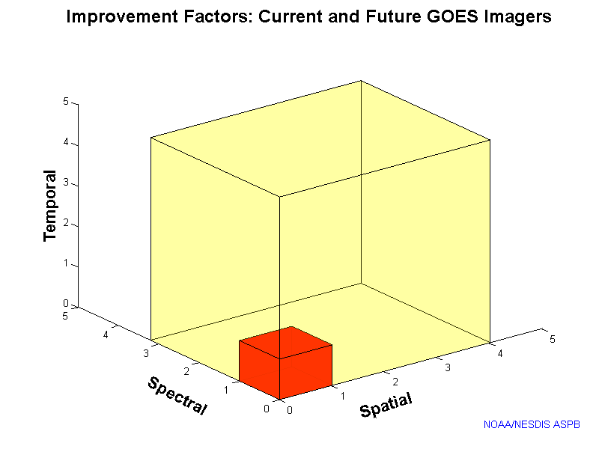
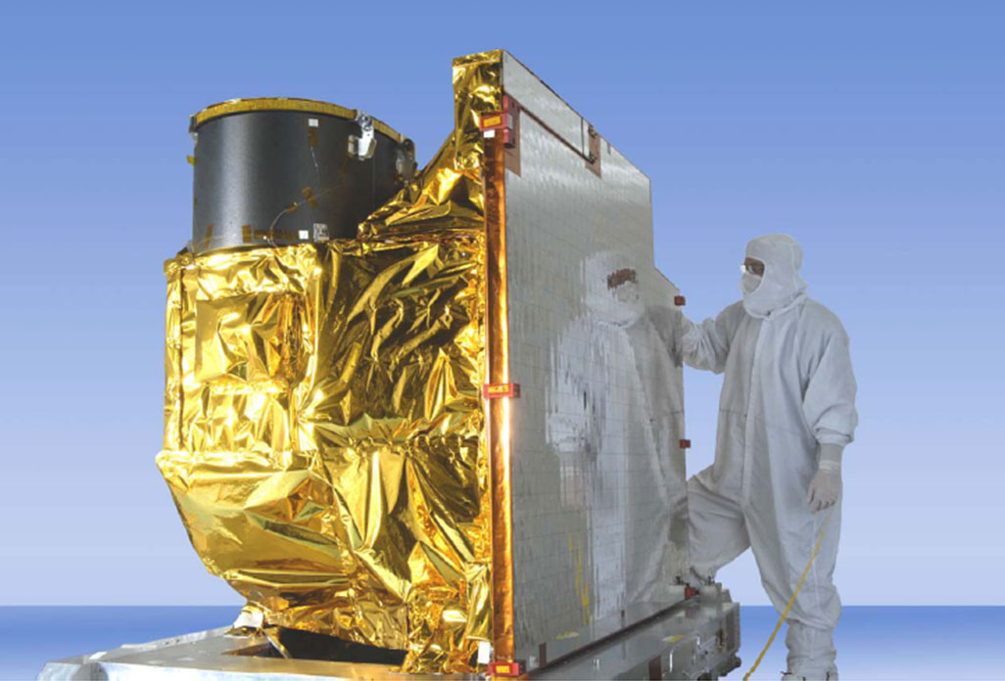
Advanced Baseline Imager (ABI)
5
4
3
X
Faster coverage (5-minute full disk vs. 25-minute)
X
Improved spatial resolution
(2 km IR vs. 4 km)
X
More spectral bands (16 on ABI vs. 5 on the current imager)
Notes:
Slide from J. Gerth, CIMSS.

Slide 12
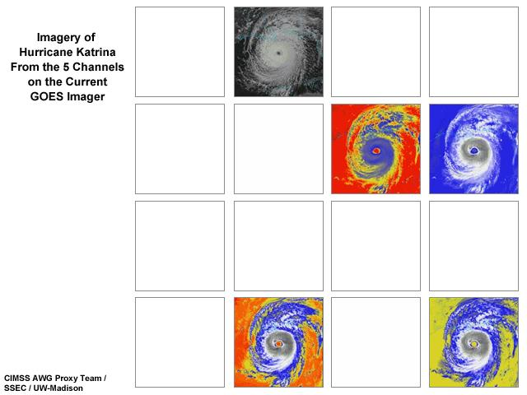
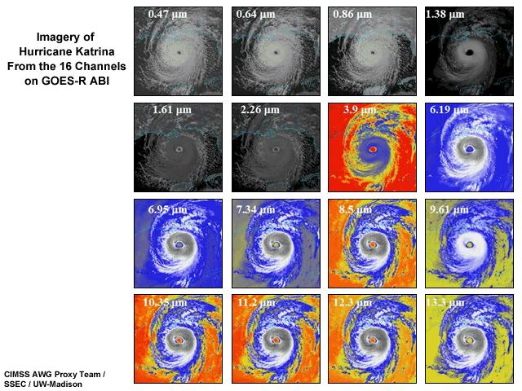
Advanced Baseline Imager - ABI
3 times the spectral data!
GOES-13/14/15 Spectral Bands
GOES-R Series Spectral Bands

Slide 13
New HTML5 WebApps!

Slide 14
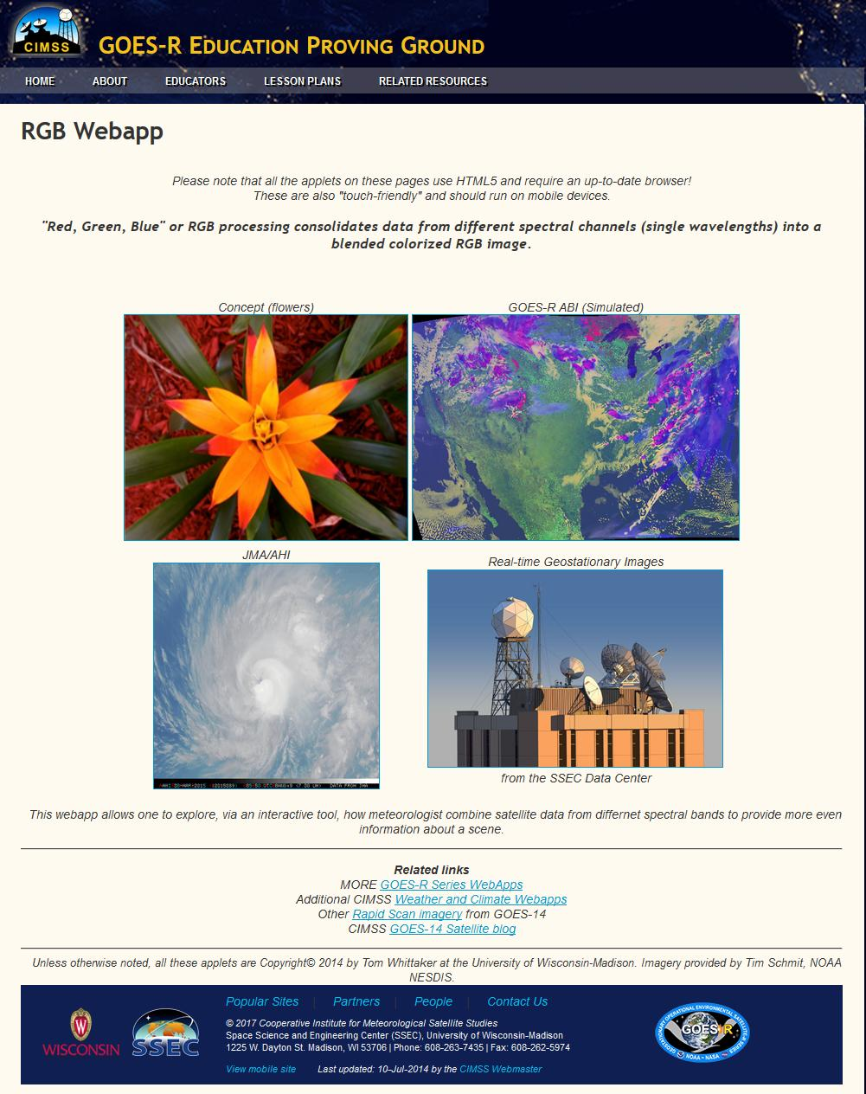

Slide 15
GOES-16/17 Virtual Science Fair
Spring 2020: Student teams conduct research using GOES- 16 or GOES-17 ABI data
There will be three winning teams: middle school, high school & grades 13/14 (community college or university). Students from the winning teams will receive $25 Amazon gift cards AND a GOES-T launch viewing invitations. (but no travel support).
The coaches/teachers of the winning teams (3 total) will have their travel & conference registration paid
to the American Meteorology Society (AMS)
Centennial meeting in Boston in January 2020
to present in the education symposium

Slide 16
GOES16/17 Science Fair Specifics
Accepting entries starting April 1st, 2020
Details and updates on-line at
http://cimss.ssec.wisc.edu/education/goesr/
All entries must be submitted by May 22nd, 2020
3-5 students allowed on each submission
1 teacher/coach per entry

Slide 17
SUMMARY -
- GOES R Education Proving Ground
http://cimss.ssec.wisc.edu/education/goesr/
- Virtual Science Fair! http://cimss.ssec.wisc.edu/education/goesr/vsf
Follow us on twitter at @UWCIMSS
Follow us on Facebook at CIMSS.UW.Madison
Contact me at margaret.mooney@ssec.wisc.edu

Slide 18
Explore Atlantic Storms:
Jupyter Notebooks Hurricane Activity
https://sched.co/Qc3g
ESIP Summer Meeting 2019, Data in Action with Jupyter Notebooks and other Earth Science Tools, Wednesday, July 17, 2019
Shelley Olds, UNAVCO
LuAnn Dahlman, NOAA
Sean Gordon, HDF Group
Keith Maull, UCAR
Source: NOAA National Environmental Satellite, Data, and Information Service (NESDIS), NOAA Environmental Visualization Laboratory

Slide 19
You CAN hack this:
Learn to modify & run code to display and analyze data using Jupyter Notebooks
Source: NOAA National Environmental Satellite, Data, and Information Service (NESDIS),
NOAA Environmental Visualization Laboratory
ESIP Summer Meeting 2019, Data in Action with Jupyter Notebooks and other Earth Science Tools, Wednesday, July 17, 2019

Slide 20
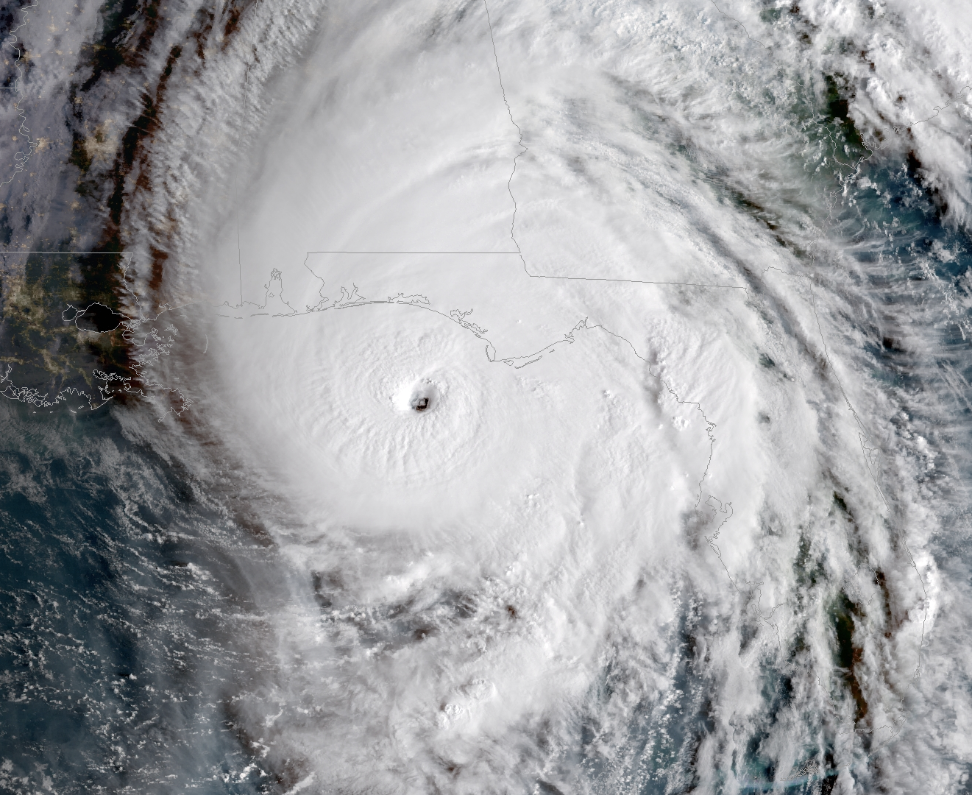
Summer Workshop Goals
Provide you with geoscience tools available online & a coding example within a Jupyter environment that you and your students can modify and enhance to foster curiosity and experimentation.
Notes:
NOAA Environmental Visualization Laboratory

Slide 21
Introductions … who are we
https://www.mentimeter.com/s/4bf8ecb388e48f06a830338bc1ea6e45/844c9883b7b5
Vote with your feet…. along a line….
Have you been to Jupyter?
I’ve created geoscience Jupyter Notebooks
I’ve used Jupyter notebooks
Is it college lined or gridded?
1
3
Curriculum design background:
I breathe and eat pedagogy
Give me some good models, I can make it work
Uh, what’s a learning objective?
Programming background:
I live and breathe code
Give me some good examples, I can modify it
Python is a type of snake, right?
2

Slide 22
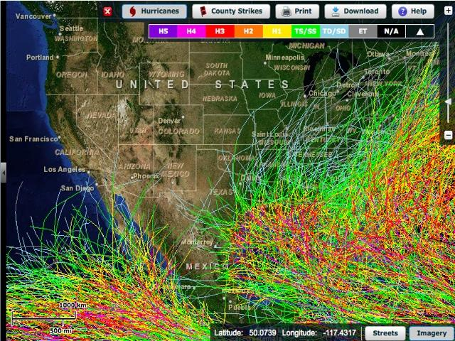
Exploring Historical Hurricane Tracks ...
https://coast.noaa.gov/hurricanes/
Notes:
Putting hurricane data on the map:
https://serc.carleton.edu/earthlabs/hurricanes/4.html

Slide 23
Exploring Historical Hurricane Tracks ...
Potential Advantages
Potential Drawbacks
Notes:
Putting hurricane data on the map:
https://serc.carleton.edu/earthlabs/hurricanes/4.html

Slide 24
Exploring Historical Hurricane Tracks ...
Potential Advantages
Fairly easy to use
Quickly dive in
Explore in detail individual storms
Potential Drawbacks
Basins can be confusing
Danger of point-click
Might not be answering the questions students have
Notes:
Putting hurricane data on the map:
https://serc.carleton.edu/earthlabs/hurricanes/4.html

Slide 25
Objectives: to build skills to
Find Jupyter notebooks by searching Github
Feel comfortable opening & running Jupyter Notebook
Build confidence in changing parameters in code cells (fail & break the code in a safe environment)
Build familiarity with decyphering code (decomposition)
Recognize patterns in code (pattern recognition), like LEGO blocks
Ask and answer your own questions - conversations with data
Notes:
Session Goals are to show demystify code
How coding is often grouped into blocks that fit together, like LEGO blocks
That you too can modify (hack) the code in a notebook
You can fail safely and try again
Learn about hurricanes
Make your own questions about exploring hurricanes

Slide 26
Jupyter … notebooks, lab, hub, collaboratory
Let’s jump in! Head to…
Github.com
Search for this repository:
ExploreAtlanticStorms

Slide 27
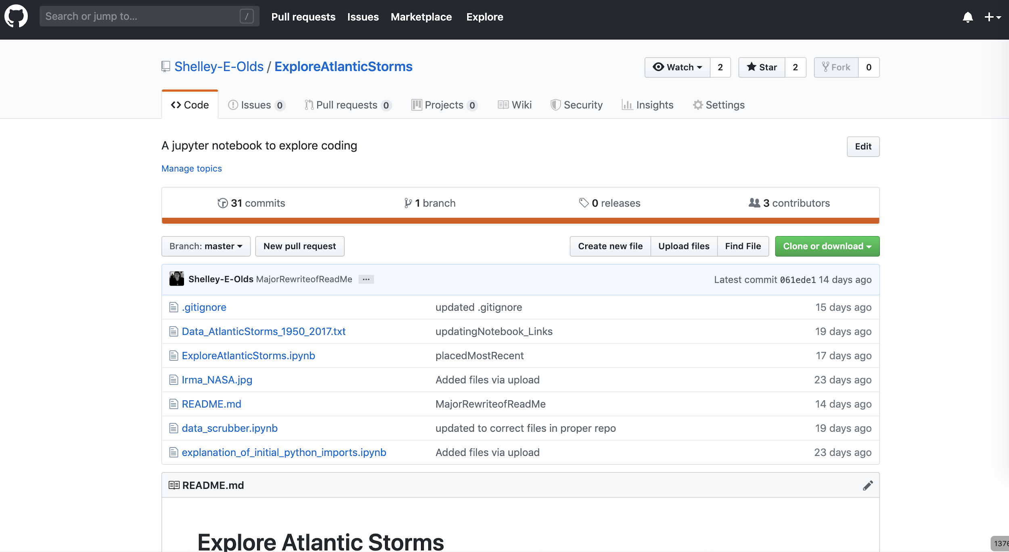
Quick walkthrough of a GitHub repository

Slide 28
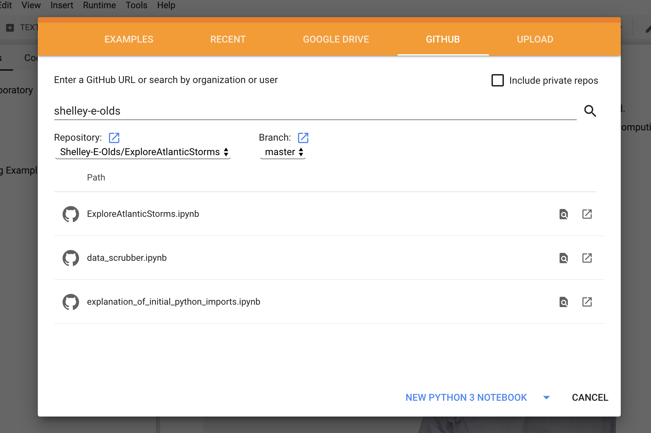
Let’s open the notebook in Google Colaboratory
https://colab.research.google.com/
File > Open notebook...
Select the Github Tab
Enter shelley-e-olds
Select ExploreAtlanticStorms.ipynb
Work in progress: data columns, coding solutions, more questions to explore & examples of printing for debugging

Slide 29
Wrap up
Finding more Jupyter notebooks - using Github
“Real” Jupyter Environments
Feedback: Menti
https://www.mentimeter.com/s/ae30df67b0bb84b2d2e773aa17d3ff45/21fa8329127c

Slide 30
Thank you!

