Slide 1
Measuring the FAIR Principles Ted Habermann Matt Jones
Peter Slaughter Margaret O’Brien
A diverse set of stakeholders—representing academia, industry, funding agencies, and scholarly publishers—have come together to design and jointly endorse a concise and measurable set of principles that we refer to as the FAIR Data Principles. Wilkinson et al., 2016
F2. Data are described with rich metadata (defined by R1 below)
R1. Meta(data) are richly described with a plurality of accurate and relevant attributes
R1.1. (Meta)data are released with a clear and accessible data usage license
R1.2. (Meta)data are associated with detailed provenance
R1.3. (Meta)data meet domain-relevant community standards

Slide 2
FAIR-TLC – Traceability, License, Connectedness
F2: Contents/components are well documented and searchable
Concrete metrics:
● Metadata documented: can you learn enough from the metadata to know if further effort with the dataset is warranted i.e timestamps, versions, counts etc.
● Indexed: Contents are indexed and ideally optimized to support the most common types of queries
● Searchable using various mechanisms: Search boxes and APIs are not only present, they are also documented, and populated with examples
● Contactable: Contact information is readily discoverable; responses are prompt
FAIR-TLC: Metrics to Assess Value of Biomedical Digital Repositories: Response to RFI NOT-OD-16-133
https://zenodo.org/record/203295#.XSyNaZNKh24

Slide 3
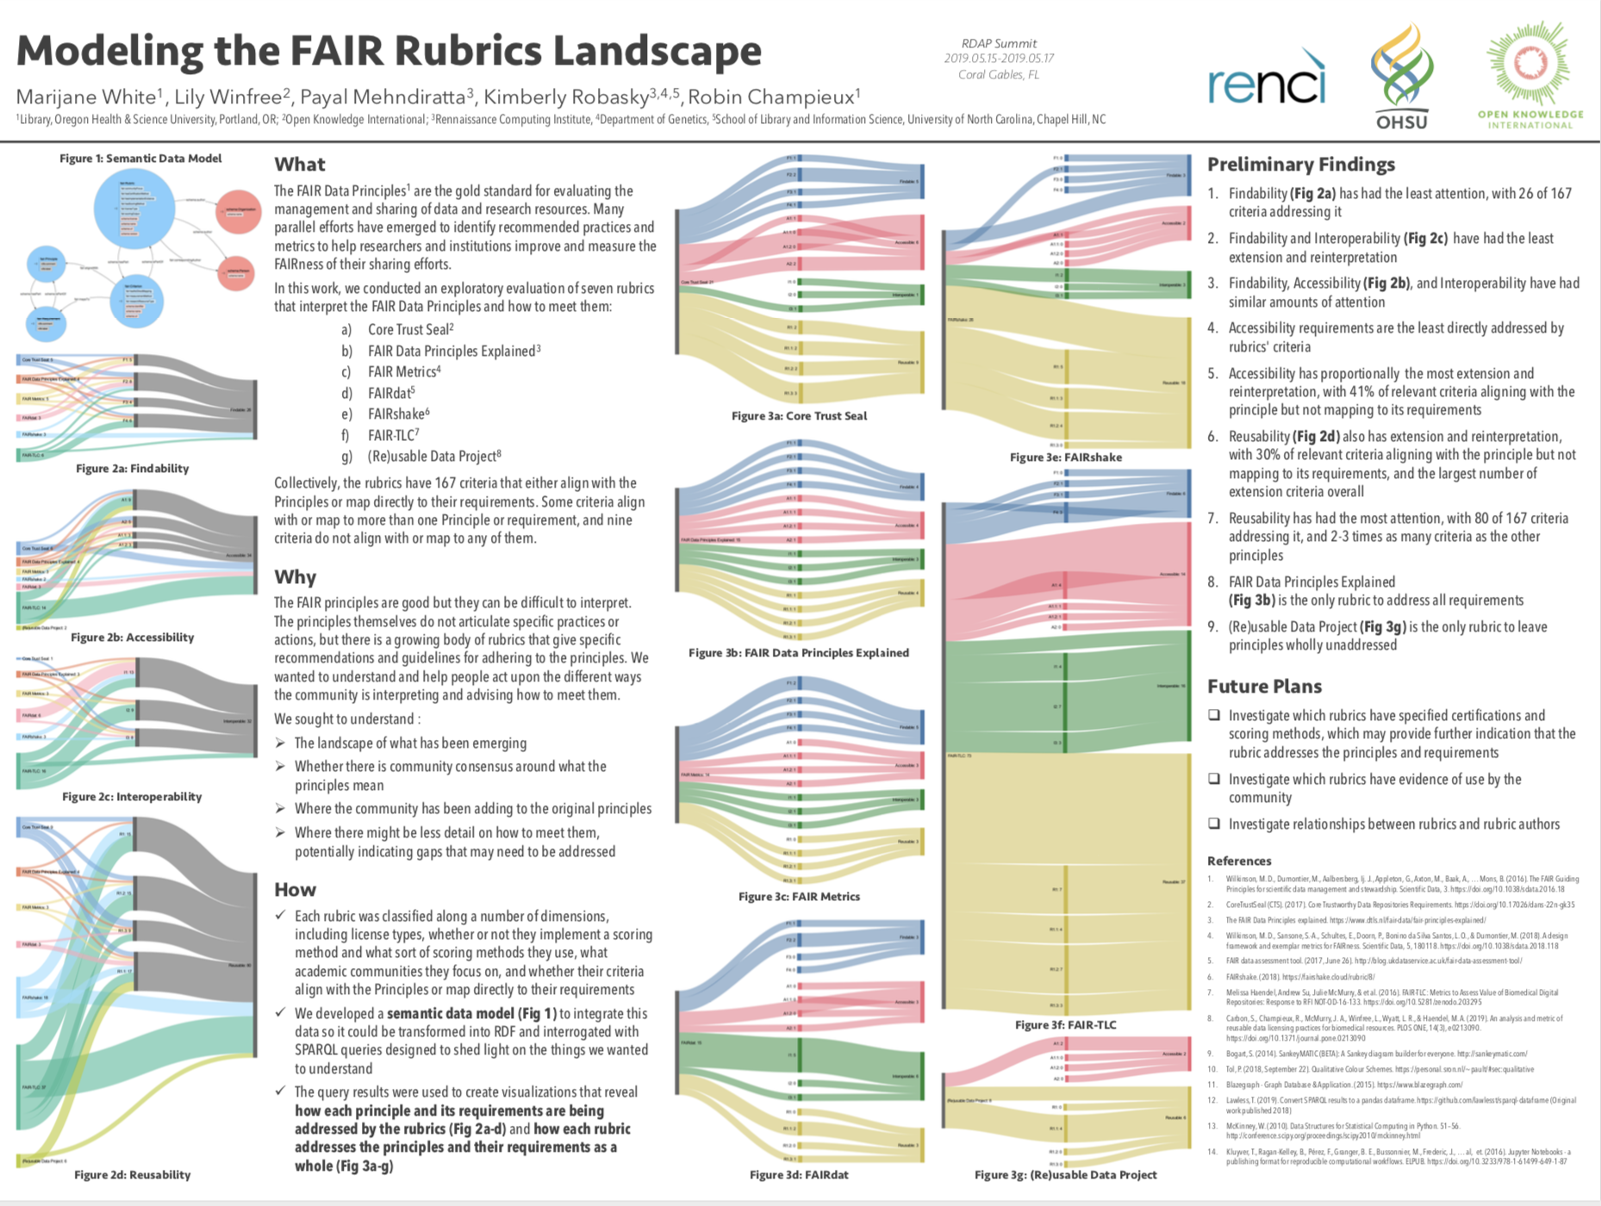
https://osf.io/685sw/

Slide 4
OAIS – Mandatory Repository Requirements
Negotiate for and accept appropriate information from information Producers.
Obtain sufficient control of the information provided to the level needed to ensure Long Term Preservation.
Determine, either by itself or in conjunction with other parties, which communities should become the Designated Community and, therefore, should be able to understand the information provided, thereby defining its Knowledge Base.
Ensure that the information to be preserved is Independently Understandable to the Designated Community. In particular, the Designated Community should be able to understand the information without needing special resources such as the assistance of the experts who produced the information.
Follow documented policies and procedures which ensure that the information is preserved against all reasonable contingencies, including the demise of the Archive, ensuring that it is never deleted unless allowed as part of an approved strategy. There should be no ad-hoc deletions.
Make the preserved information available to the Designated Community and enable the information to be disseminated as copies of, or as traceable to, the original submitted Data Objects with evidence supporting its Authenticity.

Slide 5
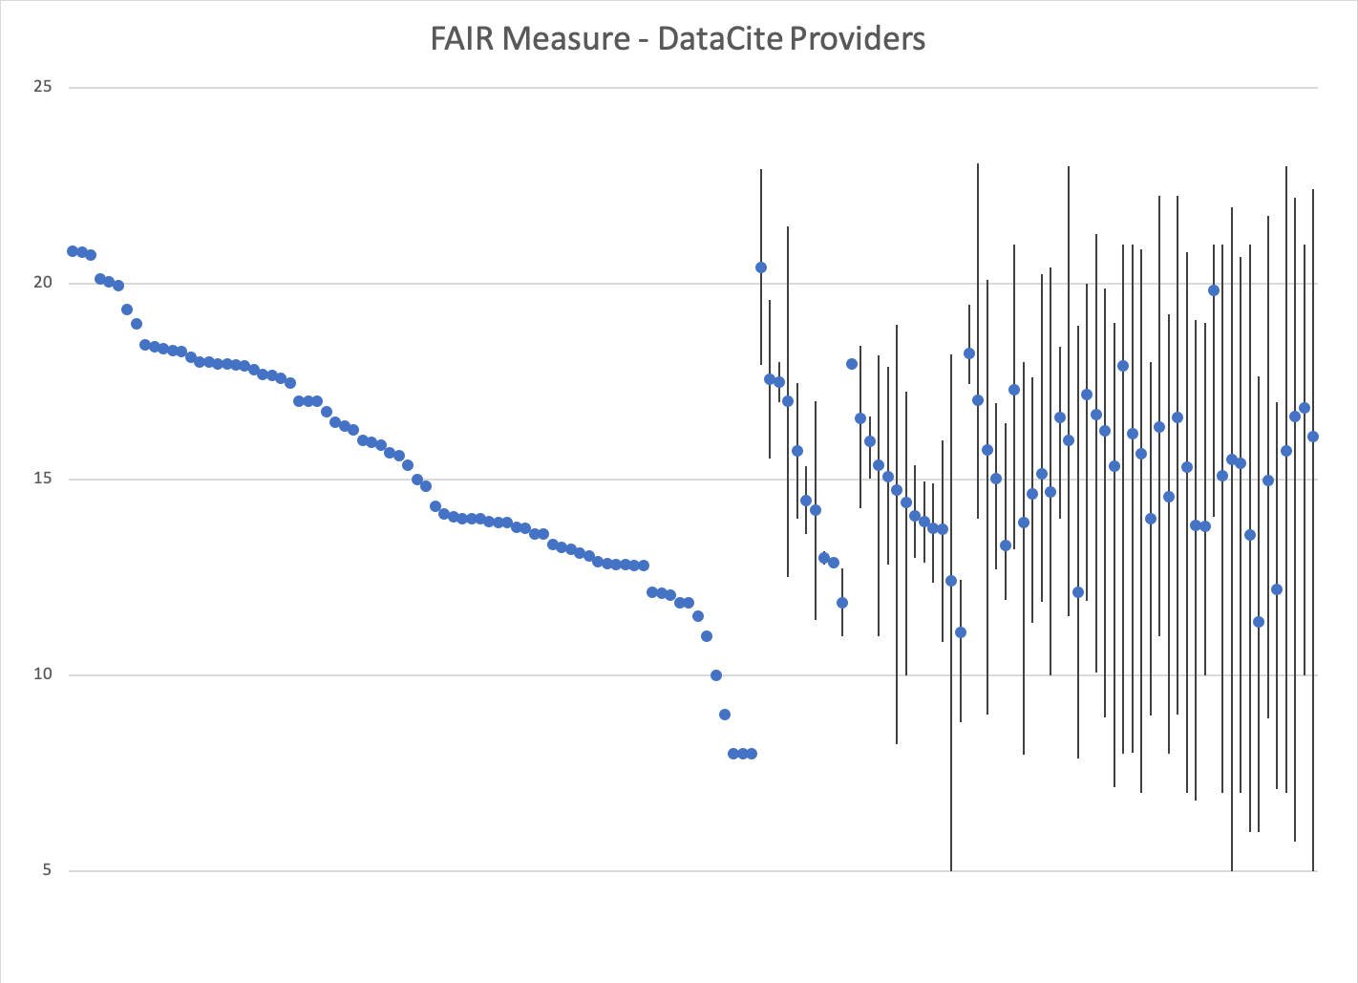
FAIR Measure – DataCite Providers
UCAR
NOAA
USGS
NASA
Dryad
ORNLDACC
NSIDC
IRIS
ANDS
UNAVCO
ESDIS
1
2
183
Number of Clients

Slide 6
DataCite FAIR – Dialect Evolution
Identifier (type)
Creator (Individual)
Title
Publisher
Publication Year
Format
Rights
Distributor Sponsor
Funder RightsHolder
Affiliation
IsDerivedFrom IsSourceOf
Creator (Organization)
dataPaper
IsDescribedBy
Describes
Date (8601)
GeoLocation
rightsURI
Collected
HasMetadata
isMetadataFor
@schemeURI
resourceTypeGeneral
FundingReference
rightsIdentifier rightsIdentifierScheme
schemeURI
Mandatory metadata schema properties must be provided.
2.0
2.1
2.2
3.0
3.1
4.0
4.1
4.2
2011
2014
2015
2016
2019

