Slide 1
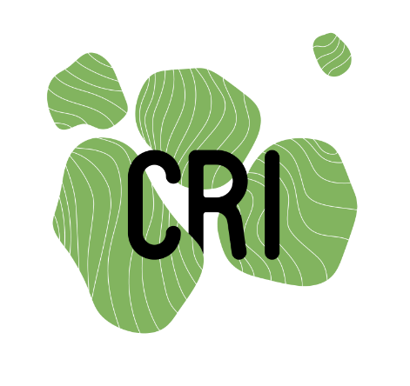
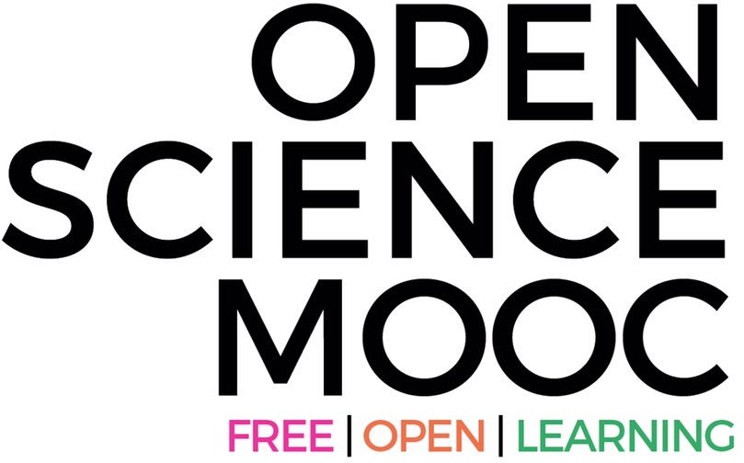
Open Science:
Just science done right?
Jon Tennant
@protohedgehog
Lausanne, Switzerland Sept 2nd, 2019
https://orcid.org/0000-0001-7794-0218

Slide 2
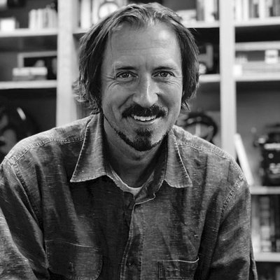
You are in the middle of a global research [r]evolution
There are (at least) five major ‘crises’:
Access – Most research still paywalled to most people
Reproducibility – Much research fails basic reproducibility tests
Serials – The dramatic price increases of journals
Evaluation – The metric that shall not be named
Copyright – No longer serves researchers or creators
https://paywallthemovie.com/
@protohedgehog

Slide 3
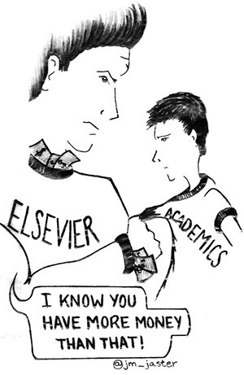
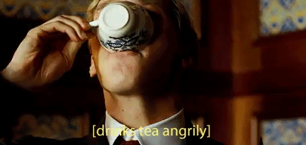
It’s not that bad, is it?
The vast majority of scholarly research and knowledge is held hostage by private corporations.
These commercial giants are ruthless racketeers that have profit margins that exceed Apple and even ‘big oil’ (>35%).
This disadvantages everyone on this planet, except for those in the wealthiest, elite research institutes.
We are not communicating research effectively, and our world is suffering as a result.
@protohedgehog

Slide 4
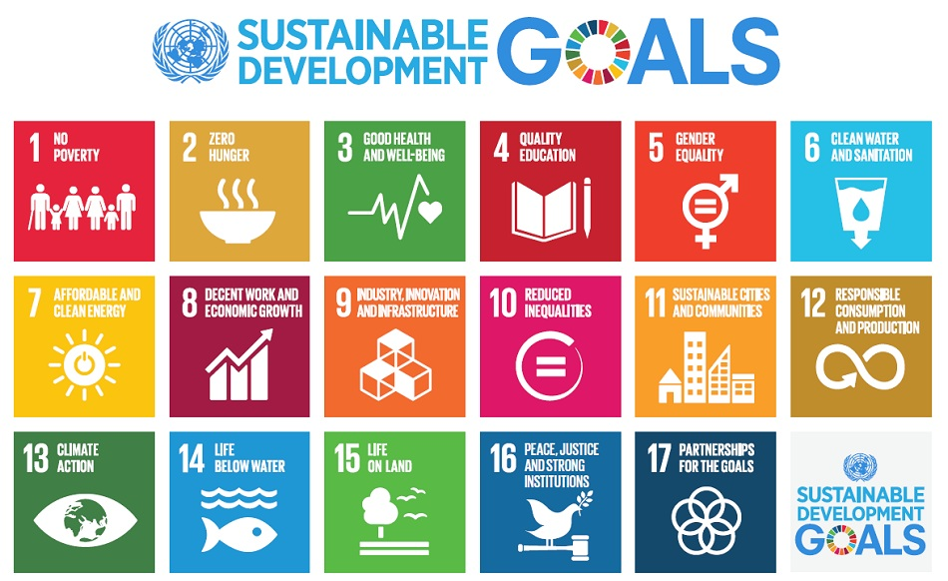
Do you believe that scientific research can help us solve these problems?
http://www.who.int/mediacentre/events/meetings/2015/un-sustainable-development-summit/en
@protohedgehog

Slide 5
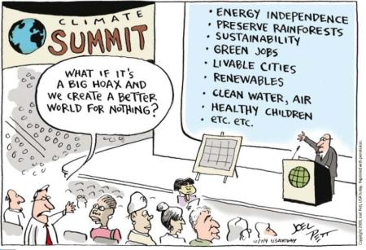
YES!
But then you also must acknowledge that by preventing access to research, we are acting against meeting these goals.
And this is what many in the present scholarly publishing industry are doing. In exchange for our money.
It’s not a bug. It‘s a feature.
@protohedgehog

Slide 6
For researchers, getting published is like going to a restaurant, bringing all of your own ingredients, cooking the meal yourself, and then being charged $40 for a waiter to bring it out on a plate for you.
You are the provider, the product, and the consumer.
WE CAN DO BETTER
@protohedgehog

Slide 7
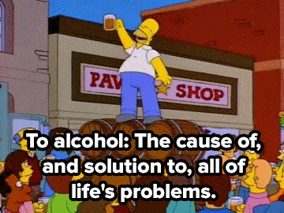
Enter “Open Science”
The solution to all of our problems?
@protohedgehog

Slide 8
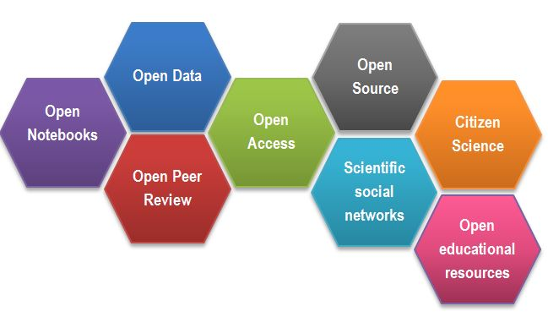
What is ‘Open Science’?
https://www.fosteropenscience.eu/content/what-open-science-introduction
@protohedgehog

Slide 9
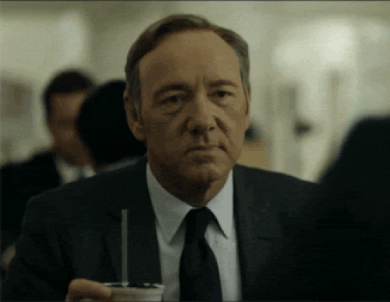
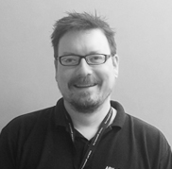
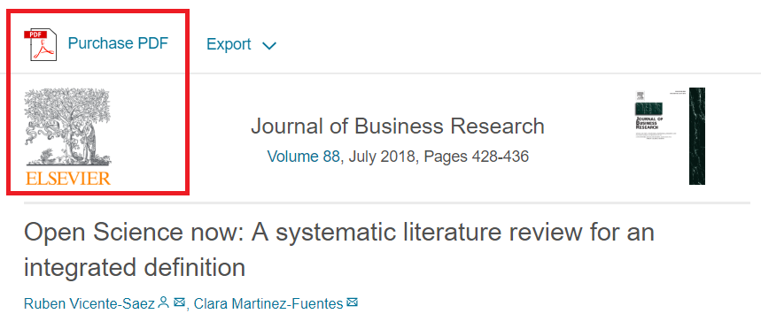
What is the difference between “Open Science” and good science?
“Open Science is transparent and accessible knowledge that is shared and developed through collaborative networks.”
“Open science describes the practice of carrying out scientific research in a completely transparent manner, and making the results of that research available to everyone. Isn’t that just ‘science’?”
https://genomebiology.biomedcentral.com/articles/10.1186/s13059-015-0669-2
https://www.sciencedirect.com/science/article/abs/pii/S0148296317305441
@protohedgehog

Slide 10
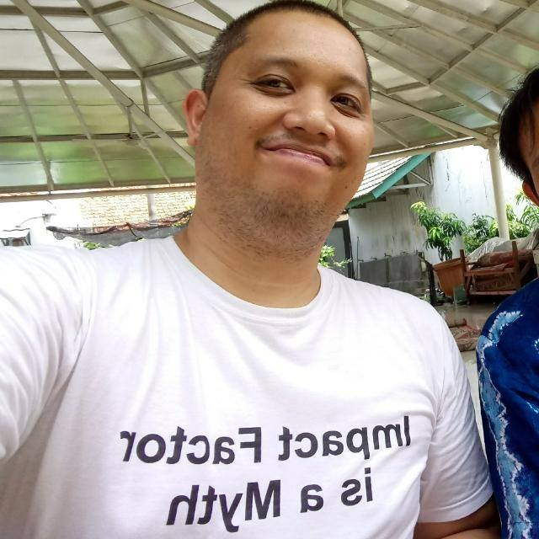
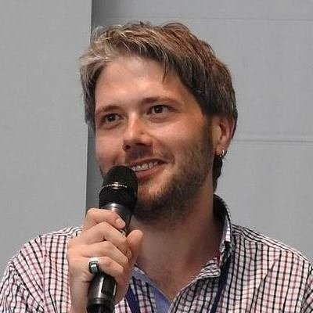
Freedom
Fairness
Justice
Truth
Liberty
Principles of Open Scholarship, by Tony Ross-Hellauer (Source, CC BY).

Slide 11
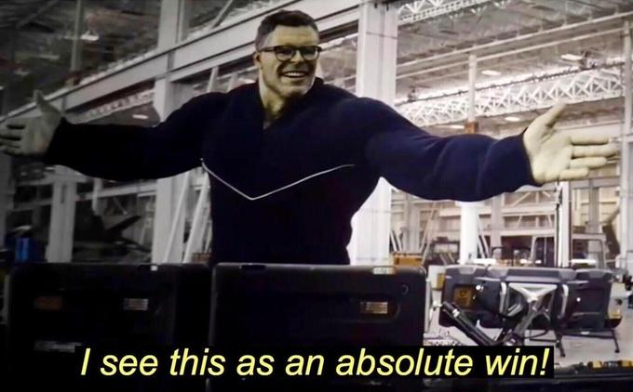
“Open science initiatives also promote diversity, justice, and sustainability through increased levels of inclusion and access, equitable distribution of opportunities and dissemination of knowledge, and increased sustainability stemming from increased generalizability.”
https://www.plu.edu/psychology/wp-content/uploads/sites/60/2019/08/grahe-paper.pdf
@protohedgehog

Slide 12
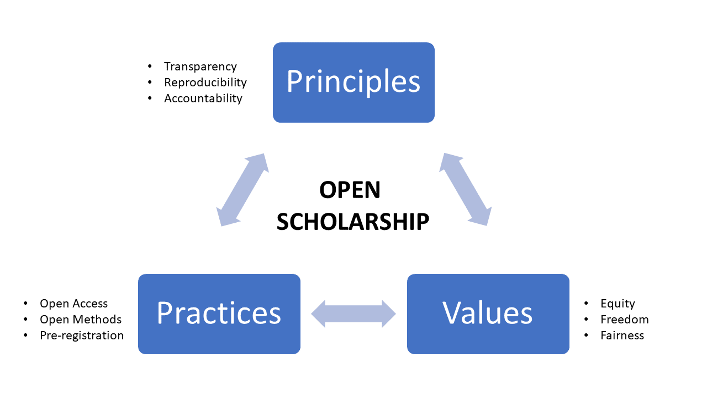
GOOD
SCIENCE
Thoughts in progress…
GOOD
PEOPLE
@protohedgehog

Slide 13
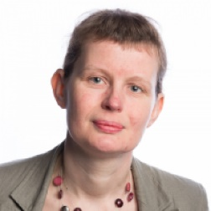
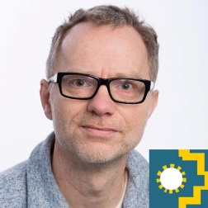
Notes:
13

Slide 14
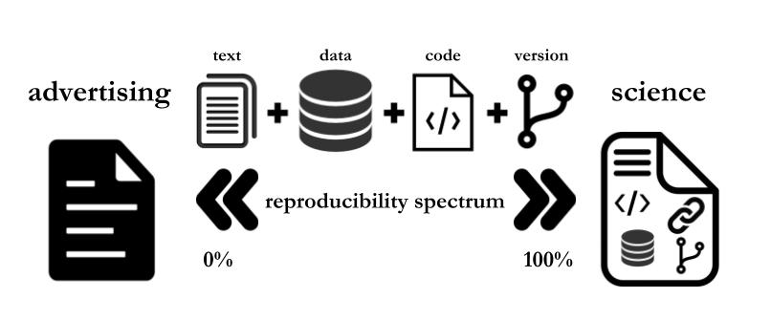
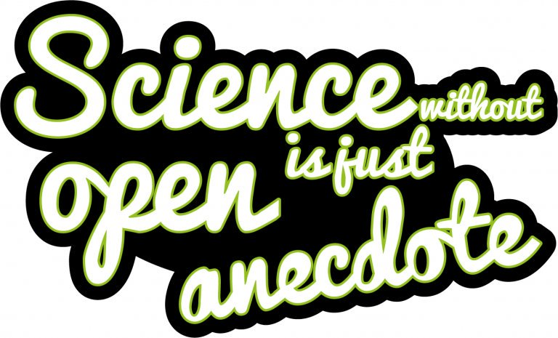
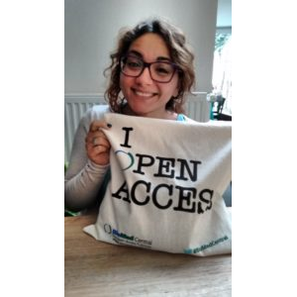
Paola Masuzzo, re-used with permission
Sticker by Melanie Imming
Notes:
14

Slide 15
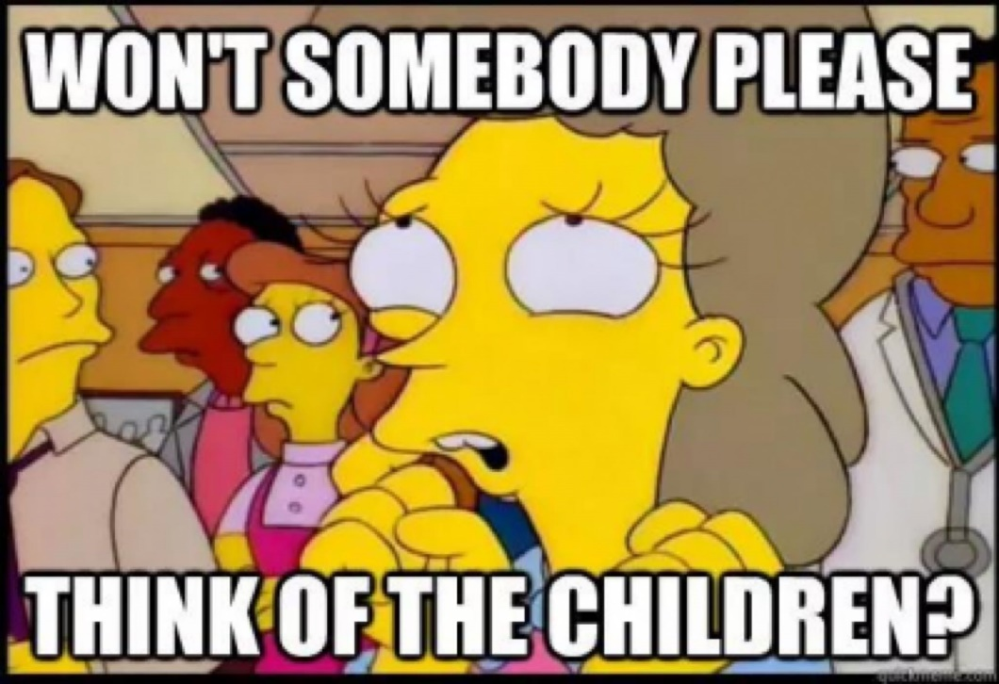
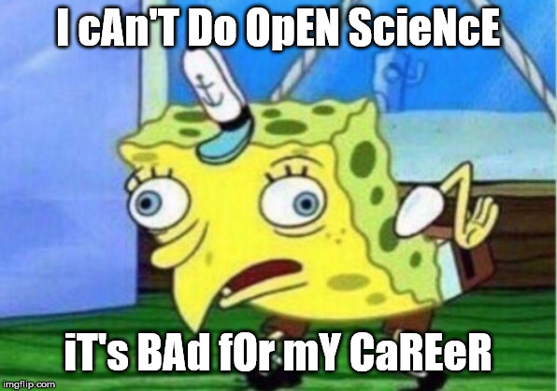
What is standing in our way?
Turns out, quite a lot actually
@protohedgehog

Slide 16
Open Science, democracy and power

Slide 17
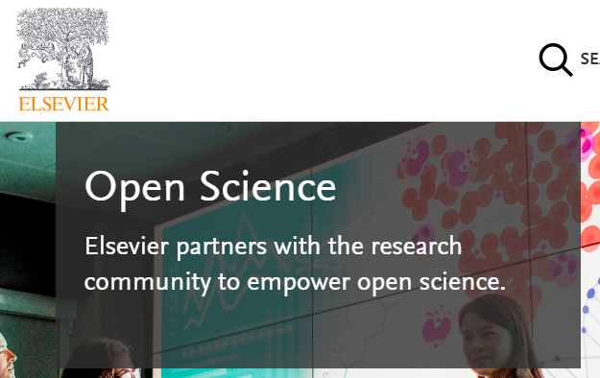
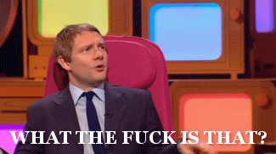
Mega-publishers are corrupting Open Science
Organisations stuck in a pre-digital mindset with a key product developed in the 17th Century.
Basically the reason why the Open Science ‘movement’ began.
Business models based on exclusion, exploitation of privilege, discrimination, extortion..
Who pay lip service to Open Science, while simultaneously subverting it to meet their own intentions.
We DO NOT share the same values and principles.
@protohedgehog

Slide 18
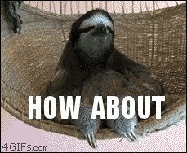
Springer Nature abusing power for profits
Page 99 of the Springer Nature IPO* prospectus:
“We also aim at increasing APCs by increasing the value we offer to authors through improving the impact factor and reputation of our existing journals.”
https://www.timeshighereducation.com/blog/springer-nature-committed-being-part-open-access-movement
https://www.timeshighereducation.com/blog/linking-impact-factor-open-access-charges-creates-more-inequality-academic-publishing
*failed…
@protohedgehog

Slide 19
We have to combat their propoganda
https://www.timeshighereducation.com/news/springer-nature-proposes-model-open-access-transition
@protohedgehog

Slide 20
Because it‘s getting worse
https://www.hrk.de/press/press-releases/press-release/meldung/projekt-deal-and-springer-nature-reach-understanding-on-worlds-largest-transformative-open-access-a/
@protohedgehog

Slide 21
And we are running out of time
“The current model of scholarly publishing contains a disastrous blend of Stockholm Syndrome and cognitive dissonance. Researchers are helplessly locked into the system because of an over-reliance on journal brands for their evaluations.
Every time we sign one of these so-called transformative contracts, which often contain multi-year lock-ins, we lose the opportunity to create something more just, sustainable, efficient and effective. We actively work against efforts to return control of publishing to the academic community. It is time to take a step back and to think again about what we really want.”
https://www.timeshighereducation.com/opinion/transformative-open-access-publishing-deals-are-only-entrenching-commercial-power
@protohedgehog

Slide 22
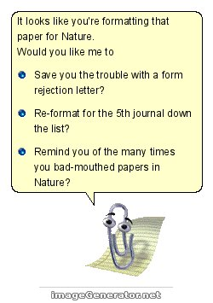
Power and culture change
The mantra ‘publish or perish’ is dead, replaced by ‘publish and perish’ due to under-funding and competitiveness in climbing the academic career ladder.
A mentality grilled into students as soon as they start, with the view that anything beyond attaining a professorship is failure.
And then we wonder why mental health problems are so rampant for researchers…
@protohedgehog

Slide 23
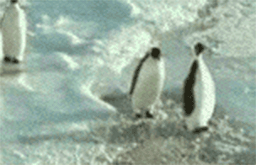
Have you ever met an average academic?
50% of academics know less than the average academic.
A system defined by cultural inertia.
Slow to adapt to new technologies and practices.
What happened to doing good science? What are the incentives for that?
We are all penguins.
@protohedgehog

Slide 24
Principles in Open Research
Drivers
Barriers
Reduce publication bias.
Increase replicability.
Increase reliability of scientific record.
Make publicly funded research publicly accessible.
Make research more efficient.
Increase public trust.
Foster collaboration.
Sustainable research.
Fear of scooping or ideas being stolen.
Fear of not being credited for ideas.
Fear of errors and public humiliation.
Fear of risk to reputation.
Fear of reduced scientific quality.
Fear of information overload.
Fear of career compromise.
Fear of backlash from senior figures.
Fear of being different.
@protohedgehog

Slide 25
Your career
Open Science
SOCIAL AND TECHNICAL BARRIERS
@protohedgehog

Slide 26
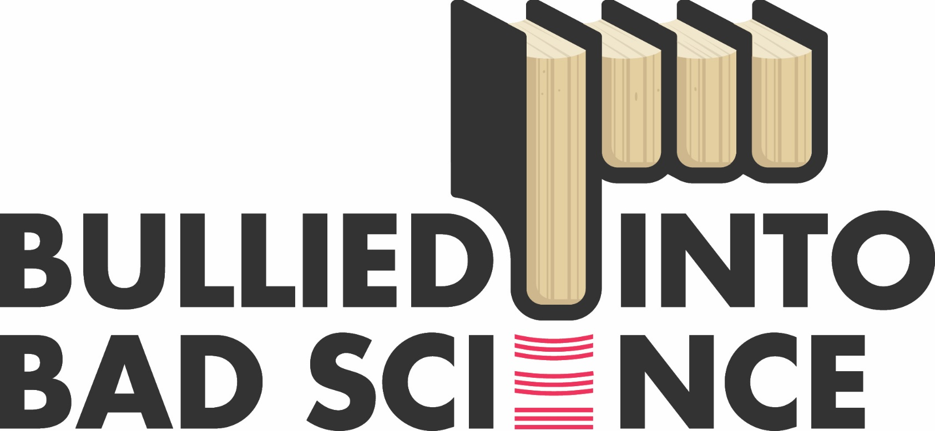
The Bullied Into Bad Science campaign is an initiative by early career researchers (ECRs) for early career researchers who aim for a fairer, more open and ethical research and publication environment.
http://bulliedintobadscience.org/
@protohedgehog

Slide 27
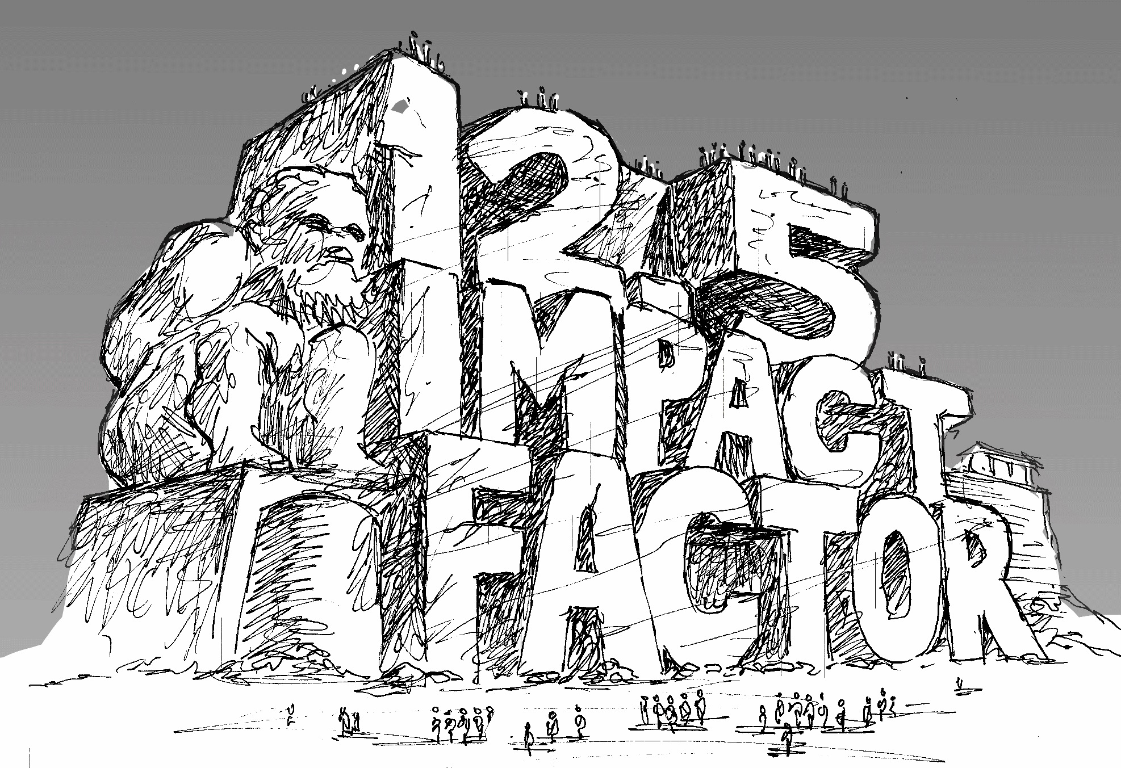
Goodhart’s Law: "When a measure becomes a target, it ceases to be a good measure.”
http://whyopenresearch.org/impactfactor
@protohedgehog

Slide 28
“Our qualitative analysis shows that 87% of the institutions that mentioned the JIF supported the metric’s use in at least one of their RPT documents, while 13% of institutions expressed caution about the JIF’s use in evaluations. None of the RPT documents we analyzed heavily criticized the JIF or prohibited its use in evaluations. Of the institutions that mentioned the JIF, 63% associated it with quality, 40% with impact, importance, or significance, and 20% with prestige, reputation, or status.”
“So consider all that we know of impact factors and think on this: if you use impact factors you are statistically illiterate.” – Stephen Curry, 2012.
https://peerj.com/preprints/27638/
http://occamstypewriter.org/scurry/2012/08/13/sick-of-impact-factors/

Slide 29
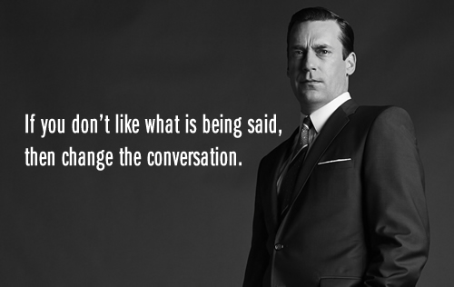
AN OPEN SCIENCE EDUCATION CRISIS
Can we break the cycle through training, support, and communication?
@protohedgehog

Slide 30
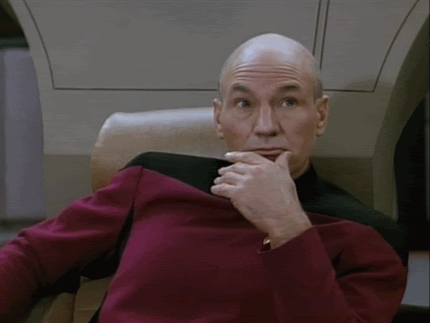
Attitudes versus practice
“60.8% of researchers do not self-archive their work even when it is free and in keeping with journal policy.”
“In a field where OA seems of practical and ethical importance for the sharing of knowledge promoting health equity, it is surprising that researchers do not make their papers available when they are legally able to do so without any cost.”
https://health-policy-systems.biomedcentral.com/articles/10.1186/s12961-017-0235-3
@protohedgehog

Slide 31
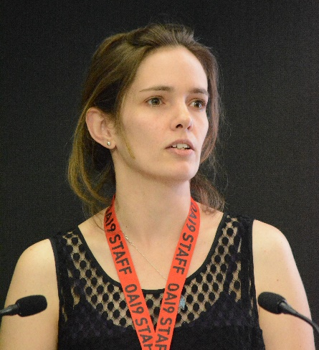
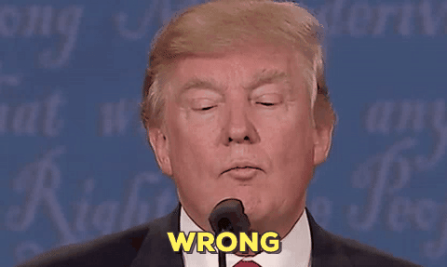
“Open Access is too expensive.”
http://whyopenresearch.org/
@protohedgehog

Slide 32
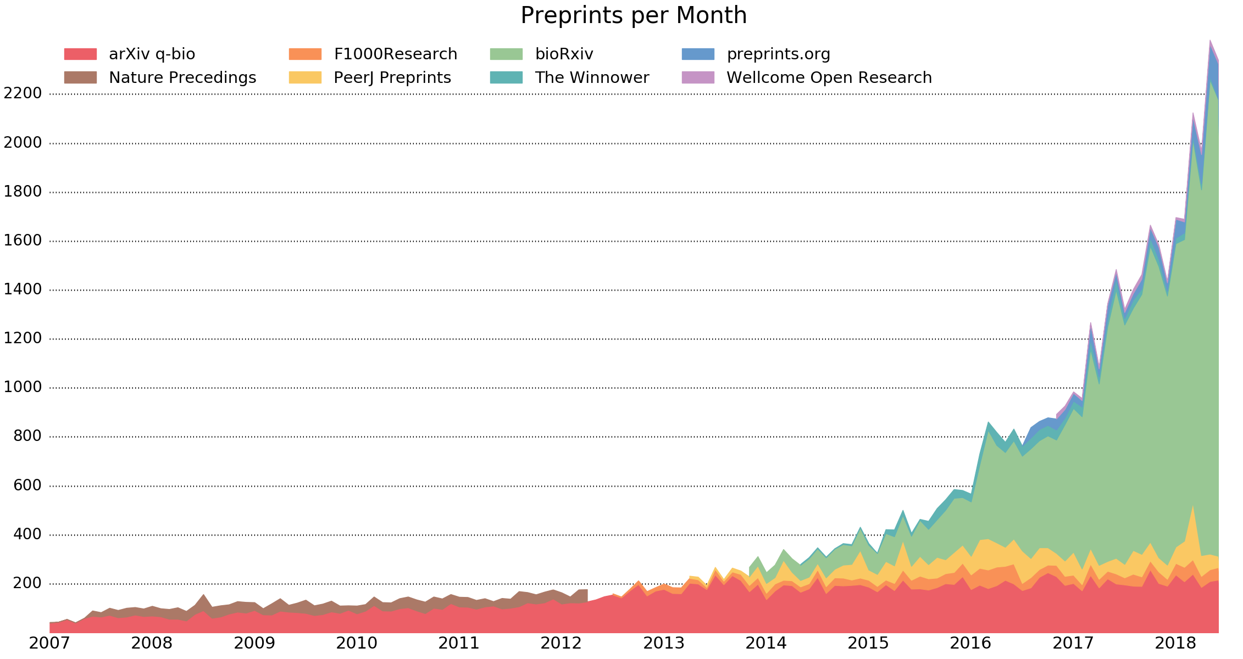
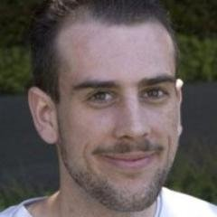
Exponential growth of preprints
http://www.prepubmed.org/monthly_stats/
@protohedgehog

Slide 33
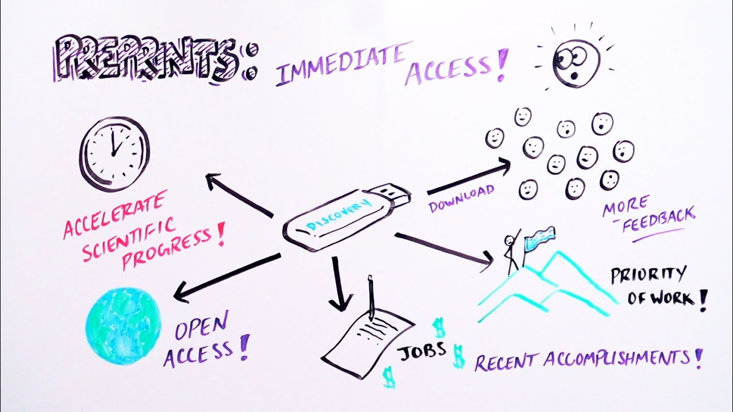
Implications of preprints
Journal-independent
Force you to read and judge based on the actual content
All power is retained by researchers
Justification of journals to prove their value once science communication is decoupled from them
What happens when peer review is finally decoupled from journals?
https://www.youtube.com/watch?v=2zMgY8Dx9co
@protohedgehog

Slide 34
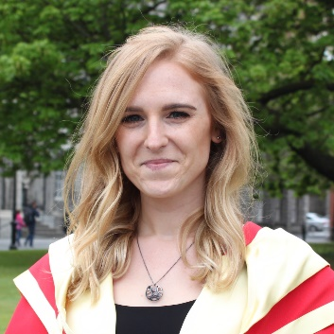
It’s your work. Publish where you want. But don’t lock it up.
@protohedgehog

Slide 35
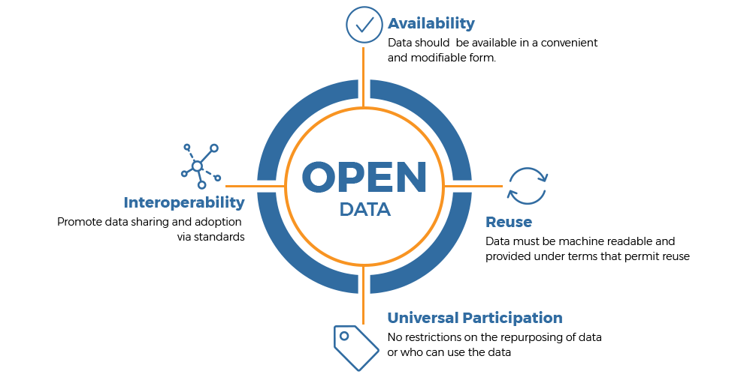
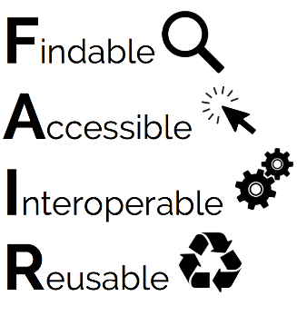
How and why to make your data open
https://www.webfirst.com/services/open-data-solutions

Slide 36
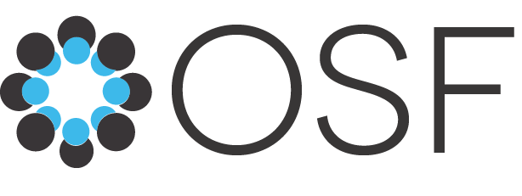
Pretty Excel spreadsheets != open data

Slide 37
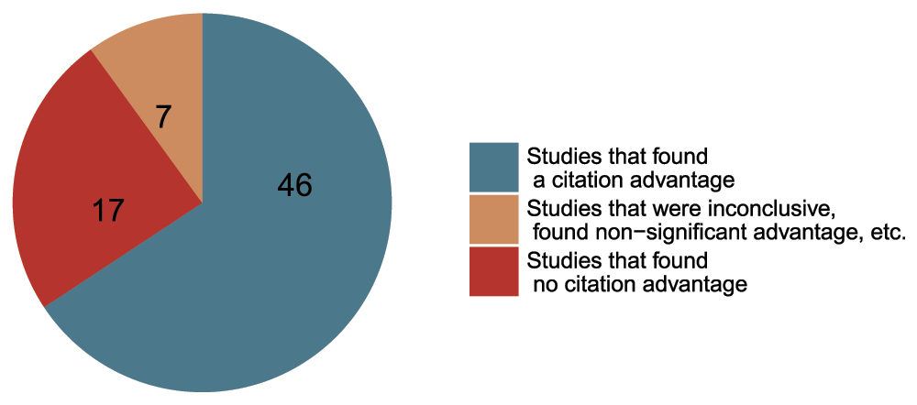
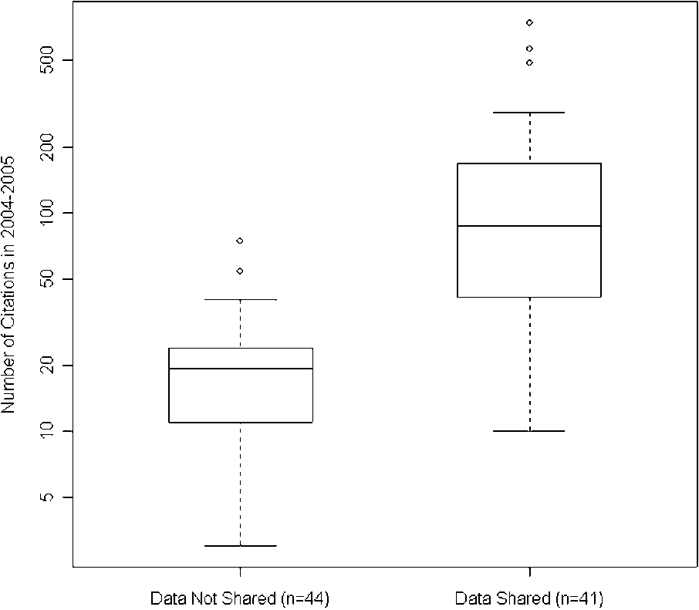
Openness is good for your work and career
Rapid communication
Greater exposure
More citations, faster
http://whyopenresearch.org
https://peerj.com/articles/175
Data from The Open Access Citation Advantage Service, SPARC Europe, accessed March 2016.
http://f1000research.com/articles/5-632/v3
@protohedgehog

Slide 38
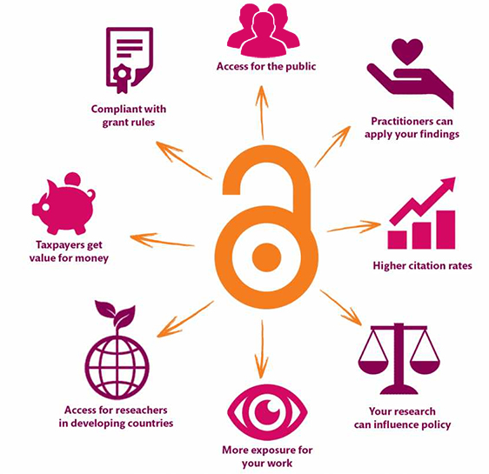
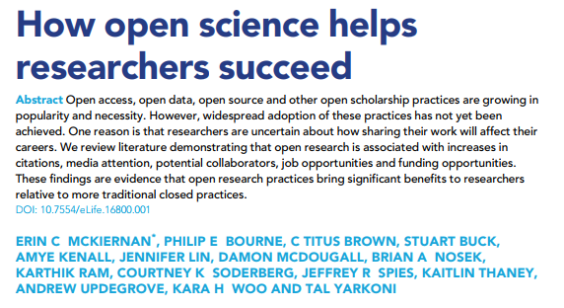
Openness is better for EVERYONE
https://elifesciences.org/articles/16800
@protohedgehog
https://kib.ki.se/en/publish-analyse/open-access

Slide 39
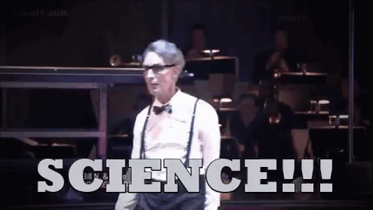
The message we should be communicating? Being more open helps YOU so much
Increases dissemination of your research.
Increases your academic profile.
Emphasises your core values.
Increases your collaborations.
Makes you a more effective researcher.
Gives you more control over your research.
@protohedgehog

Slide 40
Your career
Open Science
SOCIAL AND TECHNICAL BARRIERS
@protohedgehog

Slide 41
Your career
Open Science
TECHNICAL BARRIERS
SOCIAL BARRIERS
EDUCATION
@protohedgehog

Slide 42
What can we all achieve if we stand together?
We need to stand together as a unified global community to make sure that we are acting in the best interests of the public, not corporate gains.
#PeopleNotProfits
https://letsallstandtogether.wordpress.com/
@protohedgehog

Slide 43
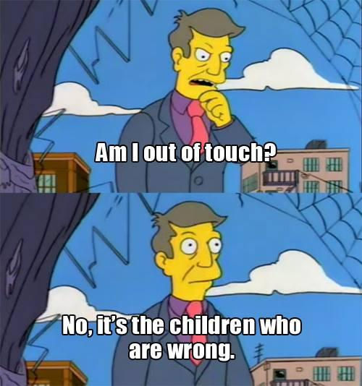
What do we need to change cultures?
Leadership from those who are less at risk
They need to invest in our future
Make sure that the system we are creating is in the best interests of future generations
For each of us to take small steps where we can
Without putting ourselves at risk
Be aware of the options available to us
And some times to be brave
To stand up for what we believe in
To ask the challenging questions
To be deeply introspective of what we are doing and why
@protohedgehog

Slide 44
What do we need to change cultures?
Education, training, support.
Empowerment and leadership for the next generation.
Shifting power dynamics to reduce bias and abuse.
Building a global community based on strong values, sharing and collaboration.
Massive-scale engagement to re-align Open Science with current incentive structures.
GitHub: https://github.com/OpenScienceMOOC
Website: https://opensciencemooc.eu
Twitter: @OpenScienceMOOC
Email: info@opensciencemooc.eu
@protohedgehog

Slide 45
Welcome to the Open Science MOOC!
To help make ‘Open’ the default setting for all global research.
We want to help create a welcoming and supporting community, with good tools, teachers, and role-models, and built upon a solid values-based foundation of freedom and equitable access to research.
@protohedgehog

Slide 46
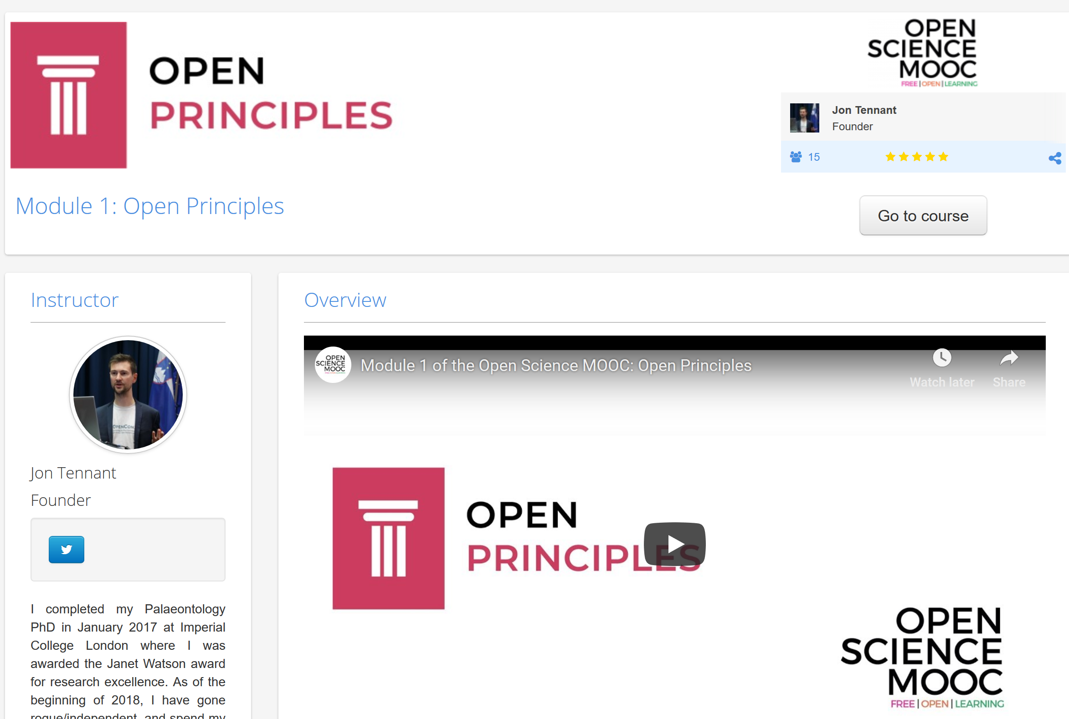
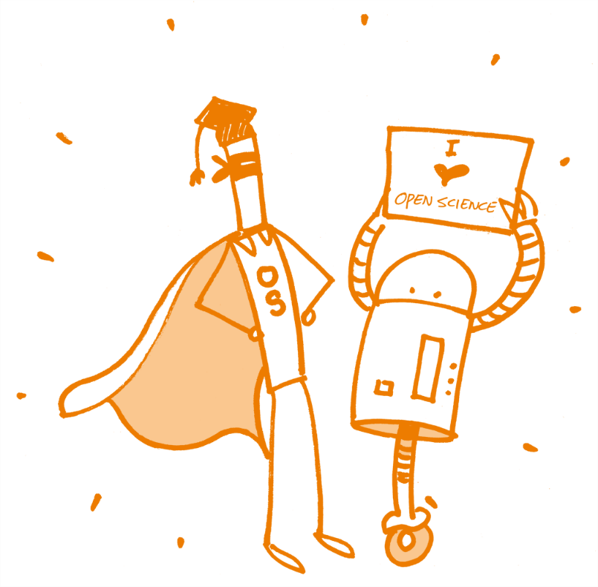
Recently launched!
https://eliademy.com/catalog/oer/module-1-open-principles.html
Image license: CC0 1.0 Universal; Patrick Hochstenbach

Slide 47
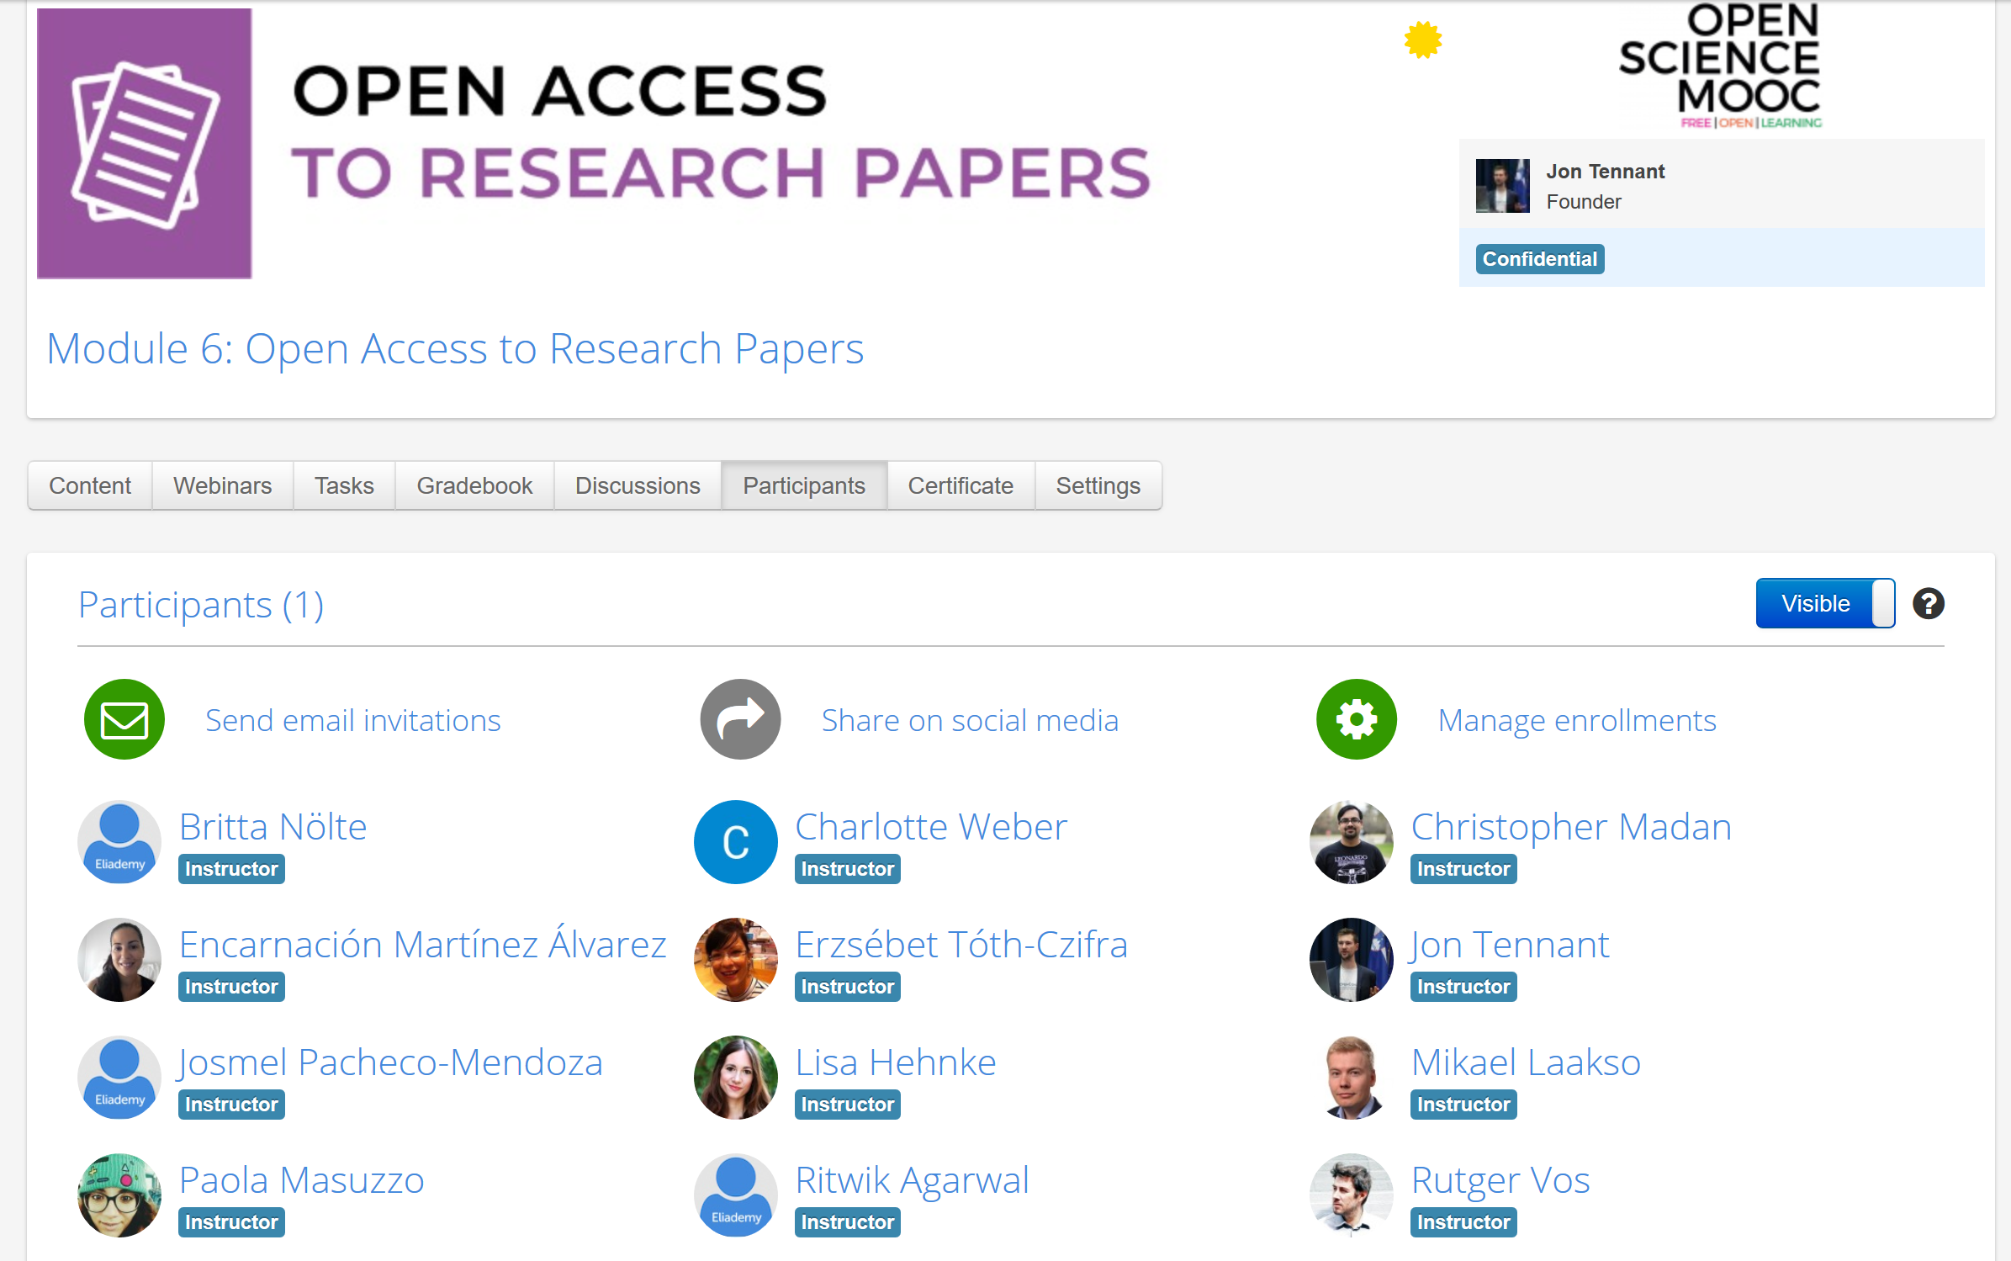
TOP SECRET

Slide 48
How do we get to where we want?
Imagine a future defined by the values and principles of Open Science:
Freely available public good
Rigorous and reproducible
Open to ALL
Isn’t that just GOOD science?
@protohedgehog

Slide 49
The ultimate goal
Pooling knowledge and resources to create a decentralised scholarly infrastructure, with communities as the focus.
Inclusivity
Equality
Accountability
Freedom
Fairness
Justice
Truth
Rigour
Transparency
Reproducibility
SCIENCE AS A PUBLIC GOOD FOR THE BETTERMENT OF SOCIETY
#PeopleNotProfits
http://elephantinthelab.org/do-we-need-an-open-science-coalition/
@protohedgehog

Slide 50
Melanie Imming, & Jon Tennant. (2018, June 8). Sticker open science: just science done right.
Zenodo. http://doi.org/10.5281/zenodo.128557
@protohedgehog

