Slide 1
What are In Silico Trials?
Prof Marco Viceconti
Alma Mater Studiorum – University of Bologna
Public slide set to introduce the concept

Slide 2
Why we need new ways to test new medical products?

Slide 3
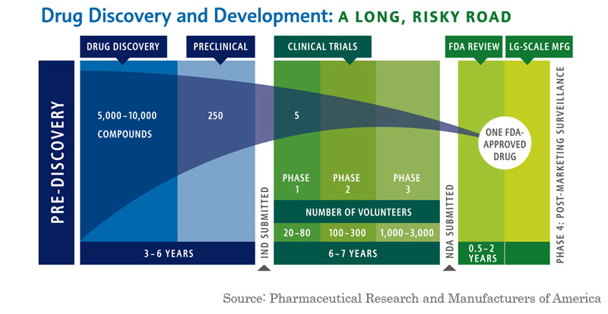
This is the problem /1

Slide 4
This is the problem /2
Source: Tufts Center for the Study of Drug Development, USA - 2014

Slide 5
The impact of growing prices
Universal Healthcare
Sustainability
Improve health in developing countries

Slide 6

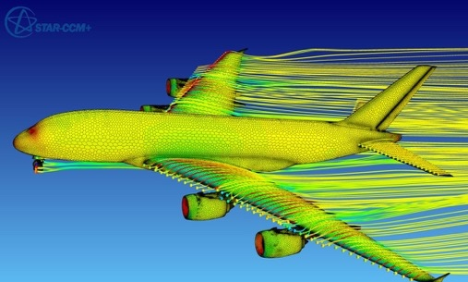
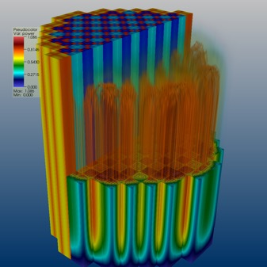
Why not use computer simulation?
In any other industrial sector
In healthcare
☓ ☓ ☓ ☓ ☓ ☓ ☓ ☓ ☓ ☓ ☓ ☓ ☓ ☓ ☓ ☓ ☓ ☓ ☓ ☓ ☓ ☓ ☓ ✓
We test safety and efficacy of new products only by trial and error
Testing is now done mostly with computer simulation

Slide 7
Can computer models predict human health?

Slide 8



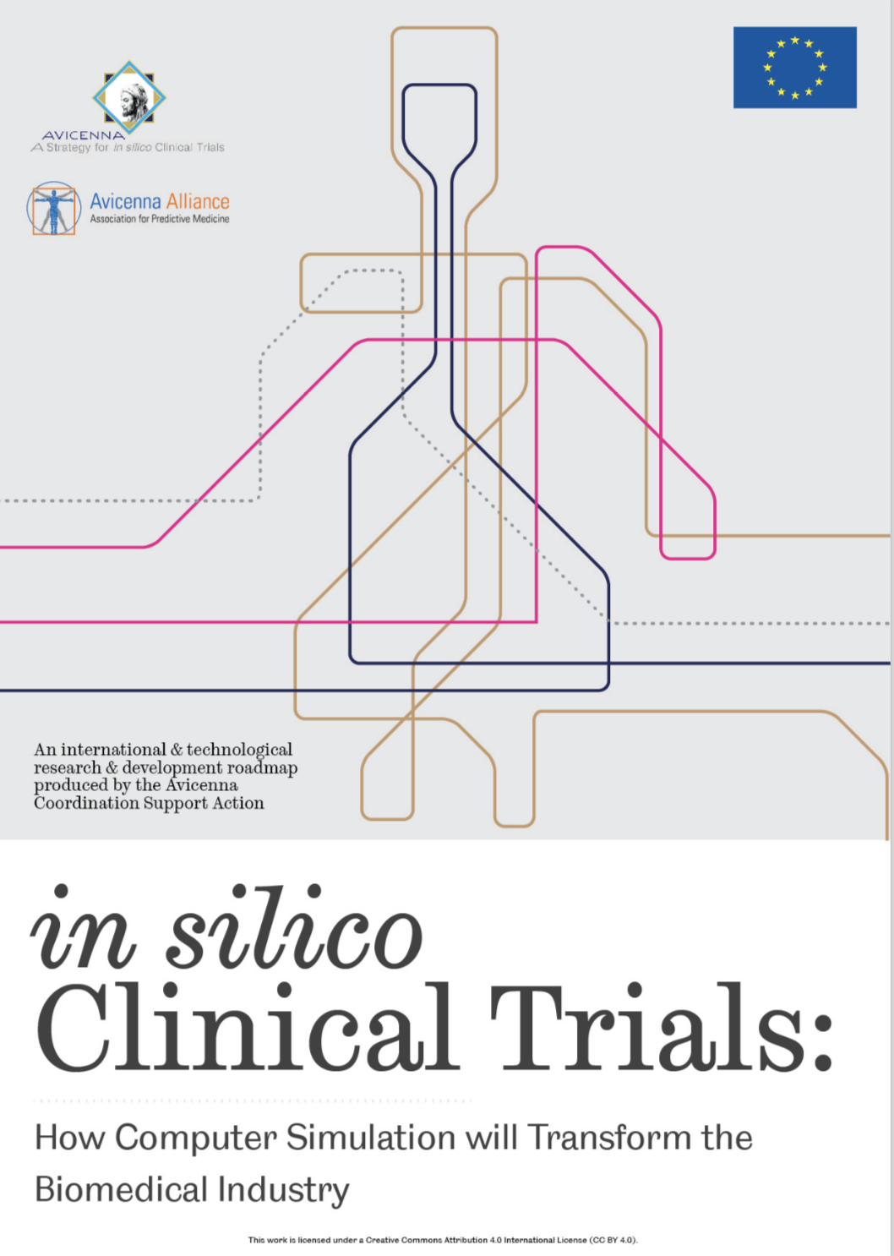
1989 – 2019: a 30 years journey
1993: Physiome
2005: VPH
2007: STEP
2010: VPH Institute
In these 30 years the idea of an In Silico Medicine with Digital Twins for each patient, and In Silico Trials to test new products, moved from science fiction to an industrial reality
2016: Avicenna

Slide 9



Models can predict health
2001: a ML model predicts biochemical failure after radical prostatectomy with a 75% accuracy
Tewari A. et al Mol Urol. 2001 5(4):163-9.
2008: FDA approves Kovatchev-Cobelli diabetes simulator to replace animal experimentation
Zisser et al Diab Tech Th 2014 16(10):613-22.
2015: Oxford Virtual Assay in silico cardiotoxicity test wins 3R prize for animal replacement
Muszkiewicz A et al Pro Bio Mol Bio 2016 120(1-3):115-27
2014: FDA allows marketing of HeartFlow vFFR-CT tool for optimal treatment of coronary stenosis
Gaus S, et al, JCCT 2013, 7(5):279-88.
2018: patient-specific models of bone strength are more cost-effective that DXA in clinical trials of bone drugs
Viceconti M, Curr Ost Rep 2018 16(3):216-223
2019: FEops HEARTguide in silico tool for planning transcatheter aortic valve implantation is CE-marked
El Faquir N, et al Int J Cardiov Img 2019

Slide 10
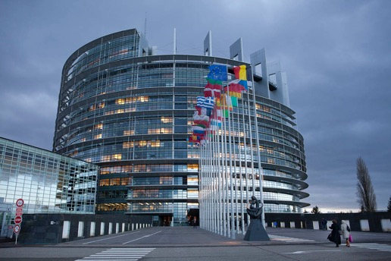
Recommendations to regulators
16 July 2015
10 March 2016
“the Committee urges FDA to engage with device and drug sponsors to explore greater use, where appropriate, of In Silico trials for advancing new devices and drug therapy applications”
Senate Fiscal Year 2016 FDA Appropriations Bill (S. 1800) & Report (S. Rept. 114-82)
“advances in alternative testing require the creation of a regulatory framework […] including for example the recognition and evaluation of modelling and simulation technologies”. EU Parliament amendment to Regulation (EC) No 726/2004
Notes:
Thanks to the legislators in Europe and USA now the scenario is changing, and all regulators are working hard to set the rules for using in silico medicine approaches in the assessment of biomedical products.

Slide 11
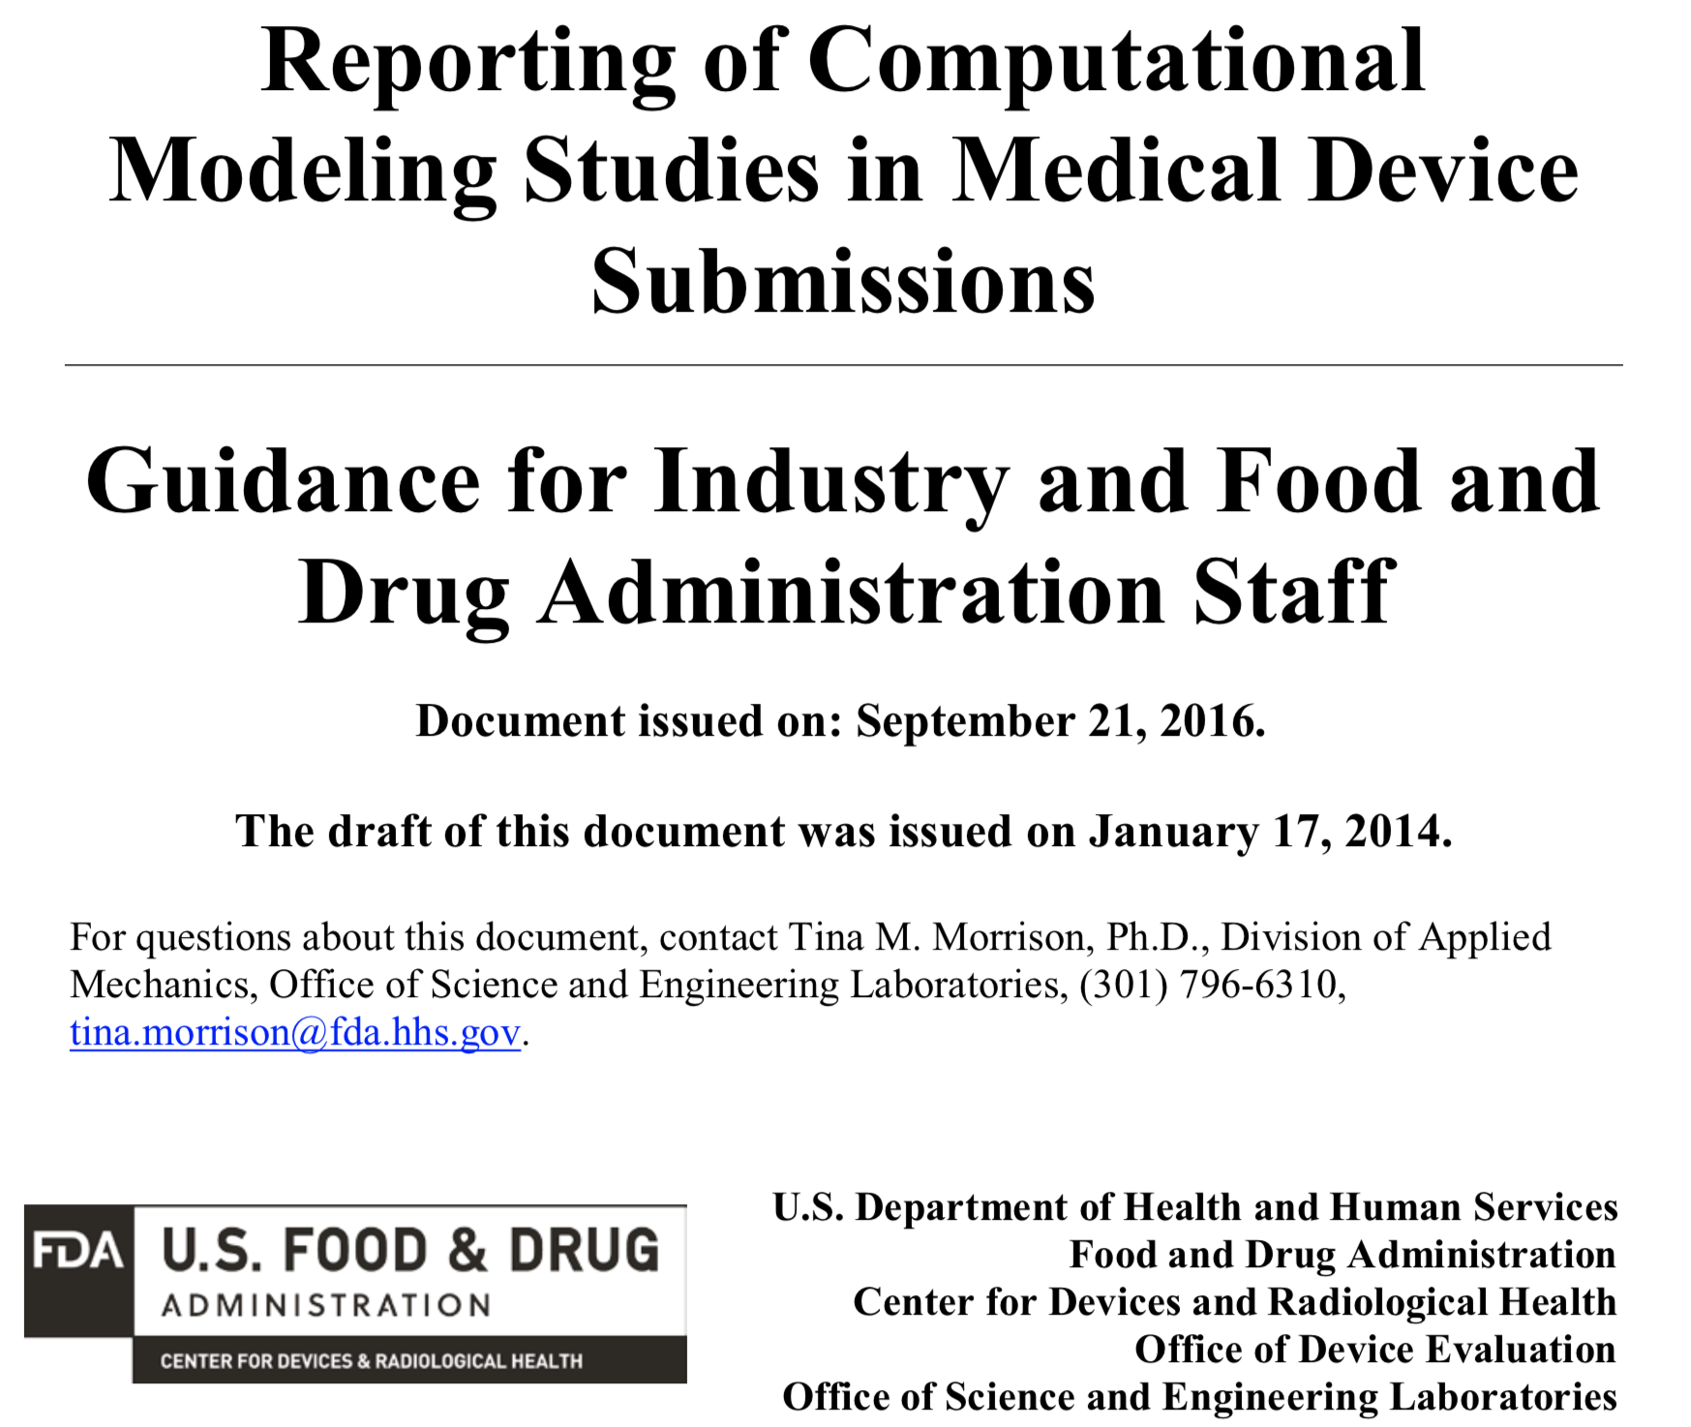
In Silico Trials: medical devices
Code Verification
System Configuration
Governing Equations, Constitutive Laws
System Properties
System Conditions
System Discretization
Numerical Implementation
Validation

Slide 12
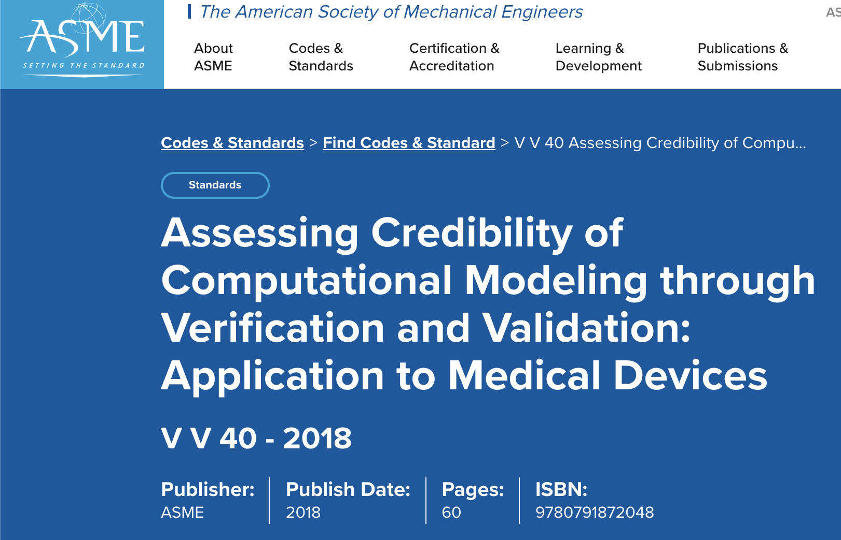
ASME V&V-40

Slide 13
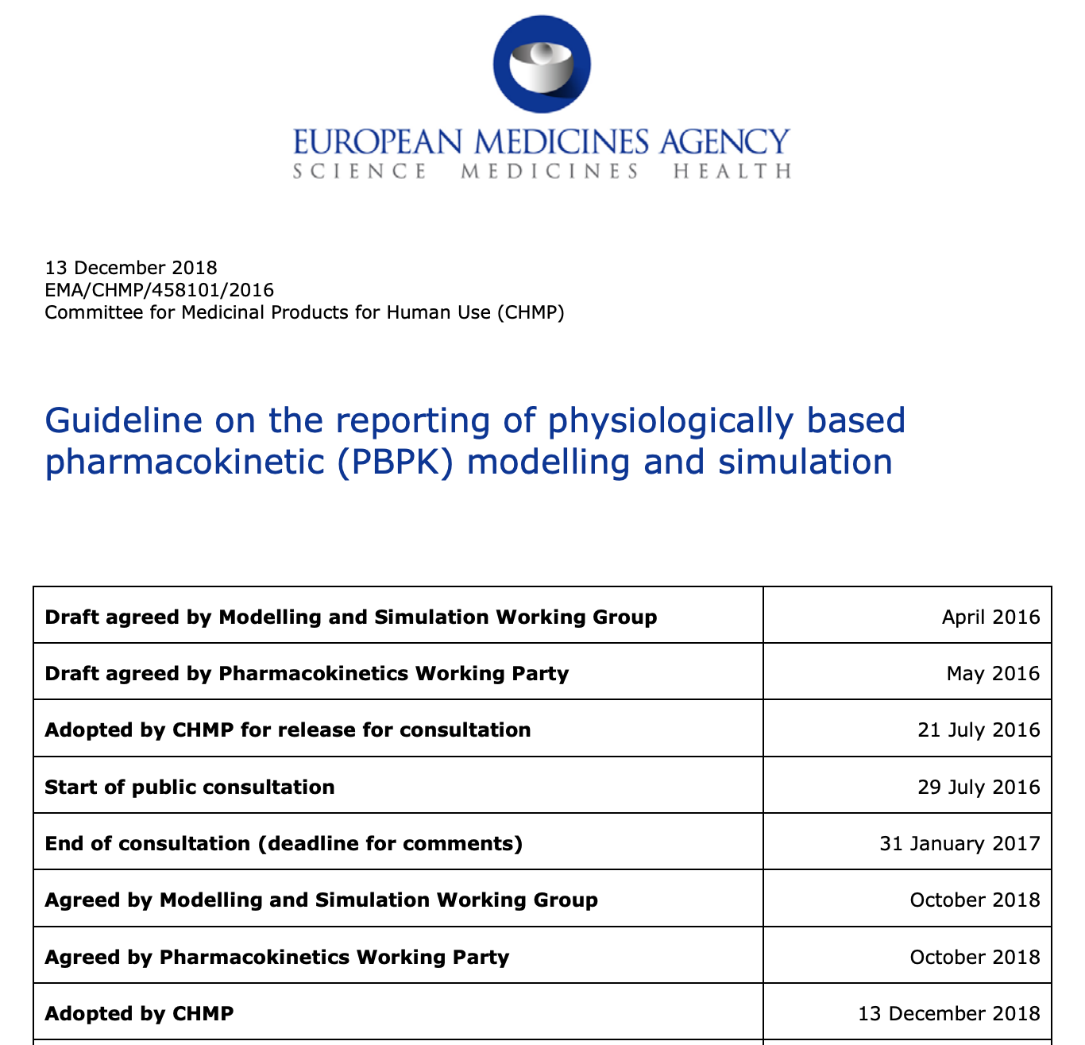
And the drugs?
PBPK is the first predictive model that EMA considers
We are working on the first Qualification request for patient-specific models to test the efficacy of therapeutic vaccines for Tuberculosis
We expect first IST methods qualified in 3-4 years

Slide 14
Credibility of predictive models

Slide 15






A model for In Silico Trials
Physiology
Treatment
Disease

Slide 16



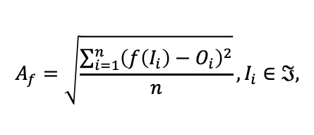
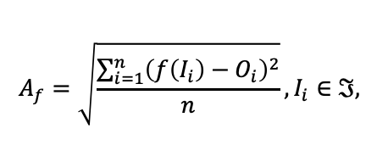
Data-driven Vs. Mechanistic
AI (Machine Learning)
Mechanistic models
$$A_{f}=\sqrt{\frac{\sum_{i=1}^{n}{{\left(f\left(I_{i}\right)−O_{i}\right)}^{2}}}{n}}, I_{i}∈ℑ,$$
$$A_{f}=\sqrt{\frac{\sum_{i=1}^{n}{{\left(f\left(I_{i}\right)−O_{i}\right)}^{2}}}{n}}, I_{i}∈ℑ,$$

Slide 17
Technical validation: ASME V&V-40

Slide 18






Clinical validation: disease + intervention
Treatment
P_{x}
P_{y}
t₀
t₁
t₂
t₀
t₁
t₂
IPx =[HLA, Age, Gender, …]
IPx =[HLA, Age, Gender, …]
Observed disease progression of Px
Observed disease progression of Py (treated)
Vx≈P_{x}
Vx≈P_{y}
IPx =[HLA, Age, Gender, …]
IPy =[HLA, Age, Gender, …]
+
treatment
Predicted disease progression of Px
Predicted disease progression of Py (treated)
Clinical Validation of Disease Progression
Clinical Validation of Treatment simulation

Slide 19

Prof. Marco Viceconti
Dipartimento di Ingegneria Industriale
Scuola di Ingegneria e Architettura
Email: marco.viceconti@unibo.it
http://www.ingegneriaindustriale.unibo.it/it/ricerca/ambiti-di-ricerca/bioingegneria-industriale

