Slide 1
Data Sprints 2019
background to preparing linked datasets

Slide 2

Why do we make data available?
Is this really a good thing?

Slide 3
good science
it’s good
science
shows confidence in your data
proves you did what you said
means it can be checked
makes it reproducible
means it can be collected

Slide 4
good citizenship
it’s good for others
makes it reusable
expected by public funders: especially the NRF
expected by more journals
becoming the academic norm

Slide 5
good self-preservation
it’s good
for you
replaces and extends appendices
gives you more citations
will become part of future career assessments

Slide 6
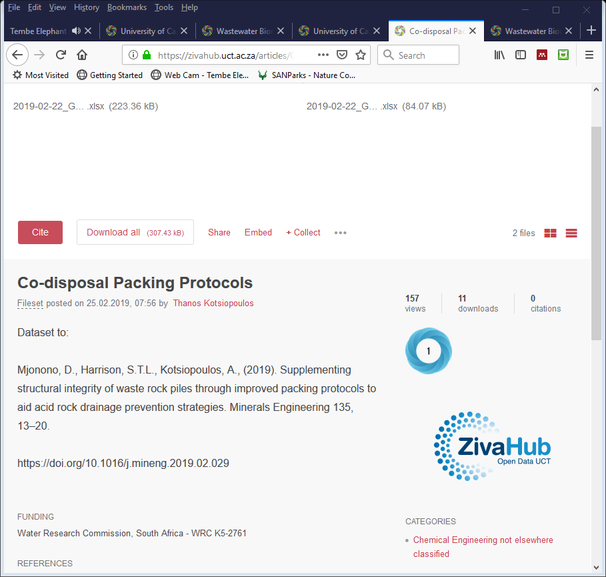
What does a dataset look like?
What are the things that make up a dataset?

Slide 7

FAIR principles findable accessible interoperable reusable/reproducible
https://commons.wikimedia.org/wiki/File:FAIR_data_principles.jpg

Slide 8
three facets information explanation location
my data
how I got it
where you find it
the actual data produced or collected by you:
  data relating to the publication
the data needed for others to understand the “actual data”:
  making it reusable/reproducible
the data needed for people to discover the “actual data”:
  making it findable

Slide 9
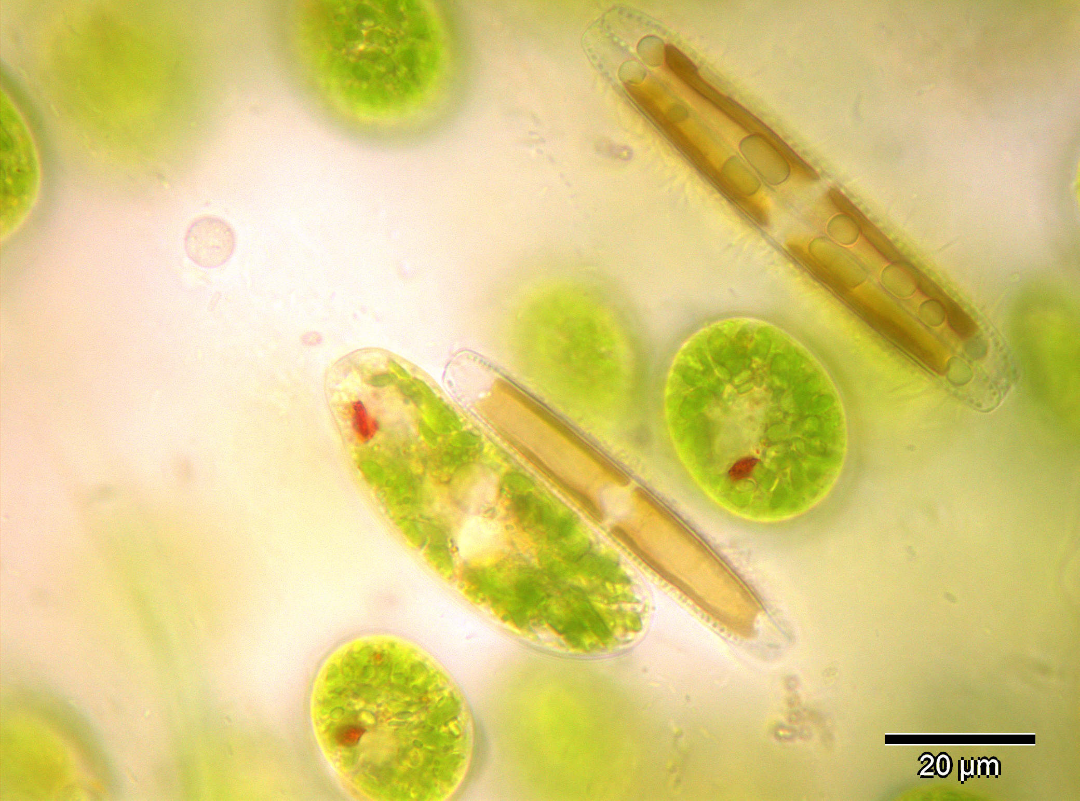
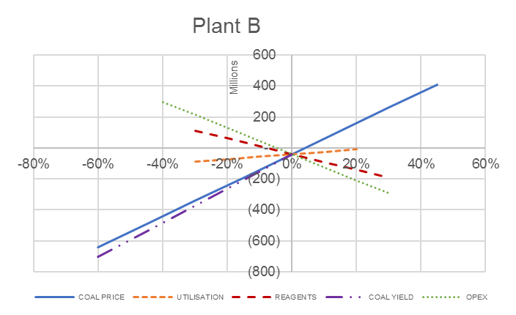
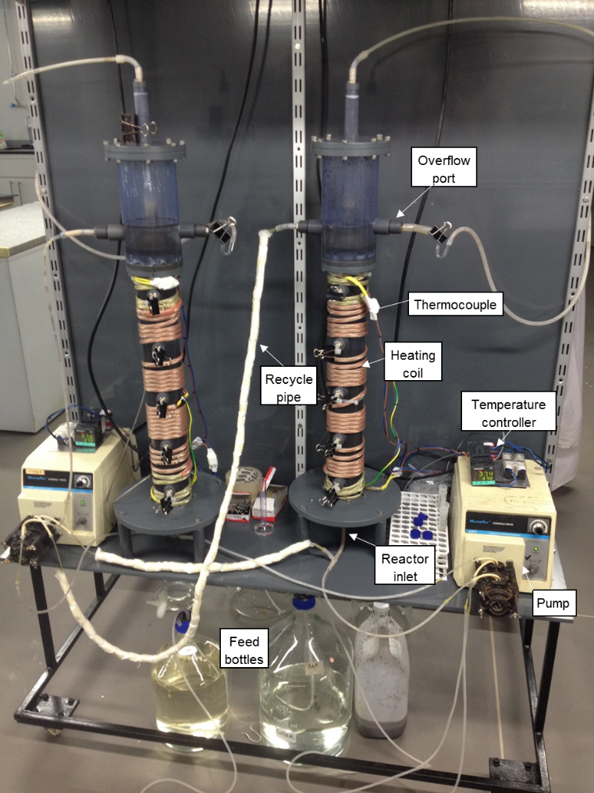
forms of data names text numbers formulae images code identifiers
var formatNumber = d3.format(",.0f"), // zero decimal places
format = function(d) { return formatNumber(d) + " " + units; },
color = d3.scale.category20();
// append the svg canvas to the page
var svg = d3.select("#chart").append("svg")
.attr("width", width + margin.left + margin.right)
.attr("height", height + margin.top + margin.bottom)
.append("g")
.attr("transform",
"translate(" + margin.left + "," + margin.top + ")");
http://www.humanities.uct.ac.za/sites/default/files/image_tool/images/14/harvard-uct-2014.pdf
https://doi.org/10.1016/j.mineng.2019.02.029
Water Research Commission
DST-NRF SARChI chair in Bioprocess Engineering UID 64788

Slide 10
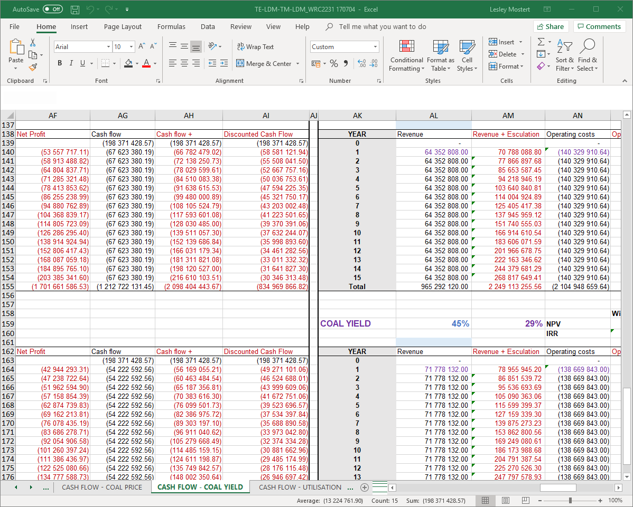
How do I start making a dataset?
How do I know what to do with my data to make it into a dataset?

Slide 11
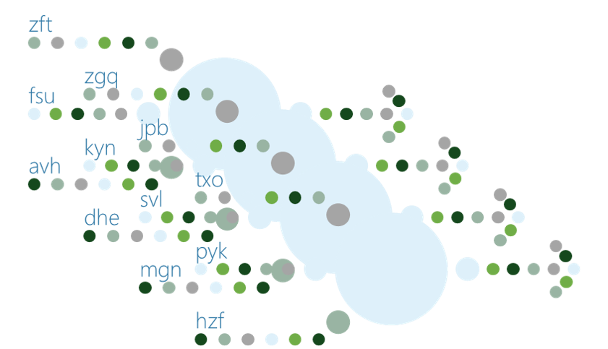
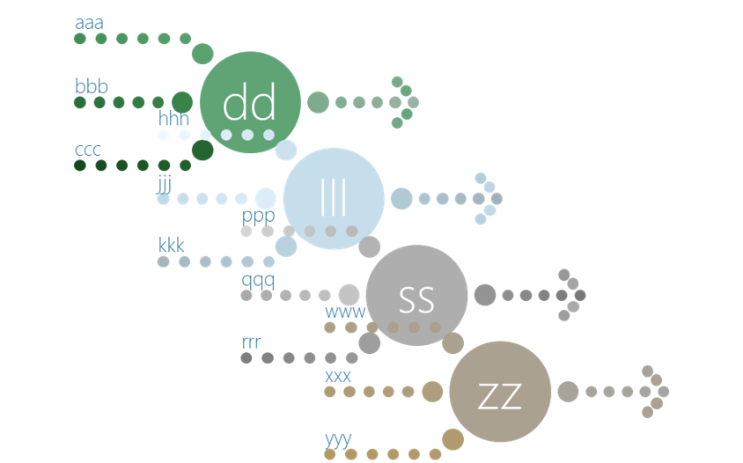
1 think: how much data?
only the data used to create the publication
  background
  supplementary
for articles data usually covers a single concise subject
  one file is enough
for theses and reports data often covers a number of areas
  several files should be used

Slide 12
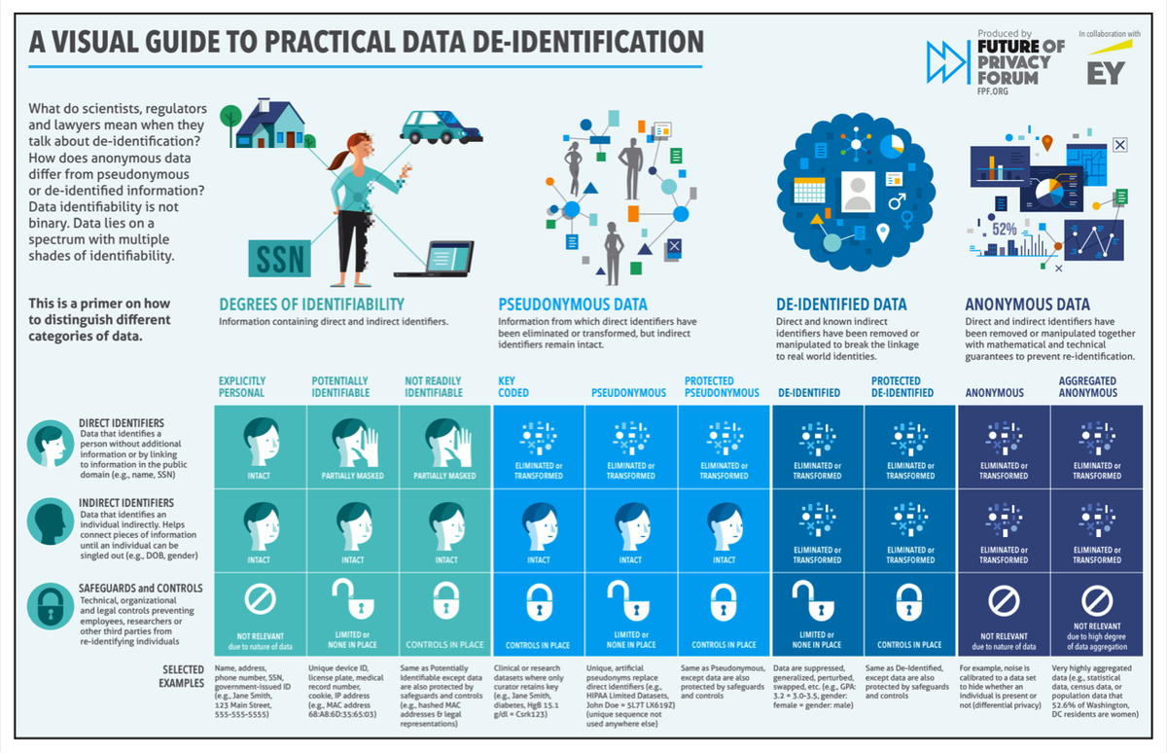
1 think: are there restrictions on the data?
does it belong to CeBER?
is it open source?
is it secret?
must someone be protected?
permission
deidentification
https://fpf.org/wp-content/uploads/2016/04/FPF_Visual-Guide-to-Practical-Data-DeID.pdf CC-BY-ND

Slide 13
1 think: what type of “information” data?
photos
flow sheets
captions
numbers
code
graphs
words
diagrams
tables
text
  tables
  lists
  descriptions
numbers
  tables
  calculations
  graphs
images
  photographs
  diagrams
  flowsheets
code

Slide 14
1 think: what type of “explanation” data?
for experiments
  experimental plan
  equipment
  conditions & methods
  assay methods
for data analysis
  calculation details
  statistical methods
  data analysis criteria
selection criteria
comments in code
data
photos & diagrams
comments
standard curves
protocols
formulae
equipment & setup

Slide 15
2 decide: what is the best format
Keyword: interoperable
Can other people use it in this format?
open access unlocked formats
  .csv / .odp .ods .odt / (.pdf) / .jpeg .tiff etc
widely accessible unlocked
  .xlsx .pptx .docx
Is the file-size for this format good?

Slide 16
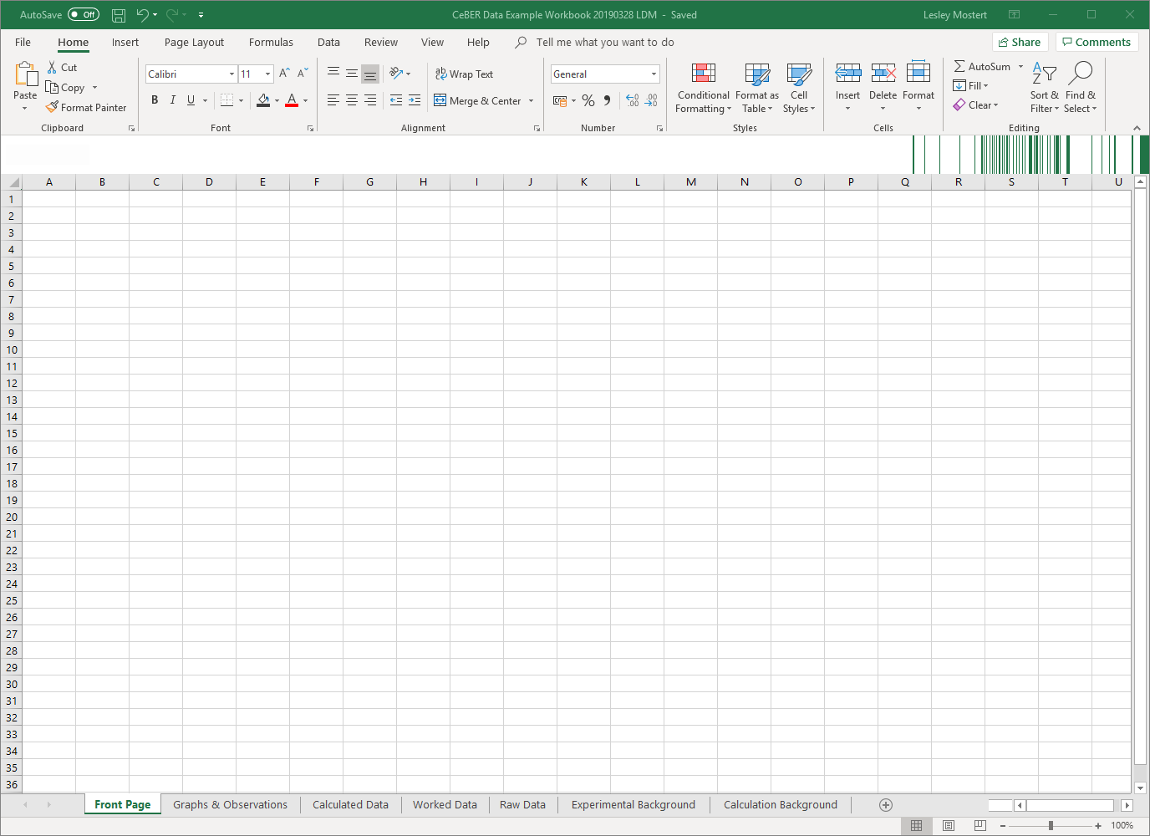
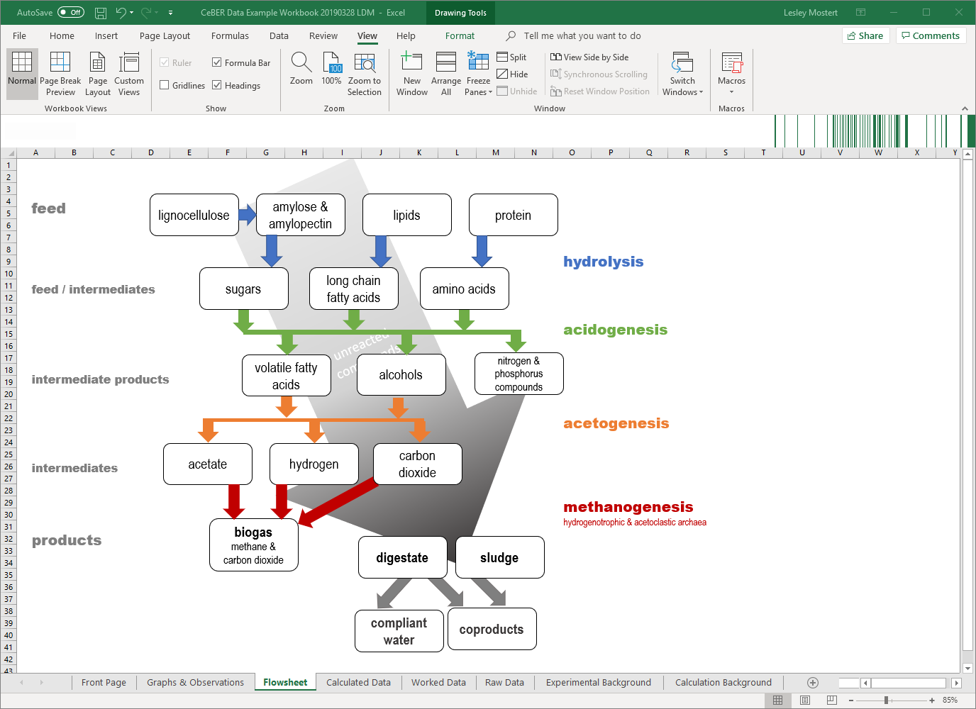
CeBER suggested format
CeBER will use MS Excel as file format for most datasets
all MS office formats can be pasted in without loss of functionality
From CeBER project report WRC K5/2473 work by Lesley Mostert and Sue Harrison

Slide 17
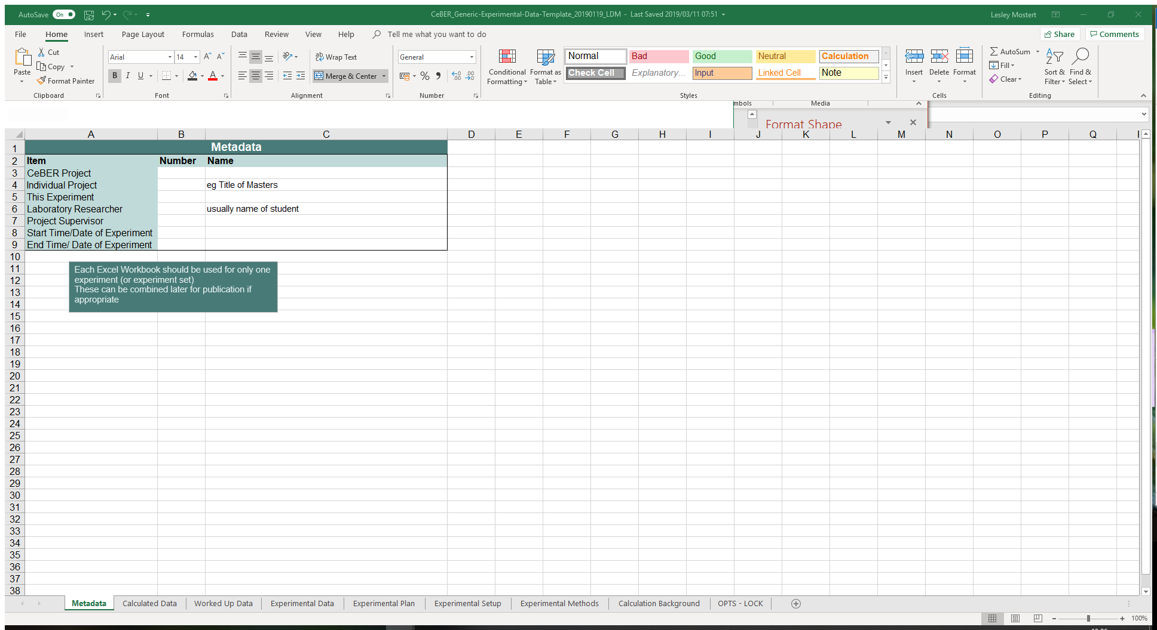
2 decide: what is the best structure
how many single-subject “units” will work?
  each unit should be one file
  some units may need a related file of a different format
  for article-linked data try for a single unit
what sheets are needed in the workbook for each unit?

Slide 18
Create the information part
my data
how I got it
where you find it
How do I format my “actual data” in the most useful way?

Slide 19
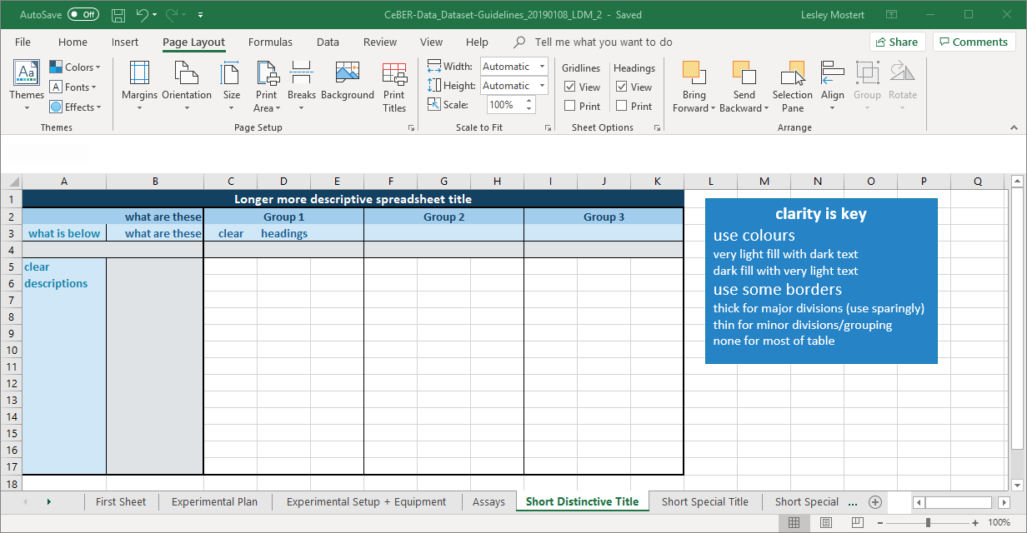
1 numerical data: tables of numbers

Slide 20
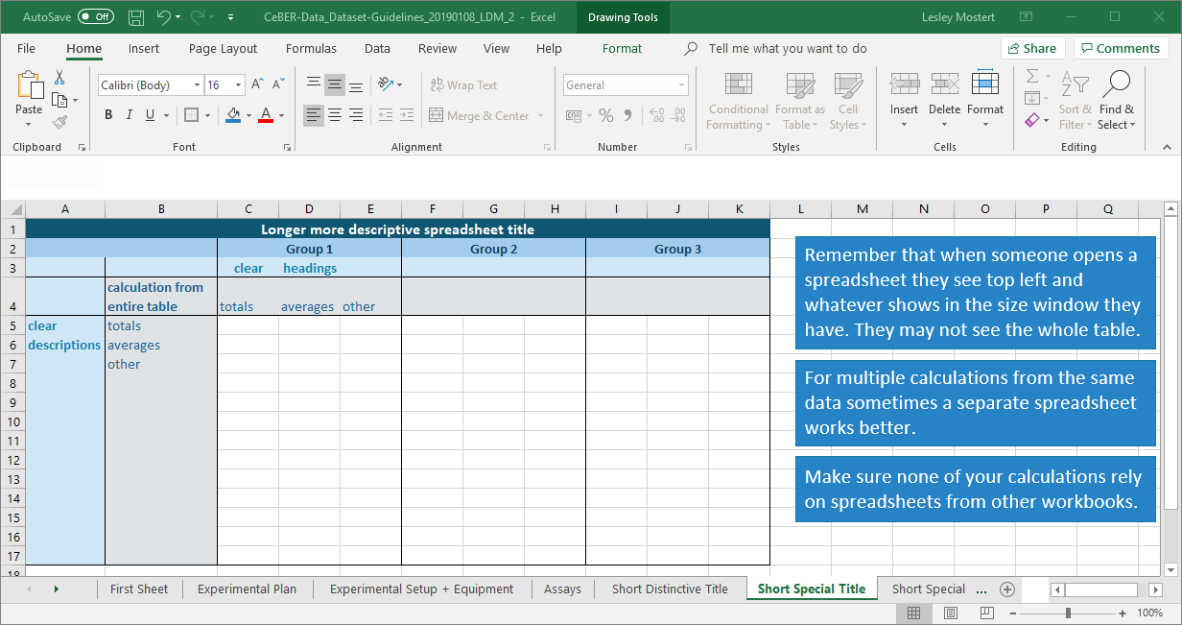
1 numerical data: minor calculations

Slide 21
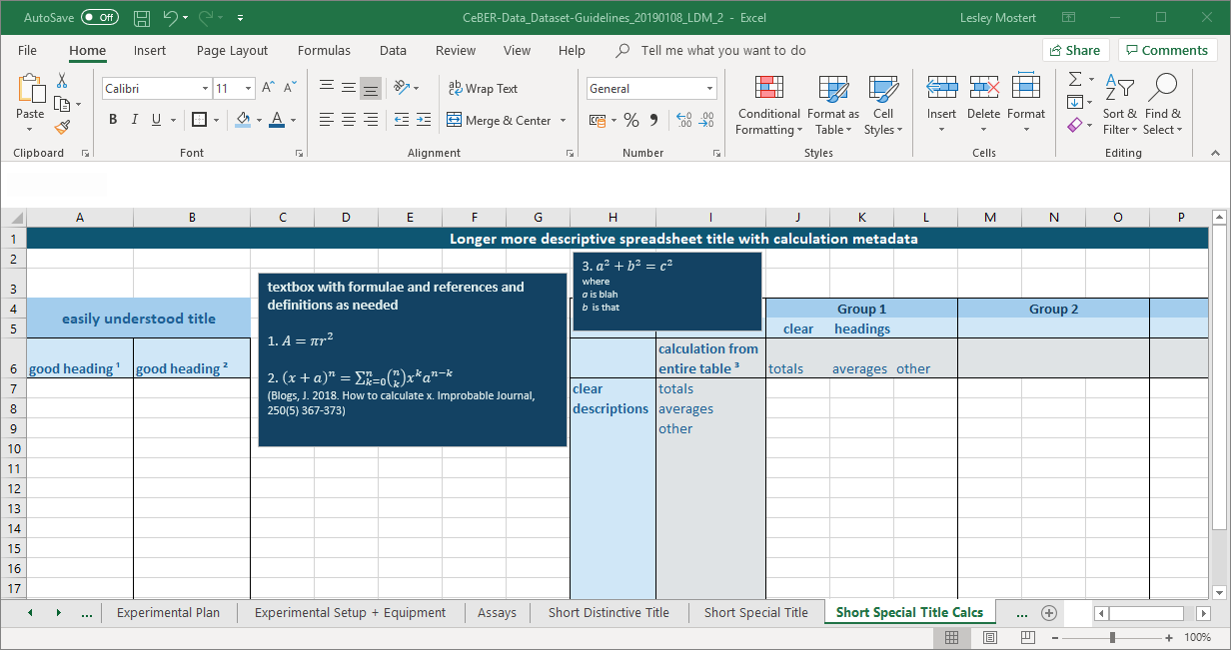
1 numerical data: major calculations

Slide 22
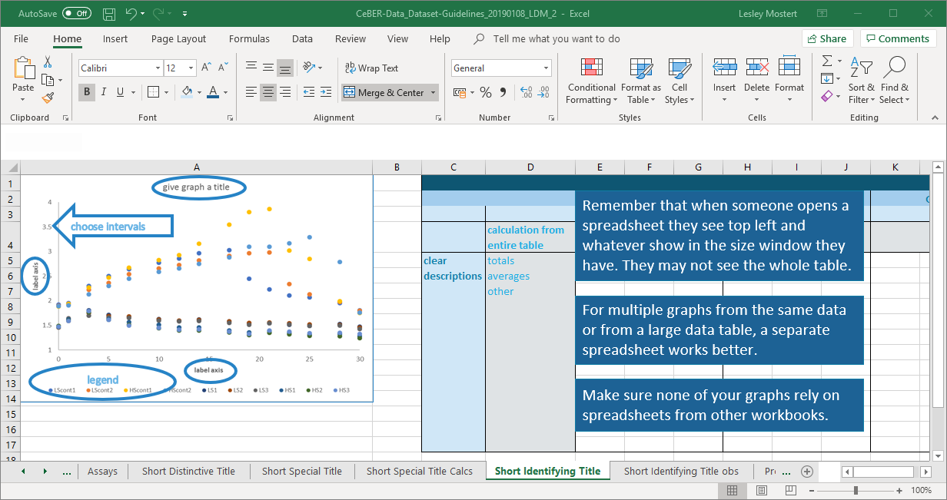
2 image data: graphs and charts

Slide 23
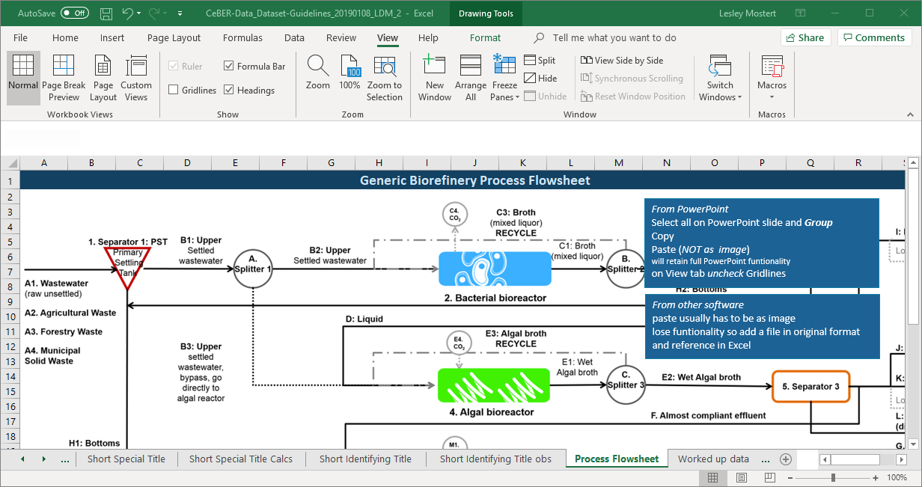
2 image data: diagrams and flowsheets
From CeBER project report WRC K5/2380 work by Bernelle Verster, Lesley Mostert and Sue Harrison

Slide 24
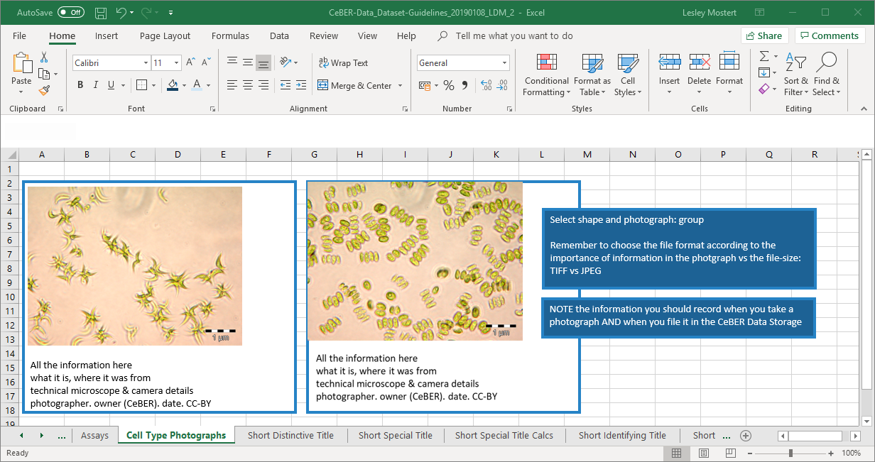
2 image data: photographs
From CeBER photograph repository

Slide 25
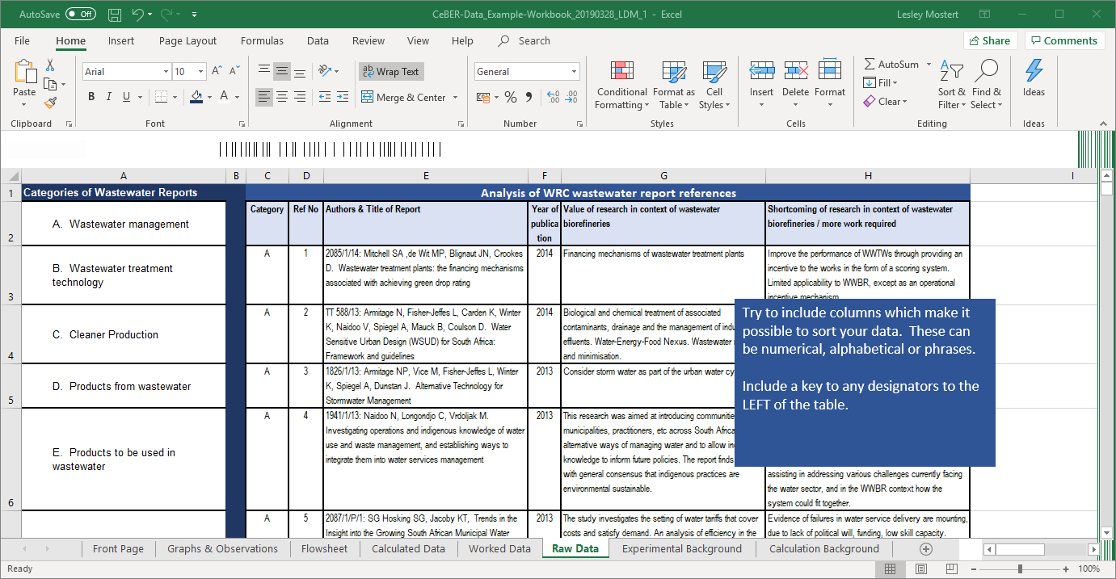
3 text data: tables
CeBER Towards Wastewater Biorefineries. Report WRC K5/2380

Slide 26
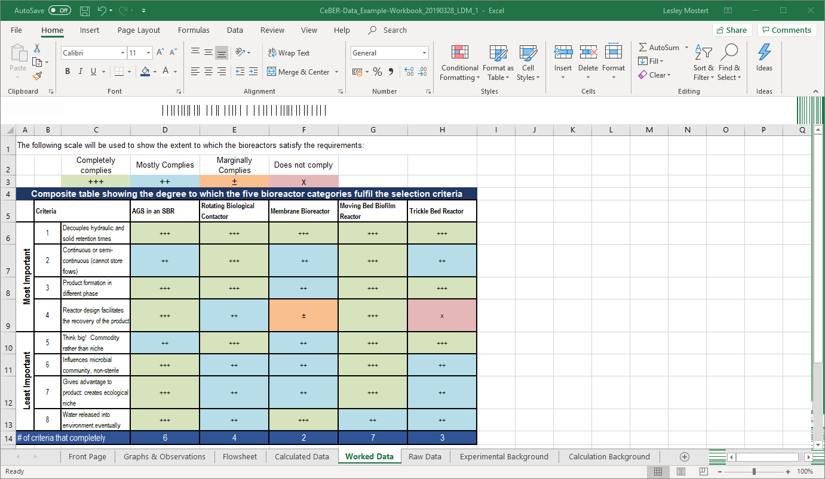
3 text data: decision matrices
CeBER Towards Wastewater Biorefineries. Report WRC K5/2380

Slide 27
Create the explanation part
my data
how I got it
where you find it
How can I make sure my “actual data” can be understood, reproduced and reused?

Slide 28
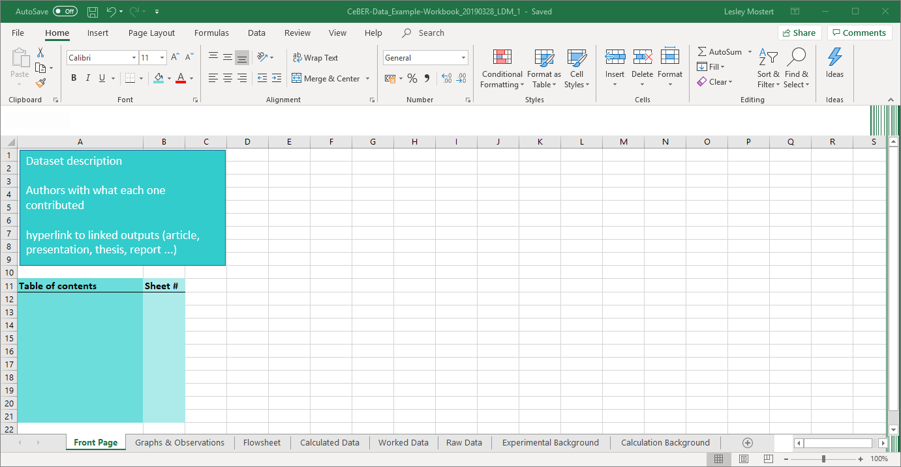
1 explain the workbook: first sheet

Slide 29
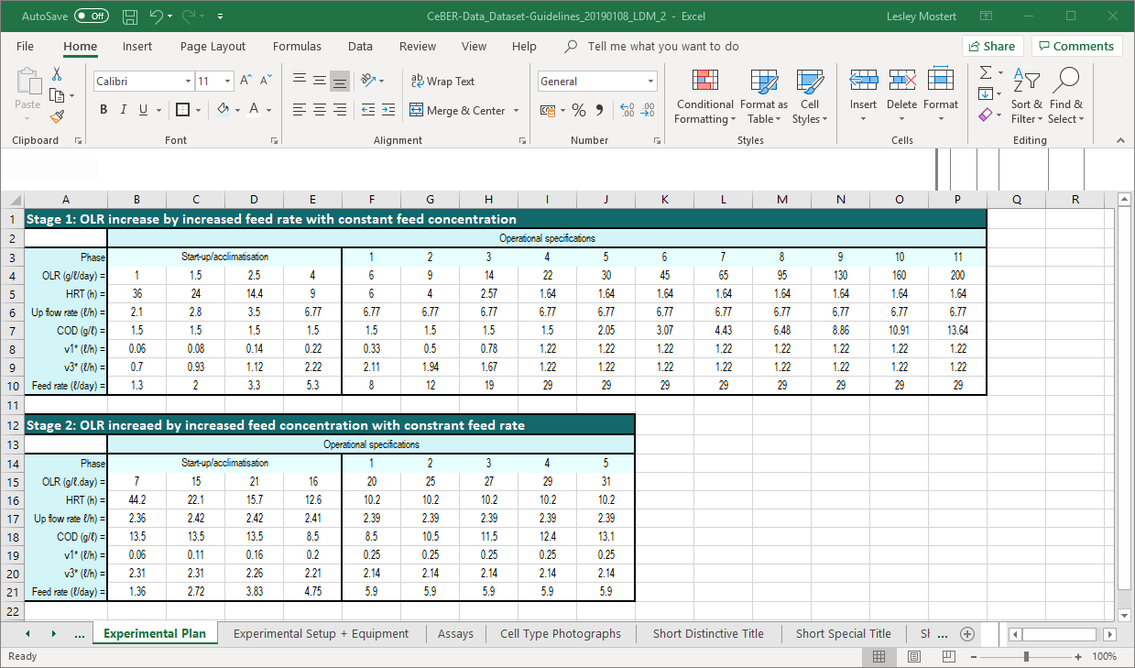
2 explain experiments: plan
some of this may be in the thesis, but some will be extras
eg dimensions, size of samples, protocols etc
From CeBER project report WRC K5/2473 work of Rory Stott, Nodumo Zulu, Mariette Smart

Slide 30
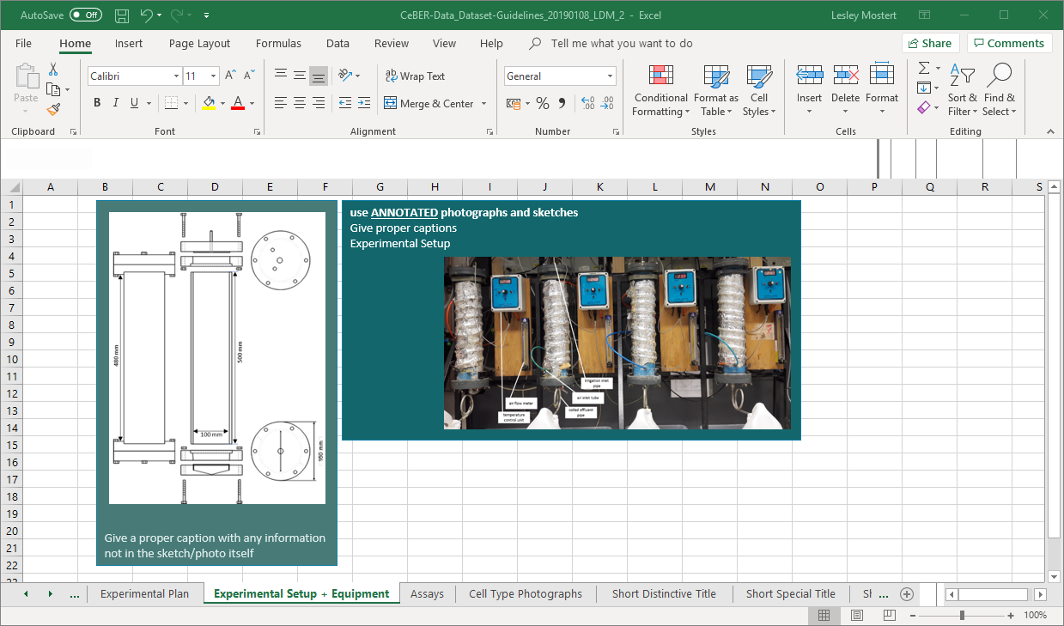
2 explain experiments: equipment & setup
some of this may be in the publication, but some will be extras
eg dimensions, size of samples, specific protocols etc
From CeBER project report WRC K5/2761 work of Olivier Tambwe and Lesley Mostert

Slide 31
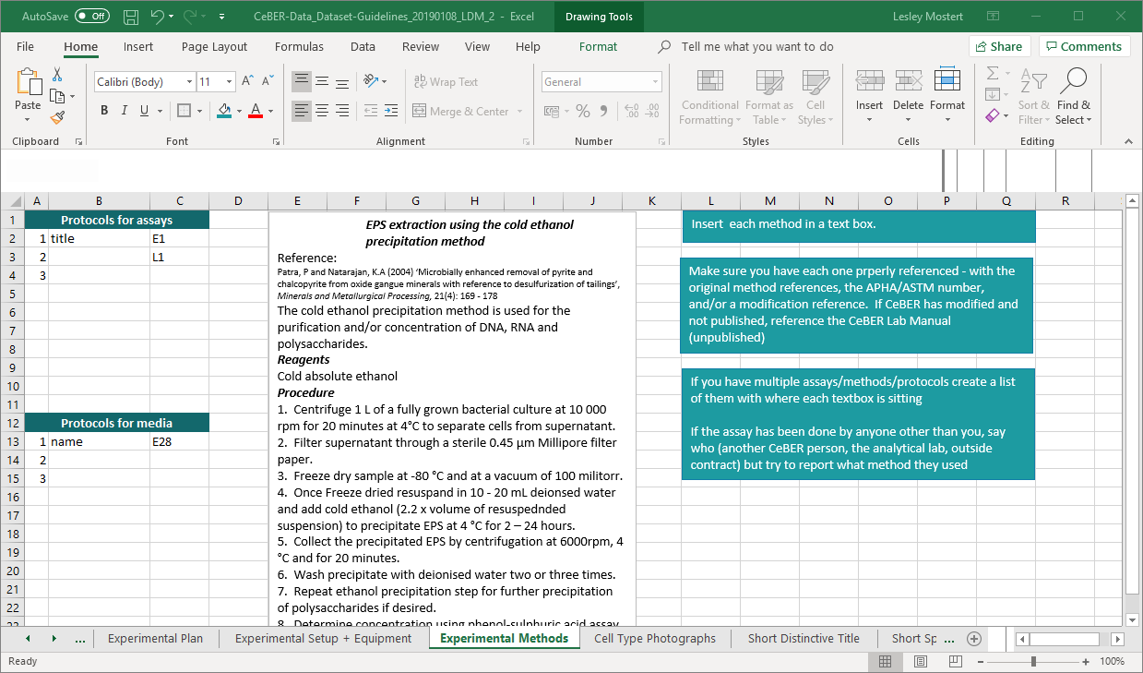
2 explain experiments: methods & protocols
some of this may be in the thesis, but some will be extras
eg dimensions, size of samples, protocols etc
From CeBER Laboratory Manual

Slide 32
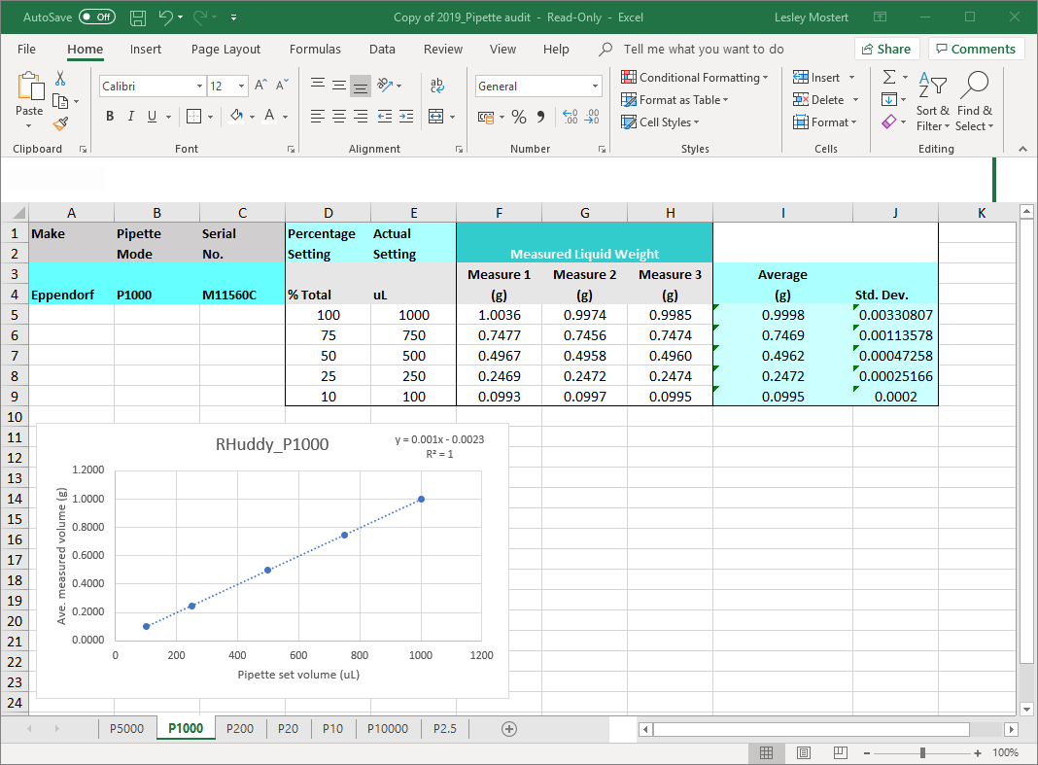
3 explain data analyses: standard curves
Depending on the level of “actual data” presented:
raw data
worked data
calculated data
Rob Huddy

Slide 33
3 explain data analyses: calculations
Formulae for calculations may be on the same sheet as the calculations – as suggested in “actual data”. When this is too complex:
Formulae and explanations on a separate sheet
  may need citations/references
  may need explanations of where values etc come from
Cross-references to the calculated data sheets
Separate sheet for constants

Slide 34
3 explain data analyses: methodologies
coming soon

Slide 35
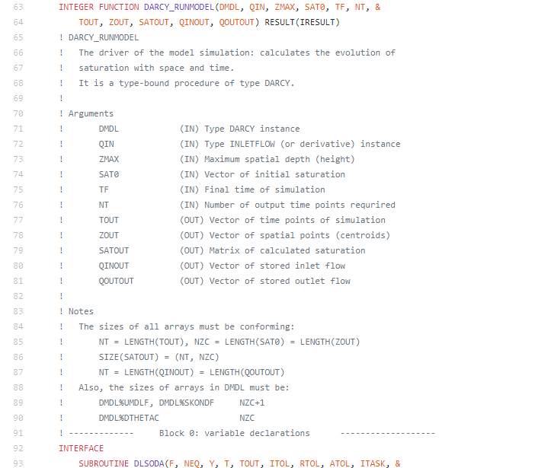
4 explain models: define arguments
arguments are meaningless without definition
clearly define
many models go wrong because units are inconsistent
specify units
From Alexey Cherkaev PhD
https://github.com/mobius-eng/phd-source-code/blob/master/Richards1D/darcy.f90

Slide 36
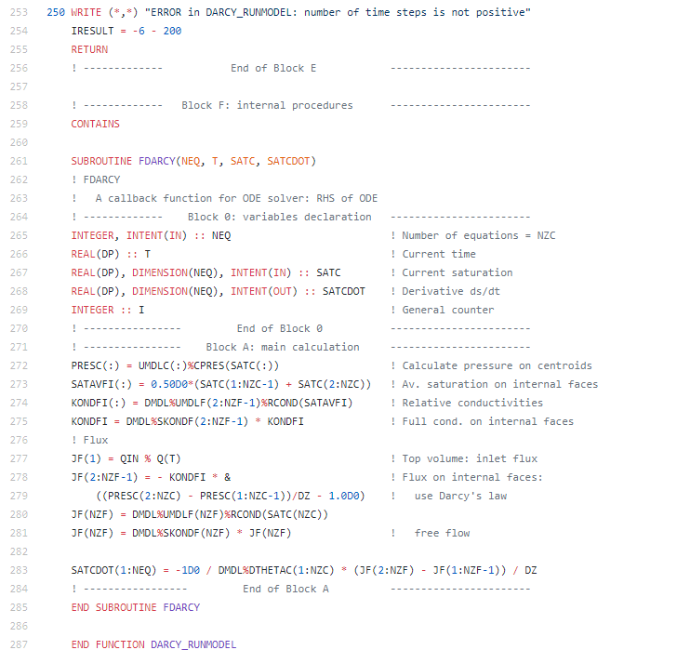
4 explain models: demonstrate logic
publishing your code is not enough
comments for “headings”
comments indicating logic
comments noting conversions
specify constants (assign to a symbol)
From Alexey Cherkaev PhD
https://github.com/mobius-eng/phd-source-code/blob/master/Richards1D/darcy.f90

Slide 37
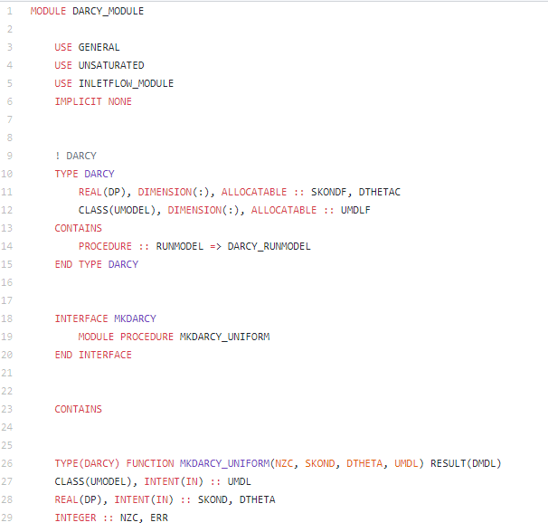
4 explain models: acknowledge sources
we are not hackers
we are academics creating models
state platform
reference
  source of reused code
  plugin passages
include seminal article where available
From Alexey Cherkaev PhD
https://github.com/mobius-eng/phd-source-code/blob/master/Richards1D/darcy.f90

Slide 38
5 explain review data:
coming soon

Slide 39
6 explain images:
coming soon

Slide 40
Create the location part
my data
how I got it
where you find it
How do I make sure my dataset can be found easily?

Slide 41
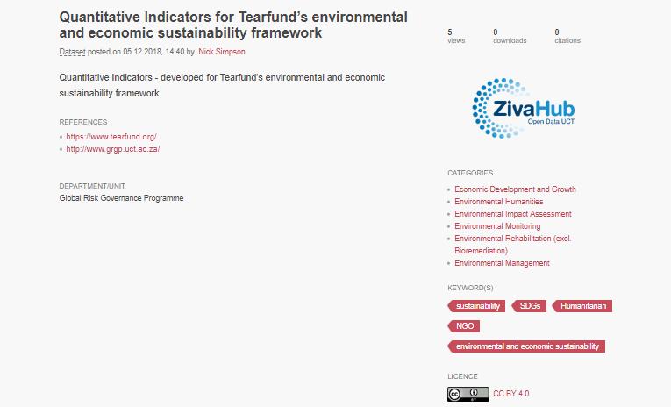
location: how people look for data
authors
publication links
organisation
categories
funders
keywords

Slide 42
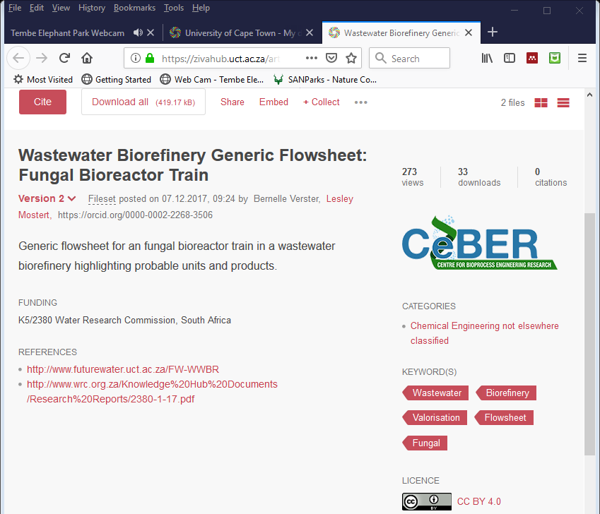
location data: people & organisations
authors of article except
  if first author did not produce the dataset, change the order
  if an author had nothing to do with the data may be left off
  if someone was involved in data creation but not article, add
for thesis add supervisors
organisations
  CeBER
  funders
  collaborators
use ORCID

Slide 43
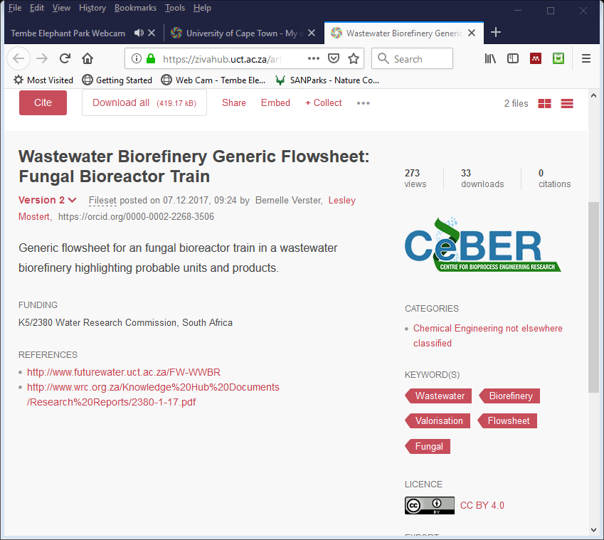
location data : publication links
link in both directions!
URL/DOI for
  article/thesis
  reports
  related datasets
DOI of dataset in related publications

Slide 44
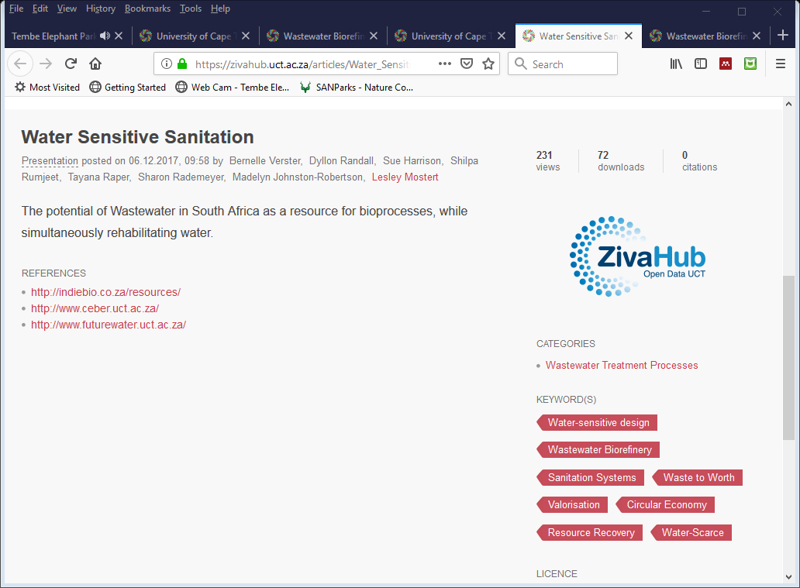
location data : categories
https://drive.google.com/file/d/1pj7Yb-sioVCFidhfIAMg2SizVKtMUZHv/view?usp=sharing
http://www.ausstats.abs.gov.au/ausstats/subscriber.nsf/0/2A3A6DB3F4180D03CA25741A000E25F3/$File/12970_2008.pdf

Slide 45
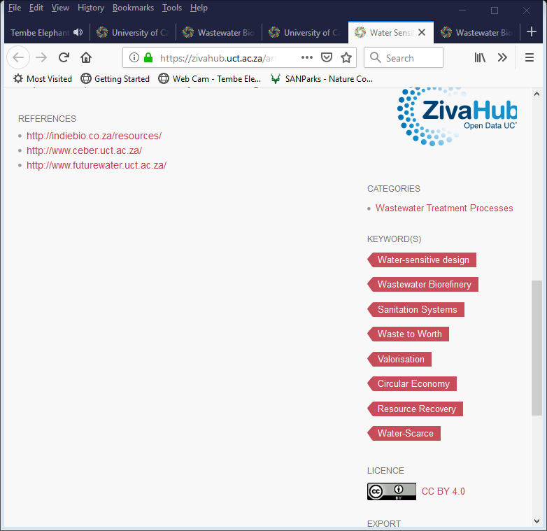
location data : keywords

Slide 46
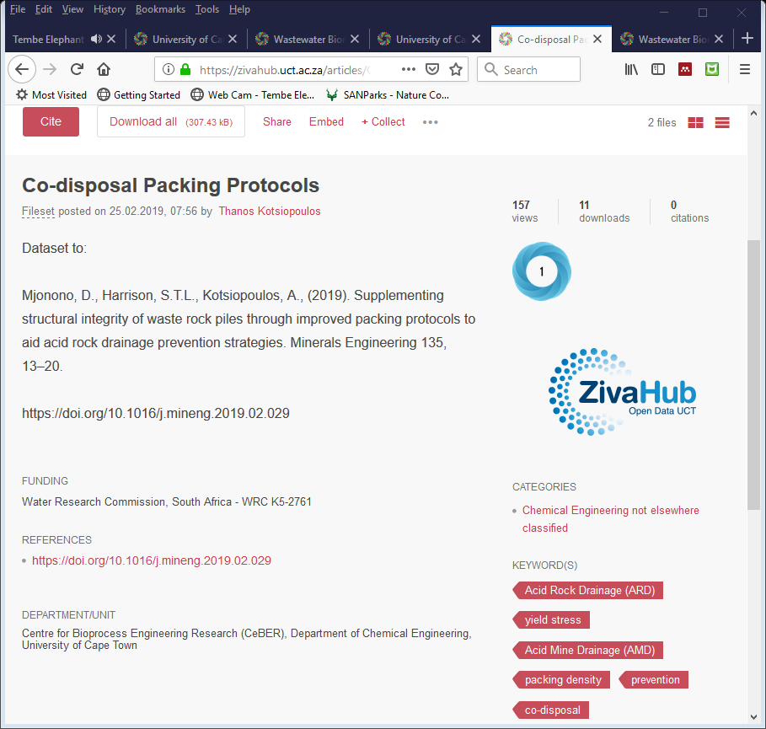
Get the dataset out there
How do I make it possible for others to access my dataset?

Slide 47
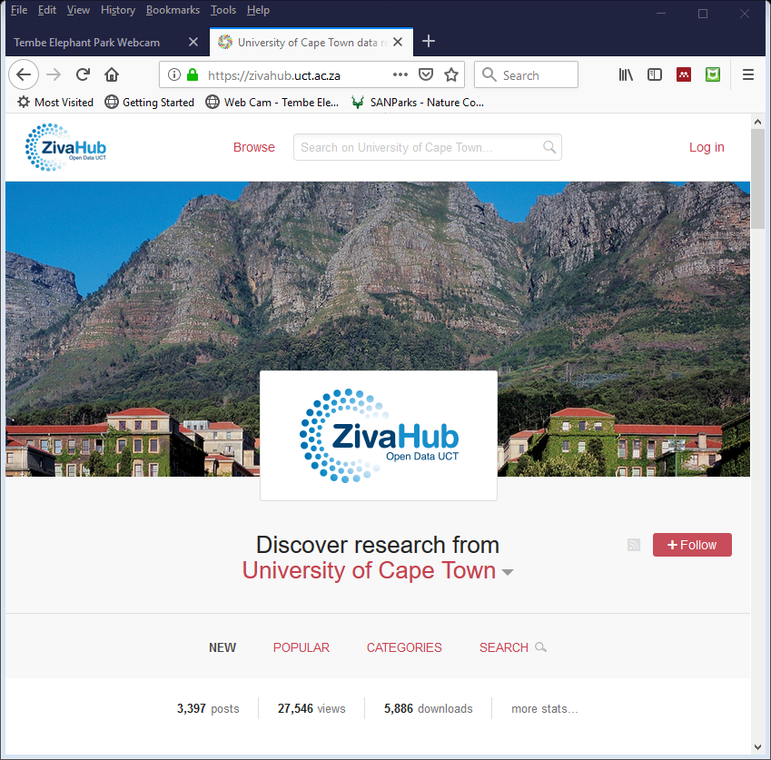
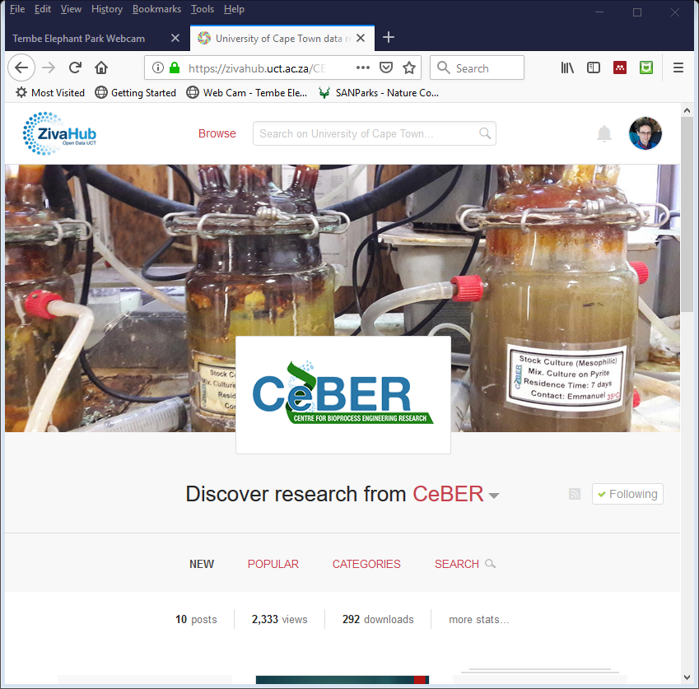
publish: repository

Slide 48
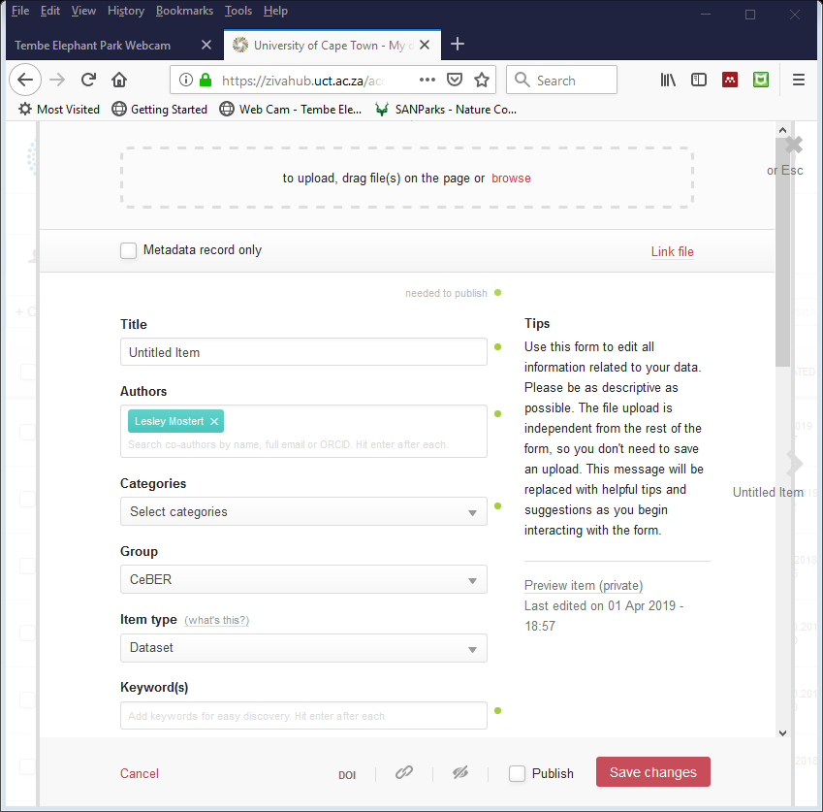
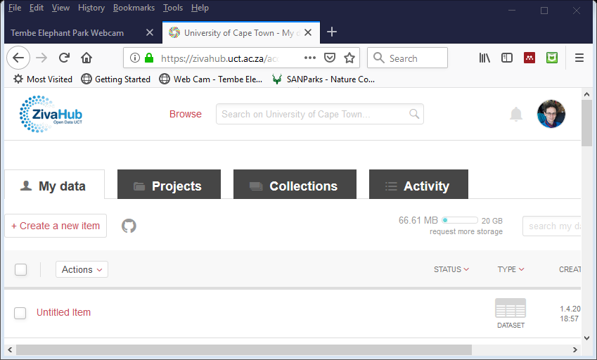
publish: save & check

Slide 49




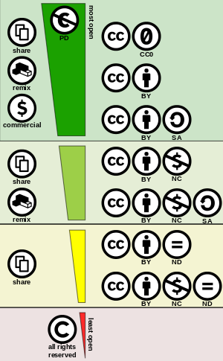
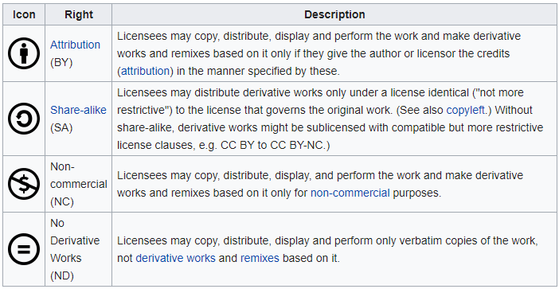

publish: license
https://en.wikipedia.org/wiki/Creative_Commons_license

Slide 50
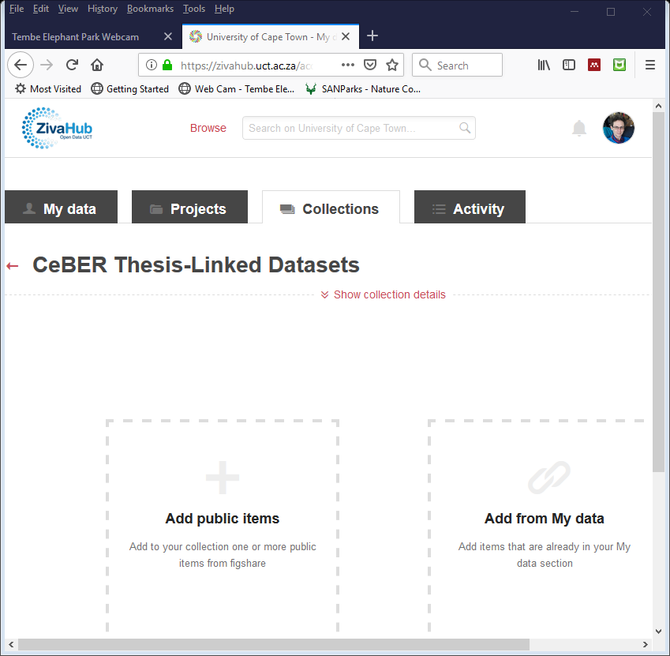
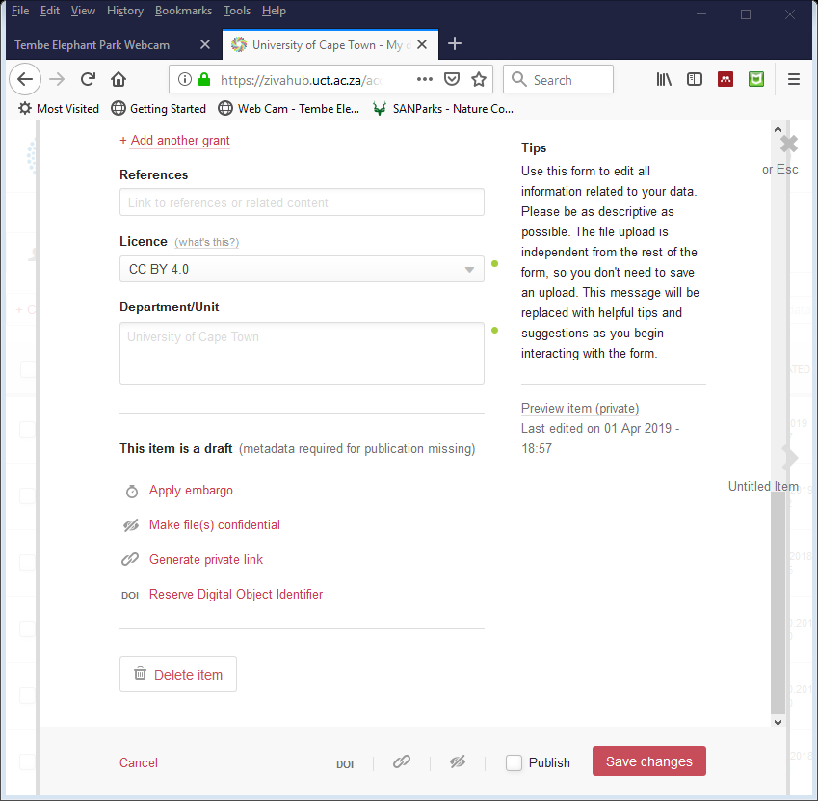
publish: publish … curation

Slide 51
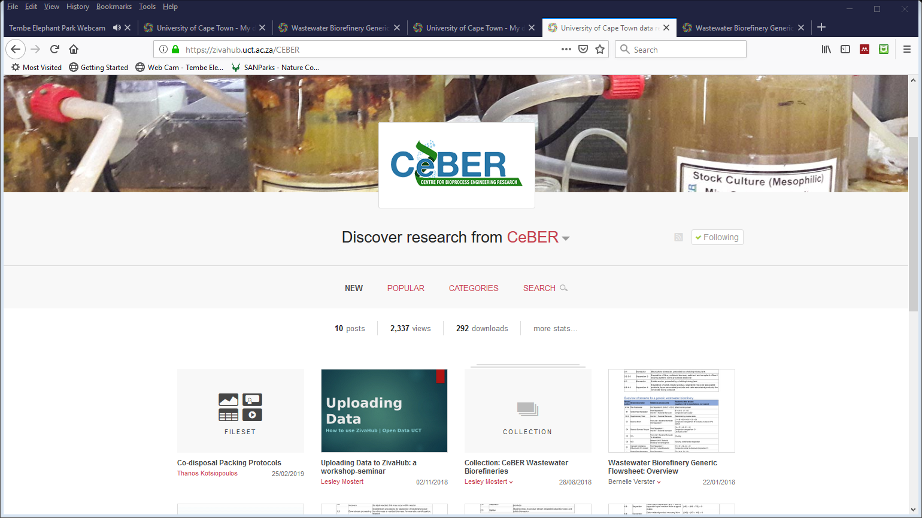
your data is important!

