Slide 1
Annotation for Transparent Inquiry (ATI) Transparency for Qualitative Social Science Research
Force 2019, Edinburgh, October 16-17, 2019
Sebastian Karcher Qualitative Data Repository

Slide 2
How Do We Make Qualitative Research Transparent?

Slide 3
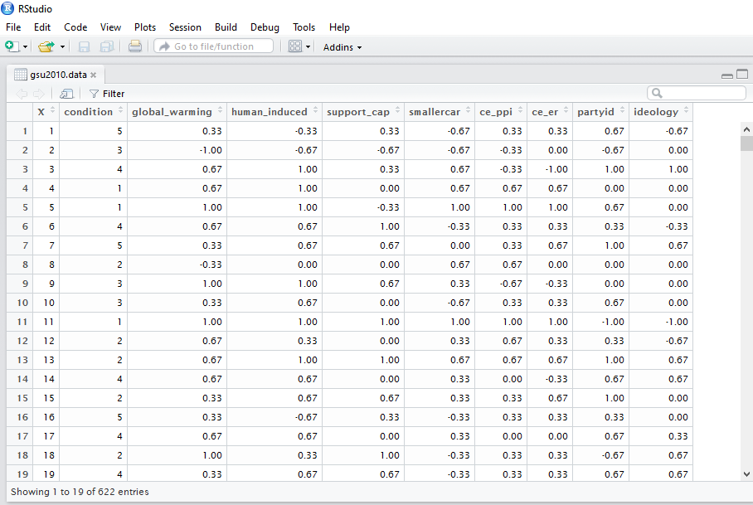
Quantitative Research: Matrix Data
Open Science
Toby Bolsen, Thomas J. Leeper, and Matthew Shapiro. 2014. “Doing What Others Do: Norms, Science, and Collective Action on Global Warming.” American Politics Research 42(1): 65–89.

Slide 4
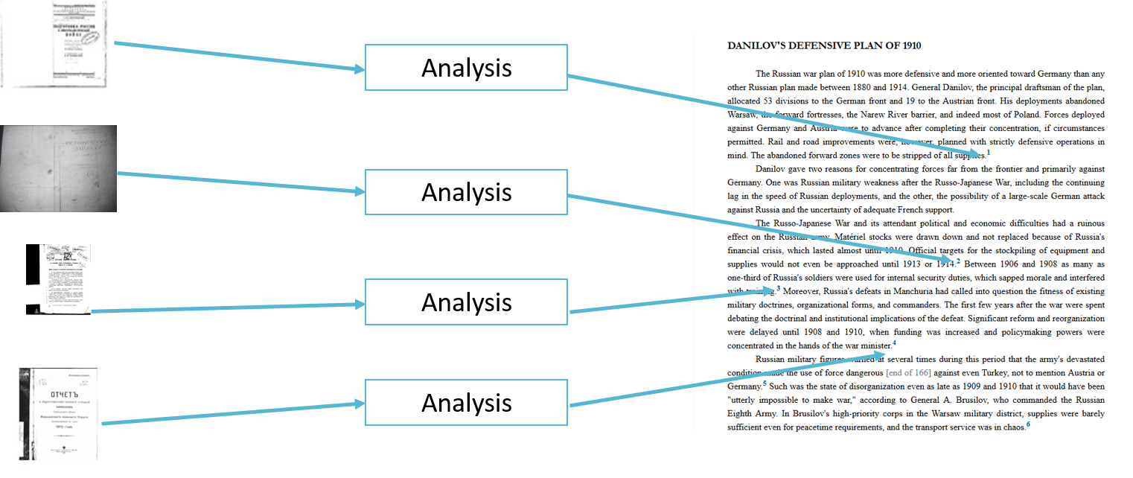
Qualitative Research: Granular Data

Slide 5
The Traditional Way

Slide 6
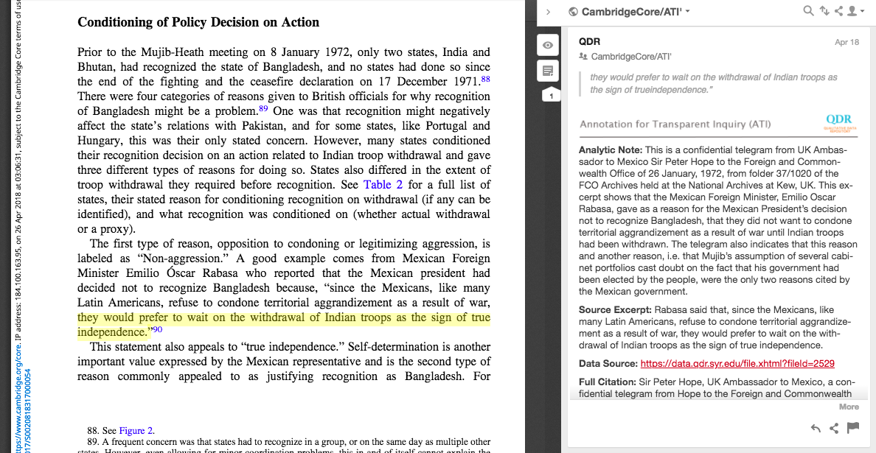
Annotation for Transparent Inquiry (ATI)

Slide 7
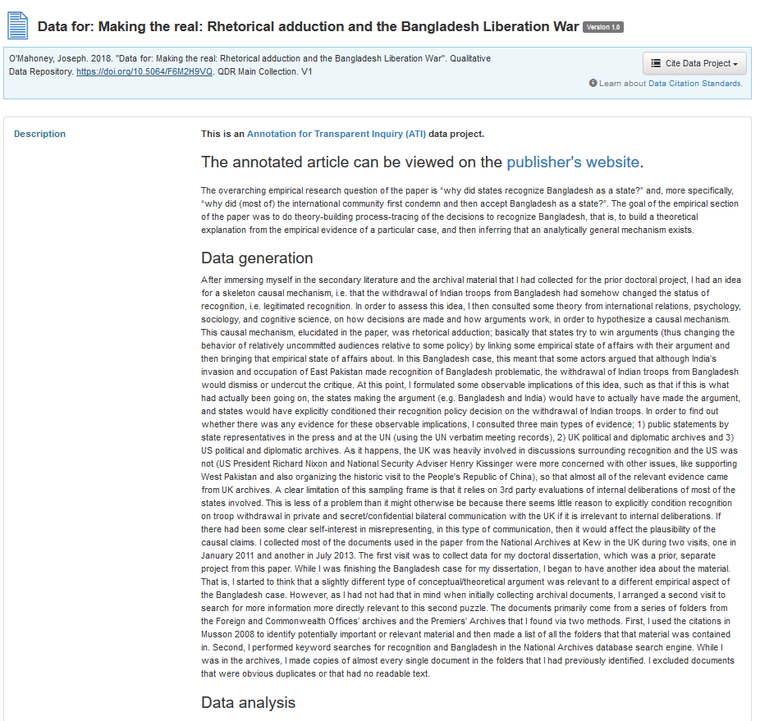
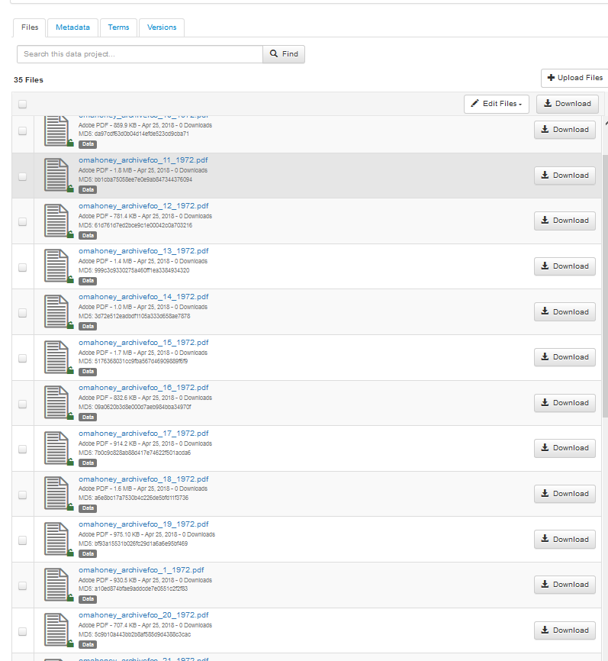
ATI: Data repository

Slide 8
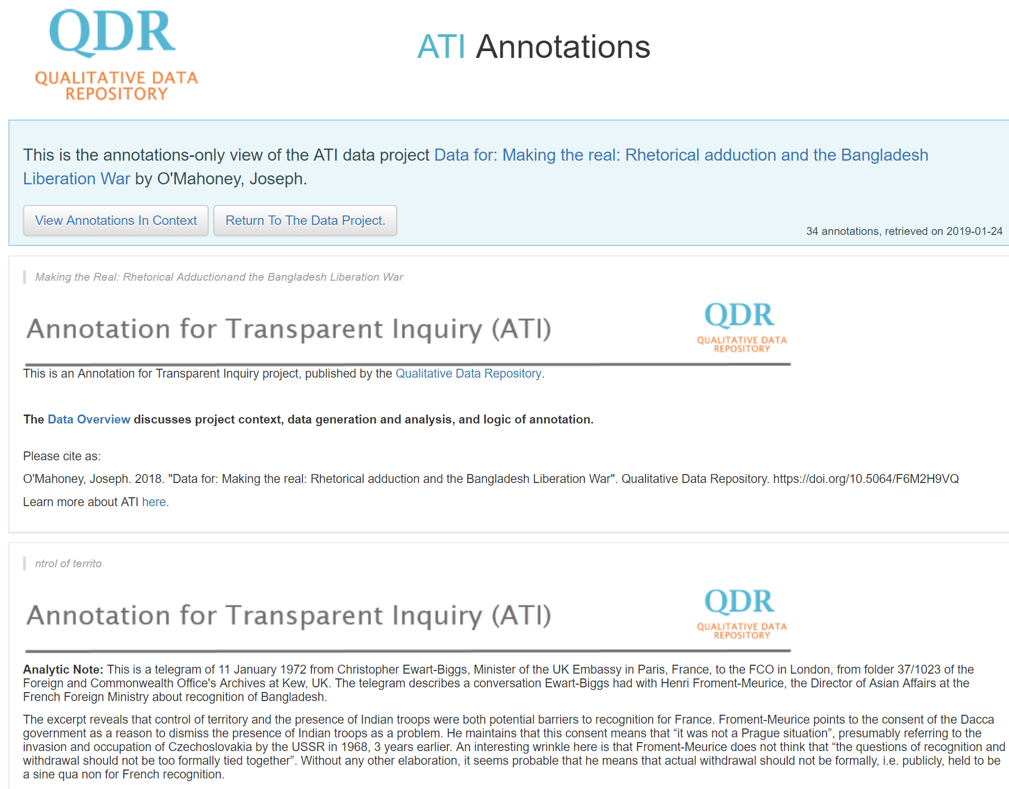
ATI: Annotations

Slide 9
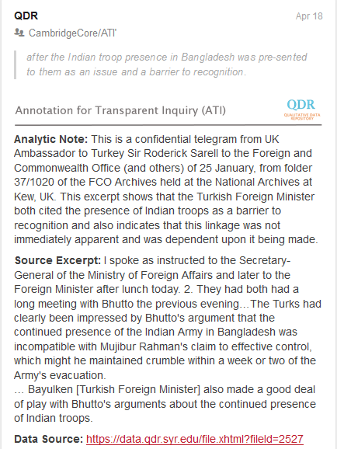
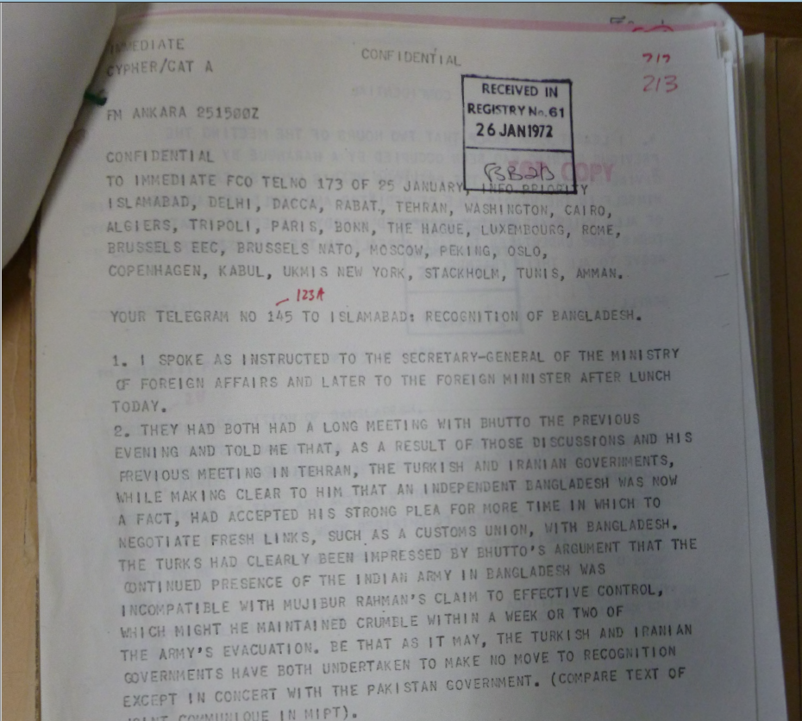
ATI examples: Historical research
Source document
Annotation
Publication
Link: http://bit.do/ati-historical

Slide 10
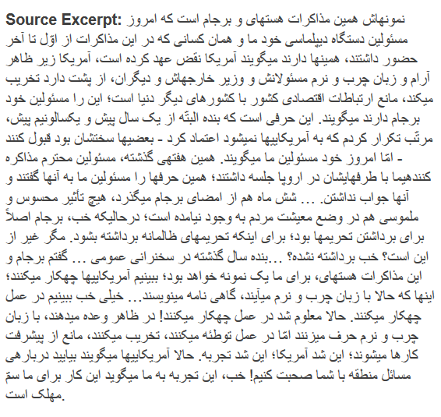
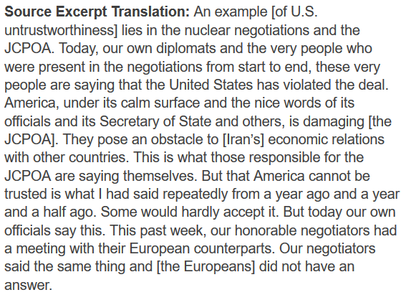
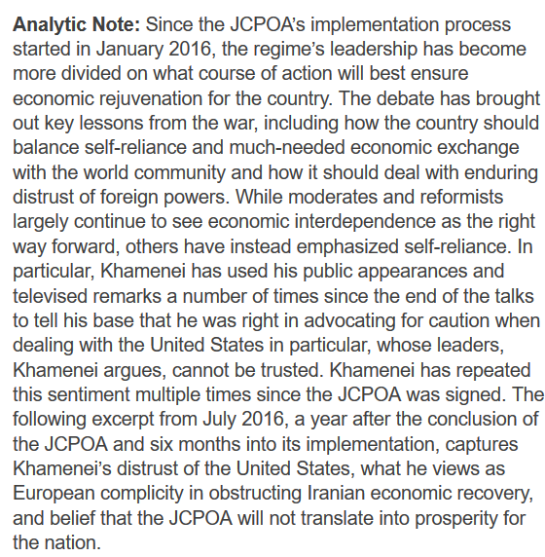
ATI Example: Excerpt, translation, and analysis
Source excerpt
Translation
Analysis
Publication

Slide 11
Example: audio in linguistics
Documentation (list of excerpts)
Data source (audio)
Publication table
Link: http://bit.do/ati-audio
Notes:
Direct link to snippet video: https://drive.google.com/open?id=1gjAdy0BSgqHJ_eQ1s6FwPNf_frnF-OZX
Direct link to raw sound file: https://drive.google.com/file/d/1uYwDxQmV24ERBBBktSy8nnrhnWQvCjJa/view?usp=sharing
Link to annotation: https://hyp.is/UvONqAaYEeibFZ8epLi12g/www.cambridge.org/core/journals/english-language-and-linguistics/article/unstoppable-glottal-tracking-rapid-change-in-an-iconic-british-variable-1/B466B1578FAC33B1B4E1FFD0A538513D/core-reader

Slide 12
Evaluating ATI: The ATI Initiative
2 Phases
1st phase: Annotating recently published articles
Collaborated closely with Cambridge University Press to test technology, workflows, and solicit articles
Projects available at qdr.org/ati/ati-models
2nd phase: Annotating during writing process
Every paper paired with reviewer, pre- and post review
Authors keep logbook & fill out survey

Slide 13
Evaluating ATI: ATI Challenge
2nd Phase of pilots
Solicited proposals for (paid) annotation & workshop
80 submissions across disciplines & continents, though skewed towards political science
Selected 19 projects, workshop in November 2018
Same reviewer/author structure
First (law review) article published
Other articles just entering peer review

Slide 14
Evaluating ATI
Time spent per project: ~20-30hs
Widely differing number of annotations (6-80/article)
Widely differing usage of annotations, some disagreement
Readers value analytical content at least as much as data
Concern about incentives
Interest in clearer typology of annotations
Existing work on annotation/citation ontologies

Slide 15
Next Steps
Promote broader adoption
Facilitate peer review
Automate curation processes
Further standardize instructions
All components of ATI are open and (where applicable) standards based

Slide 16
Questions? Comments?
Please stay in touch:
https://qdr.syr.edu
@adam42smith (Sebastian)
@qdrepository (QDR)
Email: skarcher@syr.edu
qdr@syr.edu

