Slide 1
Policy into practice
Jisc - you don't need to know
who we are, but these are some of the things we do [for you]

Slide 2
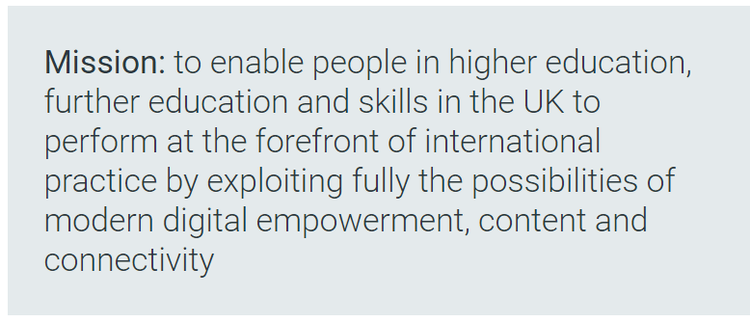
Who/what is Jisc?
Slido.com #P647
“We're a membership organisation, providing digital solutions for UK education and research”
https://www.jisc.ac.uk/about/corporate/strategy
Notes:
How many people know much about Jisc?
https://wall.sli.do/event/hju4axzv?section=7e4d00e9-663d-4e57-a75b-7253407a38db&info_modal_version=default&open_info_modal=true
All universities, FE colleges and parts of the skills sector are members
Mission – focuses on allowing individuals to fully exploit the digital environment
Around in various guises since Computer Board for Universities and Research Councils was created in 1966
[Jisc as we know it was formed by a merger of the Computer board and the information systems committee = Joint Information Systems Committee
Funding info
The majority of our funding comes from the UK national funding councils (OfS, UKRI, as well as Research England, SFC, HEFW, Dept Economy), with additional support coming from membership fees for further education and higher education institutions.

Slide 4
What do we do?
Shared digital infrastructure and services
Sector wide deals
with IT vendors and commercial publishers
Expert and trusted practical support and assistance
Research and development
https://www.jisc.ac.uk/about/who-we-are-and-what-we-do

Slide 5
Jisc RDM programmes
Managing Research Data Programme (2009-2011)
Infrastructure, data management planning, business case planning, publishing, sharing and discovering research data, RDM training materials
Managing Research Data (2011-13)
Developing training materials for specific disciplines and information professionals
Research at Risk Co-Design (2014-2016)
Establishing good data management practice in universities, as part of their core research function
Notes:
Message: Jisc has been involved in supporting RDM for a long time
Jisc has been involved in development of research data management projects for over a decade now
Between 2009-11 we funded work that developed a number of important tools, technologies and services within universities
click
Programmes that run between 2011-13: built on earlier work and also supported the development of skills and expertise for specific disciplines and support staff.
After this, the next step was to broaden the implementation of previous work
click
The led to the Research at Risk (2014-2016) led by Jisc in partnership with RLUK, RUGIT, SCONUL and UCISA, and informed by numerous stakeholder consultation events.
To provide infrastructure, advice and tools to support universities in establishing good data management practice as a core part of their research function.
Aim was to lead to a sector-owned direction of travel for RDM and develop a community governed infrastructure.
click
All this work led to the Jisc Research Data Shared Service project – the output of which transitioned to service last week.

Slide 6
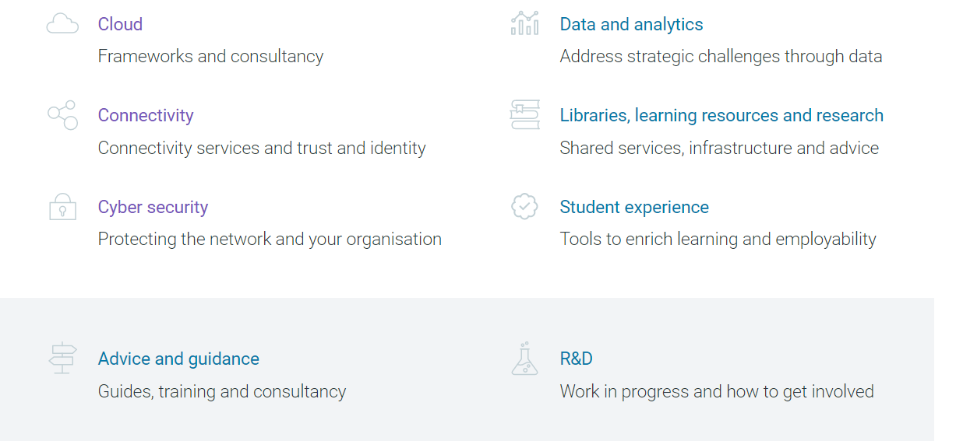
Jisc role and services for research
Notes:
We provide tools and services to underpin research and research management
Infrastructure to facilitate research and research management
Cloud
Connectivity
-Janet and Trust and Identity, authentication.
Cyber security
Services
Analytics – Chris Brown will talk to us about Jisc’s work in research analytics, and there’s a workshop on this later.
Libraries, learning resources and research - Shared services, infrastructure and advice
- Research information infrastructure – ORCiD consortium, standards, identifiers, metrics

Slide 7
Scholarly communications and open research
Submission
Acceptance
Publication
Use
Select Journal
Check compliance
Manage costs
Deposit in repository
Report on compliance
Maximise impact
Record impact
Research publication lifecycle
Report
Publications Router
SHERPA RoMEO
SHERPA Fact
Monitor UK
Monitor local
IRUS-UK
Jisc services
Open research hub
SHERPA JULIET
SHERPA REF
Jisc collections
CORE
RIOXX
OpenDOAR
Guidance, consultancy, technical support, ORCID support, OA good practice
Notes:
Quick look at some of our services
Point out open research hub – new repository and preservation software for digital research outputs, we’ll be demoing this at lunch time.

Slide 8
Some of the highlights
(for researchers)

Slide 9
All The SHERPAs
By Niklassletteland - Own work, CC BY-SA 3.0, https://commons.wikimedia.org/w/index.php?curid=40625645

Slide 10
SHERPA services
Helping authors and institutions make informed and confident decisions in open access publication and compliance.
SHERPA/FACT – Finders & Authors Compliance tool
SHERPA/RoMEO - Publisher copyright policies & self-archiving
SHERPA JULIET - funders' conditions for open access publication
SHERPA REF - comply with the open access requirements for the REF
IpenDOAR - directory of open access repositories
Notes:
SHERPA FACT
SHERPA FACT checks if compliance with funder open access policies can be achieved with a particular journal.
SHERPA RoMEO
SHERPA RoMEO gives a summary of publishers' open access archiving conditions for individual journals.
SHERPA Juliet
SHERPA Juliet enables researchers and librarians to see funders’ conditions for open access publication.
SHERPA REF
Our SHERPA REF service helps authors and institutions decide whether a journal allows them to comply with the OA REF policy
Related services
OpenDOAR, which enables the identification, browsing and search for repositories is also in the SHERPA services family.

Slide 11
Funder policies and payments
What will the funders pay for?
Glasgow University - funded by Jisc
Outputs
Funder Requirements and Paying for RDM - a systematic review http://doi.org/10.5281/zenodo.1421064
Blog https://rdmfunderrequirements.wordpress.com/
By Steven Depolo, CC BY 2.0, https://www.flickr.com/photos/stevendepolo/3354726208

Slide 12
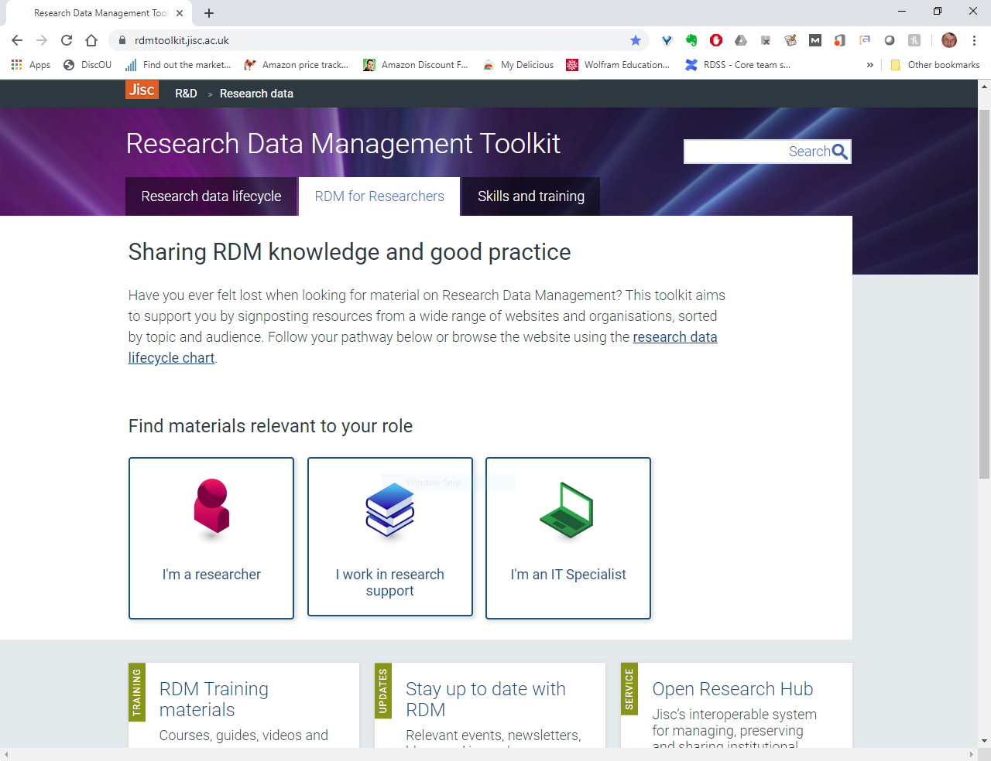

Slide 13
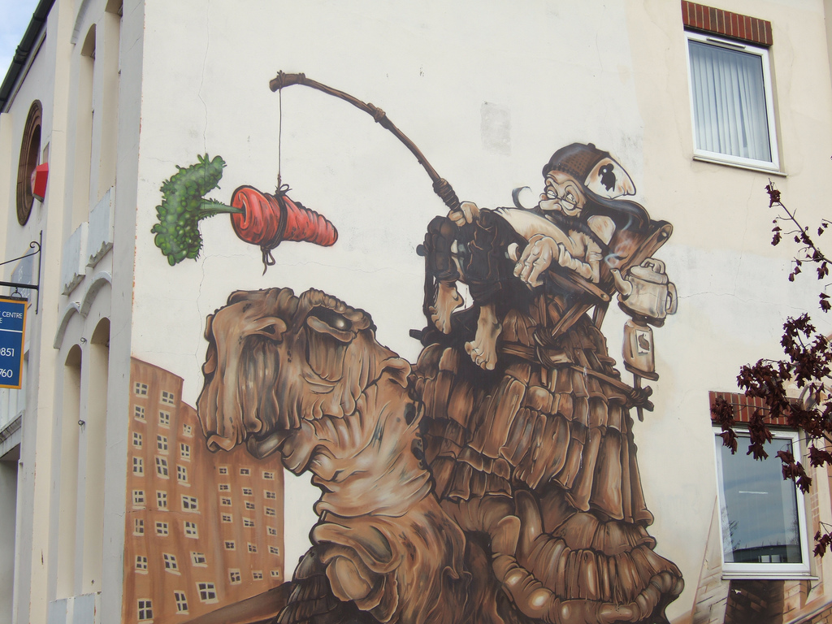
Open Research Hub
Open Research Hub
Notes:
Drivers
Funder mandates,
Builds on more R&D investment over 2 years
Open access
Also builds on open access serviccs, Jisc MRD work and other related jisc work
Sector defined requirements
“R@R” co-design challenge
Over half the HEI sector involved - Sector requirements gathering and prioritisation. (over 70 institutions involved
To date builds on £5m+ investment in repository and preservation R&D
Costs and risks
Risk to research funding -> Reduced income
Loss of research data -> Lost value of research work (17% lost key data – DAF survey)
Leakage of sensitive data -> Legal threat and cost (Unlimited fines with GDPR)
Researcher reputation -> Key staff leave (75% EXPECT HEI to do this)
Institution reputation -> Defensible integrity of research, responding to FOI etc. (e.g. Climategate £10m?)
Cost and risk of delivery -> Inefficient research and over-expensive IT

Slide 14
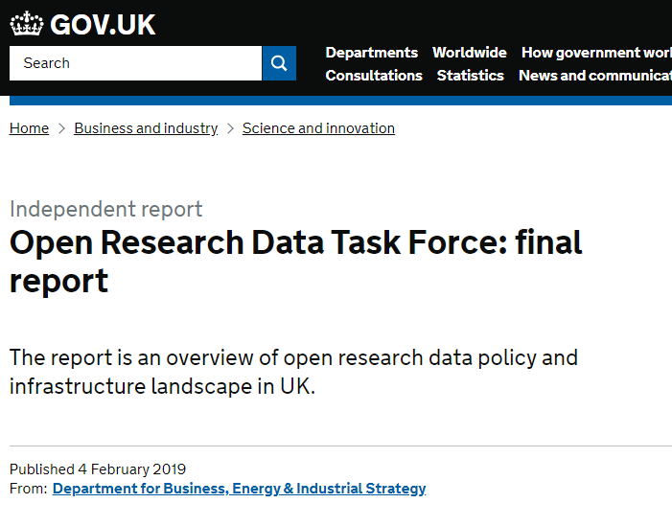
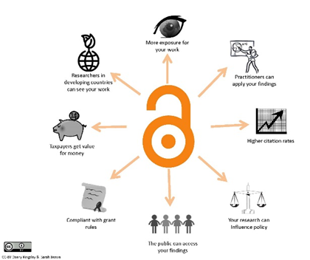
A key challenge for universities
Notes:
Universities and their researchers are under increasing pressure to from many angles
Universities can’t leave it to their researchers.

Slide 15
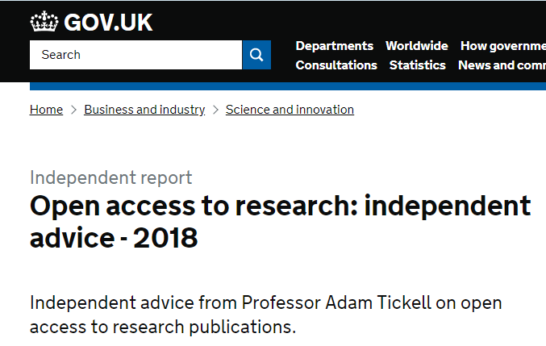
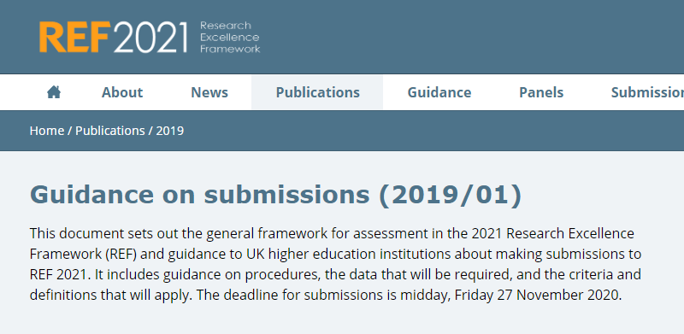
Sector mandates and good practice - OA
Notes:
Recent Open Access mandates and good practice
Recent developments in open access policies and good practice, Plan-S, the COAR guidelines on next generation repositories are re-focussing HEIs minds on infrastructure for open access articles.
ORH was developed with the long term vision of providing a single place to store, preserve and share all the outputs of research in, and (in agreement with what it’s looking like the sector is turning back to
Market research suggests that updating publications repositories takes priority over research data management. So should we now be focussing on developing the OA functionality of the ORH

Slide 16
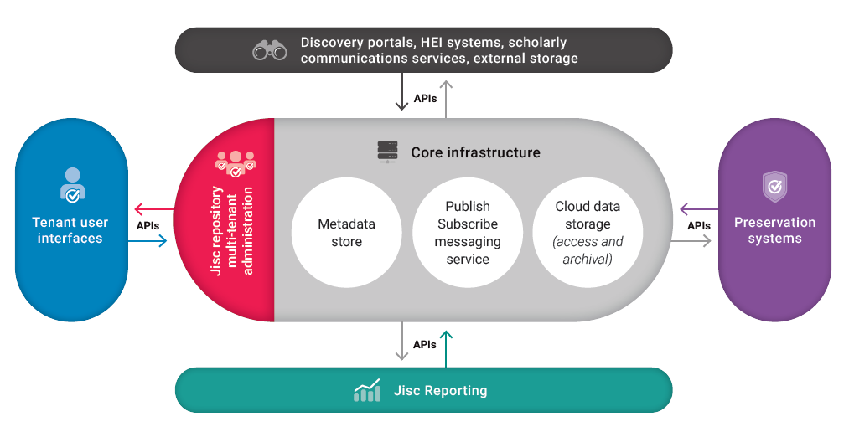
Jisc Open Research Hub
Notes:
Message: this is the system architecture
We are looking at the architecture of the service
Animation
We have a
A core infrastructure
Repository front end interface (with individual front end skins for each HEI)
API links to reporting and preservation functionality
Interoperability with other HEI and external systems

Slide 17
Service workflow summary
National research data aggregation
Preservation service
Researcher deposits data
Repository
Messaging
Or
Reporting and analytics
Layer
Record of data external deposit
Archival data storage
Institutional or external services
Notes:
Message: to achieve these objectives we needed a workflow that fits
To build a service which could meet these challenges, we mapped out this workflow
Describe life of a digital object
To drive this workflow and interoperability, we need this publish-subscribe messaging layer, based on an open, canonical data model and open APIs
Our alpha MVP demonstrated automatic ingest of data files into the preservation system from 2 different repositories, into 2 different preservation systesm – still some YouTube video of that, which I can point you to if interested.

Slide 18
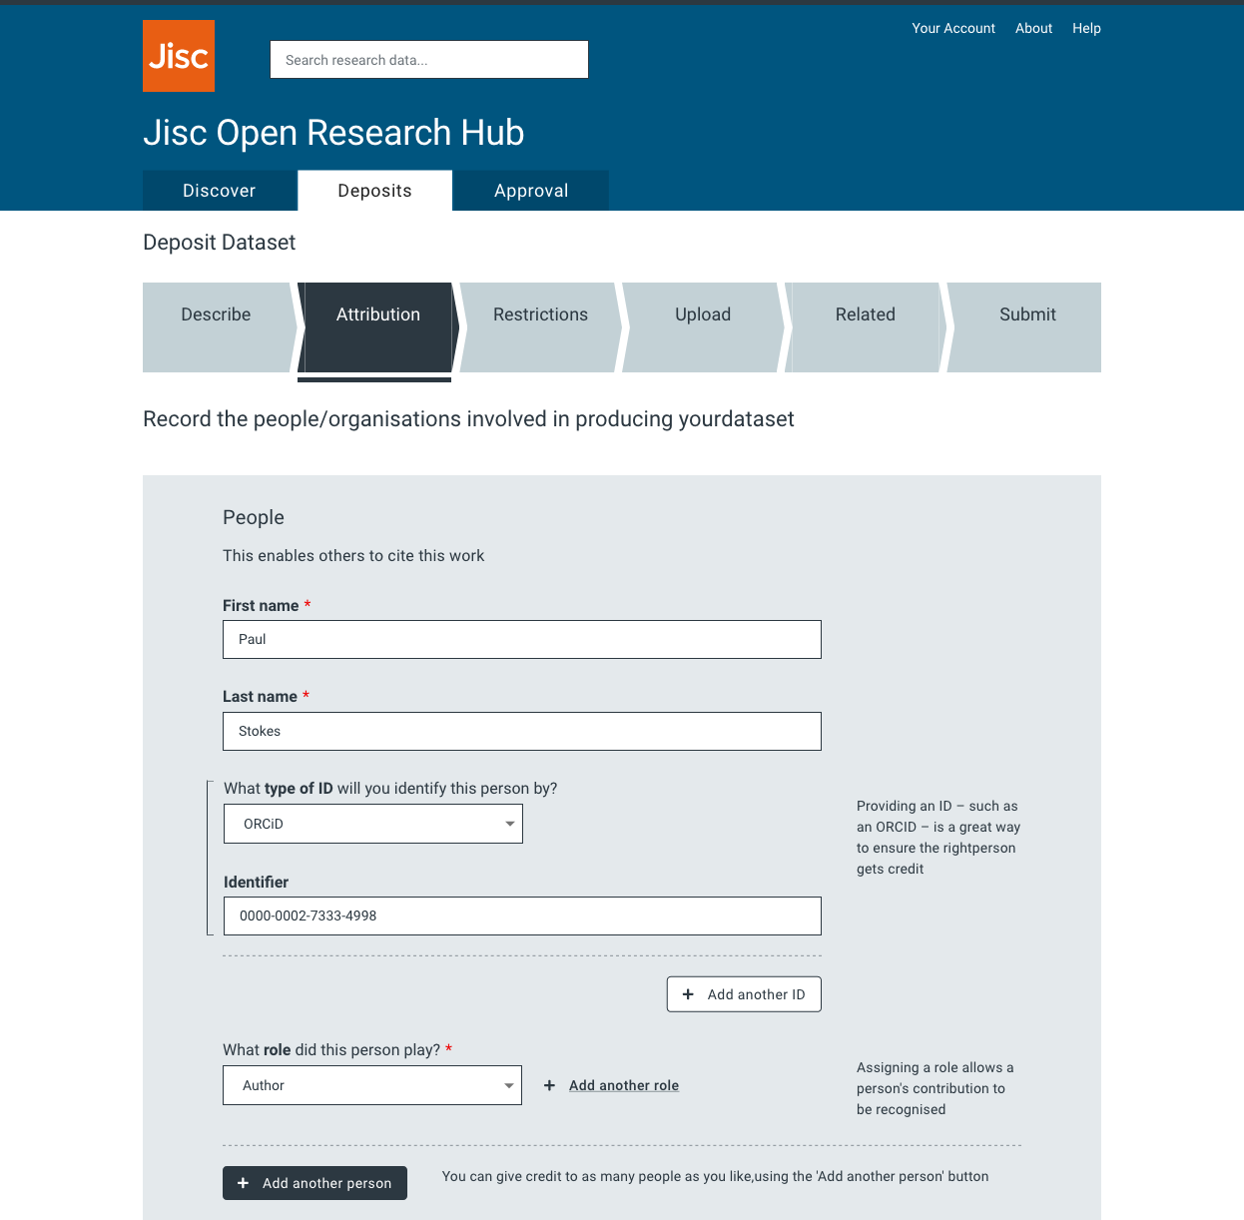
User Experience
Compelling user experience
User-centred-design approach
Many rounds of user acceptance testing (UAT)

Slide 19
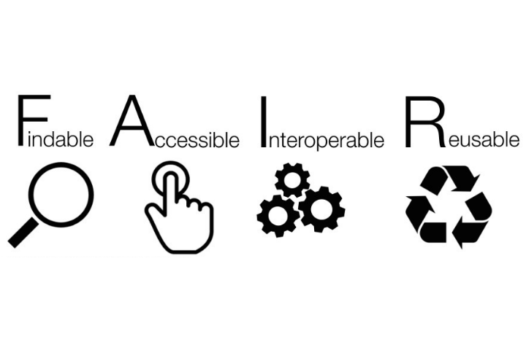
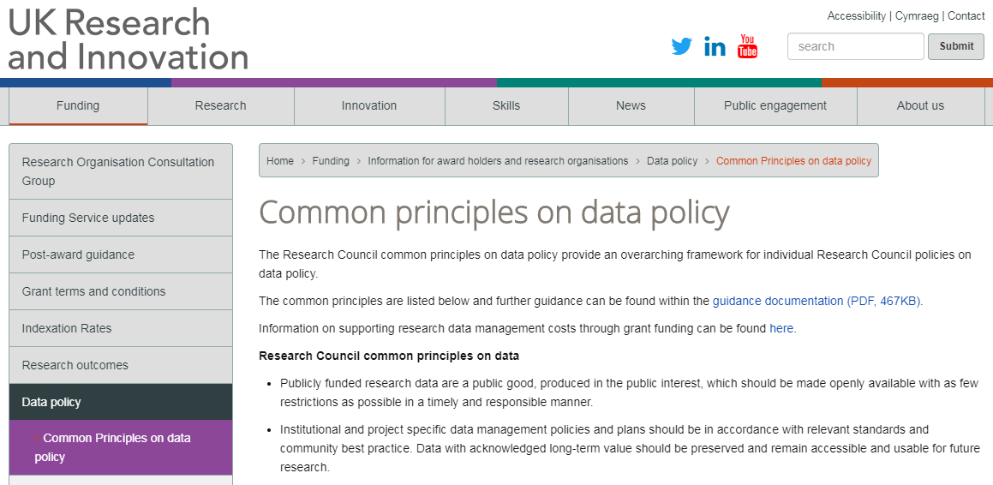
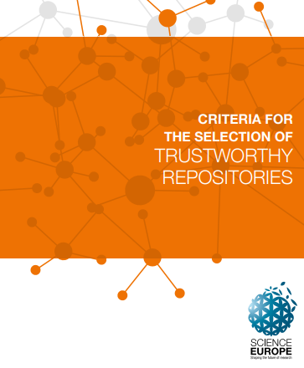
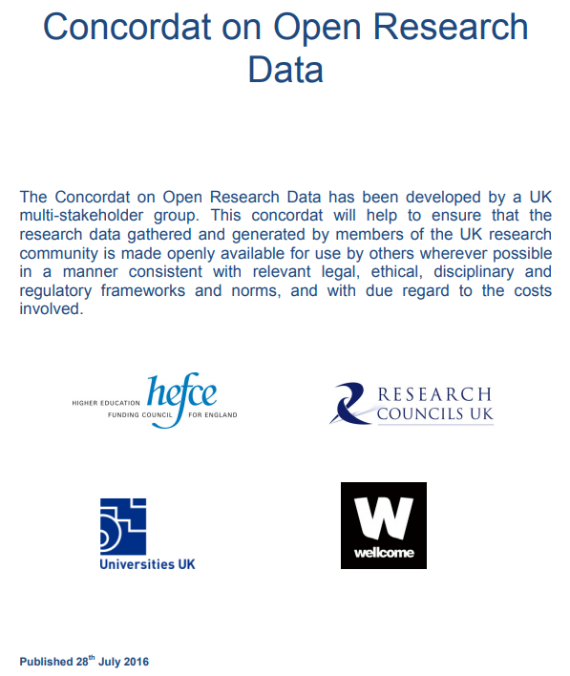
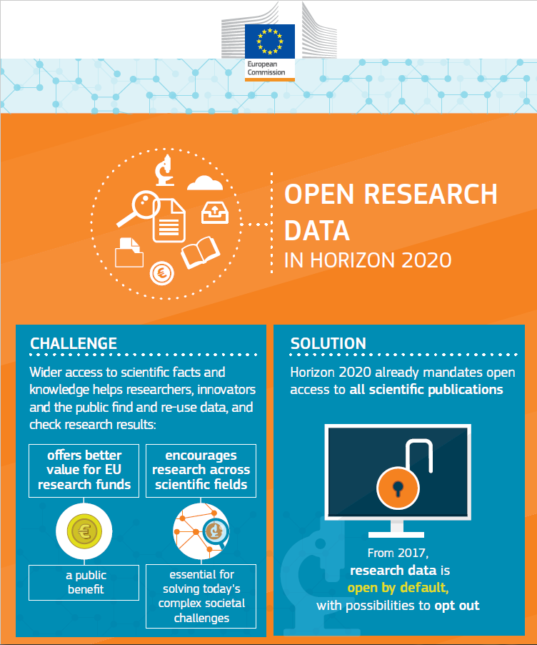
Sector policies and good practice - data
Sungya Pundir, Wikimedia Commons, CC By-SA 4.0
Notes:
Sector policies and good practice which guide research data management systems
We followed relevant sector policies and good practice around research data management - from UK bodies and international research funders and others sector bodies
This includes the guiding FAIR principles of making research data Findable, Accessible, Interoperable and Reusable.

Slide 20
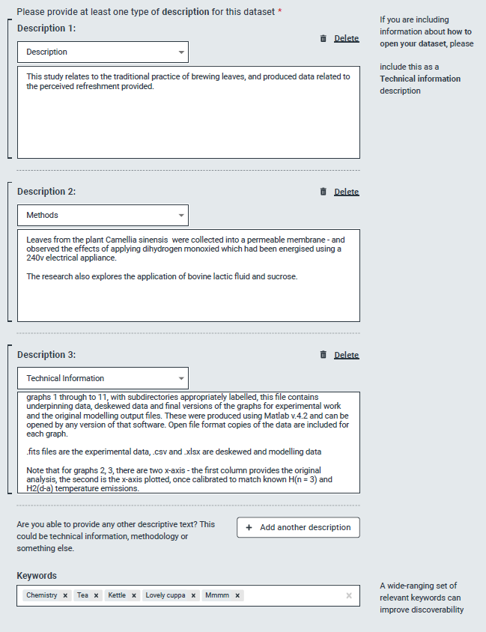
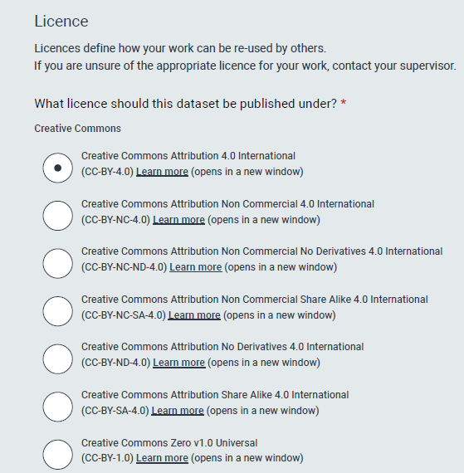
FAIR data
https://www.go-fair.org/fair-principles/
Notes:
How ORH enables FAIR
This slides shows various screen shots of an repository interface – data deposit form, showing how meeting the FAIR guidelines
Findable –persistent IDs for authors, institutions and funding, and rich metadata
Accessible – can assign licences to the work, as well as access statements
Interoperable – as well as open licences, links the works to other relevant works
Reproducible – by including detailed provenance information

Slide 21
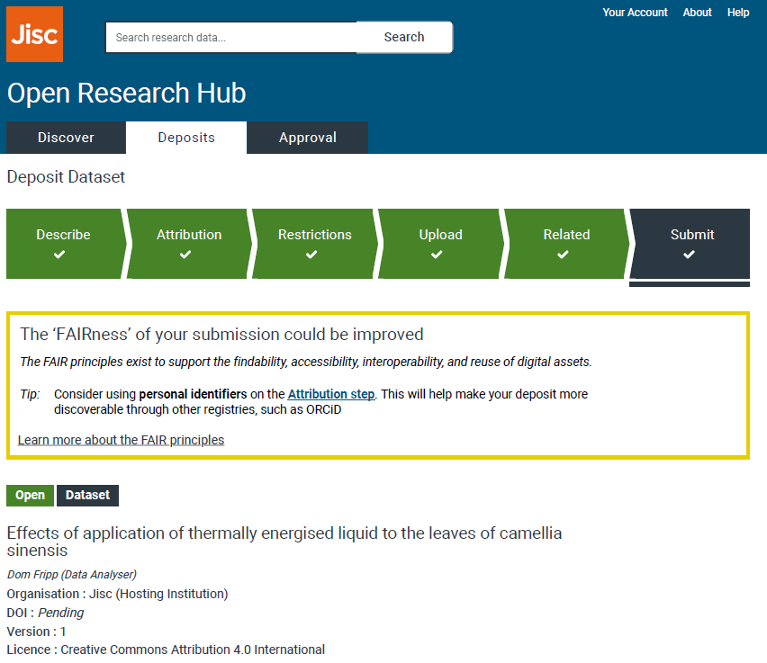
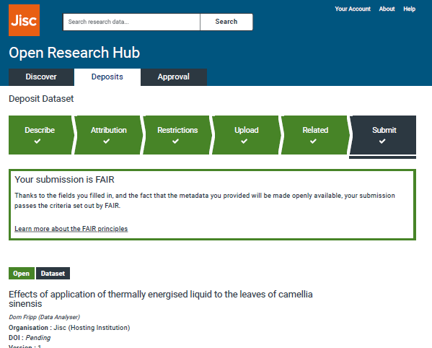
A FAIR submission?
https://zenodo.org/record/2619357
Notes:
Can ORH indicate how FAIR the data are
My colleagues Tom Davey and Dom Fripp have recently proposed a way for the repository submission workflow to help researchers make their submissions FAIR JUST WIREFRAMES

Slide 22
The way forward? Research 4.0
By Gerd Leonhard, CC BY-SA 2.0, https://www.flickr.com/photos/gleonhard/28582496750/in/photostream/

Slide 23
What are 4.0 technologies?
A.I
Robotics
5G and Internet of Things
Mixed reality
Blockchain
Quantum computing

Slide 24
Research 4.0 the landscape?
Range (not exhaustive)
Emergent / to breakthrough at scale
Quantum
AI
Biotech
Intelligent verification/reproducibility
Already in-train in the space
5G
Robotics
Automation
Machine learning
Cloud
APIs
Data/object mining
Notes:
There are many unanswered questions about exactly how technology is changing research
Supporting research that appropriately exploits and shapes opportunities from new technologies and convergences of technologies

Slide 25
Questions

Slide 26
Paul Stokes
Senior co-design manager
Jisc

