Slide 1
The citation advantage of linking publications to research data
Barbara McGillivray 6/11/2019

Slide 2
Paper and authors

Slide 3
The data sharing policy context
Journals
Funders
Researchers
Notes:
Funders: Policies for sharing research data by journals and funders are increasing
Publishers: DASs increase time and cost of publications
Researchers: Existing studies in specific disciplines show positive impact on citations
→ Researchers, publishers and funding agencies need better evidence to justify increased investment in data sharing and policy implementation

Slide 4
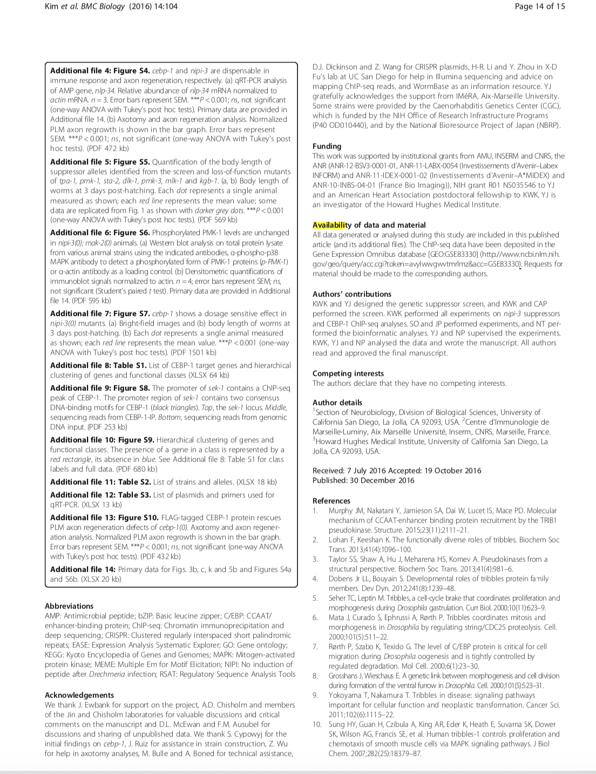
Data sharing

Slide 5
The pipeline
Notes:
We first downloaded the PubMed open access collection and
We created a database with all articles with a known identifier and which contained at least one reference (N = 1,969,175).
We identified and disambiguated authors of these papers (S = 4,253,172)
We calculated citations for each author and each publication from within the collection. We used these citation counts to calculate a within-collection H-index for each author.
Our analysis only focuses on PLOS and BMC publications as these publishers introduced mandated DAS, so we filtered the database for these articles and extracted DAS from each publication.
We annotated a training dataset by labelling each of these statements into one of four categories
We used those labels to train a natural language processing classifier.
Using this classifier we then categorised the remaining DAS in the database.
Finally, we exported this categorised dataset of M = 531,889 publications to a csv file and archived it.

Slide 6
The data
PubMed OA collection
352 journals
531,889 articles
2000-2015
PLoS and BMC
h-index
Notes:
We excluded review articles

Slide 7
Automatic classification of DAS

Slide 8
Impact of publishers’ mandates
Notes:
The number of articles with DAS increased dramatically after introduction of a publisher mandate (solid vertical line).
Figure 2A and 2B show the number of articles in the dataset between the years 2000 and 2018 inclusive. The solid vertical lines show when the publisher introduced a DAS mandate
Both publishers show clear adoption of DAS after their introduction of a mandate

Slide 9
Citation prediction
Notes:
Model: OLS model for citation counts, after a log transform and the addition of 1,
Predictors:
n_cit3: Number of citations received within 3 years after publication.
das_encouraged: If published under an encouraged DAS mandate (1) or not (0).
das_required: If published under a required DAS mandate (1) or not (0).
journal_field: Dummy variable, from Science-Metrix
The last interaction term between PLOS and the DAS classification is meant to single out the effect of DAS categories for the two publishers

Slide 10
The outcomes
Journals have been increasingly requiring data availability statements (DAS) in recent times
DAS with links to data/code (category 3) have been increasing over time
These DAS are significantly correlated with higher citation impact

Slide 11
Thank you!
bmcgillivray@turing.ac.uk
Code and data: https://doi.org/10.5281/zenodo.3470062

Slide 12
Model results

