Slide 1
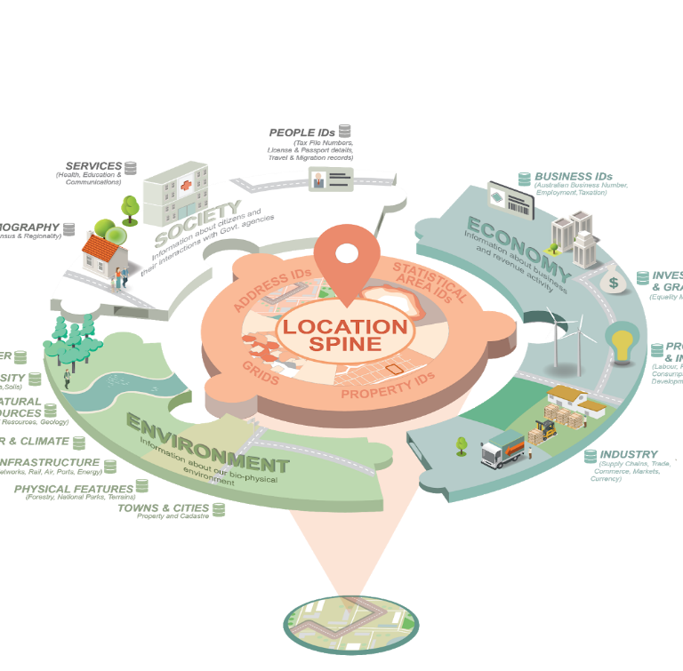
Building Loc-I: Spinning up a spatial knowledge graph should be easy... right?
Jonathan Yu, CSIRO (Loc-I Tech Lead) Paul Box, David Lemon, Ashley Sommer, Shane Seaton, Ben Leighton Simon Cox (CSIRO) Shane Crossman, Irina Bastrakova, Matt Purss Will Francis, Joe Bell, Alex Ip (GA)

Slide 2
Overview
Loc-I and problem space
Loc-I Spatial knowledge graph
Easy bits & no-so-easy bits
Learnings

Slide 3
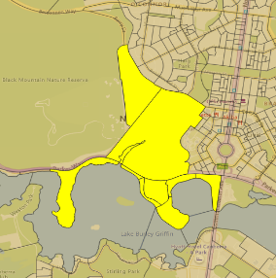
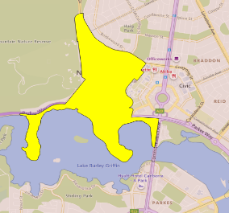
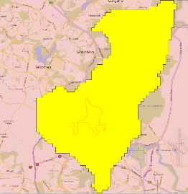
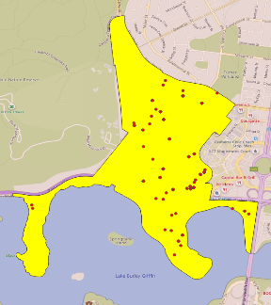
ASGS’16 SA2
How do we enable interoperability of data between one geography and another geography?
ASGS’16 SA1
Geofabric Contracted Catchment
G-NAF Street Locality

Slide 4
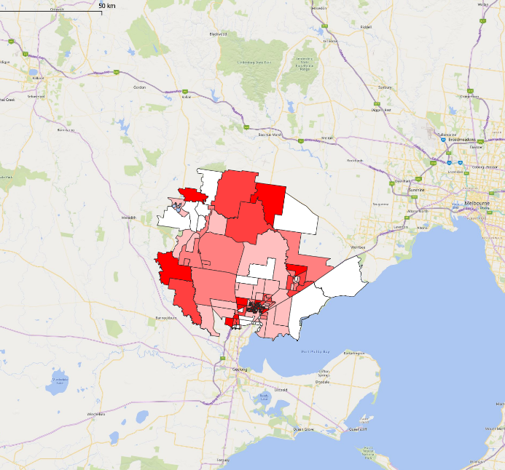
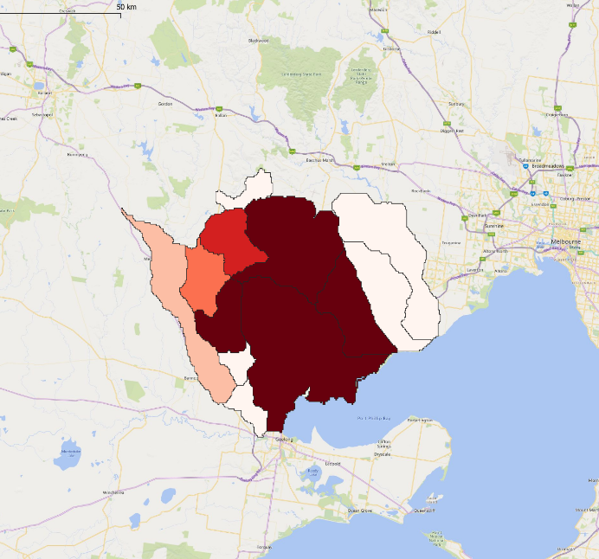
Population count as per Census districts
Understanding population via hydrological catchments
ASGS 2016 Mesh Block
Geofabric v2.1.1 Contracted Catchment
* ABS 2074.0 Census of Population and Housing. Mesh Block Counts 2016 – Lara, Geelong area, Victoria

Slide 6
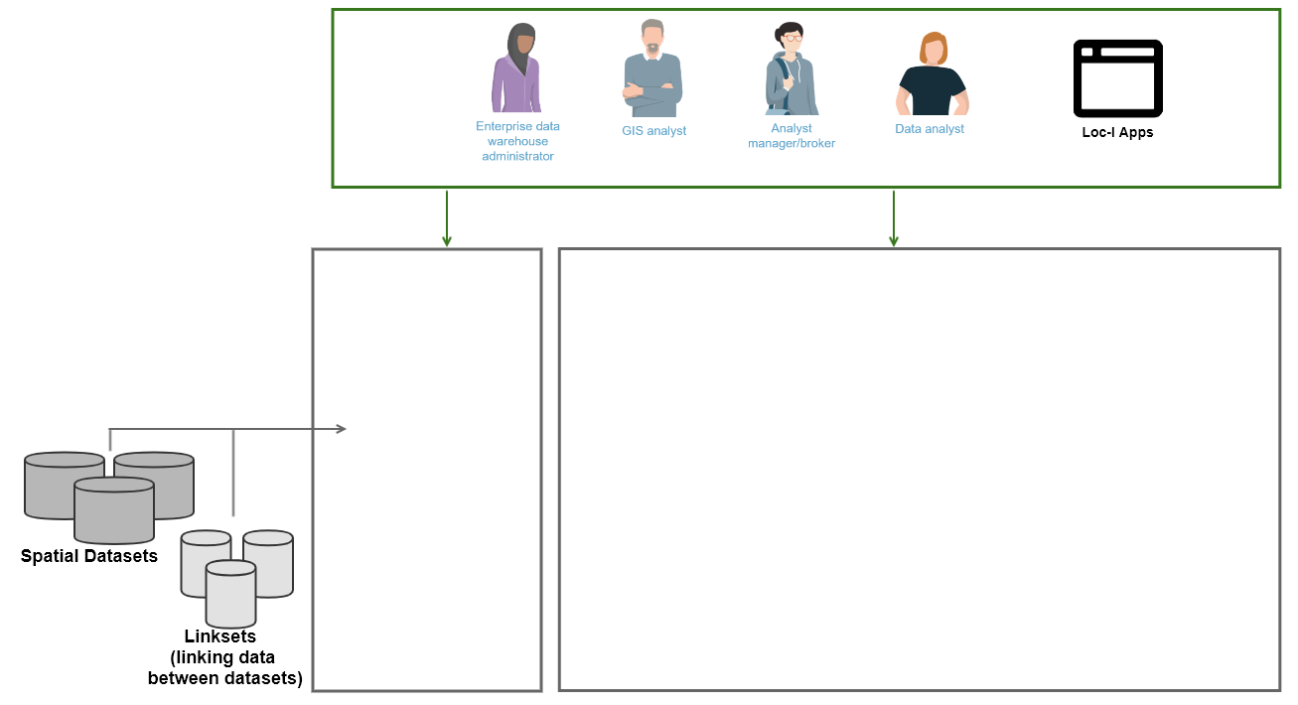
Online access
to spatial features with strong identity
Human-readable views
Machine-readable views
Useful web APIs (graph and spatial) to answer policy/research questions
Notes:
Descriptions of geography and its features
Linksets
Geometry and

Slide 7
Loc-I approach
Publish spatial data using reliable and consistent (web-)identifiers
Create and govern links between spatial features across reporting geographies (linksets)
Provide access to human- and machine- readable views and formats of Loc-I data
Develop useful APIs (graph and spatial) and apps to answer policy questions
http://linked.data.gov.au/dataset/asgs2016/ statisticalarealevel1/ 801051049
http://linked.data.gov.au/dataset/geofabric/ riverregion/9400222
geo:sfWithin
Datasets: Census regions (ASGS)
Geofabric drainage divisions, river regions, catchments
G-NAF addresses, and street localities

Slide 8
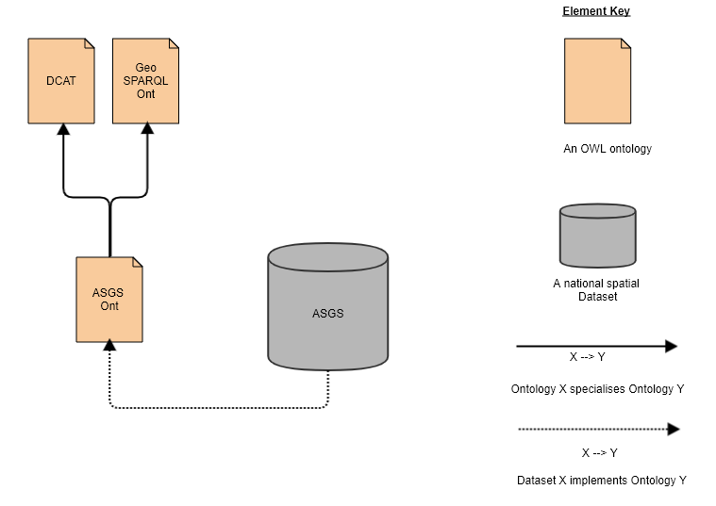
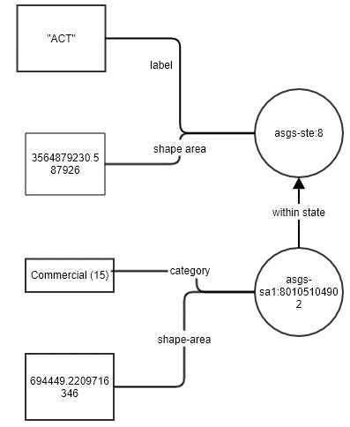
Semantically enabling spatial data

Slide 9
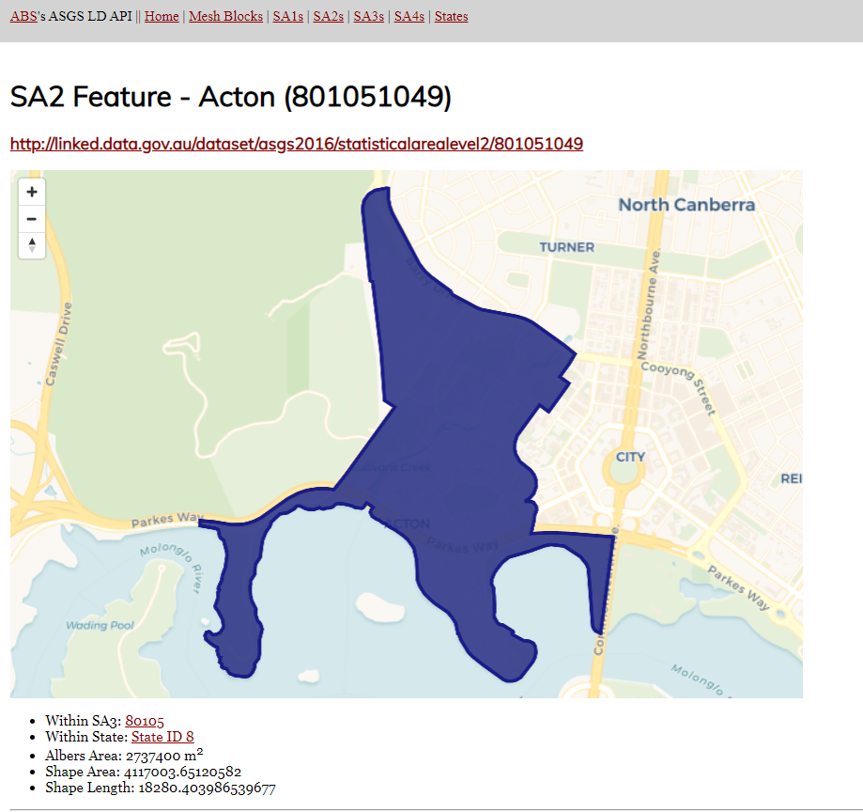
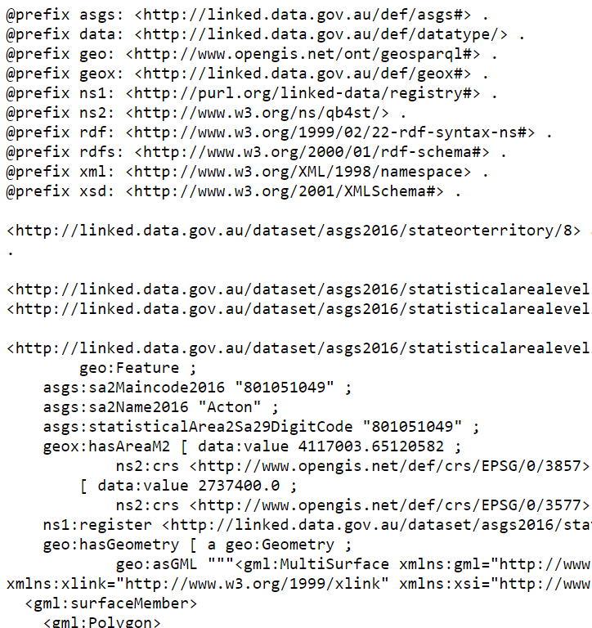
Linked Data views of features – human and machine readable

Slide 10
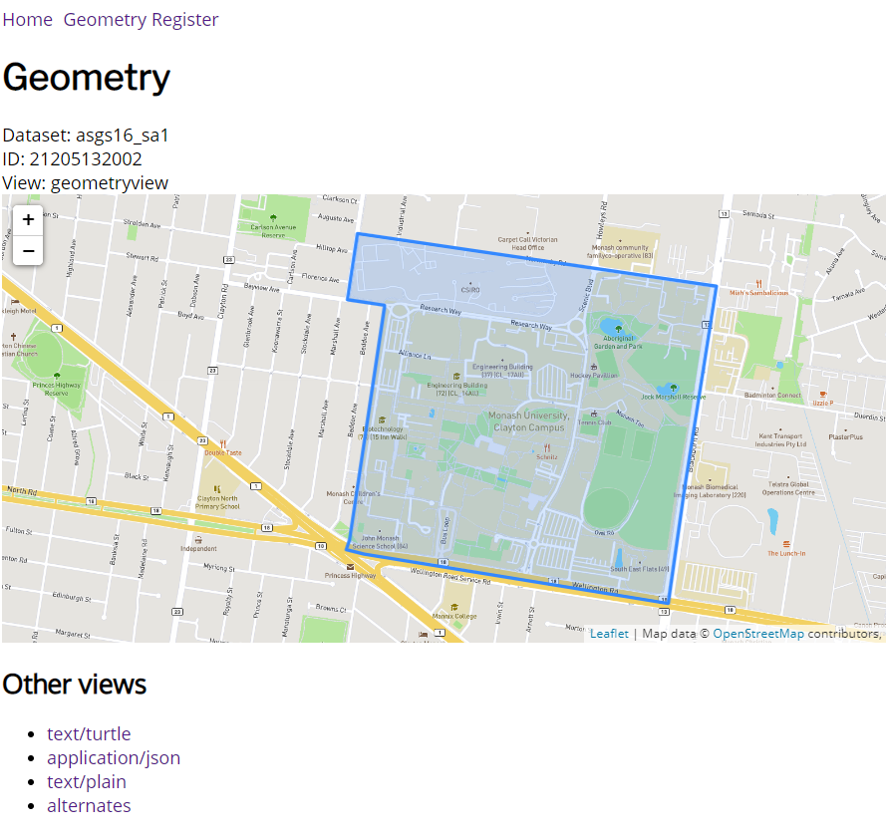
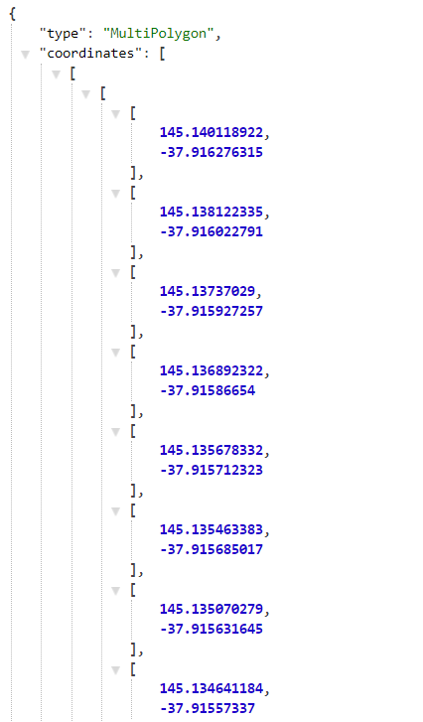
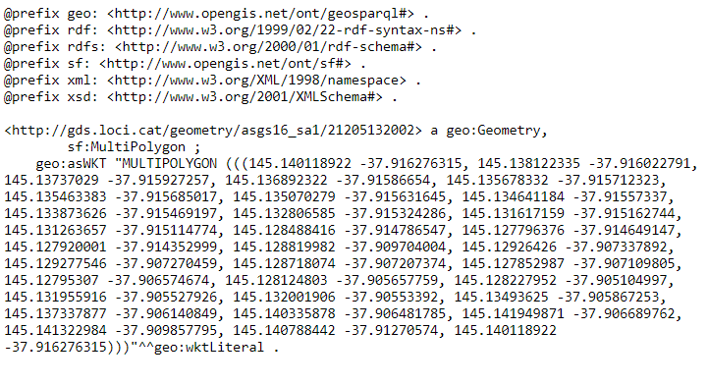
Geometry Data Service
(Linked Data for Geometries)
http://gds.loci.cat/geometry/ asgs16_sa1/21205132002

Slide 11
Online access
to spatial features with strong identity
Human-readable views
Machine-readable views
Useful web APIs (graph and spatial) to answer policy/research questions
Notes:
Descriptions of geography and its features
Linksets
Geometry and

Slide 12
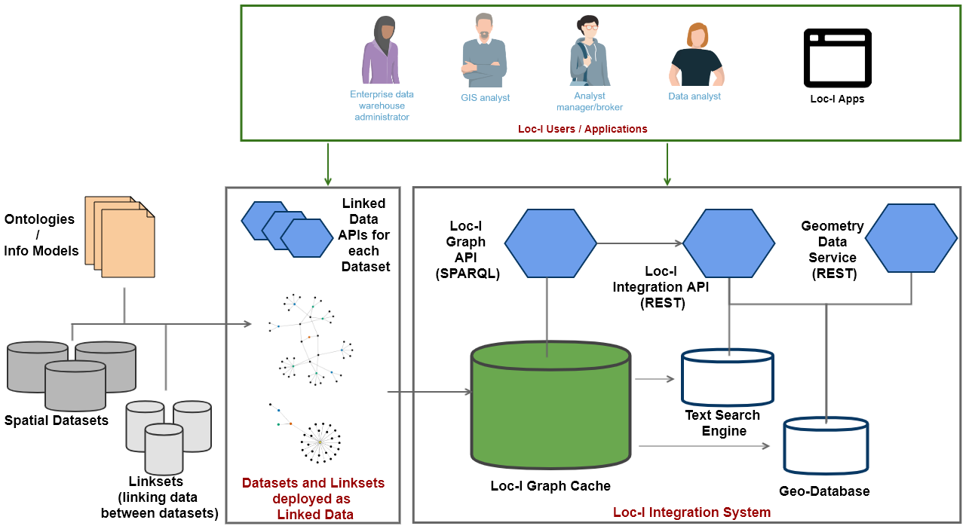
Hybrid Spatial Knowledge Graph

Slide 13
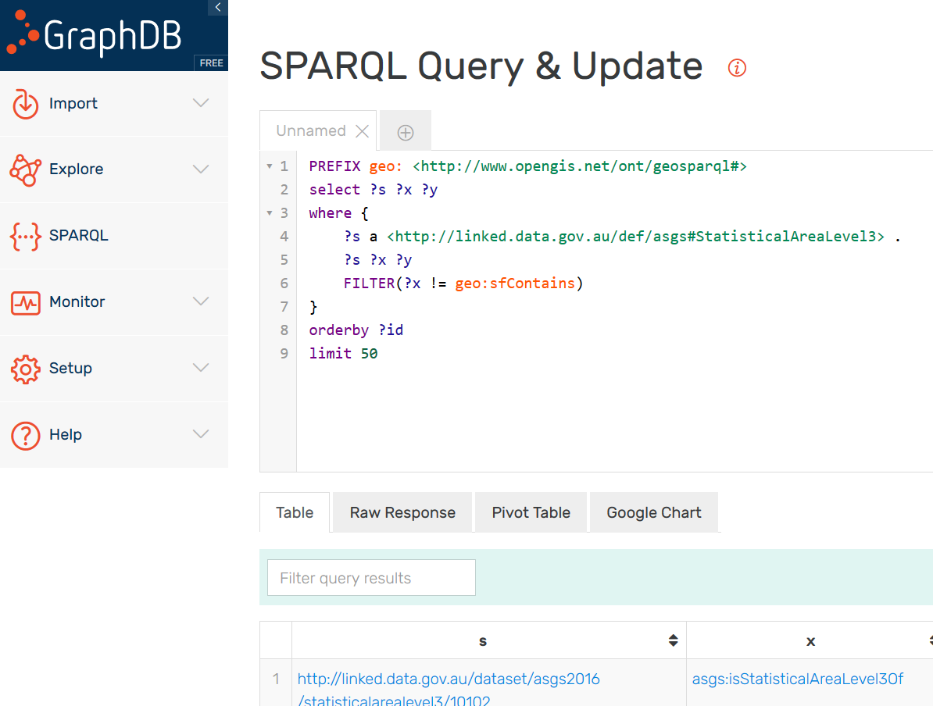
Loc-I Cache graph SPARQL API

Slide 14
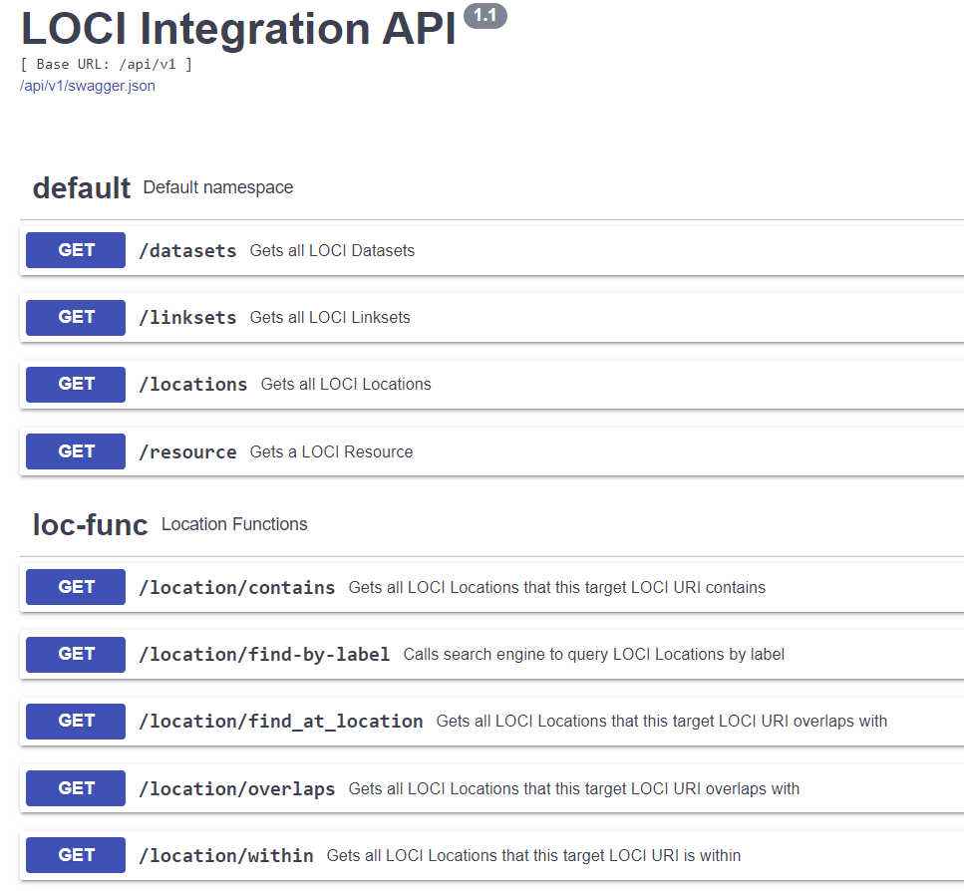
Loc-I REST Integration API

Slide 15
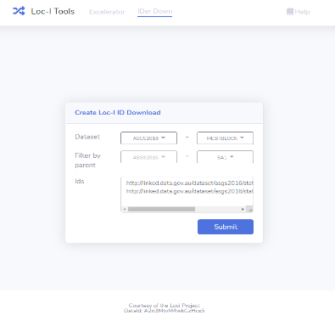
IDerDown
ASGS’16 SA2
ASGS’16 SA1
Loc-I identifier download tool Input: List of spatial feature identifiers + target geography
Output: List of matching spatial features in target geography using the Loc-I Graph
Geofabric Contracted Catchment
http://excelerator.loci.cat/iderdown
G-NAF Street Locality
(Maps currently produced in QGIS…)

Slide 16
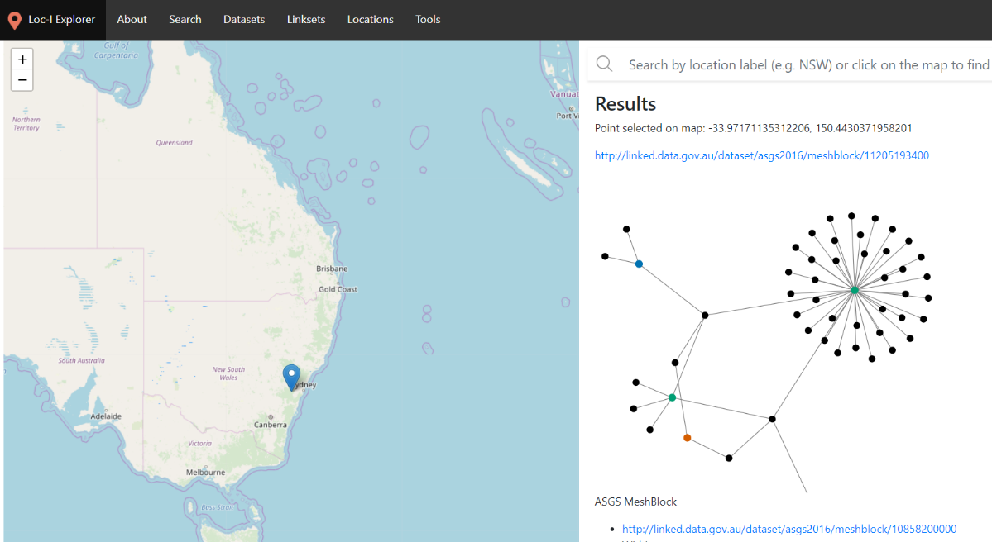
Loc-I Spatial Graph Explorer
https://explorer.loci.cat/

Slide 17
Building the Spatial Knowledge Graph was easy right?
Short answer: Yes and no!
(easy once you know what questions the Spatial Knowledge Graph is expected to answer
… and once you know how to represent the data and build APIs that can answer those questions…)

Slide 18
(What was easy now…)
Knowledge and semantics
Standards and tech stack are fairly mature …
Describing features
e.g. Linked Data, SDW BP, Spatial ontologies (Geosparql)
Spatial
Authoritative geographies exist and widely used
New approaches emerging (DGGS)
Existing web services
Fairly straightforward to produce spatial relationships between features of geographies
Tools
GIS tools (postgis, python, js, etc)
Graph/semweb tools
Easy and straightforward

Slide 19
(What are the gaps and challenges…)
Knowledge and semantics
Knowledge curation
Make the ontologies play nice with each other?
Describe links between features in a consistent way?
Automatic reasoning over everything or optimise ‘reasoning’ for just the good bits?
Spatial
Do we process spatial via geodatabase, in graph databases, or both?
Tools
What do users need and expect on applications?
(Web developers trying to write SPARQL)
(Our project team switching on reasoning over 1B+ triples)

Slide 20
Learnings
Knowledge graphs are great, but it’s not a silver bullet.
Know what questions you’re seeking to provide answers.
Optimise queries with appropriate tools:
Semantic tools for semantic reasoning
Spatial tools for spatial reasoning/processing
Text analysis/search tools for text/label searching
Reasoning. DON’T (!!) turn on automated reasoning until you’re certain all your ontologies can work together. Ontology harmonisation doesn’t happen overnight!

Slide 21
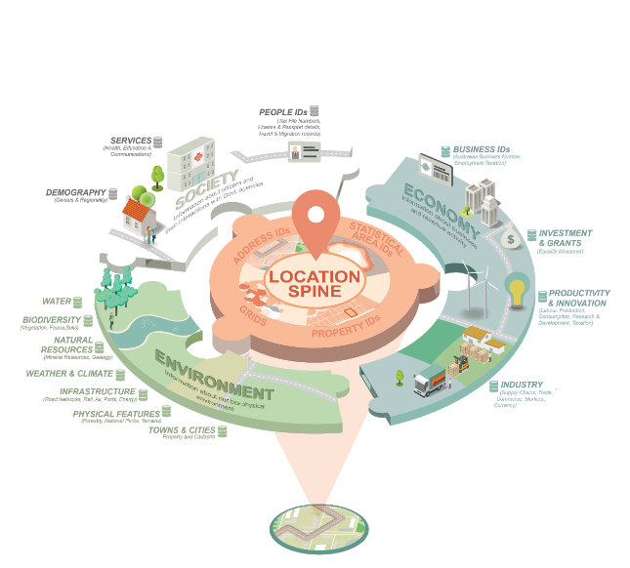
Loc-I
Spinning up a spatial knowledge graph should be easy... once you know how
Hybrid Spatial knowledge graph APIs
Challenges in this space
Come see me at my poster later!

Slide 22
Thank you
CSIRO Land and Water
Jonathan Yu Loc-I Technical Lead Research Data Scientist
+61 3 9545 2457
Jonathan.yu@csiro.au
csiro.au/landandwater

Slide 23
User Archetypes, Interactions and Environments for Loc-I Users and Technical Stakeholders
Loc-I Experience Maps | ECOSYSTEM
OTHER DATA SOURCES
The DataLab is the ABS’s Big Data Analytics capability. It includes the MADIP and BLADE data products. Access is available on request to the ABS and is subject to extensive security clearance. It exists in parallel to the operations of departments
The analytic environments for Government Departments reflect a general move towards a centralised Enterprise Data Warehouse, with analysis access this environment. Although individual departments operations vary, the generally reflect the configuration described below:
The DataLab
DATA ACCESS
OTHER INTERNAL DATA SOURCES
People
Project
Ouputs
Enterprise Data Warehouse (EDW)
Alex Ward
Data analyst
INFORMATION PRODUCTS
Safe
DATA SHARING
DATA ACCESS
Environment
Data
Gordan Abara
GIS analyst
Helga Santoso
Enterprise data warehouse administrator
Challenges are also Social/UX
Sam Sterling
DataLab analyst
Joan Kosta
Analyst manager/broker
ANALYTIC WORKFLOWS
POLICY
DATA PREP
ANALYSIS
SHARE
Commission enquiry
Develop enquiry
Sourcing data
Prepare data
Perform the analysis
Develop output
Share knowledge

Slide 24
(What new bits are we are working now…)
Knowledge and semantics
Spatial
Tools
Creating a working spatial knowledge graph
Spatial data preparation
Application development
Pre-process
and cache geographies
Excelerator
IDerDown
Explorer
Loc-I Cache
Graph
(1B+ triples)
REST APIs development
Data
User interviews & UX Testing
Documenting rules for integrating into Loc-I graph
Loc-I Integration API
Geometry
Data
Service
Rules, guides

