Slide 1
Sensors in Snowy Alpine Environments: Progress Report
Martha Apple*, James Gallagher†, Kevin Negus*, Samuel Croft*, Tyler Vendetti*, and Carson Fiechtner*
*Montana Tech, †OPeNDAP
<mapple@mtech.edu>, <jgallagher@opendap.org>

Slide 2
Alpine plants act as sentinels of climate change.

Slide 3
Overview
About Open Source Hardware
Our designs for an in-situ sensor network
LoRa Background
Test implementation

Slide 4
Open Source Hardware
Closely aligned to the Open Source Software movement
"Open hardware," or "open source hardware," refers to the design specifications of a physical object which are licensed in such a way that said object can be studied, modified, created, and distributed by anyone.¹
A few companies that support OSH:
Adafruit, SparkFun, Seeed, Mouser, OSHPark, …
Tools:
Arduino (IDE, MCUs), Fritzing (CAD), GitHub, BitBucket (code repositories)
Umbrella organizations:
OSHWA, opensource.com
1. https://opensource.com/resources/what-open-hardware

Slide 5
Most Importantly…
Open Source Hardware provides an easy way to share ideas
And learn about techniques
So we can build devices we need that (may) lack mass-market appeal

Slide 6
Overview
About Open Source Hardware
Our designs for an in-situ sensor network
LoRa Background
Test implementation

Slide 7
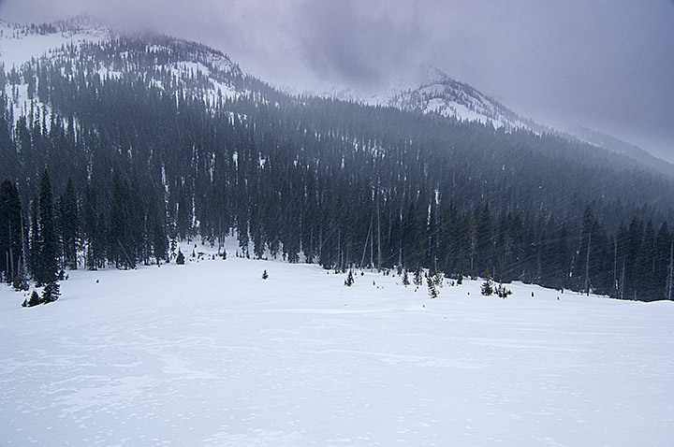
Requirements
Soil temperature and moisture monitoring
Operation unattended in remote, harsh environments
Remote connectivity
Low cost

Slide 8
Sensor Network: Basic Design
Deploy sensors at research sites (initial site: Goat Flat, ~9,000 ft).
Sensor nodes should run on battery power for 2+ years.
Use LoRa radio to connect sensor nodes to a master node.
Use the master node to forward data to the Internet.
The master node will use cell phone Satellite technology for an Internet uplink.
Subsequent implementations could use other techniques.
Data from the master node will be sent to an Application Server that can be accessed from browsers and analysis tools.
The Master node can sense a wide(r) variety of conditions such as snow pack presence.
Calibration: use reference instruments including a portable soil temperature and moisture measurement device.

Slide 9
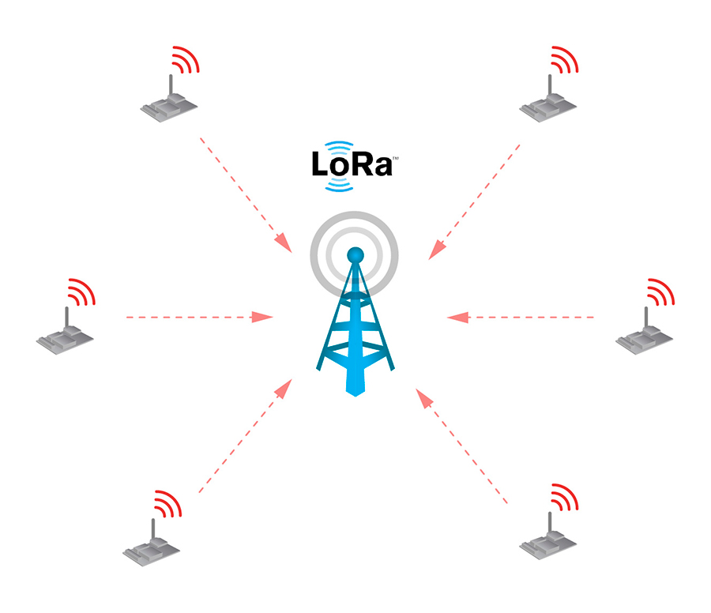
Sensor Network: Topology
Master/Sensor star topology
Sensor nodes
Collect data (temperature, soil moisture, etc.)
Use LoRa radio to send data to Master
Master
Receives data from sensors using LoRa
Forward data to ‘Application Server’ via Internet
Sensor node
Master node
Internet

Slide 10
Sensor Network: Operation
Sensors sleep most of the time to conserve power
Sensor node
Master node
Internet

Slide 11
Sensor Network: Operation
Sensors wake up and measure environmental parameters
Sensor node
Master node
Internet

Slide 12
Sensor Network: Operation
Sensors transmit data to the Master
Sensor node
Master node
Internet

Slide 13
Sensor Network: Operation
Sensors go back to sleep
Sensor node
Master node
Internet

Slide 14
Sensor Network: Operation
The Master node forwards the collected data to an Application Server in the Internet
Sensor node
Master node
Internet

Slide 15
Sensor Network: Operation
The Master returns to its nominal mode
Sensor node
Master node
Internet

Slide 16
Overview
About Open Source Hardware
Our designs for an in-situ sensor network
LoRa Background
Test implementation

Slide 17
Test Implementation – Master Node
Design work started in Fall 2019 by Mtech Students with faculty mentor
Designed to function standalone
Satellite module for connection to the Internet
MCU/RTC to control power
3.3Ah/year power requirement*
Add LoRa for Sensor Nodes
*Apple 2019 laptop has a 4.5Ah battery

Slide 18
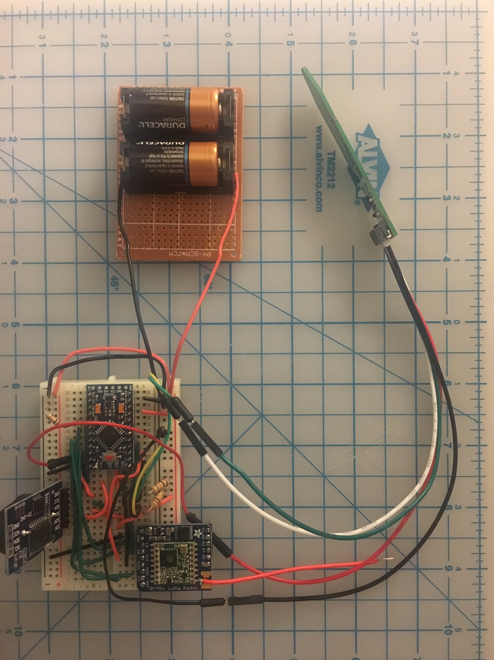
Test Implementation – Sensor Node
Sensor node
LoRa + Arduino + Temperature and soil moisture sensor
LiMnO₂ batteries (-50° C)
Prototypes operated at -25°C and were run buried in both soil and snow as well as in open air
Total parts cost < $50; options exist to reduce that cost further
Dropped MCU sleep in favor of a power latch
Estimated 1 Ah/year power requirement @ 3.0v
Design info:
github.com/jgallagher59701/Soil_moisture

Slide 19
Implementation Notes
Satellite uplink chosen by Mtech Master Node developers to broaden deployment locations (over cell technology)
Both the Mtech and OPeNDAP developers independently decided on ‘power latch’ technique to control power consumption, esp. the power used by the communication technology
A better option than the peripheral’s sleep modes
The Master Node design uses a second MCU to toggle power (using a built in clock).
The Sensor Nodes uses discreet components in combination with a real-time clock
Master/Sensor LoRa protocol
Reliable Datagram – was previously an ad hoc protocol – concerns regarding collisions
Application Server
CHORDS or ERDDAP server running on Amazon Web Services EC2 instance

Slide 20
Questions?

Slide 21
Bonus material on LoRa

Slide 22
Overview
About Open Source Hardware
Our designs for an in-situ sensor network
LoRa Background
Test implementation

Slide 23
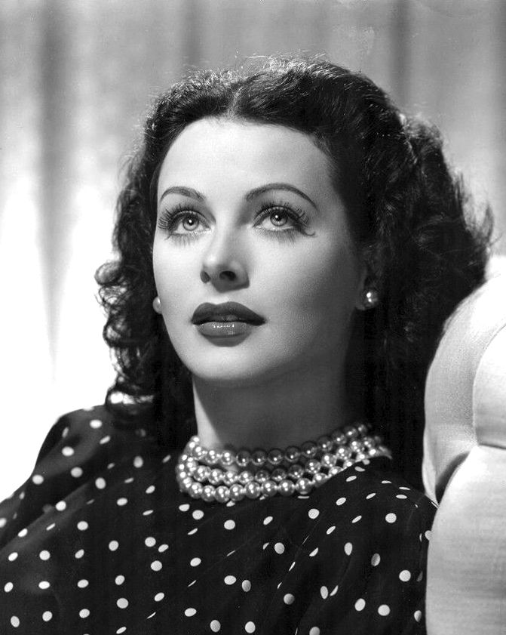
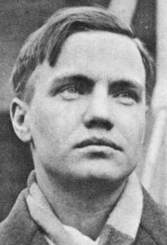
LoRa Background: What is LoRa?
“LoRa (short for Long Range) is a spread spectrum modulation technique derived from chirp spread spectrum (CSS) technology.”*
Spread Spectrum: To spread an information signal over a (wide) band of radio frequencies.
Robust transmission technique; also used in WiFi, Cell phones, Bluetooth, etc.
Hedy Lamarr and George Antheil are credited with its invention
Lamarr¹
Antheil²
*https://www.semtech.com/lora/what-is-lora
Notes:
¹ By Unknown - eBay, Public Domain, https://commons.wikimedia.org/w/index.php?curid=47176716
² By unknown - picture found at http://www.schirmer.com/default.aspx?TabId=2419&State_2872=2&ComposerId_2872=35, Fair use, https://en.wikipedia.org/w/index.php?curid=23450183

Slide 24
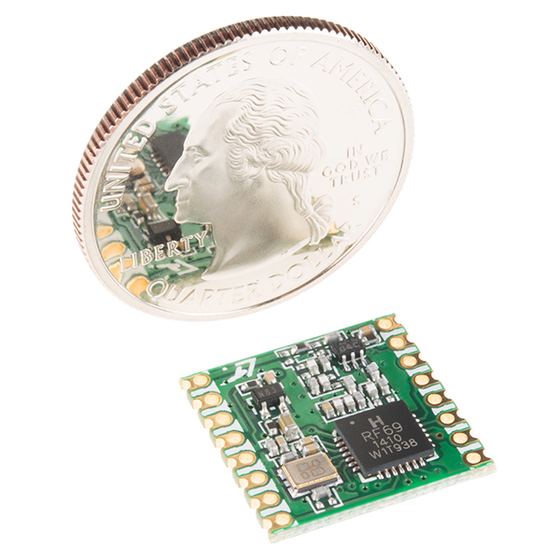
LoRa specifics
Widespread use by Internet of Things applications.
Inexpensive (~$5 eBay; $20 Adafruit/SparkFun)
Small (16mm x 16mm)
Range: 1–10km
Adjustable bit rate: 293 bps to 37.5 kbps
Adjustable error correction, etc., parameters
Works well with Arduino and similar MCUs
Good library support (e.g., RadioHead; TinyLora)
US/EU/AS frequency bands (915/868/430 MHz)
Low power – 20mA receive/100mA transmit
Image from the SparkFun website

Slide 25
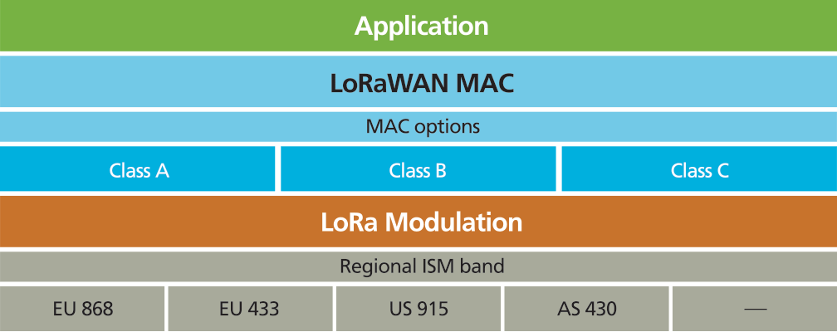
How LoRaWAN Relates to LoRa
Network layer defined by the LoRa Alliance
Physical layer defined by the radio hardware
Network Layer
Physical Layer

Slide 26
Alternatives to LoRaWAN: LoRa Physical link
MCU software library: RadioHead.²
We’re using RadioHead, but there are other libraries for LoRa.
How the physical link can be configured
Power level (5 to 23 dBm), Bandwidth, Coding rate, Chips/symbol, CRC³
The last four determine data rate and noise rejection
Supports hardware Channel Activity Detection (CAD)
Using the SPI bus
Many LoRa boards use the SPI bus and signal reads and writes using interrupts
If there are other SPI-based devices, disable interrupts while using another device
Other SPI devices include SD memory cards
2. http://www.airspayce.com/mikem/arduino/RadioHead/; or https://github.com/adafruit/RadioHead
3. https://en.wikipedia.org/wiki/Cyclic_redundancy_check

Slide 27
RadioHead Architecture
Driver + Manager: Implements the physical and logical network layers
Driver
C++ object that supports a particular transceiver
Can be used alone, without a Manager
Suitable for early prototypes and/or very simple uses
Various Drivers support different max packet sizes (28 to 255 octets)
RFM95W → 251 octets (i.e., HopeRF and Semtech LoRa boards)
Manager
C++ object that uses a Driver to implement a logical network
Objects exist for Datagram, Reliable Datagram, Router and Mesh protocols

Slide 28
RadioHead Manager Classes
These are based on well-known networking principles
Addressing: Assigning an address to each device helps maintain reliability when scaling up a network to more nodes
Datagram:
A simple addressed protocol. Every packet has an 8-bit SRC and DEST address
Also supports a Broadcast ‘address’ (0xFF)
No error detection
Reliable Datagram:
Addressing + simple error recovery: messages are acknowledged by the recipient, and unacknowledged messages are retransmitted until acknowledged or the retries are exhausted
Broadcast does not support error detection

Slide 29
Routing and Meshes
RHRouter enables multi-hop transmissions
LoRa networks can be designed to move information between star nodes
Must be deployed with care since intermediate nodes will need more power
Can support larger topological deployments with fewer Internet uplink sites
Routing tables must be manually managed in software (using 8-bit addresses)
RHMesh enables automatic route discovery
This supports dynamically adding and removing both leaf and internal nodes
Router and Mesh are useful for the ’star’ node in our design, but not for the leaf nodes, which will be powered down for all but the few seconds they sample and transmit data.

Slide 30
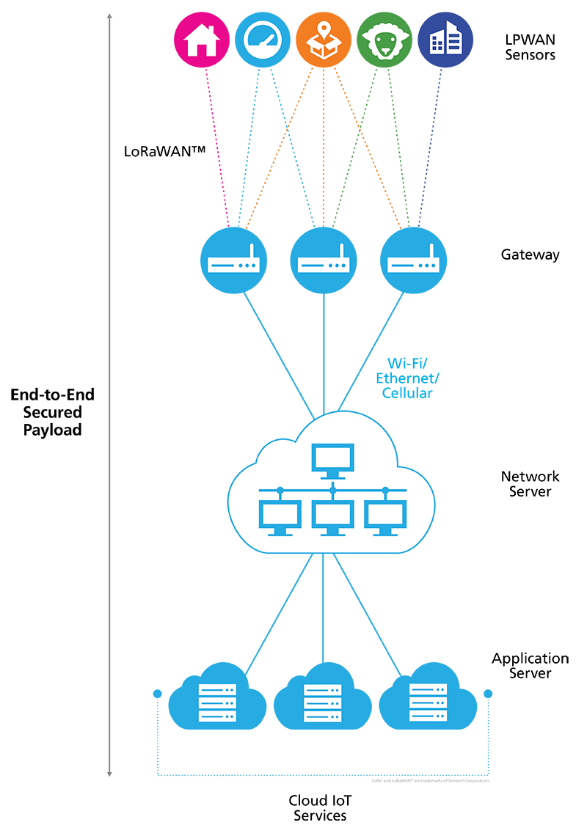
Generic IoT/LoRa Topology
Autonomous sensors communicate with LoRa Gateways
LoRa Gateways transfer information to the Internet
Once on the Internet the information can be routed to data servers, etc.
This can use LoRaWAN (a kind of Low Power Wide Area Network – LPWAN) or Datagrams
Picture: Semtech¹
Notes:
¹https://www.semtech.com/lora/what-is-lora

Slide 31
More information
What is LoRa, Semtech website: https://www.semtech.com/lora/what-is-lora
Comparison of LoRa with FSK (frequency Scaled Keying): Jesus Sanchez-Gomez, Ramon Sanchez-Iborra, and Antonio Skarmeta, Transmission Technologies Comparison for IoT Communications in Smart-Cities. 2017. DOI: 10.1109/GLOCOM.2017.8254530.
The Things Network (non-profit) : https://www.thethingsnetwork.org/
MathWorks ThingSpeak: https://thingspeak.com/
LoRa Alliance (non-profit) – LoRaWAN information source: https://lora-alliance.org/
LoRa Datagram open source implementation: https://www.airspayce.com/mikem/arduino/RadioHead/classRHReliableDatagram.html
LoRaWAN open source implementation: https://github.com/adafruit/TinyLoRa
RadioHead library: http://www.airspayce.com/mikem/arduino/RadioHead/; or https://github.com/adafruit/RadioHead

