Slide 1



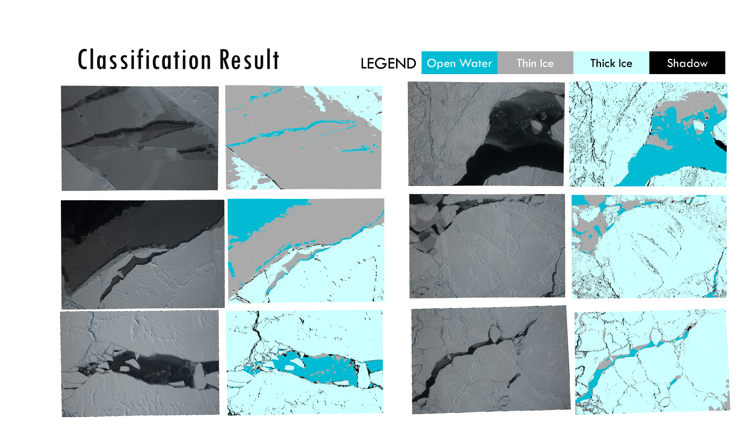
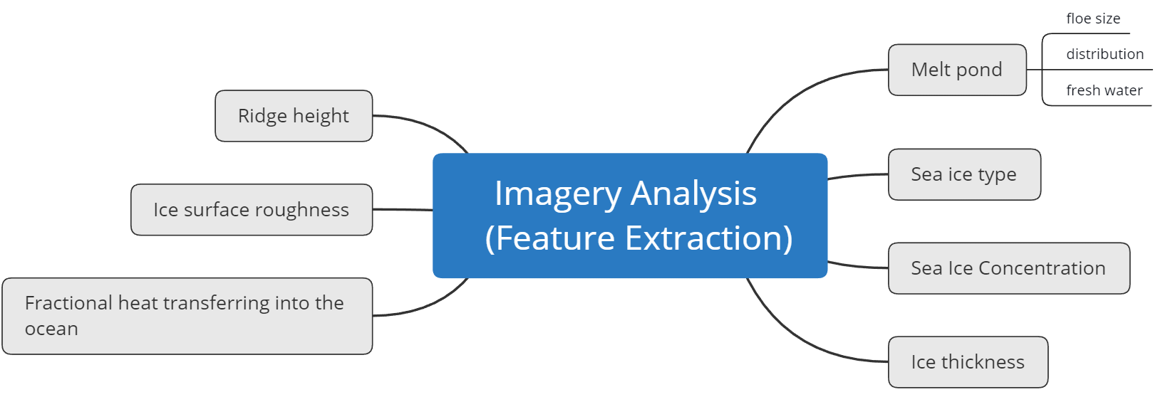
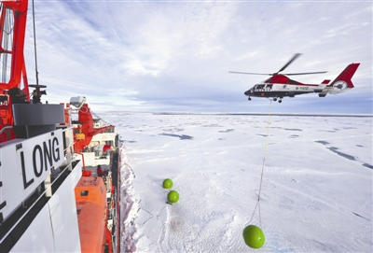
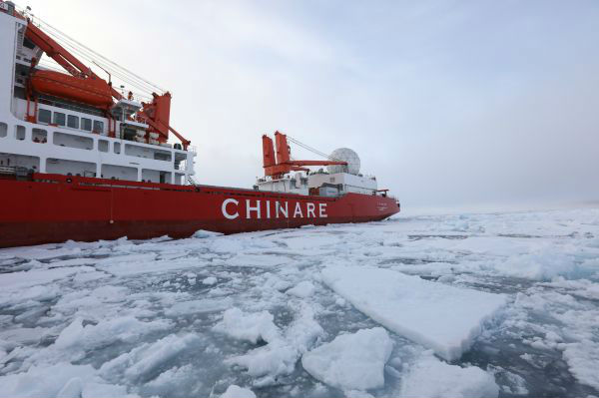
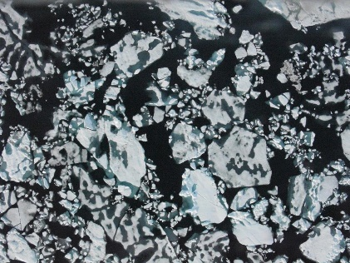
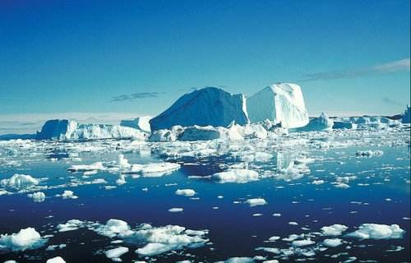
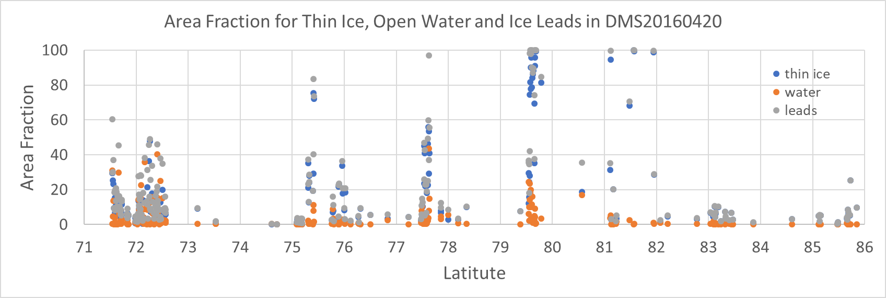
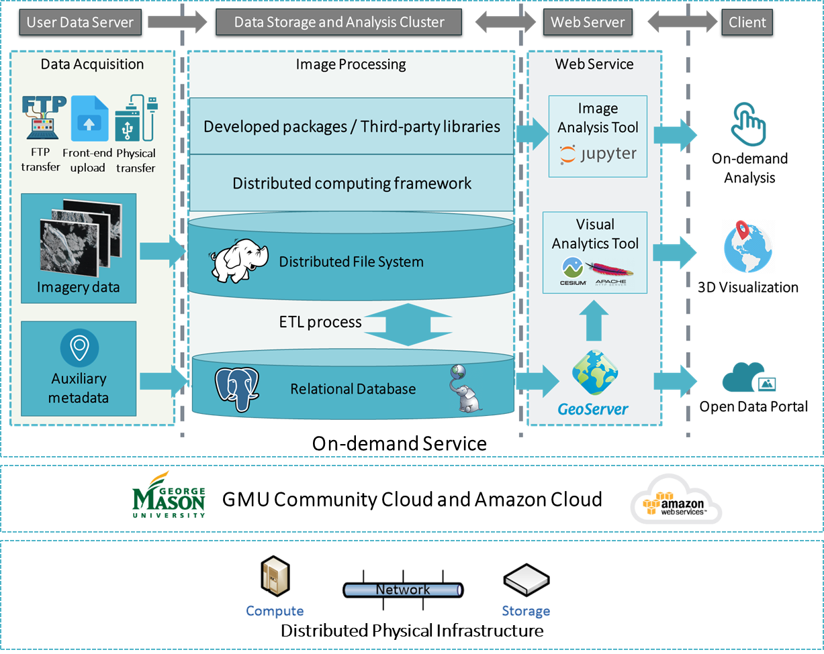
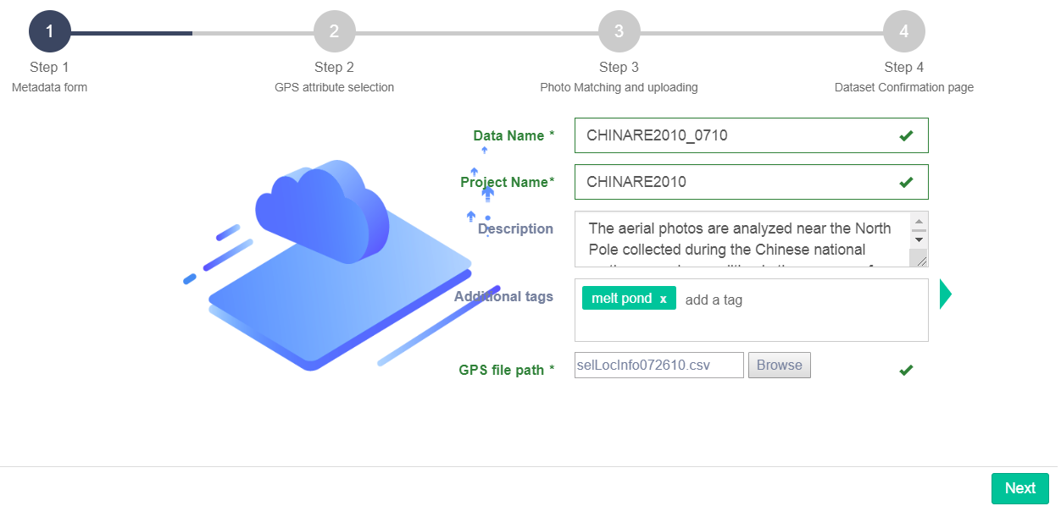
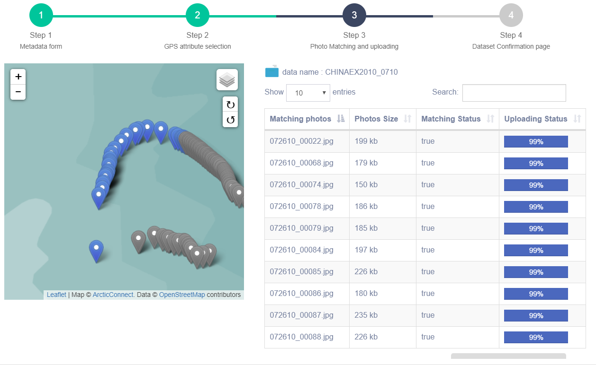
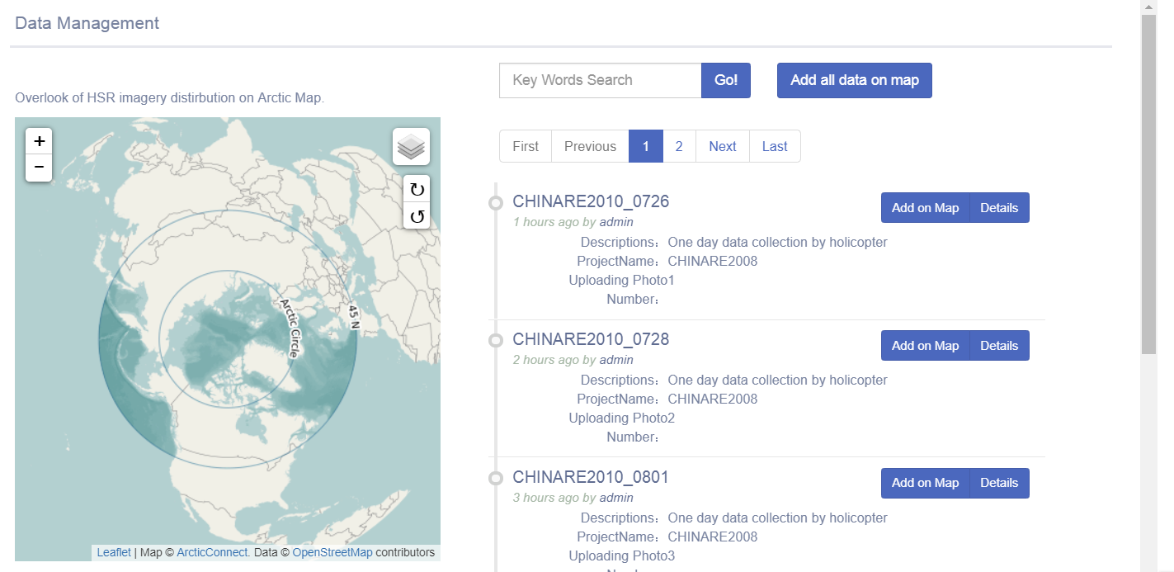
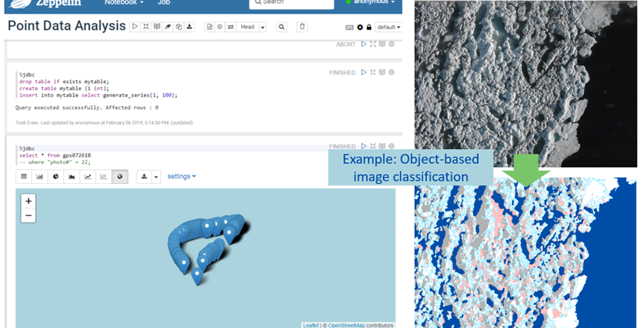
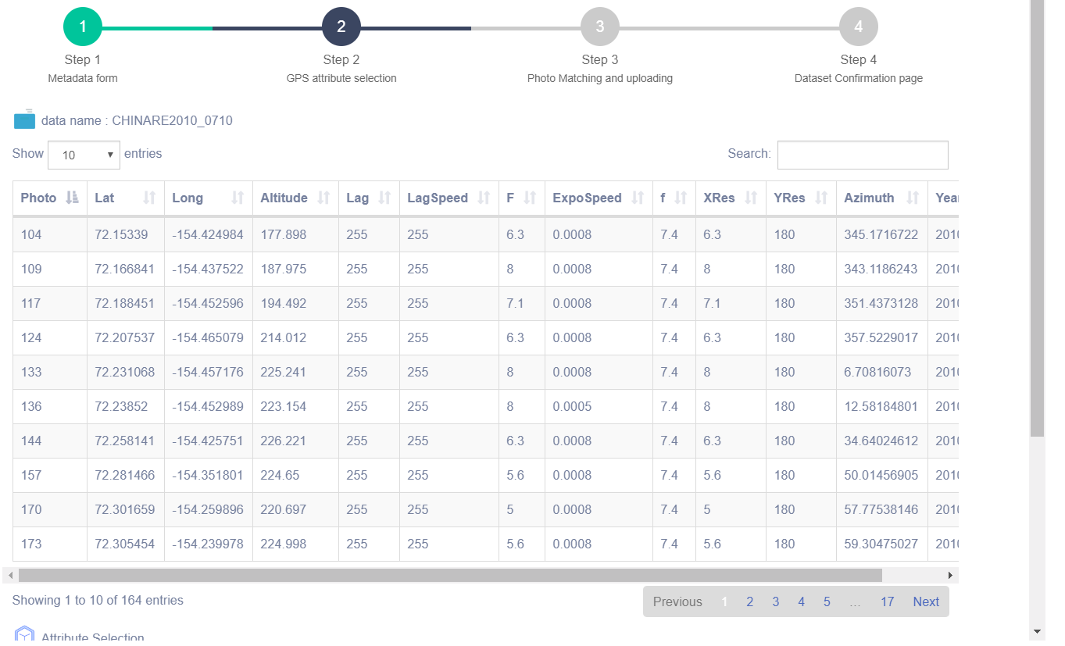



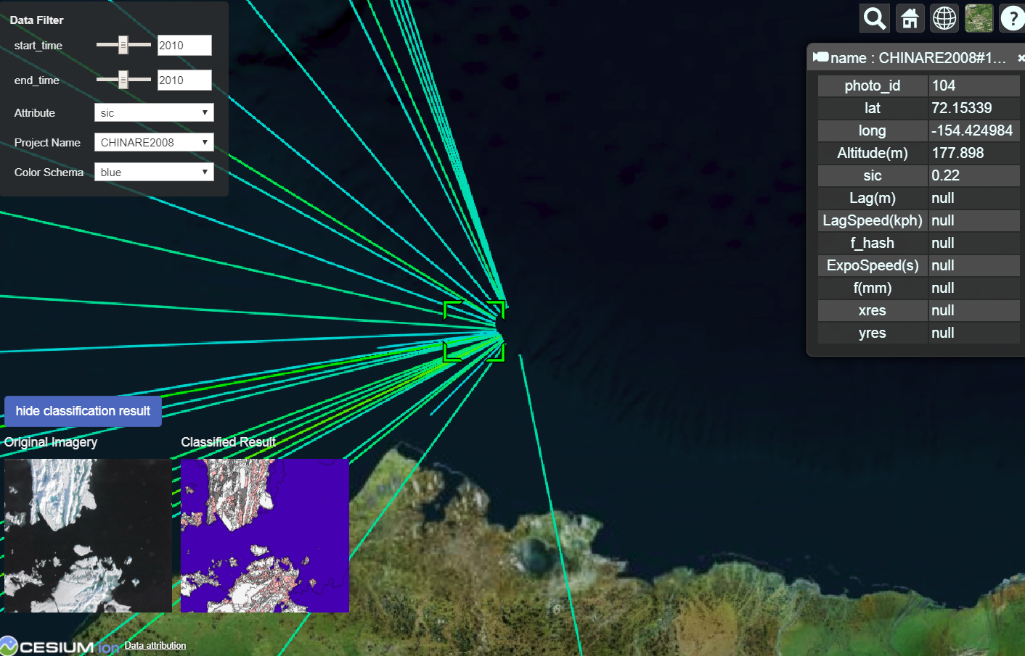



INTRODUCTION/ MOTIVATION
IMAGE ANALYSIS WORKFLOW
EXPERIMENT RESULTS
Arctic Cyberinfrastructure for on-demand HSR image analytics
Chaowei Yang¹, Dexuan Sha¹ , Xin Miao², Hongjie Xie³, Alberto Mestas-Nuñez³
NSF Spatiotemporal Innovation Center, George Mason University; 2. Missouri State University; 3. The University of Texas at San Antonio
dsha@gmu.edu; cyang3@gmu.edu; xinmiao@missouristate.edu; hongjie.xie@utsa.edu; alberto.mestas@utsa.edu
https://www.stcenter.net/
Sea ice acts as both an indicator and an amplifier of climate change. Multiple sources of sea ice observations are obtained from a variety of networks of sensors (in situ, airborne, and space-borne). To facilitate the science community to better extract important geophysical parameters for climate modeling, we are developing a smart cyberinfrastructure module for the analyses of high spatial resolution (HSR) remote sensing images of sea ice. The project contributes new domain knowledge to the sea ice community. It integrates HSR images that are spatiotemporally discrete to produce a rapid and reliable identification of ice types, and standardizes image processing so as to create compatible sea ice products. The cyberinfrastructure module is a value-added on-demand web service, e.g., reliable classification of sea ice, that can be easily integrated with existing infrastructure.
The key objective is to develop a cyberinfrastructure to efferently collect, search, explore, visualize, organize, analyze and share HSR Arctic sea ice imagery.
HSR Imagery Analysis - Geophysical Property Extraction
# | Class Name | Class Description
1 | Water | Arctic ocean, objects are rather dark and smooth.
2 | Submerged ice | Ice submerged under water along the edge, usually shown as color cyan or blue due to mixed reflection from ice surface and water. Submerged ice and melt pond will be combined into Ice/snow class for calculation of ice concentration.
3 | Shadow | Darker objects on the ice/snow caused by ridges and low solar elevation angle. Mostly, shadow is usually on ice/snow and can be combined into Ice/snow for calculation of ice concentration. But in some cases, shadow could also be on ponds that often adjacent to ridges. Therefore, further treatment about shadow on ice or ponds are needed. Shadow will also be used for calculation of ridge height.
4 | Ice/snow | Bright white objects due to high reflectance of ice/snow.
5 | Melt pond | Pools of open water formed on sea ice. Melt pond will be used for calculation of fresh water volume. Empirical equation to relate pond depth with pond area and distribution will be examined based on our existing field data and ongoing field studies.
ARCHITECTURE
DISCUSSION
MULTIPLE USER VIEWS
Photo Credits: Sandia National Laboratories
On-demand Classification Tool
Sample Data Collection | Size | Description
Declassified GFL data (1755 images) | 450 GB | The six fiducial sites and repeated images tracking data buoys/floes.
SHEBA 1998 (Perovich ) | 16.5 GB | Beaufort Sea, 13 flights between May 17, 1998 and October 4, 1998. Also a few National Technical Means high resolution satellite photographs.
HOTRAX 2005 (Perovich) | 31.3 GB | TransArctic cruise from Alaska to Norway, 10 flights from August 14, 2005 to September 26, 2005.
CHINARE 2008 (Xie) | 20.0 GB | Pacific Arctic sector (between 140 °W and 180 °W up to 86 °N), August 17 to Sept 5, 2008.
CHINARE 2010 (Xie) | 23.7 GB | Pacific Arctic sector (between 150 °W and 180 °W up to 88.5 °N), July 21 to August 28, 2010
CHINARE 2012 (Xie) | 21.2 GB | Transpolar section, (Iceland to Bering Strait), August-September 2012
SeaState 2015 (Ackley) | 50.6 GB | Chukchi sea, October 4- November 6, 2015
The time lapse camera (Haas) | 40.5 GB | Cape Joseph Henry (82.8N, -63.6W), May 2011 to July 2012.
EM-bird thickness and aerial photos | 21.2 GB | April 2009, 2011, and 2012, between 82.5 N and 86N, and -60W and -70W.
Classification Schema
Accomplishment
A prototype system includes architecture, big data management, initial analyses and visualization module;
An offline algorithm for object-based image classification of sea ice;
A collection of public and longtail sea ice HSR imagery.
Future
Develop a distributed computing framework for object-based image analysis of sea ice HSR imagery;
Integrate more image data into our system as a benchmark for sea ice parameters production;
Provide online analysis and visualization services based on extracted parameters in the cloud.
Imagery Uploading
Data Browser
Image
Process
Geophysical Feature Extraction
User Access
Extracted Data Uploading
Data Visualization
Image Owner
(has HSR
image)
Researcher
(has physical
parameter)
Explorer
(no data)
Reference:
Yang, C., Yu, M., Li, Y., Hu, F., Jiang, Y., Liu, Q., Sha, D., Xu, M. and Gu, J., 2019. Big Earth data analytics: A survey. Big Earth Data, 3(2), pp.83-107.
Wright, N.C. and Polashenski, C.M., 2018. Open-source algorithm for detecting sea ice surface features in high-resolution optical imagery. Cryosphere, 12(4).
Miao, X., Xie, H., Ackley, S.F. and Zheng, S., 2016. Object-based Arctic sea ice ridge detection from high-spatial-resolution imagery. IEEE Geoscience and Remote Sensing Letters, 13(6), pp.787-791.
Acknowledgements: This project is funded by Office of Advanced Cyberinfrastructure (OAC) through NSF (Grant #1835507, #1835784, #1835512).
Notes:
The proposal is “develop a 5D spatiotemporal visualization prototype”.
The intuitive visualization of the 5D data for better scientific research and better decision support, that’s why we want to design 5D spatiotemporal visualization methodology and develop distributed visualization prototype. The system can utilize hybrid computing with multi-core CPU and many-core GPU, explore representation model of dynamic phenomena and handle with massive datasets.
According to the system’s flowchart and architecture, we make the specific experiment plan including five important points.
What can we benefit from the research?

