Slide 1
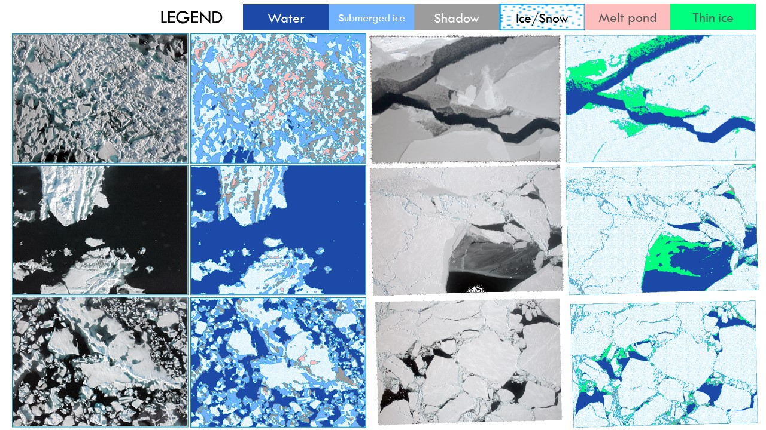
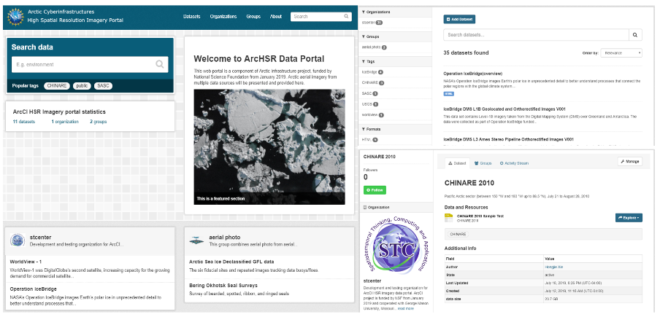
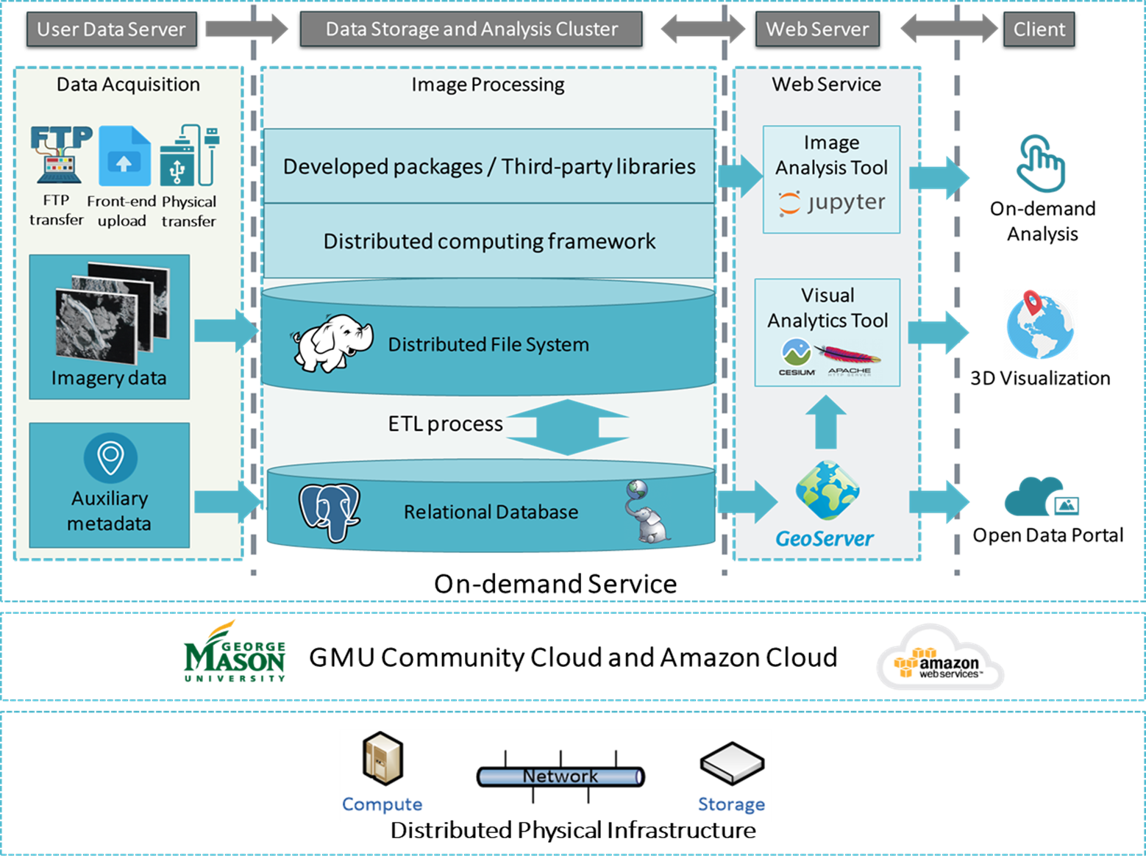
ArcCI for Sea Ice High Resolution Image Analytics
Chaowei Yang, Xin Miao, Hongjie Xie, Dexuan Sha
Grant #1835507 (GMU), #1835784 (UTSA), #1835512 (MSU)
HSR Sea Ice Image Classification Result
  Objective: Developing a cyberinfrastructure with web service to efferently collect, search, explore, visualize, organize, analyze and share high spatial resolution arctic sea ice Imagery.
Current status (2019)
  A cloud-computing-based prototype with architecture, big data and metadata management, and visualization modules; http://archsri.stcenter.net/
  An offline algorithm for object-based image classification of sea ice;
  A collection of sea ice HSR imagery with 35 datasets in 1.96 TB .
Next two years (2020 & 2021)
  Develop a distributed computing framework for Object-based image analysis of sea ice HSR imagery;
  Integrate more image data (~100TB) as a benchmark for sea ice parameters production;
  Provide online HSR image analysis and visualization services on cloud platform.
Classification Diagram
ArcCI Architecture
Open Data Portal for HSR Sea Ice Image Collection

