Slide 1
Identifying ESIP Connections
Ted Habermann, Chief Game Changer
ESIP Sponsors, Members, and Participants Can Help Connect ESIP to the World!
https://tinyurl.com/ESIPConnections
First we have to get the organization right!
Name = Federation of Earth Science Information Partners
Identifier = https://ror.org/03q5xa910

Slide 2
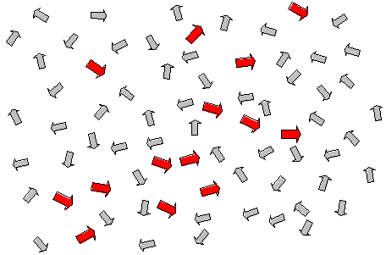
Leadership Model – Positive Deviance
Find Positive Deviants
Positive deviance says that if you want to create change, you must scale it down to the lowest level of granularity and look for people within the social system who are already manifesting the desired future state.
Take only the arrows that are already pointing toward the way you want to go, and ignore the others. Identify and differentiate those people who are headed in the right direction. Give them visibility and resources. Bring them together. Aggregate them. Barbara Waugh - Soul in the Computer

Slide 3
Leadership Model
~225
Individuals
ESIP Participants
~140 Organizations
ESIP Members
United States Geological Survey
National Aeronautics and Space Administration
National Oceanic and Atmospheric Administration
ESIP Sponsors
National Institutes of Health
National Science Foundation
United States Department of Agriculture
Centers for Disease Control and Prevention
National Aeronautics and Space Administration
United States Department of Health and Human Services
Veterans Health Administration
United States Department of Energy
United States Department of Defense
United States Department of the Interior
National Oceanic and Atmospheric Administration
U.S. Federal Agencies / Departments

Slide 4
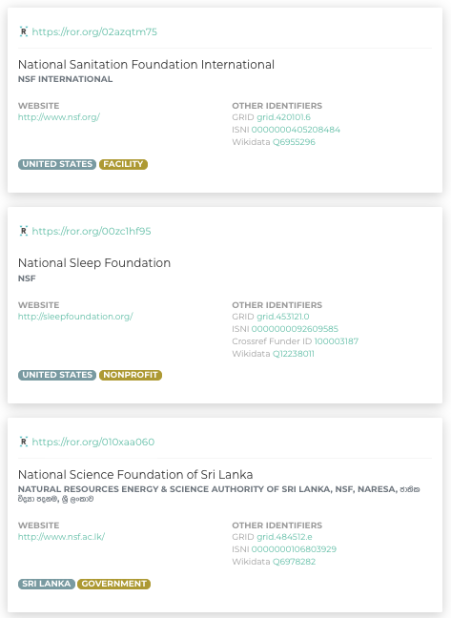
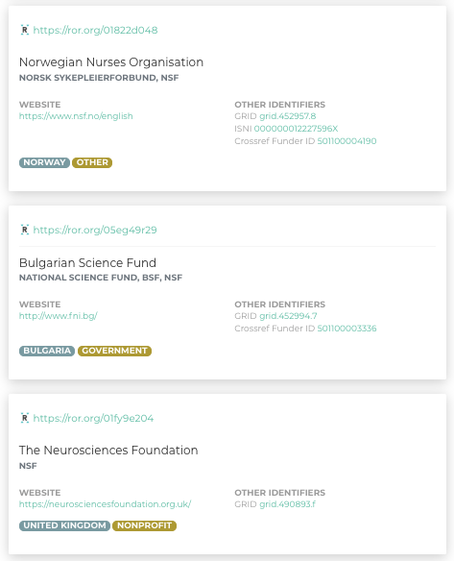
Acronyms
NSF = ?

Slide 5
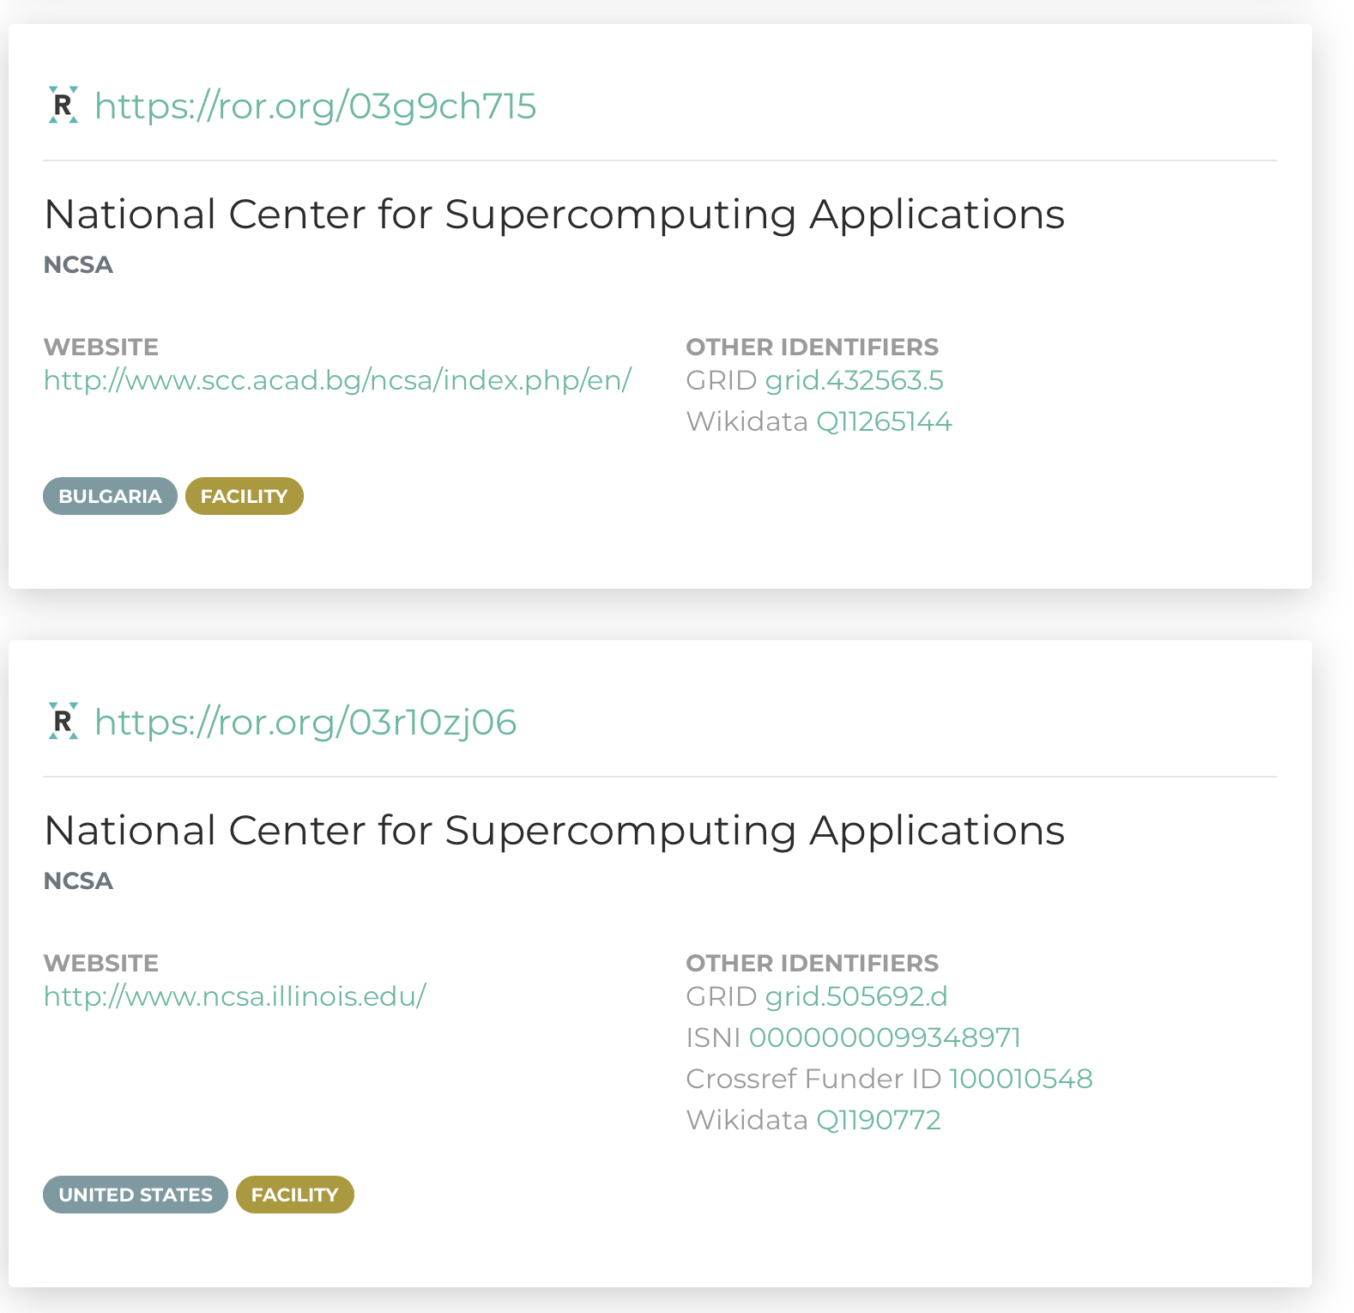
Non-Unique Names
– 778 names used 2090 times
Ministry of Health
Ministry of Education
Ministry of Justice
Ministry of Foreign Affairs
Ministry of Culture
Government Medical College
St. Luke's Hospital
Ministry of Finance
Ministry of Agriculture
Institute of Physics
St Mary's Hospital
Ministry of Defence
M√©decins Sans Fronti√®res
Ministry of the Interior
St. Joseph's Hospital
Queen Elizabeth Hospital
National Institute of Public Health
Ministry of Science and Technology
Ministry of Public Health
Department of Health
Arab Open University
World Wide Fund for Nature
Wildlife Conservation Society
United Nations Population Fund
St. Francis Hospital
Mercy Hospital
Institute of Botany
Innovation Center Denmark Facultad Latinoamericana de Ciencias Sociales Universidad Metropolitana United Nations Children's Fund Stockholm Environment Institute St. Mary's Medical Center
International Union for Conservation of Nature
Ministry of Higher Education and Scientific Research
St. Mary's Hospital St. Joseph Hospital Schiller International University Sacred Heart Hospital Ministry of Interior Ministry of Education and Science Mercy Medical Center Institute of Mathematics Institute of Biophysics Institute of Archaeology Institute of Applied Physics Good Samaritan Hospital Fortis Hospital Federal Ministry of Health
Sometimes a Name is Not Enough

Slide 6
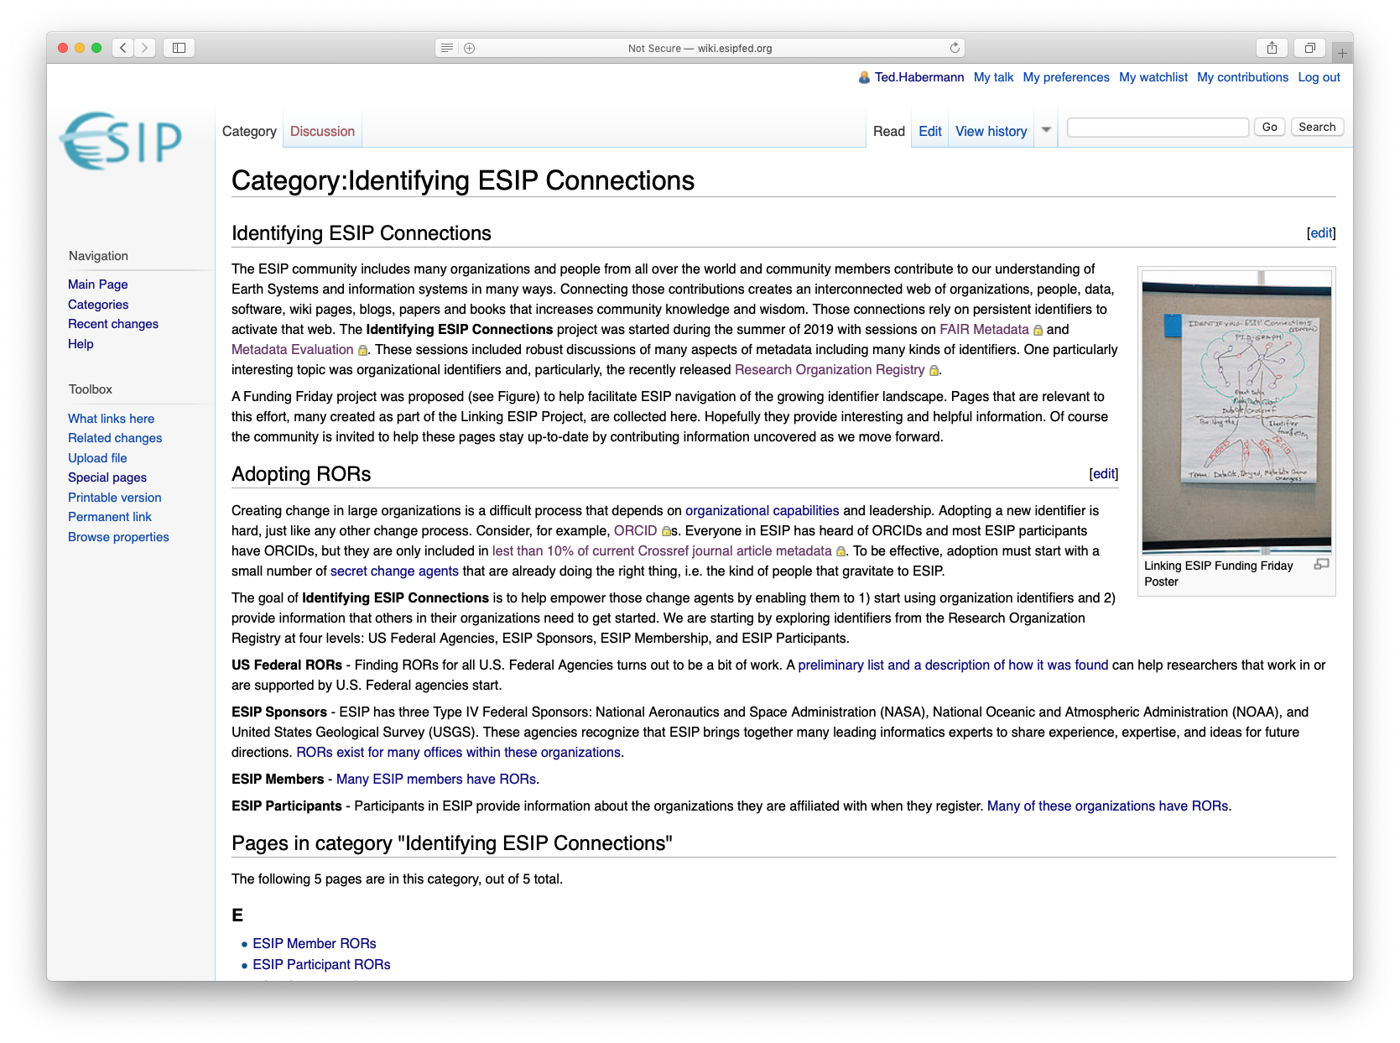
Resources – ESIP Wiki
https://tinyurl.com/ESIPConnections

Slide 7
Questions?
Maria Gould
ROR Project Lead
info@ror.org
https://www.grid.ac
ted@tedhabermann.com
https://orcid.org/0000-0003-3585-6733
@TedHaberman

