Slide 1
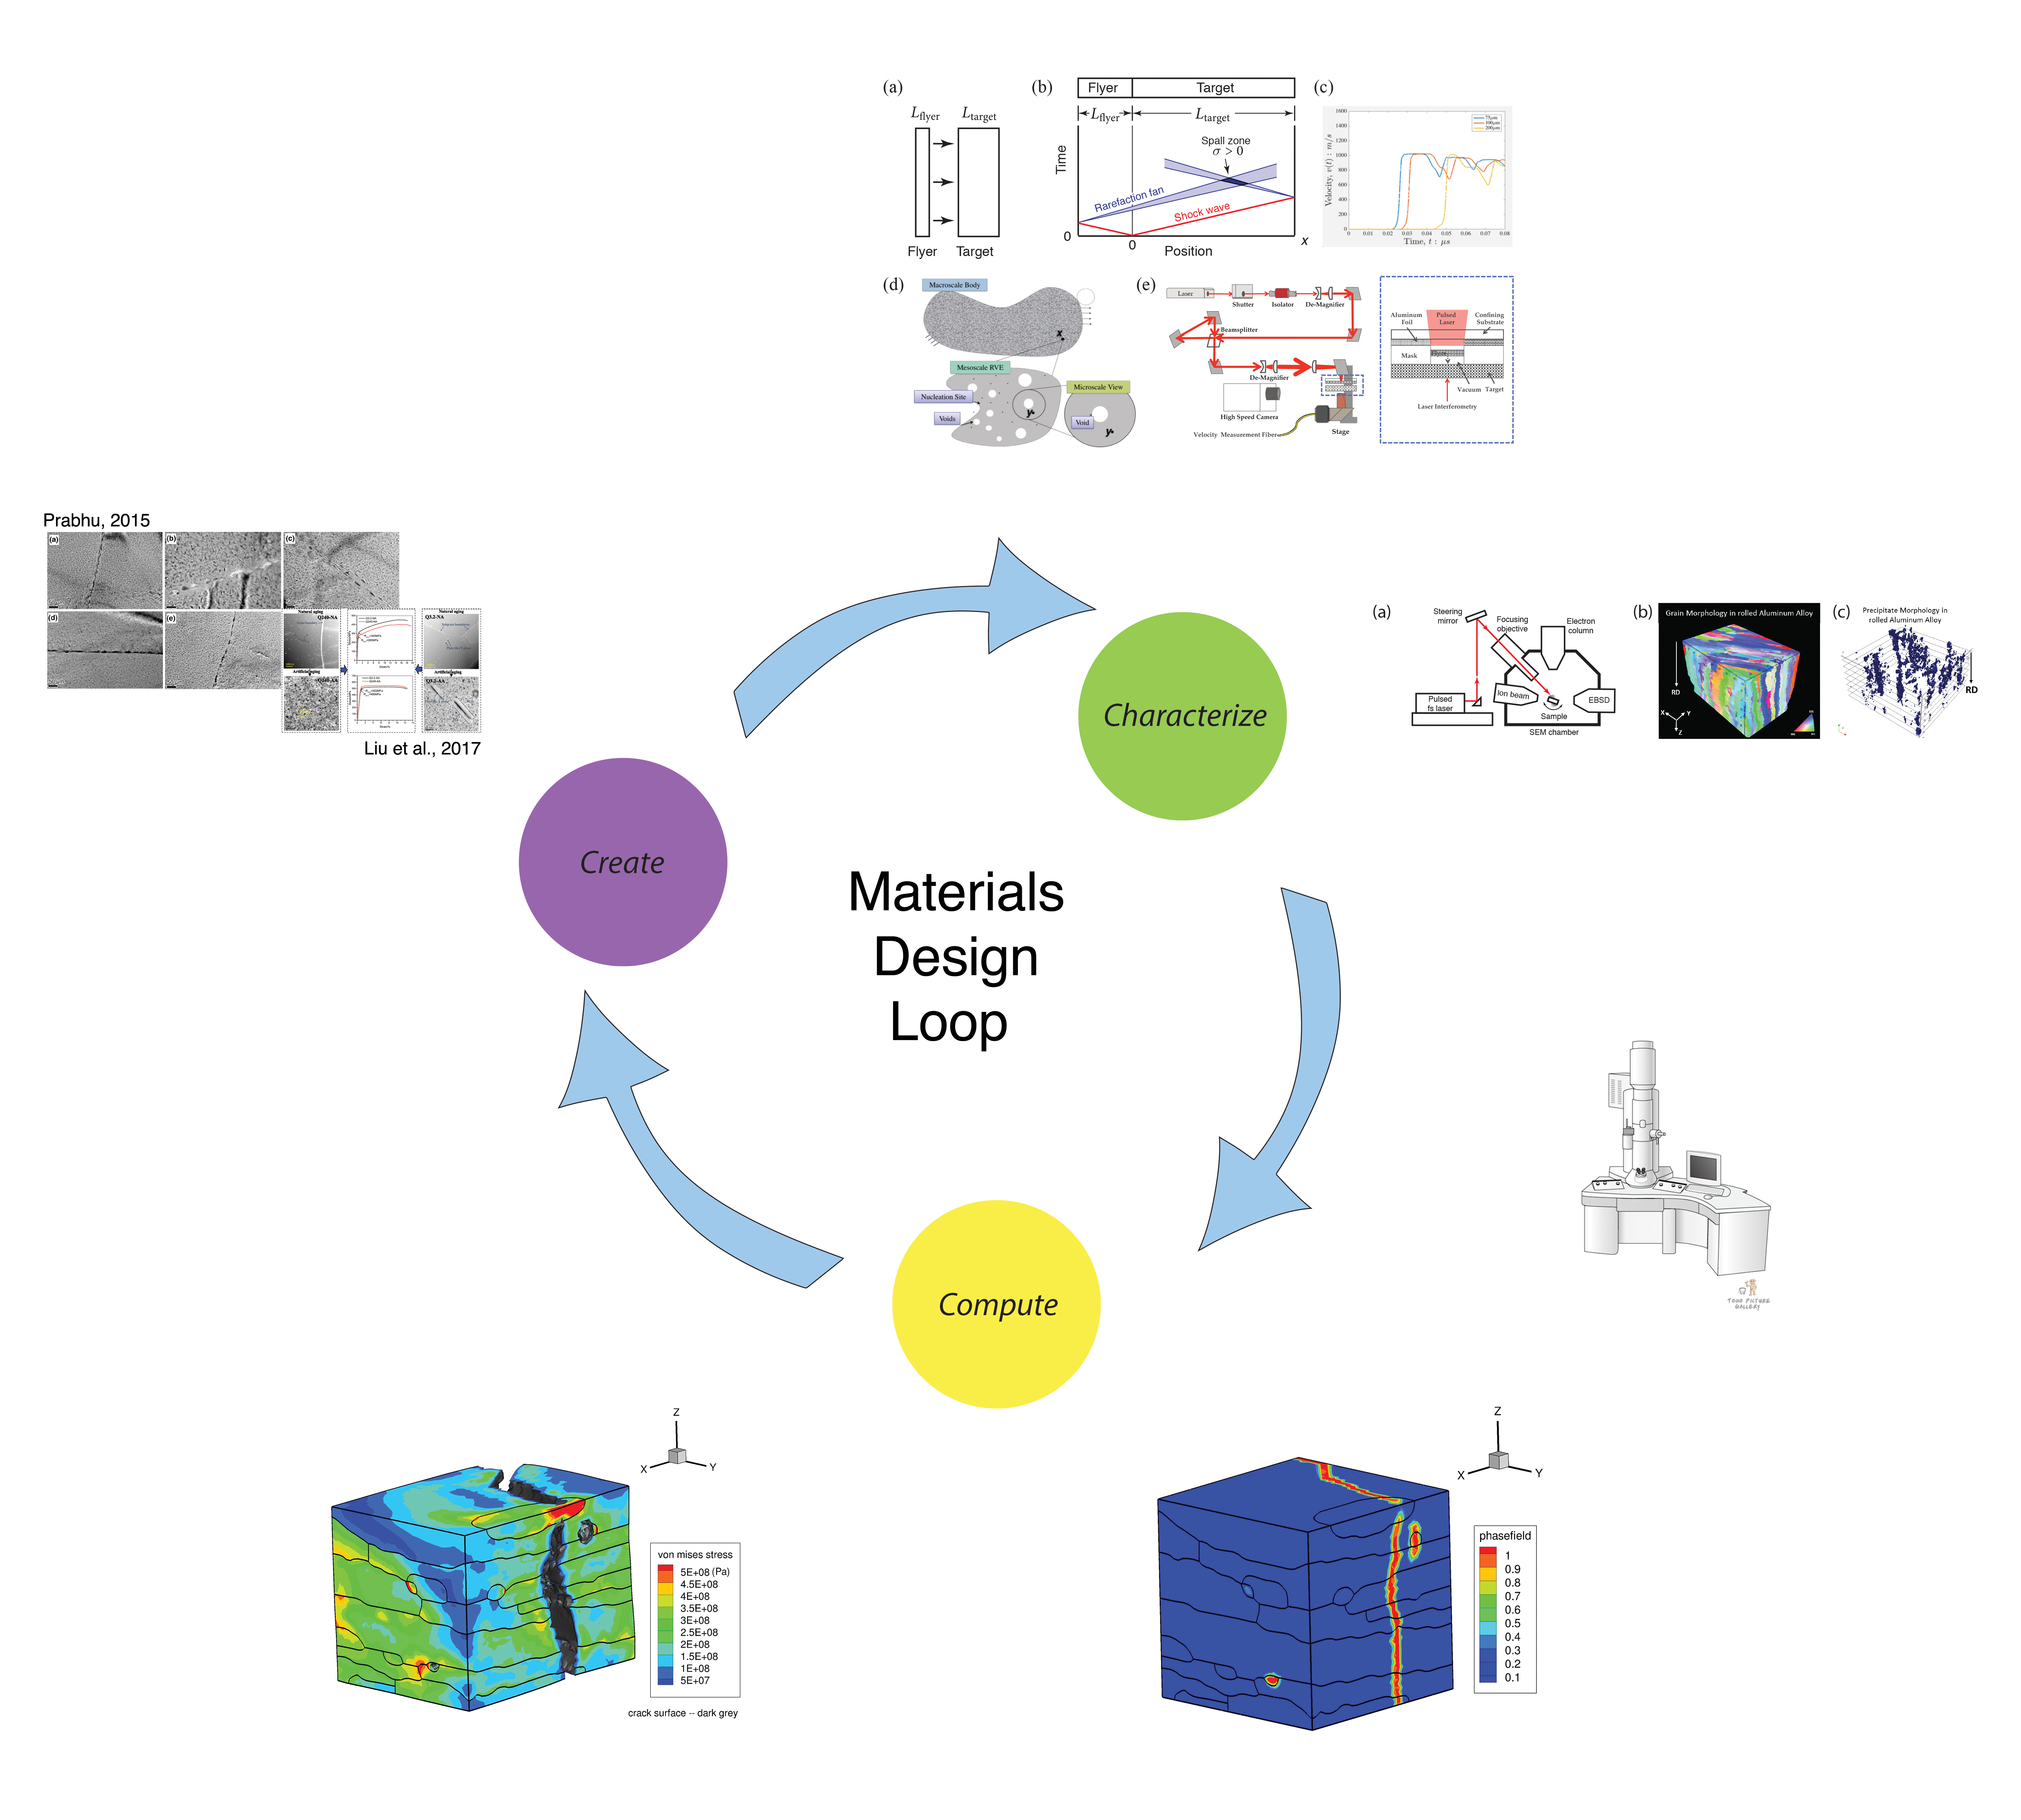
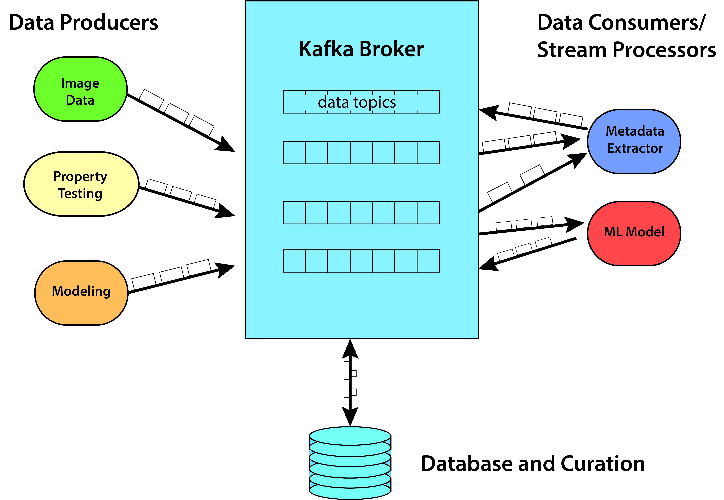
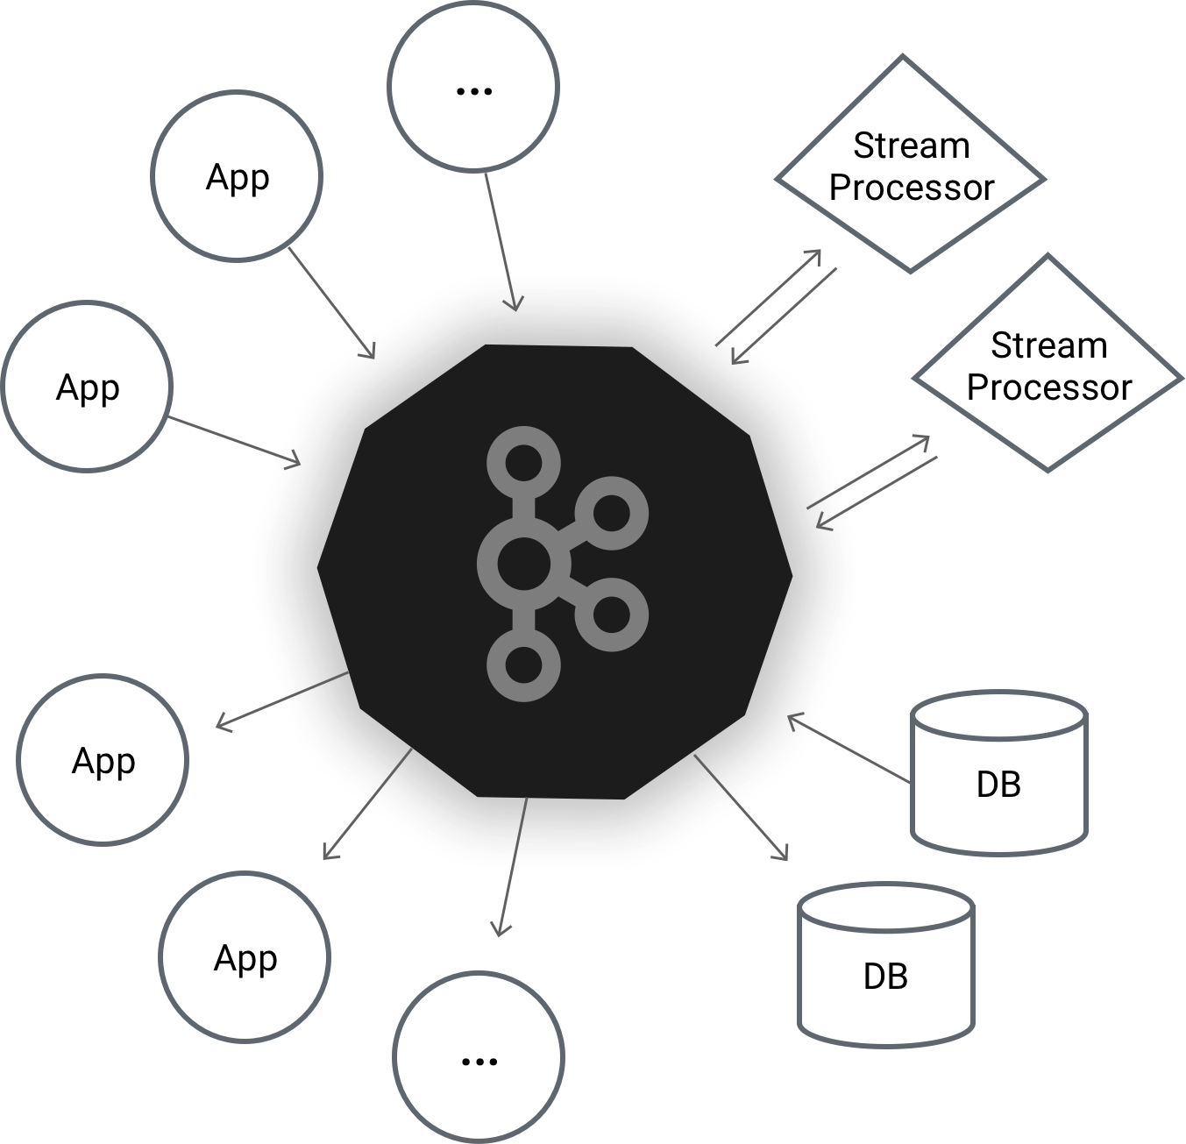
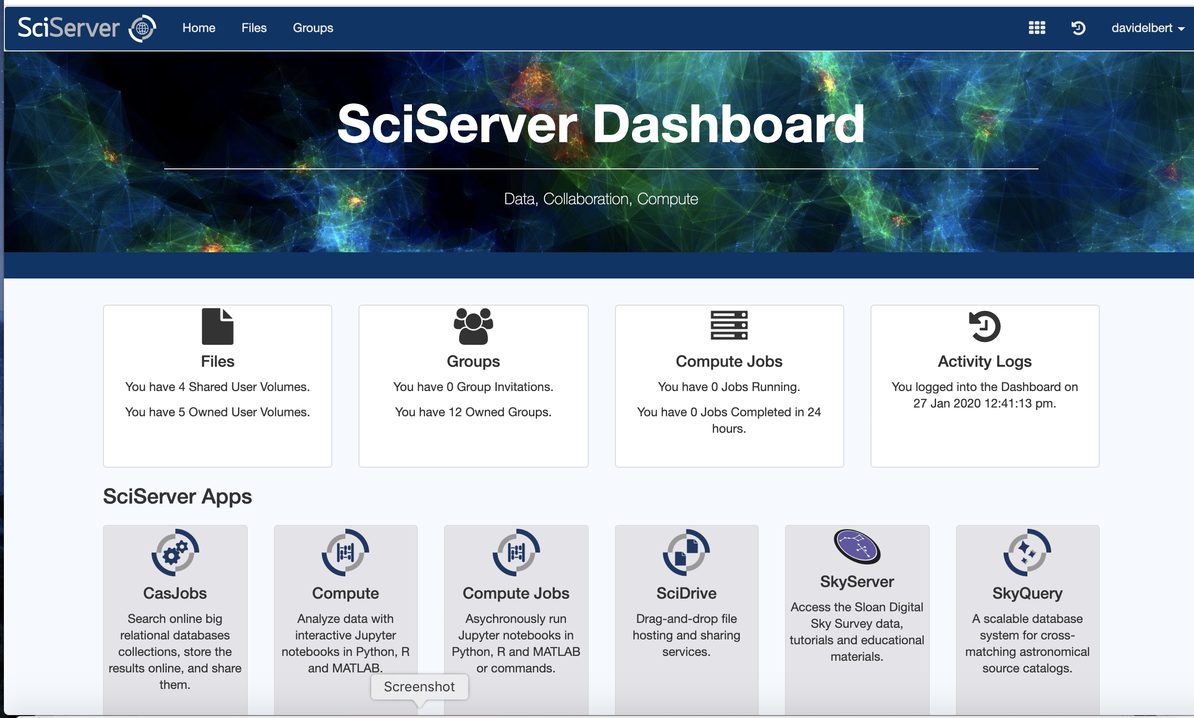
DMREF: Data-Driven Integration of Experiments and Multi-Scale Modeling for Accelerated Development of Aluminum Alloys PI: Todd Hufnagel, Co-PIs: David Elbert, Somnath Ghosh, K.T. Ramesh Johns Hopkins University
NSF CSSI PI Meeting, Seattle, WA, Feb. 13-14, 2020
Award #: 1921959
Objectives: 1. OpenMSI – Define Open Materials Semantic Infrastructure for Streaming Materials Data
2. Instantiate OpenMSI for Accelerated Design of Spall Resistant Commercial Aluminum Alloys
Science Driver: Spall fracture is shock-induced, dynamic fracture that is of practical and scientific importance. Spall fracture occurs during rapid loading by explosives, impact, or direct energy deposition. Spall experiments make it possible to reach stress levels approaching the theoretical strength of a material and probe limiting mechanisms of material failure.
Science Framework:
Data Layer Semantics and Infrastructure: Event Centric Thinking with Global Semantics
Enabling Tech:
Apache Kafka
SciServer (NSF DIBB)

