Slide 1
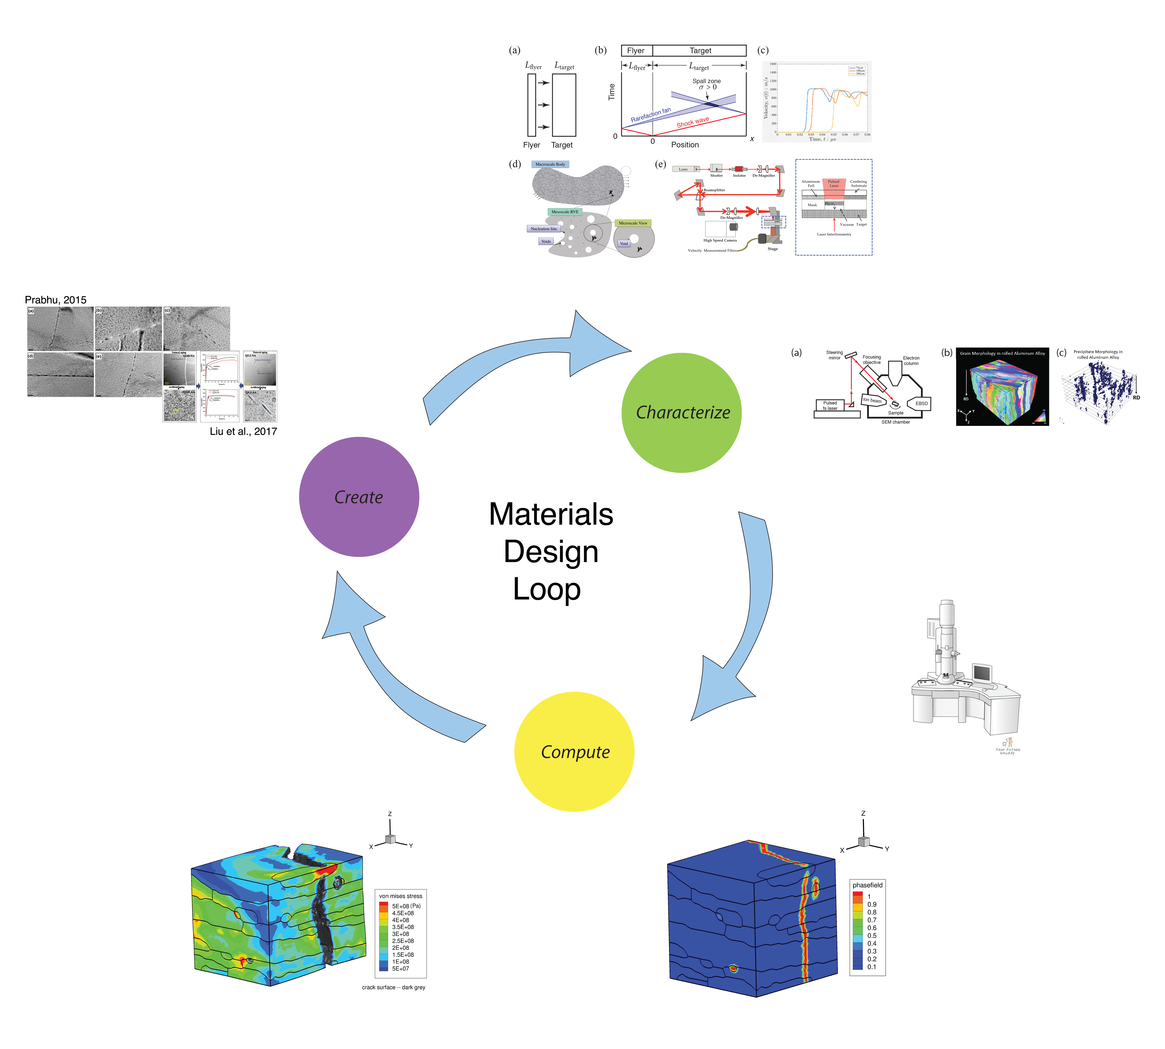
DMREF: Data-Driven Integration of Experiments and Multi-Scale Modeling for Accelerated Development of Aluminum Alloys PI: Todd Hufnagel, Co-PIs: David Elbert, Somnath Ghosh, K.T. Ramesh Johns Hopkins University – NSF Award 1921959
OpenMSI – Define Open Materials Semantic Infrastructure for Streaming Materials Data
Instantiate OpenMSI for Accelerated Design of Spall Resistant Commercial Aluminum Alloys

