Slide 1
Metabolomics Consortium People Portal: Building a research graph and portal with open source tools
Michael Conlon, Christopher P. Barnes, Kevin S. Hanson, Taeber J. Rapczak, Samantha Emerson, Hunter M. Jarrell, Alyssa Kelly NIH Common Fund Metabolomics Consortium Coordinating Center University of Florida

Slide 2
The NIH Common Fund
The NIH Common Fund cuts across the institutes (infectious disease, cancer, aging, mental health, …) to support multi-disciplinary science
26 programs including
Big Data to Knowledge
Human BioMolecular Atlas Program, mapping all cells in the human body
Metabolomics Program, understanding the small molecules of the human body and their role in human health

Slide 3
The Common Fund Metabolomics Program
The program has three goals
A public repository for metabolomics data
Improve technical ability to identity metabolites and analyze metabolomics data
Develop best practices for creating and using metabolomics data

Slide 4
Wait, what is metabolomics ?
Metabolomics is the the scientific study of small molecules present within an organism, cell, or tissue. Metabolomics informs cell biology at the molecular level
Applications across all of human health – disease, infection, growth, aging, food intake, exposure to chemicals, substance abuse, mental health
Metabolomics provides fingerprints of tissue, disease, organ function and much more

Slide 5
Okay, scientists and small molecules
Notes:
And human subject samples
Through mass spectrometer
And sophisticated software
Resulting in study data
To a data repository

Slide 6
The NIH Common Fund Metabolomics Consortium
Five centers improving our ability to identify compounds in samples
Seven centers creating software and data for metabolomics
A national metabolomics data repository (NMDR) at the University of California San Diego (UCSD)
A coordinating center at the University of Florida (UF), and its website metabolomics.info

Slide 7
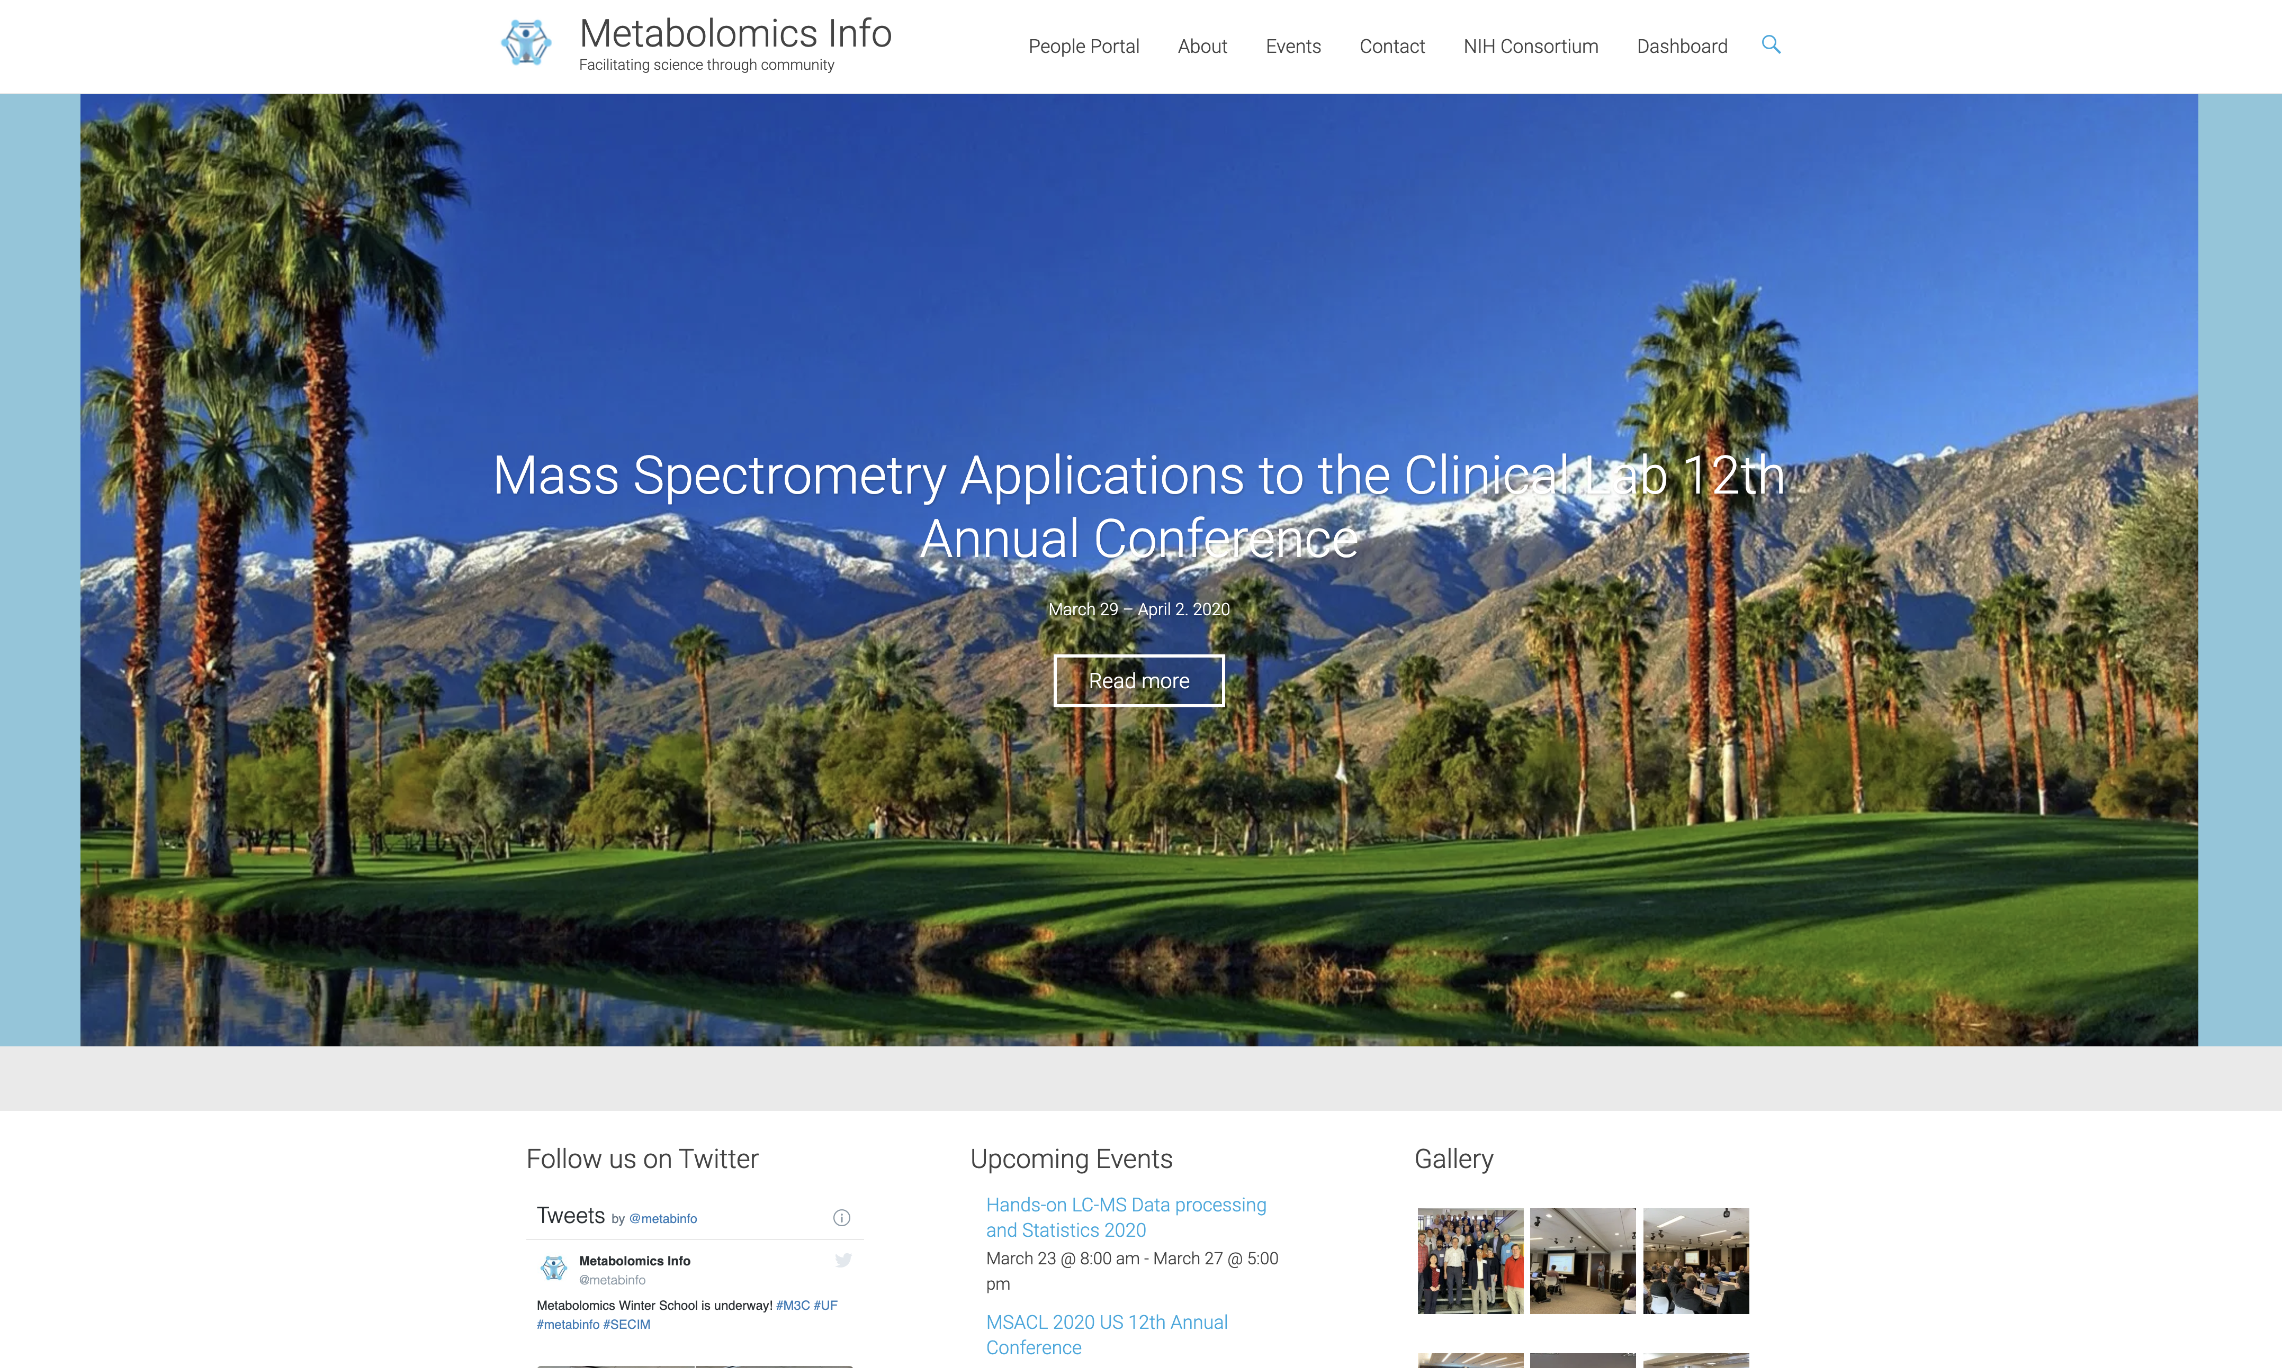
metabolomics.info

Slide 8
Who did what?
We want to know who did what:
What data sets are in the repository?
What scientists/labs made these data?
What papers did these scientists write?
And then second order questions:
Who worked with whom?
On data
On papers
On software tools
What data, tools were used in which papers?
We need a connected graph of people, datasets, papers, orgs

Slide 9
People Portal
Based on the VIVO open source system for research discovery, and its open ontology
Using open metadata from the NMDR and PubMed
Simple open technology stack: triple store, Triple Pattern Fragments, JavaScript

Slide 10
Find people, labs, data, papers in metabolomics

Slide 11
Some Stats, Future Work, Contact Info
Some Stats
771K triples
1070 studies, more each month
1367 investigators, includes lab scientists, technicians, curators
1417 research orgs
200 software tools
17,647 papers dating back to 1977
Future Work
Adding metabolomics software tools
Adding Visualizations
Social network analysis
Contact Info
Web http://metabolomics.info
Github http://github.com/ctsit/m3c-web
Email info@metabolomics.info
Twitter @metabinfo

