Slide 1
Genetics Spring 2020
Class April 2nd
Teacher: Pleuni Pennings

Slide 2
The topic of today is SARS-CoV2 genetics!
SARS-CoV2 is a coronavirus. It does weird genetics things, which I think is super interesting. Hope you too!

Slide 3
Chapter 1 (of 3) Translation of ORF1a
Let’s start at the beginning, which for a virus is the moment it enters a cell.
Viruses don't have cells, but need cells to do anything!
Image from Wikipedia

Slide 4
The SARS-CoV2 genome consists of RNA
The viral particle of SARS-CoV2 contains a single, positive strand RNA genome of about 30,000 nucleotides.
Single-stranded means that it is not base-paired.
Our own genome (as humans) consists of DNA and it is double stranded – every A is paired with a T and every G with a C. Not so in single-stranded virus genomes. Double-stranded RNA viruses also exist by the way!

Slide 5
Viruses use our ribosome to do translation
The SARS-CoV2 RNA is called “positive strand” or “positive sense” or “plus sense” because it can be translated immediately.
Once it enters a human cell, our (human) ribosome machinery starts translating the RNA. Not very smart, human cell!

Slide 6
Translation
Makes protein out of RNA
Image from Wikipedia

Slide 7
Translation of virus RNA follows mostly the normal rules
Translation starts from a start codon and going until it hits a stop codon.
You remember the start codon? AUG. That’s where it starts.
And the stop codons? UAA, UGA, UAG (Nice mnemonic for those: U Are Annoying, U Go Away and U Are Gone)

Slide 8
Look at a real SARS-CoV2 genome!
You can got to genbank and look at a SARS-CoV2 genome https://ncbi.nlm.nih.gov/nuccore/MN908947.3?report=fasta…
And copy the nucleotides into this translation tool: https://web.expasy.org/translate/
I’ll copy the links in the chat window.

Slide 9
What you see in genbank

Slide 10
Copy-pasting the sequence in the translation tool

Slide 11
And in the Expasy translate tool
This big pink blob is a large open reading frame. It starts with a start codon and has no stops until 4382 amino acids later.

Slide 12
Here is an example of a mini open reading frame.

Slide 13
The resulting string of amino acids is a poly-protein
Now here is a really great (nasty) virus trick. This string of 4382 amino acids doesn't just make one protein, it makes 11!
It is a so called "polyprotein" that can be cut up in the proper proteins.
Polyproteins are used by many viruses.

Slide 14
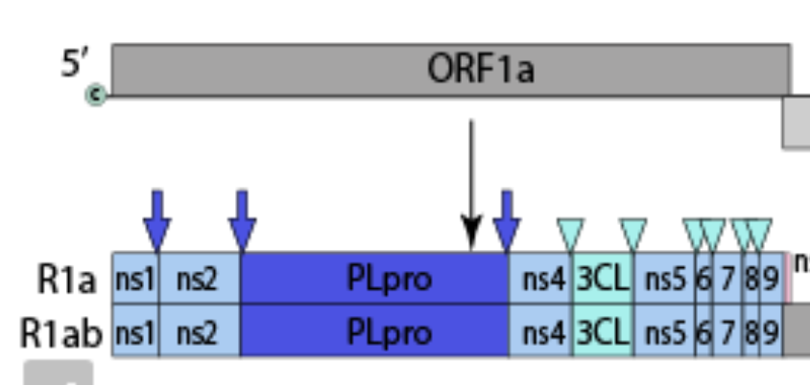
This polyprotein makes 11 proteins!
This polyprotein (SARS-CoV2 Orf1a) is cleaved (or cut) into the actual proteins, which are called ns1, ns2, PLpro (a protease), ns4, 3CL (also a protease), ns5, ns6, ns7, ns8, ns9 and ns11.

Slide 15
Who cuts the polyprotein into its parts?
You may wonder what enzyme does the cleaving of the polyprotein?
As I understand it, PL Pro (papain-like protease) and 3CL (3C-like protease) cut the polyprotein while they are still part of it.
It's called “autoproteolytic cleavage.” No need to remember that word ;-)

Slide 16
Summary of chapter 1
The SARS-CoV2 RNA is translated by our ribosome, from a start to a stop codon, resulting in a polyprotein that cuts itself into 11 proteins.
I’ll take a break – split you in break-out rooms for a few minutes and then take questions. Please talk to each other about what we’ve just discussed.
The person who lives furthest East will report back.

Slide 17
Chapter 2 – reading through a stop codon
In Chapter 1, we saw how SARS-CoV2 makes our ribosome translate its first 11 proteins.
These first 11 proteins take up a little over 13,000 nucleotides and end with a stop codon, but SARS CoV2 has 30,000 so how does it read the other 17,000? It's first key trick to translate beyond the stop codon is to "shift frame".

Slide 18
Remember that during translation, nucleotides are read in groups of three (triplets). Each triplet translates into an amino acid. This is the famous genetic code. For example, AAA translates to the amino acid Lysine.

Slide 19
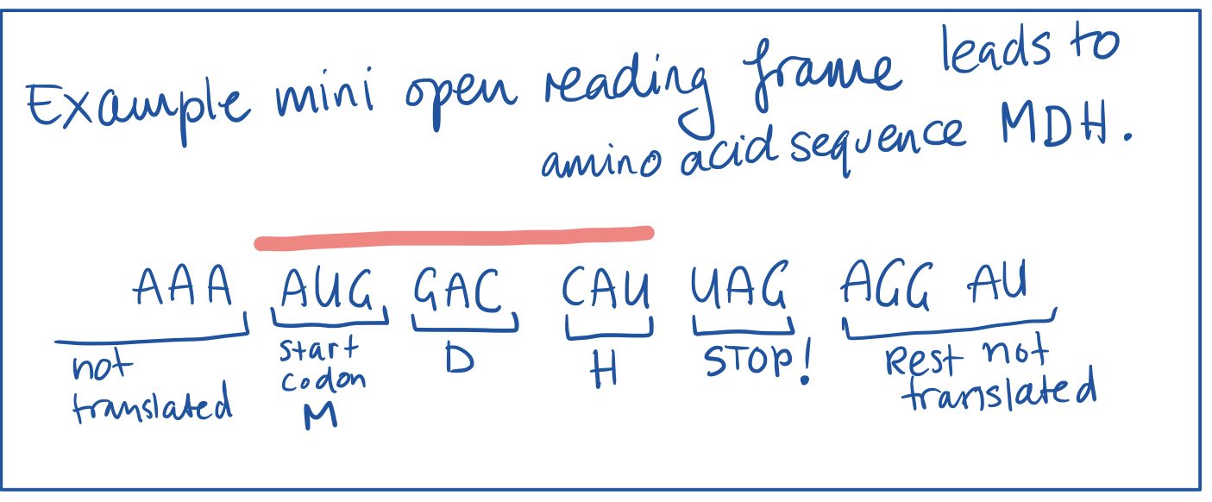
Open reading frame ends with stop codon
Here I drew a mini open reading frame, starting with the start codon AUG, then GAC, then CAU and then UAG (one of the stop codons). This translates to Methionine (M), Aspartic Acid (D), Histidine (H) – a string of only 3 amino acids – real proteins are much longer.

Slide 20
Miss a letter – shift to different frame
Importantly, translation normally stops at the stop codon. But viruses have tricks to make our ribosome slip and miss a letter – and if you miss a letter, but keep reading in triplets, the stop codon is no longer there! Instead of UAG, there is AGA.

Slide 21
Frameshift leads to much longer polyprotein
In SARS-CoV2, this frame shift which leads to reading through the stop codon leads to a polyprotein of ~7000 amino acids (as compared to the original 4382) – and the additional part includes another 5 proteins.
This trick of frame shifting to read through a stop codon is used by many viruses, including
influenza (https://ncbi.nlm.nih.gov/pubmed/22745253)
HIV (https://ncbi.nlm.nih.gov/pubmed/2447506)
SARS CoV1: https://ncbi.nlm.nih.gov/pubmed/15506971

Slide 22
You can see a big ORF in Frame 1

Slide 23
Orf 1b has 5 proteins
In this picture, you can see the organization of the first 21,000 nucleotides of the SARS-CoV2 genome, with ORF1a which stops at the stopcodon and ORF1b which continues after the stopcodon thanks the ribosomal frameshift. Image from @ViralZone
https://viralzone.expasy.org/30?outline=all_by_species

Slide 24
RNA dependent RNA polymerase
Maybe the most important protein in the ORF1b is RdRp or RNA-dependent RNA polymerase – an enzyme that can make RNA from an RNA template. In intro genetics, you'd normally learn about RNA polymerase that uses a DNA template to make RNA ( = transcription)
But many viruses don't ever use DNA. They use RNA to store their genetic material, and so they need a way to replicate the RNA. Therefore, in its genome it brings the information to create its own copying machine as it were. https://en.wikipedia.org/wiki/RNA-dependent_RNA_polymerase

Slide 25
Some viruses use RNA, some DNA and some both
Note though that while some viruses are RNA only (like coronaviruses, polio), there are also viruses w DNA (like herpes) and viruses that use both (HIV and Hep B – though not in the same way). The "Baltimore classification" gives an overview. https://en.wikipedia.org/wiki/Baltimore_classification

Slide 26
Recap Chapter 2
So to recap, #SARSCov2 uses our ribosome to translate its RNA. It stops at a stop codon OR does a virus trick called ribosomal frameshift which makes it read through the stop and translate another 5 proteins including the key enzyme RNA-dependent RNA polymerase.
About 2/3 of the genome now translated. ~9,000 nucleotides left and 13 proteins more to make. I'll tell you how that works tomorrow!

Slide 27
Chapter 3 – the last part of the genome
We’ll see how all the open reading frames on the last third of the #SARS-CoV2 genome get translated which will create the important structural proteins such as the famous S spike and the essential E envelope, M Membrane and N Nucleoprotein.

Slide 28
“Hidden” ORFs
These important structural proteins (&others) are encoded by the last 1/3 of the genome. Bec. translation always starts from 5’, these genes are “hidden” behind the final stop codon of ORF1ab, and they don’t get translated from the RNA that initially enters the cell.

Slide 29
First RdRp makes RNA from RNA
Here’s what happens. Remember the RdRp, RNA-dependent RNA polymerase? RdRp is encoded by the ORF1b (after the ignored stop) and it can synthesize RNA from RNA. RdRp starts to create RNA using the original RNA as a template. It’ll do that starting from the 3’ end of the genome.
Reminder: Synthesis of RNA (or DNA) is always done w a strand as a template, creating the complement of the template. If the original RNA had sequence 5’ ACUUGAC 3’ then the new strand of RNA will be 3’ UGAACUG 5’ (A complements U and C complements G).
If you copy 3’ UGAACUG 5' again, you get the original 5’ ACUUGAC 3’ sequence back.

Slide 30
RNA synthesis starts as normal, making a – strand
So, RNA synthesis starts and all goes normal initially, it may even be that the RdRp just synthesizes the entire 30,000 nucleotide long genome (the complement, that is, a – strand) – but often, the RdRp at some point jumps from one part of the genome to another part.

Slide 31
Similar sequences a different parts of genome
Specifically, just left (i.e., on the 5’ end) each of the ORFs like S, M and E, there is a sequence called a TRS (transcription regulatory sequence). This sequence is also present just right (i.e., on the 3’ end) of the Leader sequence.

Slide 32
Jump!
I didn’t tell you about the Leader sequence yet, but what happens with the jumping is that you get a chimera of the 3’ end of the genome glued to the Leader sequence from the 5’ end of the genome.

Slide 33
And copy again to make a + strand
Now there is a – strand RNA with the S next to the L. It is copied again to make a +strand of the same length. This "subgenomic" RNA can now be translated. The first gene after the Leader sequence will be translated (here S), until a stop codon is met.

Slide 34
Set of nested subgenomic RNAs
The leader sequence is like a signal for the ribosome to start translating. Because the jumping can happen anywhere where there is a TRS sequence, you get a whole series of “nested” subgenomic RNAs. From each of them the 5’ most ORF will be translated.

Slide 35
Chapter 3 recap
So to recap chapter 3: RNA-dependent RNA polymerase starts copying the RNA from the 3’ end of the genome but sometimes “jumps” to the leader sequence creating a set of chimeras with L next to different genes.
Once this RNA is copied again to make + strand mRNA, whichever gene is next to L gets translated. Because the jumping can happen after each gene, each gene has a chance to end up next to L.
What I find intriguing about the RdRp jumping, is that it should work some of the time, but not always. If the RdRp would ALWAYS jump just after S, then you’d never get a full length genome and no new infectious viral particles would ever be made. (That’d be good!)

Slide 36
Video that explains this lesson in 10 min (part of homework for next week)
https://youtu.be/8_bOhZd6ieM?t=1209

Slide 37
Recap of the day: coronavirus uses 3 tricks
Polyprotein (compare eukaryotes: one protein per mRNA)
Ribosomal frameshift (compare eukaryotes : we just stop at a stop codon!)
Jumping RdRp to create nested mRNAs (compare eukaryotes : would have different genes that are transcribed separately)

