Slide 1
Best Practices in Online Training:
The Software Sustainability Institute's
Experiences and Lessons Learned
Dr. Rachael Ainsworth
Research Software Community Manager
Software Sustainability Institute, University of Manchester
@rachaelevelyn
@rainsworth
https://doi.org/10.6084/m9.figshare.12631118

Slide 2
About the Software Sustainability Institute (SSI)
A national facility promoting the advancement of software in research since 2010, by cultivating better, more sustainable, research software to enable world-class research: “Better software, better research”
A collaboration between the universities of Edinburgh, Manchester, Oxford and Southampton.
Teams: Software, Training, Policy, Community and Outreach
In 2018, SSI was awarded funding from all seven UK Research Councils.
Supported by the UK Research Councils through grants EP/H043160/1, EP/N006410/1 and EP/S021779/1, with additional project funding from Jisc.

Slide 3
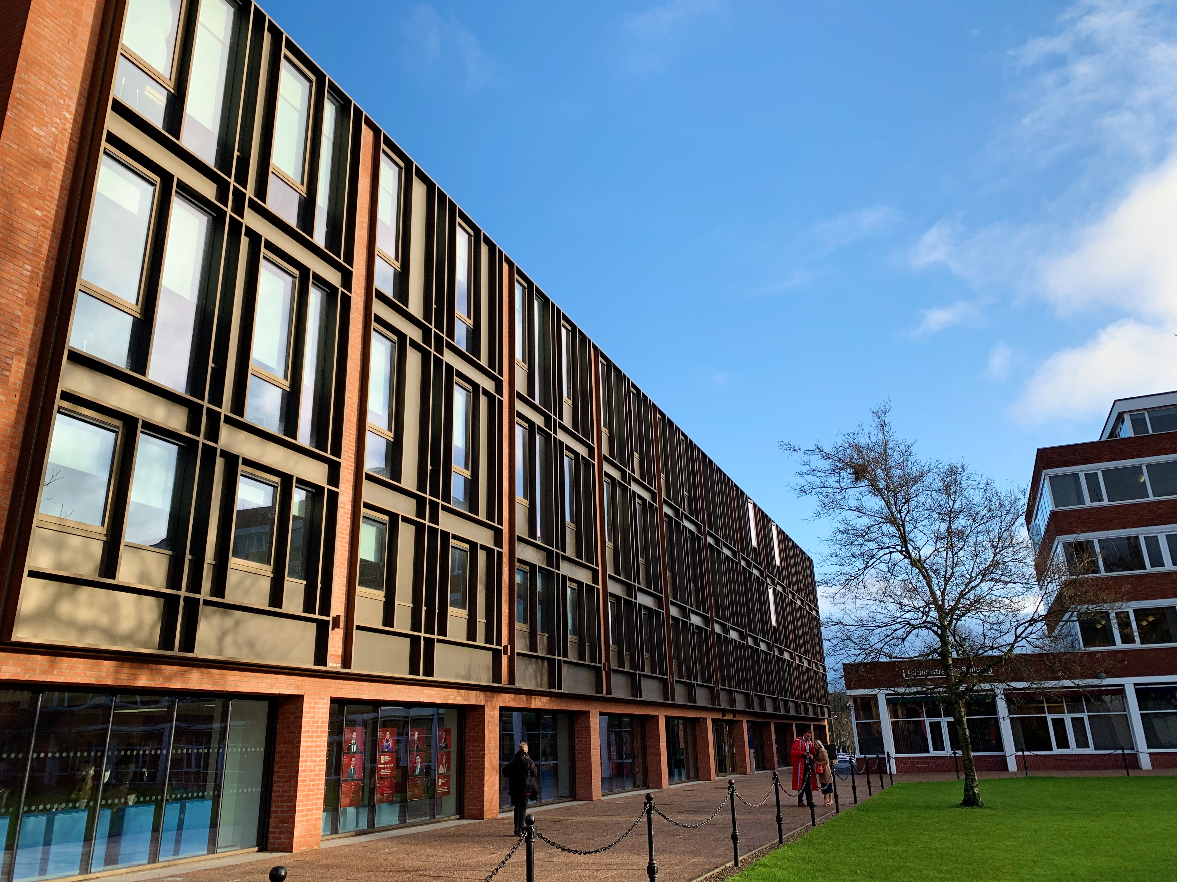
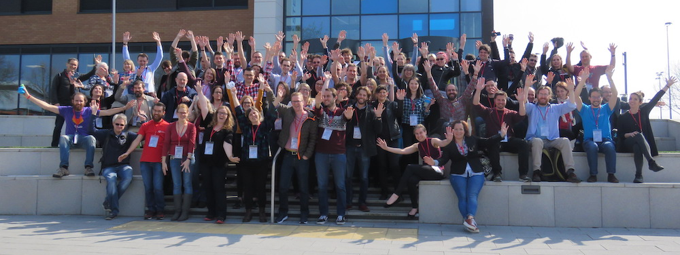
Collaborations Workshop
Bringing together researchers, developers, innovators, managers, funders, publishers, leaders and educators to explore best practices and the future of research software
Unconference: keynote presentations, mini-workshop/demo sessions, discussion group session, lightning talks, collaborative ideas group session and a hack day
CW20 took place March 31 - April 2, 2020 at Queen’s University Belfast, Northern Ireland
Themes: Open Research, Data Privacy and Software Sustainability (also Scholarly Communication and Community)
http://bit.ly/ssi-cw20

Slide 4
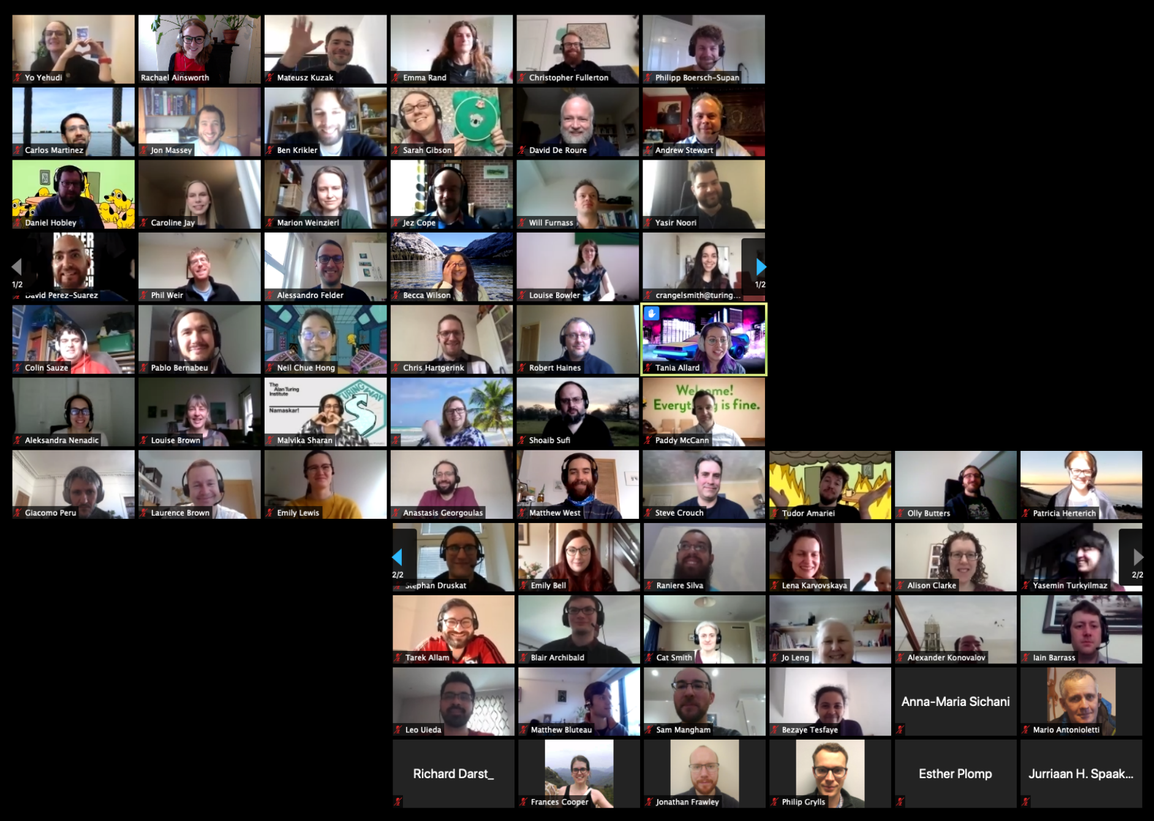
Collaborations Workshop
Bringing together researchers, developers, innovators, managers, funders, publishers, leaders and educators to explore best practices and the future of research software
Unconference: keynote presentations, mini-workshop/demo sessions, discussion group session, lightning talks, collaborative ideas group session and a hack day
CW20 took place March 31 - April 2, 2020 at Queen’s University Belfast, Northern Ireland
Themes: Open Research, Data Privacy and Software Sustainability (also Scholarly Communication and Community)
http://bit.ly/ssi-cw20
online

Slide 5
SSI’s online event experience
Steve Crouch has run afternoon training events online for the Scottish response to the Royal Society RAMP COVID initiative: https://society-rse.org/rses-contributing-to-the-national-covid-19-response-through-ramp/
Mario Antonioletti, Lucia Michielin, Aleksandra Nenadic and Giacomo Peru have been running Edinburgh Carpentries events online: https://edcarp.github.io/
Aleksandra Nenadic and Steve Crouch have run and facilitated workshops and instructor training events online: https://carpentries.github.io/instructor-training/
Shoaib Sufi moved the selection of the SSI Fellows from a face to face meeting to a successful online event which has taken place for a number of years now, and has oversight of Collaborations Workshop
Rachael Ainsworth delivered Collaborations Workshop 2020 online and organises the SSI Fellows Community Calls: https://www.youtube.com/user/SoftwareSaved
Our guidance for running online training: https://doi.org/10.5281/zenodo.3923947

Slide 6
Platforms and tools (1/2)
Video conferencing: Zoom
Meetings feel closer to an in-person event than a webinar, and empower participants to engage
Breakout rooms facilitate interaction between participants through icebreakers, group discussions, idea generation, problem solving and/or experience sharing and are often reported as participants’ favourite part of an online event
Collaborative documenting: Google Docs
Used for the agenda, roll call, taking notes, asking questions, and keeping everyone synchronised
Zero barrier to entry (doesn’t require account creation or knowledge of special syntax)
Up to 100 people can edit and comment at the same time

Slide 7
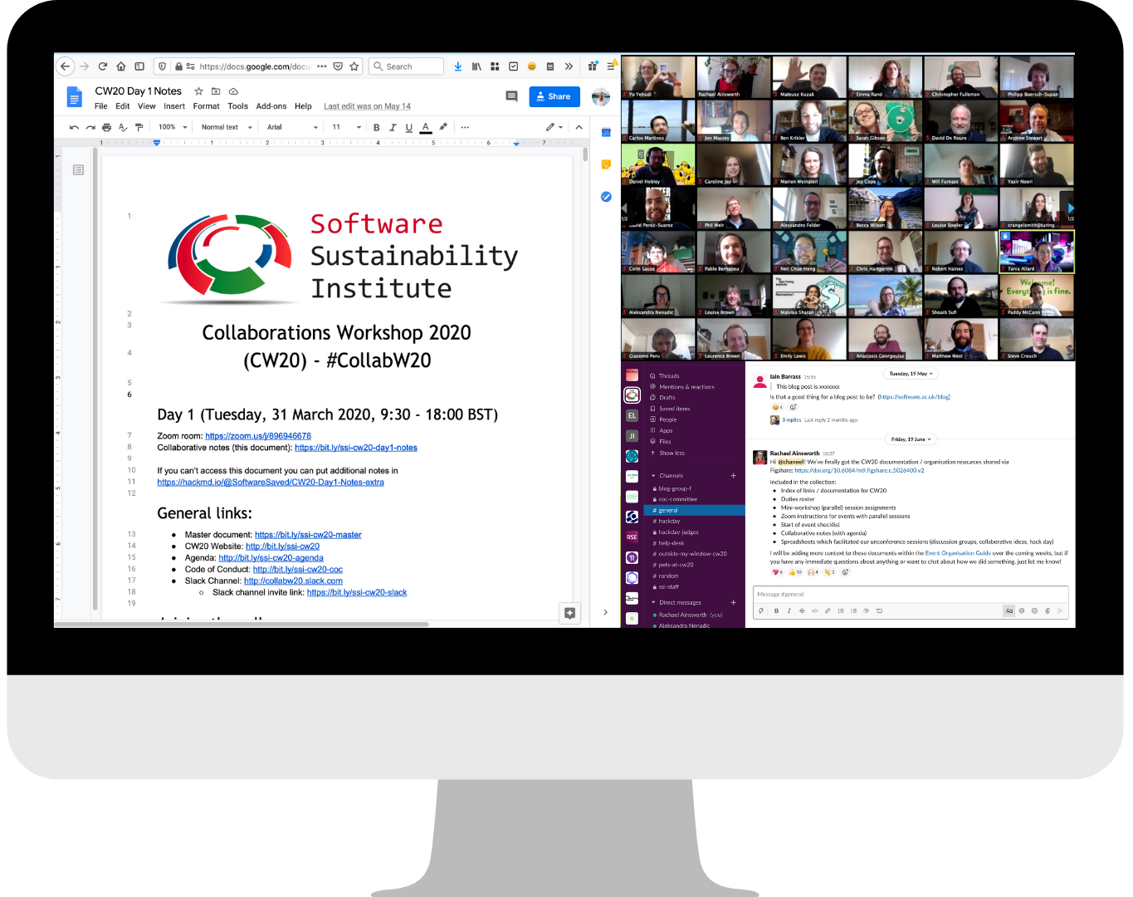
Platforms and tools (2/2)
Communication channel: Slack
A communication channel that persists outside the meeting is helpful for maintaining access to resources shared, referencing discussions and facilitating community engagement
Combination of practical channels for event organisation/communication (e.g. private channel for organisers, #help-desk) and fun channels to add a more human element to the event (e.g. #pets-at-cw20)
Physical setup
Following a screen share (with enough screen real estate to see what is happening), chat, shared documents, etc. can be a real problem
Provide advice to participants ahead of time so they can get the most out of the event (e.g. good headset, additional monitor, etc.)

Slide 8
Online event considerations
The agenda for an online event must have sufficient breaks for it to be effective and less tiring for participants
In general, shorter blocks and regular breaks are appreciated by participants (e.g. don’t go longer than 90 min without a break)
Set break times and keep to them to help people make arrangements around the event and manage expectations (e.g. caring responsibilities)
Things will take longer
Factor in extra time to complete tasks, go through training material and solve technical problems
Creating and managing breakout rooms also adds extra time to the event
Have learners at a similar skill level at the workshop to help get the pace right
Use a pre-workshop survey to gather learners' backgrounds and gauge their current skill levels
Be intentional with your Code of Conduct and adapt it for the online event
Always provide a reporting procedure and include interactions within online communication channels in the CoC

Slide 9
Roles and responsibilities
Assign an event facilitator as a designated role
It can be tiring and time consuming for the active instructor to monitor the chat, non-verbal feedback from participants and documents while they are presenting
An event facilitator can manage the participants and bring attention to issues, freeing up the instructor to instruct and the helpers to focus on helping
Get the instructor/helper to learner ratio right
As a rule the ratio of one instructor/helper to four or five learners works well for online
Have a pre-event rehearsal for the delivery team to make sure everyone has the correct setup/settings enabled, practice with the platforms that will be used, and understand roles and responsibilities
Have a pre-event meeting or office hours for presenters and participants to provide an opportunity to test their tech, troubleshoot any installation issues, and ask any questions

Slide 10
Security, permissions and data privacy
Mitigate security risks by requiring registration, enabling a meeting room password, and/or using a waiting room
Make clear to participants which information should not be shared (e.g. don’t share links to meeting room or notes on social media)
Get permission from participants
If you are going to use or publish notes and resources created at the event, then it’s important to let participants know about this before you start: provide an appropriate privacy policy at registration
If you are going to take any screenshots during the event or record the event, it’s important to let participants know and give them the option of turning their cameras off
Give permission to participants
Empower participants to edit the collaborative notes document, raise issues, and directly interrupt so that problems do not linger
For multi-day events, it can be useful to capture what learners feel is working well and what needs improving as feedback in the shared document at the end of the day so that instructors can adapt

Slide 11
Resources
Guidance for running online training: https://doi.org/10.5281/zenodo.3923947
CW20 Figshare portal: https://cw20.figshare.com/
Shared CW20 documentation and infrastructure resources
CW20 blog posts: https://software.ac.uk/tags/collaborations-workshop-2020
CW20 session recordings: https://www.youtube.com/user/SoftwareSaved
CSCCE’s Virtual Event Guide (coming 22 July 2020): https://www.cscce.org
CarpentryCon@Home session on Challenges and opportunities in transitioning meetings online (5 August 2020 at 17:00 UTC): https://2020.carpentrycon.org/schedule/#session-57

